Slide 1
MODULE: BIOMECHANICS OF GAIT
REINFORCEMENT ACTIVITY Unit B: BIOMECHANICAL ALTERATIONS IN GAIT

Slide 2
ASSUMPTIONS
Below are the joints angle courses obtained for two children with cerebral palsy. These results were obtained during own research, the full result of which was presented in a monograph edited by Michnik, Kopyto and Jochymczyk-Woźniak. Children, apart from standard rehabilitation, were treated using botulinum therapy. The results obtained before and after administration of botulinum toxin are presented. The measurements were carried out using the BTS SMART system.

Slide 3
ASSUMPTIONS
Patient 1 with diagnosed diplegia at the age of 7, with a body weight of 24 kg and a body height of 128 cm (BMI-14.63, 29th percentile, normal weight).
Patient 2 with diplegia paresis of the right side at the age of 3 years and 7 months, with a body height of 100 cm and a body weight of 14 kg. A BMI of 14 (3 percentile) classifies the subject to underweight children. During the second study after 6 months of treatment, the body mass index was 14.7; 19th percentile (height 101 cm, weight 15 kg).

Slide 4
TASK 1
Describe courses of joints angles, indicating deviations from the norm both in values and in the nature of the course

Slide 5
TASK 2
Point out the differences in courseS of joint angles appearing on the charts obtained before and after treatment and rehabilitation.

Slide 6
COURSES OF JOINT ANGLES
PERSON 1

Slide 7
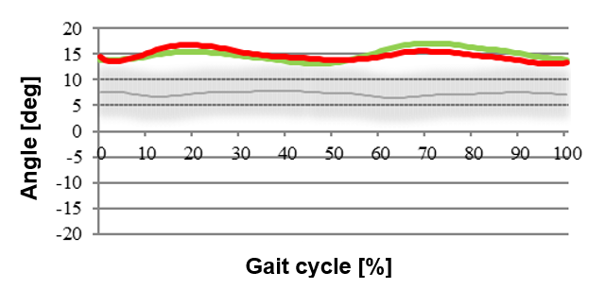
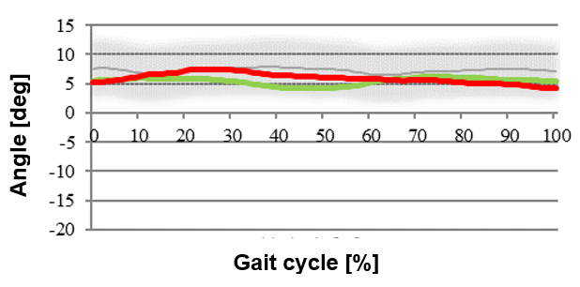
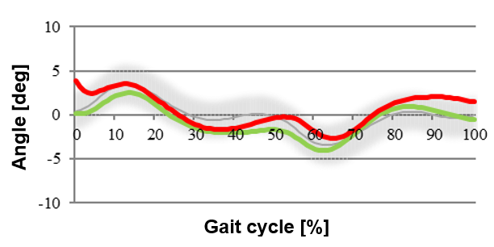
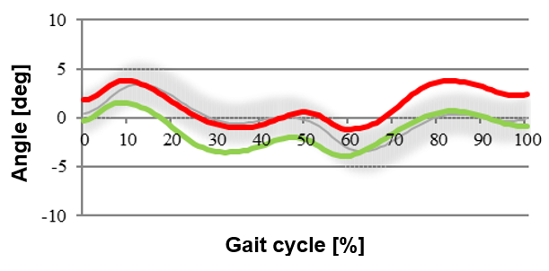
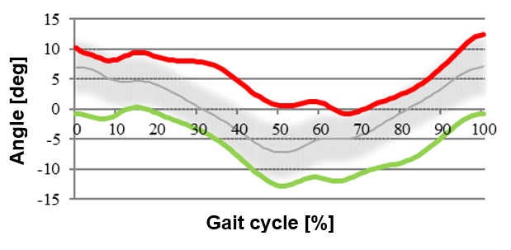
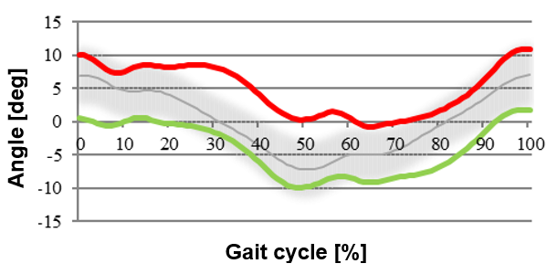
PELVIS
BEFORE TREATMENT
AFTER TREATMENT
Tilt
Obliquity
Rotation

Slide 8
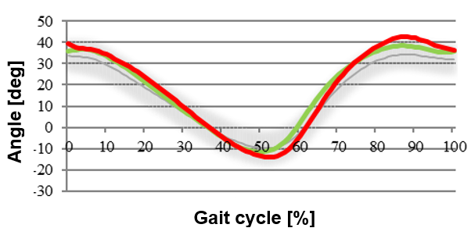
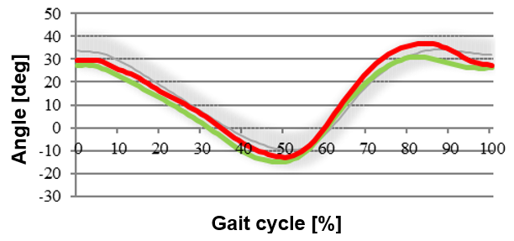
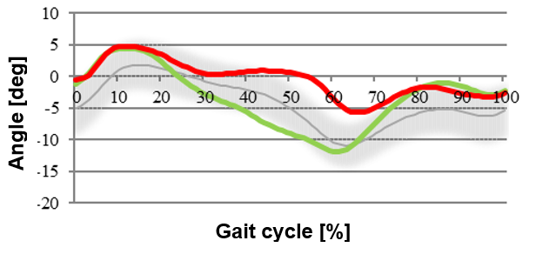
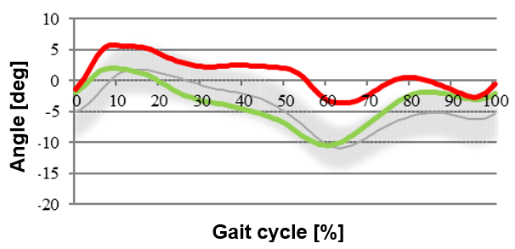
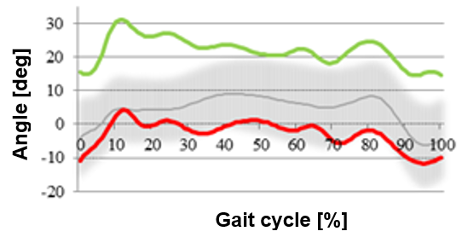
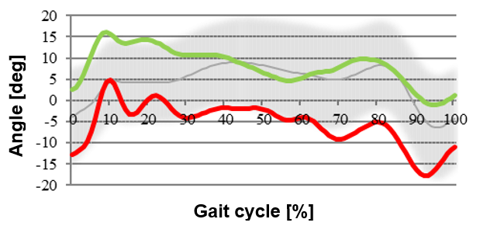
HIP JOINT
BEFORE TREATMENT
AFTER TREATMENT
Flexion/Extension
Adduction/Abduction
Rotation

Slide 9
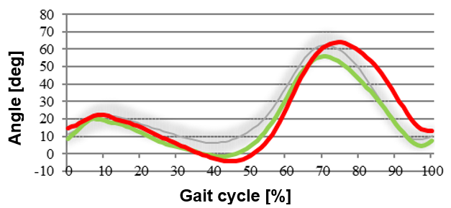
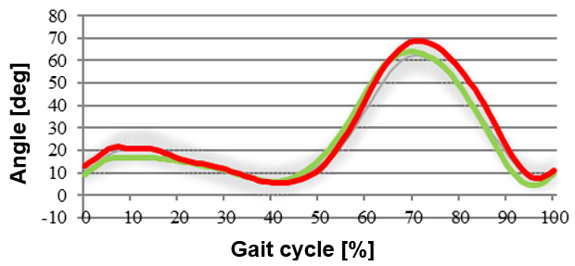
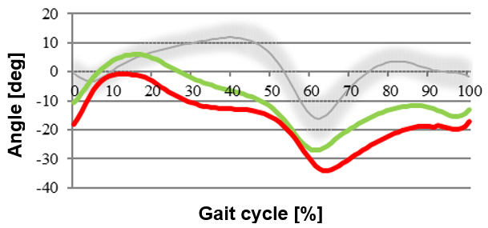
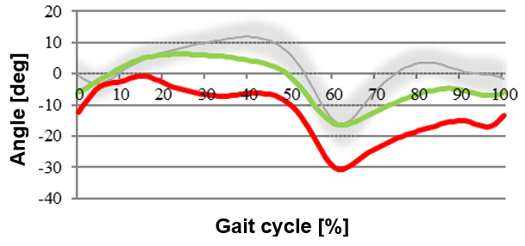
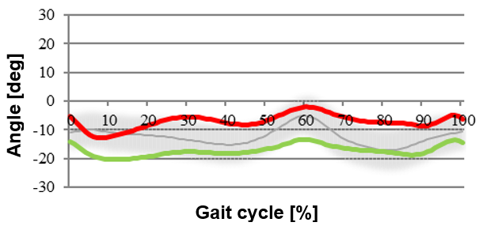
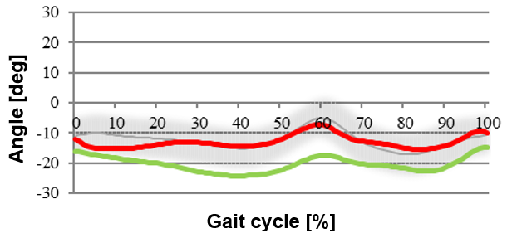
KNEE JOINT
BEFORE TREATMENT
AFTER TREATMENT
Flexion/Extension
ANKLE JOINT
Dorsiflexion/ Plantarflexion
Rotation

Slide 10
COURSES OF JOINT ANGLES
PERSON 2

Slide 11
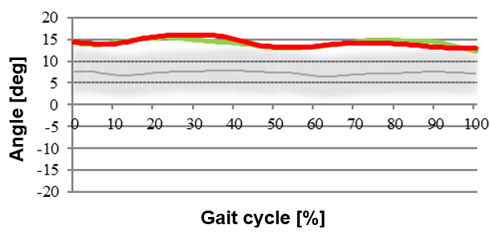
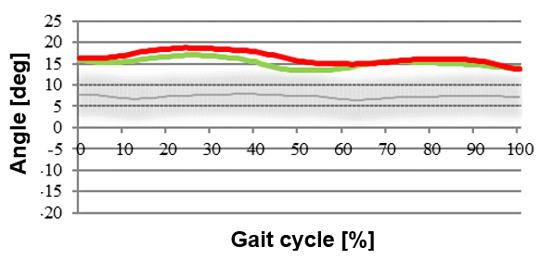
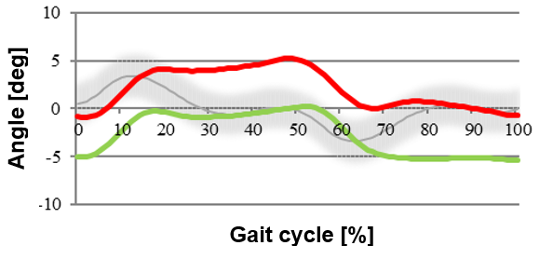
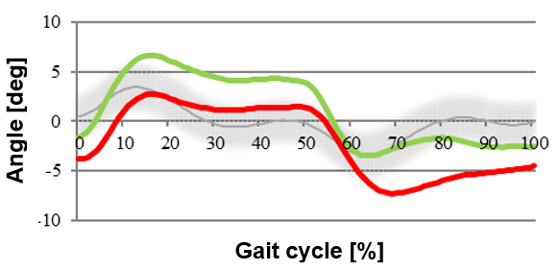
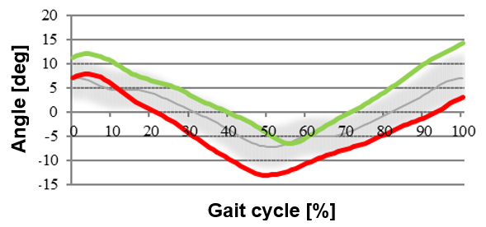
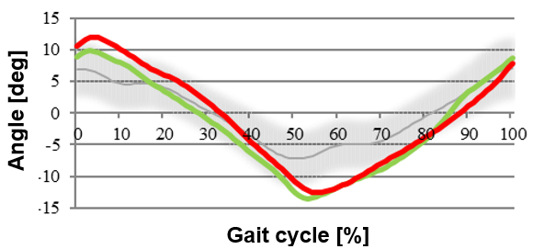
PELVIS
BEFORE TREATMENT
AFTER TREATMENT
Tilt
Obliquity
Rotation

Slide 12
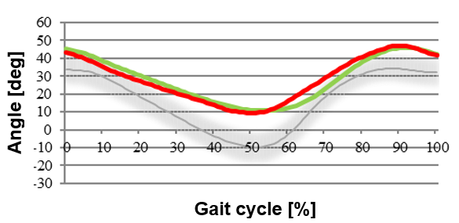
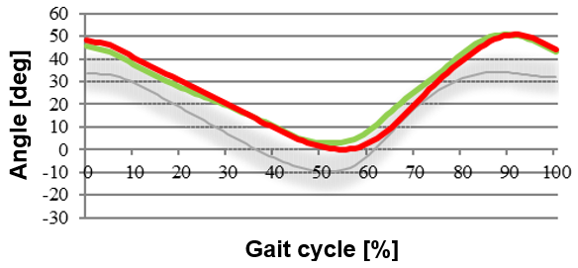
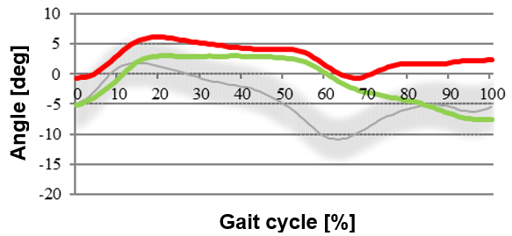
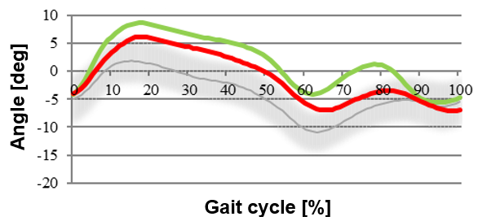
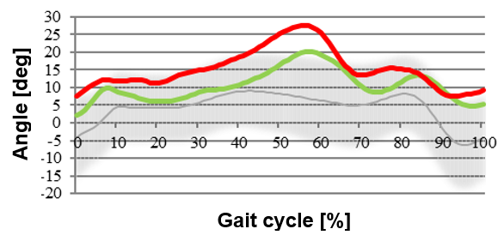
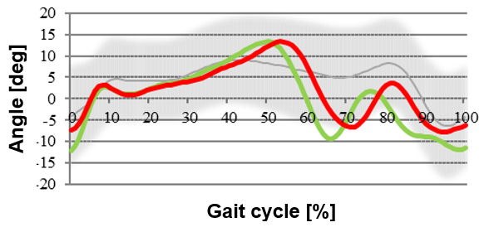
HIP JOINT
BEFORE TREATMENT
AFTER TREATMENT
Flexion/Extension
Adduction/Abduction
Rotation

Slide 13
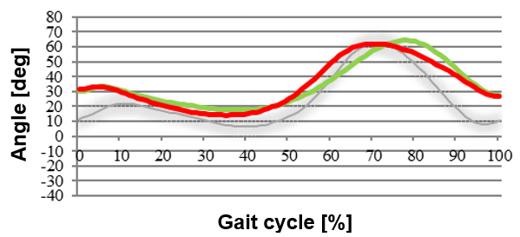
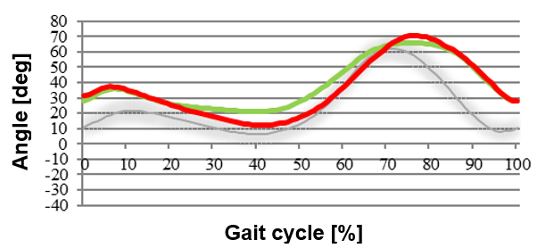
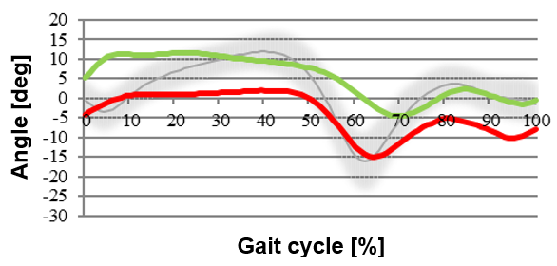
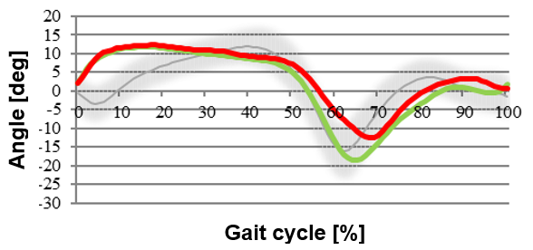
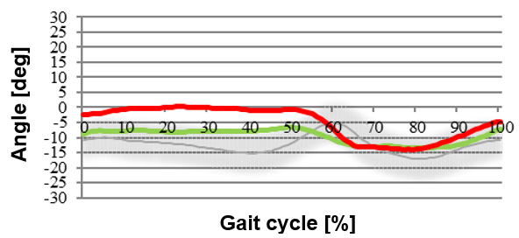
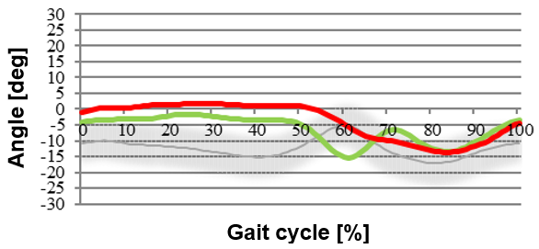
KNEE JOINT
BEFORE TREATMENT
AFTER TREATMENT
Flexion/Extension
ANKLE JOINT
Dorsiflexion/ Plantarflexion
Rotation

