Slide 1
MODULE BIOMECHANICS FOUNDATIONS
Didactic Unit A: MOVEMENTS

Slide 2
CLASS INDEX
Understanding differences between Kinematics and Kinetics variables
Understanding the concept of acceleration
-------------------------------------------------------------------------
Class workshop
Movement planes

Slide 3
Understanding differences between Kinematics and Kinetics
Kinematics and Kinetics variables
Kinematics
he motion of a body through different variables:
Kinematics describes the motion of a body.
Kinematics answer the questions about how a body moves.
Kinetics
Kinetics describes the forces that act over a body to produce movement.
Kinetics answer the questions about why a body moves.
https://ocw.mit.edu/courses/physics/8-01sc-classical-mechanics-fall-2016/week-1-kinematics/week-1-introduction/
The following variables related to the movement of a body belong to kinematic or kinetic analysis?
Energy, acceleration, power, ground reaction force, velocity, position, work, angle
Notes:
The teacher should show the content of the video and according to that, students should classify the variables.
Time=5-10´.

Slide 4
Understanding the concept of acceleration
ACCELERATION AND VELOCITY
Acceleration is the rate of change of velocity. It means that in the case that the velocity does not change, the acceleration is equal to zero.
Are you sure that you have understood the relationship between acceleration and velocity?

Slide 5
Understanding the concept of acceleration
ACCELERATION AND VELOCITY
Match the following statements:
 | High velocity, low acceleration | High velocity, high acceleration | Low velocity, low acceleration | Low velocity, high acceleration
A car accelerating at maximum after red traffic lights
A car driving by a school area at a low, almost constant velocity
A car at high velocity and try to overtake another car increasing its velocity
A car at a stable and high velocity
Activity extracted from: https://es.khanacademy.org/science/physics/one-dimensional-motion/acceleration-tutorial/a/acceleration-article?modal=1
Notes:
Time required: 10´.

Slide 6
Understanding the concept of acceleration
ACCELERATION AND VELOCITY
Match the following statements:
 | High velocity, low acceleration | High velocity, high acceleration | Low velocity, low acceleration | Low velocity, high acceleration
A car accelerating at maximum after red traffic lights |  |  |  | X
A car driving by a school area at a low, almost constant velocity |  |  | X
A car at high velocity and try to overtake another car increasing its velocity |  | X
A car at a stable and high velocity | X
Activity extracted from: https://es.khanacademy.org/science/physics/one-dimensional-motion/acceleration-tutorial/a/acceleration-article?modal=1
Notes:
Correct answers
Teacher´s explanation (if required): A driver accelerating at maximum means high acceleration because the velocity changes quickly. A car with an almost stable/constant velocity means that the velocity does not change so the acceleration is low. Acceleration is zero if the velocity is constant.
A car in a school/pedestrian zone or after red traffic lights, velocity is low (in the second case, the car is stopped, so it does not have time enough to get high velocity).
Time required: 10´.

Slide 7
CLASS INDEX
Understanding the concept of acceleration
-------------------------------------------------------------------------
Class workshop
Movement planes

Slide 8
WORKSHOP
Movement
planes
Objective:
To determine the movements planes and axis of the three movements proposed.
Instructions:
Forming working groups.
One of the students plays the role of an anatomical model.
First movement: From position 1, perform shoulder internal-external rotations without separating the elbow from the trunk.
Second movement: From position 1, perform forearm pronation and supination.
Third movement: From position 2, perform shoulder internal-external rotations.

Slide 9
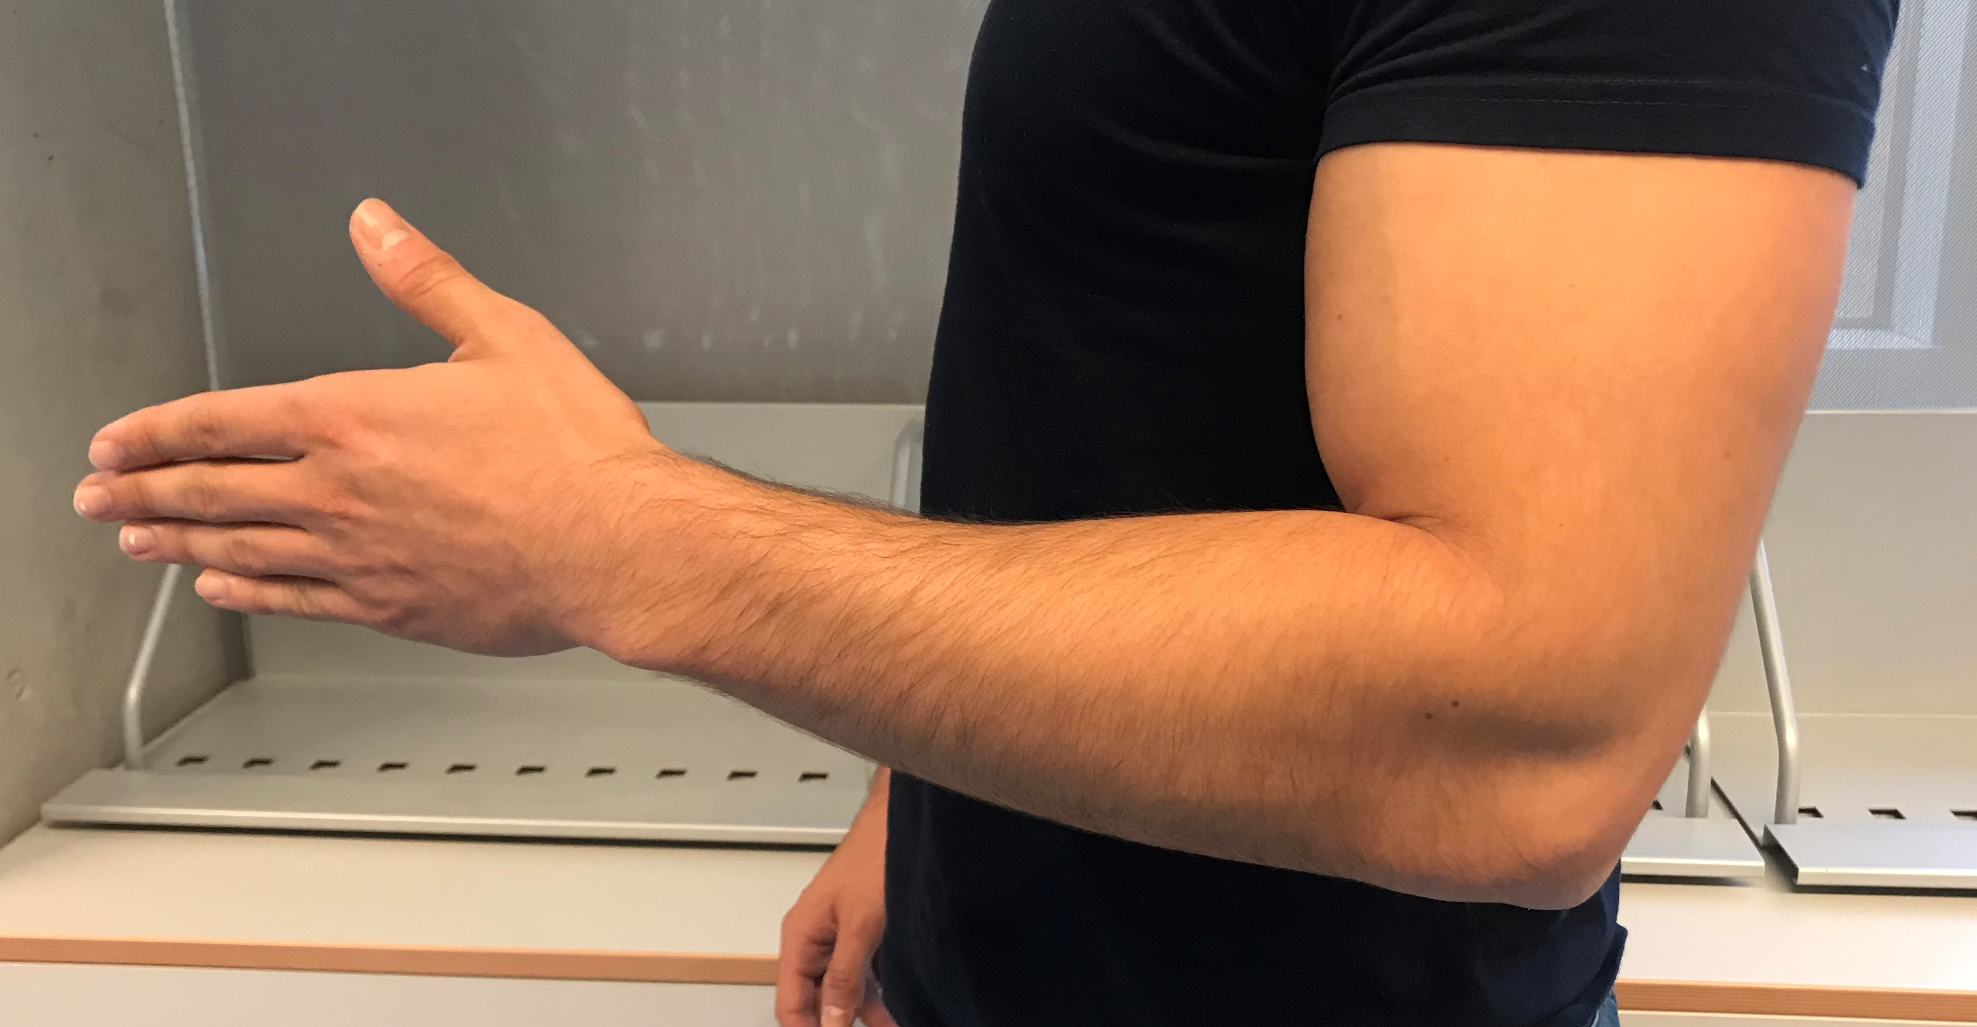
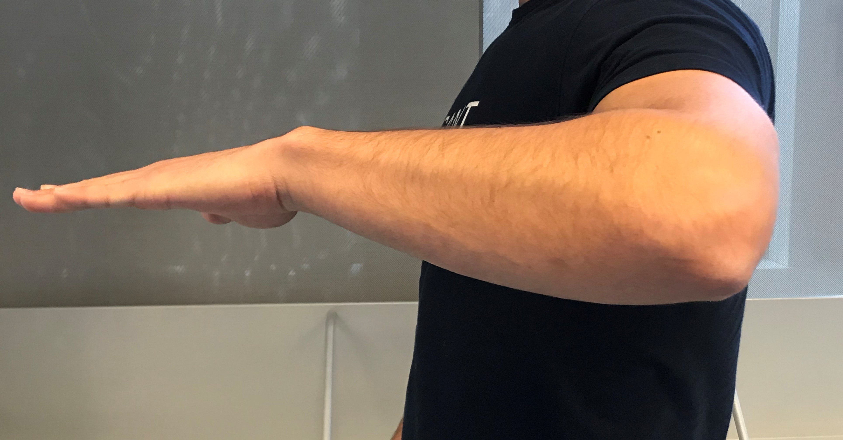
WORKSHOP
Movements
planes
Position 1
Position 2

Slide 10
Movements
planes
WORKSHOP
Solution:
First movement:
Plane: Horizontal
Axis: Lateral and Anteroposterior
Second movement:
Plane: Frontal
Axis: Lateral and Vertical
Third movement:
Plane: Sagittal
Axis: Vertical and Anteroposterior
Notes:
Check the answers with the students.

