Slide 1
MODULE BIOMECHANICS FOUNDATIONS
Didactic Unit B: FORCES AND PRESSURE

Slide 2
CLASS INDEX
Fundamental kinetic variables
-------------------------------------------------------------------------
Testing your knowledge about kinetic equations

Slide 3

FUNDAMENTAL KINETIC EQUATIONS
Kinetics answer the questions about why a body moves.
Force is the physical magnitude used to quantify the causes of the changes in the movement of bodies.
$$\vec{F}=m\vec{a}=mass∗acceleration$$
Energy is a measurement of the ability of someone or something to do work.
Kinetic Energy ${(E}_{K})$: Energy that an object possesses because of its motion.
Potential energy ${(E}_{p})$ is energy which results from position or configuration.
Work: A force is doing work if, when acting, there is a movement of the point of application in the direction of the force (same direction or the force has a component in the direction of the motion).
Power is defined as the rate of doing work or the rate of using energy.
Torque is defined by the measurement of the twisting action caused by a force that can cause an object to rotate about an axis.
Notes:
To start the class, the teacher should remember the main definitions and equations of kinetics. After that, students will do some exercises. They need the equations if they do not remember them. The students can have their notes to check the equations and units. Calculator is not required if the exercises are done directly in internet/computer. If it is not possible, they will need a calculator. They can work by pairs or groups.

Slide 4


KINETIC EQUATIONS EXERCISES
Kinetic Energy
https://www.khanacademy.org/science/ap-physics-1/ap-work-and-energy/kinetic-energy-ap/e/kinetic-energy-exercises-ap1?modal=1
Finding changes in gravitational potential energy
https://www.khanacademy.org/science/ap-physics-1/ap-work-and-energy/conservative-forces-and-gravitational-potential-energy-ap/e/gravitational-potential-energy-ap-physics-1?modal=1
Notes:
Students have to solve two exercises for each part (1 and 2).

Slide 5
KINETIC EQUATIONS EXERCISES
Work done by a force
https://www.khanacademy.org/science/ap-physics-1/ap-work-and-energy/introduction-to-work-ap/e/work-equation-ap-physics-1?modal=1
https://www.khanacademy.org/science/ap-physics-1/ap-torque-angular-momentum/torque-and-equilibrium-ap/e/torque-calculations-ap-physics-1
Notes:
Students have to solve two exercises for each part.

Slide 6
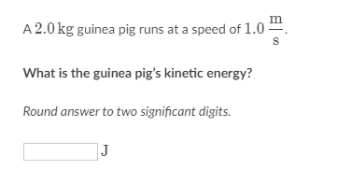
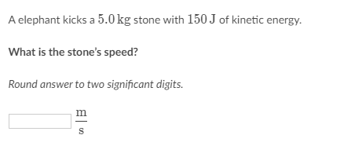
KINETIC EQUATIONS EXERCISES
Kinetic Energy
QUESTION 1
QUESTION 2
Notes:
In the case that students do not have internet/computer, they will solve these exercises using their own calculators in the class by pairs or groups.
Source: https://www.khanacademy.org/science/ap-physics-1/ap-work-and-energy/kinetic-energy-ap/e/kinetic-energy-exercises-ap1?modal=1

Slide 7
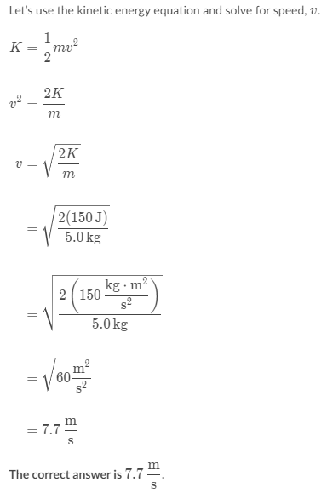
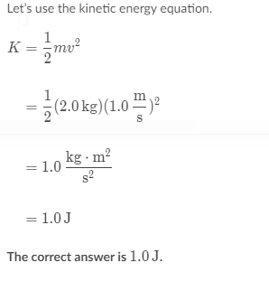
KINETIC EQUATIONS SOLUTIONS
QUESTION 1: SOLUTION
QUESTION 2: SOLUTION
Notes:
These are the solutions of the exercises proposed on slide 6.
Source: https://www.khanacademy.org/science/ap-physics-1/ap-work-and-energy/kinetic-energy-ap/e/kinetic-energy-exercises-ap1?modal=1

Slide 8
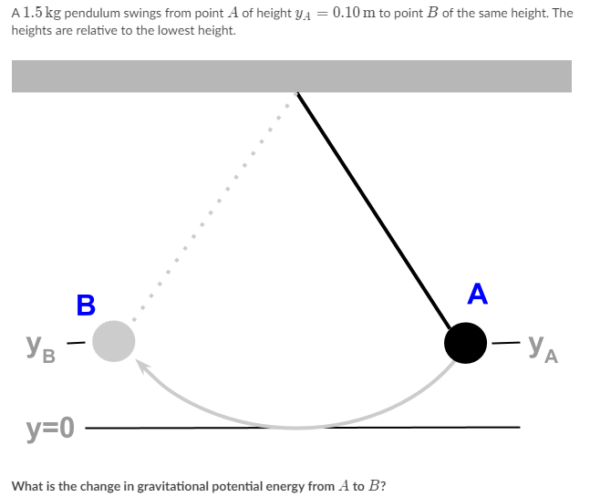
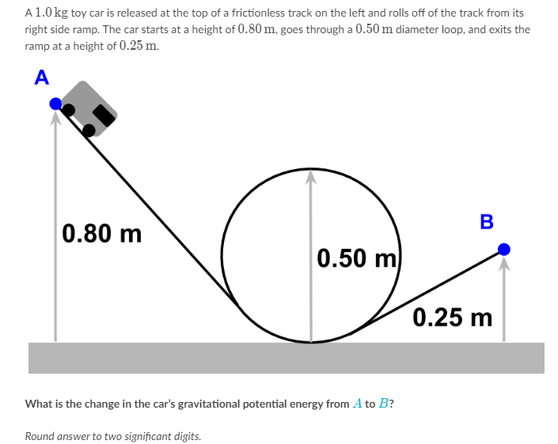
KINETIC EQUATIONS EXERCISES
Finding changes in gravitational potential energy
QUESTION 3
QUESTION 4
Notes:
In the case that students do not have internet/computer, they will solve these exercises using their own calculators in the class by pairs or groups.
Source: https://www.khanacademy.org/science/ap-physics-1/ap-work-and-energy/conservative-forces-and-gravitational-potential-energy-ap/e/gravitational-potential-energy-ap-physics-1?modal=1

Slide 9
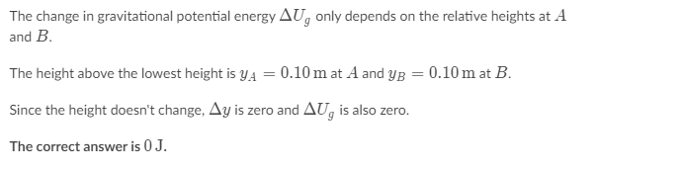
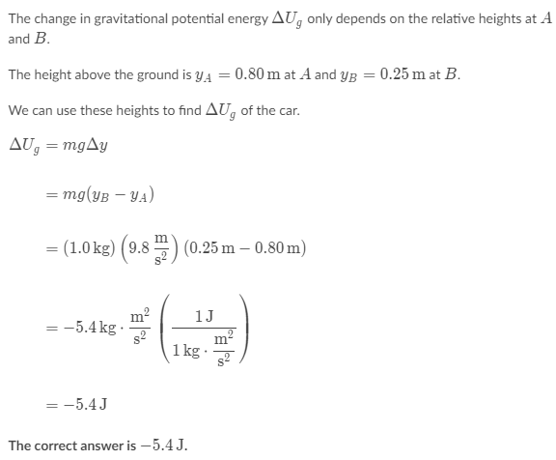
KINETIC EQUATIONS SOLUTIONS
Finding changes in gravitational potential energy
QUESTION 3: SOLUTION
QUESTION 4: SOLUTION
Notes:
These are the solutions of the exercises proposed on slide 8.
Source: https://www.khanacademy.org/science/ap-physics-1/ap-work-and-energy/conservative-forces-and-gravitational-potential-energy-ap/e/gravitational-potential-energy-ap-physics-1?modal=1

Slide 10
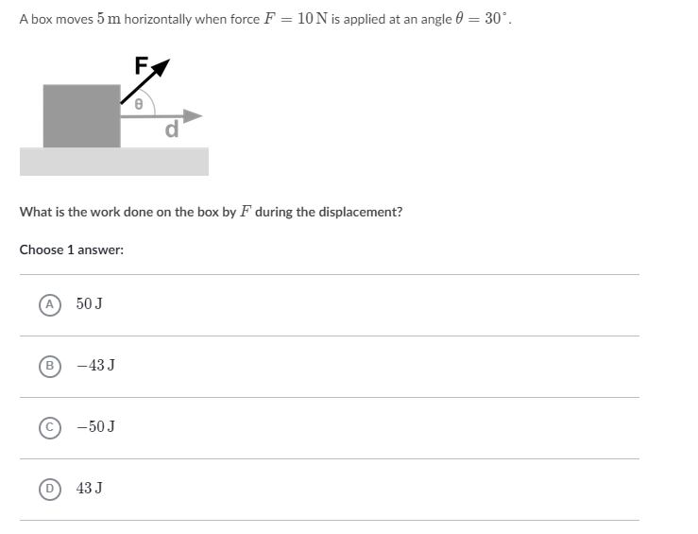
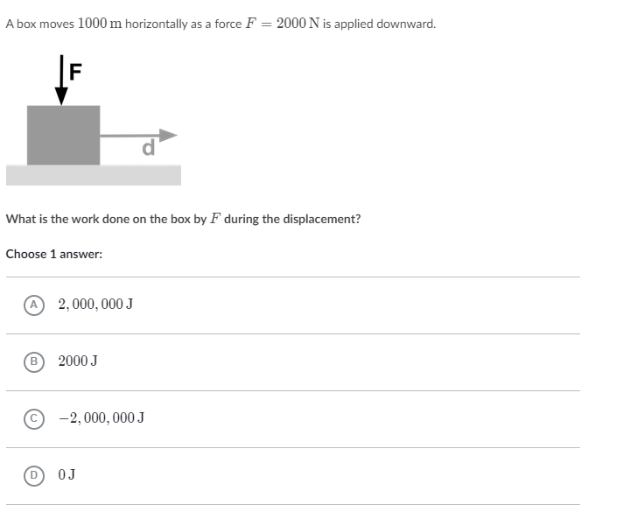
KINETIC EQUATIONS EXERCISES
Work done by a force
QUESTION 5
QUESTION 6
Notes:
In the case that students do not have internet/computer, they will solve these exercises using their own calculators in the class by pairs or groups.
Source: https://www.khanacademy.org/science/ap-physics-1/ap-work-and-energy/introduction-to-work-ap/e/work-equation-ap-physics-1?modal=1

Slide 11
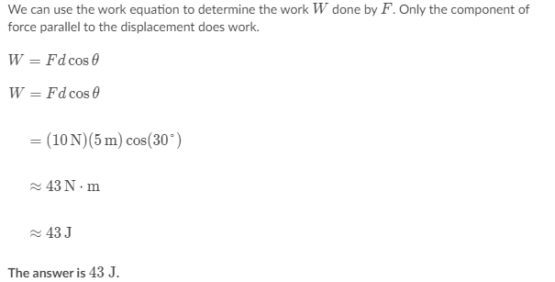
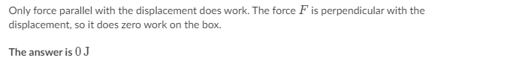
KINETIC EQUATIONS SOLUTIONS
Work done by a force
QUESTION 5: SOLUTION
QUESTION 6: SOLUTION
Notes:
These are the solutions of the exercises proposed on slide 10.
Source: https://www.khanacademy.org/science/ap-physics-1/ap-work-and-energy/introduction-to-work-ap/e/work-equation-ap-physics-1?modal=1

Slide 12
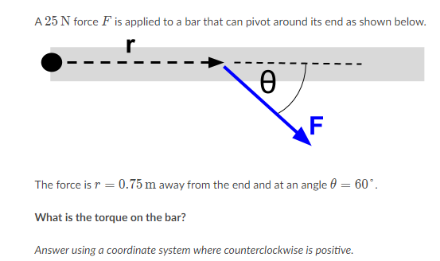
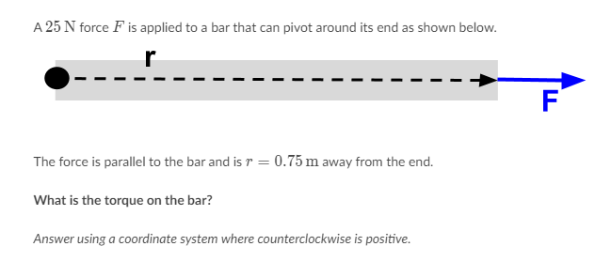
KINETIC EQUATIONS EXERCISES
Torque
QUESTION 8
QUESTION 7
Notes:
In the case that students do not have internet/computer, they will solve these exercises using their own calculators in the class by pairs or groups.
Source: https://www.khanacademy.org/science/ap-physics-1/ap-torque-angular-momentum/torque-and-equilibrium-ap/e/torque-calculations-ap-physics-1

Slide 13
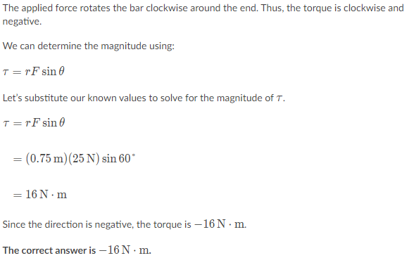
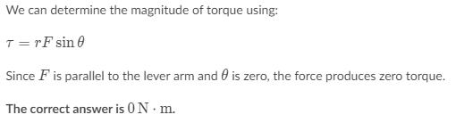
KINETIC EQUATIONS SOLUTIONS
Torque
QUESTION 7: SOLUTION
QUESTION 8: SOLUTION
Notes:
These are the solutions of the exercises proposed on slide 12.
Source: https://www.khanacademy.org/science/ap-physics-1/ap-torque-angular-momentum/torque-and-equilibrium-ap/e/torque-calculations-ap-physics-1?modal=1

Slide 14
