Slide 1
MODULE BIOMECHANICS: FOUNDATIONS OF BIOMECHANICS APPLIED TO THE LOCOMOTOR SYSTEM
Didactic Unit C: Physiological signs and morphometric parameters

Slide 2
Diagnostic and therapeutic relevance of morphometric parameters.
Morphometric and Anthropometric parameters are a series of quantitative measurements of the muscle, bone, and adipose tissue used to assess the composition of the body. The core elements of anthropometry are height, weight, body mass index (BMI), body circumferences (waist, hip, and limbs), and skinfold thickness.
These measurements are important because they represent diagnostic criteria for obesity, which significantly increases the risk for conditions such as cardiovascular disease, hypertension, diabetes mellitus, and many more. There is further utility as a measure of nutritional status in children and pregnant women. Additionally, anthropometric measurements can be used as a baseline for physical fitness and to measure the progress of fitness.

Slide 3
Diagnostic and therapeutic relevance of morphometric parameters.
Anthropometric measurements are the most basic method of assessing body composition. Anthropometric measurements describe body mass, size, shape, and level of fatness. Because body size changes with weight gain, anthropometry gives the researcher or clinician an adequate assessment of the overall adiposity of an individual.
Body weight is the most frequently used measure of obesity. In general, persons with high body weights typically have higher amounts of body fat. A variety of scales are available for measuring weight, and these should be calibrated regularly for accurate assessments of weight. Changes in weight correspond to changes in body water, fat, and/or lean tissue. Weight also changes with age in children as they grow and in adults as they accumulate fat..

Slide 4
Diagnostic and therapeutic relevance of morphometric parameters.
Body Mass Index (BMI) is a descriptive index of body habitus that encompasses both the lean and the obese and is expressed as weight divided by stature squared (kg/m2). A significant advantage of BMI is the availability of extensive national reference data and its established relationships with levels of body fatness, morbidity, and mortality in adults.16 BMI is particularly useful in monitoring the treatment of obesity, with a weight change of about 3.5 kg needed to produce a unit change in BMI. In adults, BMI levels above 25 are associated with an increased risk of morbidity and mortality,17 with BMI levels of 30 and greater indicating obesity.18 In children, BMI is not a straightforward index because of growth.
The use of BMI alone is also cautioned in athletes and persons with certain medical conditions (e.g., sarcopenia) where body weight may be altered significantly by changing proportions of muscle and fat masses.

Slide 5
Diagnostic and therapeutic relevance of morphometric parameters.
Abdominal Circumference. Obesity is commonly associated with increased amounts of intra-abdominal fat. A centralized fat pattern is associated with the deposition of both intra-abdominal and subcutaneous abdominal adipose tissue.
The ratio of abdominal circumference (often referred to incorrectly as “waist” circumference) to hip circumference is a rudimentary index for describing adipose tissue distribution or fat patterning. Abdomen-to-hip ratios greater than 0.85 represent a centralized distribution of fat. Most men with a ratio greater than 1.0 and women with a ratio greater than 0.85 are at increased risk for cardiovascular disease, diabetes, and cancers

Slide 6
Diagnostic and therapeutic relevance of morphometric parameters.
Bioelectric Impedance Analysis – biomedical measurement method for assessing the anthropometrical measures.
The analysis of body composition by bioelectrical impedance produces estimates of total body water (TBW), fat-free mass (FFM), and fat mass by measuring the resistance of the body as a conductor to a very small alternating electrical current.
Bioelectrical impedance analysers do not measure any biological quantity or describe any biophysical model related to obesity. Bioelectrical impedance analysers use math formulas to describe statistical associations based on biological relationships for a specific population, and as such the equations are useful only for subjects that closely match the reference population in body size and shape. BIA has been applied to overweight or obese and for normal weight individuals too.

Slide 7
Physiological signs as a non-invasive, basic way to asses patient state in modern, effective, multimodal biosignal acquisition systems.
Vital signs are the parameters obtaining as an effect of various physiological signals measurement, in order to assess the most basic body functions, what important in non-invasive way. They can be divided into electrical or non-electrical biosignals. The most common:
Electrocardiography - ECG,
Electromyography - EMG,
Electroencephalography - EEG,
Electrooculography - EOG,
Galvanic skin response - GSR,
Pulse wave - PW,
Body temperature - BT,
Blood pressure - BP,
Respiratory rate - RR.

Slide 8
The analysis of physiological signals is widely used for the development of diagnosis support tools in medicine. The use of multiple signals or physiological measures as a whole has been carried out using data fusion techniques commonly known as multimodal fusion, which has demonstrated its ability to improve the accuracy of diagnostic care systems.
Classification of physiological signals, which can be integrated in muti-modal measurement systems is presented on the tree diagram.

Slide 9
Physiological signs – high technology integration of multi-modal biosignal recordings in Body Sensor Networks (BSN), implemented in ‚smart’, wearable devices e.g. smart / sport-watches
In modern, implemented e.g. in smart watches and mobile phones - body sensor network (BSN) systems all mentioned bio-signs can be registered using multimodal, multichannel data acquisition and further - processing and analysis systems, to obtain a parameters & indicators allowing to estimated a cumulative, weighted multi-features indicator of patient’s state to asses her/his homeostasis or well-being.
Homeostasis refers to stable operating conditions in the internal environment (in the blood and interstitial fluid). This is how the human body maintains a rather constant internal environment despite changing external conditions. It is brought about by coordinated activities of cells, tissues, organs, and organ systems
All mentioned biosignal measurements are commonly accessible, not expensive and relatively easy to use and do not require any complex equipment.

Slide 10
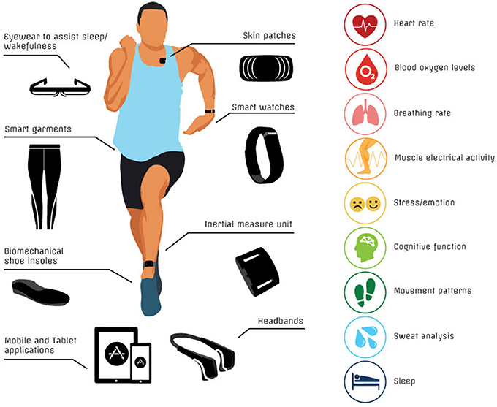
Physiological signs monitoring by means of modern wearable sensors networks
Wearable sensing technology is a category of technology devices worn by subjects that allow continuous physiological monitoring with reduced manual intervention and at low cost.
Wearable sensors concerned with quantification of movement allow to shift clinical assessment of motor dysfunction from the current subjective methods applied in some rating scales to quantifiable and accurate measures and to provide long-term quantified measures that monitor the patient's condition and overall motor progression

Slide 11
Summary, conclusions
Both morphometric and anthropometric as well as physiological signs, recording in non-invasive way by means of multi-modal biosignal recording systems carry very important information on the functioning of the human internal systems and organs.
Combined sets of anthropometric and physiological parameters are increasingly being used both in health care units as well as in everyday usage to support diagnosis, treatment and what important also ‚healthy’ lifestyle, monitored by body sensor networks.

