Slide 1
MODULE FOUNDATIONS
Didactic Unit D: TECHNIQUES FOR THE INSTRUMENTAL ANALYSIS OF MOVEMENT AND FORCES
D.1 How can movements be measured and which parameters can be analyzed? What are its main applications?

Slide 2
CLASS INDEX
How can I measure Movements? Principal Techniques for instrumental analysis in Biomechanics
Main fields of application and examples
-------------------------------------------------------------------------
Class Workshop 1 and 2

Slide 3
Measuring Movement
Evolution of movement analysis
Notes:
The evolution in the analysis of movement has been constant over time. From direct observation to photographs or videos where the expert made his own manual analysis on those images, to the development of technology that allows its study in an objective, more precise and reliable way.

Slide 4
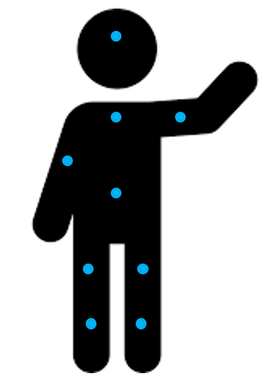
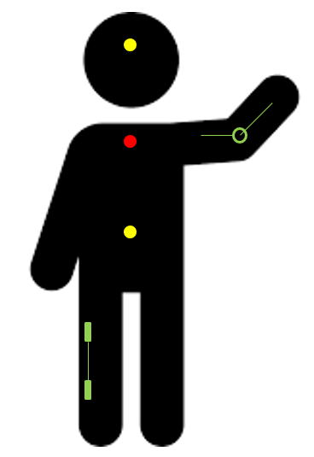
Measuring Movement
Different Techniques used in Biomechanics for Movements Analysis
Optical Systems
Inertial Systems
Others
Marker-based
Marker-less
I.M.U
Notes:
There are different motion analysis techniques and many ways to classify them. In general, we can talk about a group of motion capture systems based on images analysis; a group referred to inertial systems; and a group of other types of systems, including technologies such as GPS, inclinometers or goniometers.
Each one of them counts on its own characteristics regarding its measurement qualities and the parameters extracted from them. It is important to know them well in order to make an adequate use; some of them are simpler and others imply a high technical knowledge.

Slide 5
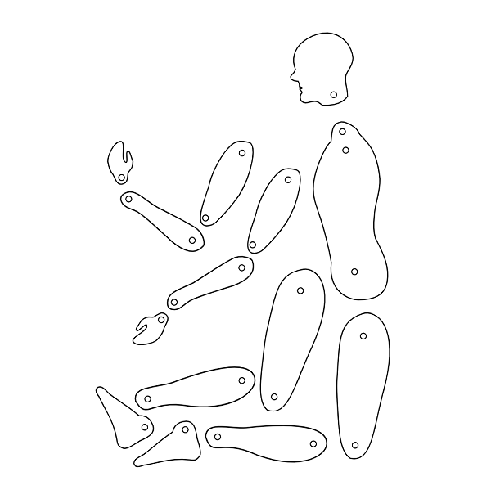
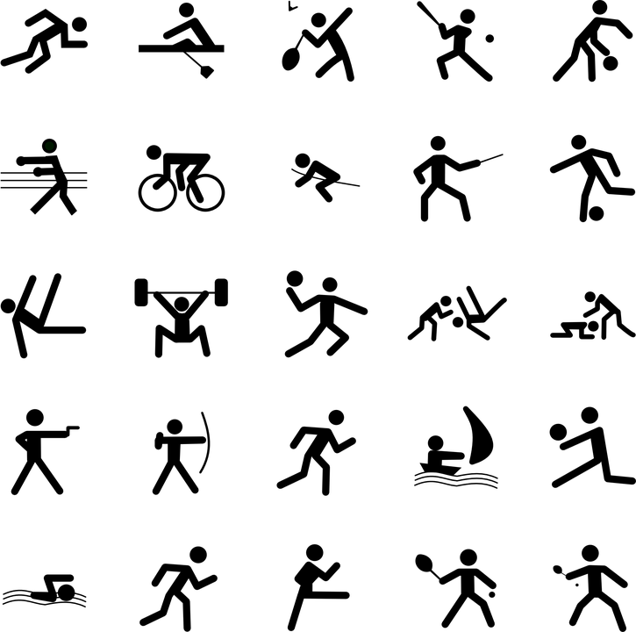
Measuring Movement
Areas of interest and examples of application
Notes:
The main areas of application of these techniques for instrumental analysis of movement are usually focused on the clinical area, and in the field of sports and ergonomics, in the latter above all for work environment study. Examples of application can range from the characterization of a musculoskeletal pathology and the functional assessment in daily activities to the evaluation of sports technique and performance, as well as the assessment of certain tasks or tools related to work.

Slide 6
Workflow 1st. Matching Up !!
Class Workshop 1
Couple 1. Jane and Peter: The Incredibles
Couple 2. John and Will: The Outsiders
Couple 3.
4. …
5.
6.
7.
8.
9.
10..
Notes:
We are going to move on to an activity related to movement analysis with instrumental techniques.
First, you should pair up and give each team a name.

Slide 7
Workflow 2nd. Topics Generation …
Class Workshop 1
1. Climbing stairs
2. …
3.
4.
5.
6.
7.
8.
9.
10..
Notes:
In this workshop, the each pair of students will have to propose a topic to look into. This topic will be an activity, gesture, pathology, joint or body part that can be measured with instrumental techniques of movement analysis in different environments. A maximum of 10 topics will be proposed. The teacher can give an initial example like “climbing stairs”.

Slide 8
Workflow 3rd. Topic lottery
Class Workshop 1
Optical motion capture system
The Outsiders
1. Climbing stairs
IMU or other
The Incredibles
Notes:
The teacher will then propose two groups for each topic, or else each pair can chose one randomly. All topics must be revised by two groups/pairs of students.
From the two groups or pairs working on the same topic, one of them will be assigned optical capture system such as 3D photogrammetry and the other pair an inertial system or other.
Now, each group has to look into Internet Scientific sources (Google Scholar, PubMed, Scopus,...) to find information about the assigned topic and the assigned instrumental technique, or more specifically, about how the topic proposed can be measured with the technique assigned.

Slide 9
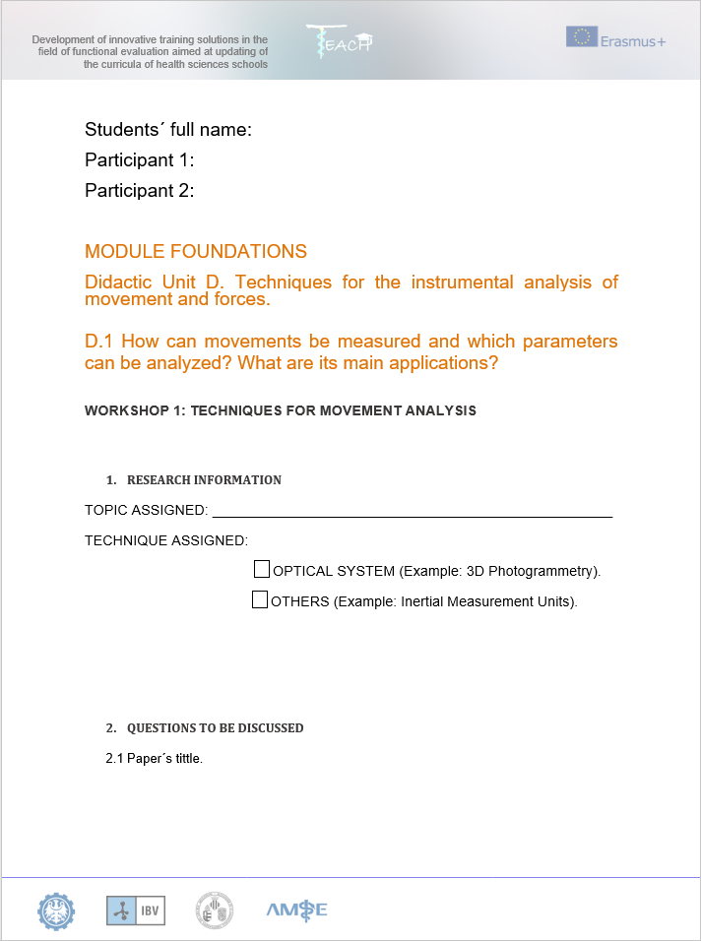
Workflow 4th. Fill the worksheet
Class Workshop 1
Notes:
The contents of the worksheet are presented by the teacher and the students will work in pairs, trying to answer all the questions. They will use the information found in the Internet Search to do so.
The teacher can collect the doubts during the execution of the practice and try to solve them at the end of the class or in another session, asking the students to look for the answers.

Slide 10
Workflow 5th. Present your results
Class Workshop 1
The Outsiders
The Incredibles
Notes:
When the students have finished the exercise and fulfilled the worksheets, a topic is chosen by the teacher and each pair assigned to it must present the answers made by the worksheet to the rest of the students in a small presentation.
Students can ask questions or help the speakers, the main conclusions are drawn regarding the similarities or differences between techniques, and optionally the best couple is voted on.

Slide 11
Class Workshop 2
Workflow 1st. Matching Up AGAIN !!
Did you read the theorical contents ??
Notes:
Before this session students should have read the theoretical contents of unit D.1.
If so, they are paired up again, forming different groups from those of workshop 1.

Slide 12
Class Workshop 2
Workflow 2nd. Prepare a PPT !!
Contents of your study
Movement of interest
Objectives
Movement Analysis Technique
Main Parameters
Notes:
The couples are instructed to prepare a small power point (or similar) presentation of a study using techniques for movement analysis with these contents: what do you want to measure and why? What would be the main objectives of your study related to movement analysis? What do you think would be the best biomechanical parameters that could help you in this study? What is the instrumental technique you would choose?
Optionally, they can look for information on the internet in case they need it to complete the presentation (only as a supporting source, not copying the information of any given scientific paper).

Slide 13
Class Workshop 2
Workflow 3rd. Presentation !!
Notes:
Each pair is asked to present the study; and both teacher and students can ask questions.
At the end of the class, students are asked to identify advantages or disadvantages of each technique regarding the objectives of the studies presented; and try to find other instrumental alternatives.

