Slide 1
MODULE FOUNDATIONS
Didactic Unit D: TECHNIQUES FOR THE INSTRUMENTAL ANALYSIS OF MOVEMENT AND FORCES
D.2 How can forces be measured and which parameters can be analyzed? What are its main applications?

Slide 2
CLASS INDEX
How can I measure forces? Principal Techniques for instrumental analysis in Biomechanics.
Case study.
Main ambits of application and examples.
-------------------------------------------------------------------------
Class Workshop
Notes:
Index of the class contents.

Slide 3
Measuring Forces
Different Techniques used in Biomechanics for Forces Analysis
Reaction Forces
Pressures
Muscular Force
Notes:
There are different force analysis techniques and many ways to classify them. In general, we can classify them depending on the objective of the evaluation: reaction forces, pressures and muscular force.
Each one of them counts on its own characteristics regarding its measurement qualities and the parameters extracted from them. It is important to know them well in order to make an adequate use; some of them are simpler and others imply a high technical knowledge.

Slide 4
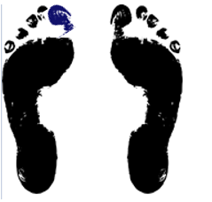
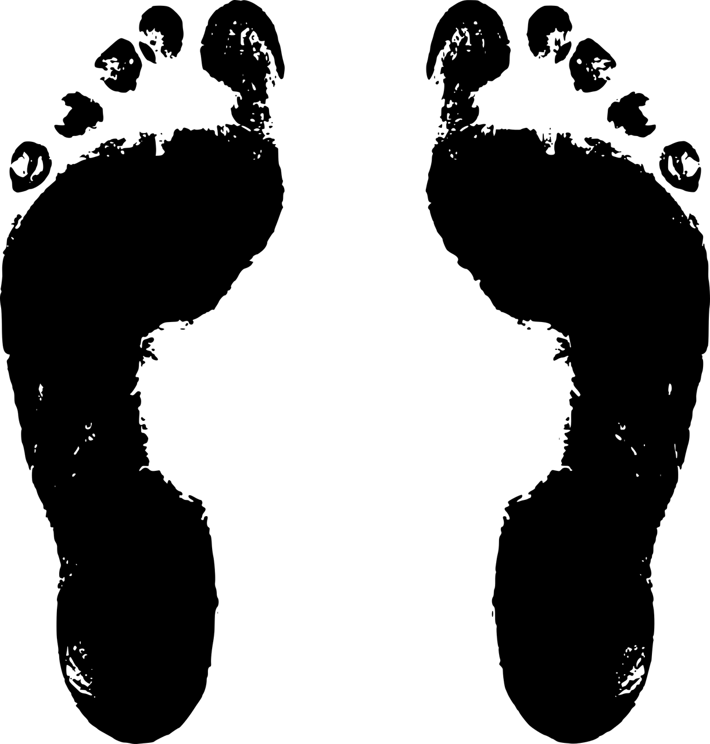
Hallux valgus
Case study
Introduction: Hallux valgus (HV) is a bone deformation over the first ray of the foot. Biomechanics of the foot can be altered in a greater or lesser extent depending on the degree of acquired deformity.
It can also produce pain and cause difficulties for normal gait.
New solutions have been adopted in surgery to avoid these problems. One of them is the minimally invasive correction through percutaneous techniques.
The main goal of this hallux valgus surgery is the morphologic and functional rebalance of the first metatarsophalangeal joint and first ray.
Hypothesis: this new technique is able to reduce biomechanics changes due to HV and improve functionality.
Objectives: Find out the effectiveness of this technique regarding functional improvements trough a clinical gait analysis, by studying both forces and pressures produced during this activity.
For that, a case study of a subject with HV deformation (mild degree) is presented.

Slide 5
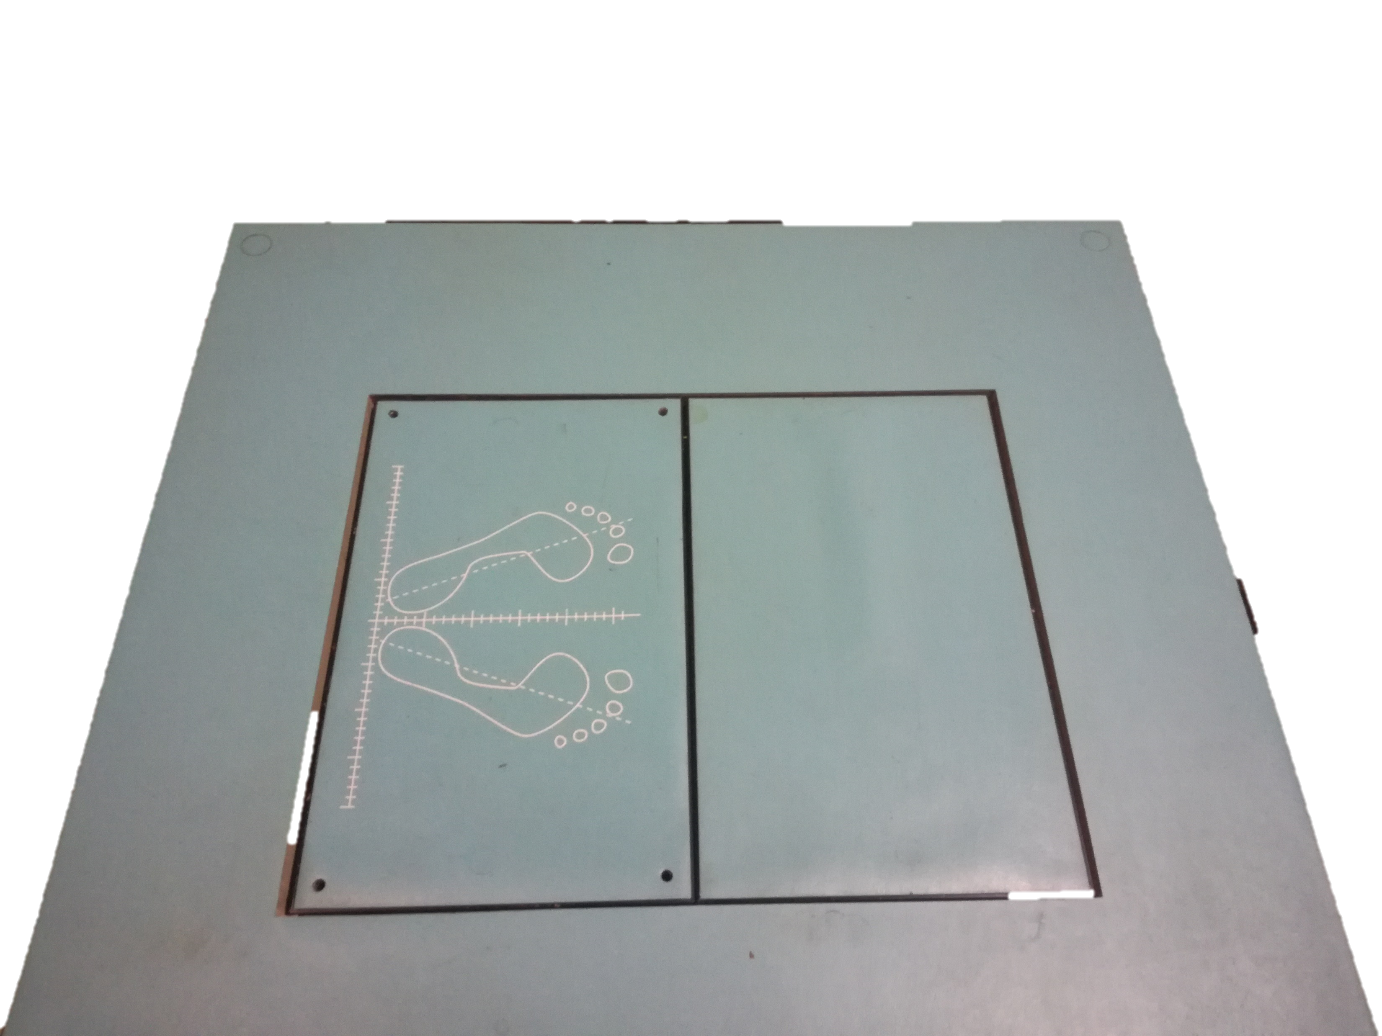
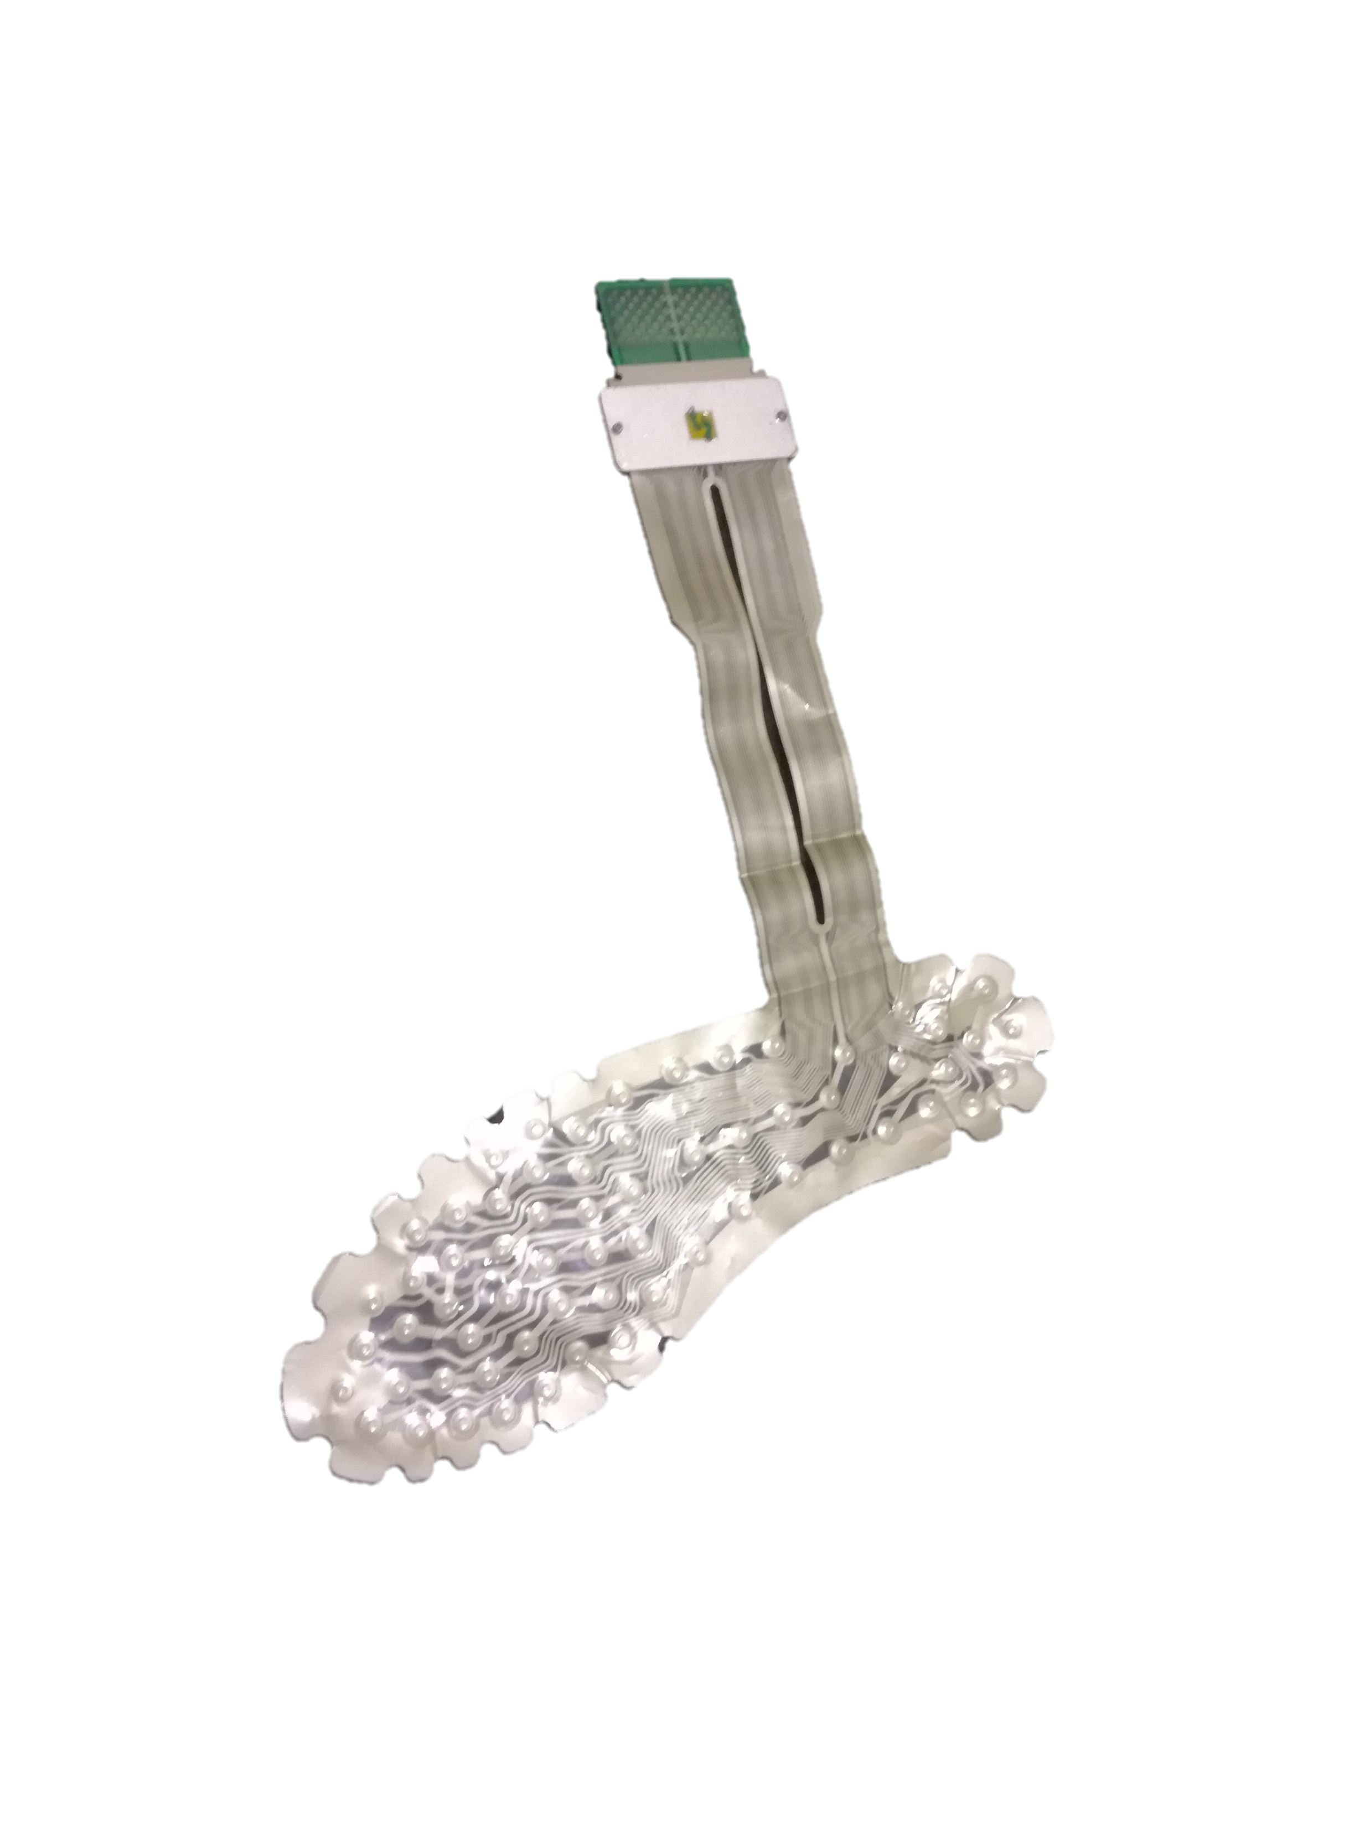
Methods
Reaction Forces
Pressures
Force platform Pressure insoles
Notes:
A dynamometric platform was used for the analysis of reaction forces in the 3 axes during the normal gait, and instrumented insoles with pressure sensors measured pressure magnitude and distribution in defined areas over the whole plantar surface

Slide 6
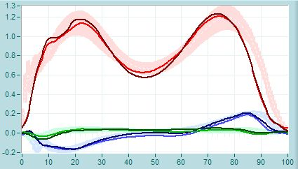
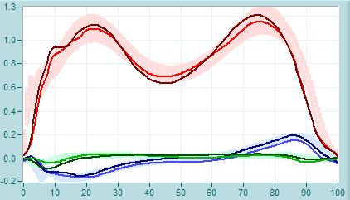
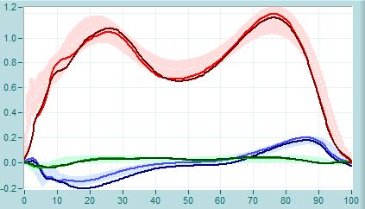
Gait Reaction Forces
Notes:
In this slide, we can see the results of the study of reaction forces during gait before surgery (PRE), 3 months (POST 3M) and 6 months (POST 6M) after the intervention.
One of the most commonly observed mechanical alterations due to the Hallux Valgus (HV) deformation is the insufficiency of the first ray during the mid-support phase. This alteration mainly impairs the propulsion phase during gait. This phase of propulsion is related to the ability to transfer the load to the metatarsals, and to the first finger at the end of the movement, to allow the taking-off and advance of the foot to the next step.
In this picture we are able to analyze the vertical and anteroposterior forces registered with the dynamometric platform, mainly in this last phase of the gait (propulsion phase, located in the image between the black dot vertical lines).
1. It can be observed that prior to surgery (PRE) there is no significant asymmetry between the vertical forces of the affected foot (light red) and the normal foot (dark red), as well as in the antero-posterior forces of the affected foot (light blue) and the normal foot (dark blue). In addition, the forces related to both feet are within the bands of normality (shaded areas) of a normal gait pattern. However, there is a small advance in the take-off phase compared to the normal pattern. This may mean that no significant functional disturbance of the gait using force platforms is observed prior to surgery.
2. In the post-surgical period (POST 3M) a difference in the magnitude of these forces (vertical/red and anteroposterior/blue) is evident in the propulsion phase between limbs, even though it does not show a significant alteration from a normal pattern
3. At 6 months (POST 6M) a return to pre-surgery values are observed; and a slight delay the propulsion phase in the gait cycle (more adjusted to normal pattern) is noted compared to PRE forces morfology .

Slide 7
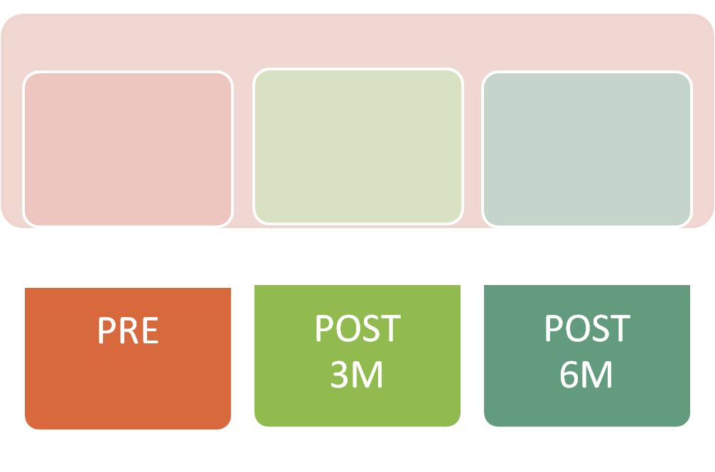
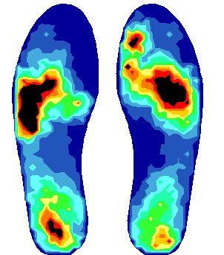
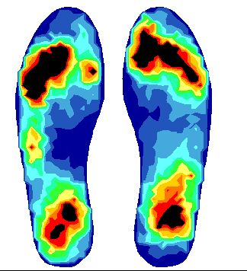
Gait Pressure Distribution
Notes:
Subjects with HV might curse with an altered pattern of plantar pressure distribution in the forefoot area compared to asymptomatic individuals.
In the case study it can be observed that:
In the PRE phase there is an alteration in the support of the meta-tarsal heads with respect to an asymptomatic pattern of the contralateral foot, highlighting an absence of load in the first metatarsal joint.
In the POST 3M phase a greater alteration is observed, evidencing a more backward meta-tarsal support, and no evident load along the first ray.
In the 6M POST phase it can be seen that there is already some load over the first toe, and a pressure distribution pattern similar to the contralateral foot.

Slide 8
Case Study: conclusions
The use of dynamometric platforms shows no alteration of functional performance of gait during the whole period studied.
Pressure insoles results show significant modifications of pressure distribution during the study, mainly regarding first ray.
A better pressure distribution is observed after the surgery.

Slide 9
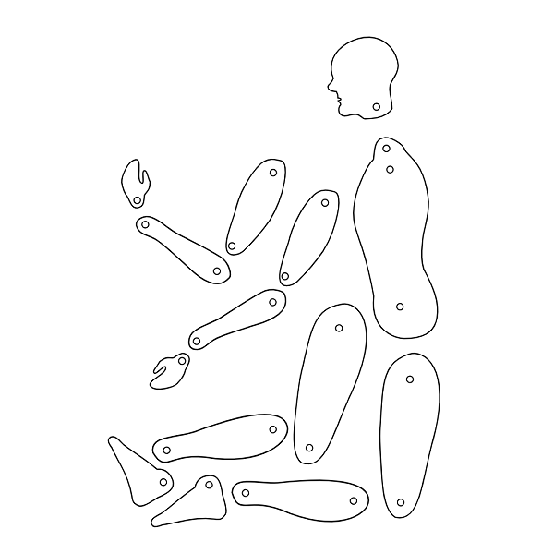
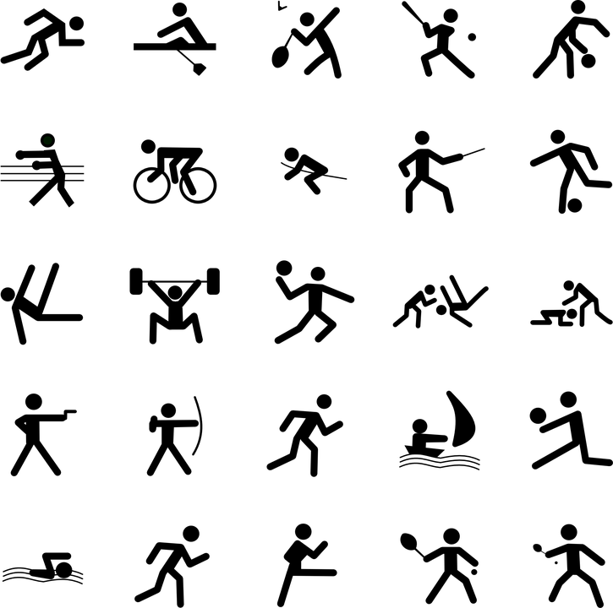
Measuring Forces
Areas of interest and examples of application
Notes:
The main areas of application of these techniques for instrumental analysis of forces are usually focused on the clinical area, and in the field of sports and ergonomics, in the latter above all for work environment study. Examples of application can range from the characterization of a musculoskeletal pathology and the functional assessment in daily activities to the evaluation of sports technique and performance, as well as the assessment of certain tasks or tools related to work.

Slide 10
Workflow 1st. Matching Up !!
Class Workshop
Couple 1. Jane and Peter: The Incredibles
Couple 2. John and Will: The Outsiders
Couple 3.
4. …
5.
6.
7.
8.
9.
10..
Notes:
We are going to move on to an activity related to forces and pressure analysis with instrumental techniques.
First, you should pair up and give each team a name.

Slide 11
Workflow 2nd. Topic selection …
Class Workshop
1. Grip force in carpal tunnel síndrome. (The incredibles)
2. Lower limb weakness after ACL surgery. (The Outsiders).
3. …
4.
5.
Notes:
In this step, each team will have to propose a topic to look into. This topic will be an activity, gesture, pathology, joint or body part that can be measured with instrumental techniques of force analysis in different environments. The teacher can give an initial example like the ones appearing in this slide.

Slide 12
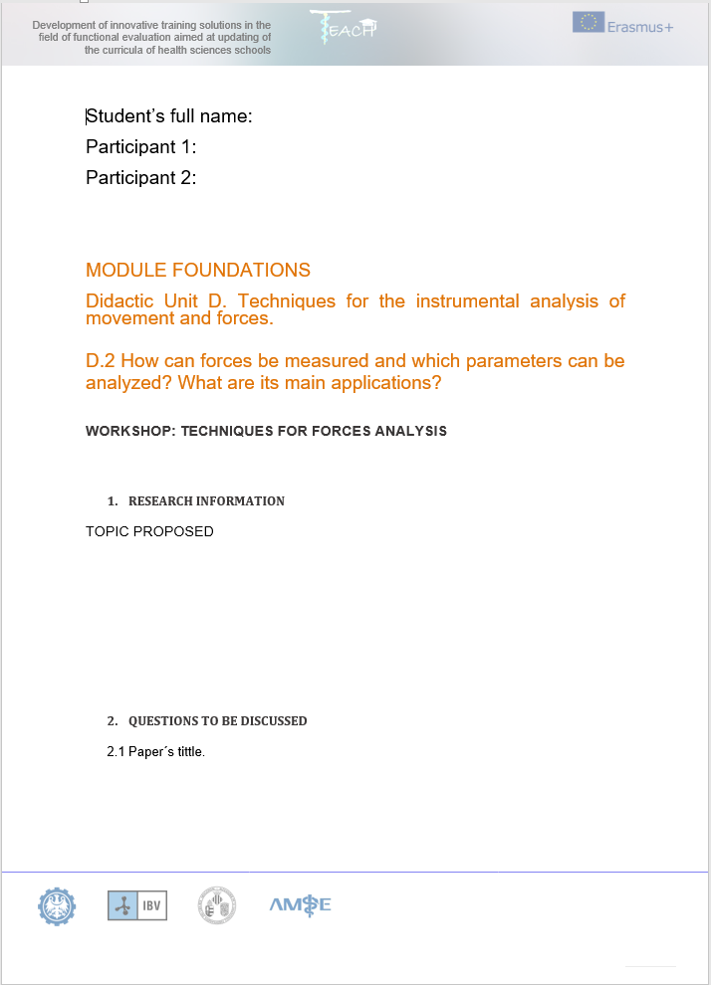
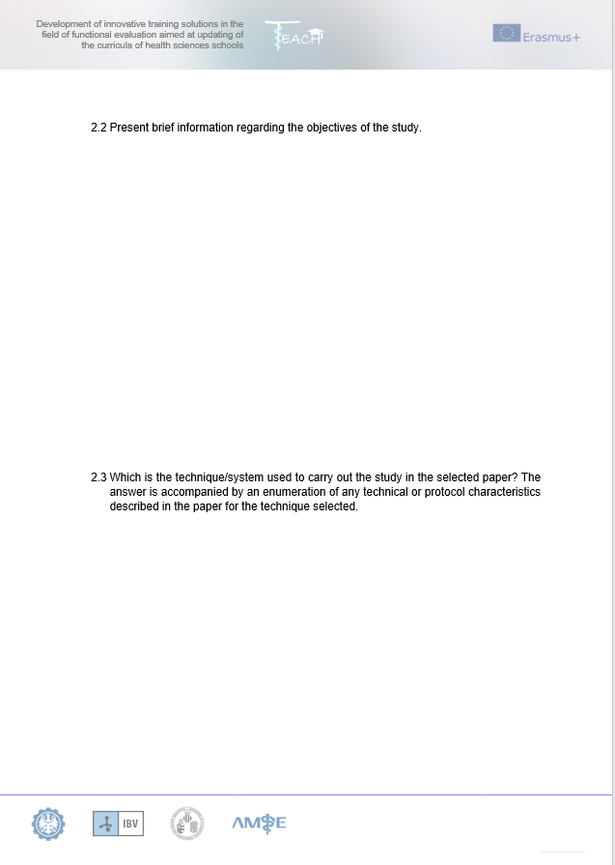
Workflow 3rd. Fill the worksheet
Class Workshop 1
Notes:
The contents of the worksheet are presented by the teacher and the students will work in pairs, trying to answer all the questions. They will use the information found in the Internet Search to do so.
After that, the students will have to prepare a little power point presentation (or similar) regarding the topic selected. The teacher can collect the doubts during the execution of the practice and try to solve them at the end of the class or in another session, asking them to look for the answers.

Slide 13
Workflow 4th. Present your results
Class Workshop 1
Notes:
Every couple present their work to the rest of the students in a small presentation. Students can ask questions regarding the exercise, and can make questions to their mates about advantages and disadvantages of techniques and its applications.

