Slide 1
MODULE BIOMECHANICS: FOUNDATIONS OF BIOMECHANICS APPLIED TO THE LOCOMOTOR SYSTEM
Didactic Unit E: TECHNIQUES FOR THE INSTRUMENTAL ANALYSIS OF PHYSIOLOGICAL SIGNS AND ANTHROPOMETRIC AND MORPHOMETRIC PARAMETERS
E.1. How can I measure physiological signs??

Slide 2
Physiological signs as a non-invasive, basic way to asses patient state in modern, effective multimodal
Vital signs are measures of various physiological signals, in order to assess the most basic body functions, what important in non-invasive way. Vital signs are an essential part of a case presentation. The act of taking vital signs, normally entails recording ECG, EMG, EEG, body temperature, pulse wave, blood pressure, respiratory rate, galvanic skin response (GSR) and others using multimodal, multichannel data acquisition and further - processing and analysis systems.
Homeostasis refers to stable operating conditions in the internal environment (in the blood and interstitial fluid). This is how the human body maintains a rather constant internal environment despite changing external conditions. It is brought about by coordinated activities of cells, tissues, organs, and organ systems
They are common, relatively easy to use, do not require any complex and expensive equipment.

Slide 3
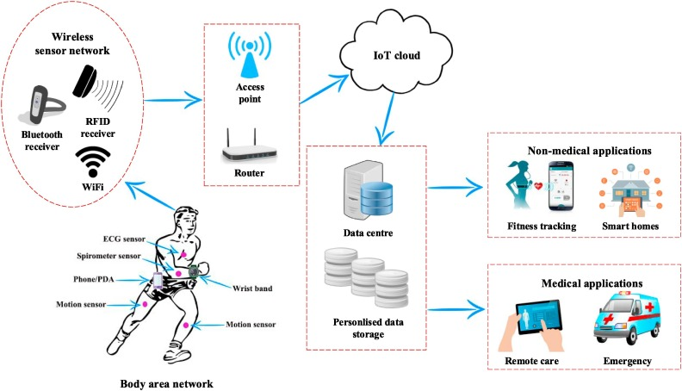
Body Sensor Networks (BSN) for multimodal physiological signal detection, processing and visualisation.
BSN
structure of complete ecosystem with signal registration in the cloud and whole communication system with final data logging in the cloud
ECG -> Heart Rate
Blood Pressure (BP)
Ear sensor
EMG
EOG
Motion inertial sensor
others

Slide 4
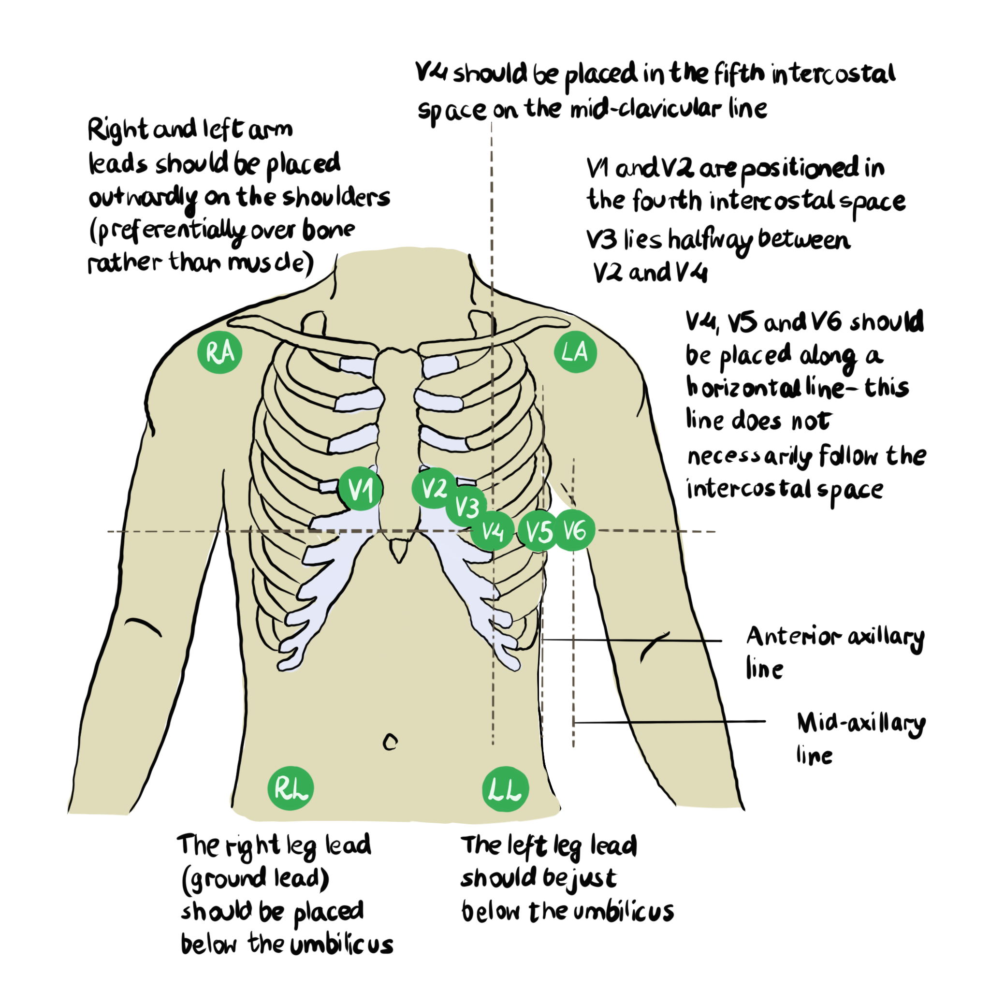
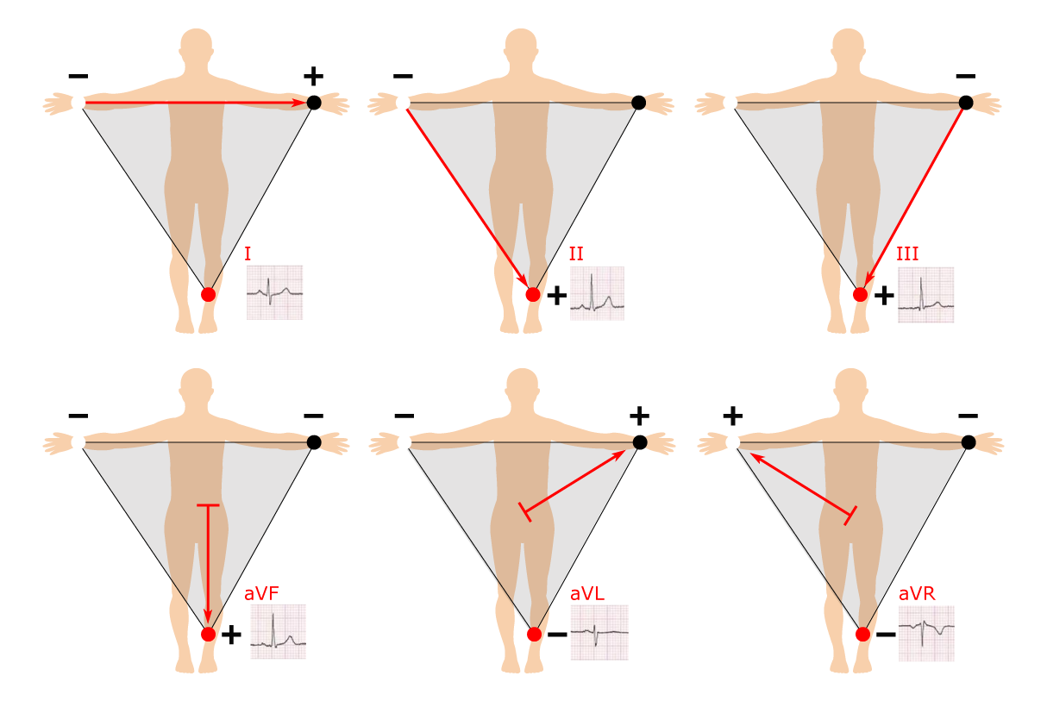
ECG – electrocardiogram:
Complete 12 leads system.

Slide 5
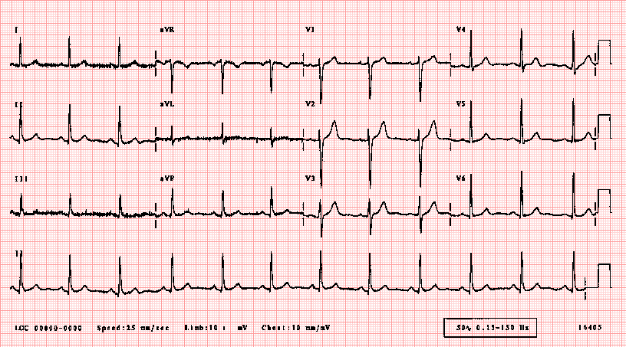
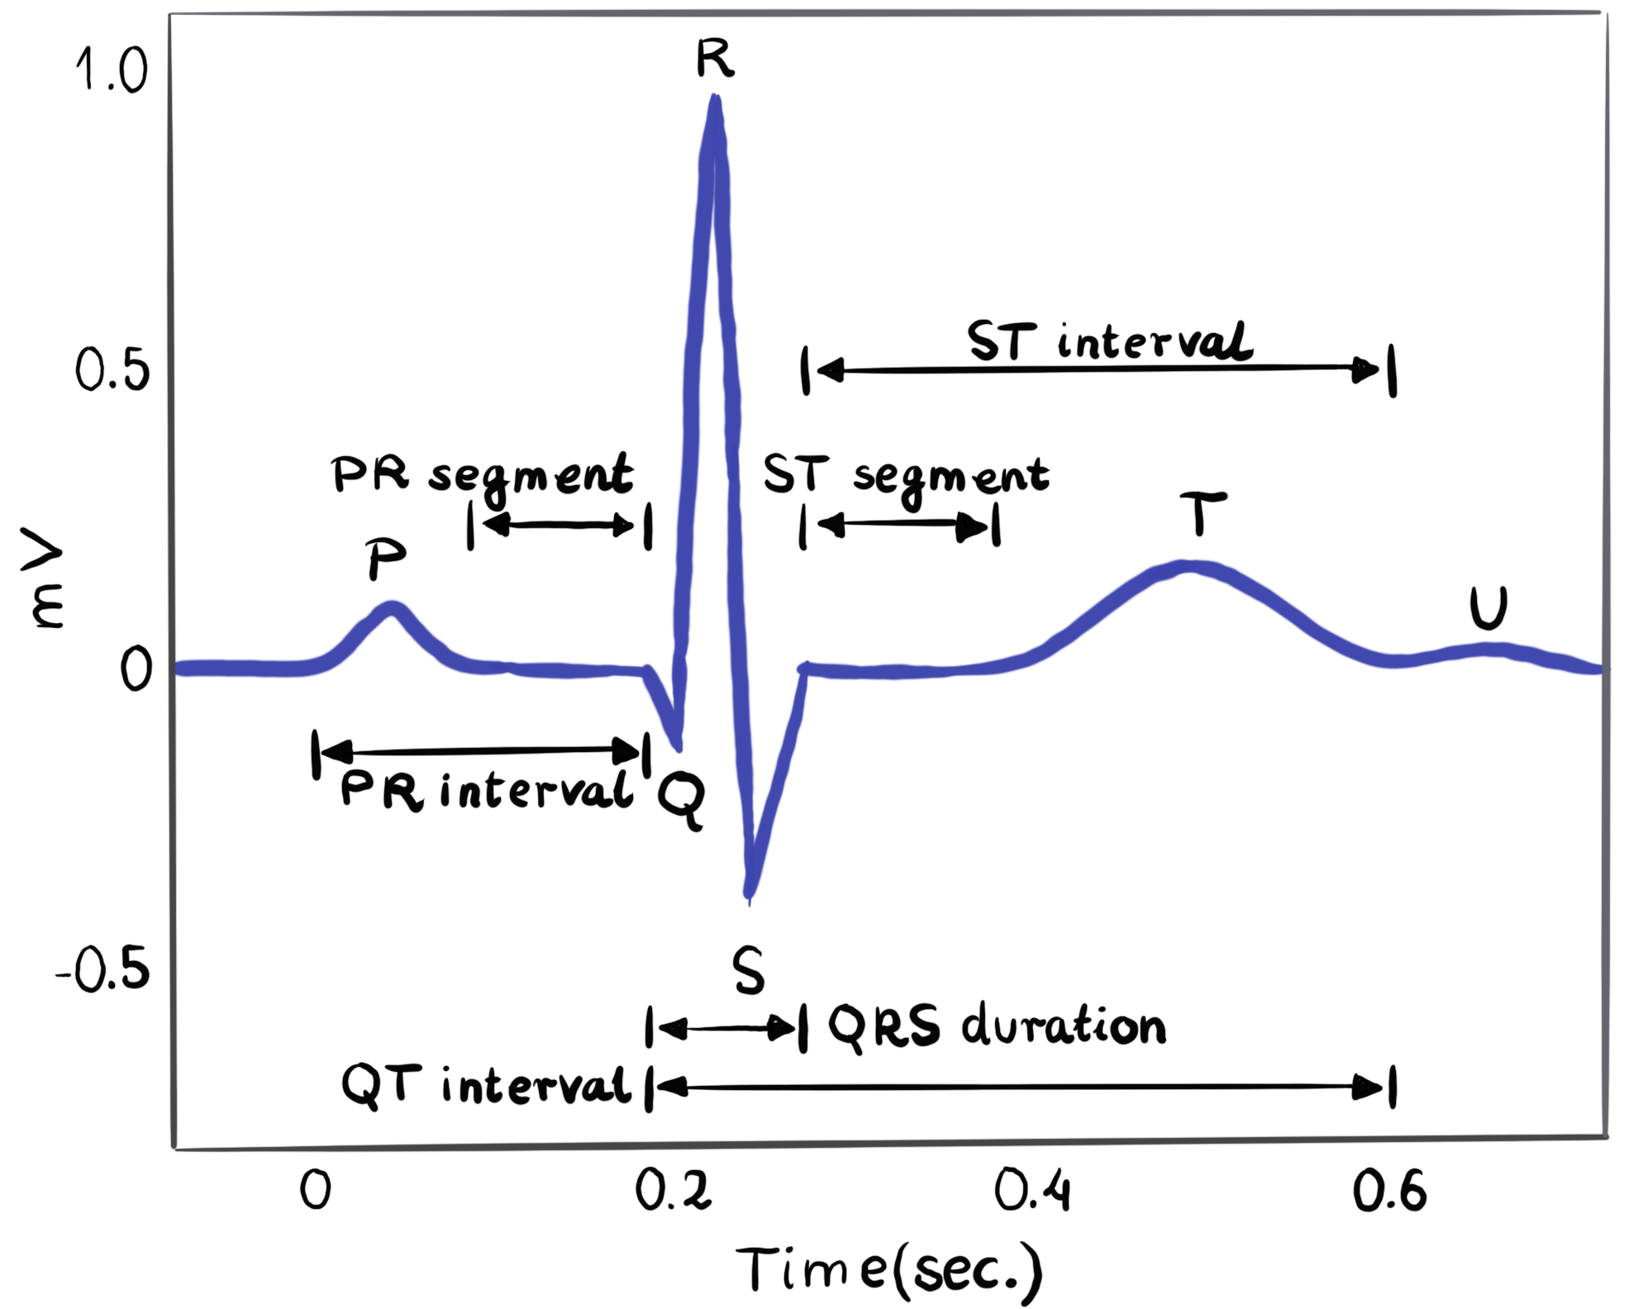
Body Sensor Networks for multimodal physiological signal detection, processing and visualisation.
Electrical activities of the heart can be recorded in the form of electrocardiogram (ECG). An ECG is a composite recording of all the action potentials produced by the nodes and the cells of the myocardium. Each wave or segment of the ECG corresponds to a certain event of the cardiac electrical simulation cycle

Slide 6
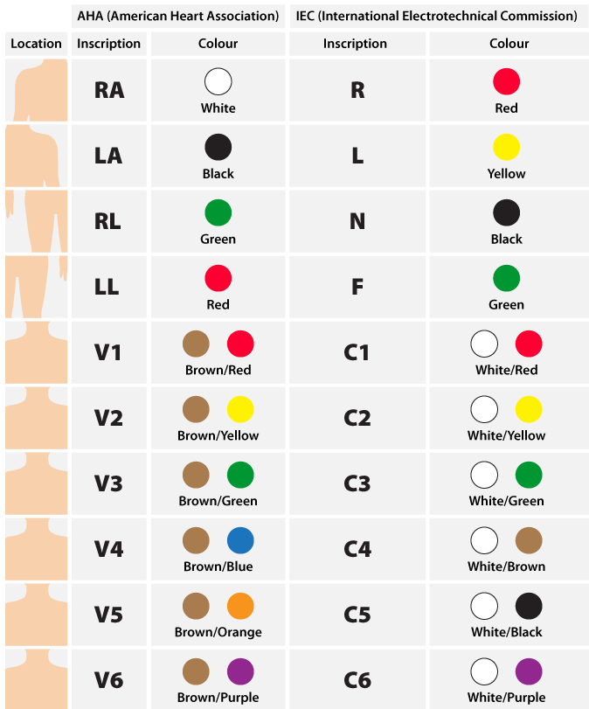
Body Sensor Networks for multimodal physiological signal detection, processing and visualisation.
I. ECG – electrocardiogram
Electrodes & ECG cable standards

Slide 7
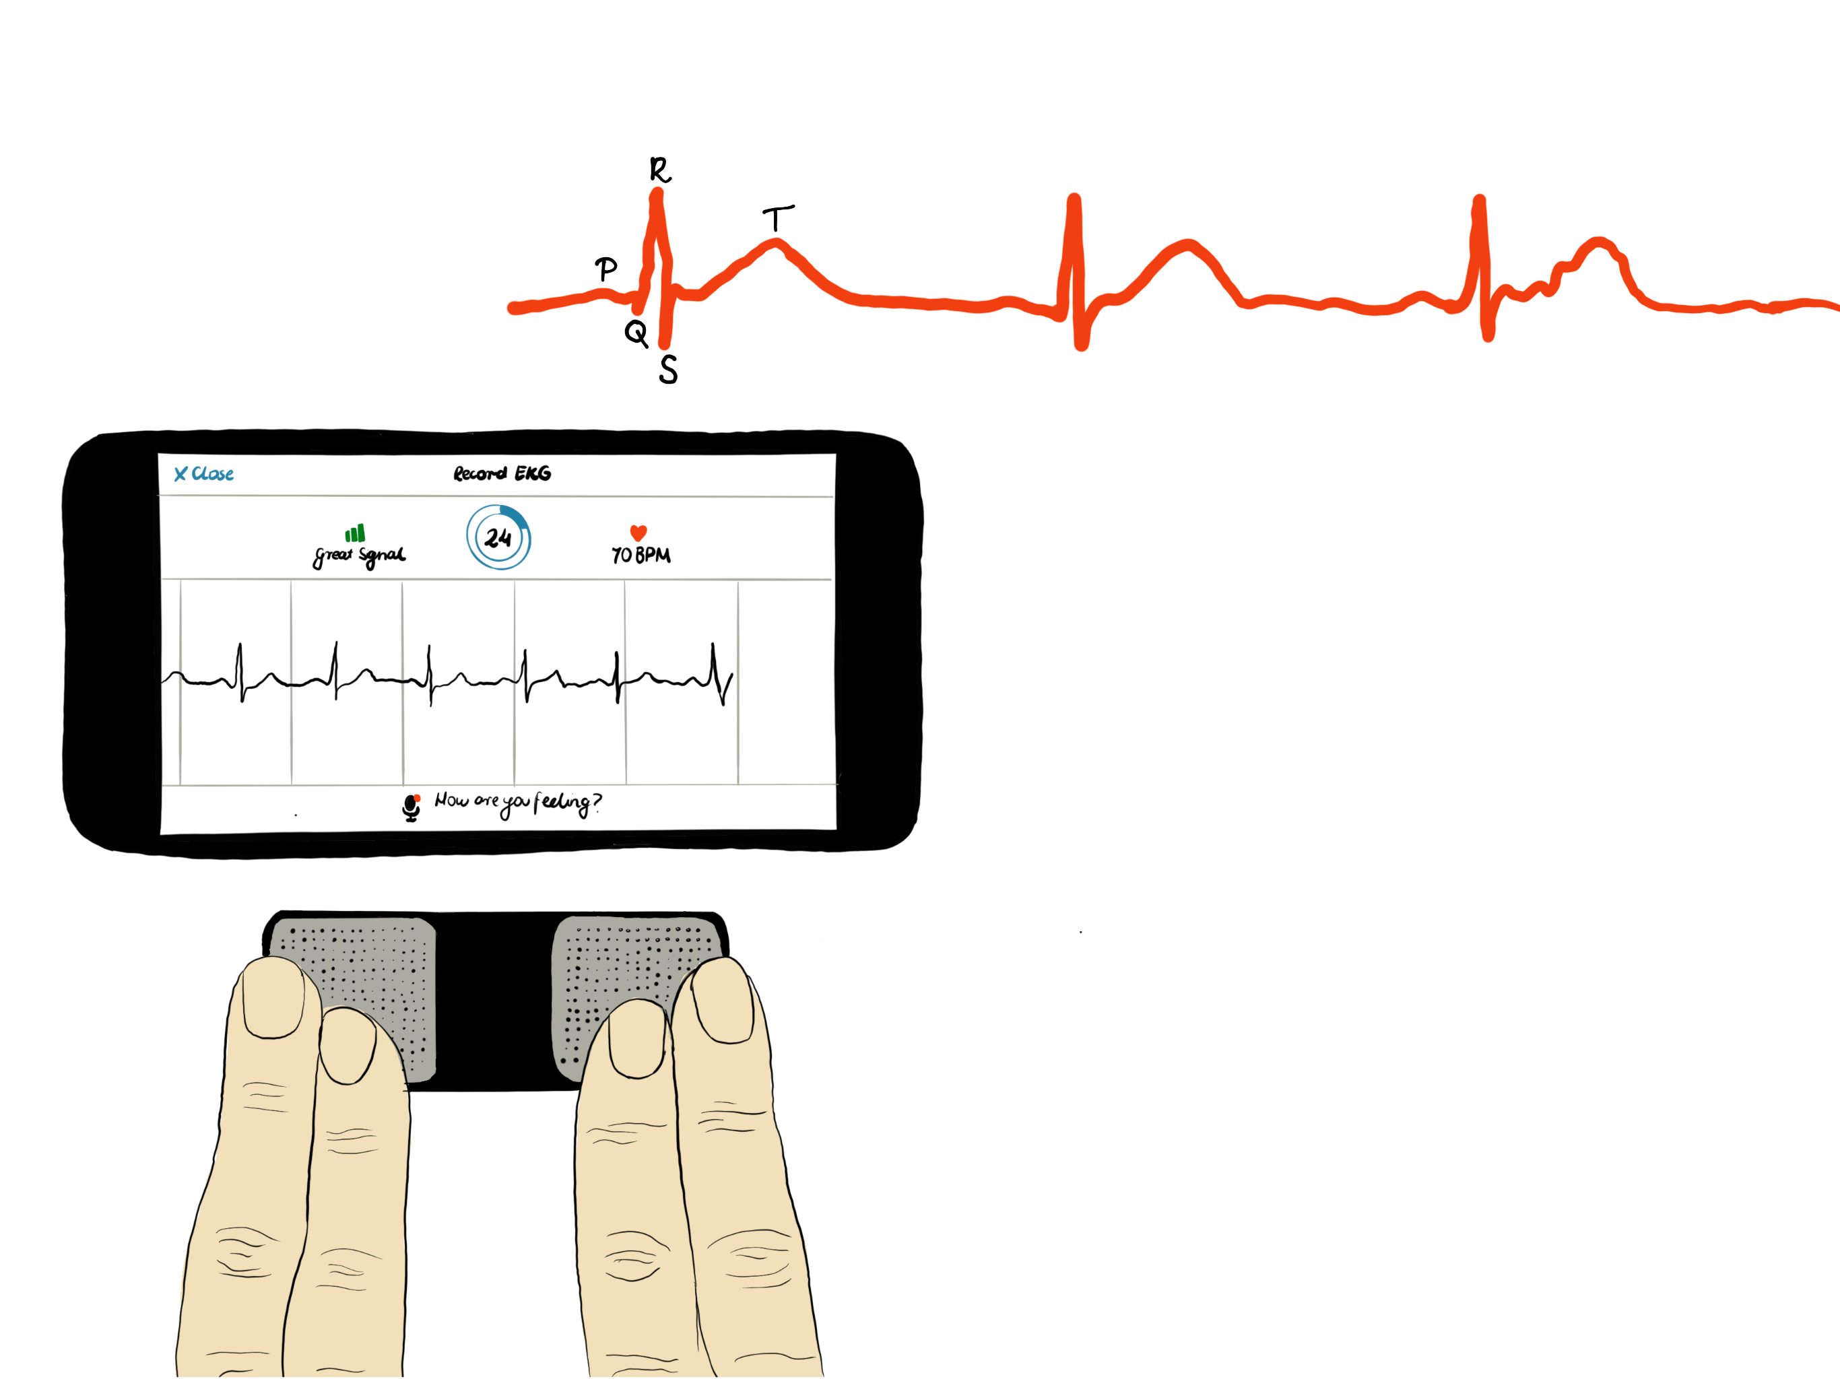
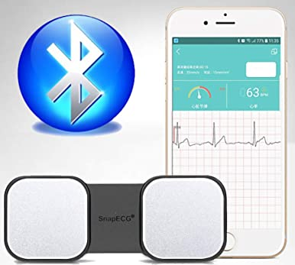
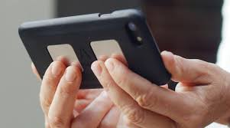
ECG – electrocardiogram, comfortable acquistion, by means of ‚smart’ systems (1 lead)
One lead ECG for convenient daily use e.g. by means of smartphone solutions, allows to obtain precise Heart Rate signal as a RR intervals.

Slide 8
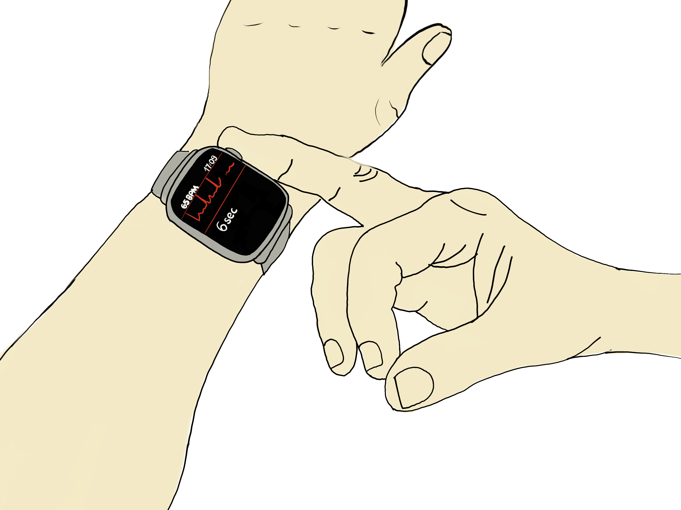
ECG – electrocardiogram, comfortable acquistion, by means of ‚smart’ systems (1 lead)
One lead ECG for convenient daily use
Smartwatch solutions.

Slide 9
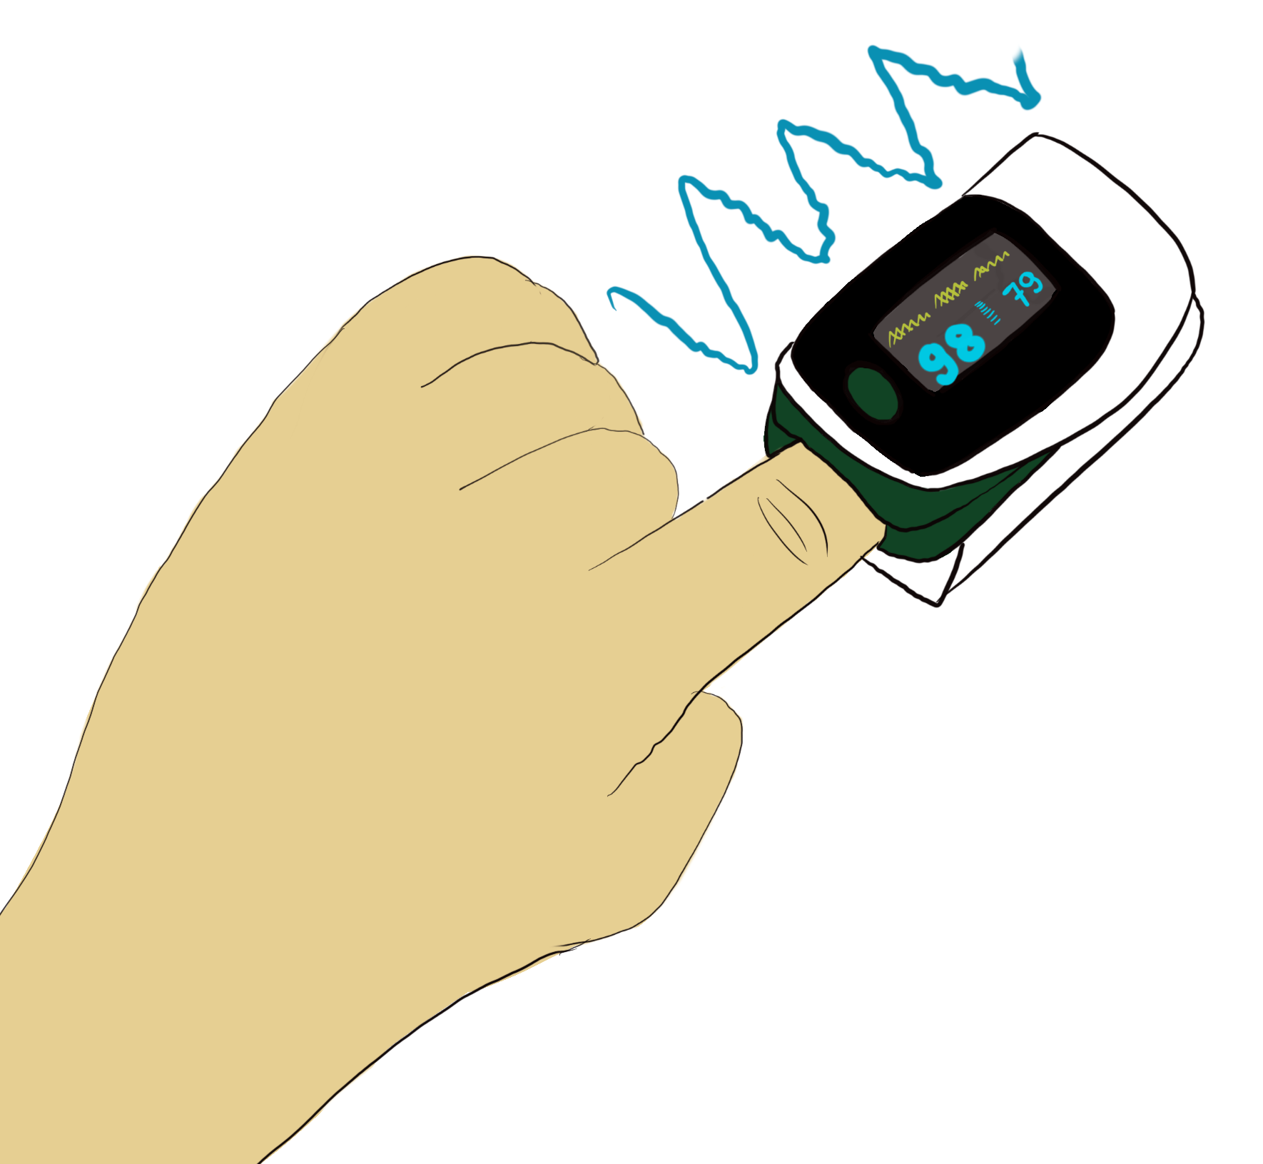
Body Sensor Networks for multimodal physological signal detection, processing and visualisation.
Photoplethysmography: PPG signals
Photoplethysmography (PPG) is a simple, non-invasive and low-cost optical technique, that can be used to detect blood volume changes in the microvascular bed of tissue. It is often used non-invasively to make measurements, which allow to obtain crucial physiological signs like e.g. pulse wave or blood saturation (SpO₂).
SpO2, also known as oxygen saturation, is a measure of the amount of oxygen-carrying hemoglobin in the blood relative to the amount of hemoglobin not carrying oxygen. The body needs there to be a certain level of oxygen in the blood or it will not function as efficiently

Slide 10
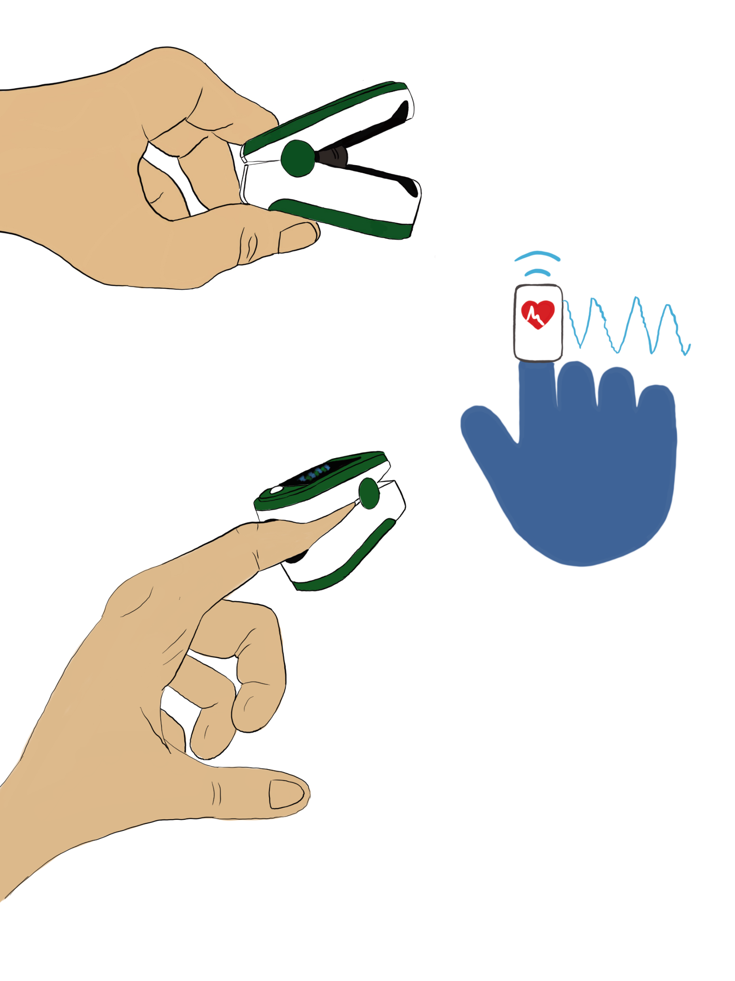
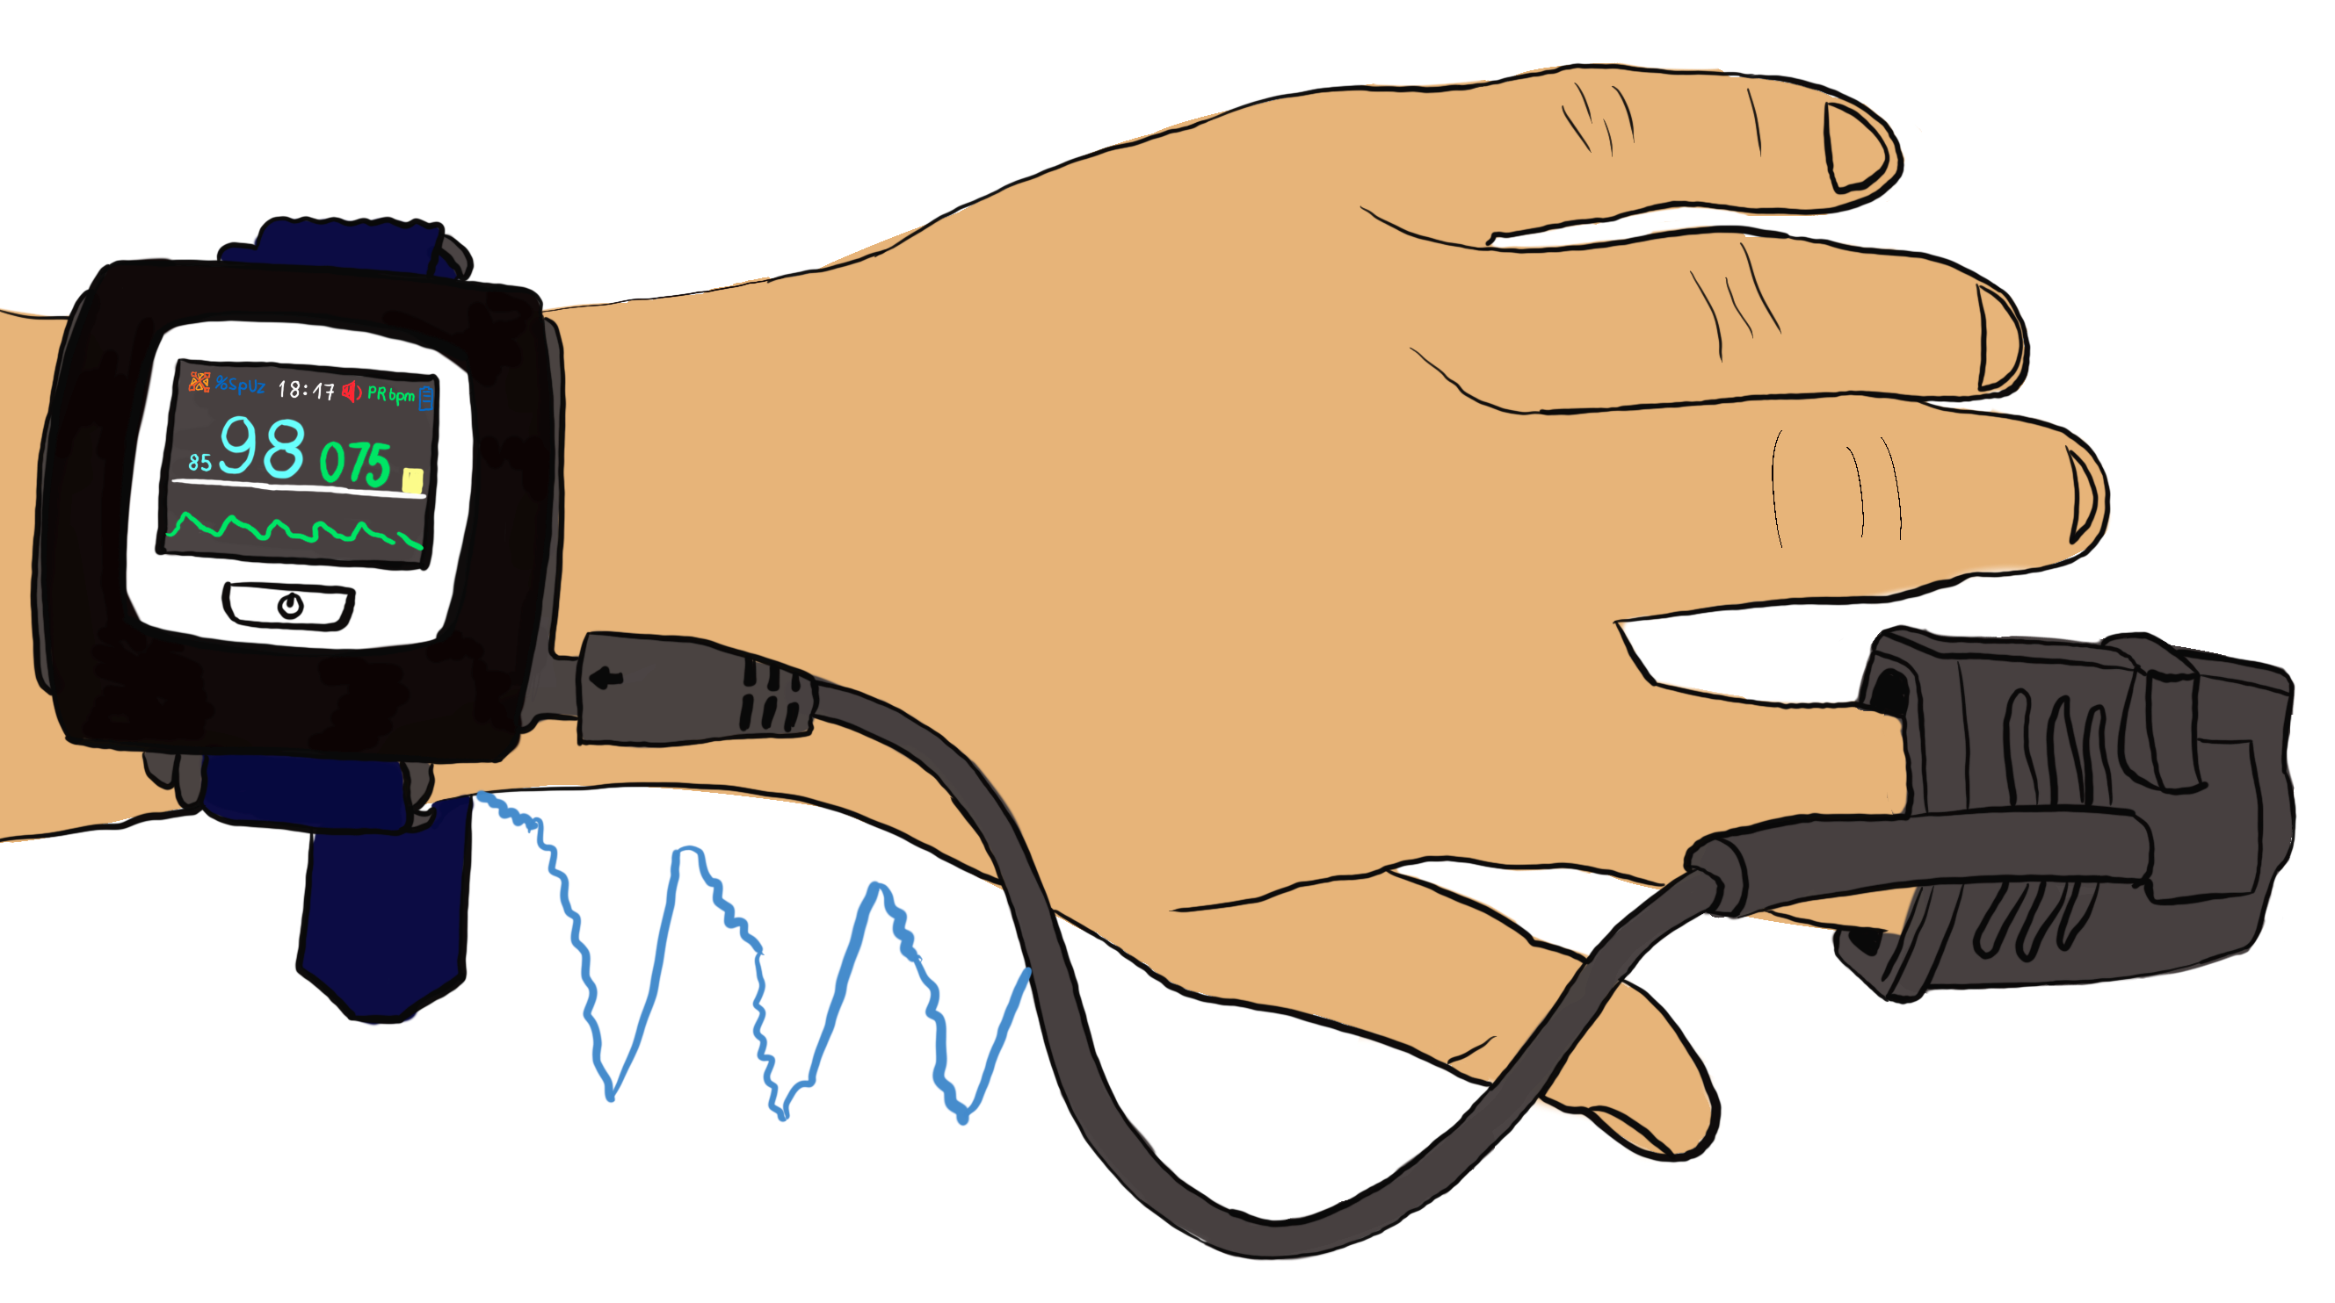
Body Sensor Networks for multimodal physiological signal detection, processing and visualisation.
PPG – smartwatch base system

Slide 11
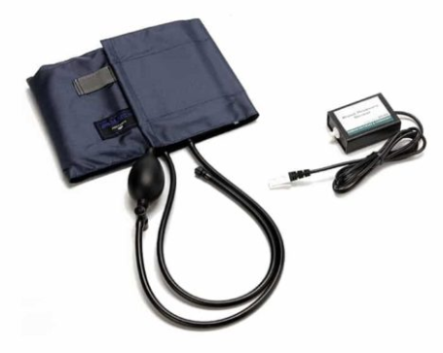
Body Sensor Networks for multimodal physiological signal detection, processing and visualisation.
Blood pressure measurement
The blood pressure sensors used commonly in clinical or home conditions is a non-invasive sensor designed to measure human blood pressure. It measures systolic, diastolic and mean arterial pressure utilizing mainly the oscillometric method. Pulse rate is also reported

Slide 12
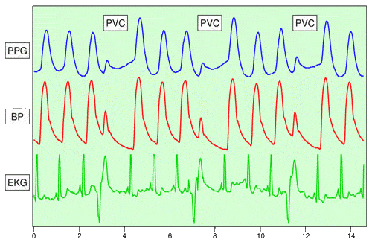
Body Sensor Networks for multimodal physiological signal detection, processing and visualisation.
Synchronized PPG, BP & ECG measurement
allows for studying multi-channels interactions of physiological

Slide 13
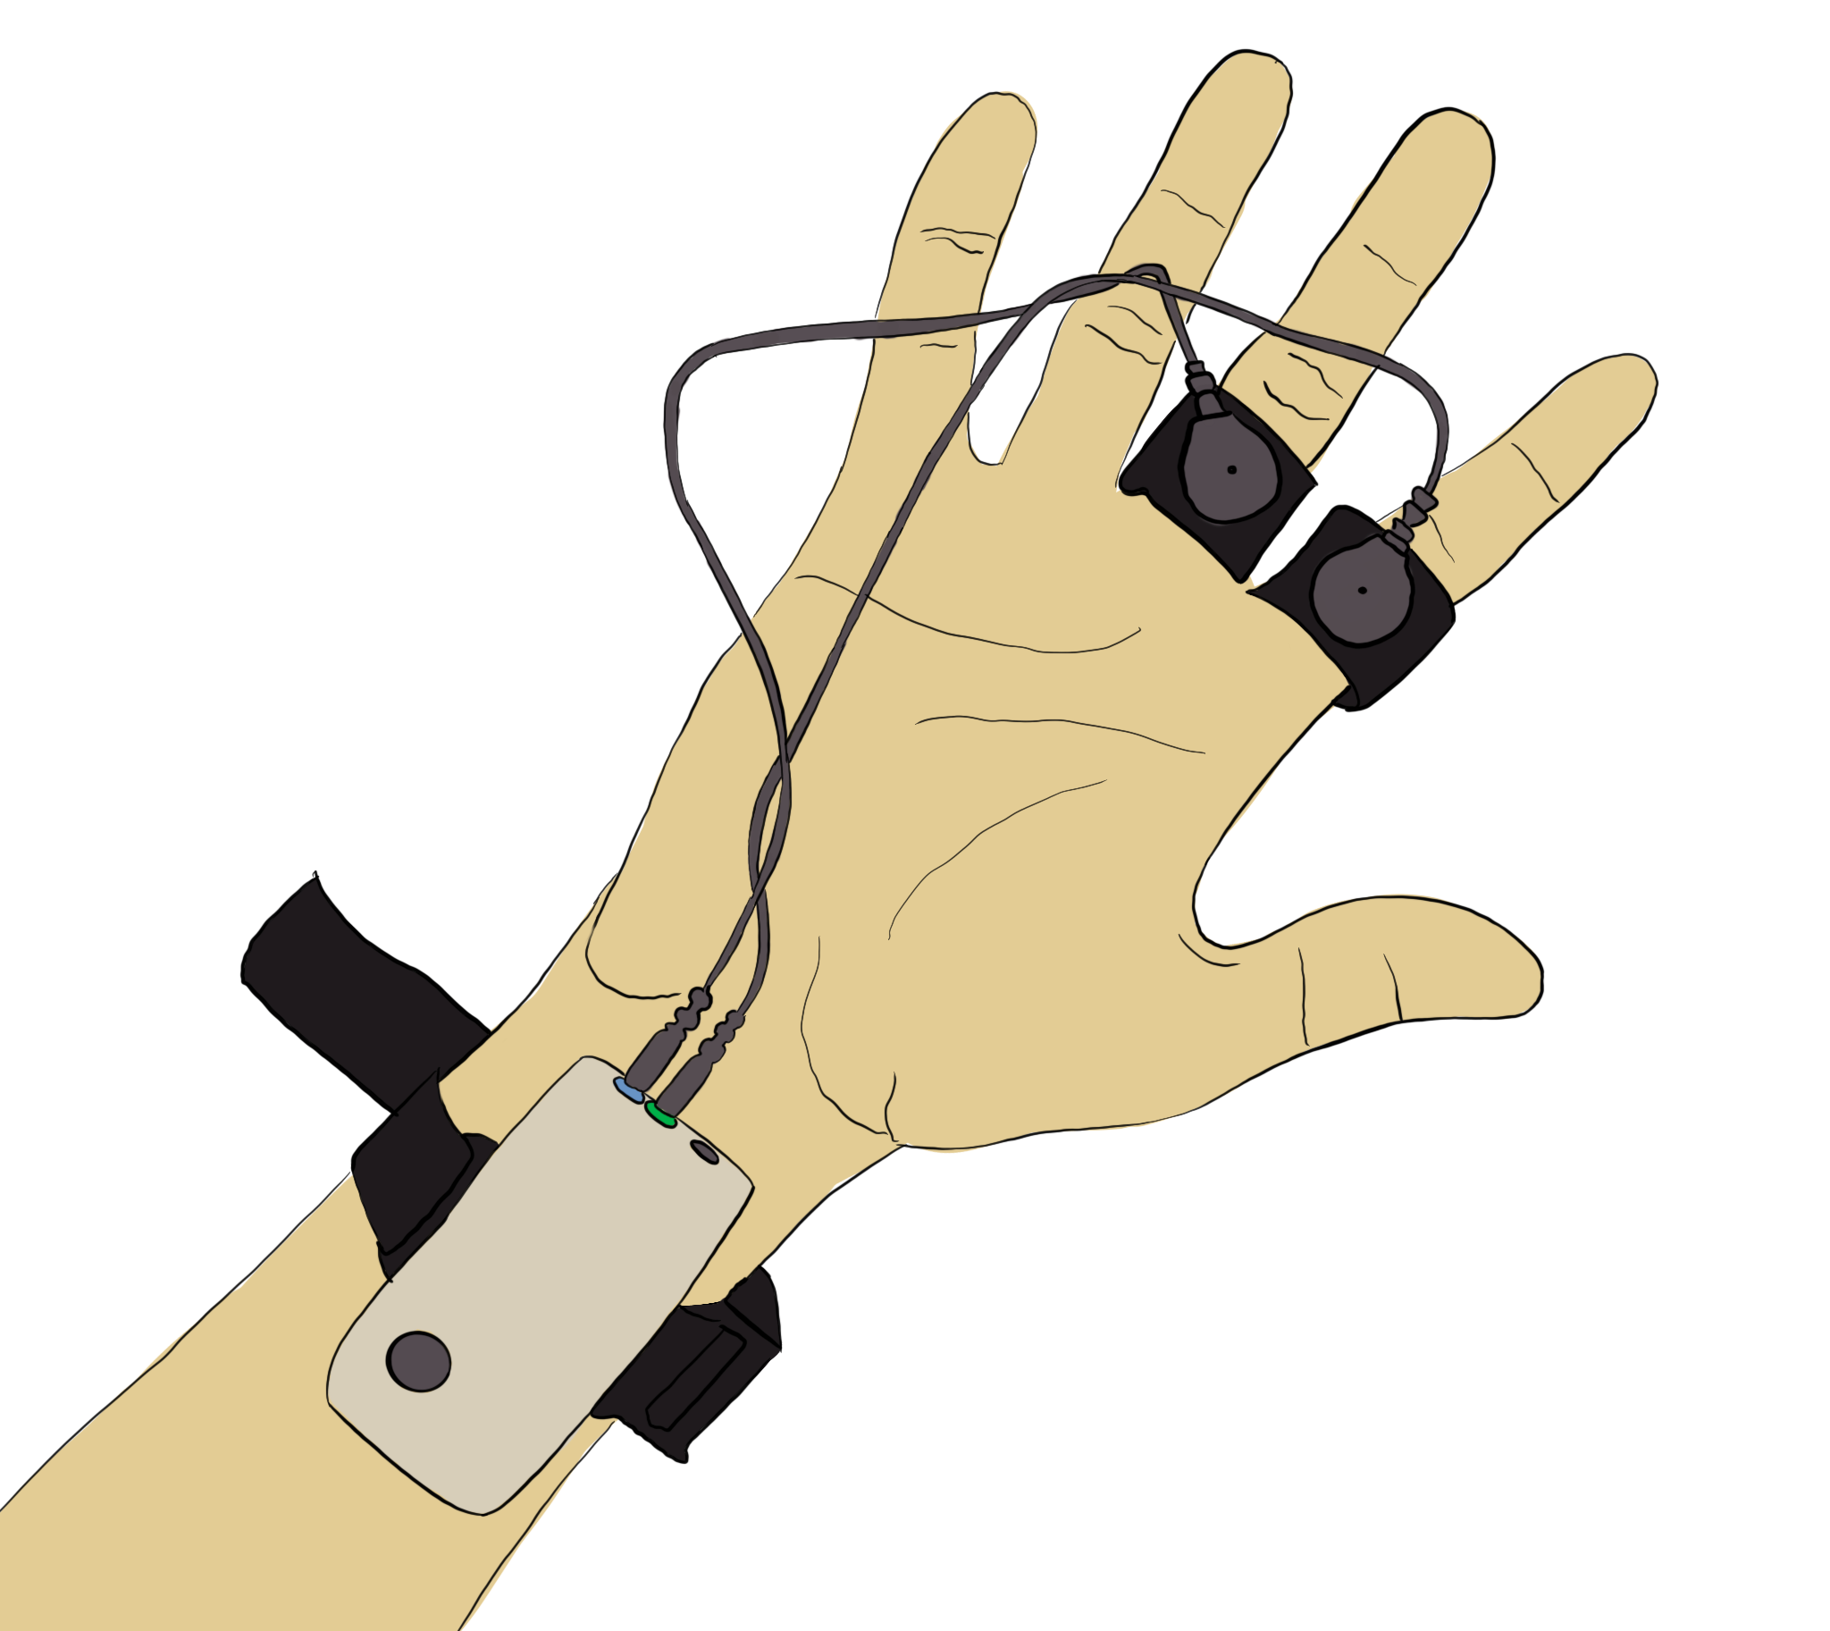
Body Sensor Networks for multimodal physiological signal detection, processing and visualisation.
GSR (Galvanic Skin Response) signal
The galvanic skin response (GSR, which falls under the umbrella term of electrodermal activity, or EDA) refers to changes in sweat gland activity that are reflective of the intensity of our emotional state

Slide 14
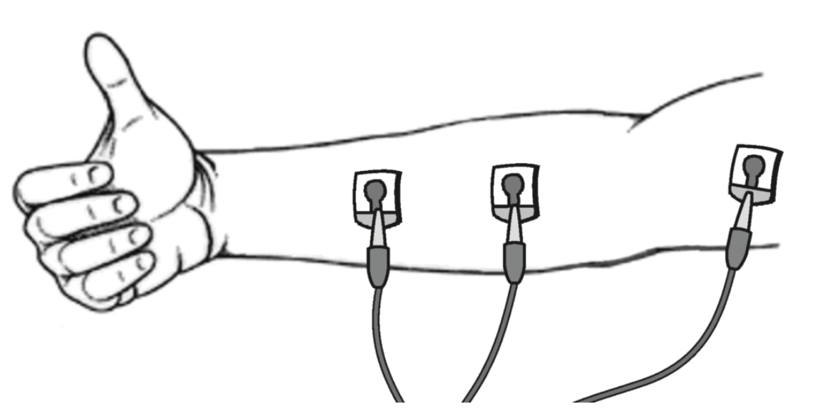
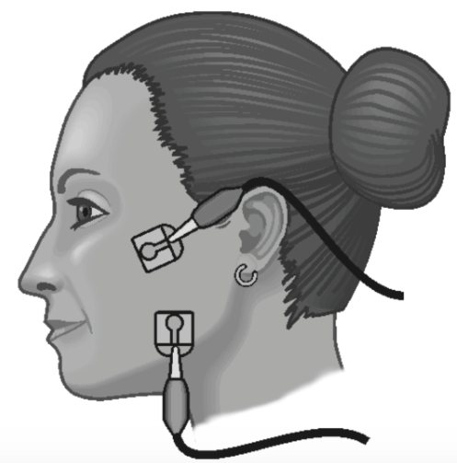
EMG (Electro MioGraphy ) signal
An electromyogram, or EMG, is a graphical recording of electrical activity within muscles. Activation of muscles by nerves results in changes in ion flow across cell membranes, which generates electrical activity. This can be measured using surface electrodes placed on the skin over the muscle of interest.
Electrical activity correlates with strength of muscle contraction, and is dependent on the quantity of nerve impulses which are sent to the muscle. This is easily visible in large muscles such as the biceps muscle in the arm and the quadriceps muscle in the leg, but can also be demonstrated in smaller, less visible muscles, such as the masseter muscle in the jaw.

Slide 15
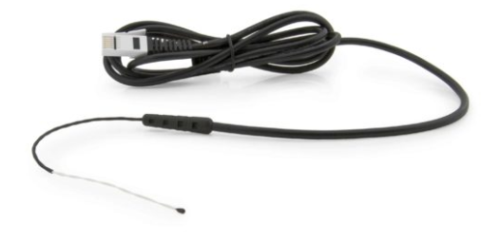
Body Sensor Networks for multimodal physiological signal detection, processing and visualisation.
T_S – surface temperature measurement in BSN systems
Surface Temperature Sensor is designed for use in situations in which low thermal mass or flexibility is required, or for a skin temperature measurement

Slide 16
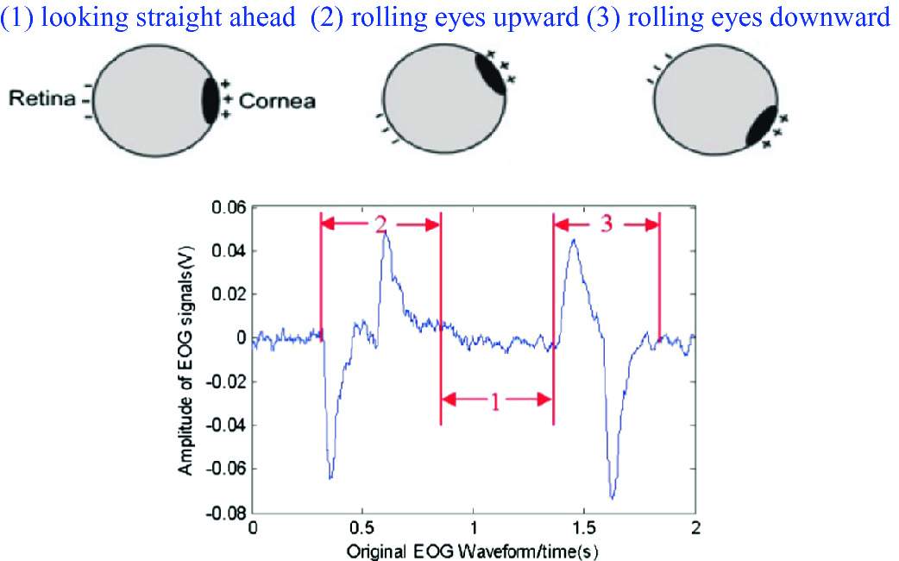
EOG (Electro OculoGgraphy ) signal
Electrooculography (EOG) is a technique for measuring the corneo-retinal standing potential that exists between the front and the back of the human eye. The resulting signal is called the electrooculogram. Primary applications are in ophthalmological diagnosis and in recording eye movements

Slide 17
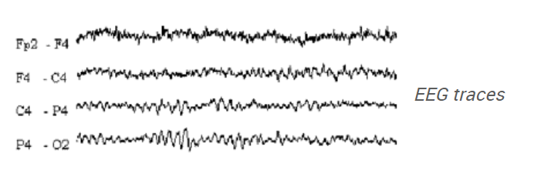
EEG (Electro EncefaloGraphy) signal
The electroencephalogram (EEG) is a recording of the electrical activity of the brain from the scalp. The first recordings were made by Hans Berger in 1929 although similar studies had been carried out in animals as early as 1870.
The waveforms recorded are thought to reflect the activity of the surface of the brain, the cortex. This activity is influenced by the electrical activity from the brain structures underneath the cortex.

Slide 18
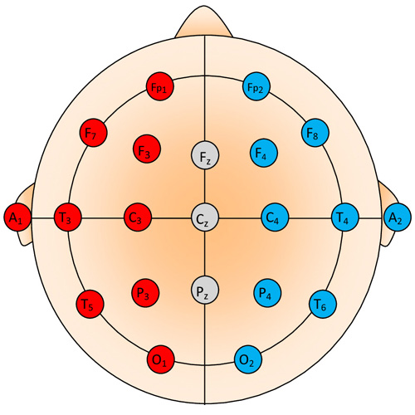
EEG (Electro EncefaloGraphy) signal
EEG Activity
EEG activity can be broken down into 4 distinct frequency bands:
Beta activity > 13 Hz
Alpha activity 8 Hz-13 Hz
Theta activity 4 Hz-7 Hz
Delta activity < 4 Hz

Slide 19
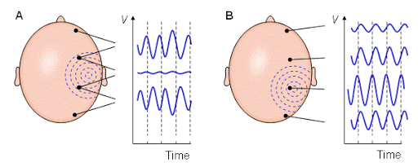
EEG (Electro EncefaloGraphy) signal

Slide 20
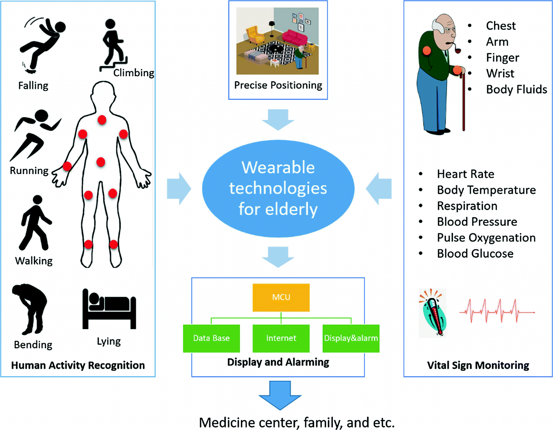
Body Sensor Networks (BSN) for elderly people tele-monitoring and protection.
Wearable BSN in remote mode of chosen physiological acquisition for elderly patient monitoring.
From hospital – to home care is an excellent example of modern telemedicine, facing the common global problems of an ageing population and a lack of medical staff.

