Slide 1
MODULE BIOMECHANICS: FOUNDATIONS OF BIOMECHANICS APPLIED TO THE LOCOMOTOR SYSTEM
Didactic Unit E: TECHNIQUES FOR THE INSTRUMENTAL ANALYSIS OF PHYSIOLOGICAL SIGNS AND ANTHROPOMETRIC AND MORPHOMETRIC PARAMETERS
E.2. What are the applications of the analysis of physiological signs?

Slide 2
Data science (data exploration & digging) is a “new oil” of XXI century
GOAL:
CHANGE RAW INPUT DATA INTO KNOWLEDGE AND WISDOM
HOW:
    To develope methods of FEATURE EXTRACTION from RAW DATA to prepare PREDICTIVE ALGORITHMS (set or RULES), based on different type of methods: mathematical, statistical, biologically inspired e.g. neural networks or based on genetic approach, by means of COMPUTER SCIENCE and rapidly developing information technologies, to find crucial, significant dependencies into data groups – to create a DECISION SUPPORT SYSTEM.

Slide 3
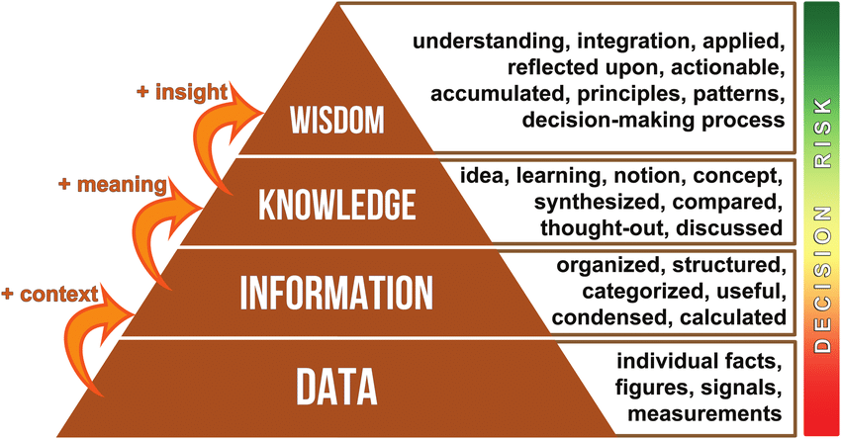

Slide 4
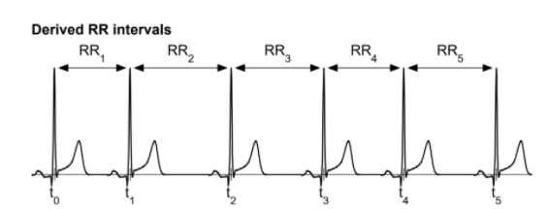
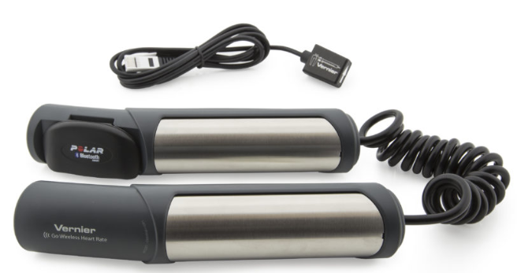
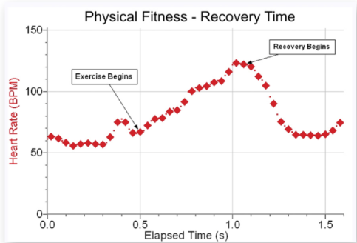
Heart rate computation from ECG signal based on RR intervals, and application from smart hand grip sensors.
User friendly Heart Rate recording for further analysis and visualisation in medical diagnosis, treatment or sport & fitness progres evaluation
The Hand-Grip Heart Rate Monitor is ideal for continuously monitoring heart rate before, during, and after exercise or while a person is stationary

Slide 5
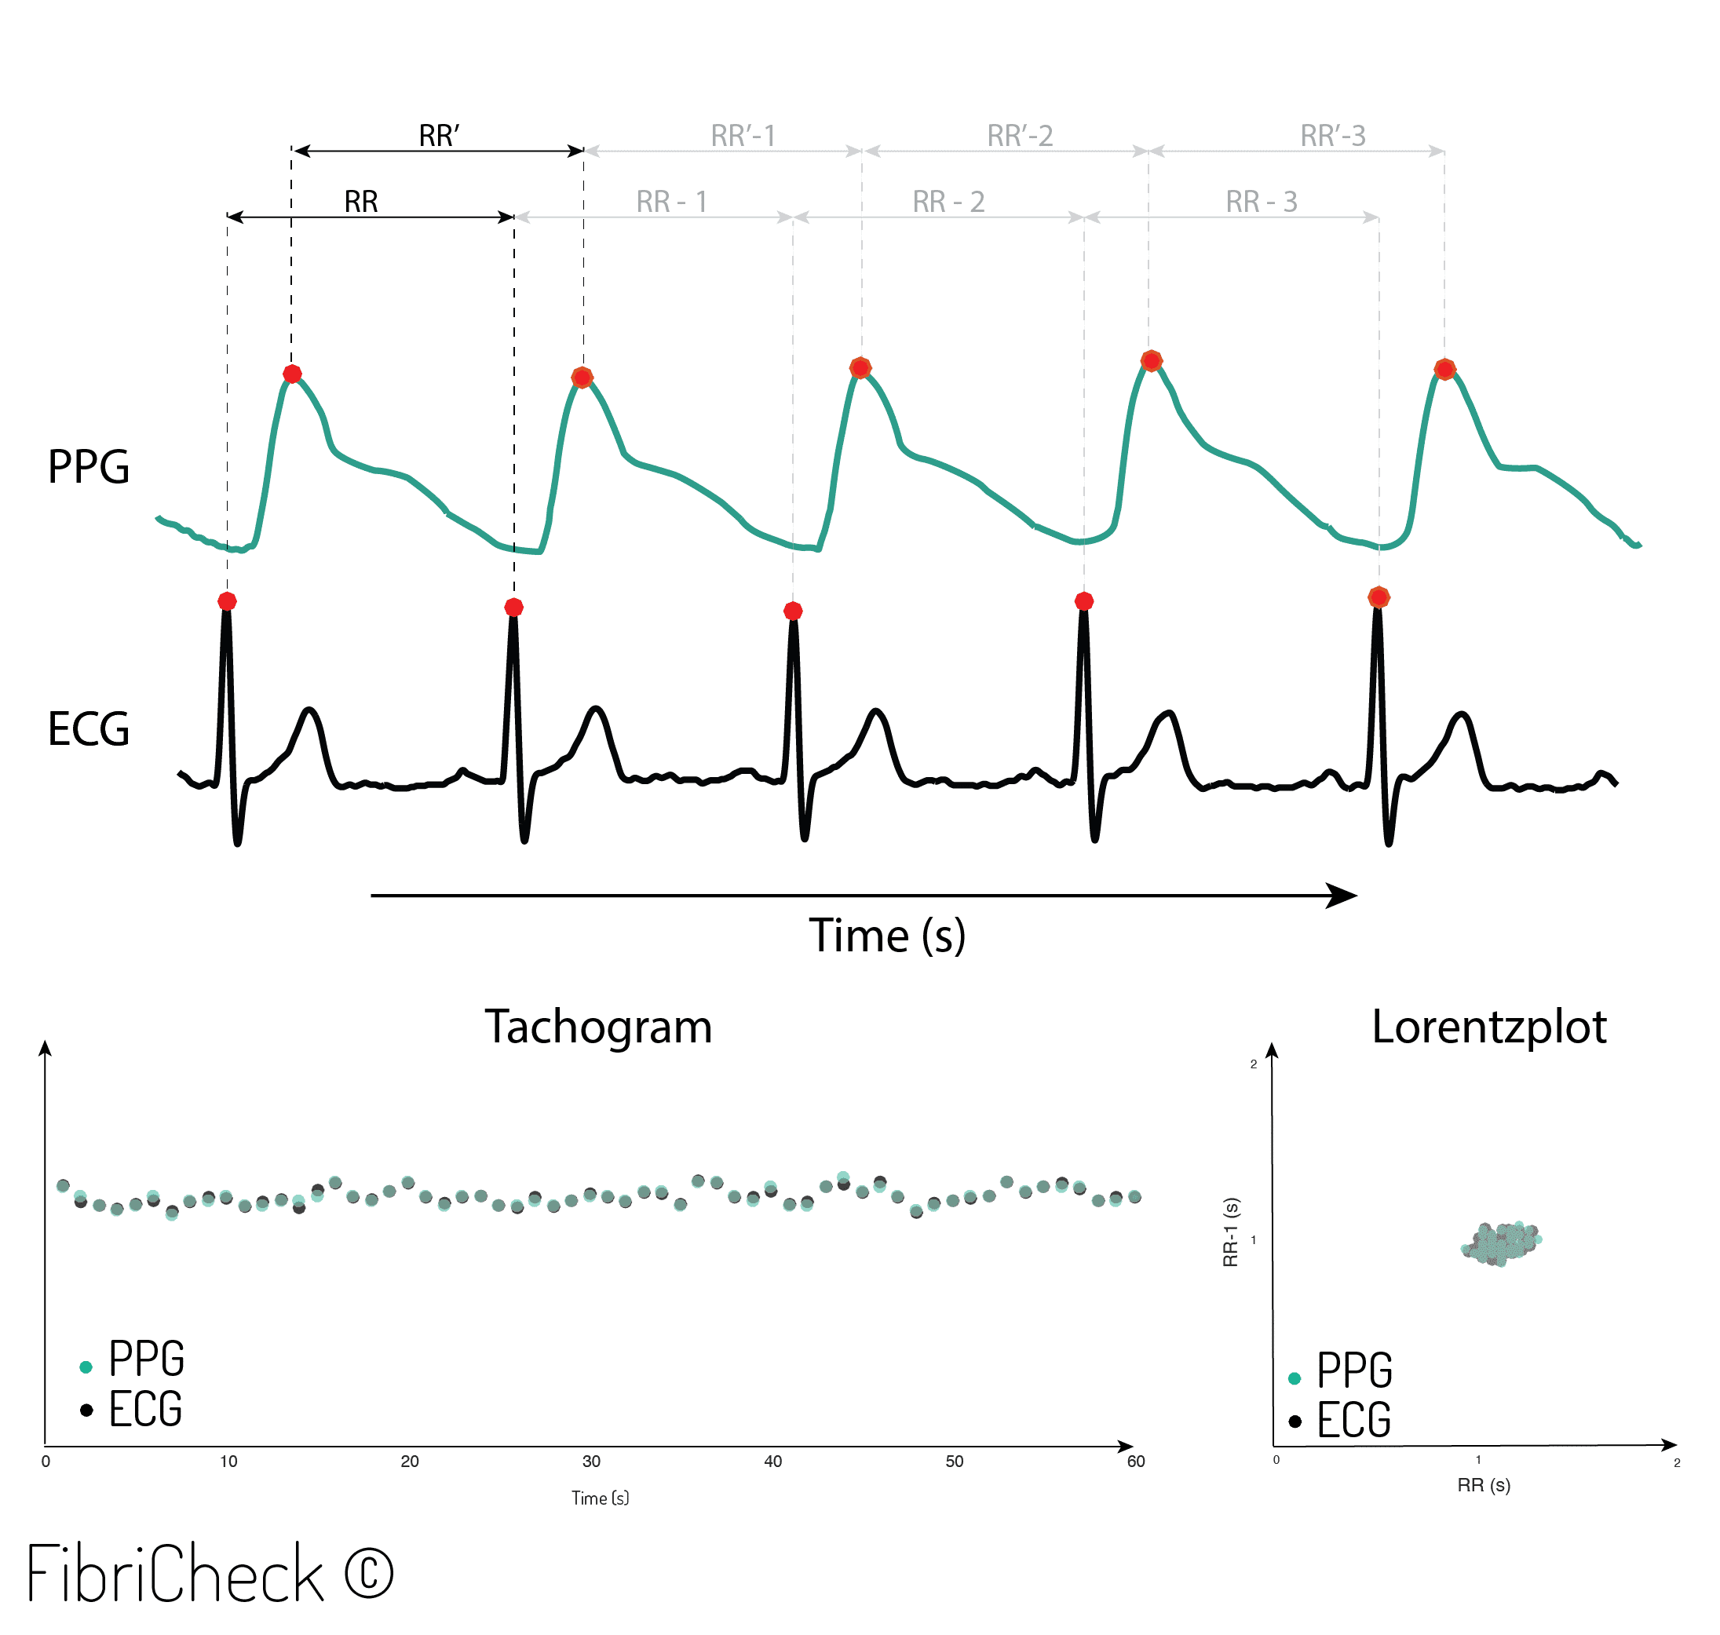
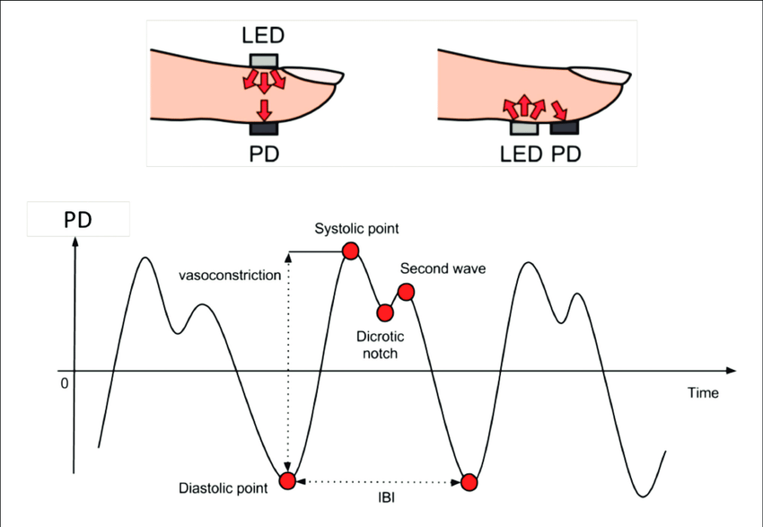
Heart rate estimation from PPG pulse wave signal.
User friendly Heart Rate recording for further analysis and visualisation in medical diagnosis, treatment or sport & fitness progres evaluation
The Hand-Grip Heart Rate Monitor is ideal for continuously monitoring heart rate before, during, and after exercise or while a person is stationary

Slide 6
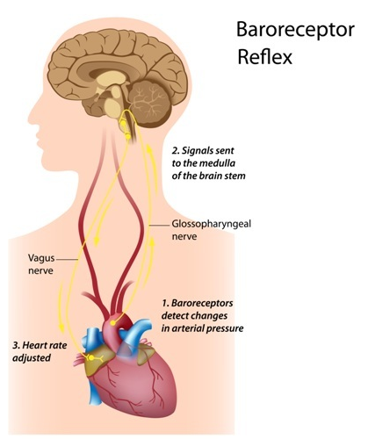
Heart rate variability analysis, reflecting noninvasivly way CNS state in wide spectrum of application
Heart rate is modulated and controlled by the Central Nervous System (CNS), mainly by means of baroreflex loop, so its analysis gives important information about the symphatetic and parasympathetic balance crucial for patient’s state – obtained in noninvasive way.
Important parameters computed from HRV signal can be obtained both in:
Time domain
Frequency domain
as well as result of non-linear analysis like:
Poincare maps.

Slide 7
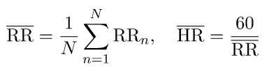
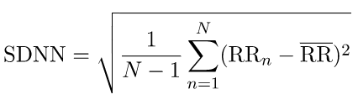
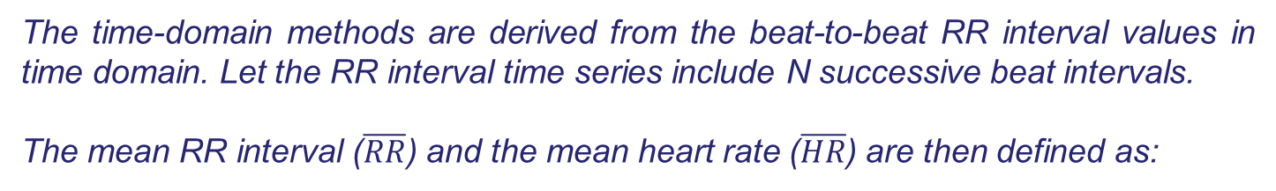
Heart rate variability analysis in wide spectrum of application
I. Time domain parameters.
The time-domain methods are derived from the beat-to-beat RR interval values in time domain. Let the RR interval time series include N successive beat intervals.
The mean RR interval ($\overline{RR}$) and the mean heart rate ($\overline{HR}$) are then defined as:
The measure of the Heart Rate variability is defined as standard deviation of RR intervals (SDNN), defined as:

Slide 8
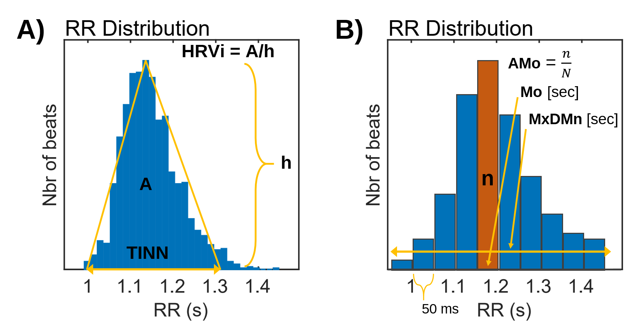
Heart rate variability analysis in wide spectrum of application
I. Time domain parameters.
In addition to statistical measures, presented on previous slide there are some geometric measures that are calculated from the RR interval histogram distribution
triangular index (HRVi) and triangular interpolation of RR intervals (TINN),
Baevsky’s stress index

Slide 9
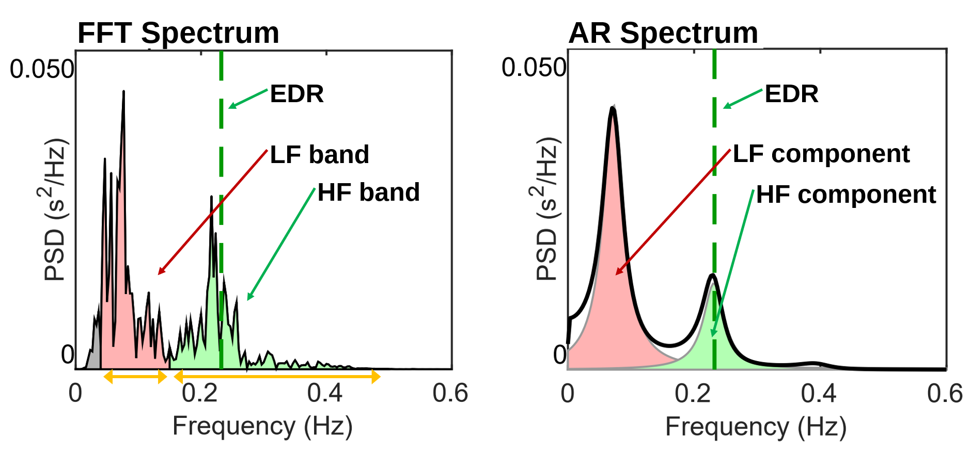
Heart rate variability analysis in wide spectrum of application
II. Frequency domain parameters from Heart Rate Spectrum.
The frequency-domain measures extracted from a spectrum estimate for each frequency band include absolute and relative powers of VLF, LF and HF bands; LF and HF band powers in normalized units; the LF/HF power ratio; and peak frequencies for each band

Slide 10
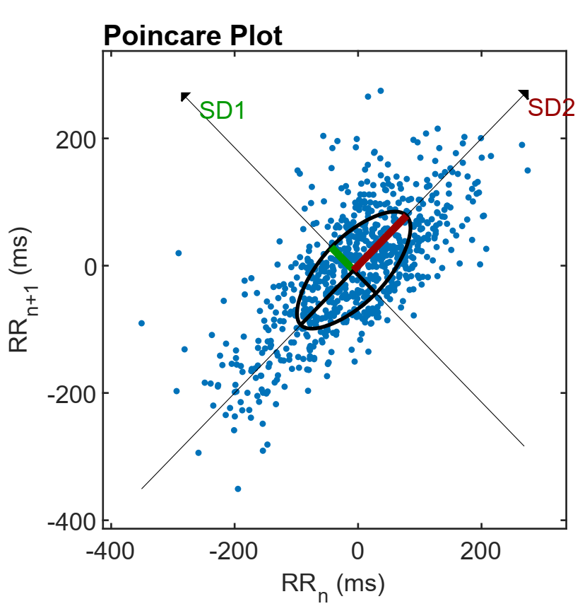
Heart rate variability analysis in wide spectrum of application
III. Nonlinear analysis of Heart Rate signal.
Considering the complex control systems of the heart it is reasonable to assume that nonlinear mechanisms are involved in heart rate regulation. The nonlinear properties of HRV have been analysed using measures such as Poincaré plot.
It is a graphical representation of the correlation between successive RR intervals, i.e. plot of RR_{n+1} as a function of RR_{n}. The shape of the plot is essential and a common approach to parameterize the shape is to fit an ellipse to the plot as shown in Fig

Slide 11
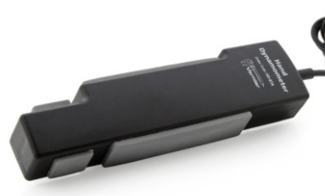
Electromyography (EMG) signal recording and analysis applications
Electromyography (EMG) signals can be used for:
clinical/biomedical applications,
Evolvable Hardware Chip (EHW) development, and
modern human computer interaction (MMI) e.g. in EMG controlled bio- prostheses
EMG signals acquired from muscles require advanced methods for detection, decomposition, processing, and classification.
Strain-gauge based isometric Hand Dynamometer can be used to measure grip strength, pinch strength, and to perform muscle fatigue studies. It can be used with other sensors (e.g., EKG Sensor) to study muscular health and activity

Slide 12
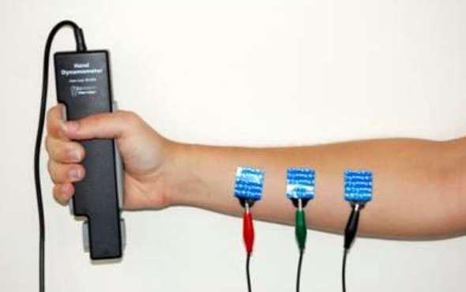
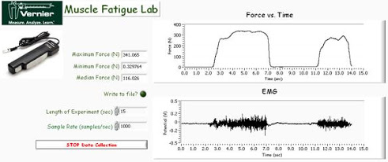
Synchronized hand force (hand grip sensor) and EMG recording e.g. in rehabilitation progress assessment

Slide 13
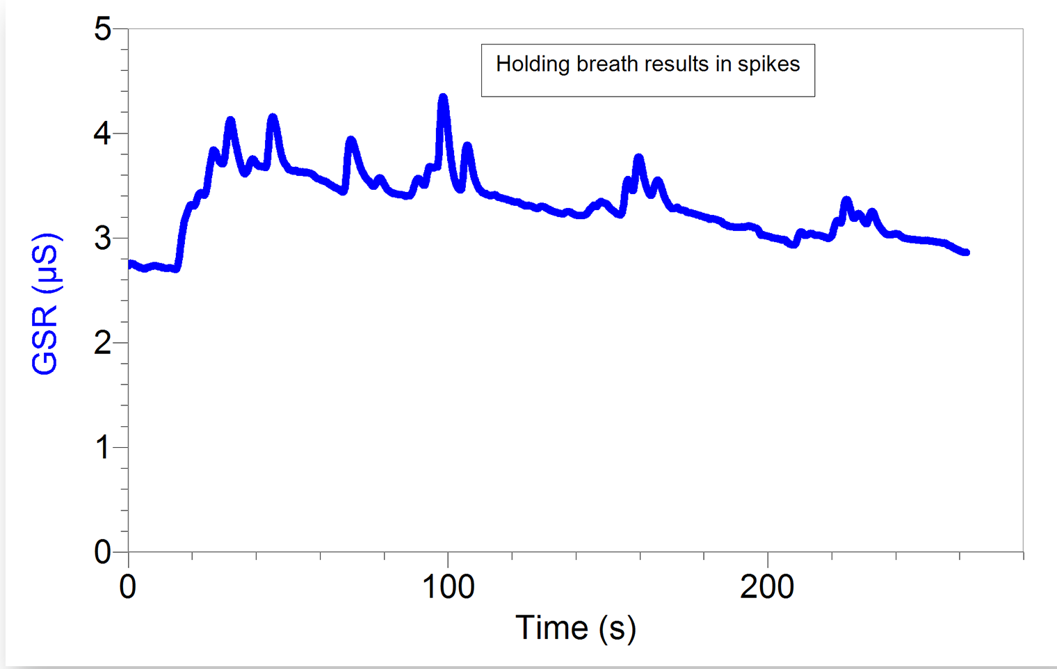
Galvanic Skin Response - applications
Galvanic Skin Response measures physio-galvanic reflex. It generates a change in skin conductivity during periods of stress, excitement, or shock and is used as a measure of sympathetic nervous system activity. It can can monitor both rapid and slow changes in skin conductivity, making it ideal for studies involving shock, arousal, and biofeedback
It monitors the conductivity of the skin between two disposable tab electrodes that are placed e.g. on two adjacent fingers of one hand

Slide 14
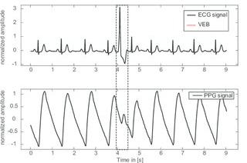
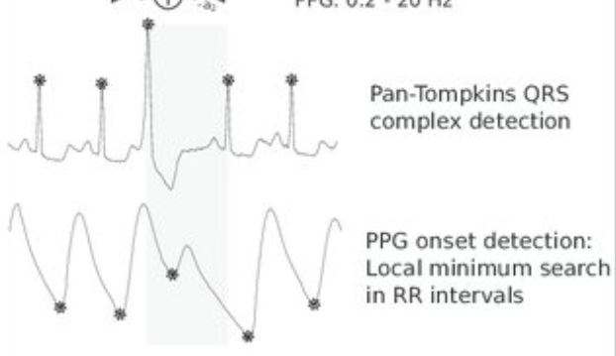
Body Sensor Networks - Multimodal synchronized recording
A Fast Multimodal Ectopic Beat Detection Method example, applied for blood pressure estimation based on pulse wave velocity measurements in wearable sensors.
Digital Signal Processing (DSP) methods for automatic feature extraction
Synchronized electrocardiography (ECG) and photoplethysmography (PPG) waveforms detecting single premature ventricular ectopic beat

Slide 15
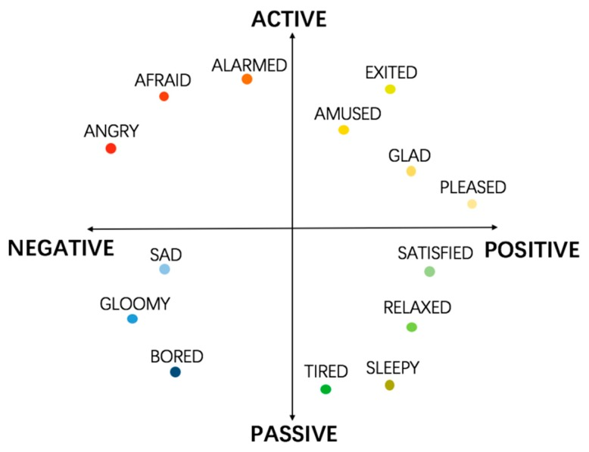
Body Sensor Networks:
Complex system example for emotion recognition
Emotional state of human depends on many factors so multimodal systems gathering and processing information from many different sensors are developed.
The relationship between performance and arousal and 2-D emotion space model is presented.

Slide 16
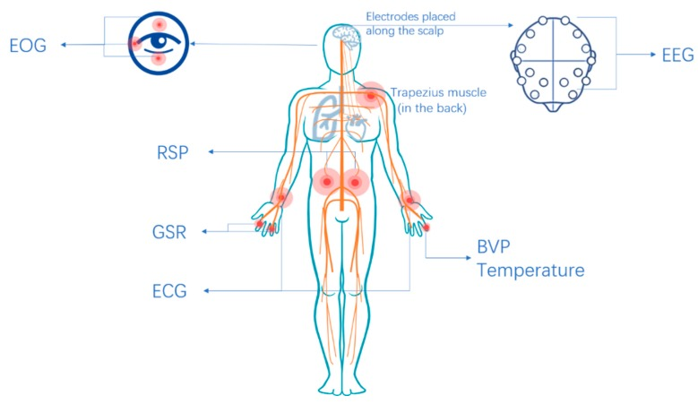
Body Sensor Networks:
Complex system example for emotion recognition
Research conducted showed, that autonomic nervous system specificity allows certain emotions to be recognized, by means of signs recorded from physiological signals
EOG,
RSP,
GRS,
ECG,
EEG,
BP,
T
physiological signals are used in multimodal reasoning system.

Slide 17
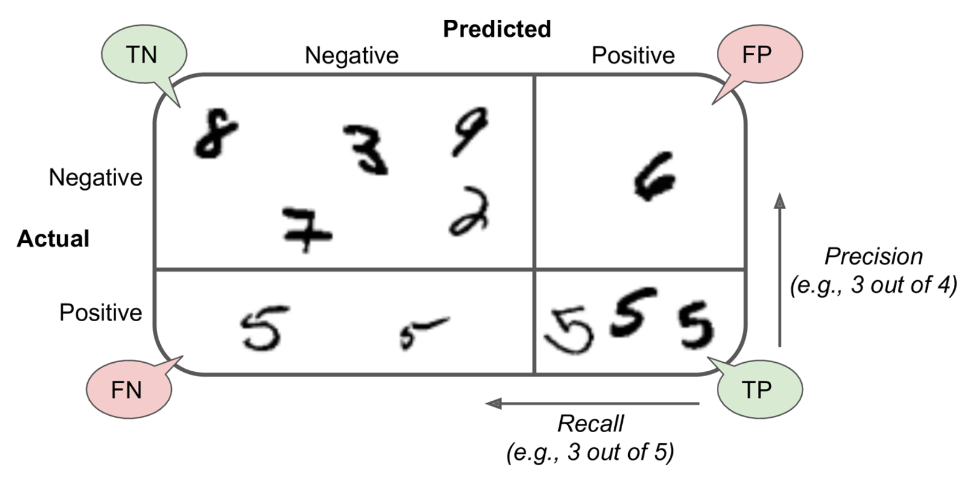
Some hints, how to properly asses the conducted research results, by means of classifier’s performance measures
Confusion Matrix
An illustrated confusion matrix shows examples of true negatives (top left), false positives (top right), false negatives (lower left), and true positives (lower right)

Slide 18
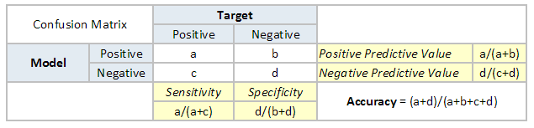
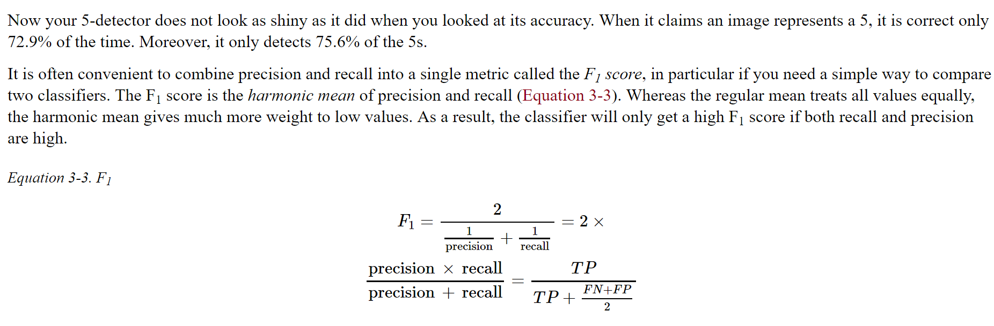
Confusion matrix – measures, indicators
It is often convenient to combine precision and recall into single metric called F1 score

Slide 19
