Slide 1
MODULE BIOMECHANICS OF SPINE
Didactic Unit E: TECHNIQUES FOR THE INSTRUMENTAL ANALYSIS OF ANTHROPOMETRIC AND MORPHOMETRIC PARAMETERS
E.3. How can I measure morphometric and anthropometric parameters?

Slide 2
Anthropometric parameters of the posture and morphological indicators, as a non-invasive basic way to asses patient state
PROCEDURES, SENSORS AND MEASUREMENTS SYSTEMS
Morphometry is introduced as quantitative approach to seek information concerning variations and changes in the forms of organisms that described the relationship between the human body and disease
Morphometrics can also be defined as the quantitative analysis of biological forms.
Anthropometry, a branch of morphometry, is the study of the size and shape of the components of biological forms and their variations in populations
Anthropometric measurements are a series of quantitative measurements of the muscle, bone, and adipose tissue used to assess the composition of the body.

Slide 3
Anthropometric Parameters of the Posture and morphological indicators,
as a non-invasive basic way to asses patient state
PROCEDURES, SENSORS AND MEASUREMENTS SYSTEMS
Anthropometric measurements are a series of quantitative measurements of the muscle, bone, and adipose tissue used to assess the composition of the body. The core elements of anthropometry are height, weight, body mass index (BMI), body circumferences (waist, hip, and limbs), and skinfold thickness. These measurements are important because they represent diagnostic criteria for obesity, which significantly increases the risk for conditions such as cardiovascular disease, hypertension, diabetes mellitus, and many more.
There is further utility as a measure of nutritional status in children and pregnant women. Additionally, anthropometric measurements can be used as a baseline for physical fitness and to measure the progress of fitness.

Slide 4
Anthropometric parameters of the posture and body movement indicators,
Classical approach
Indications.
There are several possible indications for anthropometric measurements. In children, indications include stunting, wasting, and being underweight. Stunting is when children have a low height-for-age, wasting is a low weight-for-height, and underweight is a low weight-for-age.
Mid-upper arm circumference (MUAC) is a viable measurement in children or pregnant women as a marker of nutritional status. BMI is another commonly employed index of nutritional status and used as a gauge of malnutrition in children and adults.

Slide 5
Anthropometric parameters of the posture and body movement indicators. Classical approach
Equipment.
Weight scale
Calibration weights
Box to sit on
Stadiometer
Knee caliper
Skinfold calipers
Tape measure
Infantometer to measure recumbent length

Slide 6
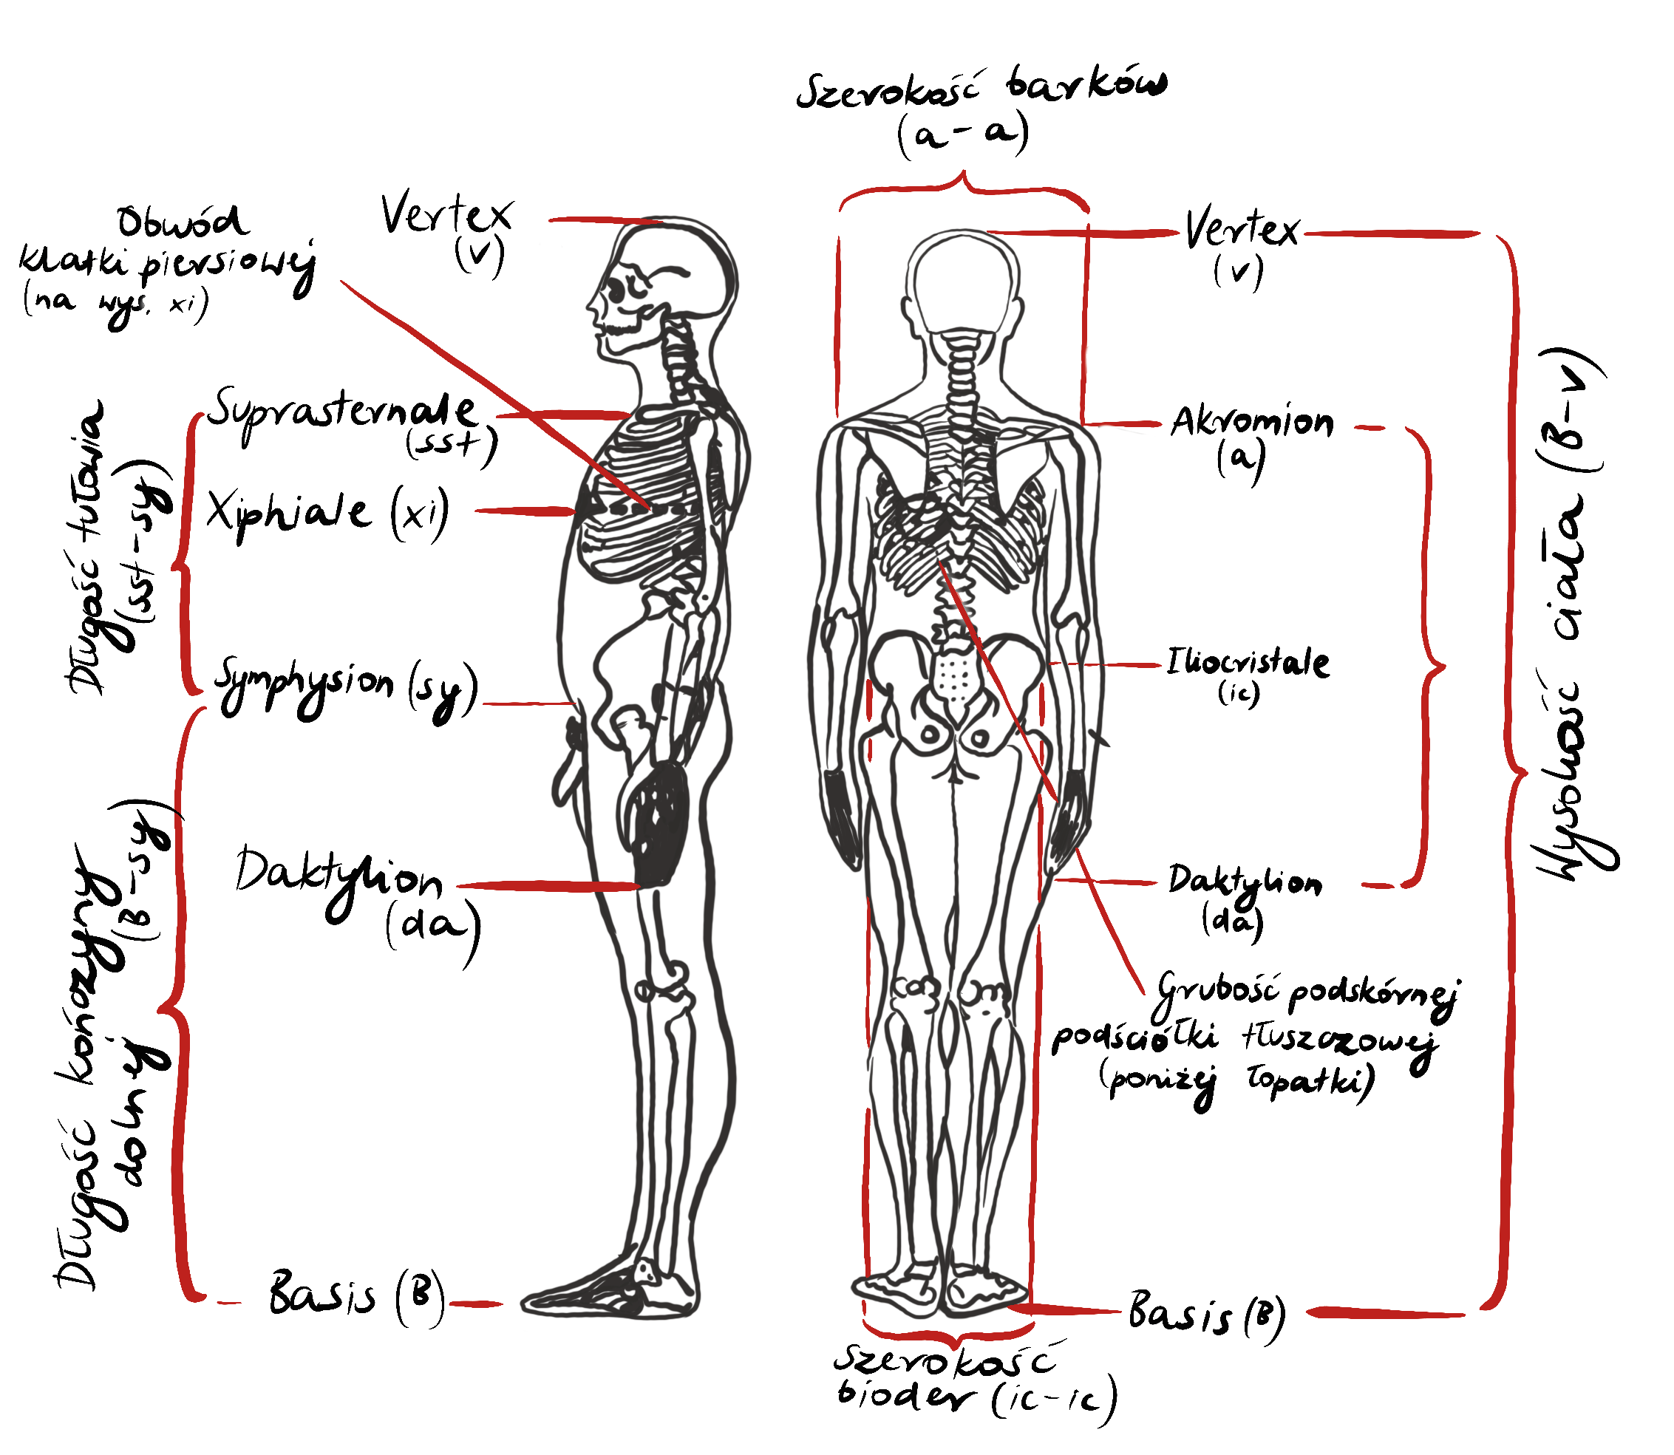
Standarized antropometric measures, indicators.
Characteristic anthropometric measuring points and procedures
Examinee’s position during the examination

Slide 7
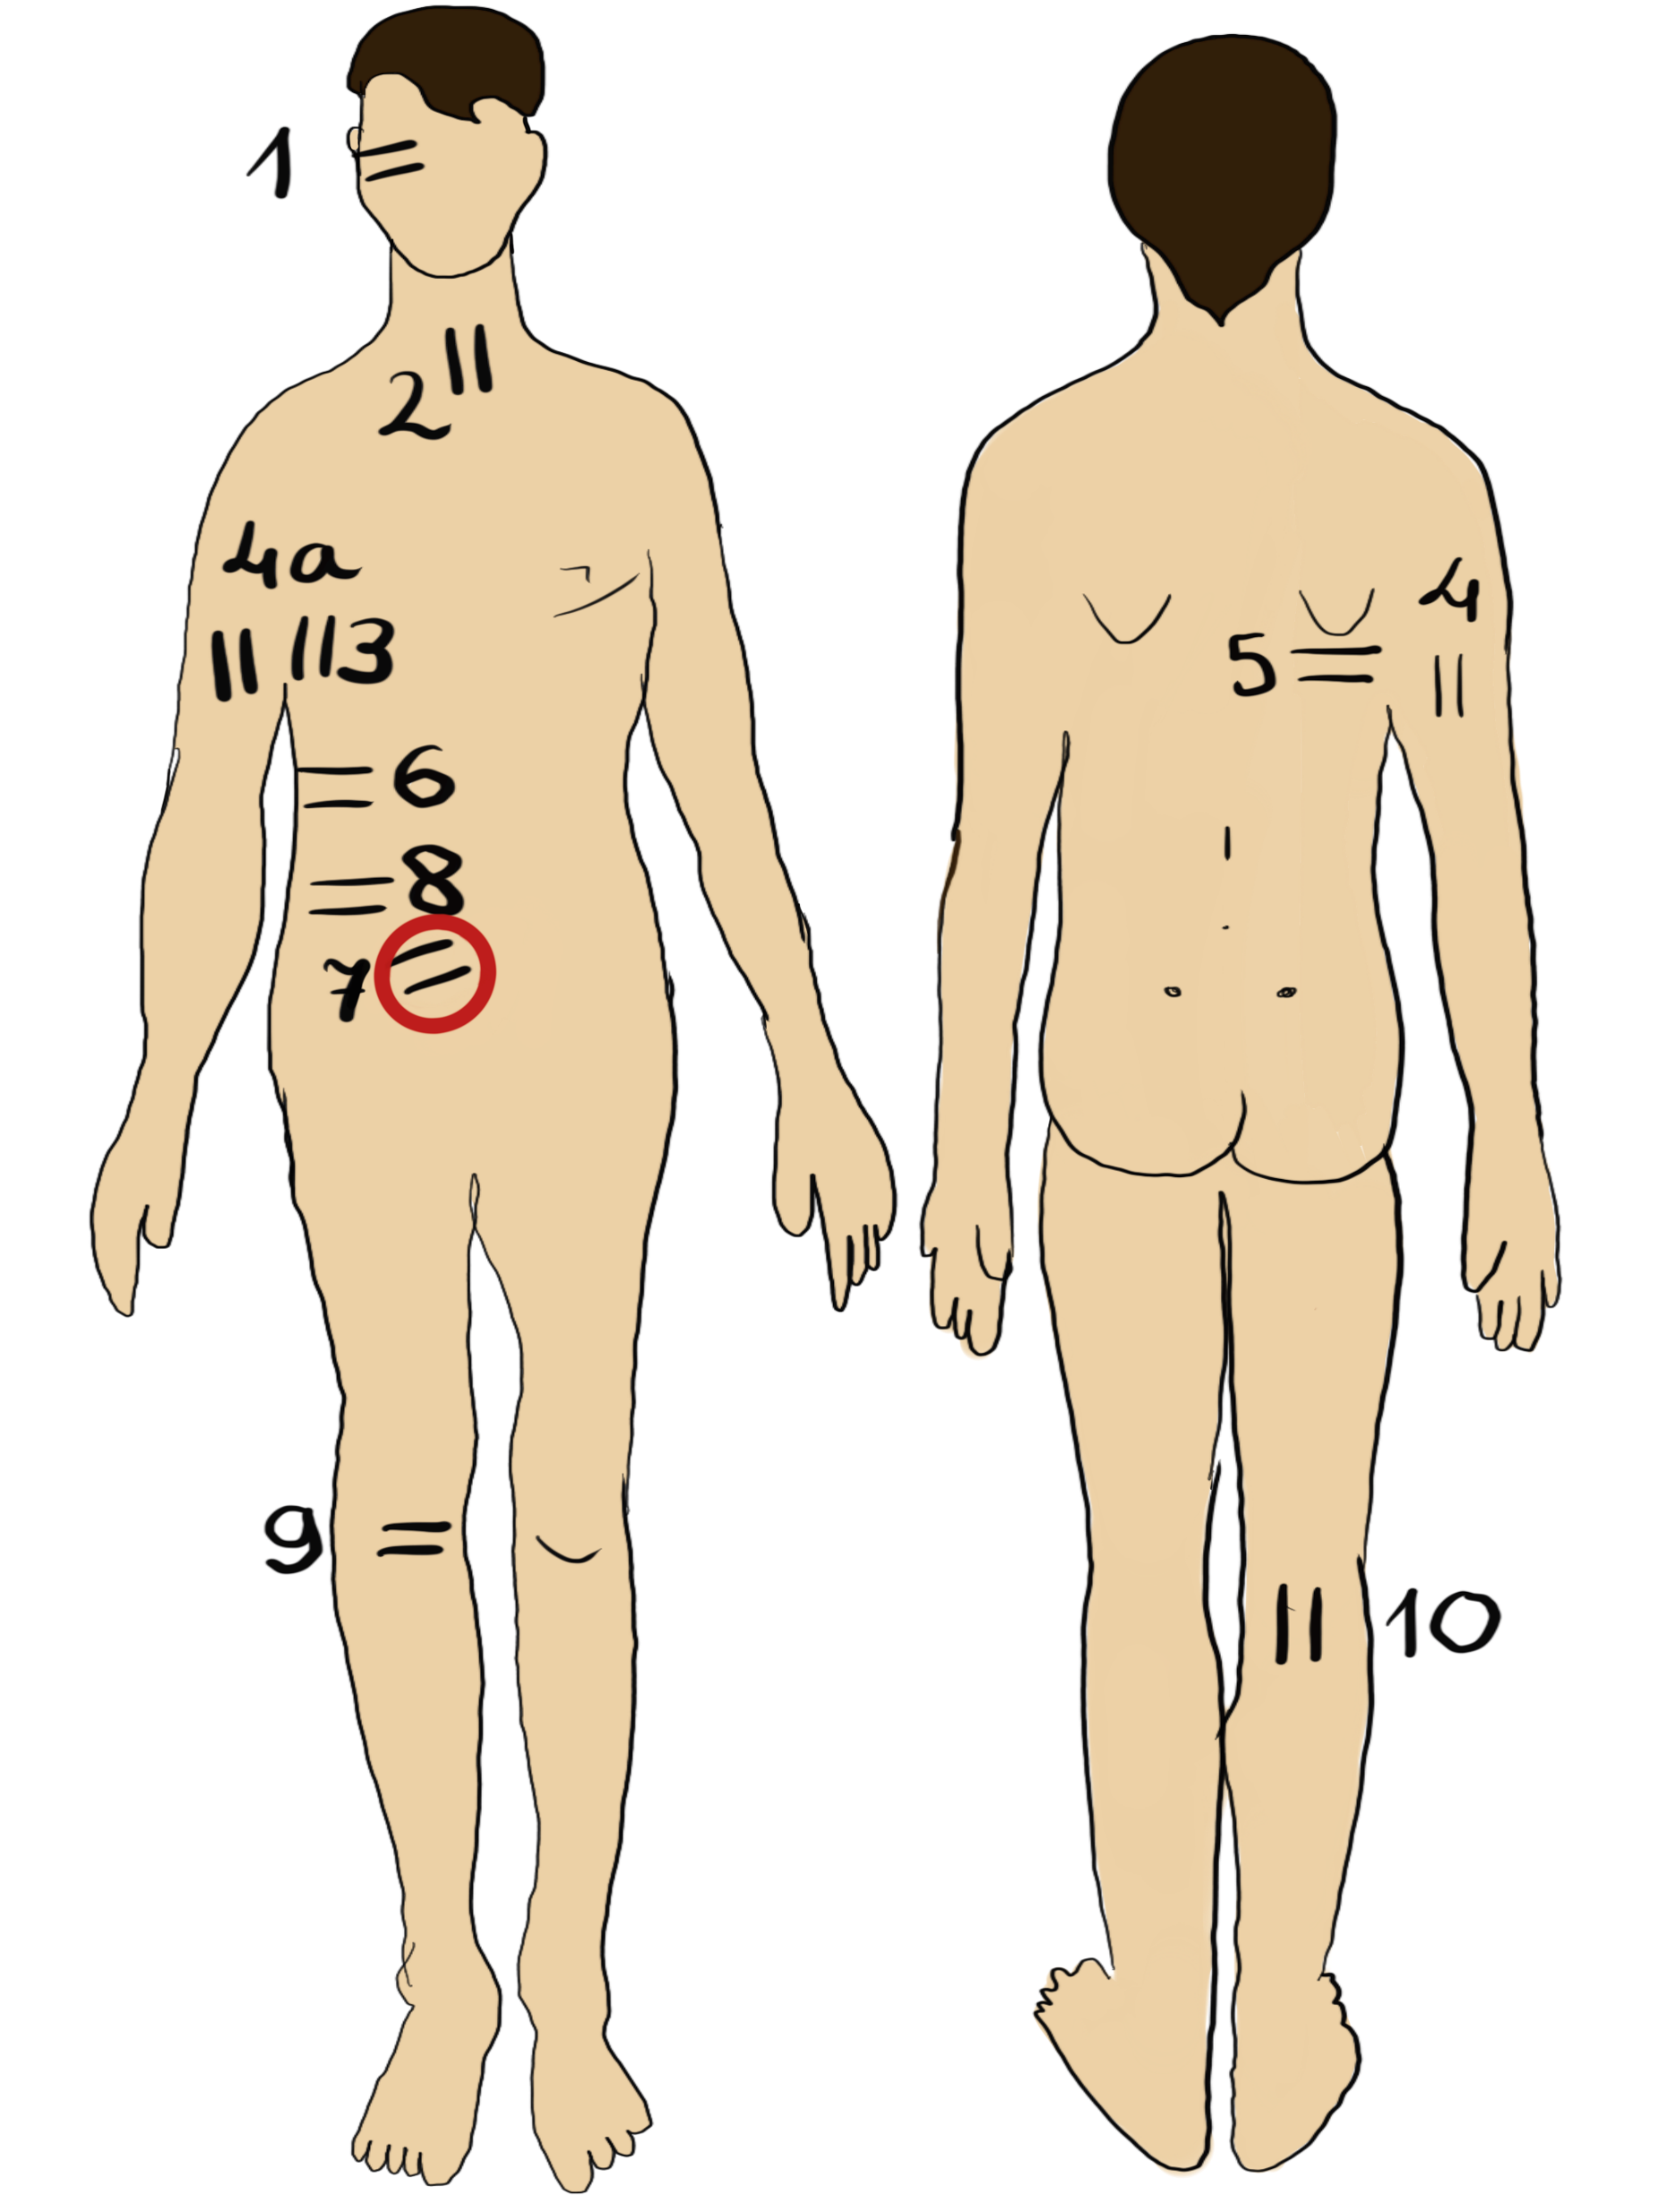
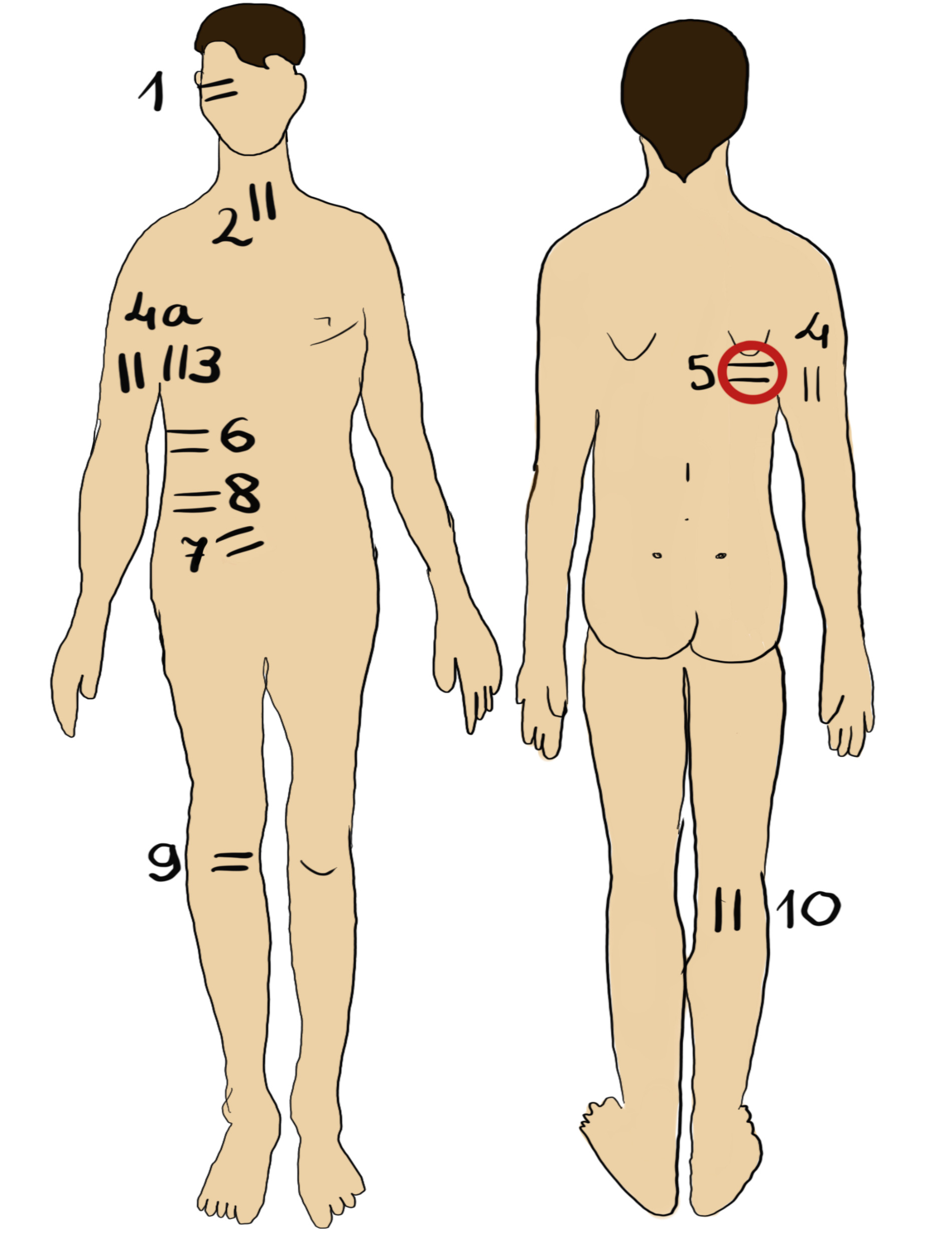
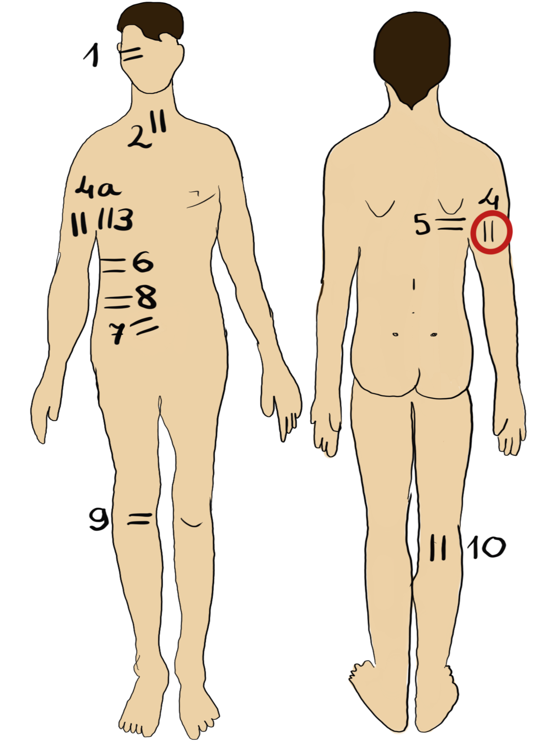
Characteristic points for measurements.
Geometrical indicators

Slide 8
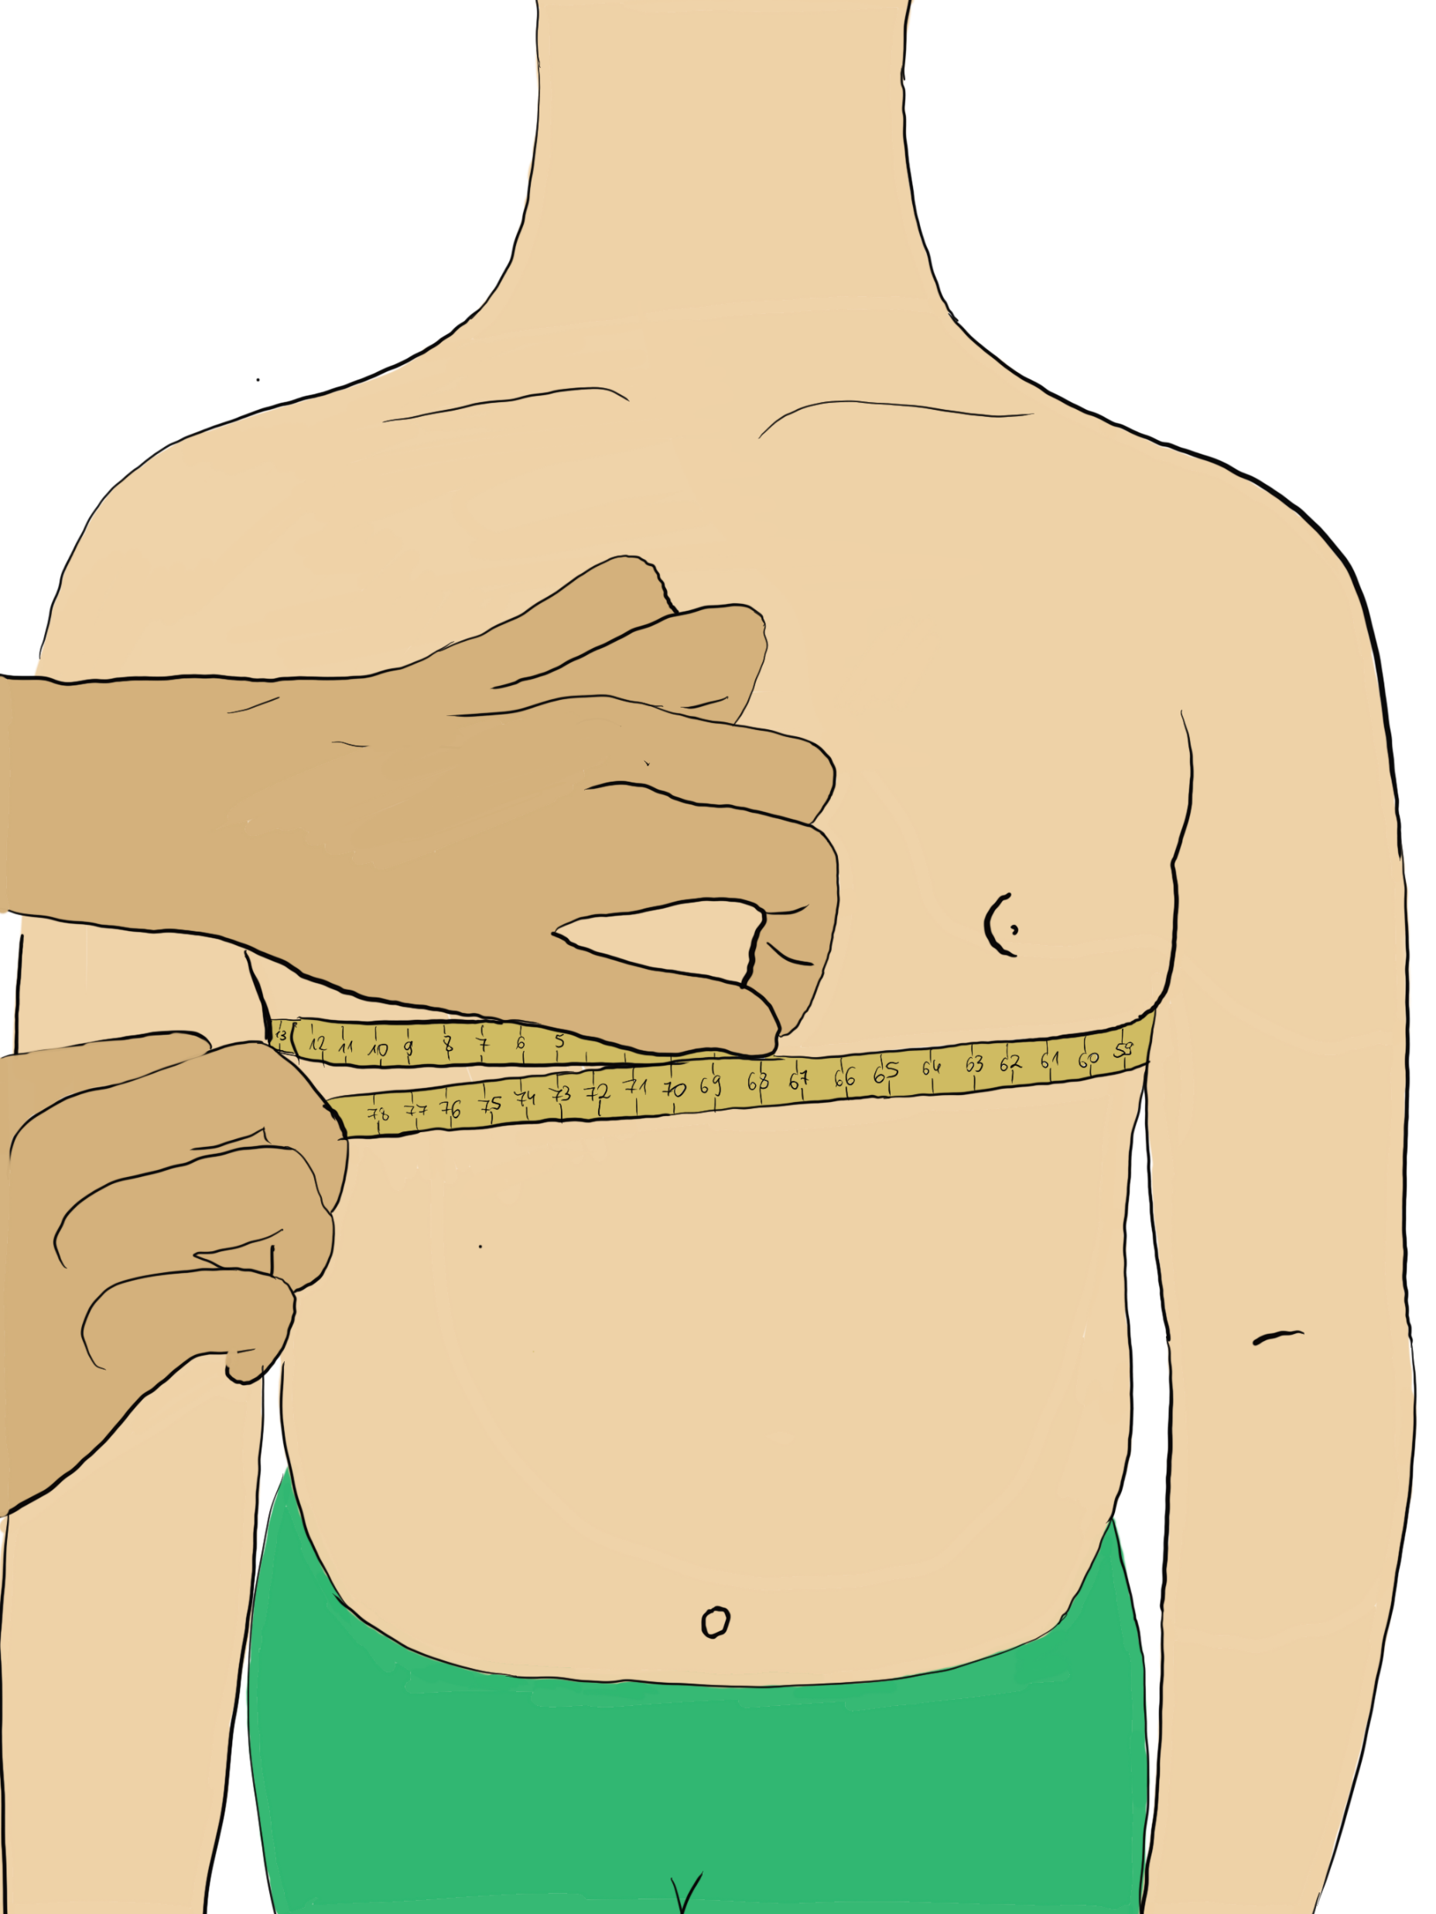

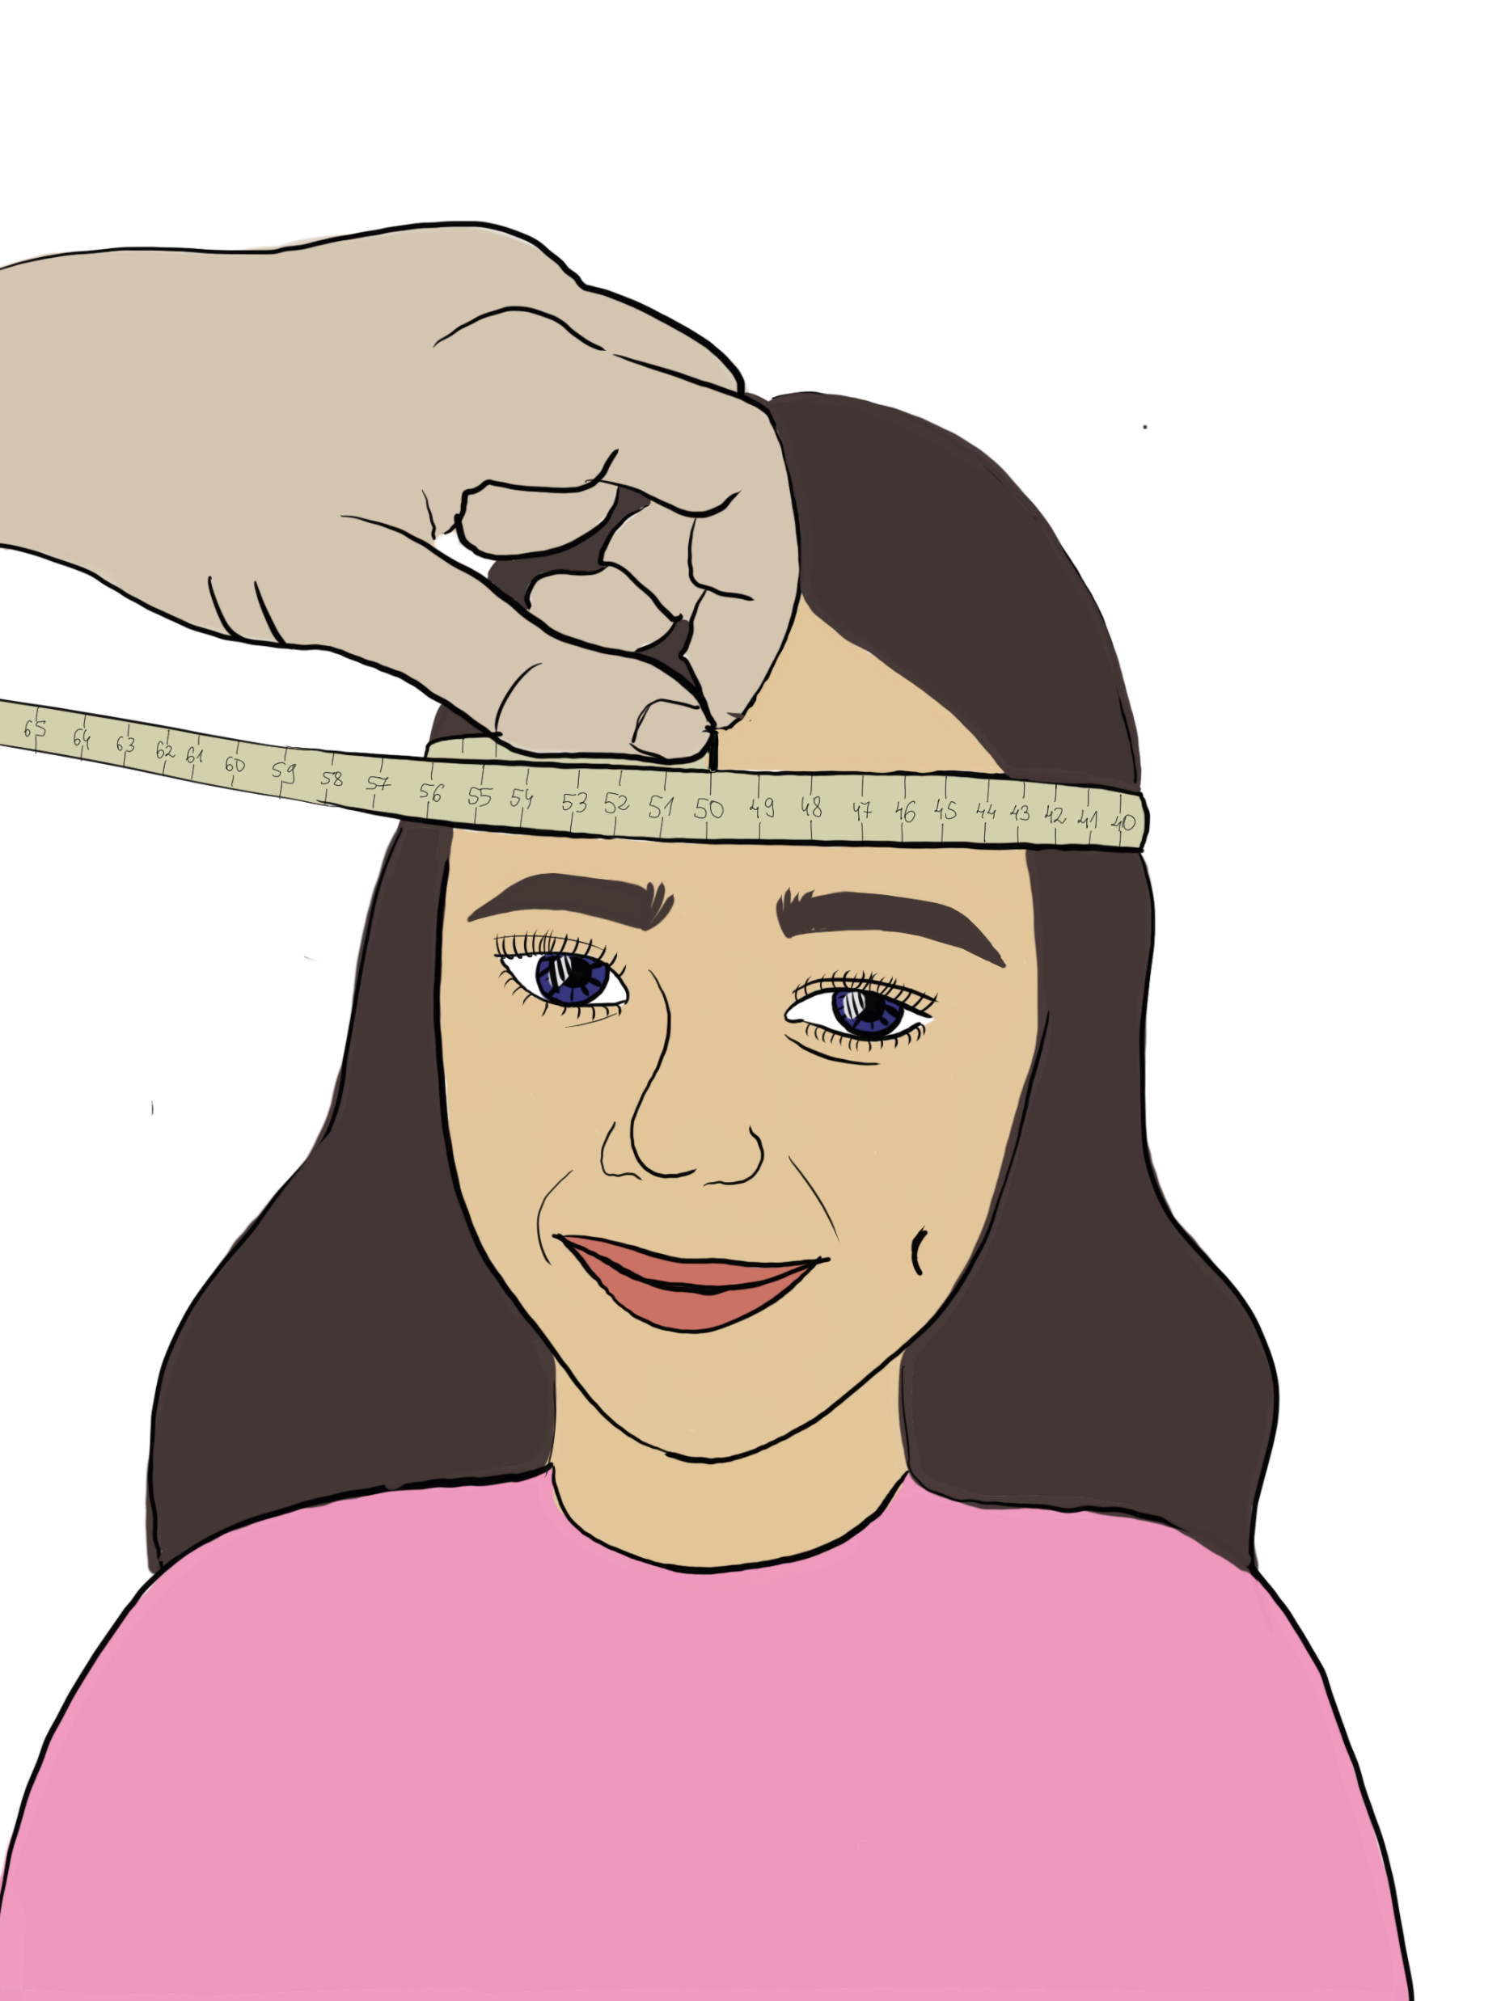
Standarized antropometric measures, indicators.
Characteristic anthropometric measuring points and procedures
Examinee’s position during the measurement

Slide 9
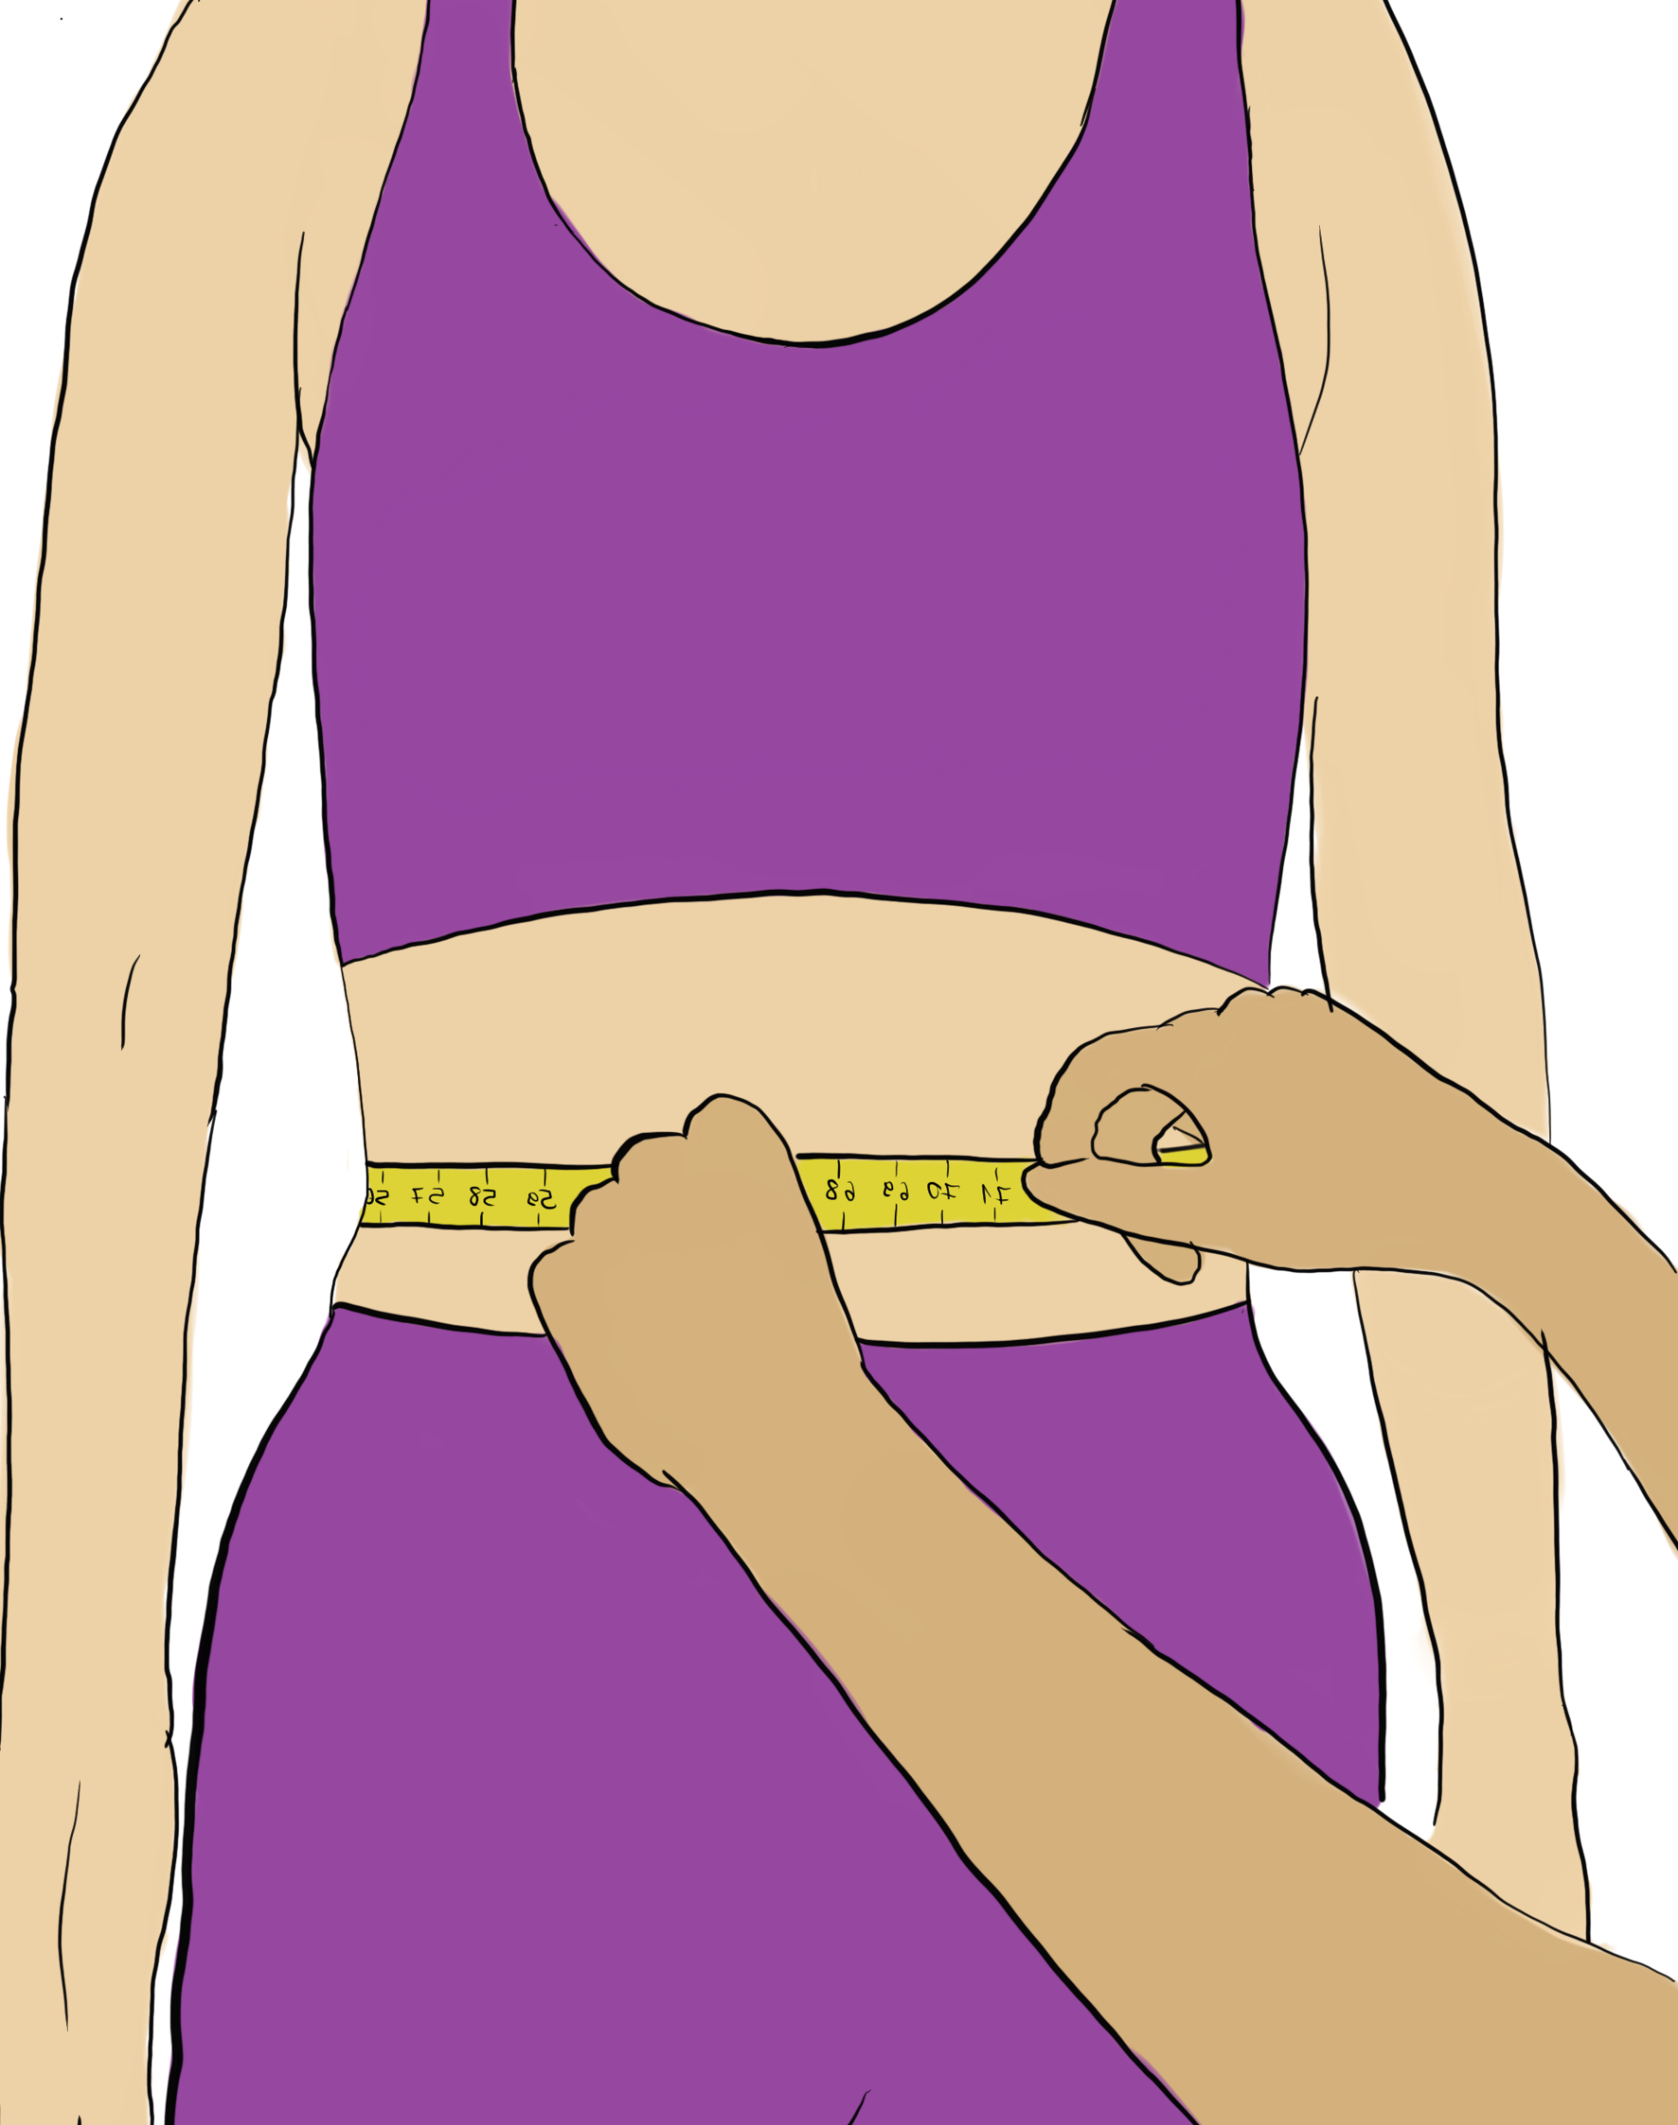
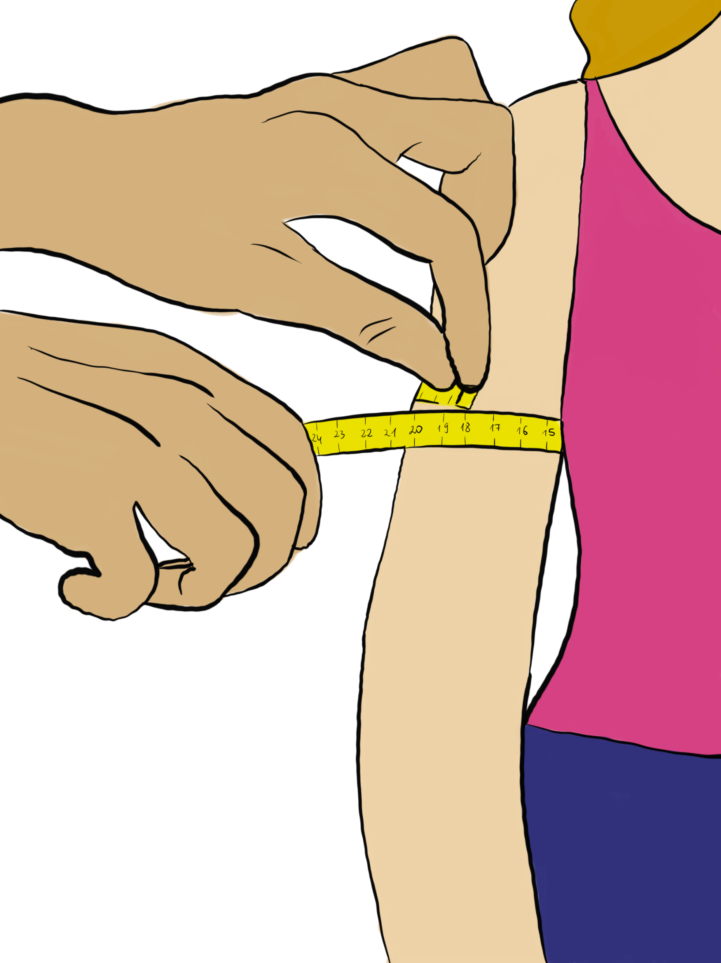
Standarized antropometric measures, indicators.
Characteristic anthropometric measuring points and procedures
Examinee’s position during the examination

Slide 10
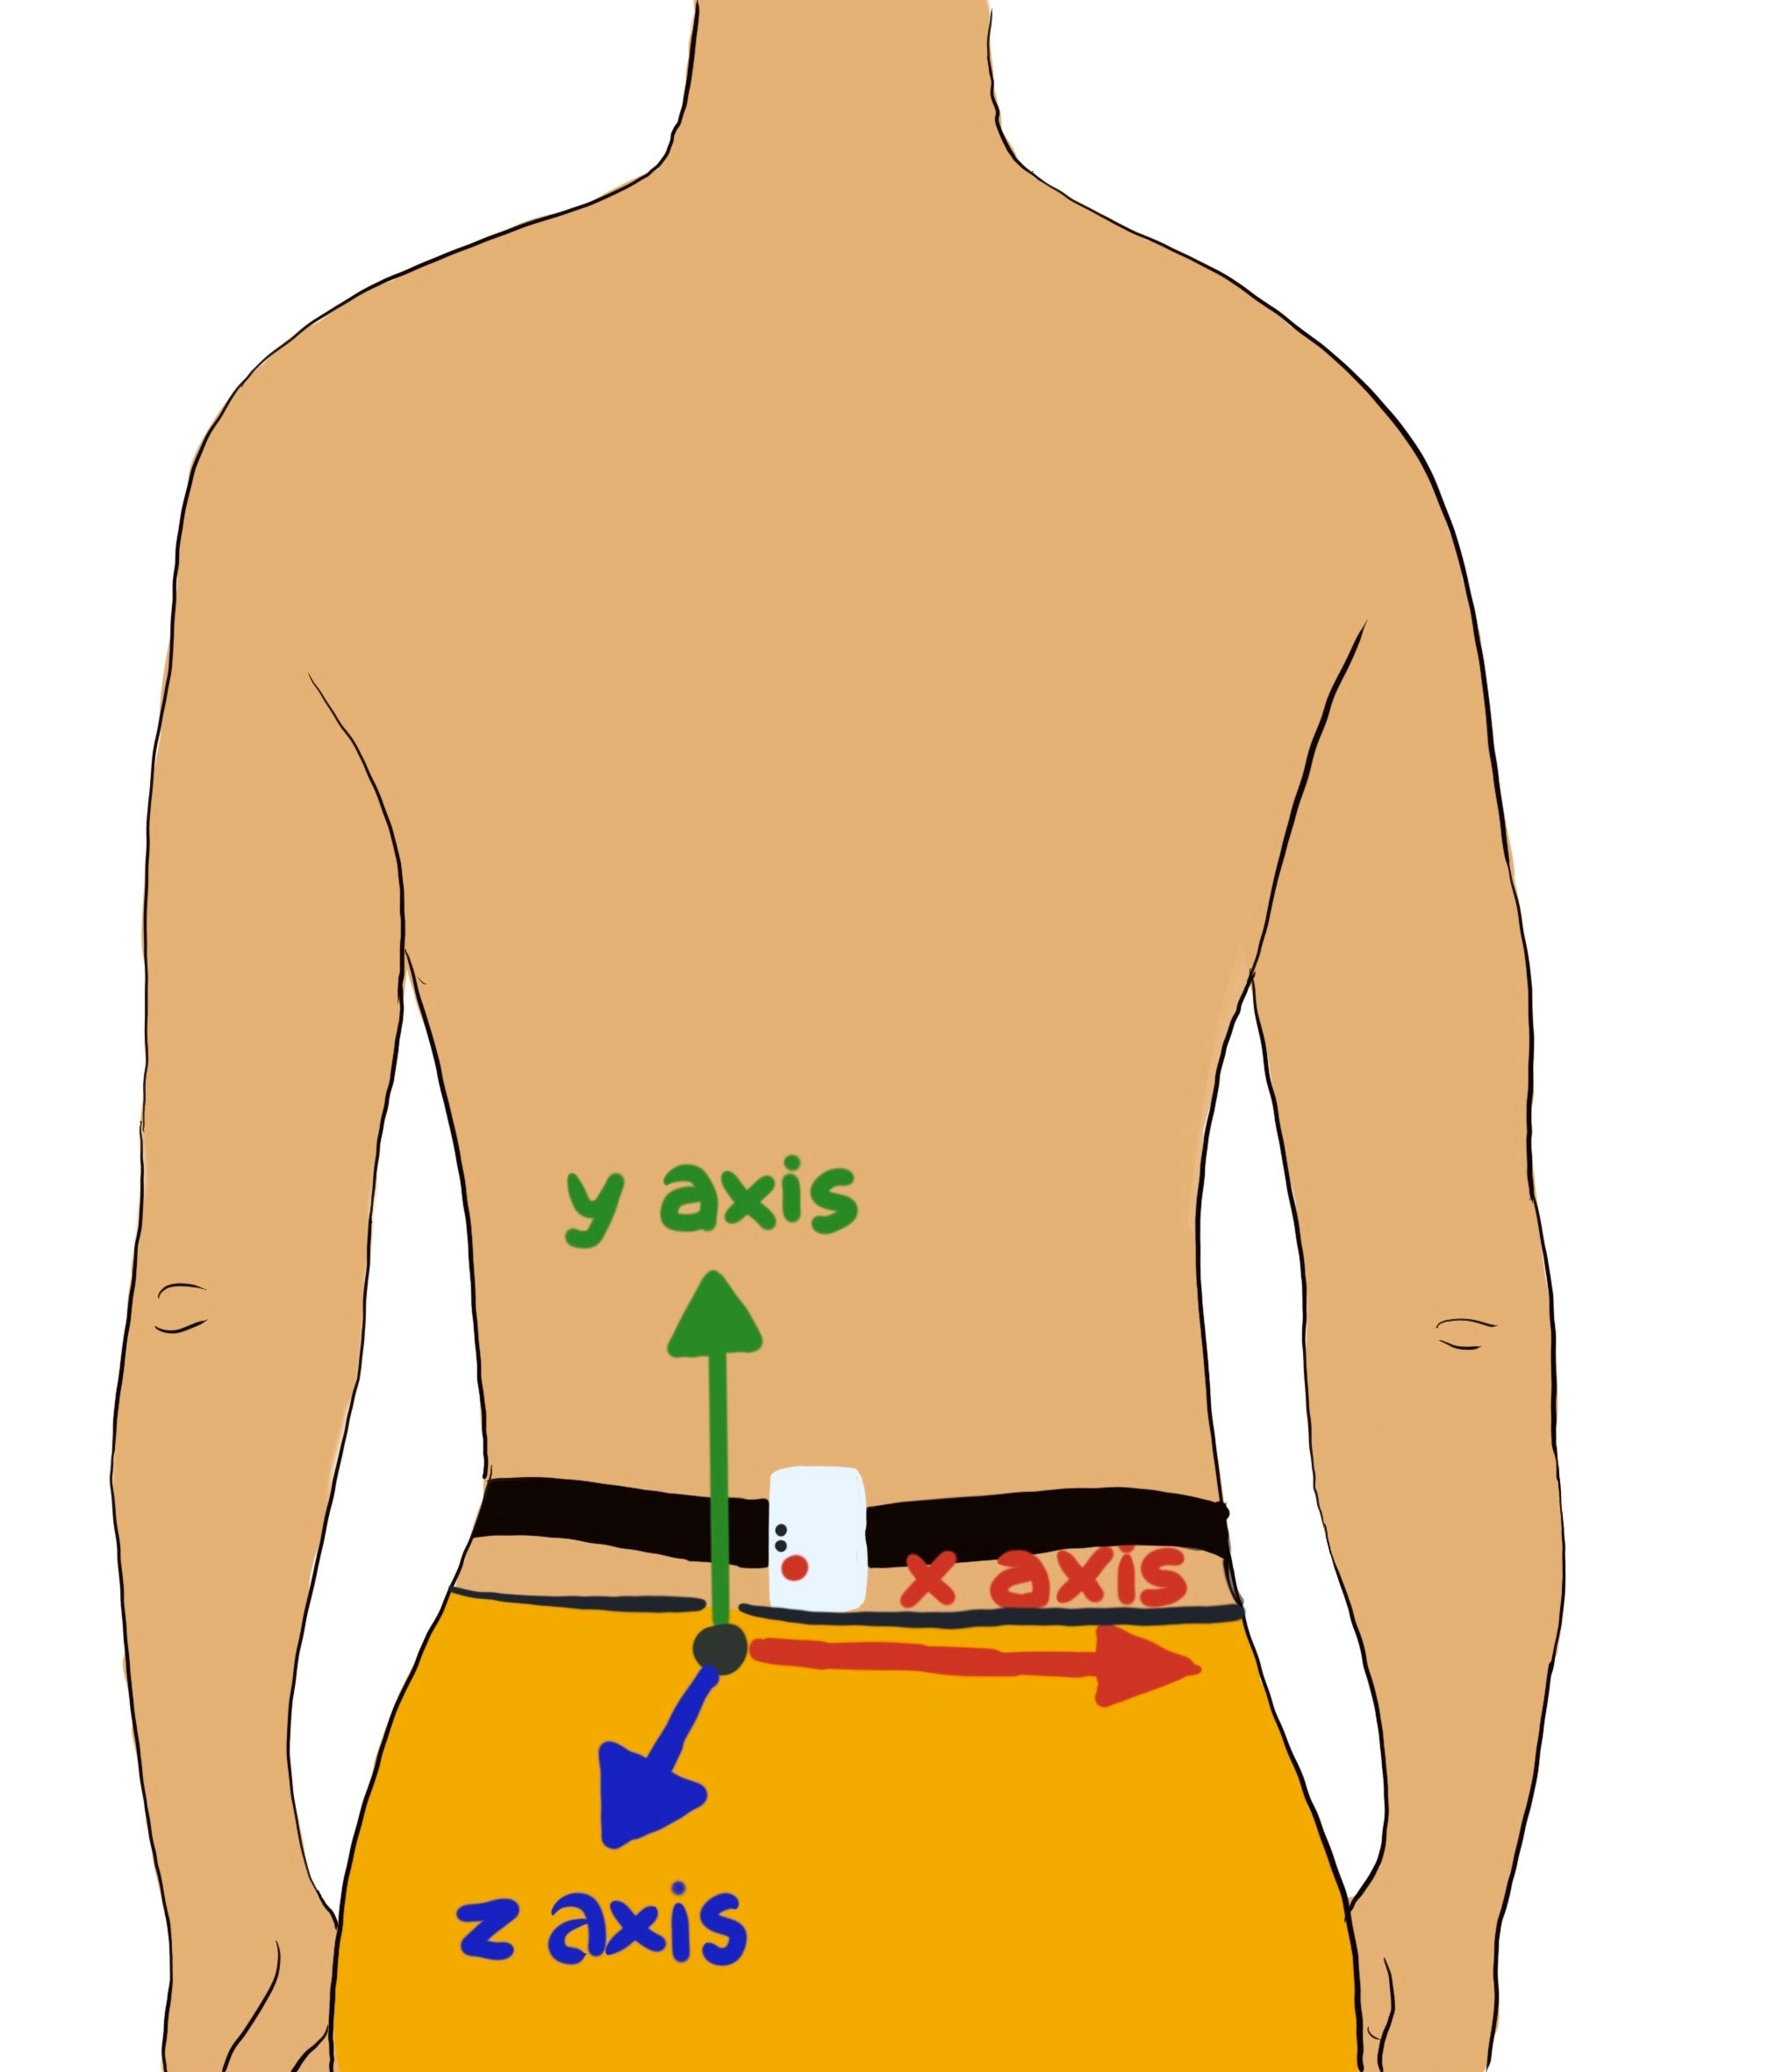
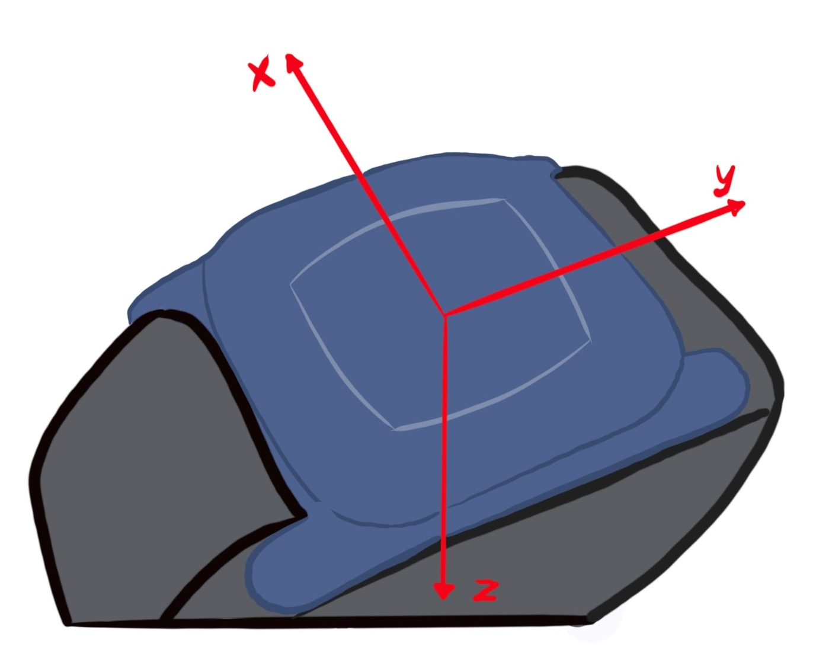
Modern methods for angle, velocity, accel of body part movements measurement.
NEW TECHNOLOGY SENSORS: IMU
One common characteristic of systems for anatomical angles detection is to compute the angle by sensing coordinates of different points on a human body in a three-dimensional space. This data can also be used to calculate the speed, acceleration, and direction of the angle.
Examinee’s position during the examination

Slide 11
Review of methods of sensing technologies
for posturę and body motion detection.
Vision-Based Systems
Vision-based systems consist of high-speed cameras and reflection markers or 3D cameras. Their operation highly depends on adjusting camera settings, selecting proper lighting conditions, and the use of video/image processing algorithms.
Vision-based systems can be divided into two categories:
  marker-based systems
  marker-less systems
Vision-based systems can provide precise and accurate measurements, but their use is limited to the laboratory setting. Additionally, their costs are relatively high.

Slide 12
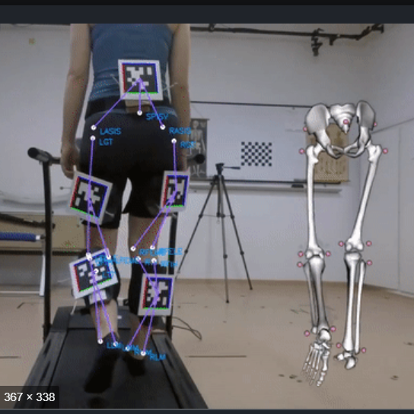
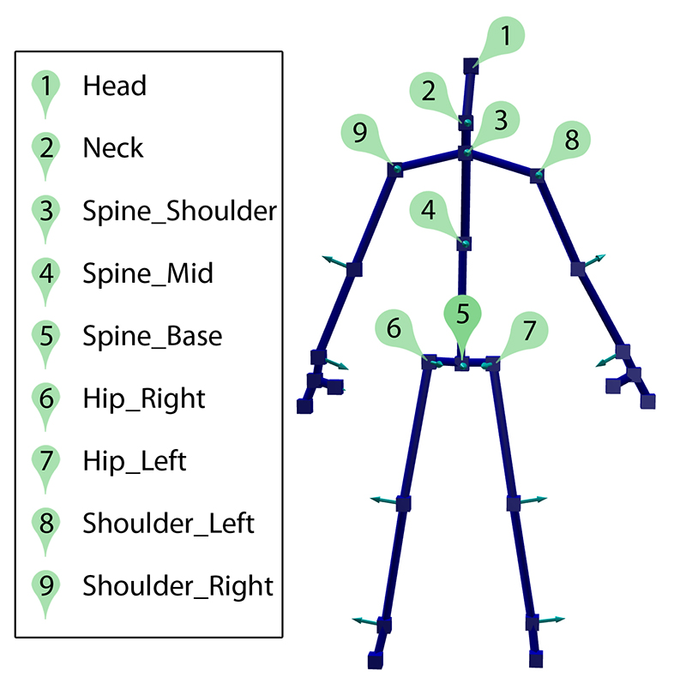
Dratf to Antrop.: Review of methods of Sensing Technologies for Body Motion Detection.
I. Vision-Based Systems

Slide 13
Review of methods of Sensing Technologies for Body Motion Detection.
Vision-Based Systems
Marker-based systems require reflection or transmitting markers for the measurement of physical movement. It uses infrared optical or high-speed cameras to detect the light reflection of the markers and measures activity using the computation of the markers’ trajectories in a three-dimensional space
Marker-less vision-based systems use multi-cameras, IR sensors, or RGB-D cameras in the analysis of body movements or postures. The analyses could be done with a single image or video clips and do not require the attachment of markers to individuals. Microsoft Kinect is a well-known commercialised marker-less motion-capturing system

Slide 14
Review of methods of Sensing Technologies for Body Motion Detection.
Vision-Based Systems
Lumbar–pelvic movements refer to the lower back area movements that include flexion, extension,
lateral flexion, anterior posterior pelvic tilt, and rotation.
  Vision-based systems can provide precise and accurate measurements, but their use is limited to the laboratory setting. Additionally, their costs are relatively high.
  The IMU-based systems can be used for out-of-hospital monitoring. Yet, they require the application of multiple IMUs to provide a relatively accurate and precise measurement. They also need wired or wireless modules for the communication of each IMU

Slide 15
Methods for angle, velocity, accel of body part movements measurement.
INERTIAL SENSORS: IMU
One common characteristic of systems for anatomical angles detection is to compute the angle by sensing coordinates of different points on a human body in a three-dimensional space. This data can also be used to calculate the speed, acceleration, and direction of the angle.
Vision-based systems can provide precise and accurate measurements, but their use is limited to the laboratory setting. Additionally, their costs are relatively high.
The inertial, IMU-based systems can be used for out of hospital monitoring. Yet, they require the application of single or better multiple IMUs to provide a relatively accurate and precise measurement. They also need wired or wireless modules for the communication of each IMU with the electronic integrated module (e.g. Smartphone) - wired or wireless

Slide 16
Methods for angle, velocity, accel of body part movements measurement.
NEW TECHNOLOGY INERTIAL SENSORS: IMU
One common characteristic of systems for anatomical angles

Slide 17
Methods for angle, velocity, accel of body part movements measurement.
NEW TECHNOLOGY SENSORS: IMU
One common characteristic of systems for anatomical angles detection is to compute the angle by sensing coordinates of different points on a human body in a three-dimensional space. This data can also be used to calculate the speed, acceleration, and direction of the angle.
IMU sensor to detect the pelvis angle

Slide 18
CONCLUSIONS
Clinical Significance & Enhancing Healthcare Team Outcomes
Anthropometric measurements have utility in assessing data of physical fitness for a wide variety of the population from children to elite athletes to the elderly. These measurements, including height, weight, circumferences, and skin folds, can be used either as a baseline or as a marker of progress.
The best way to improve the outcomes of anthropometric data is to improve the accuracy of measurements. The most effective way to improve accuracy is always to follow the same uniform methods to obtain measurements. To enhance long-term patient outcomes, an interprofessional team consisting of nurses, nurse practitioners, physician assistants, and physicians should work together to consistently promote a healthy lifestyle for patients to avoid the well-documented adverse effects of obesity and malnutrition.

Slide 19
