Slide 1
MODULE BIOMECHANICS OF SPINE
Didactic Unit E: TECHNIQUES FOR THE INSTRUMENTAL ANALYSIS OF ANTHROPOMETRIC AND MORPHOMETRIC PARAMETERS
E.4. What are the applications of the analysis of anthropometric and morphometric parameters?

Slide 2

Application fields of Anthropological & Morphometric parameters
Anthropological research/examinations are used in the prevention of diseases, developmental disorders and improvement of health of people, especially children and adolescents.
Systematic monitoring of growth allows for early detection of abnormalities and counteracts permanent health impairments.
Determining the correct dimensions for age and gender, body proportions ensuring good health and well-being motivate to change eating habits and lifestyle.
Systematic carrying out of professional analysis of body structure and nutritional status allows to monitor the effects of weight loss or weight increase therapy.

Slide 3
Anthropological parameters monitoring for prevention and obesity therapy for children and young people.
Recommendations and good practices for correct
measurement of growth and weight
Performing tests at the same time of day, preferably in the morning - fluctuations in body height and other dimensions during the day,
Performing tests in the same way, by the same person - ensures repeatability and reliability of measurements,
Verification of instruments - whether individual elements function well, i.e:
  Check if the tape is not stretched - compare it to the graduated anthropometer tube.
  The weight scale must be tared and set vertical before the test begins.
Need to assist the other person in the examination of infants and small children - help to hold the child, record and control the results.
Appropriate hygiene conditions (breaks between measurements, visible, ventilated room, disinfected instruments)

Slide 4
Bioelectrical impedance method applications for medical diagnosis and obesity treatment in children and adults
The measurement is carried out with the use of specialized body composition analyzers (e.g. Maltron, Tanita and others models), with different number of electrodes, their different configuration and different frequency of electric current with very low amplitude value.
By analysing the bioelectric impedance it is possible to determine:
  Fat mass content (%), [kg]
  Fat-free tissue mass content, including muscle and water (%), [kg]
  Basic Matter Conversion Level (BMR)
  BMI index
The availability and simplicity of this method makes it widely used in the diagnosis and therapy of obesity in both children and adults.

Slide 5
Bioelectrical impedance method applications for medical diagnosis and obesity treatment in children and adults:
recommendations, good measurement practices
Reliability and repeatability of test results requires observance of a specific methodology of body composition measurements.
In the case of four-electrode devices (e.g.Maltron type) it is necessary to rinse the skin with alcohol before placing the electrodes on it and remove any impurities.
To ensure proper electrical conductivity, the electrodes must be properly positioned (most often on the dorsal centerline of the hands and feet)
Patient should take a lying position (about 5-10 minutes before the measurement), with loose limbs.

Slide 6
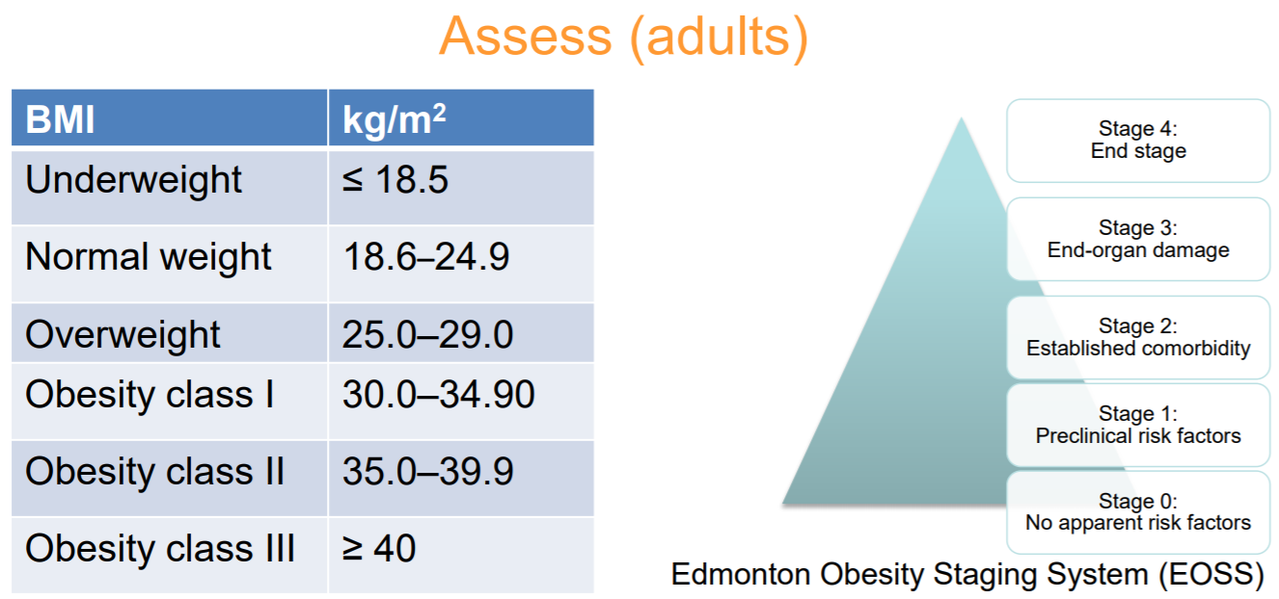
Application fields of Anthropological & Morphometric parameters
Standards of unified assessment

Slide 7
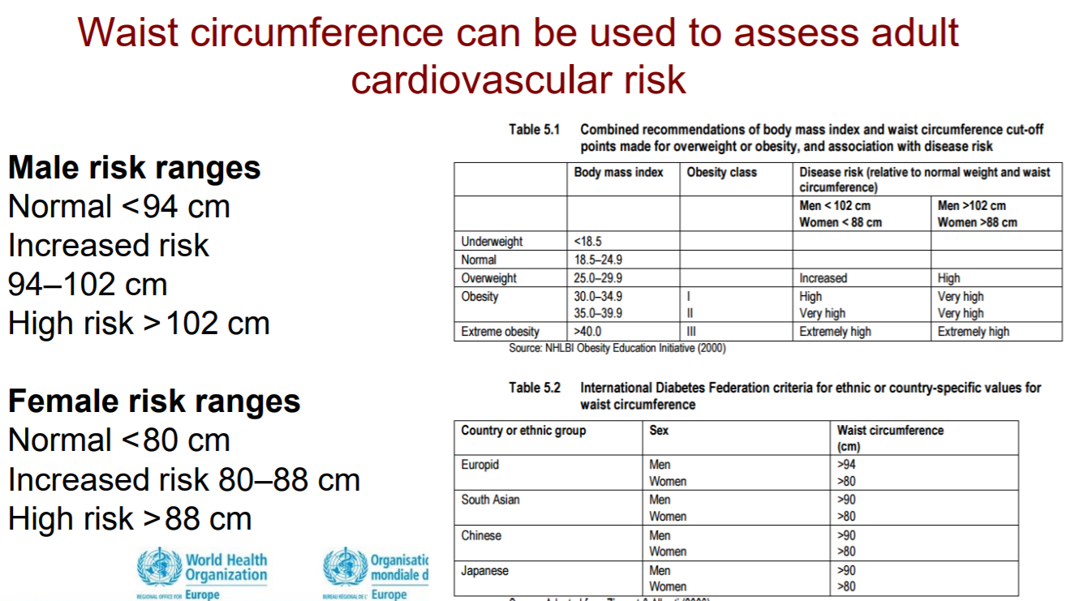
Application fields of Anthropological & Morphometric parameters
Standards of unified assessment

Slide 8
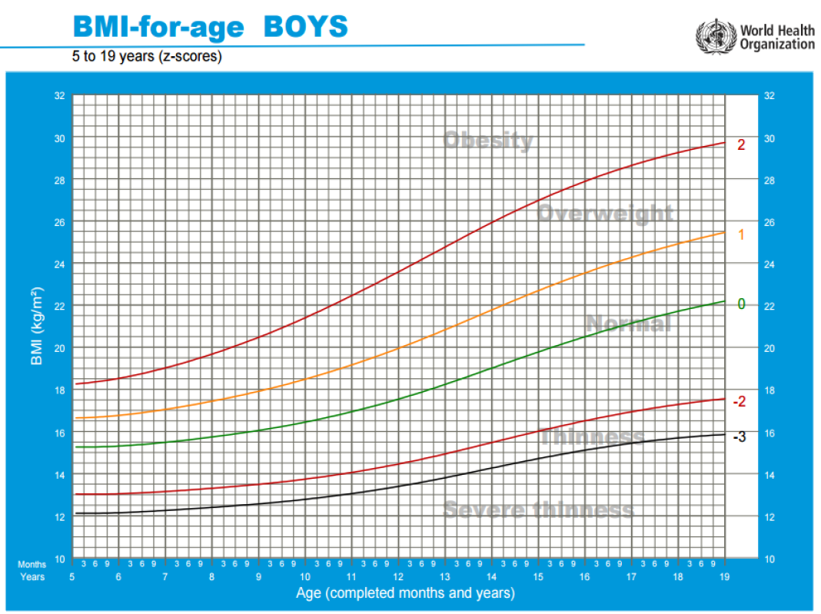
Application fields of Anthropological & Morphometric parameters
Standards of unified assessment
DO NOT use adult BMI reference ranges for children.
Child reference ranges vary constantly, according to age, sex and pubertal growth spurt.
BMI percentile takes account of this variation and so allows comparison at different ages.
z-score uses standard deviation from the mean.

Slide 9
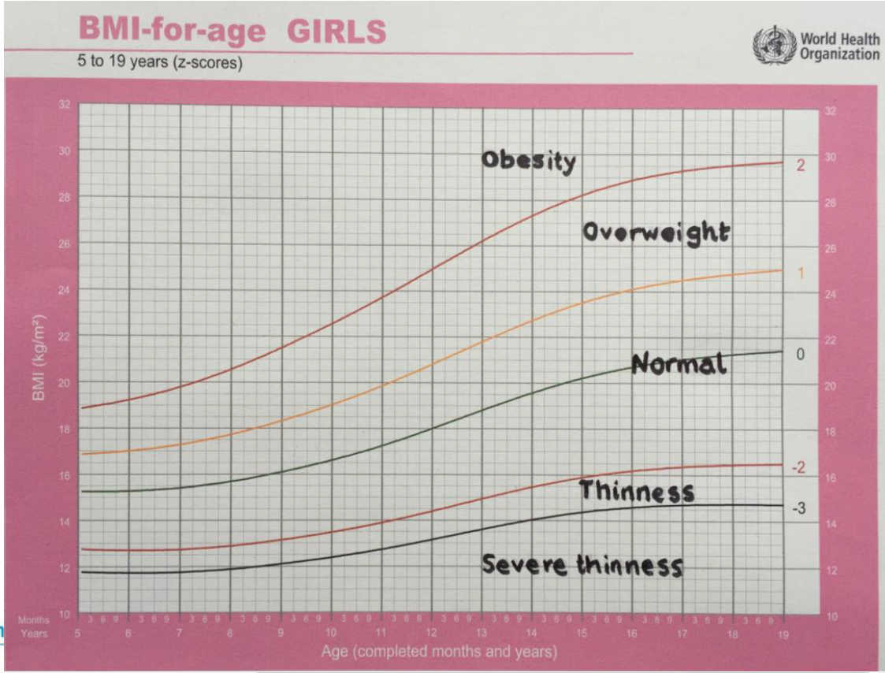
Application fields of Anthropological & Morphometric parameters
Standards of unified assessment

Slide 10
Application fields of Anthropological & Morphometric parameters
Standardization of anthropometric measurement results
Standarization method consists in normalizing a given somatic trait (e.g. body weight) of an individual to an average and standard deviation for age and sex, relative to a reference population according to the formula:
SDS = Xb – (Xn / SDn)
    where: SDS - standardization result, Xb - measurement of the test person, Xn - average standard for a given age and gender class, SDn - standard deviation from standard for a given age and gender class.

Slide 11
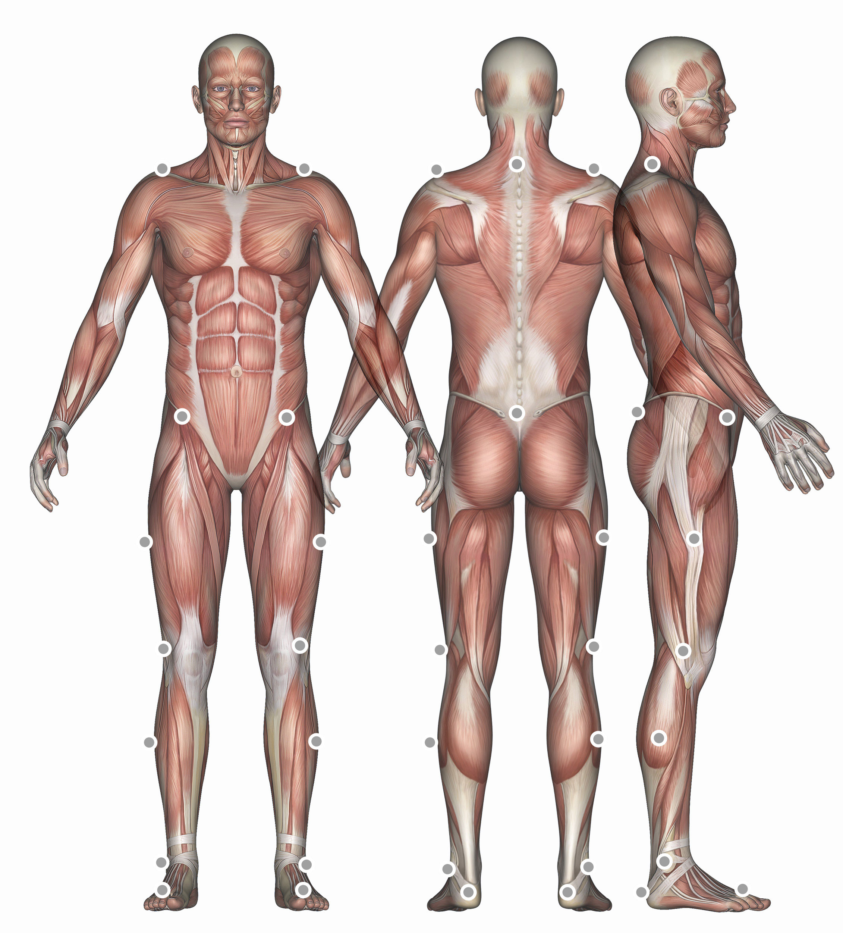
Motion Capture systems applications for anthropometric parameters monitoring during normal activity, sport or physiotherapy: Marker based or Marker-less technology
Complex Motion Capture System can integrate, synchronize & manage multimodal information in real time coming from:
  Electromyography monitor,
  Sensorized force feet platforms
  External cameras (mainly IR),
  Additional channels for the integration and synchronization of signals acquired from other, external devices.
Marker placement according to motion capture system requirements

Slide 12
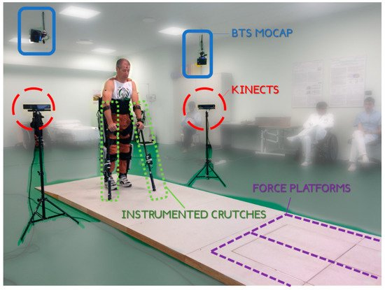
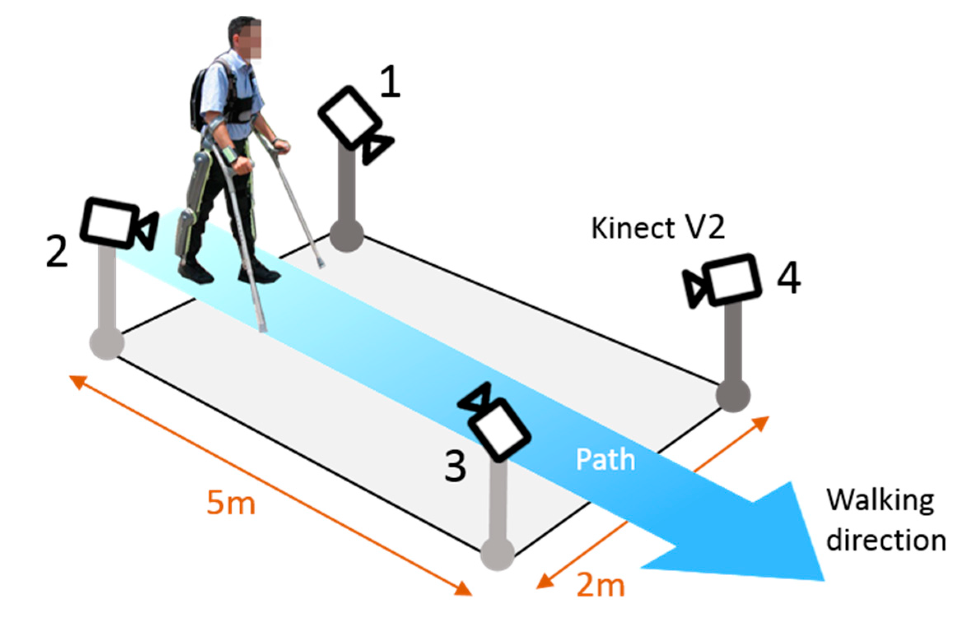
Marker less systems (e.g. kinect) as an alternative for marker based (e.g. BTS IR cameras) systems, which are more time-consuming and error sensitive.
MS Kinect system for providing the joint trajectories of both upper limb body segments and exoskeleton lower limbs application for gait parameters monitoring
BTS (gold std.) with IR cameras, Kinect system & force sensitive feet platforms

Slide 13
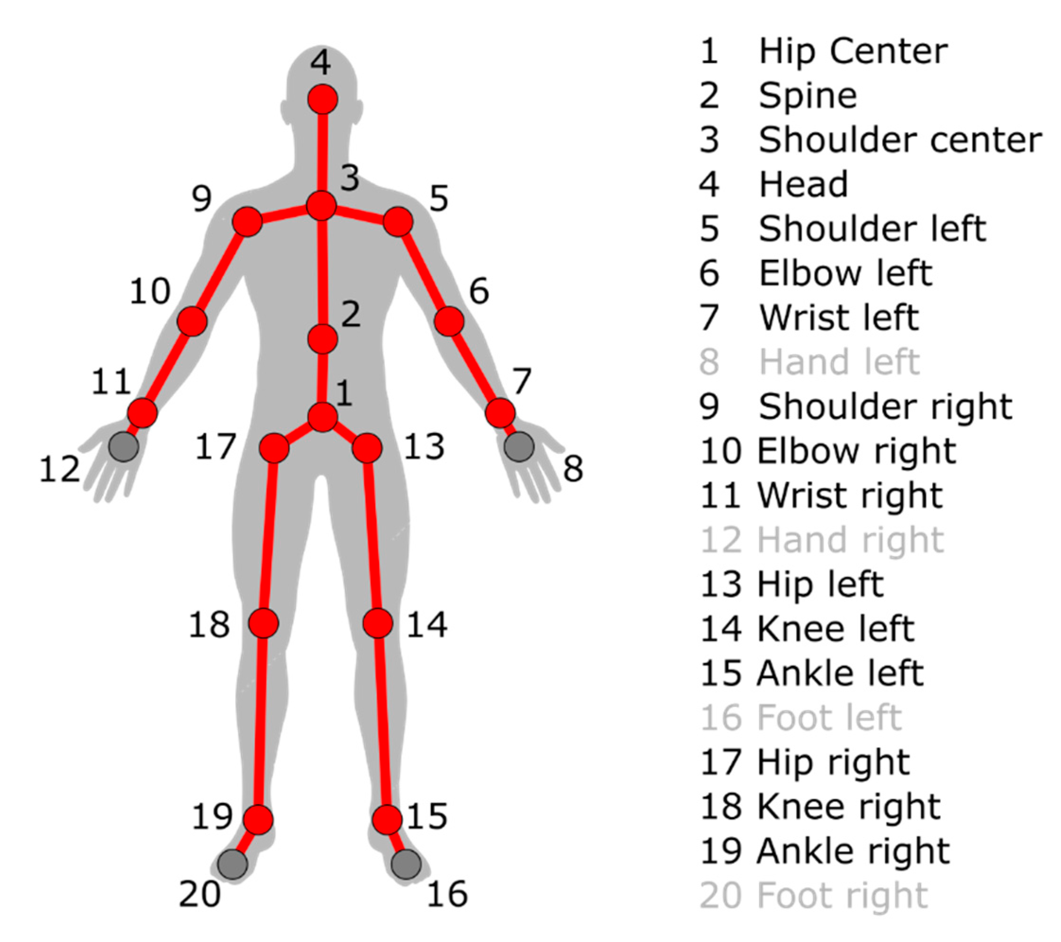
Marker less systems (e.g. kinect) as an alternative for marker based (e.g. BTS IR cameras) systems, which are more time-consuming and error sensitive.
MS Kinect system for providing the joint trajectories of both upper limb body segments and exoskeleton lower limbs application for gait parameters monitoring
Skeletal data provided by the Kinect system with the graphical representation.

Slide 14
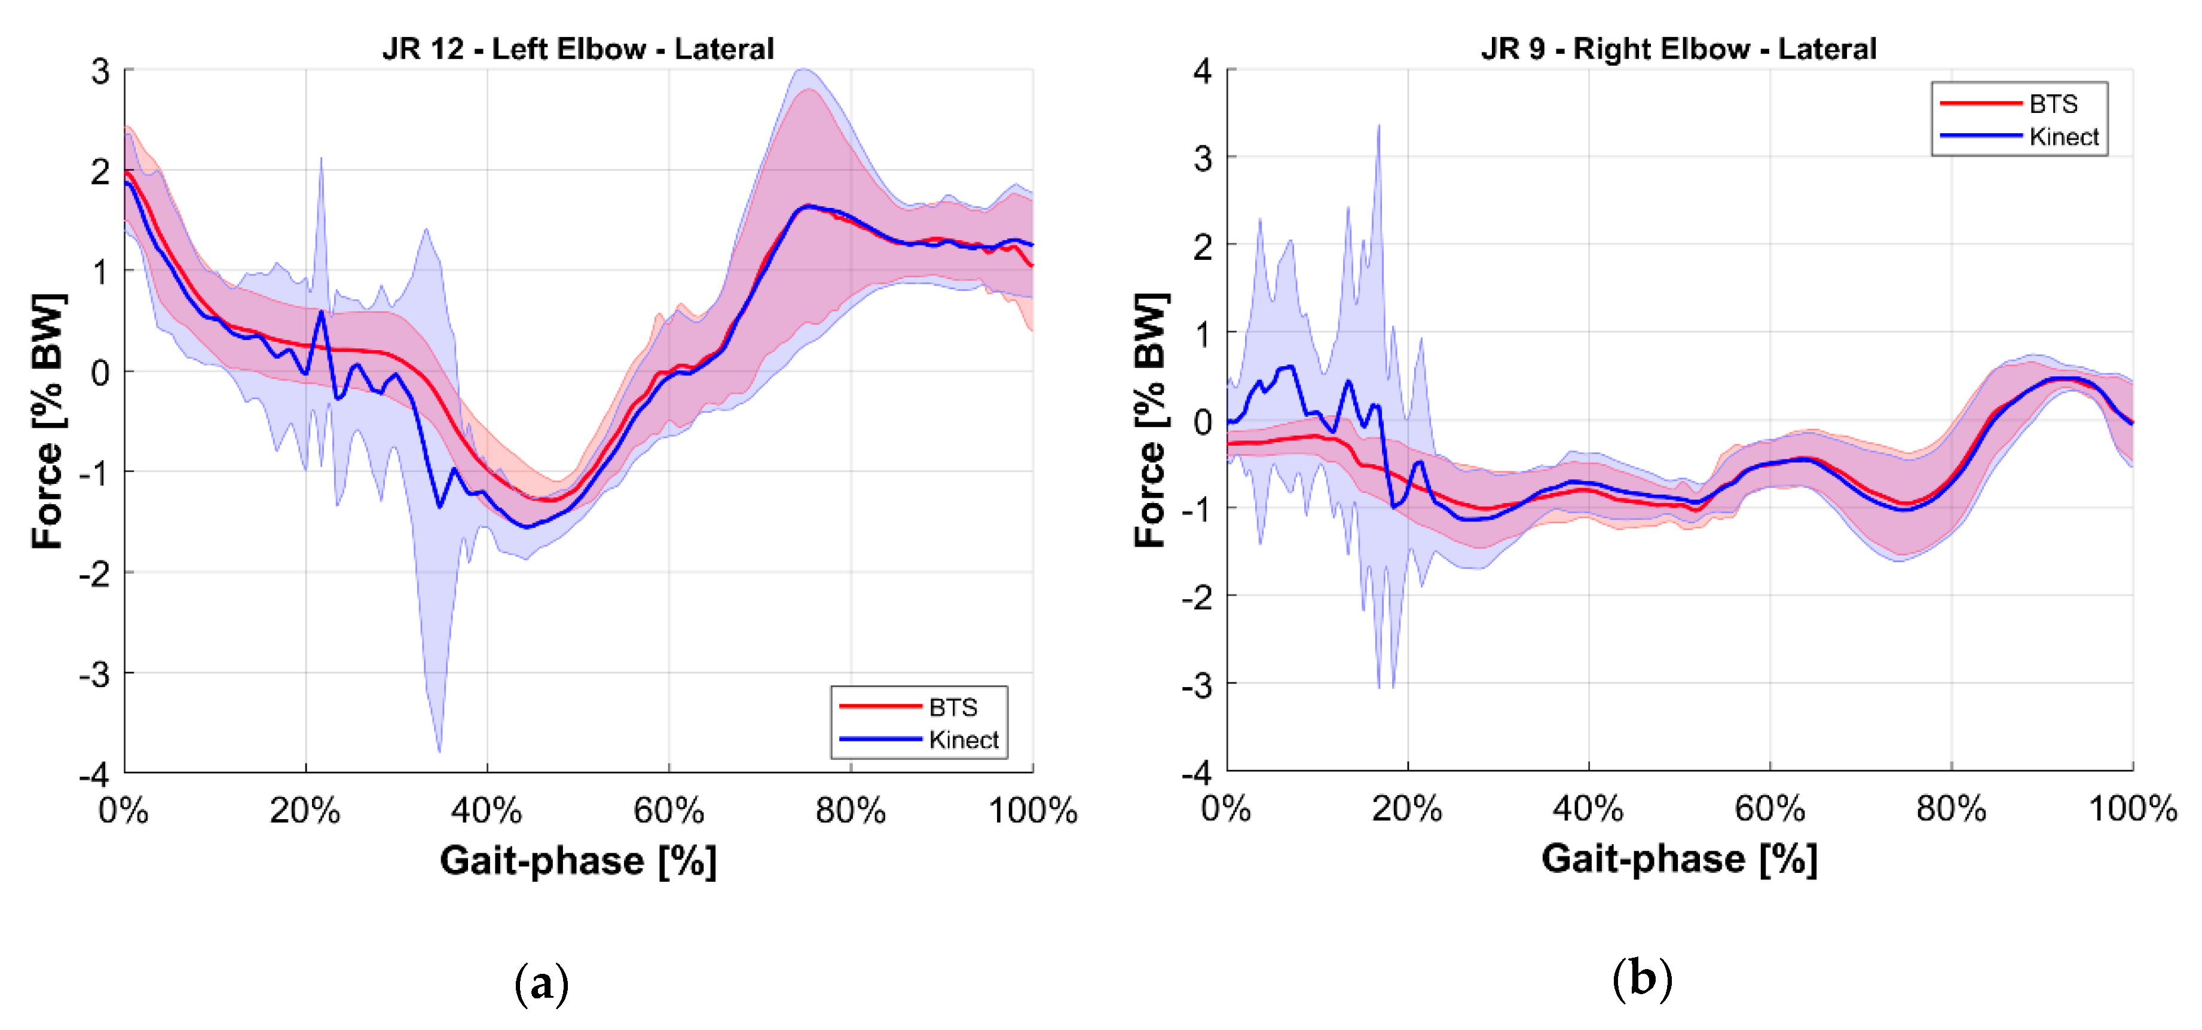
Marker less systems (e.g. kinect) as an alternative for marker based (e.g. BTS IR cameras) systems, which are more time-consuming and error sensitive.
Examples of force trajectories recorded from gold standard: BTS system and marker less - Kinekt System from left (a) and right (b) elbow (lateral), during gait
Average and

Slide 15
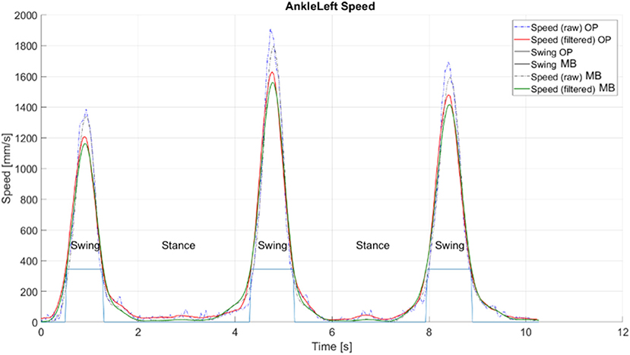
Extraction of gait phases from the trajectories of ankle nodes' velocity, explanatory example taken from a straight gait test.
OP (OpenPose- markerless system), MB (MarkerBased) optical system.
Marker and Markerless systems gave similar results

Slide 16
CONCLUSIONS
Anthropometric and morphometric parameters fulfill an important role in the assessment of overall human health and development from birth to adulthood as well as in specialised examinations among others posture and gait .
The dynamic development of biosensory, electronic and information technologies is the reason for significant progress in measurement systems supporting the classical approach and allowing for the monitoring of these parameters also at home and in the field.

Slide 17
