Slide 1
MODULE BIOMECHANICS FOUNDATIONS
Didactic Unit F: REQUIREMENTS OF A BIOMECHANICAL ASSESSMENT SYSTEM. CONCEPTS OF VALIDITY, RELIABILITY AND ACCURACY
F1. What features should an appropriate biomechanical assessment system count on?

Slide 2
OBJECTIVES
Explain what is a biomechanical assessment test and its main applications in different contexts.
Briefly introduce its main requirements: VALIDITY, RELIABILITY and USABILITY.

Slide 3
CLASS DEVELOPMENT
10’
5’
10’
Exercise1: Look for new examples
5’
Requirements for biomechanical tests and exercise 2: good and bad examples.
Key ideas and lessons learned.
Biomechanical assessment test in different contexts

Slide 4
Biomechanical assessment tests in different contexts

Slide 5
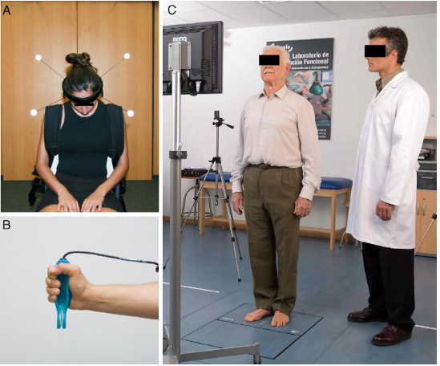
What a biomechanical test is
Images corresponding to different biomechanical assessment tests. Cervical motion analysis with fotogrametry (A), hand grip strength analysis with a hand dynamometer and posturographic assessment with force platform (C), respectively
Notes:
A biomechanical assessment test is a complementary test done by means of biomechanical techniques. It should be used in different contexts. For example, It is used as a complementary test for functional evaluation in a clinical context, to either enhance performance or reduce the injury risk a in a sportive context, for job evaluation in a occupational context or for investigation in this different fields of knowledge.
Figure 1 shows images from different biomechanical assessment tests in a clinical context.

Slide 6
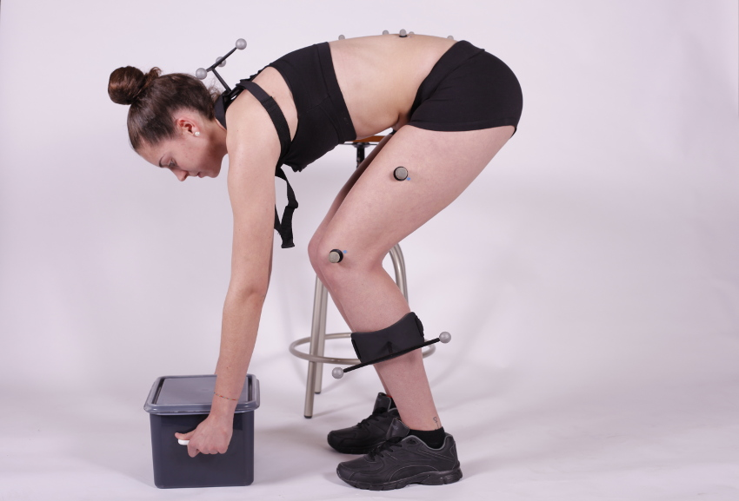
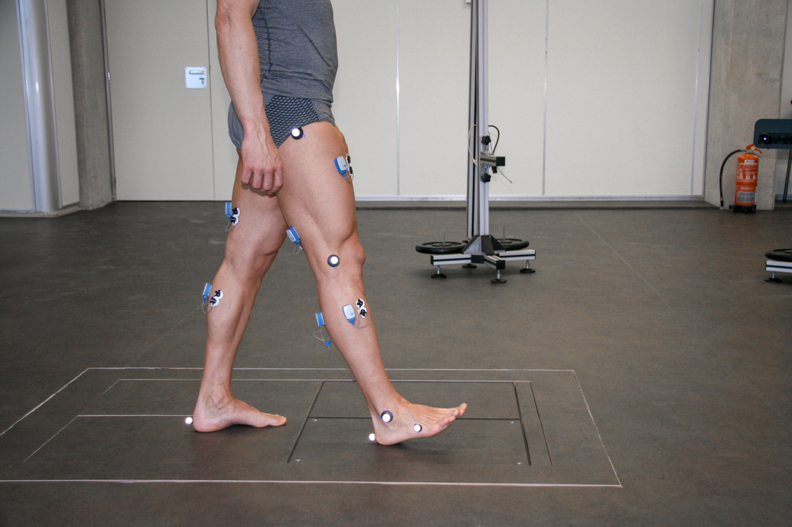
What a biomechanical test is
Images corresponding to different biomechanical assessment tests. lifting of loads for assessment of the lumbar spine or gait assessment
Notes:
In these images there are other examples of biomechanical tests commonly used in the clinical setting: gait assessment, lifting of loads for assessment of the lumbar spine or assessment of isometric grip strength.

Slide 7
Elements in a biomechanical assessment test
Function, activity or gesture subject to assessment.
Report
Instrumental technique it is based on.
Protocol
Results
Criteria for interpretation.
Notes:
The elements in a biomechanical assessment test are:
• What function, activity or gesture is subject to assessment.
• What instrumental technique it is based on.
• What assessment protocol has been used.
• What results it provides, in what units and with what data analysis techniques have been obtained.
• Existence of standardized criteria for interpretation.
Usually everything is collected in a report

Slide 8
Elements in a biomechanical assessment test
Function, activity or gesture subject to assessment.
Report
Instrumental technique it is based on.
Protocol
Results
Criteria for interpretation.
Gait
These elements sumarized
Force platform, photogrammetry and surface electromyography
Walking in a straight line at spontaneous speed
Dynamical, kinematical and physiological parameters
Normal data
Notes:
For example, gait analysis (activity is gait) by means of force platform, photogrammetry and surface electromyography (all of them are biomechanical measurement techniques) during walking in a straight line at spontaneous speed (protocol). It provides dynamical, kinematical and physiological parameters like ground reaction forces in Newtons, range of motion in lower limbs in degrees or gait velocity in meters per second and muscle activation patterns (results) that can be compared with normal data from a non-impaired population (standardized criteria for interpretation).

Slide 9
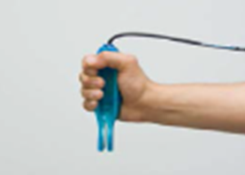
Elements in a biomechanical assessment test
Function, activity or gesture subject to assessment.
Report
Instrumental technique it is based on.
Protocol
Results
Criteria for interpretation.
Hand strength
These elements sumarized
Hand dynamometer
Maximum hand strength during 1 second
Maximum strength in Newtons
Normal data
Notes:
Another example is Grip strength analysis (function is hand strength) by means of a dynamometer (biomechanical measurement technique) during one second of maximum hand strength (protocol). It provides maximum strength in Newtons (results) than can be compared with normal data from non-impaired population (standardized criteria for interpretation).

Slide 10
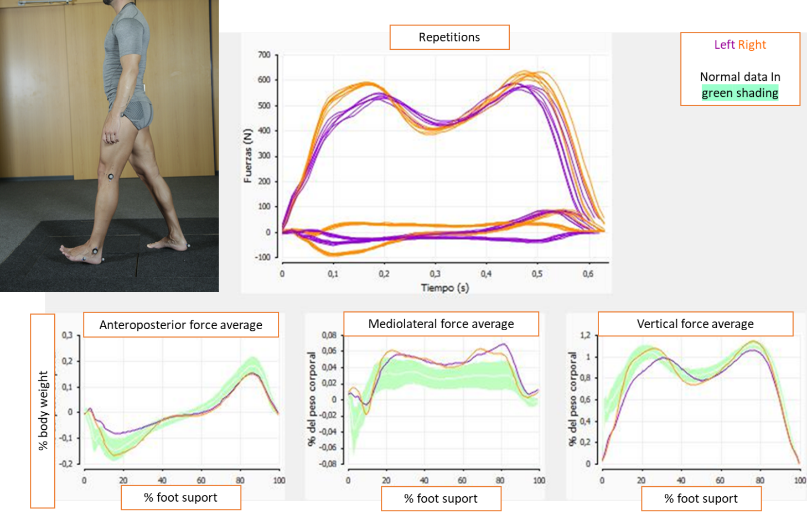
Elements in a biomechanical assessment test
Notes:
In this image, the type of results provided by the analysis with a force platform are presented in some detail. It provides graphical and numerical results than be compared with normal data.
The upper right graph represents the pattern of forces during support in its three anteroposterior, mediolateral and vertical components) for the right (orange) and left (purple) support. Asymmetry is observed.
The graphs below show each of those three components of force compared to a reference standard.
It can be used in evolutionary control after an injury to the lower limb, to plan rehabilitation treatments, such as orthotics or botulinum toxin infiltration or for evaluation of return to work

Slide 11
Common biomechanical tests in the clinical context
Assessment of activities of daily living
Balance function assessment
Assessment of mobility in upper, lower and spinal limbs
Strength assessment in upper, lower and spinal limbs
Images corresponding to different biomechanical assessment tests. lifting of loads for assessment of the lumbar spine or gait assessment
Notes:
There is some heterogeneity regarding the procedures used, despite this fact, functional evaluation with biomechanical tests is widespread in the clinical field. The most widely used biomechanical tests in the clinical context, classified according to their purpose of assessment and instrumental technique, are:
• Assessment of activities of daily living. Some examples are walk, sit to stand, lift loads or move an object by means of force plates and/or movement analysis techniques.
• Balance function assessment, using computerized posturography, based on force analysis technique.
• Assessment of mobility in upper, lower and spinal limbs, through movement analysis techniques.
• Strength assessment in upper, lower and spinal limbs, using force analysis techniques.
Each test provides results in different units. But mostly, biomechanical tests are aimed at informing about the assessed function and it is common for the results to be expressed compared to reference standards.
Let's see some examples on video.
Biomechanical tests are used as a complementary test in the assessment of patients with involvement of the musculoskeletal system or balance function and its main applications are:
Evolutionary control.
Treatment planning.
Assessment of the work capacity of a worker
Assessment of bodily harm.
Medical-legal expertise.

Slide 12
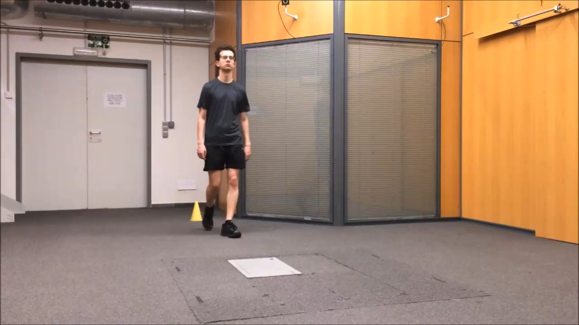
Assessment of activities of daily living:
Dynamic gait assessment
Notes:
At this video you can see the detail of protocol for dynamic gait assessment using NedAMH/IBV software.

Slide 13
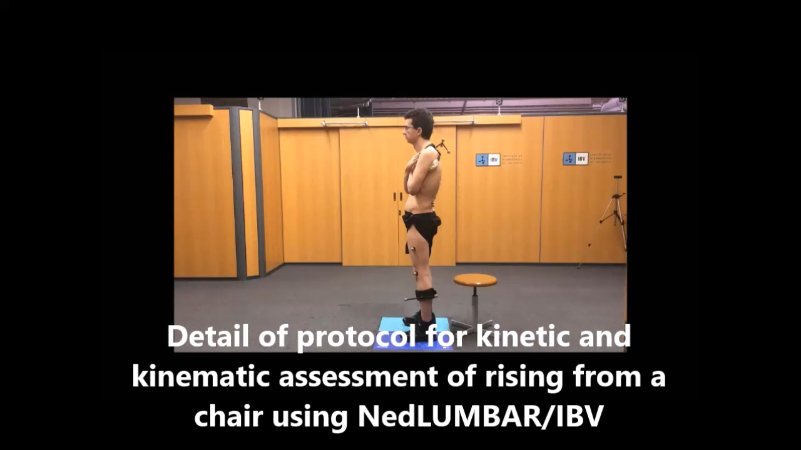
Assessment of activities of daily living:
Dynamic and kinematic assessment of rising from a chair
Notes:
At this video you can see the detail of protocol for dynamic and kinematic assessment of rising from a chair using NedLumbar/IBVsoftware.

Slide 14
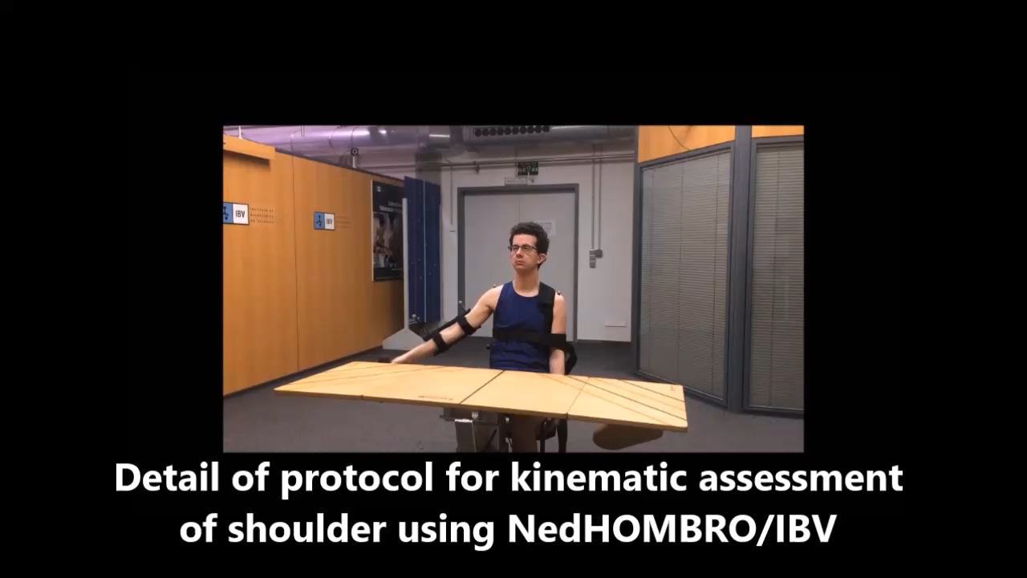
Assessment of activities of daily living:
Kinematic assessment of shoulder while lifting a weight
Notes:
At this video you can see the detail of protocol for kinematic assessment of shoulder using NedHombro/IBV
software.

Slide 15
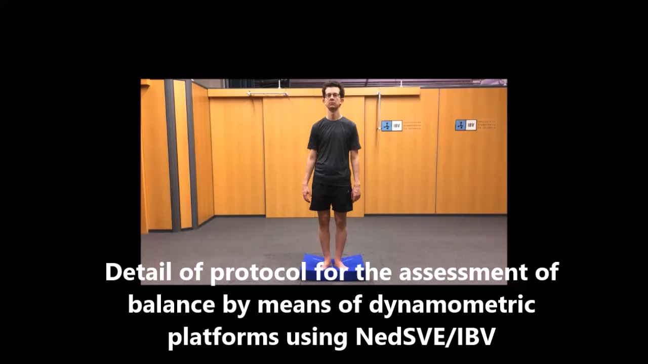
Balance function assessment using force plates
Notes:
At this video you can see the detail of protocol for the assessment of balance by means of dynamometric platforms using NedSVE/IBV
software.

Slide 16
Common biomechanical tests in other contexts
Sportive
Ergonomic
Investigation
Notes:
Common biomechanical test used in a sportive context
Sport biomechanics is the area of science concerned with the analysis of the human body movement during sport activities in order to be studied for different applications. As a global concept this branch of science is utilised to attempt to either enhance performance or reduce the injury risk in the sport and exercise task being executed.
Biomechanics is applied to the field of sport and exercise sciences amongst others to:
Enhancement of an athletes’ sport performance by quantifying their mechanical faults and targeting them, if modifiable, to try and reach the highest movement efficiency.
Injury prevention assessments, in order to identify weak areas of the athletes’ sporting activity execution which could expose the musculoskeletal unit to a lesion. Determining the safest methods for performing a particular sport or exercise task.
Study the outcome effect of an intervention, such as an ergogenic aid, surgical procedure, tracking a rehabilitation protocol and evaluating a safe return to sport.
Assessment of neuromuscular functions, muscular recruitment and loading.
The analysis of sport and exercise equipment e.g., footwear, playing surfaces, racquets…etc.
For all the different applications there is a great array of pieces of equipment which can be used in laboratory and outdoors. There is no standard about biomechanical tests in sports but these are mainly used to obtain kinetic and kinematical values and tend to be synchronised
The picture shows Side-step cutting movement testing (1. force plate, 2. reflective markers used by the 3D motion analysis system).
Common biomechanical test used in an ergonomic context
Ergonomics is the area of knowledge concerned with the study of the conditions of adaptation of a workplace to the physical and psychological characteristics of the worker. Ergonomics seeks greater performance at work.
Biomechanics measurement is applied to the field of ergonomics amongst others to:
To know postures, biomechanical load, repetitions ... during the execution of a task for risk assessment. Occupational risk assessment methods are based on the observation of the worker during his tasks. Sometimes, instrumented assessment is used for greater validity and objectivity in the evaluation.
Evaluate the reduction of effort for the worker while using exoskeletons. Exoskeletons are used in industry to improve workers' working conditions, reduce physical load, and prevent injury.
In these applications, biomechanical assessment takes place at the workplace and there are portable techniques. In ergonomics area there are standards for risk assessment however, there is no standard about biomechanical tests. Biomechanical techniques are commonly used to record objective information on postures, physical load, or repetitive movements.
The image shows measurement with electrogoniometers while using a computer.
Common biomechanical test used in an investigation context
There are many research studies that use biomechanical assessment techniques in different fields. In the context of assessing the musculoskeletal system they are used to:
Compare different surgical or rehabilitative treatments.
To assess the effect of a treatment on a patient.
Describe the biomechanical pattern of a pathology.
For example, in the study Effects of medially posted insoles on foot and lower limbs mechanics across walking and running in overpronating men of Konosen et al. (2), A biomechanical assessment analysis is presented where the effect of supinator orthoses in walking and running conditions is evaluated, both in the rearfoot and in the forefoot, through the instrumentation with markers and the use of a 3D photogrammetry system made up of 10 cameras.
The image shows Foot and ankle instrumentation detail in the Konosen study.
The main conclusions of this study suggest that the use of orthoses mainly affects the movement of the forefoot, reducing the movement of maximum eversion when walking and running.

Slide 17

Biomechanical assessment tests in different contexts.
Let´s look for examples.
Esta foto de Autor desconocido está bajo licencia CC BY
Notes:
As a part of your theoretical training you should watch some videos about biomechanical assessment using instrumented techniques that you will access from internet. There are many resources available that you can find just by searching: ”Biomechanical assessment instrumented techniques”, you can choose the most interesting for you depending of your field of interest.
Yoy can see: https://www.lboro.ac.uk/research/phc/perfomance/biomechanics/ as a good example.
Try to identify:
Context of use and objective of evaluation.
Function, activity or gesture subject to assessment.
Instrumental technique it is based on.
Protocol.
Results.

Slide 18
Requirements of biomechanical tests
Notes:
Sometimes a lot of attention is paid in testing to the quality of the measurement technique; however, the usefulness of these techniques depends on their technical quality or sophistication, and on their ability to represent reality to achieve objectives. Specifically, these objectives are the possibility of discriminating between different situations (for example, sick and healthy or good and bad execution of a sports gesture) in a reliable, valid way and at a reasonable cost.
The use of sophisticated assessment tools, together with powerful statistical analysis techniques, must be accompanied by the fulfilment of a series of fundamental criteria of validity, reliability and usability, which are essential characteristics for a maritime measurement technique accepted from the point of view clinical and scientific.
The fundamental criteria that biomechanical evaluation techniques must meet are briefly presented below.
Validity: is the property that indicates that the measure really represents the aspect that you want to assess.
Reliability: is the property that indicates that the measurement offers equivalent results when performed under equivalent conditions
Usability: it is the property that indicates that a test can be used by specific users to achieve specific objectives with effectiveness, efficiency and satisfaction in a specific use context. Usability means focusing on users.
To deepen these aspects, you can consult Topic: F2. What do validity, reliability and usability mean in biomechanical assessment and why are they important? in this same didactic unit.

Slide 19
Requirements of biomechanical tests
Validity
Reliability
Usability
Notes:
Sometimes a lot of attention is paid in testing to the quality of the measurement technique; however, the usefulness of these techniques depends on their technical quality or sophistication, and on their ability to represent reality to achieve objectives. Specifically, these objectives are the possibility of discriminating between different situations (for example, sick and healthy or good and bad execution of a sports gesture) in a reliable, valid way and at a reasonable cost.
The use of sophisticated assessment tools, together with powerful statistical analysis techniques, must be accompanied by the fulfilment of a series of fundamental criteria of validity, reliability and usability, which are essential characteristics for a maritime measurement technique accepted from the point of view clinical and scientific.
The fundamental criteria that biomechanical evaluation techniques must meet are briefly presented below:
Validity: is the property that indicates that the measure really represents the aspect that you want to assess.
Reliability: is the property that indicates that the measurement offers equivalent results when performed under equivalent conditions
Usability: it is the property that indicates that a test can be used by specific users to achieve specific objectives with effectiveness, efficiency and satisfaction in a specific use context. Usability means focusing on users.
To deepen these aspects, you can consult Topic: F2. What do validity, reliability and usability mean in biomechanical assessment and why are they important? in this same didactic unit.

Slide 20

We will try to understand these three concepts with bad and good examples.
Esta foto de Autor desconocido está bajo licencia CC BY
Notes:
We will try to understand these three concepts with bad and good examples.

Slide 21
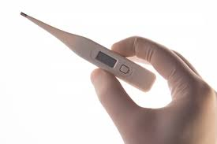
Grip strength assessment with a thermometer?
If you use a thermometer for grip strength assessment…
  Are you performing a reliable measurement?
  Are you performing a valid measurement?
Notes:
It can be repeatable because it offers equivalent measurements of temperature when we take different measurements using the same protocol, but it is not a valid measurement for grip strength assessment.
Grip strength assessment must be performed with a valid instrument for strength measurement. A thermometer is valid for temperature measurement, but not for strength assessment.

Slide 22

Grip strength assessment with a hand dynamometer?
If you use a hand dynamometer for grip strength assessment…
  Are you performing a reliable measurement?
  Are you performing a valid measurement?
  Are you performing a usable measurement?
Notes:
Reliability of measurement depends on the reliability of the dynamometer and protocol used. Repeatability must be demonstrated by intra-subject and inter-evaluator reproducibility studies.
Many studies have demonstrated the reliability of hand dynamometer for grip strength assessment with controlled protocol.
Hand dynamometer has demonstrated be valid for grip strength assessment in many studies during years.
The usability depends on aspects such as: cost-benefit for the user, safety for the patient, instructions for use of software and instrumental technique, associated documentation... Medical devices must have the corresponding certification, which includes validity, reliability and usability.

Slide 23
KEY IDEAS I
A biomechanical assessment test is a complementary test done by means of biomechanical techniques and it should be used in different contexts.
There are different biomechanical assessment tests, the elements that determine them are:
  What function, activity or gesture is subject to assessment.
  What instrumental technique it is based on.
  What assessment protocol has been used.
  What results it provides, in what units and with what data analysis techniques have been obtained.
  Existence of standardized criteria for interpretation.
Notes:
We have here the key ideas of the lesson:
A biomechanical assessment test is a complementary test done by means of biomechanical techniques and it should be used in different contexts.
There are different biomechanical assessment tests, the elements that determine them are:
What function, activity or gesture is subject to assessment.
What instrumental technique it is based on.
What assessment protocol has been used.
What results it provides, in what units and with what data analysis techniques have been obtained.
Existence of standardized criteria for interpretation.

Slide 24
KEY IDEAS II
There is some heterogeneity regarding the procedures used, despite this fact, functional evaluation with biomechanical tests is widespread in the clinical field. The most widely used biomechanical tests in the clinical context, classified according to their purpose of assessment and instrumental technique, are:
  Assessment of activities of daily living.
  Balance function assessment.
  Assessment of mobility in upper, lower and spinal limbs.
  Strength assessment in upper, lower and spinal limbs.
Biomechanical tests are also used in sportive, ergonomic or investigation contexts.
The fundamental criteria that must be met by biomechanical assessment techniques are validity, reliability and usability..
Notes:
There is some heterogeneity regarding the procedures used, despite this fact, functional evaluation with biomechanical tests is widespread in the clinical field. The most widely used biomechanical tests in the clinical context, classified according to their purpose of assessment and instrumental technique, are:
Assessment of activities of daily living.
Balance function assessment.
Assessment of mobility in upper, lower and spinal limbs.
Strength assessment in upper, lower and spinal limbs.
Biomechanical tests are also used in sportive, ergonomic or investigation contexts.
The fundamental criteria that must be met by biomechanical assessment techniques are:
Validity: is the property that indicates that the measure really represents the aspect that you want to assess.
Reliability: is the property that indicates that the measurement offers equivalent results when performed under equivalent conditions
Usability: it is the property that indicates that a test can be used by specific users to achieve specific objectives with effectiveness, efficiency and satisfaction in a specific use context. Usability means focusing on users.

Slide 25
REFERENCES
Baker R, Esquenazi A, Benedetti MG, Desloovere K. Gait analysis: clinical facts. Eur J Phys Rehabil Med. 2016 Aug;52(4):560-74.
Bausá, R., Dalmau, A., Barrachina, J., Peydro, M.F. Kinetic gait analysis in sequels of hindfoot injuries. Preliminary results. Foot and Ankle Surgery, 2007; 13(2) 63-66.
Buldt AK, Allan JJ, Landorf KB, Menz HB. The relationship between foot posture and plantar pressure during walking in adults: A systematic review. GaitPosture. 2018 May;62:56-67. doi: 10.1016/j.gaitpost.2018.02.026. Epub 2018 Feb 23.
Baydal Bertomeu JM, Medina Ripoll E, Peydro MF, Pedrero JF, López-Pascual J. Personalized vs Average normal patterns to identify pathological motion. Gait and Posture (2018), https://doi.org/10.1016/j.gaitpost.2018.06.187
Baydal Bertomeu, J.M., Page, A.; Belda Lois, J.M., Garrido Jaén, D.J., Prat, J. Neck motion patterns in wiplash-associated disorders: Quantifying variability and spontaneity of movement. Clinical Biomechanics, 2011, Clinical Biomechanics 26: 29–34.
Cabeza Ruiz, R., García Massó, X., Centeno Prada, R.A., Beas Jiménez, J.D., Colado, J.C., González, L.M. Time and frequency analysis of the static balance in young adults with Down syndrome. Gait and Posture, 2010: 33; 23 – 28
Notes:
At this slide and following you can see some examples of biomechanical assesment aplication.

Slide 26
REFERENCES II
Cofré Lizama LE, Khan F, Lee PV, Galea MP. The use of laboratory gait analysis for understanding gait deterioration in people with multiple sclerosis. Mult Scler. 2016; 22(14):1768-1776.
De Rosario, H., Vivas, M.J., Sinovas, I., Page, A. Relationship between neck motion and selfreported pain in patients with whiplash-associated disorders during the acute phase. Musculoeskeletal Science and Practice, 2018; 38: 23 – 29
Herrera Ligero, C., Garcés Pérez, L., Vivas Broseta, M.J., Sinovas Alonso, I. Functional assessment in a case of meniscopathy. Usefulness of an application to evaluate gait, singlelimb support and the climb and descent of stairs in front of isolated gait studies in the biomechanical characterization of the knee. Gait and Posture, http://dx.doi.org/10.1016/j.gaitpost.2017.06.467
Hollander K, Zech A, Rahlf AL, Orendurff MS, Stebbins J, Heidt C. The relationship between static and dynamic foot posture and running biomechanics: A systematic review and meta-analysis. Gait Posture. 2019 Jul;72:109-122. doi: 10.1016/j.gaitpost.2019.05.031. Epub 2019 Jun 1. PMID: 31195310.
Jukka Kosonen, Juha-Pekka Kulmala, Erich Müller, Janne Avela, Effects of medially posted insoles on foot and lower limb mechanics across walking and running in overpronating men. Journal of Biomechanics, 2017; 54: 58-63

Slide 27
REFERENCES III
Lafuente, R., Belda, J.M., Sánchez Lacuesta, J., Soler, C., Poveda, R., Prat, J. Quantitative assessment of gait deviation: contribution to the objective mesurement of disability. Gait and Posture, 2000; 11(3): 191 – 19
Lefèvre-Colau MM, Nguyen C, Palazzo C, Srour F, Paris G, Vuillemin V, Poiraudeau S, Roby-Brami A, Roren A. Kinematic patterns in normal and degenerative shoulders. Part II: Review of 3-D scapular kinematic patterns in patients with shoulder pain, and clinical implications. Ann Phys Rehabil Med. 2018 Jan;61(1):46-53. doi: 10.1016/j.rehab.2017.09.002. Epub 2017 Oct 5. PMID: 28987866.
López-Pascual, J., Page, A., Serra-Añó, P. Dynamic thoracohumeral kinematics are dependent upon the etiology of the shoulder injury. PLoS ONE 12(8): e0183954, https://doi.org/10.1371/journal.pone.0183954.
Malagelada, F., Amin del Carmen, V., Barke, S.J., Cano Guirao, LL., Cobo Pleguezuelos, E. The anterior mini-open approach for femeroacetabularr impingement: Gait and functional assessment at one year post-surgery. Annals of Physical and Rehabilitation Medicine, 2015; 58, (2): 60-65.
Papagiannis GI, Triantafyllou AI, Roumpelakis IM, Papagelopoulos PJ, Babis GC. Gait analysis methodology for the measurement of biomechanical parameters in total knee arthroplasties. A literature review. J Orthop. 2018 Feb 2;15(1):181-185.

Slide 28
REFERENCES IV
Rowson S, Bland ML, Campolettano ET, Press JN, Rowson B, Smith JA, Sproule DW, Tyson AM, Duma SM. Biomechanical Perspectives on Concussion in Sport. Sports Med Arthrosc Rev. 2016 Sep;24(3):100-7.
Sánchez Zuriaga, D.; López Pascual, J; Garrido Jaén, D.; Peydro de Moya, M.F.; Prat Pastor, J.M. Reliability and validity of a new objective tool for low back pain functional assessment. Spine, 2011; 36(16): 1279 – 1288.
Sanchis-Alfonso, V., Torga-Spak, R., Cortés, A. Gait pattern normalization after lateral retinaculum reconstruction for iatrogenic medial patellar instability. The Knee, 2007; 14: 484-488.
Sanchis Alfonso; V., Baydal Bertomeu, J.M., Castelli, A., Montesinos Berry, E., Marín, S., Garrido Jaén, J.D. “Laboratory Evaluation of the Pivot Shift Phenomenon Using Kinetic Analysis: A Preliminary Study”. The Journal of Bone and Joint Surgery, American 2011; 93:1256-67. 31896
Schrijvers JC, van den Noort JC, van der Esch M, Dekker J, Harlaar J. Objective parameters to measure (in)stability of the knee joint during gait: A review of literature. Gait Posture. 2019 May;70:235-253. doi: 10.1016/j.gaitpost.2019.03.016. Epub 2019 Mar 20. PMID: 30909003.

Slide 29
REFERENCES
Vivas Broseta, M.J., Bermejo Bosch, I., Peydro de Moya, F., Pitarch Corresa, S. Is kinematic analysis useful as a clinical test during whiplash associated disorders recovery? A clinical study. Gait and Posture http://dx.doi.org/10.1016/j.gaitpost.2017.06.466
Vivas Broseta, M.J., Bermejo Bosch, I., Peydro de Moya, F., Pitarch Corresa, S. Is kinematic analysis useful as a clinical test during whiplash associated disorders recovery? A clinical study. Gait & Posture, 2017; 57: 35

Slide 30


