Slide 1
MODULE: BIOMECHANICS OF GAIT
Didactic Unit A: BIOMECHANICS OF NORMAL GAIT

Slide 2
CONTENTS
Objectives
Outline of the history of biomechanical gait analysis
Normal gait – basic definitions
Description of the normal gait
Atributes and determinants of normal gait
Time-space parameters describing gait biomechanics
Kinematic quantities describing gait biomechanics – joint angles
Dynamic quantities describing biomechanics of gait – groun reactions
Other dynamic quantities describing biomechanics of gait
Muscle work during walking
Key ideas
Bibliography

Slide 3
OBJECTIVES
Find out how gait is defined.
Learn how gait is described - division into phases.
Find out what the attributes and determinants of gait are.
Find out what kinematic parameters are used to describe the biomechanics of gait and what changes these parameters subject during the gait cycle.
Find out what dynamic parameters are used to describe the biomechanics of gait and what changes these parameters subject during the gait cycle.
Find out what muscle work looks like during a gait cycle.

Slide 4
OUTLINE OF THE HISTORY OF BIOMECHANICAL GAIT ANALYSIS

Slide 5
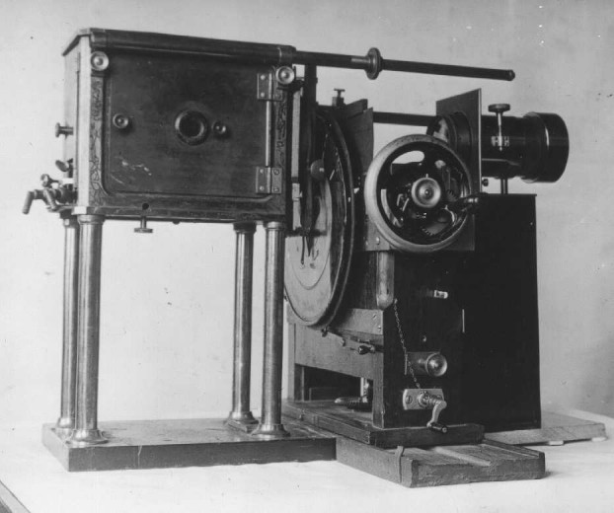
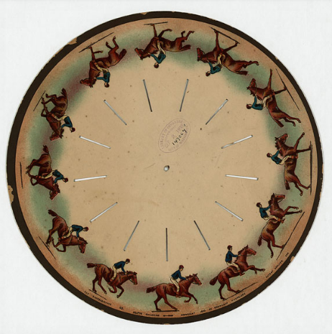
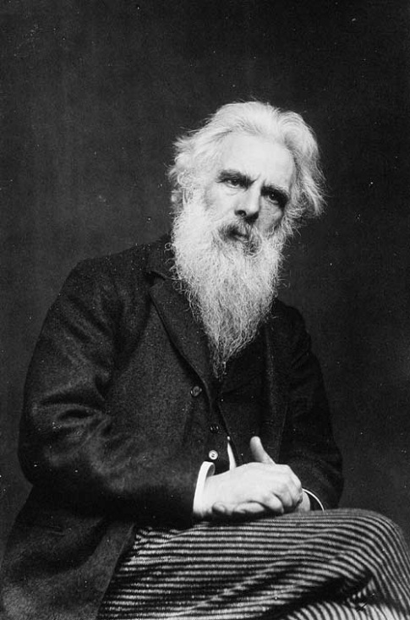
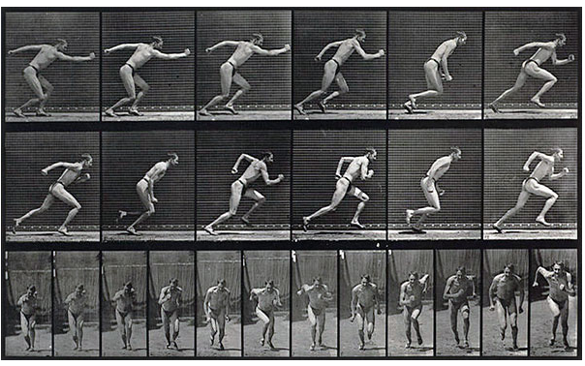
OUTLINE OF THE HISTORY OF BIOMECHANICAL GAIT ANALYSIS
Equipment used by Mybridge to conduct research
Eadweard Muybridge (1830-1904)

Slide 6
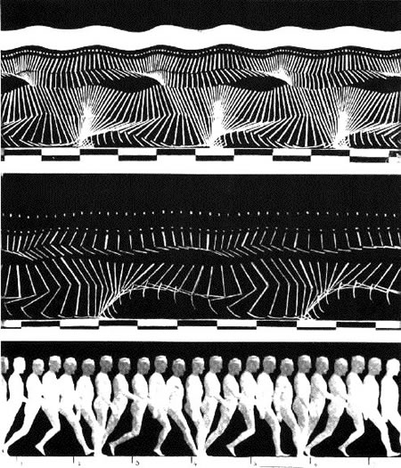
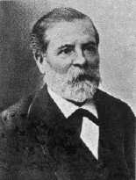
OUTLINE OF THE HISTORY OF BIOMECHANICAL GAIT ANALYSIS
The suit used by Marey and subsequent gait sequences recorded (1883)
Etienne Jules Marey (1830-1904)

Slide 7
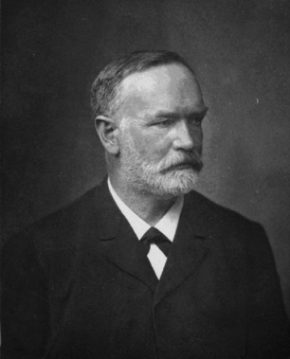
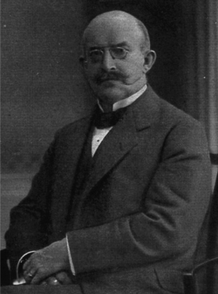
OUTLINE OF THE HISTORY OF BIOMECHANICAL GAIT ANALYSIS
Wilhelm Braune (1831 – 1892) i Otto Fisher (1861 – 1917)
The suit and hand chart of subsequent lower limb positions (1891) - Fisher and Braun study

Slide 8
NORMAL GAIT - BASIC DEFINITIONS

Slide 9
NORMAL GAIT - BASIC DEFINITIONS
Morecki defines locomotion as a movement leading to a change in the place occupied by an object in relation to the adopted reference system.
On the other hand, Błaszczyk defines the concept of human locomotion as follows: „Locomotion is a process of active movement of organisms associated with the implementation of specific life needs.
Gait according to Dega can be defined as alternating loss and regaining balance in alternately changing phases of support and swing of the lower limbs
Depending on the speed range, the bipedal locomotion can be divided into several forms differing in the coordination of movements of individual body segments: gait, run, sprint, jumps."

Slide 10
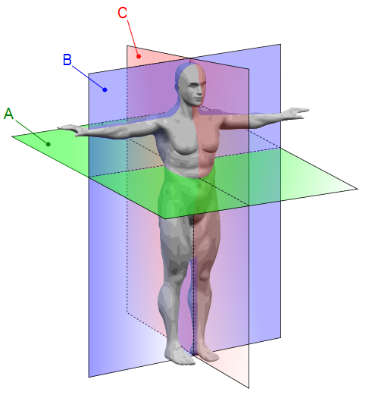
NORMAL GAIT - BASIC DEFINITIONS
Human body main planes
A – horizontal (transverse) plane,
B – frontal plane,
C – sagittal plane

Slide 11
NORMAL GAIT - BASIC DEFINITIONS
Biomechanical gait analysis is usually carried out on the basis of the so-called gait cycle using the values determined during experimental tests and using mathematical models. Gait analysis is most commonly assessed in biomechanical analysis by means of:
gait attributes
determinants of gait,
temporally-spatial parameters,
kinematic parameters,
ground reaction forces,
muscle bioelectric activity,

Slide 12
NORMAL GAIT - BASIC DEFINITIONS
values of moments of muscular forces acting in the joints,
the values of forces generated by muscles,
power,
reactions in the joints.

Slide 13
DESCRIPTION OF THE NORMAL GAIT

Slide 14
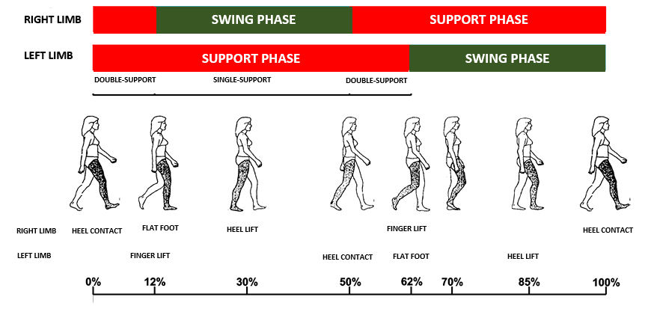
DESCRIPTION OF THE NORMAL GAIT
Gait cycle phases for the right and left limb

Slide 15
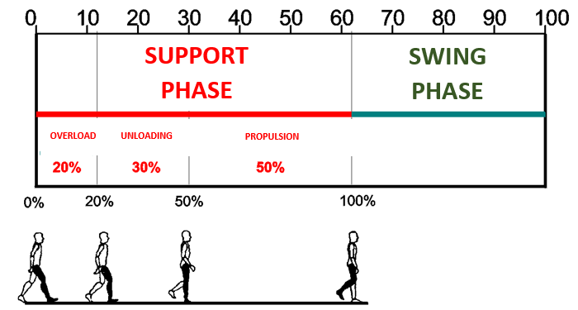
DESCRIPTION OF THE NORMAL GAIT

Slide 16
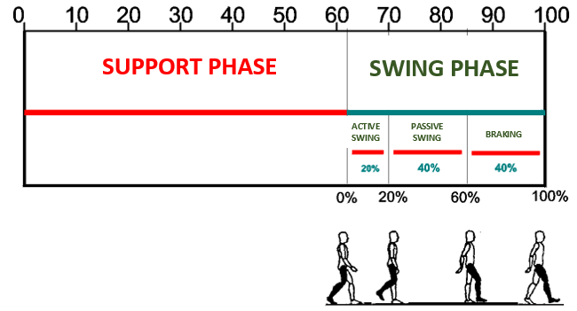
DESCRIPTION OF THE NORMAL GAIT

Slide 17
DESCRIPTION OF THE NORMAL GAIT
Walking at so-called volunteer speed is usually carried out at a speed of 4 km / h. At this speed, the walking cycle lasts about 1.1 seconds, while the individual phases, in relation to the entire walking cycle, last:
support phase around 62% of the gait cycle,
swing phase about 38% of the gait cycle,
double support phase around 12% of the gait cycle.

Slide 18
DESCRIPTION OF THE NORMAL GAIT
Division of the support phase:
overload phase,
unloading phase,
propulsion phase.
Division of the swing phase:
active swing,
passive swing,
braking phase.

Slide 19
DESCRIPTION OF THE NORMAL GAIT
  Double-support phase lasts 10-12% of the gait cycle

Slide 20
DESCRIPTION OF THE NORMAL GAIT
cadence – this is the number of steps taken in one minute. Studies have shown that the natural rhythm of locomotion in women is on average 122 steps per minute, while for men 116 steps per minute,
stride length – this is the distance between successive, same support points of the same limb, for example the points at which a given limb started the support phase or ended the swing phase,
step length – this is the distance between the selected but the same points of the right and left limb, for example the distance between the position of the heel of the right and left limb. The step length may be different for the right and left limb.

Slide 21
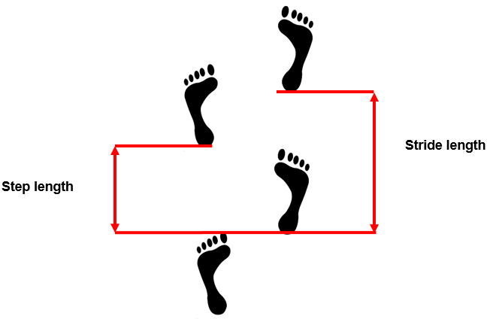
DESCRIPTION OF THE NORMAL GAIT

Slide 22
ATTRIBUTES AND DETERMINANTS OF NORMAL GAIT

Slide 23
ATTRIBUTES AND DETERMINANTS OF NORMAL GAIT
GAIT ATTRIBUTES
The following five walking attributes can be distinguished:
support stability
correct clearance under the foot during the swing phase, i.e. proper limb raising. About 18 cm is considered to be correct.
appropriate positioning of the foot before the beginning of the support phase, which, when walking correctly, begins when the heel contacts the ground.
appropriate stride length
minimization of energy consumption.

Slide 24
ATTRIBUTES AND DETERMINANTS OF NORMAL GAIT
GAIT DETERMINANTS
There are six determinants of gait:
Pelvic rotation in a horizontal plane
Pelvic obliquity in the frontal plane
Pelvic lateral movements
Knee flexion during the support phase
Functional shortening of the limb during the swing phase
Foot movement and angular changes in the ankle joint in the sagittal plane

Slide 25
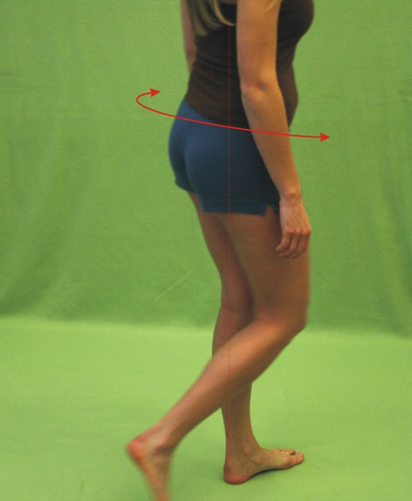
ATTRIBUTES AND DETERMINANTS OF NORMAL GAIT
Pelvic rotation in a horizontal plane

Slide 26
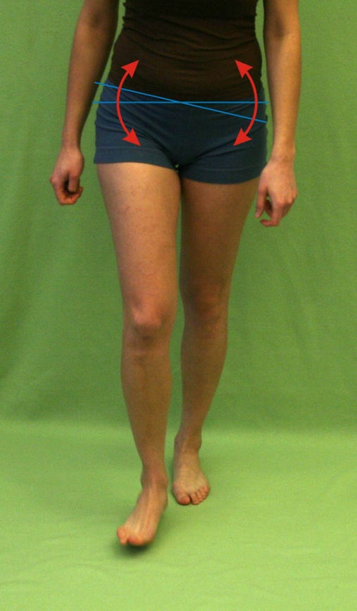
ATTRIBUTES AND DETERMINANTS OF NORMAL GAIT
Pelvic obliquity in the frontal plane

Slide 27
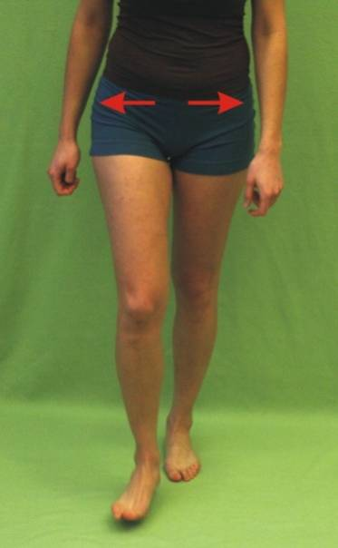
ATTRIBUTES AND DETERMINANTS OF NORMAL GAIT
Pelvic lateral movements

Slide 28
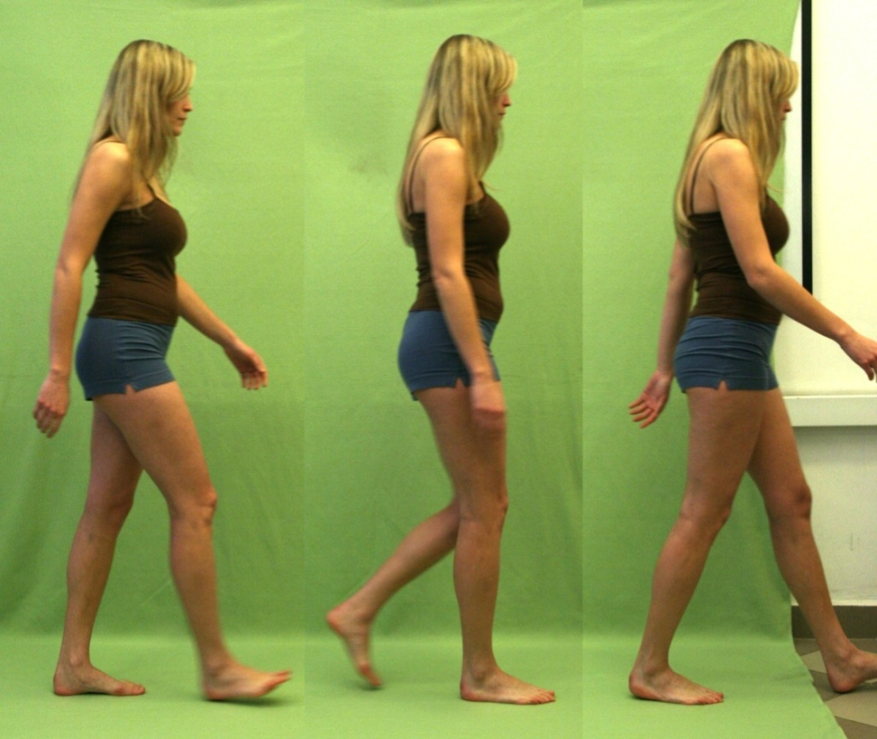
ATTRIBUTES AND DETERMINANTS OF NORMAL GAIT
Sequence of flexion and extension movement in the knee joint

Slide 29
ATTRIBUTES AND DETERMINANTS OF NORMAL GAIT
Functional shortening of the limb

Slide 30
ATTRIBUTES AND DETERMINANTS OF NORMAL GAIT
Foot movement and angular changes in the ankle joint in the sagittal plane
Correct positioning of the foot, i.e. the correct angle in the ankle joint, when the heel hits (dorsiflexion) and when the limb is detached from the ground (plantar flexion) increases the effective length of the lower limb.

Slide 31
ATTRIBUTES AND DETERMINANTS OF NORMAL GAIT
Conditions of the correct gait
A correct gait must meet the following conditions:
the steps of both lower limbs must be of the same length,
the loading time for both lower limbs must be the same,
proper coordination of the entire torso and upper limbs with the work of the lower limbs must be ensured. It consists in the fact that simultaneously with the inclination of the lower limb there is a rotation of the torso towards this limb combined with a swing of the upper limb on the same side as the lead leg,
heel contact with the ground is connected with the movement of the foot, which movement ensures correct positioning of the lower leg and thigh in external rotation,
detachment of the foot from the ground is accompanied by the adduction of the foot, which movement begins the internal rotation of the lower leg and thigh.

Slide 32
TIME-SPACE PARAMETERS DESCRIBING GAIT BIOMECHANICS

Slide 33
TIME-SPACE PARAMETERS DESCRIBING GAIT BIOMECHANICS
  The basic values describing the gait include time-space values. These values can be determined using very simple measurement methods; therefore they belong to one of the most often determined and analyzed values. You can include them:
  Gait velocity – average walking speed of healthy people varies between 4 - 6 km / h
  Cadence – frequency of steps is about 90-120 steps per minute
  Stride and step length – average length of a single step of an adult is about 0.7-0.82 m

Slide 34
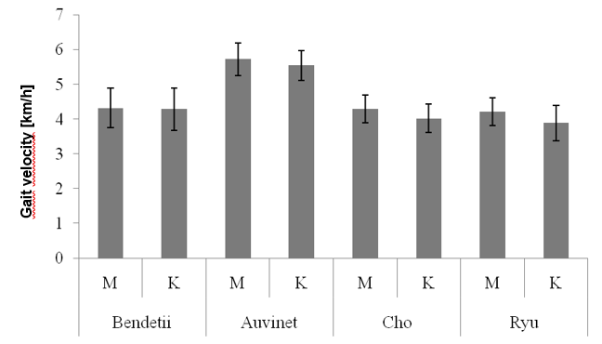
TIME-SPACE PARAMETERS DESCRIBING GAIT BIOMECHANICS
Gait velocity according to various studies with division into women and men

Slide 35
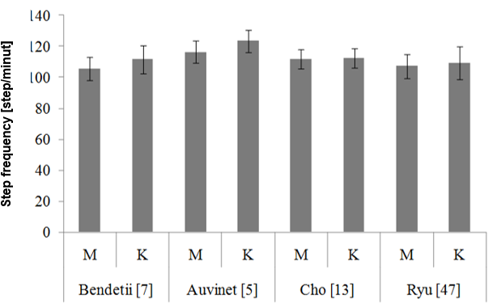
TIME-SPACE PARAMETERS DESCRIBING GAIT BIOMECHANICS
Cadence according to various studies with division into women and men

Slide 36
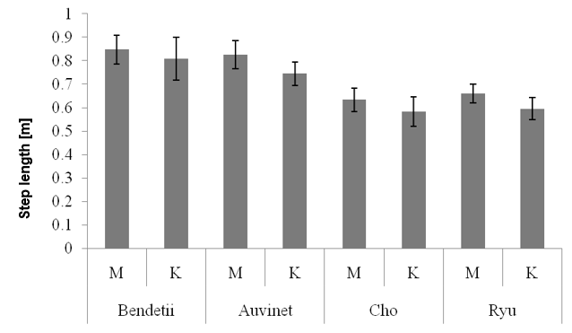
TIME-SPACE PARAMETERS DESCRIBING GAIT BIOMECHANICS
Step length according to various studies with division into women and men

Slide 37
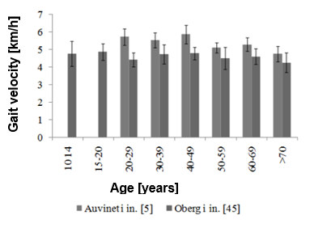
TIME-SPACE PARAMETERS DESCRIBING GAIT BIOMECHANICS
Walking speed in different age categories according to different authors

Slide 38
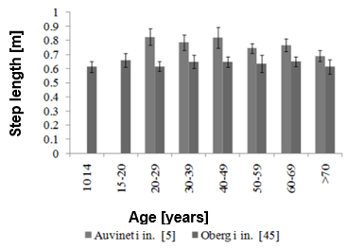
TIME-SPACE PARAMETERS DESCRIBING GAIT BIOMECHANICS
Step length in different age categories according to different authors

Slide 39
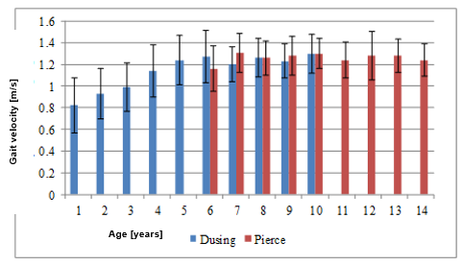
TIME-SPACE PARAMETERS DESCRIBING GAIT BIOMECHANICS
Walking speed of children of different ages

Slide 40
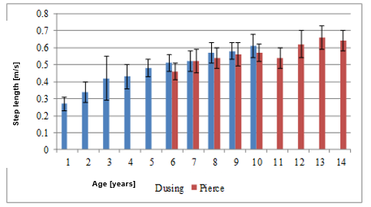
TIME-SPACE PARAMETERS DESCRIBING GAIT BIOMECHANICS
Step length of children of different ages

Slide 41
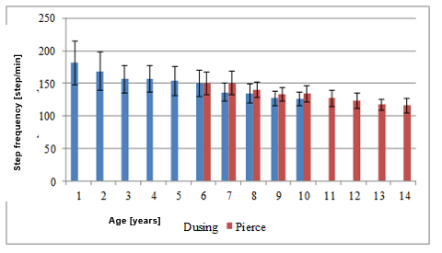
TIME-SPACE PARAMETERS DESCRIBING GAIT BIOMECHANICS
Cadence of children of different ages

Slide 42
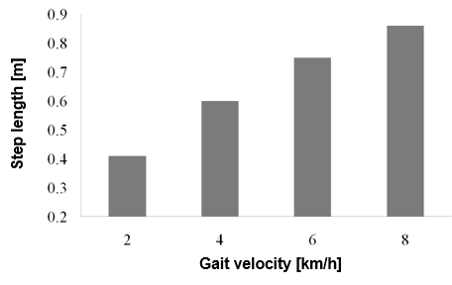
TIME-SPACE PARAMETERS DESCRIBING GAIT BIOMECHANICS
Changes in the length of the steps depending on the walking speed

Slide 43
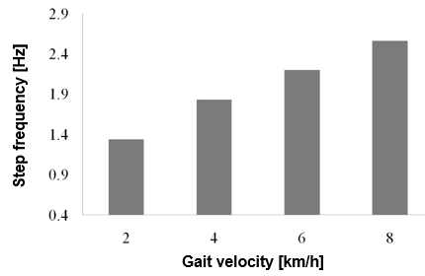
TIME-SPACE PARAMETERS DESCRIBING GAIT BIOMECHANICS
Changes in the cacence depending on the walking speed

Slide 44
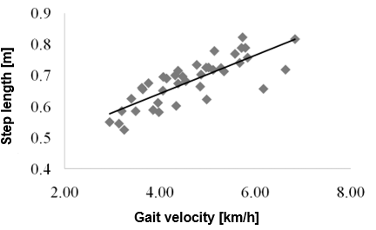
TIME-SPACE PARAMETERS DESCRIBING GAIT BIOMECHANICS
The relationship between the walking speed of healthy people and step length

Slide 45
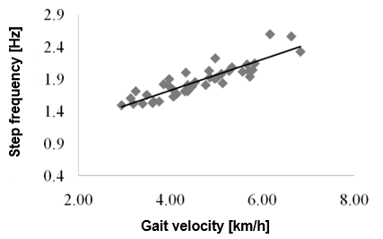
TIME-SPACE PARAMETERS DESCRIBING GAIT BIOMECHANICS
The relationship between the walking speed of healthy people and cadence

Slide 46
KINEMATIC QUANTITIES DESCRIBING GAIT BIOMECHANICS - JOINT ANGLES

Slide 47
KINEMATIC QUANTITIES DESCRIBING GAIT BIOMECHANICS - JOINT ANGLES
Next parameters describing gait biomechanics are kinematic parameters. The courses of individual joint angles are most often analyzed, however, it is also possible to determine the trajectories of selected body points as well as linear and angular velocities and accelerations.
The analysis of joint angles consists in determining the course of individual anatomical angles in the joints (usually the lower limb) and angles describing the position of the pelvis. The determined values of angles and their waveforms in time are then referred to the standard waveforms obtained for healthy people.

Slide 48
KINEMATIC QUANTITIES DESCRIBING GAIT BIOMECHANICS - JOINT ANGLES
The analysis is usually performed for the following angles:
in the case of the pelvis, these are pelvic tilt in the sagittal plane, lateral movements of the pelvis in the frontal plane (obliquity), and pelvic rotation in the transverse plane
for the hip joint, these are the angles of flexion and extension in the sagittal plane, abduction and adduction in the frontal plane, and rotation around the vertical axis
flexion and extension of the knee in the sagittal plane
dorsal flexion and plantar flexion of the foot in the ankle and foot position in the frontal plane

Slide 49
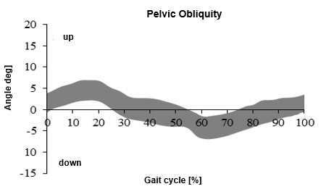
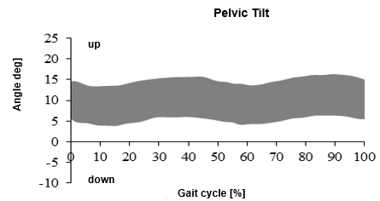
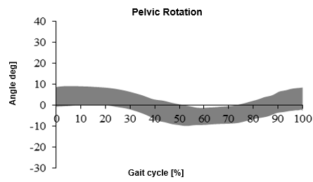
KINEMATIC QUANTITIES DESCRIBING GAIT BIOMECHANICS - JOINT ANGLES
Pelvic angle

Slide 50
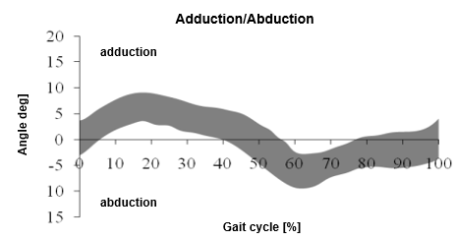
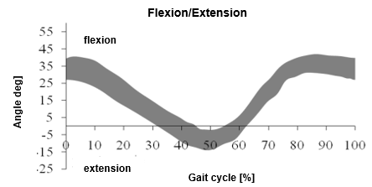
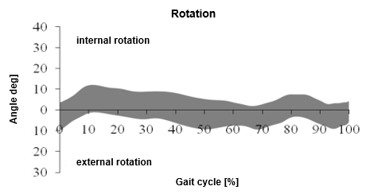
KINEMATIC QUANTITIES DESCRIBING GAIT BIOMECHANICS - JOINT ANGLES
Hip angle

Slide 51
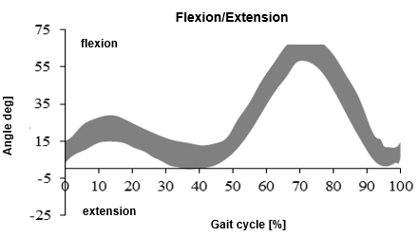
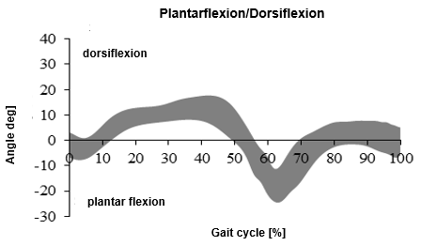
KINEMATIC QUANTITIES DESCRIBING GAIT BIOMECHANICS - JOINT ANGLES
Knee and ankle angel

Slide 52
DYNAMIC QUANTITIES DESCRIBING BIOMECHANICS OF GAIT - GROUND REACTIONS

Slide 53
DYNAMIC QUANTITIES DESCRIBING BIOMECHANICS OF GAIT - GROUND REACTIONS
Gait is a dynamic activity in which the whole body is propelled and kept in balance by skeletal muscles that generate forces that affect the human skeleton. In addition to muscular forces, the body is also influenced by forces such as gravity, inertia and ground reactions. The measurement of the latter is an important element of the analysis and description of gait biomechanics

Slide 54
DYNAMIC QUANTITIES DESCRIBING BIOMECHANICS OF GAIT - GROUND REACTIONS
Ground reactions are forces that affect a human body (when walking they affect on feet) as a response to body pressure on this ground, according to Newton's 3rd law of dynamics, which says that if one body affects the other, the other affects the first with the same force in value and direction, but with the opposite sense.

Slide 55
DYNAMIC QUANTITIES DESCRIBING BIOMECHANICS OF GAIT - GROUND REACTIONS
In the biomechanical description of gait, three ground reactions most often occur, which are actually three components of the ground reaction distributed over three forces parallel to the three axes of the coordinate system. These three components are:
vertical reaction parallel to the vertical axis of the coordinate system,
anteroposterior reaction parallel to the horizontal axis of the coordinate system determined in accordance with the gait direction of the test person,
lateral (transverse) reaction parallel to the horizontal axis of the coordinate system traced in a direction perpendicular to the walking direction of the test person.

Slide 56
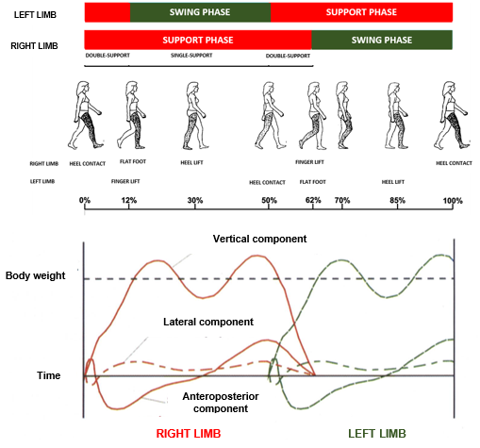
DYNAMIC QUANTITIES DESCRIBING BIOMECHANICS OF GAIT - GROUND REACTIONS

Slide 57
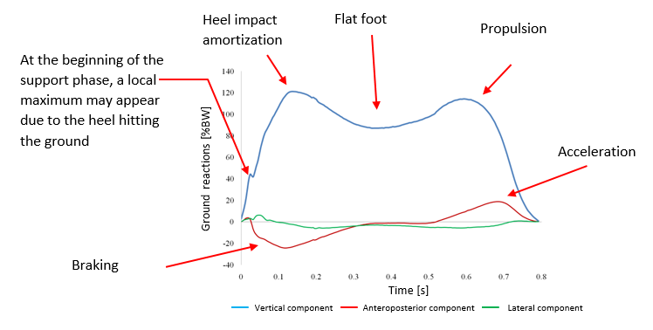
DYNAMIC QUANTITIES DESCRIBING BIOMECHANICS OF GAIT - GROUND REACTIONS

Slide 58
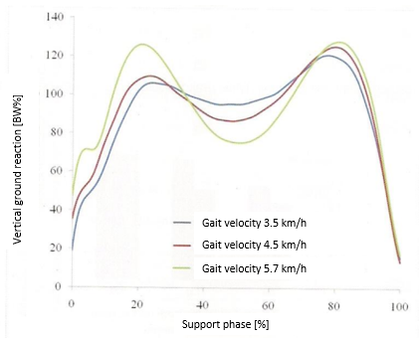
DYNAMIC QUANTITIES DESCRIBING BIOMECHANICS OF GAIT - GROUND REACTIONS

Slide 59
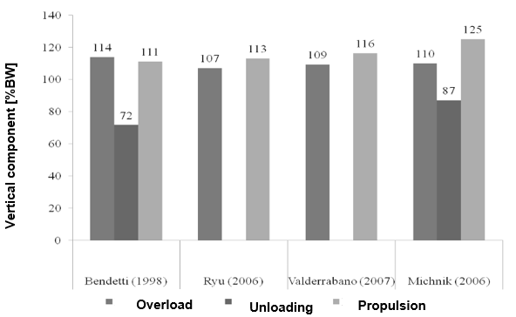
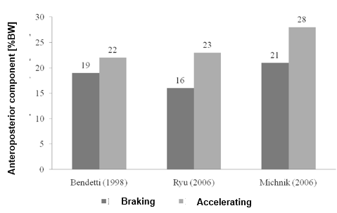
DYNAMIC QUANTITIES DESCRIBING BIOMECHANICS OF GAIT - GROUND REACTIONS

Slide 60
DYNAMIC QUANTITIES DESCRIBING BIOMECHANICS OF GAIT - GROUND REACTIONS
By conducting quantitative analysis of gait biomechanics on the basis of ground reaction, certain values are determined that describe the correctness or gait or may indicate deviations from the norm. Each of the presented parameters, except for those referring to the double-support phase, are determined separately for the right and left limbs.

Slide 61
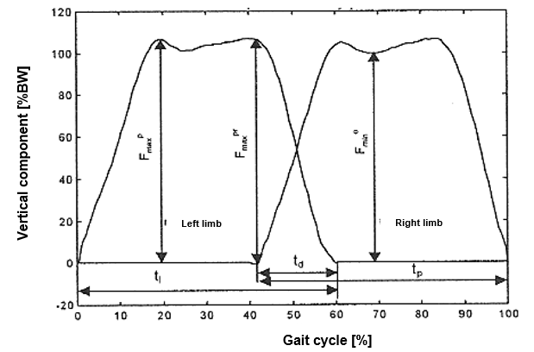
DYNAMIC QUANTITIES DESCRIBING BIOMECHANICS OF GAIT - GROUND REACTIONS
t_{l}, t_{p} – contact time of the left and right foot with the ground
t_{d} – duration of the double-support phase,
F_{max}^{p} – maximum of the overload phase,
F_{min}º – minimum of the unloading phase,
F_{max}^{pr} – maximum of the propulsive phase

Slide 62
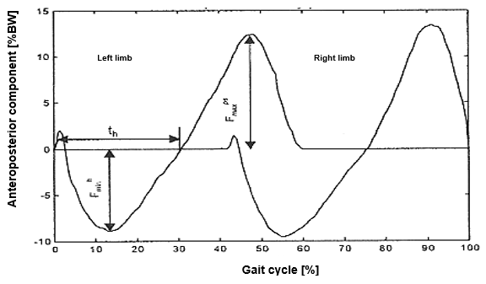
DYNAMIC QUANTITIES DESCRIBING BIOMECHANICS OF GAIT - GROUND REACTIONS
t_{h} – braking time
F_{min}^{h} – minimum of the braking phase
F_{max}^{ps} – maximum of the acceleration phase

Slide 63
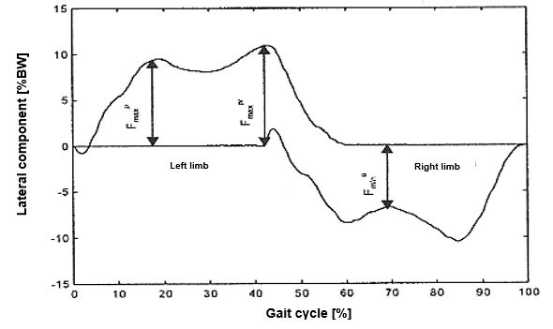
DYNAMIC QUANTITIES DESCRIBING BIOMECHANICS OF GAIT - GROUND REACTIONS
F_{max}^{p} – maximum of the overload phase,
F_{min}º – minimum of the unloading phase,
F_{max}^{pr} – maximum of the propulsive phase

Slide 64
OTHER DYNAMIC QUANTITIES DESCRIBING BIOMECHANICS OF GAIT

Slide 65
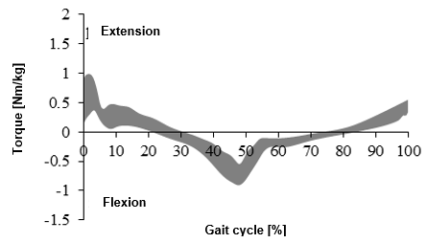
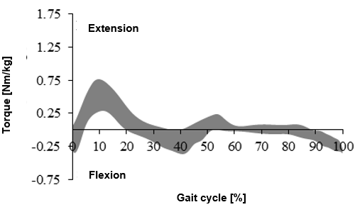
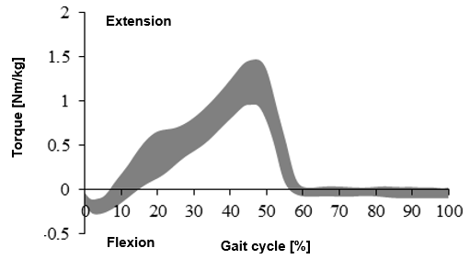
OTHER DYNAMIC QUANTITIES DESCRIBING BIOMECHANICS OF GAIT
Moments of muscle forces in the joints

Slide 66
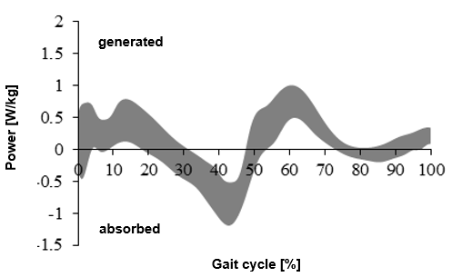
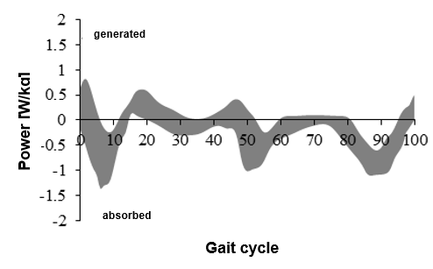

OTHER DYNAMIC QUANTITIES DESCRIBING BIOMECHANICS OF GAIT
Power in joints

Slide 67
MUSCLE WORK DURING WALKING

Slide 68
MUSCLE WORK DURING WALKING
To determine muscle work during gait, surface EMG is most commonly used. The potential difference between two electrodes located along the muscle fibers is obtained directly as the result of the measurement. The measured potential difference results from the fact of appearing and movement of action potential. Due to the method of measurement consisting in sticking electrodes to the skin, it is possible to collectively measure the electrical activity of the entire muscle or muscles group

Slide 69
MUSCLE WORK DURING WALKING
During walking, EMG measurement is usually performed for the following muscles:
anterior tibial muscle,
gastrocnemius muscle,
soleus muscle,
rectus femoris muscle,
vastus femoris muscle,
gluteus maximus muscle.

Slide 70



MUSCLE WORK DURING WALKING
Praca mięśni w obrębie stawu skokowego

Slide 71




MUSCLE WORK DURING WALKING
Praca mięśni w obrębie stawu biodrowego i kolanowego

Slide 72
MUSCLE WORK DURING WALKING
Another way of analysing muscle work is on / off analysis, i.e. determining when a given muscle starts working and when it ends, i.e. in what phase of the movement the muscle is active. A healthy muscle under normal working conditions only turns on when necessary and turns off when its work becomes unnecessary.

Slide 73
MUSCLE WORK DURING WALKING
Detection of muscle activity in the movement phase when in case of healthy person this muscle does not work, may indicate some abnormalities, such as, for example, pain, increased tension (e.g. due to spasticity), joint instability or it can result from stress or poor motor coordination. Improper muscle work may also indicate the existence of compensatory. This information can be very important, enabling the patient to be properly diagnosed and then treated

Slide 74

Aktywność mięśni działających w obrębie stawu biodrowego podczas chodu [96, 68, 105
MUSCLE WORK DURING WALKING
Muscle activity in the hip joint during the normal gait cycle

Slide 75

MUSCLE WORK DURING WALKING
Muscle activity in the knee joint during the normal gait cycle

Slide 76

MUSCLE WORK DURING WALKING
Muscle activity in the ankle joint during the normal gait cycle

Slide 77
KEY IDEAS

Slide 78
KEY IDEAS
Knowledge of gait biomechanics is necessary to evaluate the human musculoskeletal system.
For the description of gait biomechanics, parameters obtained from observation and measurements done by means of specialized equipment are used.
When assessing gait, one should simultaneously base on determined kinematic and dynamic values as well as on measurements of muscle functions. Only the use of all these elements gives a full picture of biomechanics of gait, which in turn enables the correct assessment of possible disorders.

Slide 79
BIBLIOGRAPHY

Slide 80
BIBLIOGRAPHY
Assi A, Ghanem I., Lavaste F., Skalli W.: Gait analysis in children and uncertainty assessment for Davis protocol and Gillette Gait Index, Gait & Posture 2009,vol. 30, Issue 1, s. 22–26
Auvinet B., Berrut G., Touzard C., Moutel L., Collet N., Chaleil D., Barrey E.: Reference data for normal subject obtained with an accelerometric device. Gai&Posture, 2002, 16 (2), 124-134
Baker R. The history of gait analysis before the advent of modern computers. Gait&Posture, 2007, 26, 331-342
Benedetti M.G., Catani F., Leardini A., Pignotti E., Giannini S.: Data management in gait analysis for clinical applications. Clinical Biomechanics, 1998, 13 (3), 204-215
Błaszczyk J.W.: Biomechanika kliniczna, Wydawnictwo Lekarskie PZWL, Warszawa 2004.
Bober T.: Biomechanika chodu i biegu, Studia i monografie AWF we Wrocławiu, zeszyt nr 8, Wrocław 1985

Slide 81
BIBLIOGRAPHY
Cho S.H., Park J.M., Kwon O.Y.: Gender differences in three dimensional gait analysis from 98 heslthy Korean adults. Clinical Biomechanics, 2004, 19 (2), 145-152
Davis R.B., Ounpuu S., DeLuca P.A.: Analysis of gait. Biomechanics. Principles and application, CRC Press, 2008
De Lisa J.A. (ed): Gait Analysis in the science of rehabilitation. Monograph, 002, 1998
Dec J.B., Saunders M., Inman V.T., Eberhart H.D.: The major determinants in normal and pathological gait. Journao of Bone and Joint Surgery. 1953, 35,543-558
Dega W.: Ortopedia i rehabilitacja, Wydawnictwo PZWL, Warszawa 2006.
Dusing S., Thorpe D.: A normative sample of temporal and spatial gait parameters in children using the GAITRite electronic walkay. Gait&Posture, 2007, 25, 135–139.

Slide 82
BIBLIOGRAPHY
Kadaba M.P., Ramarkrishnan H.K., Wootten M.E.: Measurement of lower extremity kinematics during level walking. Journal of Orthopaedic Research, 1989, 8, 383-392 27
Konrad P.: The ABC or EMG. A practical Introduction to Kinesiological Electromyography. Noraxon INC. USA, Version 1.0, April 2005
Kwolka A.: Rehabilitacja medyczna, Wydawnictwo Medyczne Urban & Partner, Wrocław 2001.
Leardini A., Sawacha Z. i in.: A new anatomiacally based protocol for gait analysis in children. Gait & Posture, 2007, 26, 560-571
Michnik R., Jurkojć J., Guzik A., Tejszerska D.: Analysis of loads of the lower limb during gait, carried out with the use of the mathematical model, made for patients during rehabilitation progress. Eccomas Conference Multibody Dynamics 2007, Milano

Slide 83
BIBLIOGRAPHY
Michnik R., Jurkojć J., Jureczko P., Guzik A., Tejszerska D.: Analisys of gait kinematics of patient after total hip or knee replacement. Journal of Vibroengineering, 2006, 8 (3).
Morecki A., Ramotowski W.: Problemy biocybernetyki i inżynierii biomedycznej, tom 5, Wydawnictwa Komunikacji i Łączności, Warszawa 1990
Neptune R.R., Sasaki K.: Ankle plantar flexor force production is an important determinant of the referred walk-to-run transition speed. Journal of Experimental Biology, 2005, 208, 799-808
Öberg T., Karsznia A., Oberg K.: Joint angle parameters in gait: Reference data for normal subjects 10-79 years of age. Journal of Rehabilitation Research and Development, 1994, 31 (3), 199-213

Slide 84
BIBLIOGRAPHY
Öberg T., Karsznic A., Öberg K.: Basic gait parameters: Reference data for normal subjects, 10-79 years of age. Journal of Rehabilitation Research and Development, 1993, 30 (2), 210-223
Pierce R., Orendurff M., Sienko Thomas S.: Gait parameters norms for children ages 6-14. Gait & Posture, 2002, 16, Suppl. 1, 53-54.
Romei R., Galli M., Motta F., Schwartz M., Crivellini M.: Use of the normalcy index for the evaluation of gait pathology. Gait & Posture, 2004, 19 (1), 85-90
Ryu T., Soon Choi H., Choi H., Chung M.H. .: A comparison of gait characteristics between Korean and Western people for establishing Korean gait reference data. International Journal of Industrial Ergonomics, 2006, 36, 1023–1030
Schutte L.M. i in.: An index for quantifying deviations from normal gait. Gait&Posture 2000, 11, 25-31

Slide 85
BIBLIOGRAPHY
Śnieżek A., Mężyk A., Michnik R.: Analiza dynamiki chodu prawidłowego. Aktualne problemy biomechaniki, 2007, 1
Staszkiewicz R., Ruchlewicz T., Nosiadek L.: Zmiany wybranych parametrów chodu w zależności od prędkości. Acta of Bioengineering and Biomechanics, 1999, 1 (1)
Syczewska M: Diagnostyka rehabilitacyjna narządu ruchu dziecka, Standardy Medyczne 2003, tom 5, Nr 9, s. 1254 – 1264
Syczewska M, Dembowska-Baginska B., Perek-Polnik M., Perek D.: Functional status of children after treatment for a malignant tumor of the CNS: a preliminary report, Gait & Posture 2006, vol. 23, s. 206–210

Slide 86
BIBLIOGRAPHY
Syczewska M., Lebiodowska M., Kalinowska M.: Analiza chodu w praktyce klinicznej, [W:] Biocybernetyka i inżynieria biomedyczna 2000, Pod red. Macieja Nałęcza, Tom 5, Biomechanika i inżynieria rehabilitacyjna, Red. Romuald Będziński [i in.], Akademicka Oficyna Wydawnicza EXIT, Warszawa 2004
Tejszerska D., Świtoński E.: Biomechanika inżynierska, Wydawnictwo Politechniki Śląskiej, Gliwice 2004
Valderrabano V., Nigg B.M., Vinzenz von Tscharner, Darren J. Stefanyshyn D.J., Goepfert B., Hintermann B.: Gait analysis in ankle osteoarthritis and total ankle replacement. Clinical Biomechanics, 2007, 22, 894-904
Vaughan Ch. L., Davis B.L., O’Connor J.C.: Dynamics of human gait. Kiboho Publisher, Cape Town, 1999

Slide 87
BIBLIOGRAPHY
Winter D.A., Biomechanics of human movement. John Wiley&Sons, New York, 1979
https://brain.fuw.edu.pl/edu/index.php/Pracownia_Sygna%C5%82%C3%B3w_Biologicznych/Zajecia_9
https://pl.pinterest.com/pin/420242208980082843/#
https://www.imaging-resource.com/news/2012/11/27/eadweard-muybridge-the-photographic-pioneer-who-froze-time-and-nature

Slide 88


