Slide 1
MODULE: BIOMECHANICS OF GAIT
POWER POINT EXTENSION Unit B: BIOMECHANICAL ALTERATIONS IN GAIT

Slide 2
CONTENTS
Objectives
Physiological exaggerations in normal gait
Basic dysfuncions that affect mobility
Types of pathological gait
Selected changes occurring in individual stages of pathological gait
Selected changes in kinematic quantities occurring in pathological gait
Examples of changes in dynamic parameters occurring in pathological gait
Walking on crutches as an example of pathological gait

Slide 3
Objectives
Learn the types of exaggerated gait.
Learn the types of pathological gait.
Learn examples of changes in kinematic and dynamic quantities recorded for selected diseases affecting gait regularity.

Slide 4
PHYSIOLOGICAL EXAGGERATIONS IN NORMAL GAIT

Slide 5
PHYSIOLOGICAL EXAGGERATIONS IN NORMAL GAIT
Swaying walk
Usually occurs in women, it is characterized by increased pelvic lift and lower movement in the frontal plane, as well as tilting the pelvis on the side of the lap with a simultaneous greater lowering of the shoulder on the side of the support.

Slide 6
PHYSIOLOGICAL EXAGGERATIONS IN NORMAL GAIT
Sailor walk
The center of gravity has an exaggerated sideways tilt, but to a greater extent, a swaying gait.
Majestic gait
Excessive acceleration and extension of the leg before the heel touches the ground, it is unnatural and uneconomical.

Slide 7
PHYSIOLOGICAL EXAGGERATIONS IN NORMAL GAIT
Stiff walk
It is characterized by not natural reduction of pelvic and shoulder oscillations.
Small steps walking
It can be observed in people with short lower limbs, it is characterized by short stride length but high stepping frequency.

Slide 8
BASIC DYSFUNCTIONS THAT AFFECT MOBILITY

Slide 9
BASIC DYSFUNCTIONS THAT AFFECT MOBILITY
Due to the high complexity of the gait activity as well as the complexity of the human body's functioning, gait abnormalities may be caused by many factors, which may include:
congenital defects of the musculoskeletal system,
posture defects
musculoskeletal diseases,
neurological dysfunctions of the musculoskeletal system,
traumatic musculoskeletal injuries.

Slide 10
BASIC DYSFUNCTIONS THAT AFFECT MOBILITY
Congenital defects of the musculoskeletal system
The term "congenital defects" includes all kinds of pathological changes causally related to the period of the fetal life of the child, which manifest themselves either during prenatal examinations or after childbirth - both at birth and during further development.

Slide 11
BASIC DYSFUNCTIONS THAT AFFECT MOBILITY
Congenital defects of the musculoskeletal system
The formation of this type of defect may be affected by the following factors that occur during the fetal life of child:
genetic factors,
local damage to the child,
hypoxia,
toxic compounds,
infections,
maternal hormonal disorder,
improper mother's diet,
drinking alcohol, smoking or taking other intoxicants,
ionizing radiation,
ultraposition (excessive persistence for some time in one position, for example in the flexion of the hips).

Slide 12
BASIC DYSFUNCTIONS THAT AFFECT MOBILITY
Congenital defects of the musculoskeletal system
Among the birth defects that can affect mobility impairment, the following can be mentioned:
congenital deficiencies and defects of limbs,
limb developmental disorders, e.g. hip dysplasia, hip dislocation,
congenital malformations of the chest and neck, for example, funnel-like chest, torticollis,
congenital malformations of the spine, for example, short neck, lateral curvatures of the spine

Slide 13
BASIC DYSFUNCTIONS THAT AFFECT MOBILITY
Posture defects
Posture defects are defined as individual deviations of body posture from norms considered to be the norm.
Posture defects are usually associated with incorrect spine positioning. They appear:
in the sagittal plane, for example, deepened or shallow cervical or lumbar lordosis,
in the frontal plane as, for example, lateral curvature of the spine, i.e. scoliosis.

Slide 14
BASIC DYSFUNCTIONS THAT AFFECT MOBILITY
Posture defects
The causes of postural defects include:
neurogenic causes, for example, nerve palsy,
myogenic, for example due to muscular dystrophy,
thoracogenic diseases arising, for example, after cardiovascular or respiratory diseases or as a result of thoracic surgery.

Slide 15
BASIC DYSFUNCTIONS THAT AFFECT MOBILITY
Musculoskeletal diseases
Movement organ diseases occur within the structures that make up this organ, i.e. they can occur in the bones, joints and surrounding soft tissues, such as ligaments, tendons and their sheaths, bursitis, menisci etc.

Slide 16
BASIC DYSFUNCTIONS THAT AFFECT MOBILITY
Musculoskeletal diseases
Selected musculoskeletal diseases can be included:
aseptic osteonecrosis
inflammatory diseases of the rheumatoid type
degenerative changes
discopathy and other changes occurring within the spine and sacroiliac joints

Slide 17
BASIC DYSFUNCTIONS THAT AFFECT MOBILITY
Neurological dysfunctions of the musculoskeletal system
The most common causes of neurological dysfunction of the musculoskeletal system include damage to or disturbance of the nervous system - both central and peripheral. These disorders affect the impairment or disappearance of skeletal muscle control, and thus motor disorders of the musculoskeletal system, including gait disorders.

Slide 18
BASIC DYSFUNCTIONS THAT AFFECT MOBILITY
Neurological dysfunctions of the musculoskeletal system
The neurological causes of musculoskeletal dysfunction may include:
brain disease,
inflammation of the central nervous system,
spinal cord diseases,
neuromuscular diseases.

Slide 19
BASIC DYSFUNCTIONS THAT AFFECT MOBILITY
Traumatic musculoskeletal injuries
As a result of injury, both the central and peripheral nervous system can be damaged, as well as soft tissues and bones that build the musculoskeletal system. Bone damage can include any joint fracture or dislocation. Soft tissue injuries include, among others, bruises, crushes, tears and ruptures of structures such as muscles, tendons and ligaments.

Slide 20
TYPES OF PATHOLOGICAL GAIT

Slide 21
TYPES OF PATHOLOGICAL GAIT
Due to the features of the way of movement and the causes of the disorders, several types of pathological gait have been distinguished, which can be included
steppage,
ataxic gait,
duck gait,
hemiparetic gait,
parkinsonic gait,
paretic gait,
spastic gait

Slide 22
TYPES OF PATHOLOGICAL GAIT
pathological gait due to asymmetry in the length of the lower limbs,
small steps gait,
bowing gait,
apraxic gait,
cerebellum gait,
stilt gait.

Slide 23
TYPES OF PATHOLOGICAL GAIT
Steppage
Also known as horse gait, roosters gait. Occurs in cases of peroneal nerve palsy, in people with flaccid paresis of both lower limbs. Most frequently and most strongly affect the muscles of the dorsal flexors of the foot. The dominant symptom is the presence of the so-called falling foot. A sick person, wanting to take a step forward and at the same time trying not to get his foot on the ground, is forced to bend the lower limb more strongly in the knee joint and lift it higher.

Slide 24
TYPES OF PATHOLOGICAL GAIT
Ataxic gait
Ataxic gait occurs in patients with posterior funiculis of spinal cord inflammation. It is characterized by dysmetry and uneven steps. It belongs to the wrong types of gait of a symmetrical nature on a broad basis.
Ataxic gait involves throwing the lower limb excessively bent in the knee joint forward. This is accompanied by a strong impact with the foot against the ground. In addition, gait is markedly unstable.
The causes of this condition are proprioception disorders in disease of funiculi of spinal cord. This type of gait therefore occurs in patients with proprioceptive sensory disorders. It is typical for cerebellar and cord ataxia and chorea.

Slide 25
TYPES OF PATHOLOGICAL GAIT
Duck gait
Duck gait occurs in people with paresis of the pelvic girdle and thigh muscles, which in turn results in swaying sideways when walking and difficulty climbing stairs.
The main causes of duck gait are dysplasia, dislocation of both hip joints, myopathies and muscular dystrophy.
Duck gait can also be caused by:
hip pain
hip joint abduction muscles failure,
structural anomalies of the hip .

Slide 26
TYPES OF PATHOLOGICAL GAIT
Duck gait
At the beginning of the support phase, paralysis of the gluteus myocardium causes the trunk to retract and the hip to extend forward on the side of the affected limb. Mean gluteus muscle insufficiency is the reason for the lack of stabilization of the pelvis in the support phase. With unilateral insufficiency when standing on a sick leg, the pelvis falls on the healthy side (Trendelenburg symptom). During gait, alternating pelvic tilting to one side and shoulders to the other occurs (Duchenne's symptom).

Slide 27
TYPES OF PATHOLOGICAL GAIT
Hemiparetic gait
Hemiparetic gait occurs in patients with spastic hemiparesis of cerebral origin (for example, after stroke). The gait enables preserved movements in the hip joint (the patient makes half-circles) with no flexion in the knee joint. The foot remains in clubfoot position. The lack of movement in the knee joint and the position of the foot is the result of spasticity (the so-called Wernicki-Mann arrangement).

Slide 28
TYPES OF PATHOLOGICAL GAIT
Hemiparetic gait
The patient during gait, due to the lack of movement in the knee and ankle joints, when making a step with a sick limb, makes a bow ("mows"). He leans towards the healthy side (lateral flexion of the torso). Due to spasticity, the upper limb is often attached and bent at the elbow joint. There is therefore no proper balance of upper limbs and the whole body.

Slide 29
TYPES OF PATHOLOGICAL GAIT
Parkinsonic gait
Parkinsonic gait, also known as small steps gait, is a characteristic symptom of Parkinson's disease. The patient has difficulty initiating and stopping walking. In addition, this is accompanied by a lack of physiological participation of the upper limbs.
The symptom associated with difficulty in movement is associated, among others, with the characteristic figure of the sick person. It is stiffened and leaning forward, and the patient himself has an increased ability to fall. Posture disorders also include deepened kyphosis, flexion of the hip and knee joints.

Slide 30
TYPES OF PATHOLOGICAL GAIT
Paretic gait
Paretic gait is a characteristic type of gait that occurs during flaccid paresis of both lower limbs. It is based on pulling up, piercing and shuffling with feet while knee joints are immobilized due to spasticity. The patient is barely lifting his foot off the ground. He moves slowly and with effort, usually leaning on a cane or using the help of another person.
It is characteristic of bilateral lesions of the pyramidal pathways (most often at the spinal level) or transverse injuries of the spinal cord. It is also a symptom of bilateral changes in the white matter of the brain.

Slide 31
TYPES OF PATHOLOGICAL GAIT
Spastic gait
Spastic gait, as the name implies, occurs with spasticity in the hip and knee joints. Spastic gait usually occurs in paraplegics.
The patient slightly bends the limbs in the joints, walks with small steps and scratches along the floor with his feet. The lower limbs move slowly and stiffly, and the thighs are strongly attached. As a result, the drumsticks can cross when walking (scissor gait). Feet can be plantarflexed and inverted. In addition, it happens that the patient hooks his toes on the ground. In general, the patient appears to be confined while walking.

Slide 32
TYPES OF PATHOLOGICAL GAIT
Spastic gait
In spastic gait, the pelvis often rotates incorrectly. In rotation backwards one leg seems to be more retracted. In turn, a more efficient leg (extended forward) usually takes over most of the load (as in the case of hemiplegia).
In a typical spastic step, not the heel but fingers first hit the ground. If the back is bended and lordosis occurs, excessive kyphosis of the thoracic spine may appear. Due to the uneven distribution of load, different lengths of the lower limbs and other causes of standing and sitting posture asymmetry, lateral curvature of the spine appears.

Slide 33
TYPES OF PATHOLOGICAL GAIT
Spastic gait
In addition, excessive swing of the upper limbs or excessive defensive reflexes are observed. For this reason, alternating arm movements are usually lacking. There is an incorrect position of the hands, as in the earlier period of motor development. Shoulder retraction may be accompanied by retraction of the pelvis and hips.

Slide 34
TYPES OF PATHOLOGICAL GAIT
Pathological gait due to asymmetry in the length of the lower limbs
Asymmetry in the length of the lower extremities usually causes the person to limp. With a slight shortening of the lower limb (3-5 cm), there is no obvious gait disturbance, because the patient compensates for these defects by pelvic inclination. With a larger shortening (over 5 cm), the length of the lower limbs is equalized by placing the foot of the short limb on the horse and bending the longer limb at the knee.

Slide 35
TYPES OF PATHOLOGICAL GAIT
Pathological gait due to asymmetry in the length of the lower limbs
The stride length decreases on the shorter side. The load time of a shorter limb during walking is not reduced, as is the case when a person limp as a result of pain occurring in one limb. There are also greater pelvic deflections in the frontal plane on the shorter side of the limb, with the shoulders tilting on the opposite side.

Slide 36
TYPES OF PATHOLOGICAL GAIT
Pathological gait due to asymmetry in the length of the lower limbs
Limb shortening can be real or apparent.
Real shortening occurs, among others, as a result of disorders of the ossification process, in states after fractures of the limb, especially where there has been a union with incorrect positioning of bone fragments.
Apparent shortening occurs during muscle contracture in the hip joint and flexion contracture. Abductive contracture causes the apparent extension of the lower limb.

Slide 37
TYPES OF PATHOLOGICAL GAIT
Small steps gait
In this type of movement, the step forward is unnaturally reduced. As a result, the length of the step is smaller and the number of steps per unit of time greater. It should be remembered that in people with short lower limbs this is a normal type of gait. In other cases, it may be the result of cerebral cortex dysfunction, or may be caused, for example, by stroke.
Bowing gait
Occurs during contracture and stiffness of the hip and knee joints, while limiting lumbar movement.

Slide 38
TYPES OF PATHOLOGICAL GAIT
Apraxic gait
The patient's movements are awkward and uncertain. It is caused by cortical disruption of movement integration processes generally as a result of damage to the frontal lobe.
Cerebellum gait
Caused by damage to the cerebellum tracts or centers, it is characterized by a lack of coordination.
Chód szczudłowy Stilt gait
Is the effect of forefoot amputation.

Slide 39
SELECTED CHANGES OCCURRING IN INDIVIDUAL STAGES OF PATHOLOGICAL GAIT

Slide 40
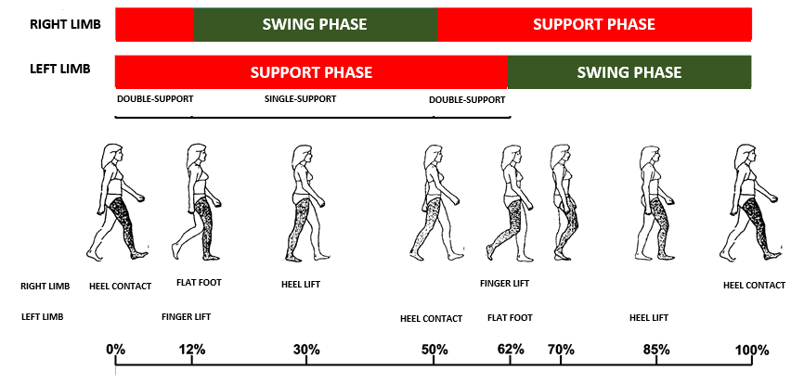
SELECTED CHANGES OCCURRING IN INDIVIDUAL STAGES OF PATHOLOGICAL GAIT

Slide 41
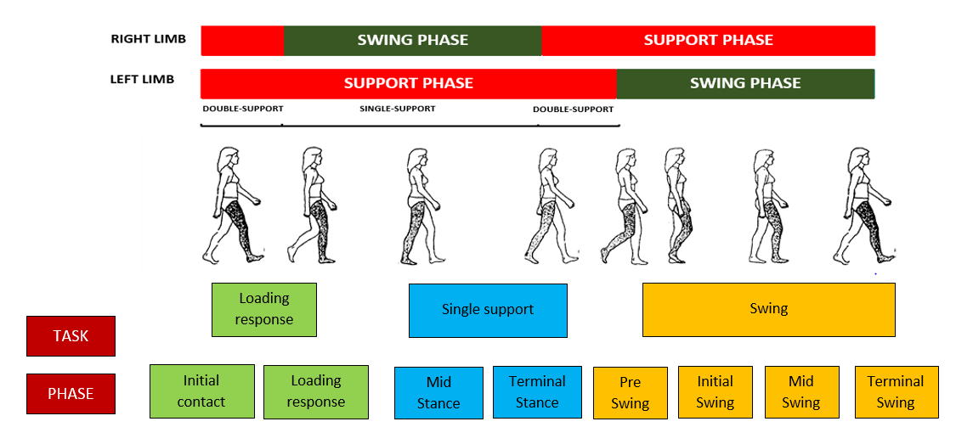
SELECTED CHANGES OCCURRING IN INDIVIDUAL STAGES OF PATHOLOGICAL GAIT

Slide 42
SELECTED CHANGES OCCURRING IN INDIVIDUAL STAGES OF PATHOLOGICAL GAIT
Initial contact
The phase corresponds to the contact of the foot with the ground, starting the next walking cycle. In a healthy person, this phase begins with placing the lateral part of the heel on the ground. It is also the beginning of the two-support phase in the analysis of the gait cycle of the opposite limb.
In the case of gait disturbances, the onset of foot contact with the ground may not be from the heel but from placing the whole foot or toes. These disorders may result, for example, from spasticity of the plantar flexor muscles of the foot, reduced mobility in the ankle or factors causing the foot to drop during the swing phase.

Slide 43
SELECTED CHANGES OCCURRING IN INDIVIDUAL STAGES OF PATHOLOGICAL GAIT
Loading response
In this phase, the body weight is quickly transferred to the limb. The adoption of body weight is associated with the cushioning of this force by flattening the foot. This phase lasts until the opposite limb loses contact with the ground. Most muscles work in an eccentric way, i.e. they generate strength while increasing length. This is to partially slow down movement, maintain body weight on the limb, but also to ensure uninterrupted movement of the body forward.
Pathological gait in this phase may be associated with improper, eccentric muscle work or improper foot work, which instead of smooth movement flaps quickly to the ground.

Slide 44
SELECTED CHANGES OCCURRING IN INDIVIDUAL STAGES OF PATHOLOGICAL GAIT
Midstance
This is the first phase in the single support phase of gait. The whole foot adheres to the ground with its entire surface, supporting the weight of the entire body moving forward, and in this phase being exactly above it. An important element of this phase is keeping the limb linearity.
The most common deviations from the norm that can be seen in this phase are the lack of linearity of the limb, knee hyperextension or pelvis falling to the opposite side (Trendelenburg symptom), which indicates the failure of the gluteal muscles of the limb in support.

Slide 45
SELECTED CHANGES OCCURRING IN INDIVIDUAL STAGES OF PATHOLOGICAL GAIT
Terminal stance
There is further movement of the body forward over the lower limb. Body weight begins to be maintained by forefoot. The task of this phase is to bring the center of gravity of the body out of the support plane. This phase ends when the opposite limb is placed on the ground. Proper mobility in the hip and metatarsophalangeal joints is necessary for the proper implementation of this phase. The lack of proper mobility in these joints is associated with deviations from the norm at this stage of gait.

Slide 46
SELECTED CHANGES OCCURRING IN INDIVIDUAL STAGES OF PATHOLOGICAL GAIT
Preswing
This is the finishing phase of the support of the analysed limb. This limb is quickly unloaded by transferring the body weight to the opposite limb. This is preparation for the swing phase, while also constituting the second period of the two-support phase.
The most common problem is the improper, incomplete transfer of body weight to the opposite limb.

Slide 47
SELECTED CHANGES OCCURRING IN INDIVIDUAL STAGES OF PATHOLOGICAL GAIT
Initial swing
This is the first phase of the swing phase. The foot is raised above the ground and the thigh begins to move forward.
The most common problems noticeable in this phase are insufficient functional shortening of the limb or the lack of active dorsiflexion of the foot.

Slide 48
SELECTED CHANGES OCCURRING IN INDIVIDUAL STAGES OF PATHOLOGICAL GAIT
Midswing
During this phase, the thigh continues to move forward. The extension movement in the knee joint also begins. The foot is kept in a neutral position.
Problems appearing in this phase are the same as in the Initial swing phase: insufficient functional shortening of the limb or the lack of active dorsiflexion of the foot.

Slide 49
SELECTED CHANGES OCCURRING IN INDIVIDUAL STAGES OF PATHOLOGICAL GAIT
Terminal swing
It begins when the tibia crosses a vertical line. The work of the limb is to slow down momentum of the lower leg and prepare the limb for subsequent contact with the ground. There is extension of the limb in the knee joint. The muscles work in an eccentric manner when braking.
The most common problem occurring in this phase is improper, eccentric muscle work. This results in a lack of control over the extension movement in the knee joint (improper braking of this movement), which in turn causes the lower leg to be thrown forward at too high a speed.

Slide 50
SELECTED CHANGES IN KINEMATIC QUANTITIES OCCURRING IN PATHOLOGICAL GAIT

Slide 51
SELECTED CHANGES IN KINEMATIC QUANTITIES OCCURRING IN PATHOLOGICAL GAIT
Time-space parameters
Pathological gait is most often associated with changes in the value of time-space parameters. Usually the stride length is shortened. The cadence is also changing. Both of these changes affect the gait speed, which usually decreases.
The determination of changes in the value of the time-space values of gait is usually made by comparing it to the average values. For normal walking, the walking speed of healthy people varies between 4 - 6 km/h. The frequency of steps at this speed is usually in the range of 90 - 120 steps per minute, while the length of the steps 70 - 82 cm.

Slide 52
SELECTED CHANGES IN KINEMATIC QUANTITIES OCCURRING IN PATHOLOGICAL GAIT
Time-space parameters
The analysis of gait speed change should also be enriched by reference of the measured value to the theoretical value obtained from the formula for comfort speed.
$$V_{c}=a\sqrt{gl}$$
where:
g – gravity constant (9,81 m/s2)
l – length of limb,
a – proportionality factor.
The coefficient a, according to literature reports is 0.4 according to [5] or 0,42

Slide 53
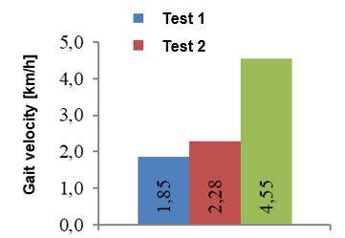
SELECTED CHANGES IN KINEMATIC QUANTITIES OCCURRING IN PATHOLOGICAL GAIT
Time-space parameters after stroke
The following graphs show the values of walking speed, cadence and stride length obtained for a person after a stroke. Results based on own research.
The gait speed determined before the beginning (test 1) and after the end (test 2) of rehabilitation

Slide 54
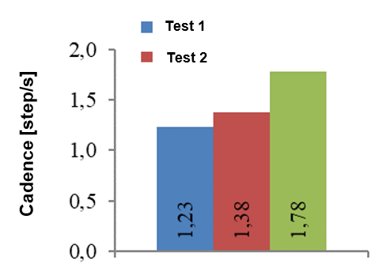
SELECTED CHANGES IN KINEMATIC QUANTITIES OCCURRING IN PATHOLOGICAL GAIT
Time-space parameters after stroke
Cadence determined before the beginning (test 1) and after the end (test 2) of rehabilitation

Slide 55
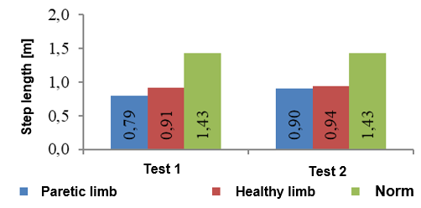
SELECTED CHANGES IN KINEMATIC QUANTITIES OCCURRING IN PATHOLOGICAL GAIT
Time-space parameters after stroke
Stride length determined before the beginning (test 1) and after the end (test 2) of rehabilitation

Slide 56
SELECTED CHANGES IN KINEMATIC QUANTITIES OCCURRING IN PATHOLOGICAL GAIT
Joint angle courses
The course of joint angles belongs to the parameters that most clearly show changes in biomechanics of pathological gait in relation to normal gait. In these waveforms one can observe both subsequent pelvic and limbs positions, mutual positions of individual limbs elements as well as symmetry of movement.

Slide 57
SELECTED CHANGES IN KINEMATIC QUANTITIES OCCURRING IN PATHOLOGICAL GAIT
Joint angle courses
Analysis of the courses of joint angles should be carried out both:
in terms of angle values in the joints at individual stages of gait, referring to the angles obtained for normal gait,
in terms of the quality of the movement - whether it is jerky, shaky or following the right trajectory,
shape of the joint angle change over time - it should be observed whether the resulting graph of the angle change over time is similar to the correct one even when the range of motion, i.e. the values of angles obtained in subsequent stages of movement deviate from the norm.

Slide 58
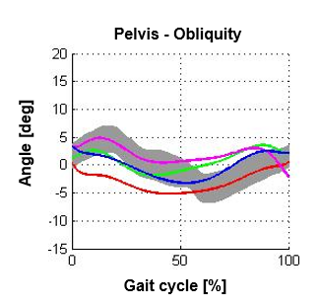
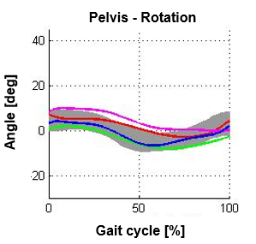
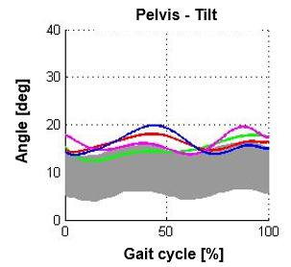
SELECTED CHANGES IN KINEMATIC QUANTITIES OCCURRING IN PATHOLOGICAL GAIT
Joint angle courses for patient after stroke

Slide 59
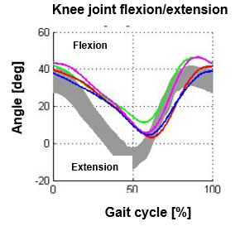
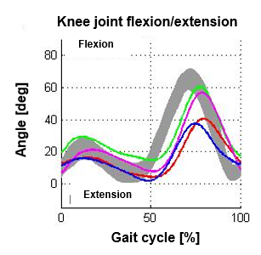
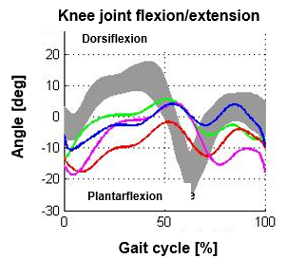
SELECTED CHANGES IN KINEMATIC QUANTITIES OCCURRING IN PATHOLOGICAL GAIT
Joint angle courses for patient after stroke

Slide 60
EXAMPLES OF CHANGES IN DYNAMIC PARAMETERS OCCURRING IN PATHOLOGICAL GAIT

Slide 61
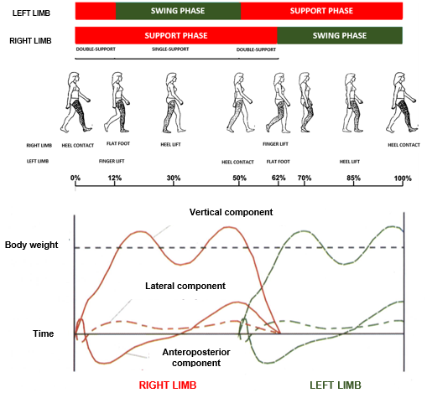
EXAMPLES OF CHANGES IN DYNAMIC PARAMETERS OCCURRING IN PATHOLOGICAL GAIT
Ground reactions

Slide 62
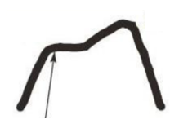
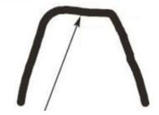
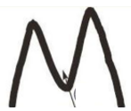
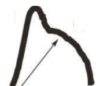
EXAMPLES OF CHANGES IN DYNAMIC PARAMETERS OCCURRING IN PATHOLOGICAL GAIT
Ground reactions
Heel Plateau
Central Plateau
Central Depression
Foreroot Plateau

Slide 63
WALKING ON CRUTCHES AS AN EXAMPLE OF PATHOLOGICAL GAIT

Slide 64
WALKING ON CRUTCHES AS AN EXAMPLE OF PATHOLOGICAL GAIT
One or two balls can be used. Below is a summary of the degree of unload when using one and two balls
using one crutch
Locomotion with 1 crutch provides the opportunity to unload the limb from 0 to 50% (crutch kept on the side of the healthy lower limb). Unloading 50% of the limb is conditioned by moving the crutch from the lower limb more than when walking with 2 crutches. If the crutch is more parallel to the lower limb, the unload will be less than 50%.

Slide 65
WALKING ON CRUTCHES AS AN EXAMPLE OF PATHOLOGICAL GAIT
using two crutches
2-crutches locomotion provides the opportunity to unload the limb from 0% (full load) to 100% (full unload). Unloading at 0% is equivalent to 100% loading and can be called "walking with crutches". It should be noted that despite the fact that locomotion with crutches with 0% unloading of the limb is possible, in gait learning it is used sporadically.

Slide 66
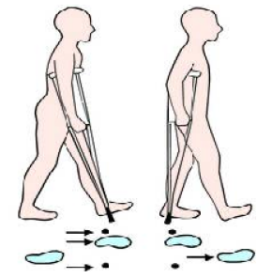
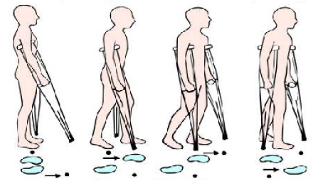
WALKING ON CRUTCHES AS AN EXAMPLE OF PATHOLOGICAL GAIT
Types of gait on crutches
Four-point gait
Three-point gait

Slide 67
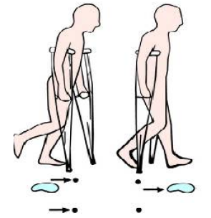
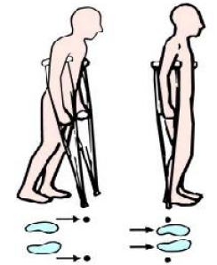
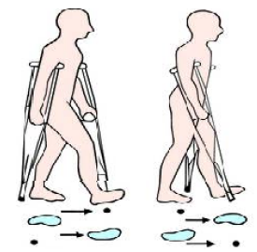
WALKING ON CRUTCHES AS AN EXAMPLE OF PATHOLOGICAL GAIT
Types of gait on crutches
Two-point gait
Swing-through gait
Swing-to gait

Slide 68
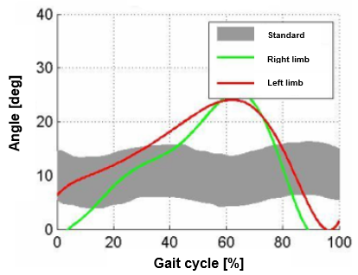
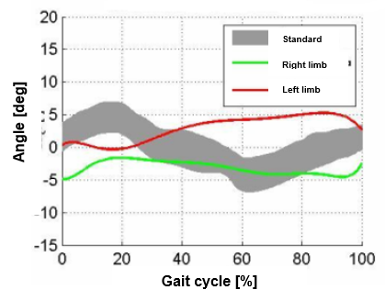
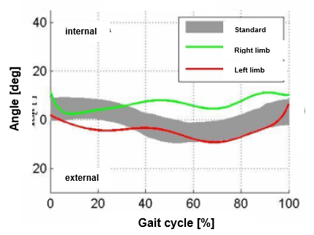
WALKING ON CRUTCHES AS AN EXAMPLE OF PATHOLOGICAL GAIT
Examples of courses of joint angles during swing-to gait
Arrangement of the pelvis in the sagittal plane
Arrangement of the pelvis in the frontal plane
Arrangement of the pelvis in the transverse plane

Slide 69
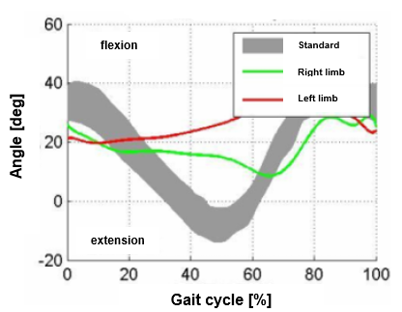
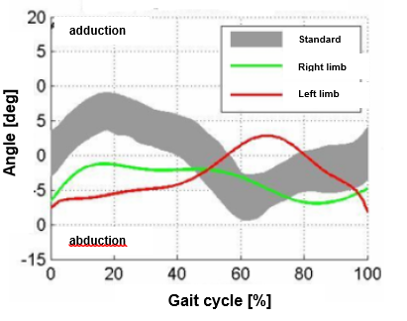
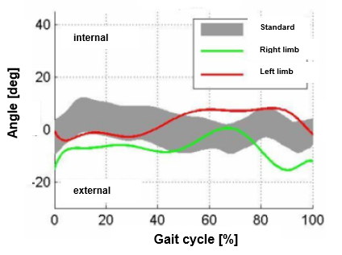
WALKING ON CRUTCHES AS AN EXAMPLE OF PATHOLOGICAL GAIT
Przebiegi kątowe w chodzie o kulach przez kołysanie się do wysokości kul
Changing of the hip angle in the sagittal plane
Changing of the hip angle in the frontal plane
Changing of the hip angle in the transverse plane

Slide 70
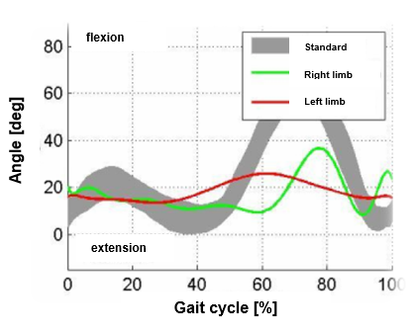
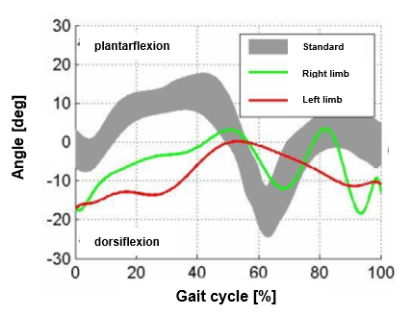
WALKING ON CRUTCHES AS AN EXAMPLE OF PATHOLOGICAL GAIT
Przebiegi kątowe w chodzie o kulach przez kołysanie się do wysokości kul
Changing the angle at the knee joint (flexion/extension)
Changing the angle at the ankle joint (dorsiflexion/plantarextension)

Slide 71
KEY IDEAS

Slide 72
KEY IDEAS
Analiza wielkości kinematycznych w chodzie patologicznym Selected dysfunctions of the musculoskeletal system
Types of pathological gait.
Selected changes in kinematic and dynamic quantities in pathological gait
Walking on crutches as an example of pathological gait
Analysis of kinematic quantities in pathological gait

Slide 73
BIBLIOGRAPHY

Slide 74
BIBLIOGRAPHY
Błaszczyk J.W.: Biomechanika kliniczna, Wydawnictwo Lekarskie PZWL, Warszawa 2004.
Dega W.: Ortopedia i rehabilitacja, Wydawnictwo PZWL, Warszawa 2006.
England SA, Granata KP.: The influence of gait speed on local dynamic stability of walking. Gait&Posture, 2007, 25, 172–8.
Konieczny G., Wrzosek Z.: Wybrane dysfunkcje narządu ruchu. W: Podstawy rehabilitacji dla studentów medycyny. Red. Zdzisław Wrzosek. PZWL Wydawnictwo Lekarskie, 2012

Slide 75
BIBLIOGRAPHY
McAndrew PM, Dingwell JB, Wilken JM.: Walking variability during continuous pseudo-random oscillations of the support surface and visual field. J Biomech, 2010, 43, 1470–5
McAndrew Young PM, Dingwell JB.: Voluntary changes in step width and step length during human walking affect dynamic margins of stability. Gait&Posture, Elsevier B.V.; 2012, 36, 219–24
Rábago CA, Dingwell JB, Wilken JM.: Reliability and Minimum Detectable Change of Temporal-Spatial, Kinematic, and Dynamic Stability Measures during Perturbed Gait. Haddad JM, editor. PLoS One 2015;10:e0142083

Slide 76
BIBLIOGRAPHY
Syczewska M., Lebiodowska M., Kalinowska M.: Analiza chodu w praktyce klinicznej, [W:] Biocybernetyka i inżynieria biomedyczna 2000, Pod red. Macieja Nałęcza, Tom 5, Biomechanika i inżynieria rehabilitacyjna, Red. Romuald Będziński [i in.], Akademicka Oficyna Wydawnicza EXIT, Warszawa 2004
Tejszerska D., Świtoński E.: Biomechanika inżynierska, Wydawnictwo Politechniki Śląskiej, Gliwice 2004
Wallmann H.W.: Physical Matters: Introduction to Observational Gait Analysis. Home Health Care Management & Practice, December 2009, 22 (1)

Slide 77
BIBLIOGRAPHY
https://docplayer.pl/7488681-Podstawy-biomechanicznej-analizy-chodu-czlowieka.html 01.2020
http://medical-dictionary.thefreedictionary.com/_/viewer.aspx?path=MosbyMD&name=crutch_gait.jpg 01.2020.

