Slide 1
MODULE BIOMECHANICS OF GAIT
Didactic Unit C: How Do I Assess Gait?
C.3 What are the advantages of the use of instrumental techniques versus scales and physical examination to assess gait?

Slide 2
C.3 WHAT ARE THE ADVANTAGES OF THE USE OF INSTRUMENTAL TECHNIQUES VERSUS SCALES AND PHYSICAL EXAMINATION TO ASSESS GAIT?
INDEX
Introduction and objectives.
Features and properties of gait assessment tools: comparison between available techniques.
Key Ideas.
Bibliography.

Slide 3
C.3 What are the advantages of the use of instrumental techniques versus scales and physical examination to assess gait?
Introduction and objectives

Slide 4
1. INTRODUCTION AND OBJECTIVES
EVALUATION OF GAIT
Observation
Clinical scales /test and questionnaires
Instrumental techniques
FUNDAMENTAL DIFFERENCES
Choose between evaluation types
Combination of evaluation types

Slide 5
1. INTRODUCTION AND OBJECTIVES
OBJECTIVES
To review the advantages and disadvantages of valuation methodologies for human gait.
To know the statistical properties of the gait assessment methodologies available.
To establish the technical knowledge that allow healthcare professionals to choose the most appropriate gait assessment technique for their clinical or research context.

Slide 6
C.3 What are the advantages of the use of instrumental techniques versus scales and physical examination to assess gait?
Features and properties of gait assessment tools: comparison between available techniques

Slide 7
2. FEATURES AND PROPERTIES OF GAIT ASSESSMENT TOOLS: COMPARISON BETWEEN AVAILABLE TECHNIQUES.
2.1 Usability
The ease which people can use a particular tool
Is it easy to use?
Does it take a long time?
Is it feasible to use it in my work area?
To achieve an specific goal

Slide 8
2. FEATURES AND PROPERTIES OF GAIT ASSESSMENT TOOLS: COMPARISON BETWEEN AVAILABLE TECHNIQUES.
2.1 Usability
Instrumental techniques
Clinical scales / Test and questionnaires
Strict protocol framed
Manage correctly the instrumentation of the subject
Post-treatment of data after measurement
Long time spent
Protocol biased by subjectivity
No instrumentation
No data treatment after measurement
Short time spent

Slide 9
2. FEATURES AND PROPERTIES OF GAIT ASSESSMENT TOOLS: COMPARISON BETWEEN AVAILABLE TECHNIQUES.
2.1 Usability
Gait cycle
Gait velocity, stride lenght, step lenght, cadence, double support time, support and swing phase time
Table 1. Comparation of features between Instrumented walkway and photogrammetry system.

Slide 10
2. FEATURES AND PROPERTIES OF GAIT ASSESSMENT TOOLS: COMPARISON BETWEEN AVAILABLE TECHNIQUES.
2.1 Usability
Characteristic | Observation gait analysis | Questionnaire, Scales and clinical Test | Instrumental techniques
Time cost | + | + | + / ++/ +++ (depending on the system used)
Evaluator training | + | + | ++ / +++ (depending on the system used)
Context of use | Clinical | Clinical and research | Research
Usability | + | ++ | +++
Table 2. Comparation of features between observation analysus, questionnaire, scales and clinical tests and instrumental techniques.

Slide 11
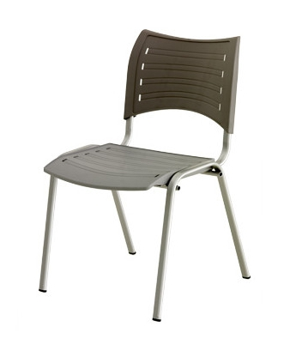
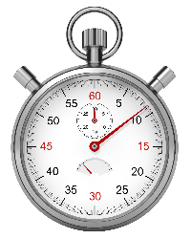
2. FEATURES AND PROPERTIES OF GAIT ASSESSMENT TOOLS: COMPARISON BETWEEN AVAILABLE TECHNIQUES.
2.2 Equipment requirements
Evaluation scale or questionnaire
Clinical tests

Slide 12
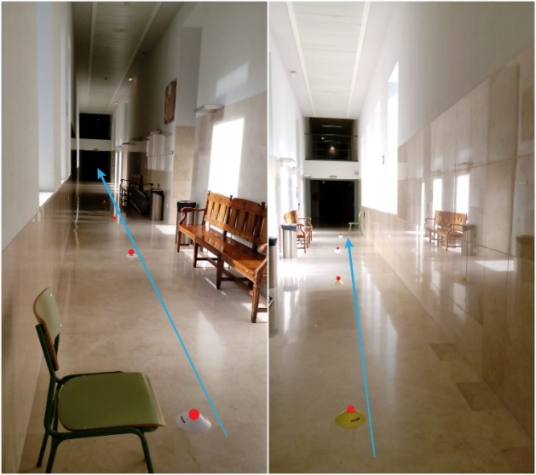
2. FEATURES AND PROPERTIES OF GAIT ASSESSMENT TOOLS: COMPARISON BETWEEN AVAILABLE TECHNIQUES.
2.2 Equipment requirements
6-minutes walking test
Measures the distance a patient can quikly walk in a 6-minute period.
Evaluates the global an integrated resposes of all systems involved during exercise.
Assess the submaximal level of functional capacity.
100-ft hallway.
No exercise equipment.
No advanced training for technicians.
Figure 1. 6-minutes walking test set up

Slide 13
2. FEATURES AND PROPERTIES OF GAIT ASSESSMENT TOOLS: COMPARISON BETWEEN AVAILABLE TECHNIQUES.
2.2 Equipment requirements
6-minutes walking test
Countdown timer.
Mechanical lap counter.
Two small cones.
A chair that can be easily moved along the walking course.
Worksheets on a clipboard.
Adhesive tape or colored stickers.
Borg scale.
Pulse oximeter.
Sphygmomanometer and stethoscope.
Telephone.
A source of oxygen.
Automated electronic defibrillator.
Image 1. 6-minutes walking test set up

Slide 14
2. FEATURES AND PROPERTIES OF GAIT ASSESSMENT TOOLS: COMPARISON BETWEEN AVAILABLE TECHNIQUES.
2.2 Equipment requirements
•More quantity of material required
•Higher specialized material required
Appraisal with Instrumental techniques
Sensor or measurement equipment
Software and computer
Supplies

Slide 15
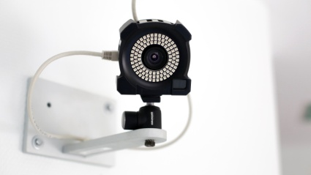
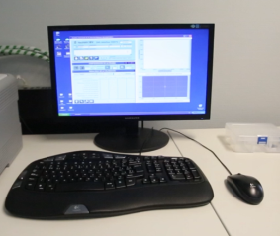
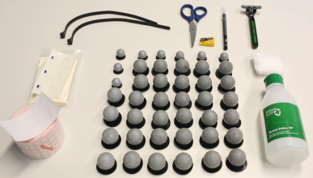
2. FEATURES AND PROPERTIES OF GAIT ASSESSMENT TOOLS: COMPARISON BETWEEN AVAILABLE TECHNIQUES.
2.2 Equipment requirements
Materials needed to do a gait evaluation with a photogrammetry system
Multi-camera system
Software and computer
Landmarks
Figure 2. Photogrammetry system and its components

Slide 16
2. FEATURES AND PROPERTIES OF GAIT ASSESSMENT TOOLS: COMPARISON BETWEEN AVAILABLE TECHNIQUES.
2.2 Equipment requirements
Characteristic | Observation gait analysis | Questionnaire, Scales and clinical Test | Instrumental techniques
Equipment | + | + | +++
Supplies | - | + | ++
Economic cost | + | + | +++
Table 3. Requirements of gait assessment tools

Slide 17
2. FEATURES AND PROPERTIES OF GAIT ASSESSMENT TOOLS: COMPARISON BETWEEN AVAILABLE TECHNIQUES.
2.3 Objectivity of the results and statistical analysis
Instrumented assessment tools
Objective data obtained.
No interpretation of the evaluator.
Analysis trough observation
•Subjective data obtained.
•Results subject to interpretation.
•Clinical scales are very useful instruments, but are subject to double subjectivity (patient and evaluator).
Analysis trough questionnaires
Analysis trough clinical scales

Slide 18
2. FEATURES AND PROPERTIES OF GAIT ASSESSMENT TOOLS: COMPARISON BETWEEN AVAILABLE TECHNIQUES.
2.3 Objectivity of the results and statistical analysis
Subjective and objective measure of step legth
Step length = 0.46 m
Figure 3. Step length and height ítem from the Tinetti Mobility Test, Gait section.
Figure 4. Step length assessment with an instrumented walkway (GAITrite).

Slide 19
2. FEATURES AND PROPERTIES OF GAIT ASSESSMENT TOOLS: COMPARISON BETWEEN AVAILABLE TECHNIQUES.
2.3 Objectivity of the results and statistical analysis
Objective results measured with instrumental techniques
•Data can be comparable with other data from the same patient.
•Data can be comparable with other results between patients.
•Objective data between subjects should be normalized to be compared.

Slide 20
2. FEATURES AND PROPERTIES OF GAIT ASSESSMENT TOOLS: COMPARISON BETWEEN AVAILABLE TECHNIQUES.
2.3 Objectivity of the results and statistical analysis
Subjective data measured with scales and questionnaires
•Subjective measures can be highly correlated with objective measures.
•Value added to assessment scales used in clinical settings.
•If they are highly correlated with the results of the assessment using an instrumental technique, the subjective data measure will be valid.

Slide 21
2. FEATURES AND PROPERTIES OF GAIT ASSESSMENT TOOLS: COMPARISON BETWEEN AVAILABLE TECHNIQUES.
2.3 Objectivity of the results and statistical analysis
Subjective data obtained trough scales and questionnaires
(scored as a number)
Both capable of being stadistically analysed
Objective data obtained from an instrumental technique

Slide 22
2. FEATURES AND PROPERTIES OF GAIT ASSESSMENT TOOLS: COMPARISON BETWEEN AVAILABLE TECHNIQUES.
2.3 Objectivity of the results and statistical analysis
Dynamic Parkinson Gait Scale (DYPAGS)
Semi-quantitative variable
Qualitative categorical variable
Tinetti Mobility Test (TMT)
Naked-eye analysis obtaining characteristics of human gait
Subjective

Slide 23
2. FEATURES AND PROPERTIES OF GAIT ASSESSMENT TOOLS: COMPARISON BETWEEN AVAILABLE TECHNIQUES.
2.4 Validity
• Validity refers to the accuracy of the measurement.
•A valid instrument must offer accurate and valid interpretable data.
•Validity refers to an specific matter and on a defined population.
•Reliability and validity are not totally independent:
A non reliable instrument
Valid
A reliable instrument
Can be Invalid

Slide 24
2. FEATURES AND PROPERTIES OF GAIT ASSESSMENT TOOLS: COMPARISON BETWEEN AVAILABLE TECHNIQUES.
2.4 Validity
Procedure to measure the validity of a tool
•New techniques or tools need to be compared with a “Gold Standard”.
•¿Does tool A measure as precisely as tool B does in human gait?
•Usually analyzed with Pearson or Spearman Correlation Coefficient (r).
•Level of validity considered as:
Excellent: > 0.6
Adequate: 0.59 – 0.31
Poor: < 0.6

Slide 25
2. FEATURES AND PROPERTIES OF GAIT ASSESSMENT TOOLS: COMPARISON BETWEEN AVAILABLE TECHNIQUES.
2.4 Validity
¿What type of tools have the most validity to measure gait or a specific characteristic of gait?
Instrumental measurement techniques
>
Valid
Scales and clinical tests
•More precise instruments to measure a certain variable of the gait.
•Not all the instrumental techniques are equally precise.

Slide 26
2. FEATURES AND PROPERTIES OF GAIT ASSESSMENT TOOLS: COMPARISON BETWEEN AVAILABLE TECHNIQUES.
2.4 Validity
Figure 4. Comparison of the common technologies used to measured spatiotemporal gait parameters (Moissenet F. and Armand S. 2016). For each instrumental technique, the degree of precision and the cost of the technique are mentioned.

Slide 27
2. FEATURES AND PROPERTIES OF GAIT ASSESSMENT TOOLS: COMPARISON BETWEEN AVAILABLE TECHNIQUES.
2.5 Reliability
• Reliability is the ability to reproduce a consent result in time and space or with diffferent observers.
•It is one of the quality criteria of an instrument.
•An instrument may not be considered reliable under different conditions.
•Reliability refers to whether an assessment instrument gives the same results each time it is used in:
The same settings
The same type of subjects

Slide 28
2. FEATURES AND PROPERTIES OF GAIT ASSESSMENT TOOLS: COMPARISON BETWEEN AVAILABLE TECHNIQUES.
2.5 Reliability
Procedure to measure the validity of an instrument
It depends on what is intended to measure:
Stability
Internal consistency
Equivalence
It estimates the consistency of measurement repetition
(Homogeneity)
All the subparts of an instrument measure the same characteristic
The concordance degree of several observers

Slide 29
2. FEATURES AND PROPERTIES OF GAIT ASSESSMENT TOOLS: COMPARISON BETWEEN AVAILABLE TECHNIQUES.
2.6 Sensitivity to change and Responsiveness
• It is defined as the ability of an instument to measure change in state, regardless of whether the change is relevant or meaningful to the decisión-maker.
•It is related to the evaluation of the impacts of programs and treatments in clinical science.
•It is specially relevant in applied settings where program or treatment effects are often not particularly strong, and measurement conditions can be quite variable.
Sensitivity to change

Slide 30
2. FEATURES AND PROPERTIES OF GAIT ASSESSMENT TOOLS: COMPARISON BETWEEN AVAILABLE TECHNIQUES.
2.6 Sensitivity to change and Responsiveness
• It is defined as the ability of an instrument to measure a meaningful or clinically important change in a clinical state.
•It is not considered a generalizable property and should be assessd for each population and purpose for which the measure is used.
•A change score on a measure should equal of exceed its minimally important difference (MID) estimate to be considered important.
Responsiveness

Slide 31
2. FEATURES AND PROPERTIES OF GAIT ASSESSMENT TOOLS: COMPARISON BETWEEN AVAILABLE TECHNIQUES.
2.6 Sensitivity to change and Responsiveness
Related to sensitivity
Biomechanical assessment techniques
Clinical assessment scales
>
Sensitivity to detect changes on gait features

Slide 32
2. FEATURES AND PROPERTIES OF GAIT ASSESSMENT TOOLS: COMPARISON BETWEEN AVAILABLE TECHNIQUES.
2.6 Sensitivity to change and Responsiveness
Figure 5. The image shows two rulers.
The upper ruler is more precise tan the lower ruler
The upper ruler is more sensitive to length measure than the lower one

Slide 33
2. FEATURES AND PROPERTIES OF GAIT ASSESSMENT TOOLS: COMPARISON BETWEEN AVAILABLE TECHNIQUES.
2.6 Sensitivity to change and Responsiveness
Most accurate systems
Photogrammetry systems
Optoelectronic cameras
More sensitive to the measurement of spatio-temporal variables
Figure 4. Comparison of the common technologies used to measured spatiotemporal gait parameters (Moissenet F. and Armand S. 2016).

Slide 34
2. FEATURES AND PROPERTIES OF GAIT ASSESSMENT TOOLS: COMPARISON BETWEEN AVAILABLE TECHNIQUES.
2.7 Floor and ceiling effect
Fenomenon produced when a range of function covered by a measure is less than the range experienced by patientes.
•Meassure may lack responsiveness.
•Spikes at highest or lowest response option is often interpreted as evidence of ceiling or floor effects.
•They are important to assess of the effectiveness of interventions prospective evidence of the performance of a measure.

Slide 35
2. FEATURES AND PROPERTIES OF GAIT ASSESSMENT TOOLS: COMPARISON BETWEEN AVAILABLE TECHNIQUES.
2.7 Floor and ceiling effect
Ceiling effect
(Score toward the high end)
Floor effect
(Score toward the down end)
Can be biased
Patients could be “worse off” than the measure could capture
Patients could be “better off” than the instrument can mesure

Slide 36
2. FEATURES AND PROPERTIES OF GAIT ASSESSMENT TOOLS: COMPARISON BETWEEN AVAILABLE TECHNIQUES.
2.7 Floor and ceiling effect
Instrumental gait assessment techniques
Clinical gait assessment scales
Floor effect
Ceiling effect
Reason: the difference of ease or difficulty with which each of them can be performed by patients

Slide 37
2. FEATURES AND PROPERTIES OF GAIT ASSESSMENT TOOLS: COMPARISON BETWEEN AVAILABLE TECHNIQUES.
2.7 Floor and ceiling effect
Clinical gait assessment scales
•Defined following structured questionnaires.
•They reduce sensitivity with other clinical assessment instruments or technologies.
•Small changes in the functional capacity due to the intervention of the profesional are very difficult to identify.

Slide 38
2. FEATURES AND PROPERTIES OF GAIT ASSESSMENT TOOLS: COMPARISON BETWEEN AVAILABLE TECHNIQUES.
2.7 Floor and ceiling effect
Instrumental gait assessment techniques
•The assessment protocols require the patient to be carried out.
•Gait assessment in patients with severe impairment in ambulation is not possible.
•The floor effect may limit the entry of severely injured individuals.

Slide 39
C.3 What are the advantages of the use of instrumental techniques versus scales and physical examination to assess gait?
3. Key ideas

Slide 40
3. KEY IDEAS
The medical staff have to know the methodological characteristics and statistical properties at the time of choosing a gait assessment tool. This is necessary to avoid methodological errors and biases in the measured results.
Regarding usability, clinical scales and tests have the advantage that they are possible to develop in a short time, they do not require specialized training from the rater and they can be used in any context such as in clinical practice.
The equipment required to use clinical tests and scales is much less and accessible than the equipment needed to perform a gait assessment with biomechanical assessment instruments.
The most important quality of instrumental biomechanical assessment techniques is that they provide objective data obtained without interpretation of the evaluator (i.e. directly assessment of one or more dimensions of gait pattern), so their use is mainly in the research area. On the contrary, the information obtained through scales and clinical tests is influenced by the interpretation and perception of the evaluator.

Slide 41
3. KEY IDEAS
The high precision of the instrumental measurement techniques gives them the quality of being more valid to measure a gait characteristic than the scales or clinical tests.
The reliability is usually better in biomechanical instruments because the repeatability of the measurement does not depend on the observer but on other factors, such as performing the measurement with a standardized protocol.
The more accurate a measuring instrument is, the more sensitive to change the instrument will be. The sensitivity of equipment must be sufficient to measure minimal clinically important difference in the outcomes that professional intent to observe in a given population.
The clinical scales and tests have a greater tendency to have a ceiling effect, that is, the participants' scores cluster toward the high end (or best possible score) of the measure / instrument. On the other hand, the instrumental techniques have a greater floor effect, where the participants' scores cluster toward the down end. This is due to patients could be “better off” than the measure could capture or “worse off” than the instrument can measure.

Slide 42
C.3 What are the advantages of the use of instrumental techniques versus scales and physical examination to assess gait?
4. Bibliography

Slide 43
4. BIBLIOGRAPHY
Gutierrez-Clavería M, Beroíza T, Cartagena C, Caviedes I, Céspedes J, Gutiérrez-Navas M, Oyarzún M, Palacios S, Schönffeldt P. Guidelines for the six-minute walk test. RevChil Enf Respir2009; 25: 15-24.
Innerd P, Catt M, Collerton J, Davies K, Trenell M, Kirkwood T, Jagger C. A comparision of subjective and objective measures of physical activity from the Newcastle 85+ study. Age Ageing. 2015 Jul;44(4):691-4.
Crémers J, Phan R, Delvaux V, Garrauxa G. Construction and validation of the Dynamic Parkinson Gait Scale (DYPAGS). Parkinsonism & Related Disorders. Volume 18, Issue 6, July 2012, Pages 759-764.
Tinetti M.E. Performance-Oriented Assessment of Mobility Problems in Elderly Patients. J Am Geriatr Soc. 1986 Feb;34(2):119-26.
Wrisley D, Kumar N. Functional Gait Assessment: Concurrent, Discriminative, and Predictive Validity in Community-Dwelling Older Adults. Phys Ther. 2010 May;90(5):761-73.
Pinto R, Birmingham T, Leitch K, Atkinson H, Jones I, Giffin J.R. Reliability and validity of knee angles and moments in patients with osteoarthritis using a treadmill-based gait analysis system. Gait & Posture 80 (2020) 155-161.
Taherdoost H. Validity and Reliability of the Research Instrument: How to Test the Validation of a Questionnaire/Survey in a Research. International Journal of Academic Research in Management (IJARM). Vol. 5, No. 3, 2016, Page: 28-36.
De Souza A, Costa N, de Brito E. Psychometric properties in instruments evaluation of reliability and validity. Epidemiol. Serv. Saude, Brasília, 26(3), Jul-Sep 2017.

Slide 44
4. BIBLIOGRAPHY
Sullivan G. A primer on the Validity of Assessment Instruments. J Grad Med Educ. 2011.
Meng L, Millar L, Childs C, Buis A. A strathclyde cluster model for gait kinematic measurement using functional methods: a study of inter-assessor reliability analysis with comparison to anatomical models. Computer methods in biomechanics and biomedcal engineering. Comput Methods Biomech Biomed Engin. 2020 Jun 16;1-10.
Geerse D, Coolen B, Roerdink M. Quantifying Spatiotemporal Gait Parameters with HoloLens in Healthy Adults and People with Parkinson’s Disease: Test-Retest Reliability, Concurrent Validity, and Face Validity. Sensors (Basel). 2020 Jun 5;20(11):3216.
Hee-jae Kim, Ilhyoek Park, Hyo joo Lee, On Lee. The reliability and validity of gait speed with different walking pace and distances against general health, physical function, and chronic disease in aged adults. J Exerc Nutrition Biochem. 2016;20(3):046-050.
Wrisley D, Marchetti G, Kuharsky D, Whitney S. Reliability, Internal Consistency, and Validity of Data Obtained With the Functional Gait Assessment. Phys Ther. 2004 Oct;84(10):906-18.
McHugh M. Interrater reliability: the kappa statistic. Biochem Med (Zagreb). 2012 Oct; 22(3): 276-282.
Lipsey, M. W. (1983). A scheme for assessing measurement sensitivity in program evaluation and other applied research. Psychological Bulletin, 94(1), 152–165.
Jaeschke R, Singer J, Guyatt GH. Ascertaining the minimal clinically important difference. Cont Clin Trials. 1989;10:407–415.

Slide 45
4. BIBLIOGRAPHY
McGlothlin A. and Lewis R. Minimal Clinically Important Difference Defining What Really Matters to Patients. JAMA October 1, 2014 Volume 312, Number 13.
Bohannon R and Glenney S. Minimal clinically important difference for change in comfortable gait speed of adults with pathology: a systematic review. Journal of Evaluation in Clinical Practice 20 (2014) 295–300.
Moissenet F, Armand S. Chapter 17: Qualitative and quantitative methods of assessing gait disorders. Orthopedic Management of Children with Cerebral Palsy. 2015 Ed. Nova Science Publishers, Inc. ISBN: 978-1-63483-318-9-
Jackson A, Carnel C, Ditunno J, Schmidt M. Boninger M, Schmeler M, Williams S, Donovan W. Outcome Measures for Gait and Ambulation in the Spinal Cord Injury Population. J Spinal Cord Med. 2008;31:487–499.
Feeny DH, Eckstrom E, Whitlock EP, Perdue LA. Agency for Healthcare Research and Quality, US. A Primer for Systematic Reviewers on the Measurement of Functional Status and Health-Related Quality of Life in Older Adults. September 2013.
Middleton A, Fritz S. Assessment of Gait, Balance, and Mobility in Older Adults: Considerations for Clinicians. Curr Transl Geriatr and Exp Gerontol Rep (2013) 2:205–214.

Slide 46
The European Commission's support for the production of this publication does not constitute an endorsement of the contents, which reflect the views only of the authors, and the Commission cannot be held responsible for any use which may be made of the information contained therein.

