Slide 1
MODULE BIOMECHANICS OF GAIT
Didactic Unit D: INSTRUMENTED ANALYSIS OF GAIT
D.4 USEFULNESS OF BIOMECHANICAL INSTRUMENTED ANALYSIS OF GAIT

Slide 2
D.4 In which cases and how can a biomechanical instrumented analysis be useful?
INDEX
Objectives
Contents:
  Clinical application
  Useful in sports analysis
  Ergonomics implications
  Assistance in legal medicine
Key ideas
References
Notes:
Traumatología y ortopedia – Neurología – Envejecimiento
Diagnóstico – Efectividad de tratamientos – Simulación – Caracterización de la población

Slide 3
D.4 In which cases and how can a biomechanical instrumented analysis be useful?
I. OBJECTIVES

Slide 4
I. OBJECTIVES
To study the clinical application of instrumented biomechanical gait analysis and the different research designs in which it is used.
To analyze the application of the instrumented biomechanical gait analysis in the sports field and the information it provides to athletes and coaches.
To study the practical application in the area of ergonomics and exemplify how the instrumented biomechanical gait analysis can improve jobs conditions.
To study how the instrumented biomechanical gait analysis is applied in legal medicine where a dysfunction must be characterized to determine a degree of incapacity for work or financial compensation.

Slide 5
D.4 In which cases and how can a biomechanical instrumented analysis be useful?
II. CONTENTS
II.1 Clinical application of biomechanical instrumented gait analysis.

Slide 6

II.1 CLINICAL APPLICATION
What is the use of instrumented gait analysis in medical practice?
To characterize the population
To support the medical diagnosis
To assess the effectiveness of medical and physical rehabilitation treatments

Slide 7

II.1 CLINICAL APPLICATION
Instrumented gait analysis to characterize the population
How different is the gait of people with a disease compared to people with similar characteristics but healthy?
What normality values should we achieve when applying a gait treatment?
How does gait evolve throughout of a pathology?

Slide 8
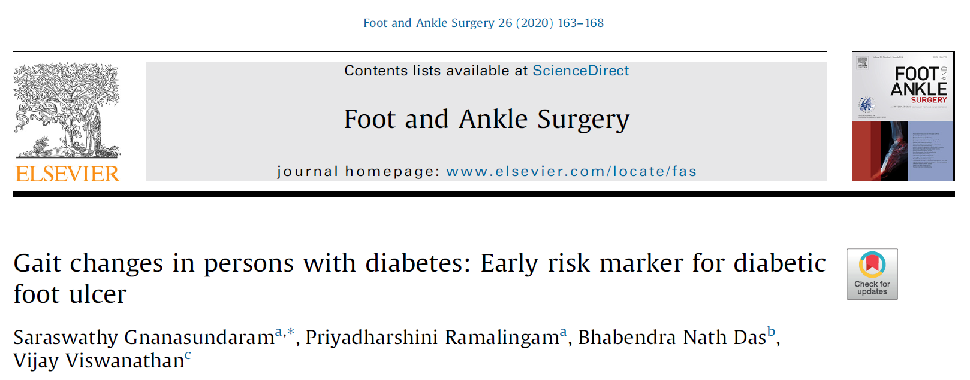
II.1 CLINICAL APPLICATION
Instrumented gait analysis to characterize the population
Example
Diabetes Mellitus
Peripheral neuropathy
Vasculopathy
Foot deformities
Foot ulcer

Slide 9
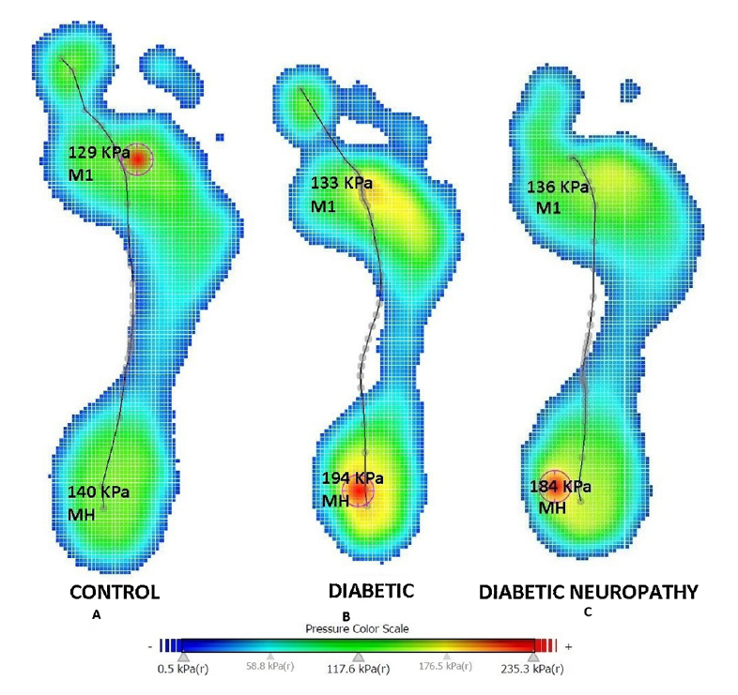
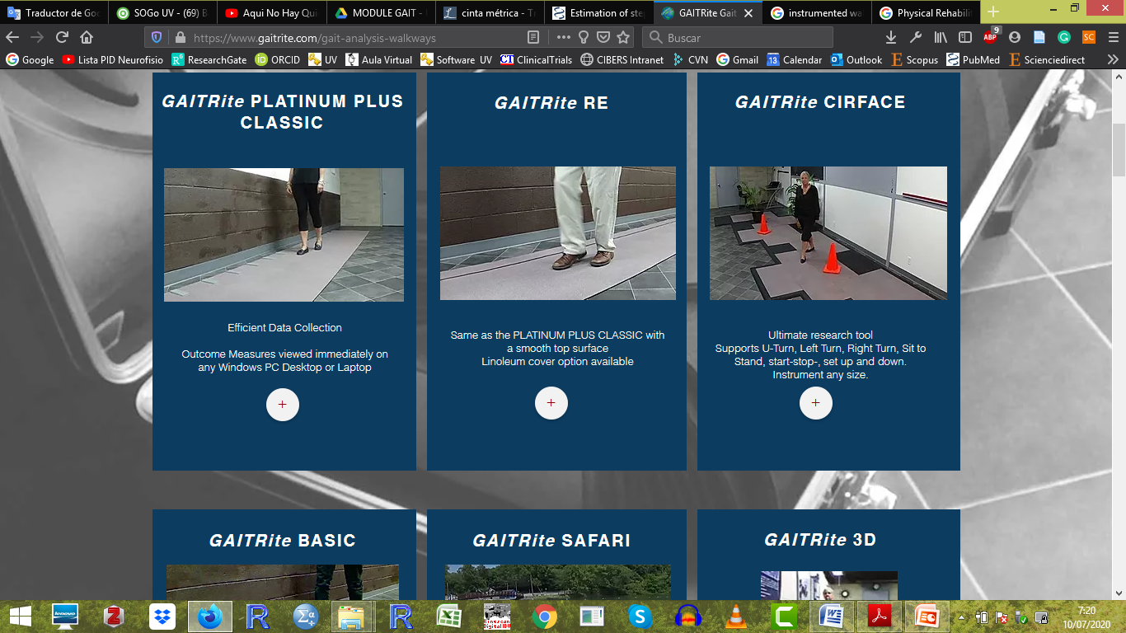

II.1 CLINICAL APPLICATION
Instrumented gait analysis to characterize the population
Example
What is the dynamic plantar pressure profile of persons with diabetes without neuropathy and the diabetic neuropathy, compared with the healthy control ?
Figure 1 - instrumented walkway example (GAITrite) and surface area results of the foot contact during walking (Gnanasundaram et al. 2020)

Slide 10

II.1 CLINICAL APPLICATION
Instrumented gait analysis in medical diagnosis and decision-making
How should I intervene in my patient?
I need an analysis of his gait!
Diagnosis
Additional information
Medical treatment

Slide 11
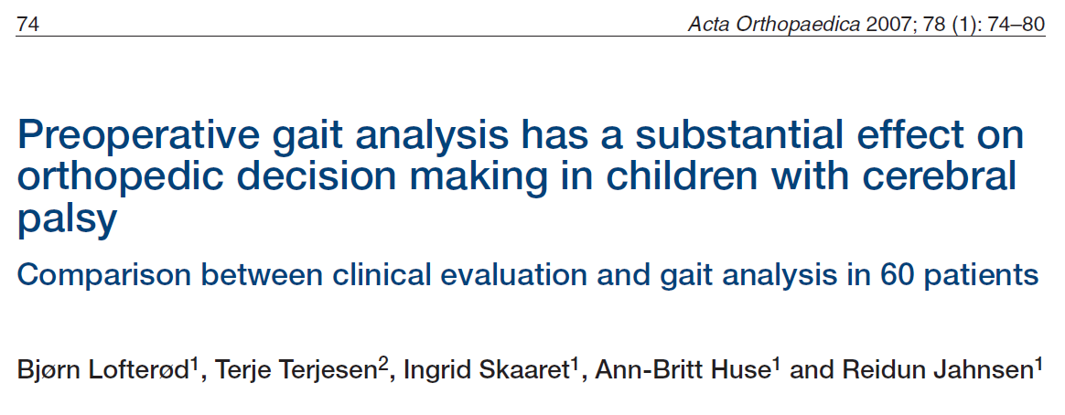
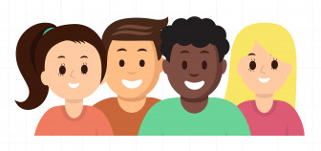
II.1 CLINICAL APPLICATION
Instrumented gait analysis in medical diagnosis and decision-making
Example
60 children between 4 and 18 years-old with cerebral palsy
They had a specific surgical plan outlined
3-dimensional kinematics and kinetics analysis
How did the surgical plan change after the gait analysis?

Slide 12
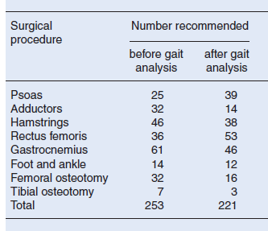
II.1 CLINICAL APPLICATION
Instrumented gait analysis in medical diagnosis and decision-making
Example
13%
Figure 2 – Results from Lofterød et al. 2015

Slide 13

II.1 CLINICAL APPLICATION
Instrumented gait analysis to assess the effectiveness of treatments
How effective is my medical treatment?
Is treatment A more effective than treatment B?
Diagnosis
Assessment pre-treatment
Medical intervention
Assessment post-treatment

Slide 14
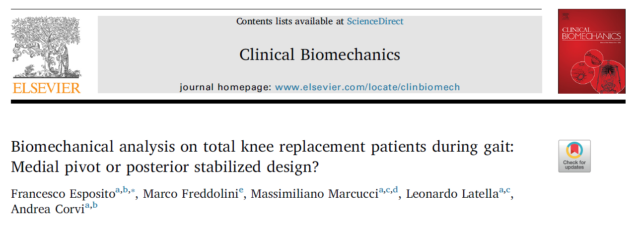

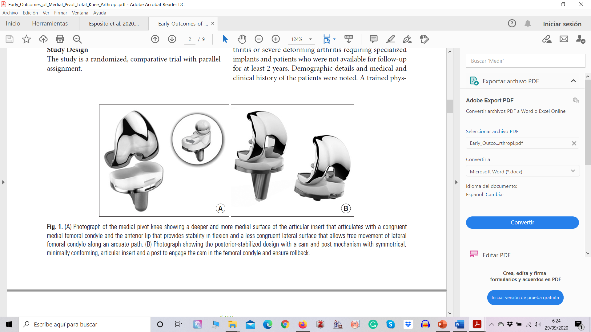
II.1 CLINICAL APPLICATION
Instrumented gait analysis to assess the effectiveness of treatments
Example
Prothesis A
Instrumented gait analysis
Instrumented gait analysis
Prothesis B

Slide 15
II.1 CLINICAL APPLICATION
Instrumented gait analysis to assess the effectiveness of treatments
Example
Both prothesis reduced walking speed, reduced stride length and increased stance time respect to control group.
Reduction of knee flexion and flexor moment in patients with Medial Pivot mechanism.
Prolonged muscular activity of rectus femoris was observed in Medial Pivot patients compared to Posterior Stabilized.
Medial Pivot prothesis, causes a less rigid knee pattern than Posterior Stabilized prothesis, and seems to better reproduce the physiological condylar movement as gait parameters

Slide 16
D.4 In which cases and how can a biomechanical instrumented analysis be useful?
II. CONTENTS
II.2 Usefulness of biomechanical instrumented gait analysis in sports science

Slide 17

II.2 USEFULNESS IN SPORTS SCIENCE
What is the use of instrumented gait analysis in sports science?
Analysis of the sporting gesture
Injury prevention
Effectiveness of physical activity and sports

Slide 18
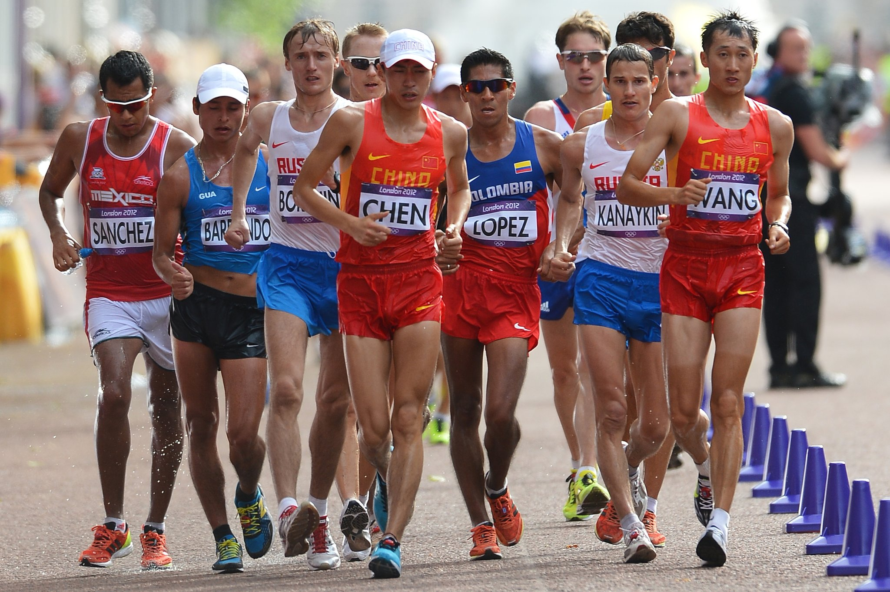
II.2 USEFULNESS IN SPORTS SCIENCE
Gait analysis in sports gesture
Long-distance discipline within the sport of athletics
One leg must be in contact with the ground
the knee must be fully extended from first contact with the ground until the “vertical upright position”.
Figure 3 – Racewalking event. Image from The New York Times.

Slide 19
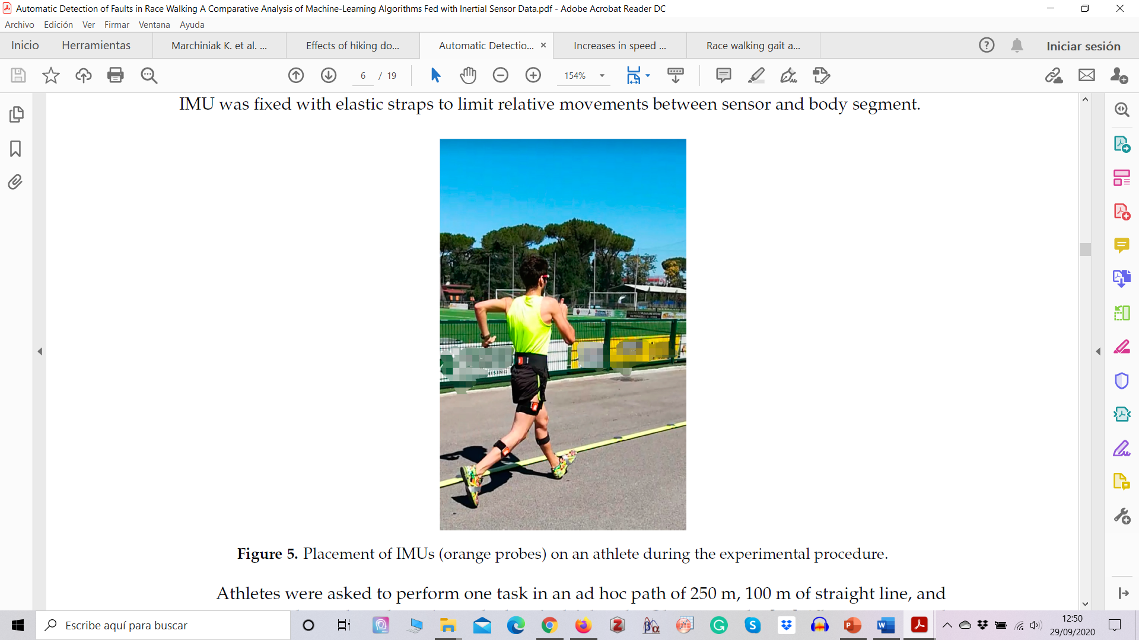
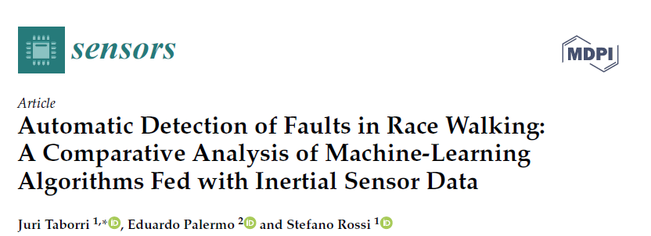
II.2 USEFULNESS IN SPORTS SCIENCE
Gait analysis in sports gesture
Example
Define the best-performing classifiers for the automatic and objective detection of illegal steps from the instrumented gait analysis with inertial sensors.
Figure 4 – Placement of IMUs (orange probes) on an athlete during the experimental procedure. Image from Taborri et al. 2018.

Slide 20
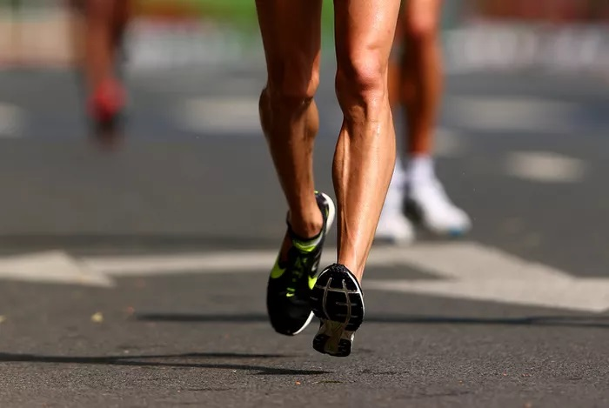

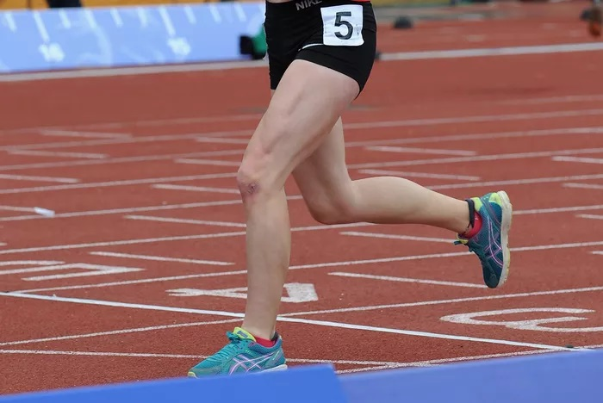
II.2 USEFULNESS IN SPORTS SCIENCE
Gait analysis in sports gesture
Example
Loss of contact
Legal gait
Loss contact
Knee-bent
Knee-bent
Linear acceleration
Linear acceleration
Control through observation
Angular velocity

Slide 21
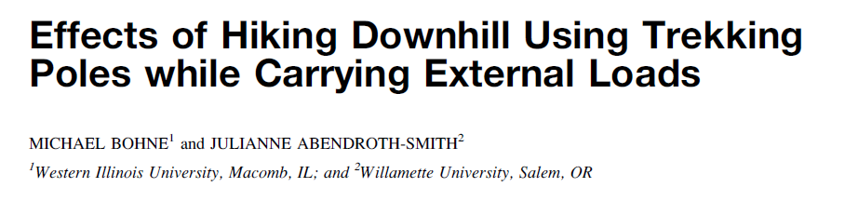
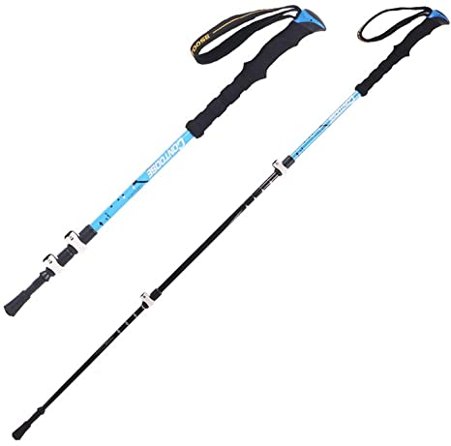
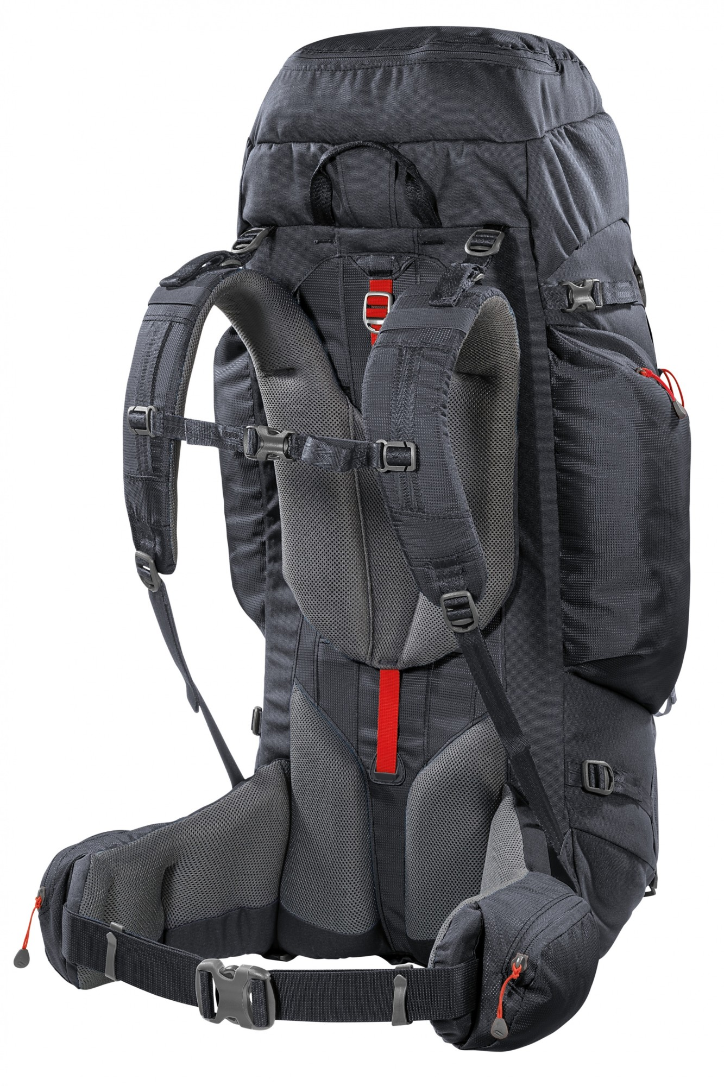
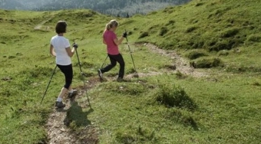
II.2 USEFULNESS IN SPORTS SCIENCE
Gait analysis to study injury conditions
Example
+
+

Slide 22
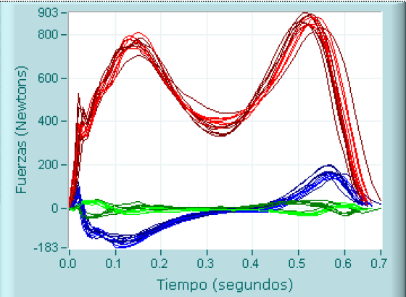
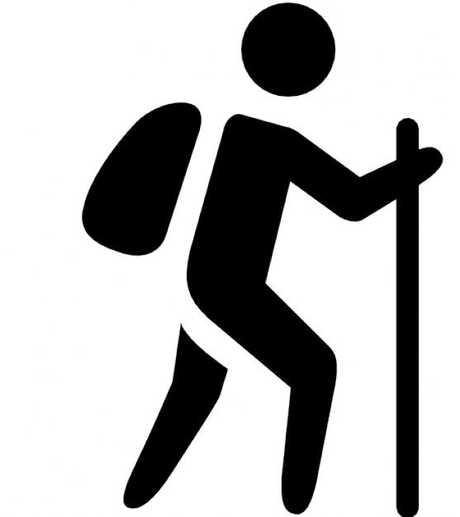
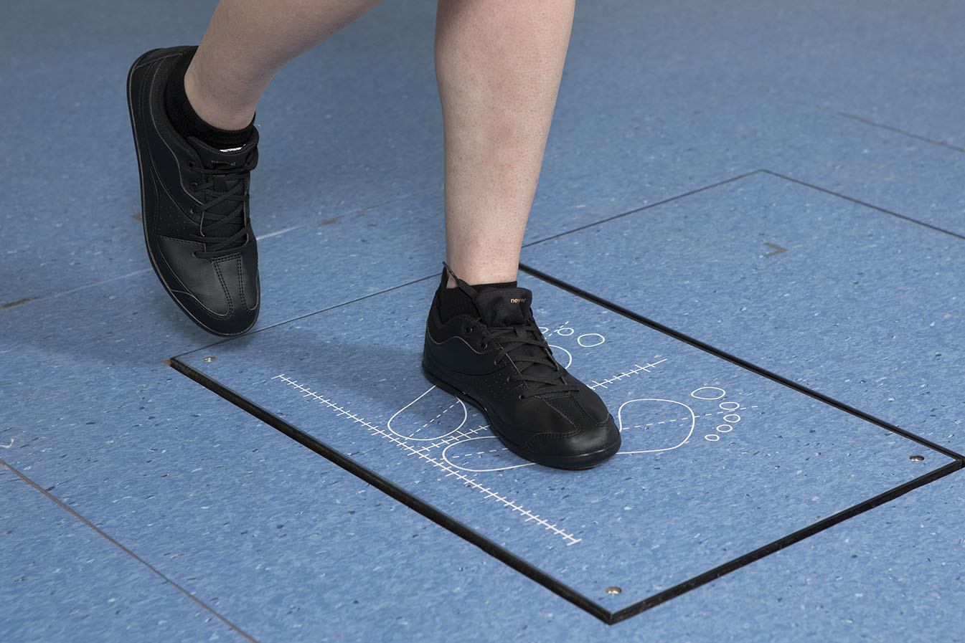
II.2 USEFULNESS IN SPORTS SCIENCE
Gait analysis to study injury conditions
Example
With poles: reduction of the moments at each of the joints
With poles: reduction of the power absorption for the ankle and knee
20º
With poles
Without poles
Packs only resulted in a larger power generation at the hip.
No pack
Pack 15% BW
Pack 30% BW

Slide 23
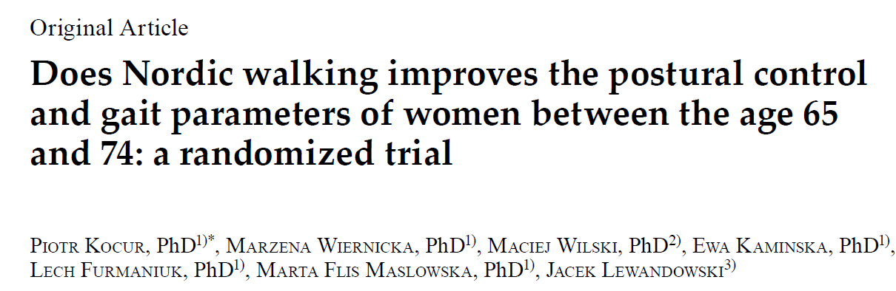
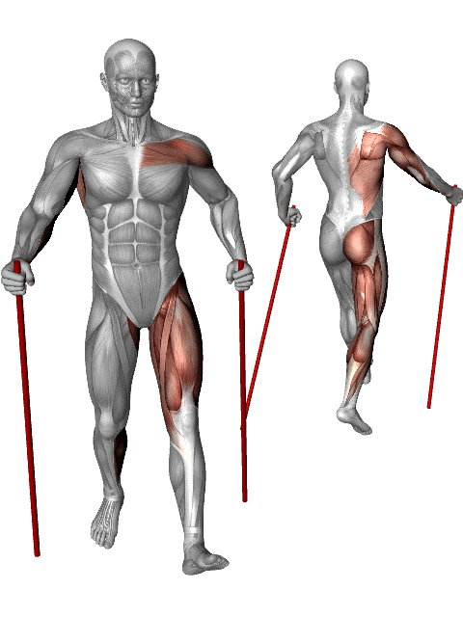
II.2 USEFULNESS IN SPORTS SCIENCE
Gait analysis to assess effectiveness of physical activity and sports
Example
Active movement of arms
What is the effect on the asymmetry in upper and lower limb movements of Parkinson’s disease?
More muscle involve
Figure 5 – Animation of muscle involve in the development of Nordic Walking (Image from http://b.nw.free.fr)
Notes:
http://b.nw.free.fr/PluXml/index.php?article313/what-are-the-muscles-used-in-nordic-walking

Slide 24
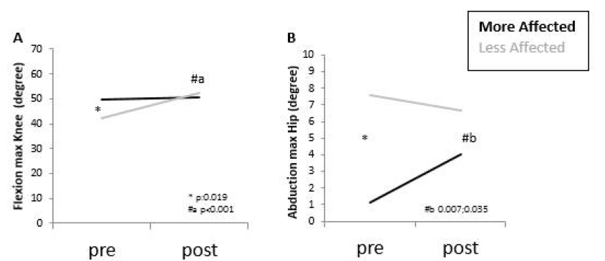
II.2 USEFULNESS IN SPORTS SCIENCE
Gait analysis to assess effectiveness of physical activity and sports
Example
14 participants
11 weeks / two weekly sessions of NW
3D motion analysis system
Figure 6 – Plug-in-Gait Full-Body with thirty-five landmarkers. (Image from Baudet et al. 2014)
Figure 7 – Results from Kocur et al. 2019
Notes:
Biomechanical model: Baudet et al. 2014

Slide 25
D.4 In which cases and how can a biomechanical instrumented analysis be useful?
II. CONTENTS
II.3 Ergonomics implications of biomechanical instrumented gait analysis

Slide 26

II.3 ERGONOMICS IMPLICATIONS
Ergonomics
Is the scientific discipline concerned with the understanding of interactions among humans and other elements of a system, and the profession that applies theory, principles, data and methods to design in order to optimize human well-being and overall system performance.
Physical requirements and risks measured through biomechanical tools.
Walking and standing is an essential part of many jobs.

Slide 27
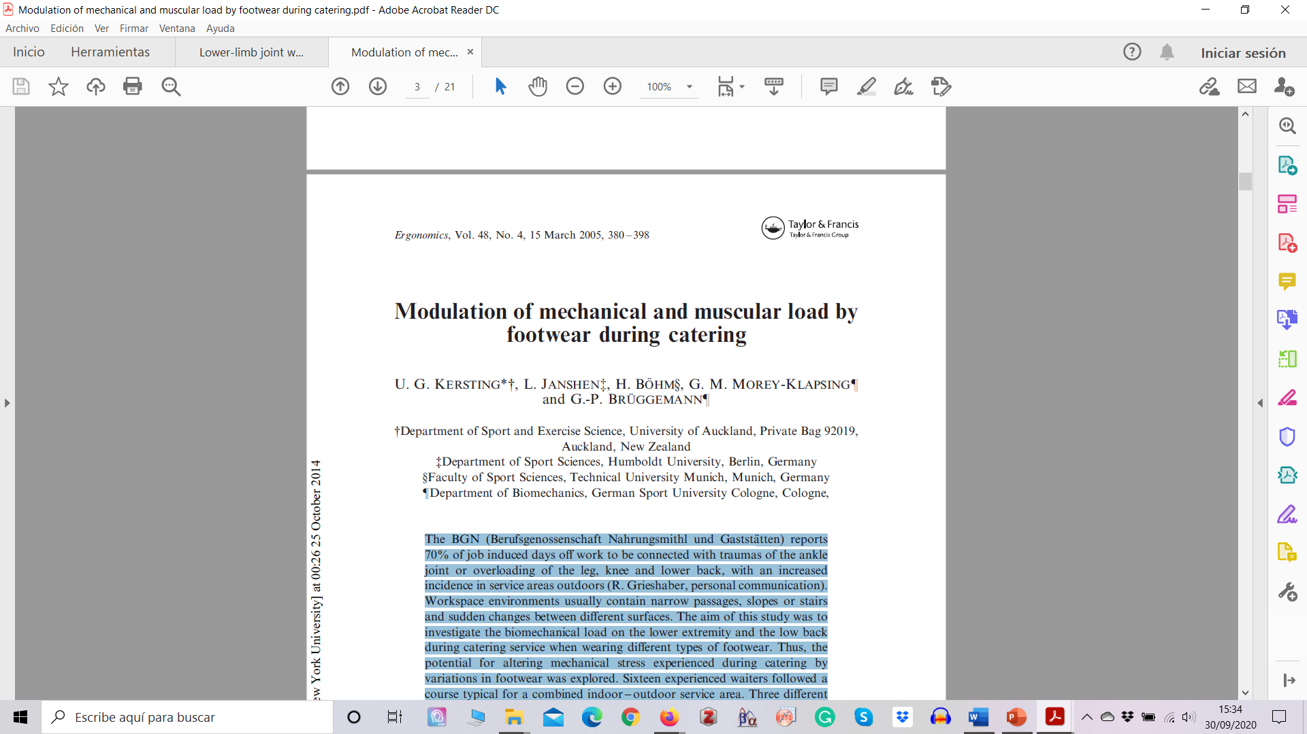

II.3 ERGONOMICS IMPLICATIONS
Example
To investigate the biomechanical load on the lower extremity and the low back during catering service when wearing different types of footwear.
70% of job induced days off work to relate to traumas of the ankle joint or overloading of the leg, knee and lower back.
Increased incidence in service areas outdoors

Slide 28
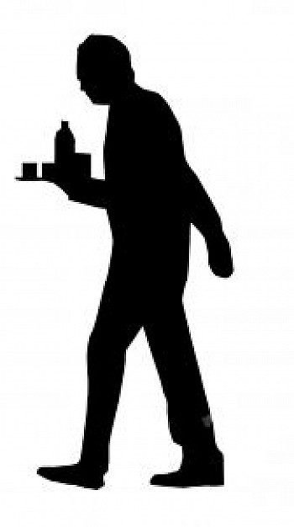
II.3 ERGONOMICS IMPLICATIONS
Example
Surface EMG: tibialis anterior, gastrocnemius medialis, peroneus longus
16 experienced waiters
Accelerometer fixed at the anterior tibial aspect of each leg
Three types of ground
Paved
Gravel
PVC
Custom-made in-shoe goniometer
Three types of footwear
Plantar pressure in-shoe (99 sensors per insole and 50 Hz )
Casual
Neutral
Functional
Figure 7 – Instrumentation from Kersting U. et al. 2015

Slide 29
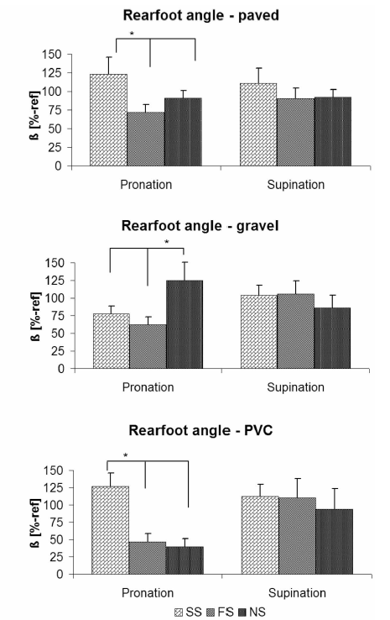
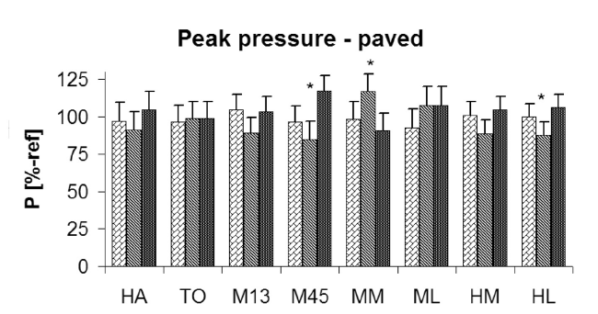
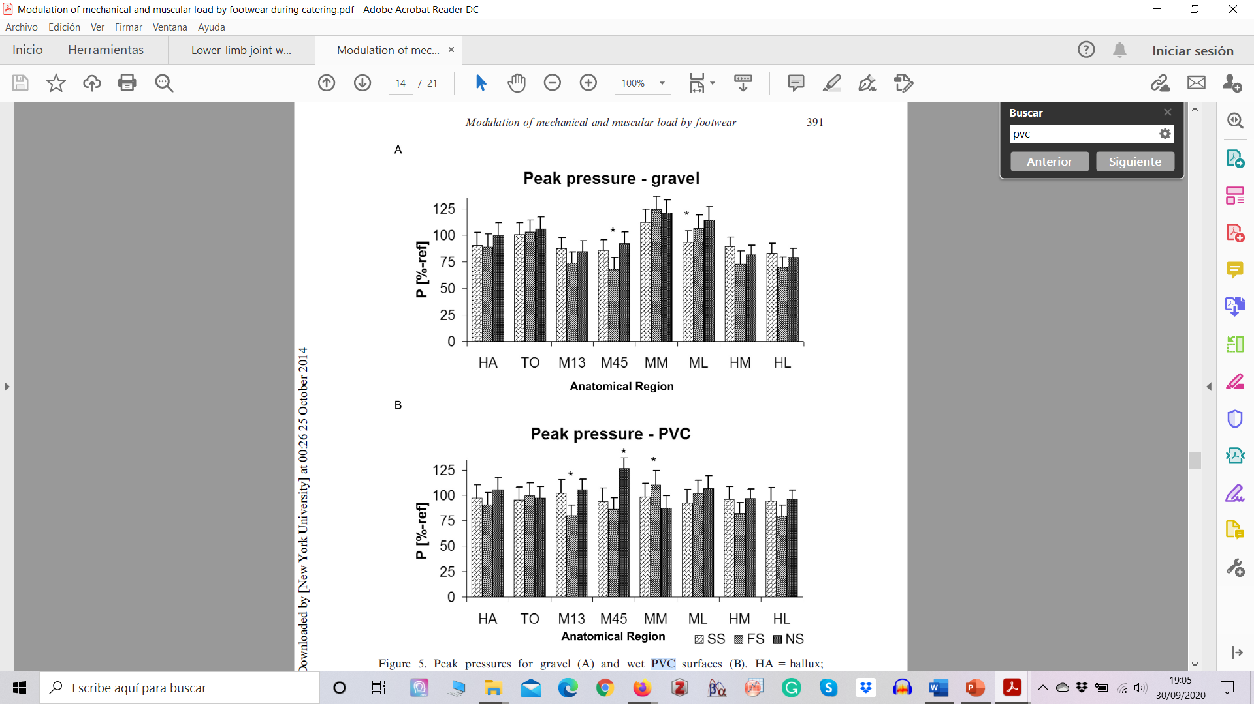
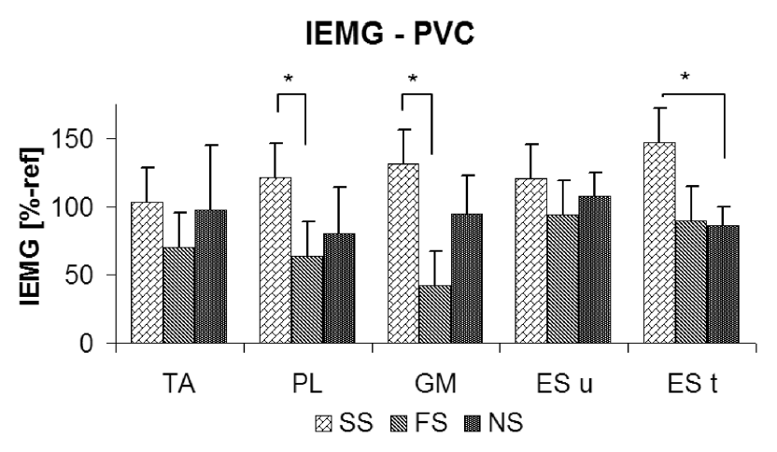
II.3 ERGONOMICS IMPLICATIONS
Example
Shoes and Surface have an effect on gait
Differences between footwear increase in critical situations

Slide 30
D.4 In which cases and how can a biomechanical instrumented analysis be useful?
II. CONTENTS
II.4 biomechanical instrumented gait analysis to assist legal medicine

Slide 31

II.4 ASSISTANCE IN LEGAL MEDICINE
Malingering
Is falsification or profound exaggeration of illness (physical or mental) to gain external benefits such as avoiding work or responsibility, seeking drugs, avoiding trial (law), seeking attention, avoiding military services, leave from school, paid leave from a job, among others.
Is not a psychiatric disorder!
Notes:
Ubaid ullah Alozai; Pamela K. McPherson. Malingering. Treasure Island (FL): StatPearls Publishing; 2020 Jan-.
https://www.ncbi.nlm.nih.gov/books/NBK507837/

Slide 32
II.4 ASSISTANCE IN LEGAL MEDICINE
Caused disease
Alleged disease
Immitted disease
Disguised disease
Exaggerated disease
Imputed disease
Modes of Malingering
Notes:
Ubaid ullah Alozai; Pamela K. McPherson. Malingering. Treasure Island (FL): StatPearls Publishing; 2020 Jan-.
https://www.ncbi.nlm.nih.gov/books/NBK507837/

Slide 33
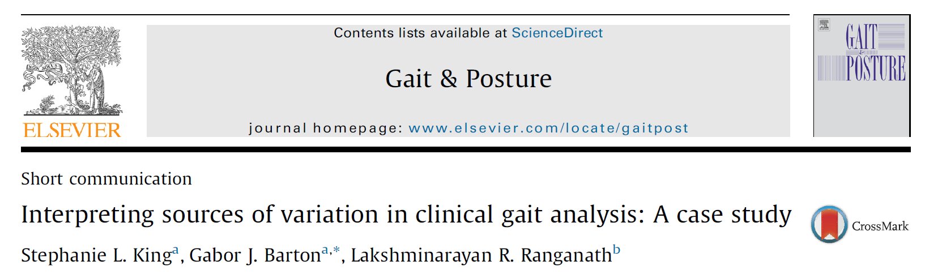
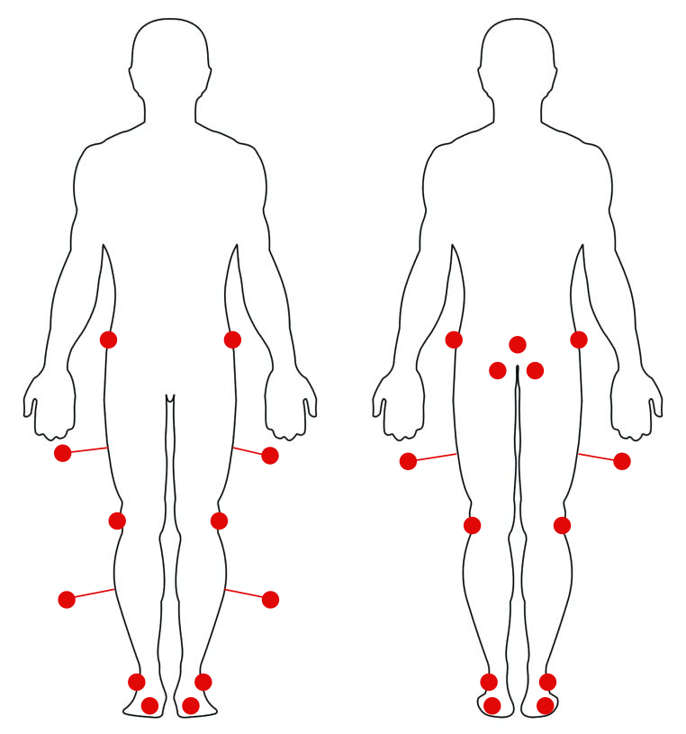
II.4 ASSISTANCE IN LEGAL MEDICINE
Example 1
Patient with severe osteoarthritis
Discuss sources of gait deviations during a gait analysis to identify in an objective way the malingering from a patient.
Gait deviation due to experimental error
A genuine gait deviation is a trusted abnormality
Intentional or non-habitual gait deviations are simulating by the patient
Figure - Helen Hayes marker set configuration

Slide 34
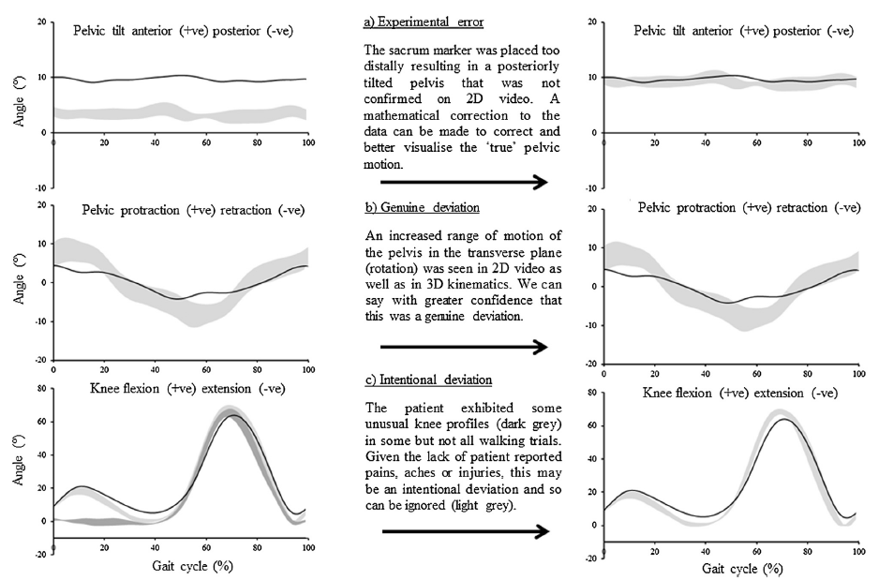
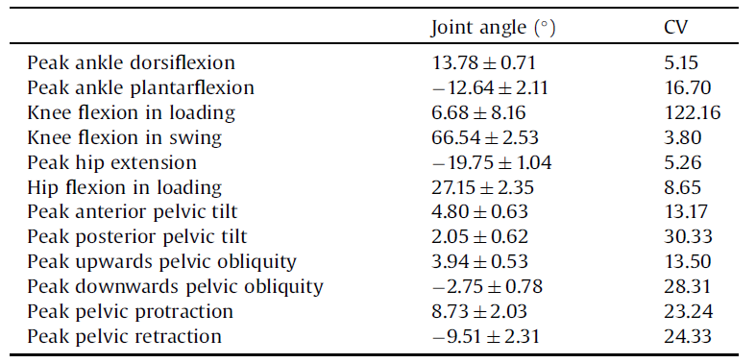
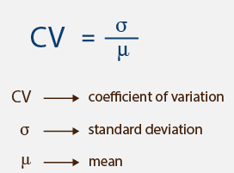
II.4 ASSISTANCE IN LEGAL MEDICINE
Example 1
Figure – Results from King S. et al. 2017

Slide 35
Instrumented Analysis of Gait - Clinical Application
III. KEY IDEAS

Slide 36
III. KEY IDEAS
The instrumented biomechanical assessment of gait is useful in medicine as it allows characterizing the population, supporting medical diagnosis and decision-making, and evaluating the effectiveness of medical and rehabilitative gait treatments.
In the sports field, the instrumented biomechanical gait evaluation allows us to analyze the sporting gesture, the performance conditions that can cause injury, and the impact of the sporting activity itself on the population. This information is useful in sports such as race-walking, hiking or Nordic walking.
In the area of ergonomics, the instrumented biomechanical gait assessment allows to analyze the impact of working conditions on the lower extremities and lumbar spine, being able to clearly identify changes in the worker's apparel or in the elements surrounding the job as the type of ground or the most demanding actions.
Within legal medicine, instrumented biomechanical gait evaluation allows the identification of abnormal and inconsistent movement patterns, related to simulation, which are usually characterized by a great variability of the repetitions recorded.

Slide 37
Instrumented Analysis of Gait - Clinical Application
IV. REFERENCES

Slide 38
IV. REFERENCES
Gnanasundarama S, Ramalingama P, Nath Dasb B, Viswanathanc V. Gait changes in persons with diabetes: Early risk marker for diabetic foot ulcer. Foot and Ankle Surgery 26 (2020) 163–168.
Lofterød B, Terjesen T, Skaaret I, Huse A, Jahnsen R. Preoperative gait analysis has a substantial effect on orthopedic decision making in children with cerebral palsy: Comparison between clinical evaluation and gait analysis in 60 patients. Acta Orthopaedica 2007; 78 (1): 74–80.
Espositoa F, Freddolinie M, Marcuccia M, Latellaa L, Corvia A. Biomechanical analysis on total knee replacement patients during gait: Medial pivot or posterior stabilized design? Clinical Biomechanics 78 (2020) 105068.
Kulshrestha V, Sood M, Kanade S, Kumar S, Datta B, Mittal G. kinemat Early Outcomes of Medial Pivot Total Knee Arthroplasty Compared to Posterior-Stabilized Design: A Randomized Controlled Trial. Clinics in Orthopedic Surgery 2020;12:178-186.
Taborri J, Palermo E, Rossi S. Automatic Detection of Faults in Race Walking: A Comparative Analysis of Machine-Learning Algorithms Fed with Inertial Sensor Data. Sensors 2019, 19, 1461.
Bohne M, Abendroth-Smith J. Effects of Hiking Downhill Using Trekking Poles while Carrying External Loads. Medicine & Science in Sports & Exercise: January 2007 - Volume 39 - Issue 1 - p 177-183.

Slide 39
IV. REFERENCES
Kocur P, Wiernicka M, Wilski M, Kaminska E, Furmaniuk L, Flis Maslowska M, Lewandowski J. Does Nordic walking improve the postural control and gait parameters of women between the age 65 and 74: a randomized trial. J. Phys. Ther. Sci. 27: 3733–3737, 2015.
Baudet A, Morisset C, d’Athis P, Maillefert J, Casillas J, Ornetti P, Laroche D. Cross-Talk Correction Method for Knee Kinematics in Gait Analysis Using Principal Component Analysis (PCA): A New Proposal. PlosOne, July 2014. Volume 9, Issue 7. e102098.
Kersting U, Janshen L, Bohm H, Morey-klapsing G, Bruggemann G. Modulation of mechanical and muscular load by footwear during catering. Ergonomics, Vol. 48, No. 4, 15 March 2005, 380 – 398.
Adam A, Verdú F. La simulación en medicina legal: una relación de casos malingering in legal medicine: a list of cases. Gac. int. cienc. forense ISSN 2174-9019. Nº 10. Enero-Marzo, 2014.
Díaz Salazar C. Simulation and deception in assessing practice. Med Segur Trab (Internet) 2014; 60 (235) 379-391.
King S, Barton G, Ranganath L. Interpreting sources of variation in clinical gait analysis: A case study. Gait & Posture 52 (2017) 1–4.

Slide 40
The European Commission's support for the production of this publication does not constitute an endorsement of the contents, which reflect the views only of the authors, and the Commission cannot be held responsible for any use which may be made of the information contained therein.

