Slide 1
MODULE BIOMECHANICS OF SPINE
Didactic Unit A
Topic: Biomechanics of the normal spine

Slide 2
A. Biomechanical of normal spine
Objectives
Normal biomechanics of the cervical spine
Normal biomechanics of the thoracic spine
Normal biomechanics of the lumbar, sacral and coccygeal spine
What load does the spine undergo when we are on different rest positions?
How is the biomechanics of the spine when we make functional motor gestures?
Conceptual maps
Bibliography

Slide 3
B. Biomechanical alterations of the spine
1. Objectives

Slide 4
1. OBJECTIVES
The objectives of this didactic unit are:
To rework the biomechanics of the different segments of the spine in normal conditions and their kinematic possibilities.
To review the biomechanics of the spine in normal condition in the main resting positions of the human being.
To revise the biomechanics of spine in normal condition during usual daily functional gestures.

Slide 5
B. Biomechanical alterations of the spine
2. Normal biomechanics of the cervical spine

Slide 6
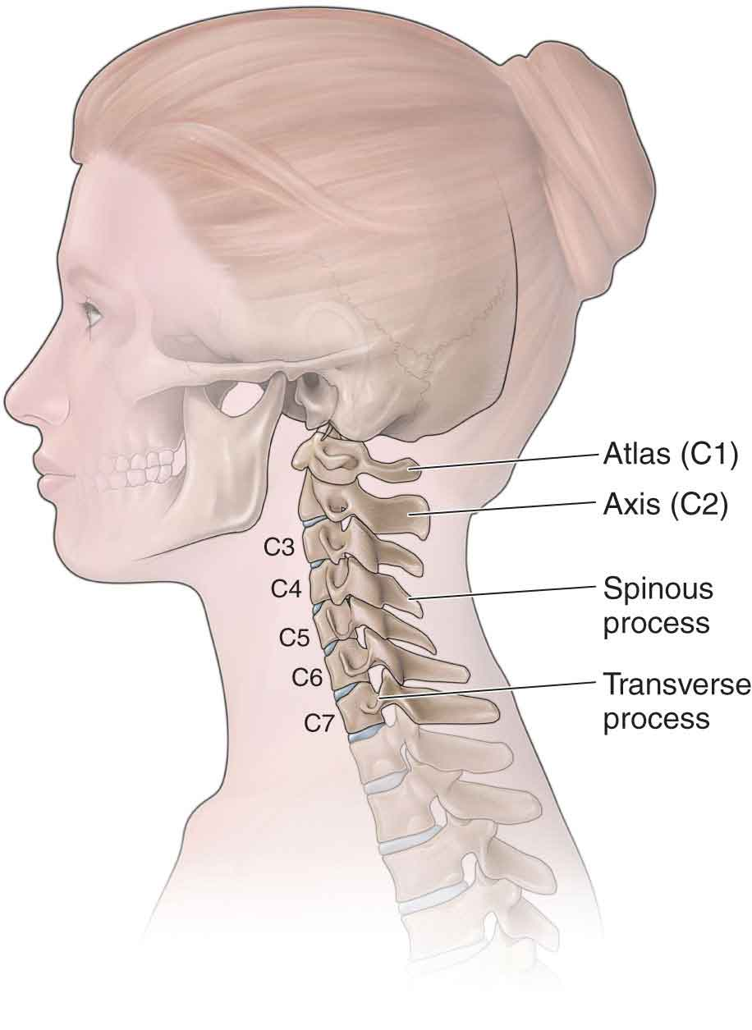
2. NORMAL BIOMECHANICS OF THE CERVICAL SPINE
7 vertebrae with lordotic curve.
It is divided in upper cervical spine (C1-C2) and lower cervical spine (C3-C7).
It has its own Functional Spine Unit (FSU) formed by:
Two adjacent vertebrae
The interconnecting soft tissue between them.
FSU has 12 potential movements divided in 3 axes.
Figure 1. Cervical spine basic structures
(extracted from www.muskuloskeletalkey.com)

Slide 7
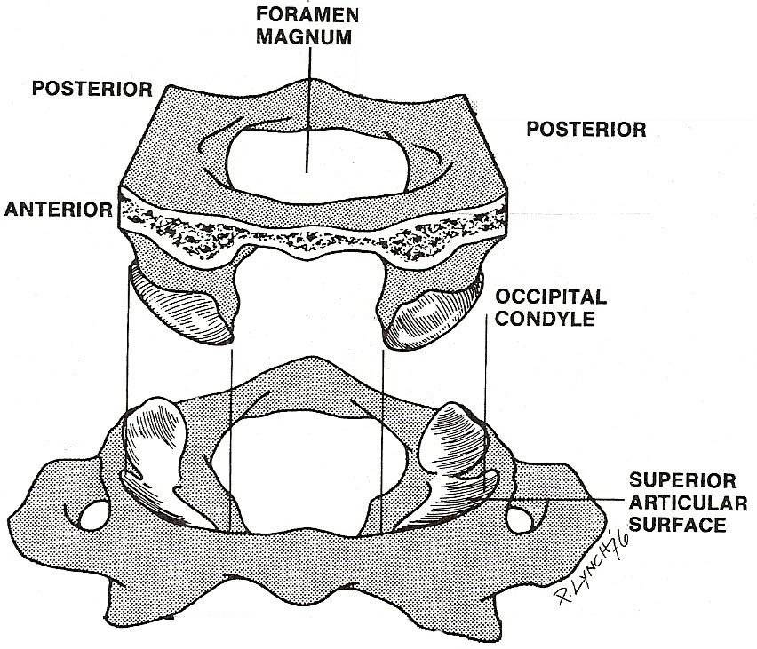
2.1. BIOMECHANICS OF UPPER CERVICAL SPINE
ATLANTO-OCCIPITAL JOINT
Primary movements: flexion, extension and nodding movements.
Movement restriction by:
Base of the skull.
Tension of posterior neck muscles.
Submandibular tissues.
Compression of suboccipital muscles.
Figure 2. Atlanto-occipital joint
(extracted from www.quiropracticagirona.com)

Slide 8
2.1. BIOMECHANICS OF UPPER CERVICAL SPINE
ATLANTO-OCCIPITAL JOINT
ROTATION
LATERAL FLEXION
Contralateral:
•Occipital condyle impacts with the anterior wall of atlantal socket.
Ipsilateral:
•Occipital condyle impacts with the posterior wall of atlantal socket.
Contralateral:
•Atlanto-occipital joint capsule prevents the condyle’s lifting.

Slide 9
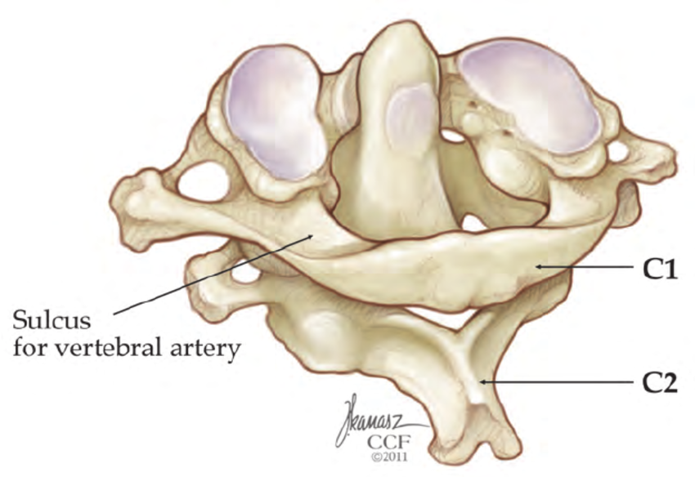
2.1. BIOMECHANICS OF UPPER CERVICAL SPINE
ATLANTO-AXIAL JOINT
Complex composed by:
Two lateral facet joints.
The arlantodental articulation.
Posterior odontoid’s surface.
Transverse ligament.
Figure 3. Atlanto-axial joint. Image from Clark JG. et al. 2011.

Slide 10
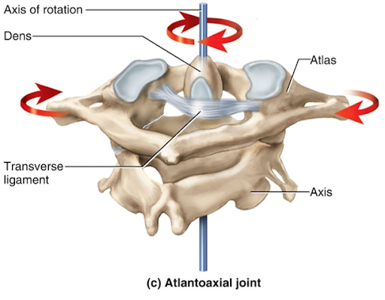
2.1. BIOMECHANICS OF UPPER CERVICAL SPINE
ATLANTO-AXIAL JOINT
The atlanto-axial median joint allows the atlas spins and glides around the pivot.
Lateral atlanto-axial joints are plane joints.
Joint stabilization provided by transverse, alar and apical ligaments.
During rotation, the atlas can move forward or backwards.
Figure 4. Odontoid pivot (extracted from www.imagequiz.co.uk)

Slide 11
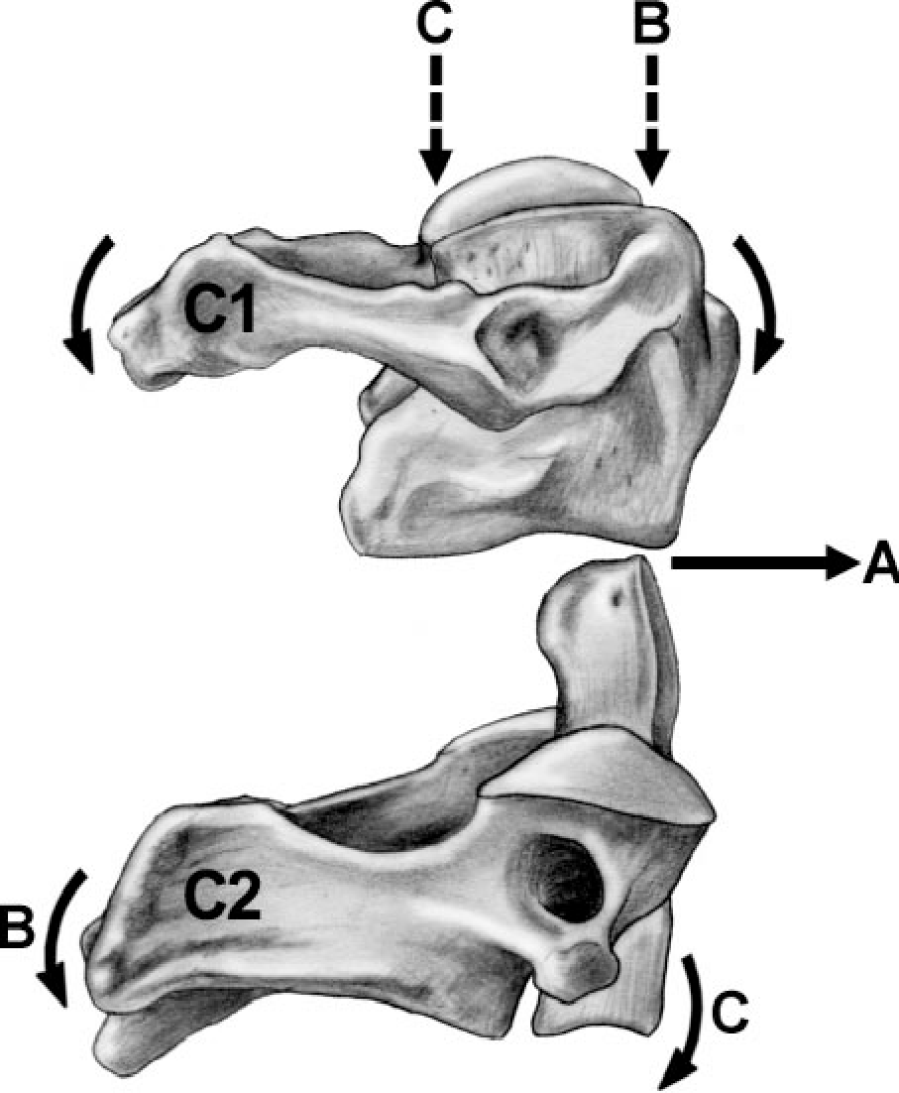
2.1. BIOMECHANICS OF UPPER CERVICAL SPINE
ATLANTO-AXIAL JOINT
Atlas flexes when cervical spine extends and viceversa
Backward movement limited by odontoid process. Forward movement limited by transversal and alar ligaments.
During axial compression C1 starts to move passively.
Tectorial membrane provides stability in backward movements.
Figure 4. Odontoid pivot (extracted from www.imagequiz.co.uk)

Slide 12
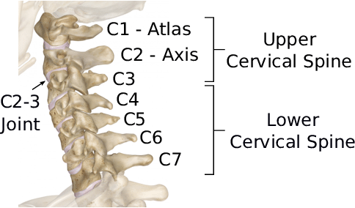
2.2. BIOMECHANICS OF LOWER CERVICAL SPINE
It is considered as lower cervical spine C3 to C7
C3 superior facets allows medial movement
Axis processes rest in a socket form by superior processes of C3
C2-C3 performs an opposite lateral flexion
Figure 5. Cervical spine scheme. Image from Barker S. et al. 2015.

Slide 13
2.2. BIOMECHANICS OF LOWER CERVICAL SPINE
Lower cervical vertebrae are separated by an intervertebral disc.
Articular surfaces are similar to a saddle joint:
Inferior Surface of vertebral body is concave downward.
Superior Surface of vertebral body is concave upward.
Forwards and backwards movements
Side-to-side movements
Transverse axis.
Perpendicular axis

Slide 14
B. Biomechanical alterations of the spine
3. Normal biomechanics of the thoracic spine

Slide 15
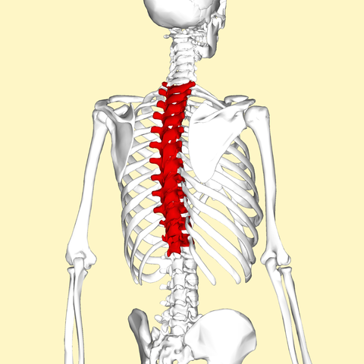
3. NORMAL BIOMECHANICS OF THORACIC SPINE
Sagital balance of the spine through erector spinae and abdominal muscles.
3 dimentional motions.
12 vertebraes (T1-T12) with a concave curvature called kyphosis.
Kyphosis normal angle of 45º:
Range of kyphosis of 20-70º asymptomatical.
Kyphosis is determined by lumbar lordosis and lower cervical vertebrae position.
Figure 6. Posterior ¾ view of Thoracic spine (extracted from www.lifeder.com)
.

Slide 16
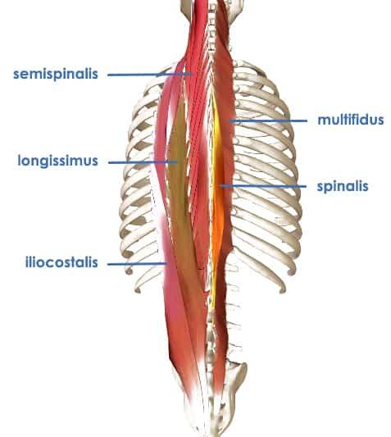
3. NORMAL BIOMECHANICS OF THORACIC SPINE
The thoracic spine has a musculature complex that maintain upright spinal position.
Axial loads increases in larger thoracic angles.
Thoracic vertebraes:
Support compressive loads in the anterior body area.
Resist tensile loads in the posterior body área.
Figure 7. Muscular thoracic spine complex (extracted from www.precisionmovement.coach)
.

Slide 17
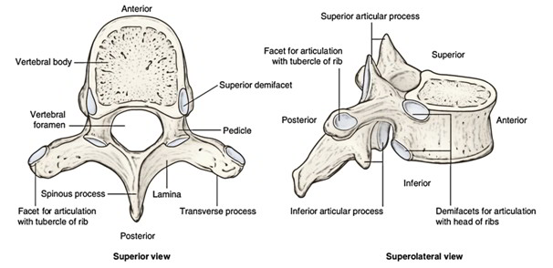
3. NORMAL BIOMECHANICS OF THORACIC SPINE
Figure 8. A thoracic vertebrae type (extracted from www.earthslab.coach)
.
Figure 9. Wedge angle and Facet joint angles of the thoracic spinal motion segments. Image from Galbusera F. et al. 2018..

Slide 18
3. NORMAL BIOMECHANICS OF THORACIC SPINE
Vertebral morphology due to kyphosis
Wedge angle ingrease till midthoracic vertebral bodies
Facets’s inclination limits F/E and rotation
Facets almost have a coronal orientation
Facets’s tilt angle increase gradually toward the lumbar spine
Resistance to translation and axial loads

Slide 19
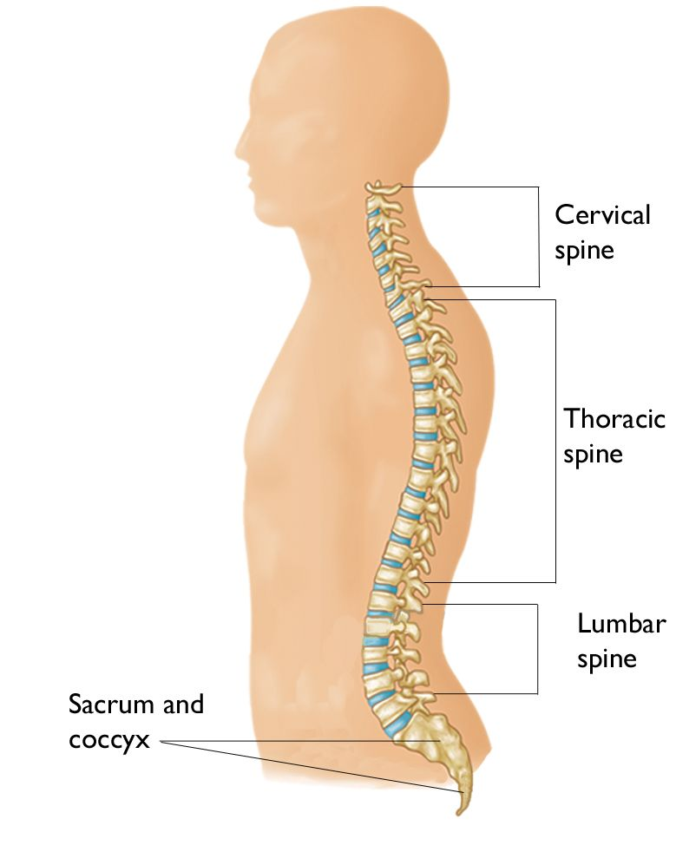
3. NORMAL BIOMECHANICS OF THORACIC SPINE
Thoracolumbar transition zone
Cervico-thoracic transition zone
Cervico-thoracic transition zone (C7-T1)
Facets’s orientation change in transverse plane from frontal toward sagital plane.
Sagital plane facets’s angle tends to decrease. Transverse angle tends to increase in superior direction.
Thoracolumbar transition zone (T11-L1)
Figure 10. Spine’s transition zones (edited from www.orthoinfor.aaos.org)
.

Slide 20
3. NORMAL BIOMECHANICS OF THORACIC SPINE
Kyphosis make vertebral body adopt a wedge shape
Presented towards lower thoracic spine
Disc’s máximum height reach at T10-T11
Discs heights decrease, but anulus fibrosus gets thicker and stronger
Figure 9. Wedge angle and Facet joint angles of the thoracic spinal motion segments. Image from Galbusera F. et al. 2018..

Slide 21
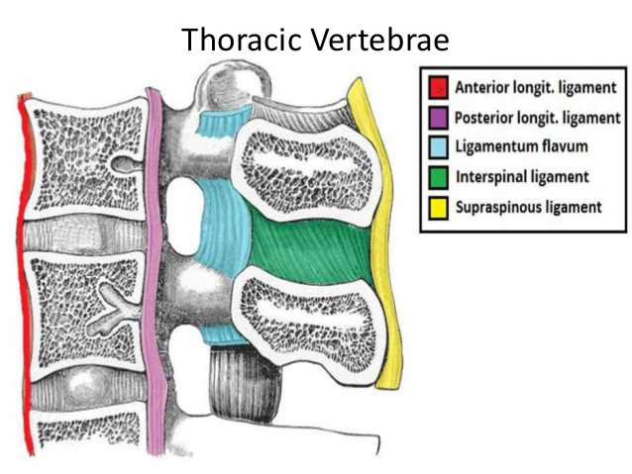
3. NORMAL BIOMECHANICS OF THORACIC SPINE
Figure 11. Thoracic ligament complex (extracted from www.slideshare.com)

Slide 22
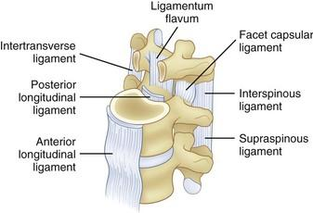
3. NORMAL BIOMECHANICS OF THORACIC SPINE
THORACIC SPINAL MOTION SEGMENT
Neutral zone
Close to neutral position
Bone and ligament structures offer minimal resistance
Figure 12. Thoracic ligament complex (extracted from www.clinicalgate.com)

Slide 23
3. NORMAL BIOMECHANICS OF THORACIC SPINE
THORACIC SPINAL MOTION SEGMENT
During forward bending
During backward bending
During lateral bending
During axial rotation
The superior vertebra flexes relative to inferior vertebra
The superior vertebra extends relative to the inferior vertebra
The superior vertebra should laterally flex relative to the inferior vertebra.
Rotation coupled in ipsi/contralateral directions
The superior vertebra rotates in the same direction as the axial rotation

Slide 24
3. NORMAL BIOMECHANICS OF THORACIC SPINE
THORACIC SPINAL MOTION SEGMENT
Rib cage influence instantaneous rotational axes.
In flexion/extension motions, rotational axis shifts to posterior in the sagittal plane.
In flexion/extension and lateral bending, instantaneous rotational axes run through the lower vertebra,
In axial rotation, rotation axis is located close to the posterior part of vertebral body.
Functional spinal unit does not consider the anterior portions of the ribs nor costocondral/sternochondral joints or sternum.
Study through ring unit.

Slide 25
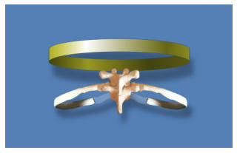
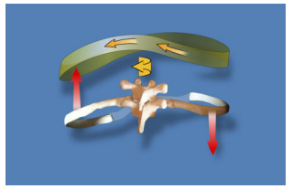
3. NORMAL BIOMECHANICS OF THORACIC SPINE
THORACIC SPINAL MOTION SEGMENT
Figure 13. (Left) A typical thoracic ring (Right) kinematics of typical thoracic ring. Image from Lee DG. et al. 2015.

Slide 26
B. Biomechanical alterations of the spine
4. Normal biomechanics of the lumbar, sacral and coccygeal spine

Slide 27
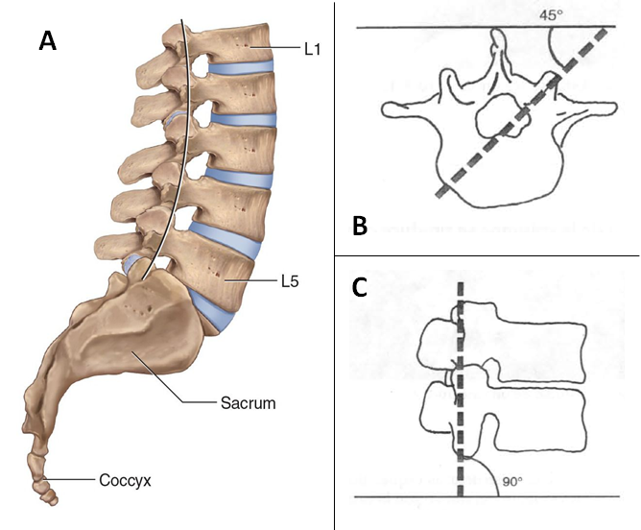
4. NORMAL BIOMECHANICS OF THE LUMBAR, SACRAL AND COCCYGEAL SPINE
5 lumbar vertebrae, 5 fused sacral vertebrae, 4-5 coccygeal vertebrae.
Lumbar’s posterior concavity (lordosis), sacrum’s anterior concavity.
Lumbar vertebrae characteristics:
Widest and biggest vertebral body to bear high loads.
With terminar bony endplates.
Vertebral bodies with different heights depending anterior or posterior zone.
Figure 14. A: Lumbar spine, sacrum and coccyx. Image from Joseph E. Muscolino 2015. B-C: orientation of the lumbar faces respect sagital and transverse plane. Image B and C from Nordin M. 2001.

Slide 28
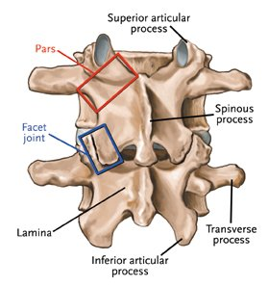
4. NORMAL BIOMECHANICS OF THE LUMBAR, SACRAL AND COCCYGEAL SPINE
Lumbar vertebrae facets:
90º and 45º orientation in transverse plane.
Load sharing with intervertebral discs (IVD).
Determine high resistance with translational and rotational movements.
Facilitate flexion and extension movements.
Figure 15. Lumbar vertebrae structures (extracted from www.joint-pain-solutions.com)

Slide 29
4. NORMAL BIOMECHANICS OF THE LUMBAR, SACRAL AND COCCYGEAL SPINE
LUMBAR SPINAL MOTION SEGMENT
Flexion movements
Extension movements
IVD increase its thick in the posterior part.
Nucleus pulposus goes backward.
Capsule and ligaments get tighter.
IVD increase its thin in the posterior part.
Nucleus pulposus goes forward.
Anterior longitudinal ligament strech and posterior ligaments distend.
Limited by bone and tensión.

Slide 30
4. NORMAL BIOMECHANICS OF THE LUMBAR, SACRAL AND COCCYGEAL SPINE
LUMBAR SPINAL MOTION SEGMENT
Lateral bending
IVD increase its thick on the contralateral side.
Nucleus pulposus shifts slightly to ipsilateral side.
Facets rise in contralateral side.
Facets drop in ipsilateral side.

Slide 31
4. NORMAL BIOMECHANICS OF THE LUMBAR, SACRAL AND COCCYGEAL SPINE
LUMBAR SPINAL MOTION SEGMENT
Figure 16. Segmental motion of lumbar spine. A: flexion, B: extension, C: anterior view of lateral bending, D: posterior view of lateral bending. Images from Kapandji A.I. 1998

Slide 32
4. NORMAL BIOMECHANICS OF THE LUMBAR, SACRAL AND COCCYGEAL SPINE
THE SACRUM AND COCCYX
Sacrum
Coccyx
Articulates with 5º lumbar vertebrae, coccyx and iliac bones.
With intervertebral discs.
Iliolumbar ligament limitates movement at lumbosacral and sacroiliac joints.
Articulates with sacrum with a fibrocartilaginous joint.
Anterior and posterior lateral sacrococcygeal ligament, intercornual ligaments and IVD bound the sacrococcygeal joints.

Slide 33
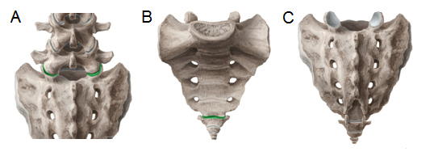
4. NORMAL BIOMECHANICS OF THE LUMBAR, SACRAL AND COCCYGEAL SPINE
THE SACRUM AND COCCYX
Figure 17. The lumbosacral and sacrococcygeal joint. A: zygapopohyseal joints from lumbosacral union. B: Anterior view of sacrococcygeal joint. C: Posterior view of sacrococcygeal joint. Images from KenHub web site.

Slide 34
B. Biomechanical alterations of the spine
5. What load does the spine undergo when we are on different rest positions?

Slide 35
5. WHAT LOAD DOES THE SPINE UNDERGO WHEN WE ARE ON DIFFERENT REST POSITIONS?
Standing position
Sitting position
Weight transmission through sacrum, ilium to femur.
Relaxed standing preassure of 0.48 to 0.5 Mpa.
Weight transmisión through sacrum, ilium to ischial tuberosities.
Lumbar supporthas the greatest infuence on lumbar lordosis.
Figure 18. Standing and sitting model (extracted from www.shutterstock.com)

Slide 36
5. WHAT LOAD DOES THE SPINE UNDERGO WHEN WE ARE ON DIFFERENT REST POSITIONS?
Supine or lying position
Flexing legs in lying position increase L4-L5 preassure in 0.08MPa.
Coughing or sneezing increase preassure in 0.38 MPa .
Laughing increase preassure in 0.15 MPa.
Figure 19. Lying model (extracted from www.es.dreamstime.com)

Slide 37
B. Biomechanical alterations of the spine
6. How is the biomechanics of the spine when we make functional motor gestures?

Slide 38
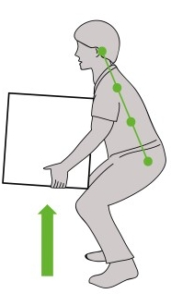
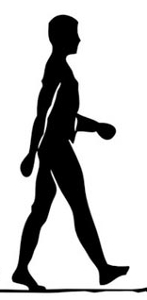
5. HOW IS THE BIOMECHANICS OF THE SPINE WHEN WE MAKE FUNCTIONAL MOTOR GESTURES?
Lift and carry objects
Gait
Lifting techniques are important to reduce intradiscal pressure.
50% more pressure during bent forward.
More lumbar stability and balance during lifting.
Importance of facets
Intradiscal load increase 0.2 to 2.5 times in L3-L4.
Máximum load in takeoff phase.
Exists a linear coorelation between intradiscal load and walking speed.
Figure 20. Lifting and gait model (extracted from www.neurospinewellnesscenter.com & www.brightmindcenter.com )

Slide 39
B. Biomechanical alterations of the spine
7. Key ideas

Slide 40
7. KEY IDEAS
The spine has four major interrelated functions: support, mobility, housing and protection, and control.
Motion segment is the "Functional Spine Unit" (FSU) that consists of two adjacent vertebrae and the interconnecting soft tissue, devoid of musculature. Each FSU has six grades of freedom.
The cervical section is made up of 7 vertebrae and form one of two lordosis of the spine, which greatly increase the resistance to the stress of axial compressions compared to a rectilinear column (up to ten times).
The Atlanto-occipital joint is formed for atlas and the condylar part of the occipital bone, allows the nodding movements by the rolling and gliding of the occiputal condyles on the concave surface of the socket, located in the superior face of the lateral mass of the atlas.

Slide 41
7. KEY IDEAS
The atlanto-axial complex is composed by two lateral facet joints, the unique atlantodental articulation and the joint between the posterior surface of the odontoid and the transverse ligament and allows the anterior arch of the atlas spins and glides around the pivot, allowing the atlas and head to rotate from side to side as one unit.
The thoracic spine have 12 vertebrae from T1 to T12 that form a concave curvature to the ventral direction in the sagittal plane call kyphosis. The kyphotic nature of the spine further leads to a primary compressive load distribution in anterior direction toward the vertebral body, whereas the posterior mainly have to resist tensile loads.
The distal region of the spine is made up of the lumbar section of 5 vertebrae, the sacral section of 5 fused vertebrae and the coccygeal section, made up of 4–5 vertebrae. While the lumbar spine has a posterior concavity lordosis, the sacrum has an anterior concavity.

Slide 42
7. KEY IDEAS
In the movements of lumbar extension and flexion, is observed the most vertebral translation, which makes the measurement of lumbar translation a determining factor of spinal instability.
The load on the intervertebral discs changes depending on the position of the body and the actions performed. In the supine position, the intradiscal pressure at the lumbar level is around 0.08 MPa, while during relaxed standing, the pressure varies between 0.48 and 0.5 MPa. In a sitting position, the pressure is similar to biped position, but the inclination of the backrest greatly influences the decrease in this pressure, as does the use of arm rest.
During gait the intradiscal lumbar load increase between 0.2 to 2.5 times with respect to the intradiscal pressure at rest. However, during the gesture of lifting a weight from the ground, the pressure rose further by 70% to 220%, especially if it does it with the back bent and the knees extended. It will also influence this intradiscal pressure if the weight that is lifted is away from the body.

Slide 43
B. Biomechanical alterations of the spine
8. Bibliography

Slide 44
8. BIBLIOGRAPHY
Bogduk, N. Mercer, S. Biomechanics of the cervical spine. I: Normal kinematics. Clinical Biomechanics. 2000 (15) 633-648.
Brasiliense, LBC. Lazaro, BCR. Reyes, PM. Dogan, S. Theodore, N. Crawford, NR. Biomechanical contribution of the Rib Cage to Thoracic Stability. Spine. 2011, 36(26):E1686-E1693.
Ebraheim, NA. Patil, V. Liu, J. Haman, SP. Yeasting, RA. Morphometric analyses of the cervical superior facets and implications for face dislocation. International Orthopaedics (SITCOT). 2008, 32:97-101.
Friis, EA. Arnorl, PM. Goel, VK. Mechanical testing of cervical, thoracolumbar, and lumbar spine implants. Elsevier. 2017 May; 161-180.
Galbusera, F. Wilke, HJ. Biomechanics of the spine. Chapter 4 - Basic Biomechanics of the lumbar spine. Elsevier. 2018, 51-67.
Hansen, L. de Zee, M. Rasmussen, J. Andersen, TB. Wong, C. Simonsen, EB. Anatomy and Biomechanics of the Back Muscles in the Lumbar Spine With Reference to Biomechanical Modeling. Spine. 2006, 31(17):1888-1899.
Herkowitz, HN. Garfin, SR. Eismont, FJ. Bell, GR. Balderston, RA. Rothman-Simeone The Spine: Expert Consult. Elsevier. Chapter 7- Biomechanics of the Spinal Motion Segment. 2015, 109-128.
Joseph E. Muscolino. Manual Therapy for the Low Back and Pelvis. A clinical orthopedic approach. Ed. Wolters Kluwer. 2015.
Kapandji, AI. Fisiología Articular – Tronco y Raquis 5ª Edición. Chapter 3 – El raquis lumbar. 1998, 76-128.
Kiapour, A. Joukar, A. Elgafy, H. Erbulut, DU. Agarwal, AK. Goel, VK. Biomechanics of the sacroiliac joint: anatomy, function biomechanics sexual dimorphism, and causes of pain. International Journal of Spine Surgery. 2020, 14:S3-S13.

Slide 45
8. BIBLIOGRAPHY
Lee, DG. Biomechanics of the thorax – reseach evidence and clinical expertise. Journal of Manual and Manipulative Therapy. 2015, 23(3):128-138.
Liebsch, C. Wilke, HJ. Biomechanics of the spine. Chapter 3 – Basic Biomechanics of the Thoracic Spine and Rib Cage. Elsevier. 2018, 35-50.
Lomeli-Rivas, A. Larrinúa-Betancourt, JE. Biomecánica de la columna lumbar: un enfoque clínico. Acta Ortopédica Mexicana. 2019, 33(3):185-191.
Menchetti, PPM. Cervical Spine Minimally Invasive and Open Surgery. Chapter 2 – Functional Anatomy and Biomechanics of the Cervical Spine. Springer. 2016. 11-26.
Miralles, RC. Puig, M. Biomecánica clínica de aparato locomotor. Part 4 – Biomecánica de los movimientos. Mason, S.A. 2000, 295-315.
Oakes, PC. Sardi, JP. Iwanaga, J. Topale, N. Oskouian, RJ. Tubbs, S. Translation of Hecker’s 1922 „the Occipital-Atlanto-Axial Ligament System”. Clinical Anatomy. 2017, 30:322-329.
Pope, MH. Biomechanics of the Lumbar Spine. Ann Med. 1989 Oct;21(5):347-51.
Romberg, K. Olsén, MF. Kjelby-Wendt, G. Hallerman, KL. Danielsson, A.Thoracic mobility and ist relation to pulmonary function and rib-cage deformity in patients with early onset idiopathic scoliosis: a long-term follow-up. Spine Deformity. 2020, 8:257-268.
Stammen, JA. Herriott, R. Kang, YS. Bolte, J. Dupraix, R. Sequential Biomechanics of the Human Upper Thoracic Spine and Pectoral Girdle. Annals of Advances in Automotive Medicine. 2012 Oct, 56:151-162.

Slide 46
8. BIBLIOGRAPHY
Swartz, EE. Floyd, RT. Cendoma, M. Cervical Spine Functional Anatomy and the Biomechanics of Injury Due to Compressive Loading. Journal of Ahtletic Training. 2005; 40(3)c155-161.
Tague, RG. Fusion of Coccyx to Sacrum in Humans: Prevalence, correlates, and effect on pelvic size, with obstetrical and evolutionary implications. American Journal of Physical Anthropology. 2011, 145:426-437.
Travascio, F. Eltoukhy, M. Asfour, S. Spine Biomechanics: A review of current aprroaches. Spine Research. 2015, 1(1:4)
Watson, C. Paxinos, G. Kayalioglu, G. The Spinal Cord. Chapter 3 – The Vertebral Column and Spinal Meninges. Elsevier. 2008, 17-36.
Yoganandan, N. Nahum, AM. Melvin, JW. Accidental Injury Biomechanics and Prevention Third Edition. Chapter 15 – Thoracic Spine Injury Biomechanics. Spinger. 2015, 435-450.
Zentrum für Chirurgie, AI. Biomechanics of the Thoracic Spine – Development of a Method to Measure the influence of the Rib Cage on Thoracic Spine Movement. Medicine. 2012.

Slide 47
The European Commission's support for the production of this publication does not constitute an endorsement of the contents, which reflect the views only of the authors, and the Commission cannot be held responsible for any use which may be made of the information contained therein.

