Slide 1
MODULE BIOMECHANICS OF SPINE
Didactic Unit B
Biomechanical alterations of the spine

Slide 2
B. Biomechanical alterations of the spine
Introduction
Objectives
Training contents
Summary
Conceptual maps
Bibliography.

Slide 3
B. Biomechanical alterations of the spine
Part 1. Objectives

Slide 4
1. OBJECTIVES
The objectives of this didactic unit are:
To learn the biomechanics behind the main cervical, thoracic and lumbosacral spine pathologies.
To know the biomechanics related to the conservative techniques and treatment of the main spine pathologies.
To know the biomechanics related to the surgical intervention of the main spine pathologies.

Slide 5
B. Biomechanical alterations of the spine
Part 2. Biomechanics of the main pathologies of the cervical spine

Slide 6
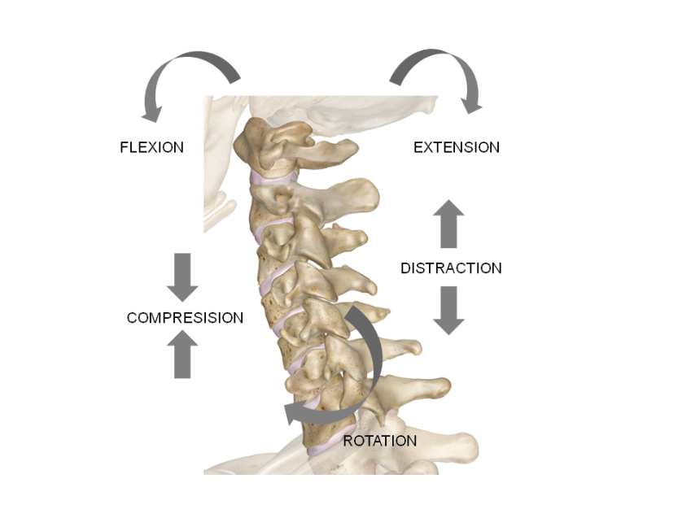
2.1. INTRODUCTION
There are a variety of reproducible injury patterns based on the direction and magnitude of force applied to the highest segment of the spine:
Flexion
Lateral-flexion
Extension
Compression
Shear
Rotation
Figure 1. Injury mechanisms
of the cervical spine
(extracted from www.innerbody.com)

Slide 7
2.2. INJURIES OF THE UPPER CERVICAL SPINE
1/3 of the total of cervical injuries
40% of this results by death
Injury level of the Cervical Spine
Fractures of condyles of the occipital bone
Atlantoocipital dislocation
Fractures of the Atlas
Fractures of the Axis
Atlantoaxial dislocation

Slide 8
2.2. INJURIES OF THE UPPER CERVICAL SPINE
Main causes
Young patients
Elderly patients
Osteoporosis
High energy trauma
Main injury’s mechanism
Hiperflexion
Hiperextension
Latero-flexion
Rotation
Combination of all

Slide 9
2.2.1. FRACTURES OF CONDYLES OF THE OCCIPITAL BONE
Occipital condyle fractures (OCFs)
Rare traumatic injury
Associated with instability
Occipitoatlantoaxial joint complex
Easily undetected under radiographs but detected with CT scan.
Figure 2. CT Scan of a minimally displaced fracture of the right inferior medial occipital condyle.
(from Muhammad Waseem et al. 2014)

Slide 10
2.2.1. FRACTURES OF CONDYLES OF THE OCCIPITAL BONE
Table 1: Anderson and Montesano (1988) Classification of OCF
Type | Description | Biomechanics | Stability
I | Impaction | Results from axial loading; ipsilateral alar ligamente may be compromised but stability is maintened by contraleteral alar ligament and tectorial membrane | Stable fracture
II | Skull base extension | Extends from occipital bone via condyle to enter foramen magnum; stability is maintened by intact alar ligaments and tectorial membrane | Stable fracture
III | Avulsion | Mediated via alar ligament tension; associated disruption of tectorial membrane and contralateral alar ligament may cause instability | Unstable fracture

Slide 11
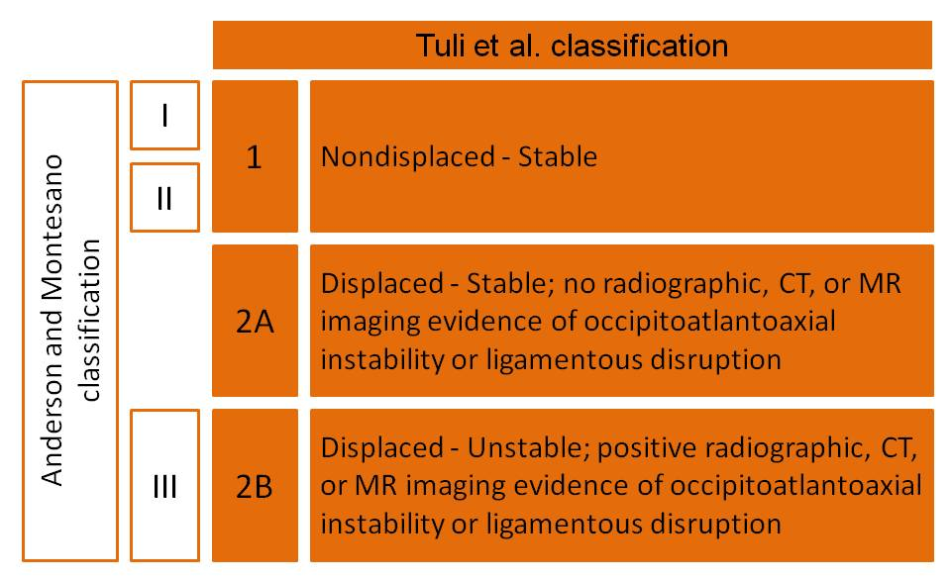
2.2.1. FRACTURES OF CONDYLES OF THE OCCIPITAL BONE
Figure 3. Tuli et al. (1997) Classification of Occipital Condyle Fractures. From Hanson J.et al. 2002

Slide 12
2.2.2. ATLANTOOCIPITAL DISLOCATION
Atlantooccipital dislocation (AOD) or Occipital dissociation (OCD)
Dissociation of the occiput from cervical spine
Produced in distraction and extensión forces applied to occiput in relation to atlas.
Injury mechanism in rapid decelerations.
AOD commonly in children:
Due to its relation head-body mass.
Due to its occipital condyles are smaller.
Due to its atlantooccipital ligaments are more lax.
Due to its craniovertebral junctions are more horizontal.

Slide 13
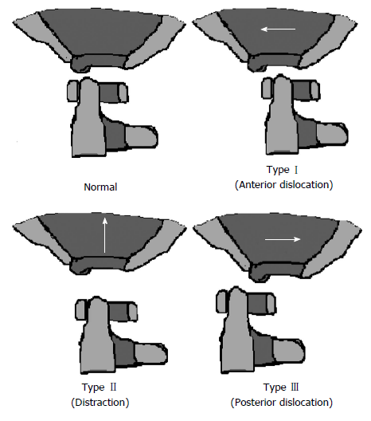
2.2.2. ATLANTOOCIPITAL DISLOCATION
Figure 4. The Traynelis classification for Atlantoocipital dislocation (from Hall GC. et al. 2015)

Slide 14
2.2.3. FRACTURE OF THE ATLAS
Fractures of the Atlas
Traumatic axial loading trough occiput
Also produced by extensión, flexion and rotation forces.
Depending the different combination of forces anterior or posterior arch fracture or a unilateral mass fracture can occur.

Slide 15
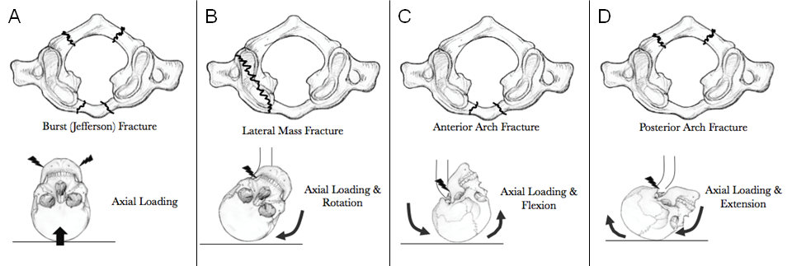
2.2.3. FRACTURE OF THE ATLAS
Figure 5. Atlas vertebral fractures (Image from: www.ebconsult.com)

Slide 16
2.2.4. ATLANTOAXIAL DISLOCATION
Atlantoaxial dislocation
Refered to instability between atlas and axis (C1-2)
Traumatic, inflammatory, idiopathic or congenital abnormalities can produce instability.
Extremely rare injury by trauma if there’s not a pre-existing injury .
Disruption of the transverse ligament of the Atas.
Also a rare injury of alar and apical ligaments due to transverse ligament injury may be produced.

Slide 17
2.2.4. ATLANTOAXIAL DISLOCATION
Table 2: Clinical signs of atlantoaxial dislocation (Yang et al. 2014)
Less serious signs | Moderate signs | Most severe signs
Approximately 50% of patients present with neck pain and/or neck movement restriction 70% of patients present with weakness and/or numbness 90% of patients present with pyramidal signs | Sphincter disturbances Lower cranial nerve dysfunction Respiratory distress | Myelopathy Respiratory failure Vertebral artery dissection Neurologic compromise Rarely quadriplegia Death if left untreated

Slide 18
2.2.4. ATLANTOAXIAL DISLOCATION
Atlantodental Interval (ADI)
Small slitlike space between the posterior aspect of the anterior atlas ring and the anterior aspect of the odontoid process
Measured by flexion and extensión radiograph of the neck.
Sagittal radiograph measurement. From a line projected superiorly along the anterior border to the axis body to the anterior arch of the atlas
ADI is constant during head movements. Normaly 3mm in adults, 5mm in children.
70% of atlantoaxial clinical is due to anterior dislocation.

Slide 19
2.2.4. ATLANTOAXIAL DISLOCATION
Figure 6. ADI during flexo-extensión cervical spine’s movement (from Yang et al. 2014)

Slide 20
2.2.5. FRACTURE OF THE AXIS
Fracture of axis
The most common fracture of the spinal spine (10% of all spine injuries).
Clinically silent unless they cause spinal cord compression.
Odontoid fracture can be caused by both extensión and flexion forces.
The injury of alar, transverse, anterior and posterior longitudinal ligaments may produce unstable C1-2 complex.
The traumatic spondylolsthesis of the Axis creates dramatic instability.
The lower cervical compensates the altered sagital balance of upper cervical spine.

Slide 21
2.3. INJURIES OF THE LOWER CERVICAL SPINE
Burst fractures
Teardrop fracture
Midsagittal cleavage fracture
Disruption of the facet joints
Spinous apophysis fracture
Whiplash-associated disorder

Slide 22
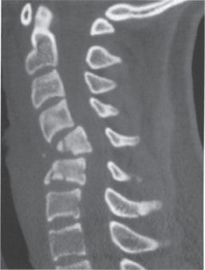
2.3.1. BRUST FRACTURES
Axial loading force in cervical spine
Neck position in neutral. No flexion force applied.
Compresion fracture
Vertebrae body from C3 to T1 may be injured
Posterior ligamentous complex remain intact
Maintained force may retropulse the vertebral body causing spinal cord injury.
Figure 7. Sagittal CT showing C5-6 burst fracture with compromised canal of the spinal cord (from Neupsykey.com)

Slide 23
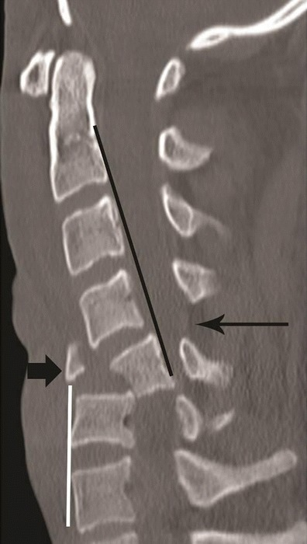
2.3.2. TEARDROP FRACTURE
Produced in mixed axial compression and flexion forces
Posterior portion of the vertebral body retropulsed into the canal.
Posterior subluxation of the vertebral body
Acute kyphosis
Disruption of the anterior and posterior longitudinal ligament
High incidence of quadriplegia.
Figure 8. Sagittal CT
teardrop fracture in Young patient
(from ResearchGate.com)

Slide 24
2.3.3. MIDSAGITTAL CLEAVAGE FRACTURE
Variation of Burst fracture.
Usually seen in lower cervical spine (C4-5-6)
The C4-5-6 closed bony ring shape determine this fracture.
Fracture in lamina and facet joint disruption due to vertebral body fracture.
Highly and glossly unstable injury.
Body bony parts often impinge spinal cord.

Slide 25
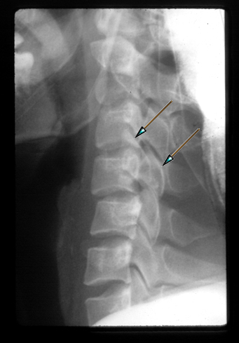
Flexion/extensión forces mixed with rotatory forces may produce facet dislocation.
C4-5 or C5-6 levels usually affected.
May involve a fracture in one or both vertebral facet.
Inferior facets of the higher vertebra slide over the lower vertebra
2.3.4. DISRUPTION OF THE FACET JOINTS
Figure 9. Bilateral facet dislocation (from Orthobullets.com)

Slide 26
2.3.4. DISRUPTION OF THE FACET JOINTS
Unilateral facet dislocation
Bilateral facet dislocation
Forces acting are mostly flexion and rotatory.
Often monoradiculopathy symptom
Forces acting are mostly flexion/distraction.
Less rotatory forces than in unilateral dislocation.
The forces acting allows upper cervical dislocate anteriorly over lower cervical.

Slide 27
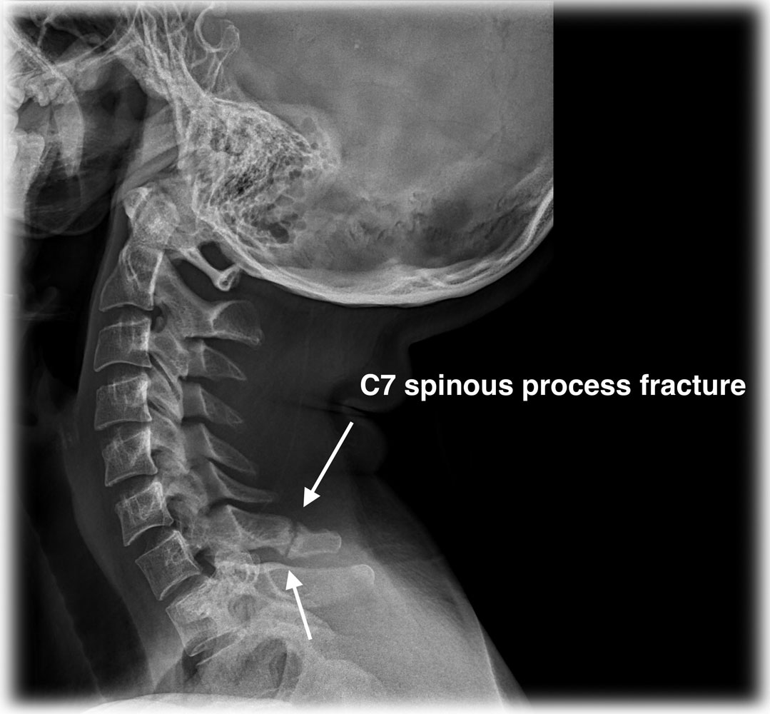
2.3.5. SPINOUS APOPHYSIS FRACTURE
Rupture of one or more cervical spinous processes.
Usually refered as “excavator fracture”
High magnitude force transmitted from shoulder girdle to spinous apophysis
Fracture usually located in C6-7 due to its longer spinous processes
Spinous processes ar not able to whitstand high flexor moment
Fracture close to vertebral body
Figure 10. Fracture of the C7 spinous process (from earthlab.com)

Slide 28
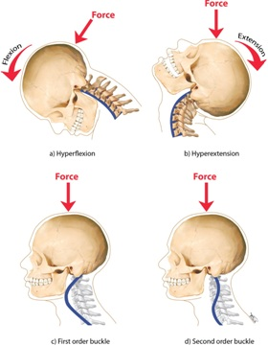
2.3.6. WHIPLASH-ASSOCIATED DISORDER
Term to describe clinical manifestations of whiplash injury
Mechanism of acceleration-deceleration of energy transfer to the neck
Produced from rear end or side-impact motor vehicle collisions
Also produced during diving activities.
Figure 11. Whiplash mechanism and vector force applied (from activephysioterapy.com)

Slide 29
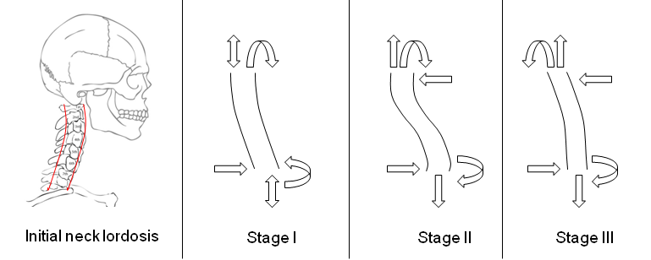
2.3.6. WHIPLASH-ASSOCIATED DISORDER
Figure 12. Models of neck deformation, and force and momento diagrams at three stages of a rear-end impact (from Luan F. et al. 2009)

Slide 30
2.3.6. WHIPLASH-ASSOCIATED DISORDER
Table 3: Phases and kinematics events during a rear impact (Kaneoka K. et al 2002)
Phase 1: Slede motion | Phase 2: Neck axial force | Phase 3: Axial and shear force | Phase 4: Full extension
0-40 ms | 40-100 ms | 100-160 ms | 150-220 ms
a. The seat begins to press the back of the volunteer | a. The torso moves forward–pushed by the seatback | a.The sled slows the torso rebounds and moves forward with some backward rotation | a. The torso moves forward and downward
b. The spine begins to straighten | b. The torso moves upward–parallel to the seat inclination,causing axial compression of the cervical spine due to the inertia of the head, which reaches a maximum | b. The axial force on the neck decreases while the shear force on the neck reaches a peak at about 120 ms | b. The head and neck rotation reaches full extension
c. Cervical motion has not occurred | c.The head remains stationary due to inertia, with a slight initial flexion | c. The head begins to rotate into extension | c. Shear and axial forces in the neck decrease
d. No muscular response in the neck | d. C6 rotates earlier into extension than the upper vertebral segments (C3, C4 and C5) | d. The cervical spine moves into alignment in extension | d. The muscular discharge finishes by around 220 ms
 | e. The vertebrae of the neck assumes an “S” shape with the upper region in flexion and the lower region in extension | e. The EMG of the sternocleidomastoid discharges from about 115 ms
 | f. No muscular response in the neck

Slide 31
B. Biomechanical alterations of the spine
Part 3. Biomechanical alteration of the thoracic and lumbar spine

Slide 32
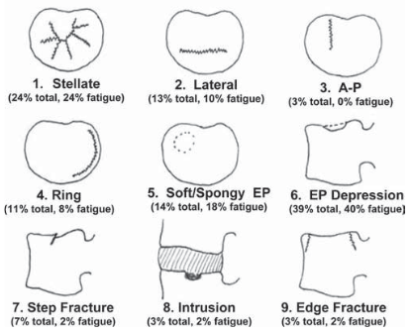
3.1. ENDPLATE FRACTURES
Located mainly in thoracic and upper lumbar spine
Produced by axial compressive, flexion forces or a mix of both
Fractures located in the central area, peripheral área or transverse the endplate
It plays a primary role in burst fracture
Figure 12. Vertebral endplate fracture classification system (from Gallagher S. et al. 2005)

Slide 33
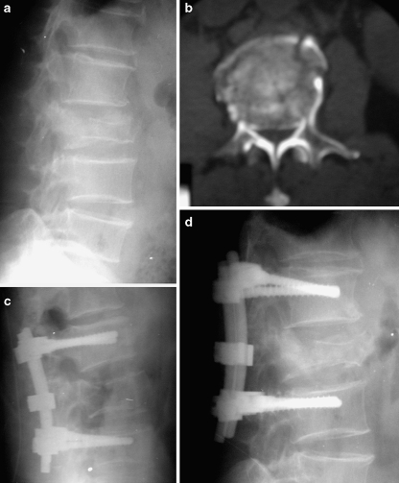
3.2. BURST FRACTURES
Produced by compression forces of high magnitude.
Anterior and posterior vertebral body failure, body height loss and retropulsión.
T11 to L2 is biomechanically the weakest segment against this fracture
Lower neurological signs than in cervical spine burst fracture
Can be stabilized by the posterior longitudinal ligament
Classified as mechanical, neurological or combined
Figure 13. a) Lateral radiograph shows an L2 burst fracture in a 59-year-old man. b) Axial CT image demonstrates 70% canal compromise. Image from Altay M. et al. 2007.

Slide 34
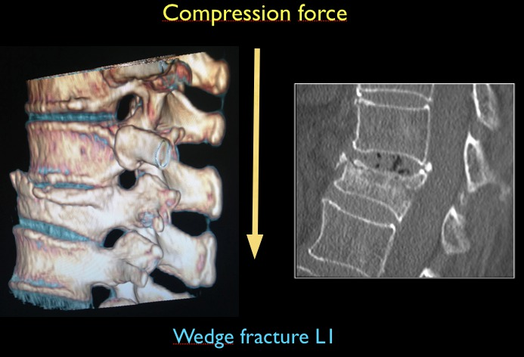
3.3. WEDGE FRACTURES
Produced by an axial compression force combined with a momento of flexion
Mechanical failure in the anterior region of the vertebral body
The line of action of the compresive force is placed anterior to the vertebral body
Usually damage of posterior ligaments
T12-L1 has the highest fracture incidence due to increased load-bearing
Common fracture in osteoporosis patients
Figure 14. Compression wedge fracture from sagittal multiplanar reconstruction. The injurie no involvement in the posterior elements. Image from González-Montané J.L. 2014.

Slide 35
3.4. SEAT-BELT INJURIES
Common lesión of thoracolumbar junction area
Ligamental disruption with facet dislocation is unstable
Consequences as ligament damage, bone fracture or fracture-dislocation bone
Fracture result of a hyperflexion mixed with a distraction force

Slide 36
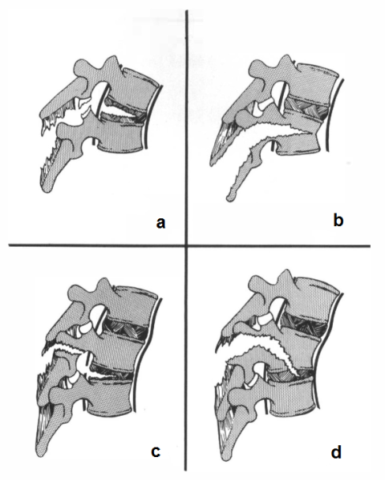

3.4. SEAT-BELT INJURIES
Figure 15. Seat-belt fracture classification. a: pure ligamentous disruption with facet dislocation. b: Chance fracture with horizontal splitting of bone. c: Injury of posterior ligamentous complex, pedicle and disc. d: Injury of posterior ligamentous complex, pedicle, body and disc injury. a and b are injuries at one level. c and d are injuries in two levels. Image from Yu WY. et al. 1986

Slide 37
B. Biomechanical alterations of the spine
Part 4. Biomechanical considerations after spine intervention

Slide 38
4.1. UPPER CERVICAL INTERVENTION
Occiput-C1-C2 complex
C1-C2 complex
The most mobile portion of the cervical spine
It makes the largest contribution to flexion-extension
Axial rotation as its main movement contribution

Slide 39
4.1. UPPER CERVICAL INTERVENTION
Occipitocervical fusion
Prevents
Main indication for this procedure: instability of the craniocervical junction.
Complications
Disorders as trauma, malignancy, rheumatoid arthritis, congenital anoalies, of ifectious diseases.
Compression of the neural structures.
Cervical deformities.
Reduction of pain.
Cervical mobility restriction.
Dysnea or dysphagia.

Slide 40
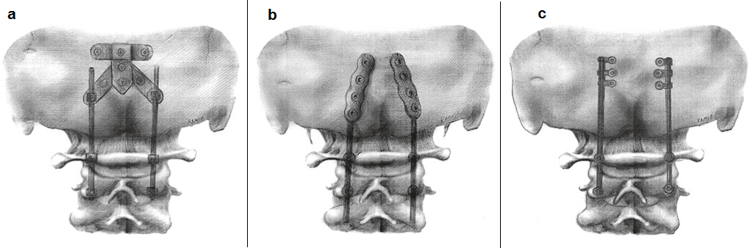
4.1. UPPER CERVICAL INTERVENTION
Figure 16. The most common screw-based constructs. (a) Occipital plate. (b) Hinged rods with an integrated occipital plate end. (c) Eyelet connectors directed medially. Image from Ashafai NS. et al. 2019.

Slide 41
4.2. LOWER CERVICAL INTERVENTION
Immobilization or joint replacement
Research experiences
Can affect adjacent levels due to biomechanical changes.
No average segmental motion difference was observed between interventions (Nabhan A. et al)
25.6% patients with anterior cervical fusión would develop new syntomatic disease in adjacent segments within 10 years.

Slide 42
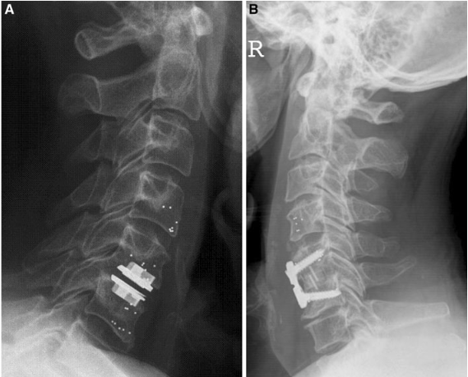
4.2. LOWER CERVICAL INTERVENTION
Figure 17. Lateral X-ray of acervical spine showing thetantalum markers of thevertebral body C4, C5 and C6. a - Incorporated tantalum markers after disc replacement. b - The same with titanium plate fixation. Image from the study of Nabhan A. et al (2011).

Slide 43
4.3. THORACIC AND LUMBAR INTERVENTION
Spinal fusion
Spino-pelvic aligment
Satisfactory short termed technique.
Lumbar hypolordosis is an independent risk factor for disc degeneration progression.
Long term difficulties in adjacent levels.
Syntomatic degeneration is one of the most frequent reason for further surgery.
T12-L1 level is the most usual intervention zone.
Affects spinal loading.
Its relation with disc degeneration and adjacent segment degeneration are highly discussed.

Slide 44
4.3. THORACIC AND LUMBAR INTERVENTION
Research experiences
Se Jin Choi et al. (2018) study suggest that L4-5 and L5-S1 contribute to spinal extensión and lateral flexion ROM but not a significat role in spinal flexion movements.
Obid P. et al (2017) study determines the loss of mobility segment by segment in three systems of instrumentation for lumbar spine fusión from T11 to L5.
Is not proved that hybrid constructs limit the ROM more than rigid instrumentation.

Slide 45
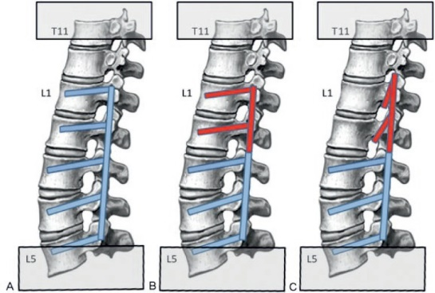
4.3. THORACIC AND LUMBAR INTERVENTION
Figure 18. Schematic overview showing the setup of the three test groups from study of Obid P. et al. (2017). (A) Group R: four-level rigid instrumentation; (B) group D: two-level rigid instrumentation (L3–L5) combined with the Elaspine system (Spinelab AG, Winterthur, Switzerland) (L1–L3); and (C) group H: two-level rigid instrumentation (L3–L5) combined with laminar hooks (L1–L3).

Slide 46
5. KEY IDEAS
There are different types of injures on the cervical spine depending on the direction and magnitude of the force that is applied on the spine: flexion, extension, compresion, distraction, rotation.
The upper cervcal spine injuries commonly result in death (about 40%) and because the type of injury can damage important areas of the central nervous system. The most referenced injuries in the literature are: Fractures of condyles of the occipital bone, Atlantoocipital dislocation, Fractures of the Atlas, Atlantoaxial dislocation, and Franctures of the axis.
Lower cervical spine injuries represent a broad array of injury patterns and degrees of instability, being the most common: the Burst fractures, the Teardrop fractures, the Midsagittal cleavage fracture, the Disruption of the facet joints, the Spinous apophysis fracture, and the Whiplash-associated disorder.

Slide 47
5. KEY IDEAS
The great difference between the cervical spine and the thoracic and lumbar areas that the latter has a stiffness that the cervical spine does not have, so the mechanisms of injury are very different between them.
In the thoracic and lumbar regions the most common injuries are usually: the Endplate fractures, the Burst fractures, the Wedge fractures, and the Seat-belt injuries typical in the thoracolumbar junction.
Medical treatments applied to spinal injuries can usually be conservative or surgical, depending on the severity of the injury and the stability of the damaged vertebral segment. Different medical decisions can have an important impact on functionality, since it will produce biomechanical changes in vertebral function in order to repair or stabilize the lesion.

Slide 48
5. KEY IDEAS
In the upper cervical spine, immobilization techniques can reach restrict cervical mobility until 40% of total cervical flexion-extension, and if occiput-C1 and C2 are involved, the limitation can reach 60% of total cervical rotation and 10% of total lateral bending.
In the lower cervical spine, more severe interventions such as fusion bring with them the adjacent segment disease, inducing stress, load, and intradiscal pressure at levels adjacent to the fusion site.
In the thoracic and lumbar spine, more severe interventions also limit mobility, being critical fusion sites for loss of function T11-L5, L4-L5, and L5-S1.

Slide 49
6. BIBLIOGRAPHY
Anderson P.A., and P.X. Montesano. Morphology and Treatment of Occipital Condyle Fractures. Spine (Phila Pa 1976). 1988 Jul; 13(7):731-6.
Altay M., Ozkurt B., Aktekin CN., Ozturk AM., Dogan O., Tabak A.Y. Treatment of unstable thoracolumbar junction burst fractures with short- or long-segment posterior fixation in magerl type a fractures. Eur Spine J. 2007 Aug; 16(8): 1145–1155.
Ashafai NS., Visocchi M., Wasik N. Occipitocervical Fusion: an updated review. Acta Neurochir Suppl 2019;125:247-252.
Bensch FV, Koivikko MP, Kiuru MJ, Koskinen SK. The incidence and distribution of burst fractures. Emerg Radiol. 2006;12:124–9.
Boughton OR, Bernard J, Szarko M (2015). Odontoid process fractures: the role of the ligaments in maintaining stability. A biomechanical, cadaveric study. SICOT J. 1: 11.
Cahueque M., Cobar A., Zuñiga C., Caldera G. Management of burst fractures in the thoracolumbar spine. Journal of Orthopaedics 13 (2016) 278–281.
Christiansen BA., Bouxsein ML. Biomechanics of Vertebral Fractures and the VertebralFracture Cascade. Curr Osteoporos Rep (2010) 8:198–204.
Comín M., Prat J., Soler-G C. et al. (1995) Biomecánica del Raquis y Sistemas reparación. 1º Edición, Instituto de Biomecánica de Valencia, España.
Curry WH., Pintar F.A., Doan N.B, Nguyen H.S., Eckardt G., Baisden J.L., Maiman D.J., Paskoff G.R., Shender B.S., Stemper B.D. Lummbar spine endplate fractures: Biomechanical evaluation and clinical considerations through experimental induction of injury. J Orthop Res. 2016 Jun;34(6):1084-91.

Slide 50
6. BIBLIOGRAPHY
Cusick J.F. and Yoganandan N. Biomechanics of the cervical spine 4: Major Injuries. Clinical Biomechanics Vol 17, Issue 1 January 2002, Pages 1-20.
Denis F. The three column spine and its significance in the classification of acute thoracolumbar spinal injuries. Spine. 1983;8:817–31.
Dickman C.A., Greene K.A., Sonntag V.K. Injuries Involving the transverse atlantal ligament: Classification and treatment guidelines based upon experience with 39 injuries. Neurosurgery 1996 Jan; 38(1):44-50.
Dowdell J., Kim J., Overley S., Hecht A. Biomechanics and common mechanisms of injury of the cervical spine. Hand Clin Neurol 2018;158:337-344.
Ghobrial GM., Lavelle W.F., Florman J.E., Riew K.D., Levi A.D. Symptomatic adjacent level disease requiring surgery: analsys of 10-year results from a prospective randomized, clinical tral comparing cervical disc arthroplasty to anterior cervical fusion. Neurosurgery 2019 Feb 1;84(2):347-354.
Gonzáles-Montané J.L. What can CT and MRI add to the assessment of symptomatic vertebral compression fracture in osteoporotic patients? From Congress ECR 2014, Number of poster C-0960. DOI: 10.1594/ecr2014/C-0960.
Hall GC., Kinsman MJ., Nazar RG., Hruska RT., Mansfield KJ., Boakye M., Rahme R. Atlanto-occipital dislocation. World J Orthop. 2015 Mar 18;6(2):236-43.
Heary R.F., Sanjeev K. Decision-making in burst fractures of the thoracolumbar and lumbar spine. Indian J Orthop. 2007 Oct-Dec; 41 (4): 268-276.

Slide 51
6. BIBLIOGRAPHY
Hilibrand A.S., Carlson G.D., Palumbo M.A., JonesP.K., Bohlman H.H. Radiculopathy and myelopathy at segments adjacent to the site of a previous anterior cervical arthrodesis. J Bone Joint Surg Am. 1999 Apr;81(4):519-28.
Izeki M., Neo M., Takemoto M., Fujibayashi S., Ito H., Nagal K., Matsuda S. The O-C2 angle established at occipito-cervical fusion dictates the patient's destiny in terms of postoperative dyspnea and/or dysphagia. Eur Spine J (2014) 23:328-336.
Kaneoka K, Ono K, Inami S, et al. The human cervicalspine motion during rear impact collisions: a proposed cervicalfacet injury mechanism during whiplash trauma. J Whipl RelatDisord 2002; 1(1): 85-97.
Lei Li, Wen-Fei Liu, Hong-Kun Jiang, Yun-Peng Li. Biomechanical evaluation of four different posterior screw and rod fixation techniques for the treatment of the odontoid fractures. Int J Clin Exp Med. 2015;8(6):8571-8580.
Luan F, Yang KH, Deng B, et al. Qualitative analysis ofneck kinematics during low-speed rear-end impact. Clin Biomech (Bristol, Avon) 2000;15(9):649-657.
Martín-Ferrer S. High cervical spine injuries: classification, therapeutic indications, and surgical approaches: 286 consecutive cases. Neurocirugia (Astur). 2006 Oct;17(5):391-419.
Miyata M., Neo M., Fujibayashi S., Ito H. Takemoto M., Nakamura T. O-C2 angle as a predictor of dyspnea and/or dysphagia after occipitocervical fusion. Spine (Phila Pa 1976). 2009 Jan 15;34(2):184-8.

Slide 52
6. BIBLIOGRAPHY
Nabhan A., Ishak B., Steudel W.L., Ramadhan S., Steimer O. Assessment of adjacent-segment mobility after cervical disc replacement versus fusion: RCT with 1 year's results. Eur Spine J (2011) 20:934-941.
Nightingale, R, Myers, BS, and Yoganandan, N, Biomechanical Aspects of Cervical Spine Trauma, in Accidental Injury: Biomechanics and Prevention, N. Yoganandan, A. Naham, and J.W. Melvin, Editors. 2014, Springer: New York, NY.
Obid P., Danyali R., Kueny R., Huber G., Reichl M., Richter A., Niemeyer T., Morlock M., Püschel K., Übeyli H. Hybrid Intrumentaation in Lumbar Spinal Fusion: A Biomechanical Evaluation of three different instrumentation techniques. Global Spine J. 2017 Feb;7(1):47-53.
Pertersilge CA., Emery SE. Thoracolumbar burst fracture: Evaluating stability. Seminars in Ultrasound, CT and MRI Volume 17, Issue 2, April 1996, Pages 105-113.
Pryputniewicz D.M. and Hadley M.N. Axis Fractures. Neurosurgery 2010 Mar;66(3 Suppl):68-82.
Rihn JA, Fisher C, Harrop J et al. (2010). Assessment of the posterior ligamentous complex following acute cervical spine trauma. J Bone Joint Surg Am. 92: 583–589.
Ryba L., Cienciala J., Chaloupka R., Repko M., Vyskocil R. Injury of Upper Cervical Spine. Soud. Lek 2016;61(2):20-5.
Se Jin Choi, Ji Won Moon, Dalsung Ryu, Chang Hyun Oh, Seung Hwan Yoon. Range of Motion According to the fusion level after lumbar spine fusion: A retrospective study. Nerve. 2018;4(2):55-59.

Slide 53
6. BIBLIOGRAPHY
Spitzer WO, Skovron ML, Salmi LR, et al. Scientific mono-graph of the Quebec Task Force on Whiplash-Associated Disorders:redefining “whiplash” and its management. Spine 1995; 20(8Suppl): 1S-73S.
Torreti J.A. nd Sengupta D.K. Cervical Spine Trauma. Indian J Orthop 2007 Oct;41(4):255-67.
Traynelis, V.C., Marano, G.D., Dunker, R.O., Kaufman,H.H.: Taumatic atlanto-occipital dislocation: Case report. J Neurosurg 1986; 65: 863-870.
Tuli S., Charles H.T., Fehlings M.G., Mackay M. Occipital Condyle Fractures. Neurosurgery, Volume 41, Issue 2, August 1997, Pages 368–377.
Waseem M., Upadhyay R., Al-Husayni H., and Agyare S. Occipital condyle fracture in a patient with neck pain. Int J Emerg Med. 2014; 7:5.
Wenning KE. and Hoffmann M.F. Does isolated atlantoaxial fusion resul in better clinical outcome compared to occipitocervical fusion? Journal of Orthoedic Surgery and Research (2020) 15:8.
Yang S.Y., Boniello A.J., Poorman C.E., Chang A.L., Wang S., Passias P.G. A review of the diagnosis and treatment of atlantoaxial dislocations. Global Spine J. 2014 Aug; 4(3): 197–210.
Yu WY, Siu CM. Seat belt injuries of the lumbar spine--stable or unstable? Paraplegia. 1989 Dec;27(6):450-6.

Slide 54
The European Commission's support for the production of this publication does not constitute an endorsement of the contents, which reflect the views only of the authors, and the Commission cannot be held responsible for any use which may be made of the information contained therein.

