Slide 1
MODULE BIOMECHANICS OF SPINE
Didactic Unit C: HOW DO I ASSESS SPINE?
C.1. What methods may I apply to assess the function of the spine appropriately?

Slide 2
CLASS INDEX
Assessing impairment: anamnesis and physical examination of the spine
Measuring function in the spine: the most widespread devices
-------------------------------------------------------------------------
Class workshop
Physical examination: movement analysis

Slide 3
Assessing impairment: anamnesis and physical examination of the spine
MEDICAL HISTORY (ANAMNESIS)
Personal data: age, profession, employment status, health habits, etc.
Previous pathologies
Current illness:
When and where the pain appeared; time of evolution.
Nature of the pain: mechanical/inflammatory/neuropathic. Attenuating or exacerbating factors.
Location and frequency of pain. Radiating and territory.
Other associated symptoms: cephalea, dizziness, sensory or motor impairment, etc.

Slide 4
Assessing impairment: anamnesis and physical examination of the spine
MEDICAL HISTORY (ANAMNESIS)
Essential! Detect:
Warning signs
Interference in the progression of the illness
YELLOW FLAGS
Job environment: incapacitations or compensations.
Prior treatment has failed.
Mistaken beliefs about pain or fear of it.
Psychosocial factors: patient's acceptance of their role as an ill person, disorders or alterations in mood, lack of social or family support or over-protective behaviours.
Possible serious underlying cause.
RED FLAGS (lumbar pain)
Neurological condition: severe paresis.
Cauda equina syndrome.
Ankylosing spondylitis pain.
Prior trauma.
Constitutional syndrome.
Personal oncological antecedents.
Associated fever syndrome.
Drug addiction via parents.
Steroid use.
1st episode at <20 or >50 years of age.

Slide 5
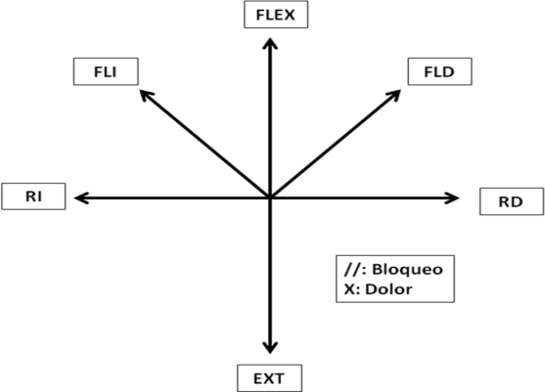
Assessing impairment: anamnesis and physical examination of the spine
PHYSICAL EXAMINATION: CERVICAL SPINE
Inspection: asymmetries, attitude, posture, lumps, changes in skin colour, atrophies, etc.
Palpation: painful areas, vertebral alignment, stability of the cervical structures, bulges, contractions or increase in muscle fibre tone, etc.
Exploration of cervical mobility: active and passive.

Slide 6
Assessing impairment: anamnesis and physical examination of the spine
PHYSICAL EXAMINATION: CERVICAL SPINE
Neurological exploration (if advisable!): osteotendinous reflexes, strength and sensitivity.
Root | Painful territory | Sensory damage | Muscular weakness | Reflexes affected
C3-C4 | Paraspinal muscles, superior shoulder | Neck | Diaphragm, nuchal muscles, strap muscles | None
C5 | Neck, shoulder, anterior arm | Shoulder | Deltoid, supraspinatus, infraspinatus, rhomboid, biceps, brachioradialis | Biceps, brachioradialis
C6 | Neck, shoulder, anterior upper arm extending to antecubital fossa | Thumb, index finger, radial forearm | Deltoid, supraspinatus, infraspinatus, rhomboid,biceps, brachioradialis, pronator teres, flexor carpi radialis, extensor carpi radialis | Biceps, brachioradialis
C7 | Neck, shoulder, dorsum of forearm | Middle finger | Triceps, latissimus dorsi, pronator teres, flexor carpi radialis, extensor carpi radialis | Triceps
C8 | Neck, shoulder, ulnar forearm | Ring, little fingers, hypothenar eminence | Intrinsic hand muscles, finger extensors, finger flexors | None
T1 | Neck, shoulder, ulnar arm | Ulnar forearm | Intrinsic hand muscles (Homer's syndrome) | None

Slide 7
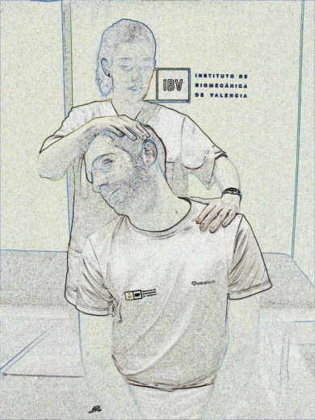
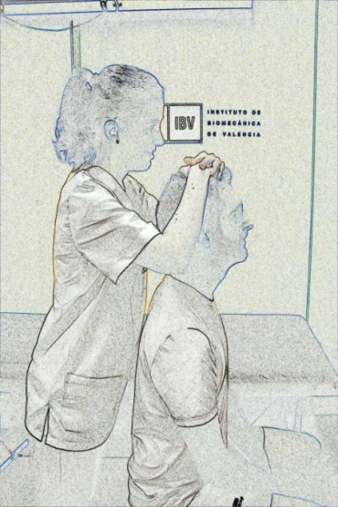
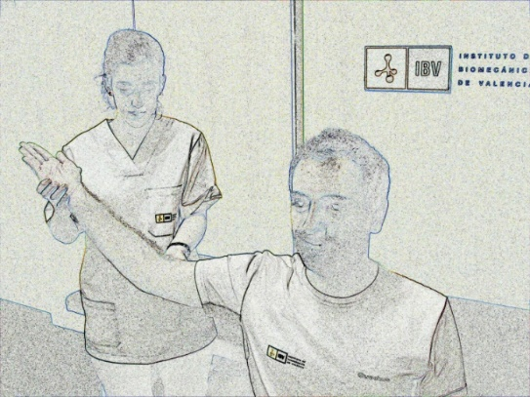
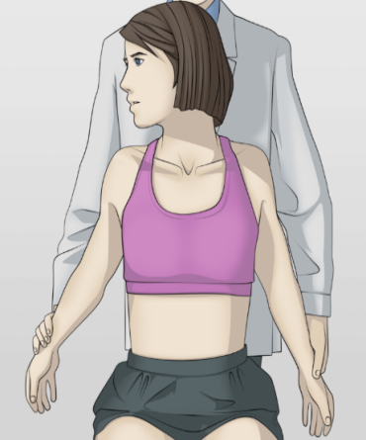
Assessing impairment: anamnesis and physical examination of the spine
PHYSICAL EXAMINATION: CERVICAL SPINE
Specific tests: only if indicated and depending on diagnostic suspicion.
SOTO-HALL TEST
LASÈGUE BRAQUIAL
SPURLING TEST
JACKSON TEST
ADSON TEST
Notes:
The teacher should explain how to perform these tests on students.
Also, the teacher may use the following links in order to show a complete physical examination of the cervical spine during class:
https://www.youtube.com/watch?v=X4yjcxlBpuo https://www.youtube.com/watch?v=_oZp-FKeDe0
https://www.youtube.com/watch?v=nz84ESfxMwM

Slide 8
Assessing impairment: anamnesis and physical examination of the spine
PHYSICAL EXAMINATION: DORSAL AND LUMBAR SPINE
Inspection: asymmetries, attitude, posture, lumps, changes in skin colour, deformity and alterations in physiological curves in the lateral plane, atrophies (including atrophy of lower limbs) etc.
Palpation: painful areas, vertebral alignment, stability of the dorsolumbar structures and pelvis, bulges, contractions or increase in muscle fibre tone, etc.
Exploration of dorsal and lumbar mobility: active and passive.
Dorsal: flexion and extension (extension: reduction of kyphosis/flexion: voluntary increase of dorsal kyphosis) + rotations.
Lumbar: flexion and extension, rotation, lateral flexion.

Slide 9
Assessing impairment: anamnesis and physical examination of the spine
PHYSICAL EXAMINATION: CERVICAL SPINE
Neurological exploration (if indicated!): osteotendinous reflexes, strength and sensitivity.
Root | Painful territory | Sensory damage | Muscular weakness | Reflexes affected
L3 | Anterior thigh, groin | Anterior thigh | Iliopsoas, adductors, quadriceps | Knee
L4 | Anterior thigh | Medial calf, medial foot | Quadriceps, adductors, (iliopsoas) | Knee
L5 | Posterolateral thigh and calf, extending into toe and dorsum of foot | Dorsum of foot, great toe, lateral calf | Tibialis anterior, tibialis posterior, extensor hallucis longus, peronei, gluteus medius, tensor fascia latae | None
S1 | Posterolateral thigh and calf, extending into toe and dorsum of foot | Lateral foot, posterior calf, sole of foot | Gastroc-soleus, hamstrings, gluteus maximus | Ankle

Slide 10
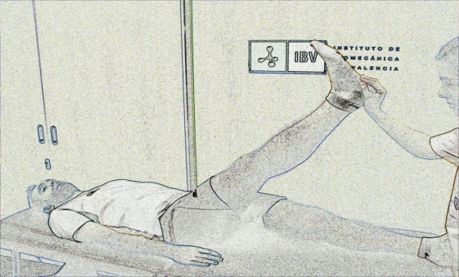
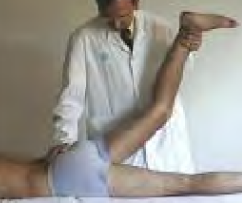
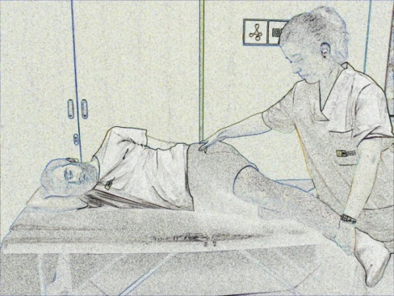
Assessing impairment: anamnesis and physical examination of the spine
PHYSICAL EXAMINATION: LUMBAR SPINE
Specific tests: only if indicated and depending on diagnostic suspicion.
Other manoeuvres
LASÈGUE BILATERAL IN SEDESTATION
LASÈGUE & BRAGARD TEST
NERI TEST
PHALEN
REVERSE LASÈGUE
LASÈGUE IN DECUBITUS PRONE (BARRAQUER-FERRÉ)
VALSALVA
LASÈGUE IN DECUBITUS (LATERAL)
Notes:
The teacher should explain to students how to perform these tests.
Also, the teacher may use the following links in order to show a complete physical examination of the cervical spine during class:
https://www.youtube.com/watch?v=q1gX9hORtLY https://www.youtube.com/watch?v=IijlOJPHk1s&t=23s

Slide 11
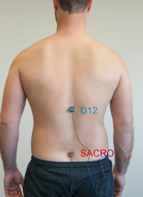
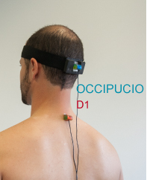
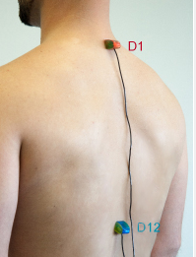
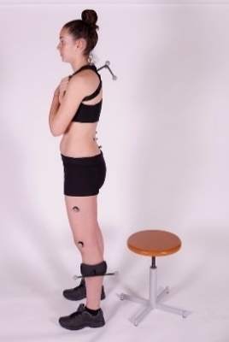
Measuring function in spine: the most widespread devices & clinical scales
MOVEMENT ASSESSMENT
Classic goniometers
Inclinometers
Others:
Electronic inclinometers
Photogrammetry: gold standard in measuring kinetic parameters (related to mobility: angles, speed, acceleration).

Slide 12
CLASS INDEX
Assessing impairment: anamnesis and physical examination of the spine
Measuring function in the spine: the most widespread devices
-------------------------------------------------------------------------
Class workshop
Physical examination: movement analysis

Slide 13
WORKSHOP
Physical examination: movement analysis
Form work groups.
In order to measure each segment, one of you will act as the patient and the others will take the measurement and note down the results.
Change roles to measure each segment.
You must follow the instructions for the measurement you have in your work sheet, and indicate the angle obtained in each field’s corresponding segment.
You may ask your teacher if you have any queries.
You can take the measurements with the GONIOMETER, INCLINOMETER or both, depending on what instruments you have in the class.
Notes:
HAND OUT SHEETS. TAKE MEASUREMENTS. THEY HAVE APPROXIMATELY 1 H FOR THE WORKSHOP.

Slide 14
WORKSHOP
Physical examination: movement analysis
You are going to take measurements of mobility using a goniometer and/or inclinometer (instructions in the physical examination file).
In addition, you are going to carry out several tests to measure the flexibility of the dorsal and lumbar column using a tape measure.
DORSAL COLUMN
Ott’s test
This is used to measure the degree of flexibility in the dorsal column. It is carried out with the patient standing, measuring the distance between a point marking vertebra (spinous process) C7 and a point 30 cm below.
The subject is asked to perform an anterior flexion, attempting to curve the dorsal region as much as possible, and vice-versa; with normal subjects performing anterior flexion, the distance between the two points marked increases from 2 to 4 cm, and in extension it decreases by 1-2 cm.
Notes:
HAND OUT SHEETS. TAKE MEASUREMENTS. THEY HAVE APPROXIMATELY 1 H FOR THE WORKSHOP.

Slide 15
WORKSHOP
Physical examination: movement analysis
You are going to take measurements of mobility using a goniometer and/or inclinometer (instructions in the physical examination file).
In addition, you are going to carry out several tests to measure the flexibility of the dorsal and lumbar column using a tape measure.
LUMBAR COLUMN
Schöber’s test
In this case, the two points marked correspond to vertebra S1 and a point 10 cm below.
This distance should increase in flexion by about 5 cm for normal subjects, and decrease in extension by 2 to 3 cm. The test is positive (pathological) in flexion when there is an increase of less than 5 cm in the distance calculated between the two points.
Notes:
HAND OUT SHEETS. TAKE MEASUREMENTS. THEY HAVE APPROXIMATELY 1 H FOR THE WORKSHOP.

Slide 16
The European Commission's support for the production of this publication does not constitute an endorsement of the contents, which reflect the views only of the authors, and the Commission cannot be held responsible for any use which may be made of the information contained therein.

