Slide 1
MODULE BIOMECHANICS OF SPINE
Didactic Unit D: INSTRUMENTED ANALYSIS OF THE SPINE
D.1. Which cervical biomechanical instrumented evaluation protocols exist?
Notes:
This presentation is for Didactic Unit D: Instrumented analysis of the spine.
D.1. Which cervical biomechanical instrumented evaluation protocols exist?

Slide 2
D.1. Which cervical biomechanical instrumented evaluation protocols exist?
OBJECTIVES
To recall the main features that make up a biomechanical evaluation test.
To learn some of the protocols used for kinematic evaluation of the cervical spine.
To learn some of the protocols used to evaluate strength and muscular activity in the cervical spine.
To work on defining a protocol for evaluating cervical mobility.
Notes:
This session’s objectives are as follows:
To recall the main features that make up a biomechanical evaluation test.
To learn some of the protocols used for kinematic evaluation of the cervical spine.
To learn some of the protocols used to evaluate strength and muscular activity in the cervical spine.
At the end of the class, we shall work on listing the different factors that may affect a measurement of cervical mobility and strength, and we will draw up an evaluation protocol.

Slide 3
D.1. Which cervical biomechanical instrumented evaluation protocols exist?
INDEX
Remember: What is a biomechanical test? What does it involve?
Protocols to evaluate motion
Electrogoniometry and inclinometry
Photogrammetry and inertial sensors
Others: Kinect, MCU system
Protocols to evaluate strength:
Isometric dynamometry.
Assessment of muscular activity: Surface EMG
Notes:
Before the activity, we shall briefly look at the topics in this index.
In doing so, we will recall what is involved in a biomechanical evaluation test.
Afterwards, we shall look in more detail at the topic at hand, in this case showing the different protocols for a biomechanical assessment of the cervical spine from the point of view of an evaluation of motion, as well as of strength or muscular activity.
Remember that you can see the entire video of the presentation as well as several articles on cervical spine evaluation that bolster the content of this class.
Also remember that any function, activity or gesture performed by the locomotor system could be assessed biomechanically if the evaluator so wishes, provided that the appropriate steps are followed in doing so as regards the choice of technique (valid and reliable), design of the protocol and gesture to be assessed, and the interpretation of the results.

Slide 4
What is a biomechanical test? What does it involve?
Complementary test done by means of biomechanical techniques
There are different biomechanical assessment tests. The aspects that define them are:
• What function is being assessed.
• What instrument and technique it is based on.
• What assessment protocol has been used (D.1).
• What results it provides, in what units and with what data analysis techniques they have been obtained.
• Standardised criteria for interpretation..
Notes:
Remember that a biomechanical evaluation test is a complementary one carried out using different types of instrumental techniques.
The concept of a biomechanical test includes:
The function or activity being assessed (e.g. motion or strength, or activities such as walking, sitting, picking up a box, etc.).
The instrumental techniques used to evaluate it (e.g. dynamometers, electromyography, inclinometers, photogrammetry, etc.).
The exact protocol for evaluation, i.e. precise instruments if required, the characteristics of the gesture(s) evaluated and in what order.
The results obtained: what units they are given in, how such data has been processed and how it is analysed.
How this data is interpreted, i.e. standardised interpretation criteria.

Slide 5
What is a biomechanical test? What does it involve?
There are different biomechanical assessment tests. The aspects that define them are:
• What function is being assessed.
• What instrument and technique it is based on.
• What assessment protocol has been used.
• What results it provides, in what units and with what data analysis techniques they have been obtained.
• Standardised criteria for interpretation.
Notes:
This class is going to focus on reviewing the different existing protocols for evaluation of the cervical spine. That includes learning what gesture we are measuring and what instruments are used if necessary.

Slide 6
D.1. Which cervical biomechanical instrumented evaluation protocols exist?
INDEX
Remember: What is a biomechanical test? What does it involve?
Protocols for evaluating motion
Electrogoniometry and inclinometry
Photogrammetry and inertial sensors
Others: Kinect, MCU system
Protocols to evaluate strength:
Isometric dynamometry.
Others: isokinetic.
Assessment of muscular activity: Surface EMG
Notes:
Concentrating on protocols, firstly we shall see some of those carried out in evaluating cervical spine mobility with the instrumental techniques commonly used to do so in biomechanical evaluation laboratories and units: electrogoniometry, inclinometry in (in this case electronic), photogrammetry, inertial sensors and other examples such as BTE Technologies’ Multi-Cervical-Unit (MCU) and Microsoft’s Kinect system.

Slide 7
Protocols for evaluating the cervical spine
Evaluating motion: protocols?
We may decide to measure any other gesture provided that:
We know how to choose the right instrument and technique;
Suitable biomechanical model;
Proper data processing;
Valid, reliable results obtained;
Standardised interpretation of the results.
Notes:
Again, remember that we could actually evaluate any other gesture of interest for the cervical spine provided that:
We know how to choose the right instrument and technique;
The biomechanical model is suitable (how the markers or sensors are placed, the measuring instrument and whether this type allows us to obtain the data we need).
The data is properly processed;
The results obtained are valid and reliable;
There are standardised criteria for interpreting the results.

Slide 8
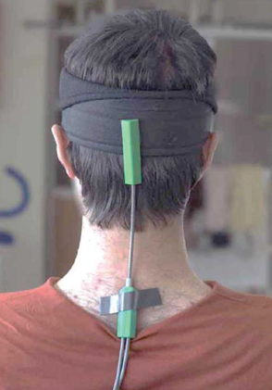
Protocols for evaluating the cervical spine
ELECTROGONIOMETRY
Prior calibration
Device placed by users with knowledge about locating anatomical points.
Motion to be measured performed according to the established protocol:
T. Allahyari et al,. once for each arc. The maximum range is reached at the patient’s chosen speed.
T. Allahyari et al. 2016
Notes:
One of the simplest ways of assessing spinal mobility is by evaluating the active or passive range of motion in angles.
In this case, although we can use a visual analysis, measuring tape, classic goniometers or manual inclinometers, there are instrumental techniques that can help us improve the accuracy and reliability of the measurements.
In this case, we can see an electrogoniometry system used by T. Allahyari et al. in their study.
This was a validation study by Kinect compared to electrogoniometry to measure cervical mobility.
For the measurement with electrogoniometers and after appropriate calibration of the device, the study’s authors placed an upper device in the occipital region using an elastic headband, and a lower one over vertebrae T1 to T4 with double-sided adhesive tape, as seen in the photo.
Afterwards, they took the measurements by asking the subject to perform maximum active arc motions to be evaluated at the speed chosen by the subject.

Slide 9
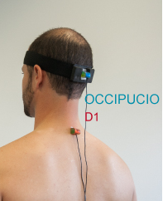
Protocols for evaluating the cervical spine
INCLINOMETRY
Electronic inclinometry system using two inclinometers:
The inclinometers are placed to assess the axes of motion for lateral flexion and flexion-extension of the neck.
Occipital Protuberance
T1
Protocol based on the American Medical Association’s guide (three measurements differing by less than 10% or 5º). The neutral position is measured, then the active or passive motion to be assessed (flexion, extension or lateral flexions) is performed.
Notes:
As you now know, cervical mobility can also be assessed with inclinometers. In this case, the system shown uses two electronic inclinometers placed on the occipital protuberance and on T1. The software used is designed to measure the active and passive ranges of motion for the upper and lower limbs and the spine.
For the motions of lateral flexion and flexion-extension of the neck, one of them is placed on the occiput and the other over vertebra (spinous process) T1, as shown in the picture.

Slide 10
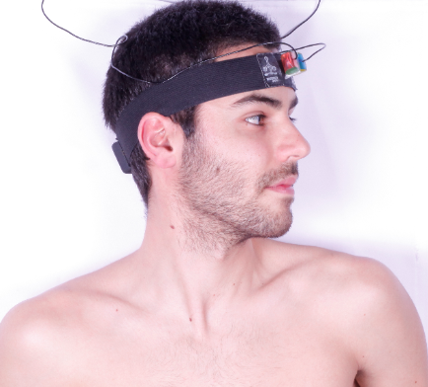
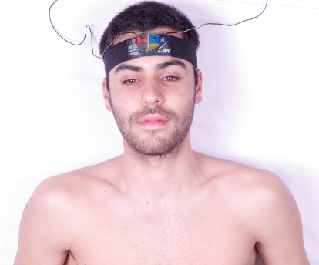
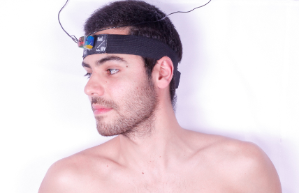
Protocols for evaluating the cervical spine
INCLINOMETERY: cervical lateral flexion
A minimum of three valid measurements according to the AMA’s repeatability criteria, differing by less than 10% or 5°.
Neutral position
Maximum left rotation motion.
Maximum right rotation motion.
Notes:
For cervical rotations, the placement of the inclinometers and the subject’s posture are different.
In this case, both inclinometers are placed on the individual’s forehead region, with the individual in decubitus supine and their head in line with their trunk.
Next, as with the other axes, firstly the neutral position is recorded with their head in line with their trunk and looking towards the ceiling. Afterwards, we ask for a maximum left rotation without moving the trunk, and then a maximum right rotation.
The initial instructions given to the subject, as well as the evaluator’s orders and control during the measuring process and if necessary the performance of a test gesture, are fundamental in order for the protocol to be carried out properly so as to obtain valid results.

Slide 11
Protocols for evaluating the cervical spine
PHOTOGRAMMETRY
Notes:
This video shows a protocol for evaluating the cervical spine being performed from a kinematic point of view.
Using this measuring system, the laboratory’s videophotogrammetry cameras record all of the movements of the markers on the subject’s head.
While doing so, the subject first performs the limits test by repeating maximum motions in all of the axes for several seconds, then an additional functional test in which they note down the symbols appearing on different light displays. This protocol allows us to obtain data about ranges and angles, as well as about the quality of the movement, such as velocity, acceleration, harmony and repeatability of the movements made.
Although they are not shown in this video, the initial instructions given to the subject, as well as the evaluator’s orders and control, are fundamental in order for the protocol to be carried out properly so as to obtain valid results.

Slide 12
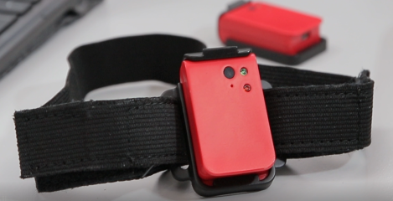
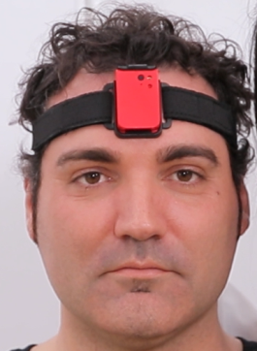
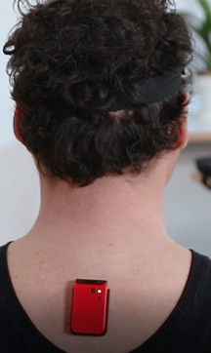
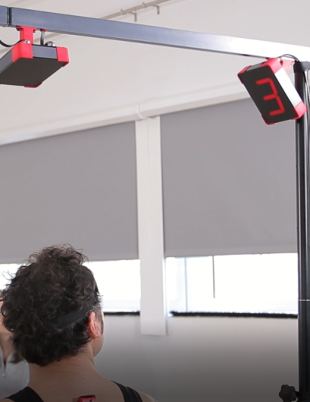
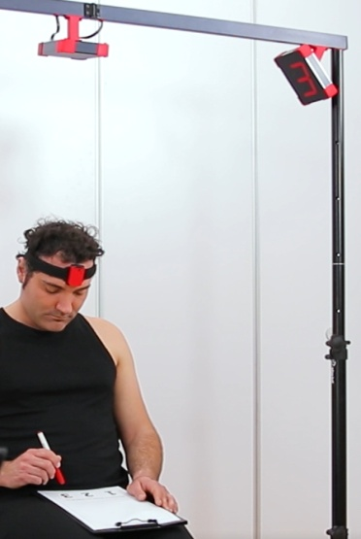
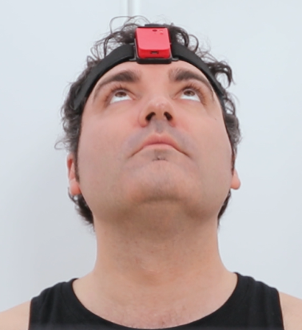
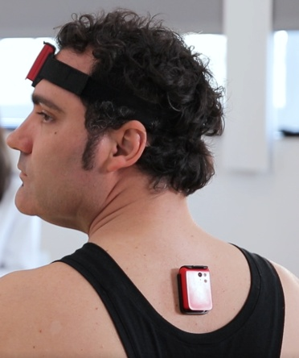
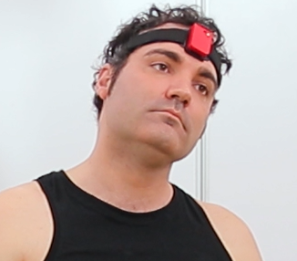
Protocols for evaluating the cervical spine
INERTIAL SENSORS
Evaluation protocols the same as for photogrammetry.
Some technical limitations compared to photogrammetry, but a faster, simpler instrumentation process.
Notes:
The same gestures that we can evaluate with photogrammetry could in theory also be measured with another kind of instrument, such as inertial sensors.
That is the case of the system shown here, which uses the same kinematic cervical evaluation protocol explained before, but the measurements are taken with inertial sensors.

Slide 13
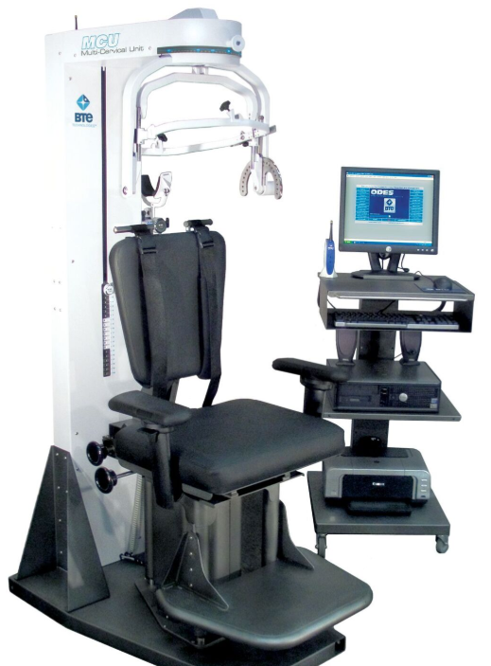
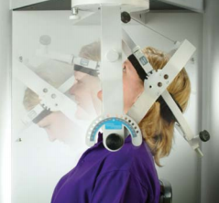
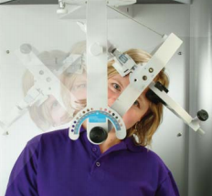
Protocols for evaluating the cervical spine
Multi Cervical Unit (MCU; BTE®)
Combined system to measure cervical MOTION AND ISOMETRIC STRENGTH.
Based on a computerised goniometry system.
In order to see how to carry out a motion evaluation protocol with this instrument, it is advisable to see some videos online such as this one (see the first part):
https://www.youtube.com/watch?v=WJpOEvj0NXg
The material that the hyperlinks lead to is public and available for viewing online. It has been selected for its suitability to the subject covered in this unit after a search using the terms "Multi Cervical Unit" in the website indicated above. You can find and view other interesting public educational videos like these using the same search terms.
Information and images from:
https://www.btetechnologies.com/rehabilitation/mcu/
Notes:
The system shown next is quite well known among biomechanical evaluation laboratory users.
It is the company BCE’s Multi Cervical Unit. This system is a combination of a goniometry system with a system for measuring isometric strength, and is computerised in both cases.
To carry out an evaluation protocol, in this case to evaluate a range of motion, the subject is seated in the measuring station and the measuring device is fitted around their head. They are asked to perform the desired motions at the speed they choose in each of the axes studied.
Using the link on the screen, you can access public content showing this system’s evaluation protocol (if the room has an Internet connection, we can also access the video directy through the hyperlink).

Slide 14
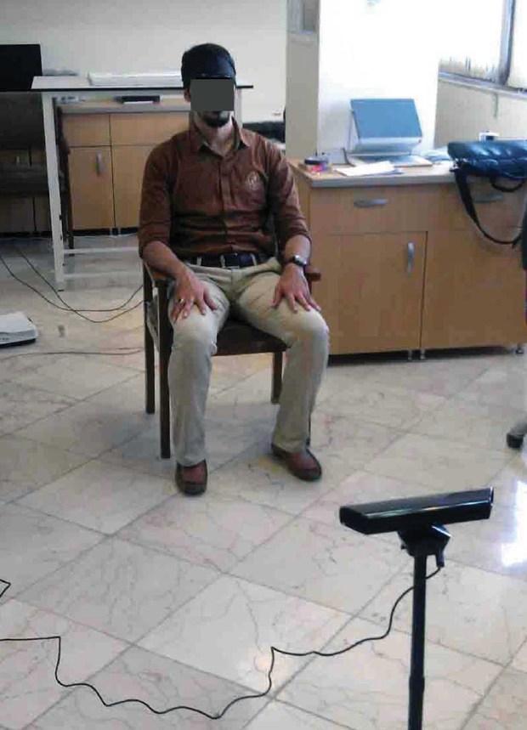
Protocols for evaluating the cervical spine
Microsoft Kinect System
Sitting position with Kinect sensor 2 m in front of the subject and 1 m above the ground. No instruments required.
The subject being evaluated must perform maximum motions in each of the cervical spine’s arcs of motion, including flexion-extension, lateral extensions and rotations.
Before beginning, the process is explained in detail to the subject, with the evaluator performing the gestures to explain them. A preliminary test is carried out to ensure they have understood the instructions.
Information and images from: T. Allahyari et al. 2016
Notes:
The Microsoft Kinect System uses a system of depth sensors without the need for markers. It is capable of evaluating the motion of the different body segments.
In the study by T. Allahyari et al., which compared this system with electrogoniometry to measure cervical motion, they proposed measuring cervical motion with Kinect by seating the subject 2 m away from the measuring sensor, as shown in the image.
The subject being evaluated must then perform maximum motions in each of the arcs of motion studied for the neck, including flexion-extension, lateral extensions and rotations.
The authors stress the importance of explaining to the subject the movements they have to make and how to do so, including carrying out a test before beginning to take the definitive measurements.

Slide 15
D.1. Which cervical biomechanical instrumented evaluation protocols exist?
INDEX
Remember: What is a biomechanical test? What does it involve?
Protocols to evaluate motion
Electrogoniometry and inclinometry
Photogrammetry and inertial sensors
Others: Kinect, MCU system
Protocols to evaluate strength:
Isometric dynamometry.
Assessment of muscular activity: Surface EMG
Notes:
Next, we shall review some protocols to assess the cervical spine’s isometric strength.

Slide 16
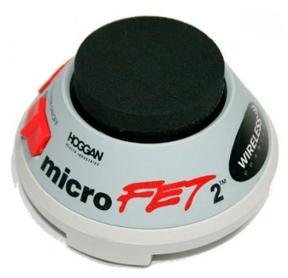
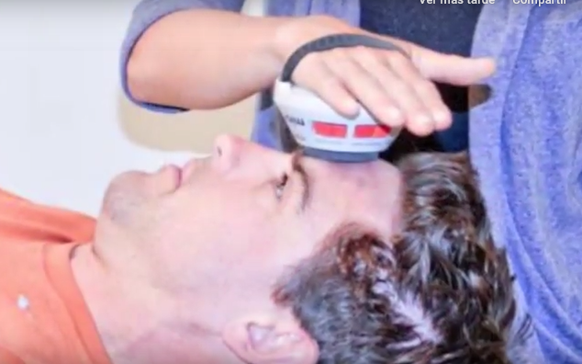
Protocols for evaluating the cervical spine
ISOMETRIC DYNAMOMETRY
These devices are to measure resistance force without changing the length of the muscle fibres and with no movement of the joints.
They are the most commonly used (isokinetic ones are not widely used in the cervical region).
Different protocols.
MicroFET2 manual dynamometer for musculoskeletal evaluation
Evaluation of isometric force in each arc. Maximum force peak determined and force curves and graphs generated.
Information and images from:
https://tienda.fisaude.com/dinamometro-evaluacion-musculo-esqueletica-microfet2-p-39680.html
Notes:
It is not very common to evaluate strength in the cervical spine, and isometric dynamometry is usually used when doing so.
Isometric dynamometers measure the resistance force without a change in length of muscle fibres; in other words, with no movement of the joints. There are different protocols to carry out this kind of assessment, although manual dynamometers are fairly often used, which the evaluator holds, opposing resistance and holding back movement of the neck in the axis studied.
This is the case with the MicroFET2 dynamometer shown on the screen, which determines the peak force, also generating force graphs and curves.

Slide 17
Protocols for evaluating the cervical spine
Multi Cervical Unit (MCU; BTE®)
Combined system to measure cervical MOTION and ISOMETRIC STRENGTH.
In order to see how to carry out an isometric force evaluation protocol with this instrument, it is advisable to see some videos online such as this one (second part of the video):
https://www.youtube.com/watch?v=WJpOEvj0NXg
The material that the hyperlinks lead to is public and available for viewing online. It has been selected for its suitability to the subject covered in this unit after a search using the terms "Multi Cervical Unit" in the website indicated above. You can find and view other interesting public educational videos like these using the same search terms.
Information and images from:
https://www.btetechnologies.com/rehabilitation/mcu/
Notes:
The Multi Cervical Unit system that we saw before also has a device for measuring isometric force in the structure placed on the evaluated person’s head.

Slide 18
D.1. Which cervical biomechanical instrumented evaluation protocols exist?
INDEX
Remember: What is a biomechanical test? What does it involve?
Protocols to evaluate motion
Inclinometry
Photogrammetry and inertial sensors
Others: MCU system
Protocols to evaluate strength:
Isometric dynamometry.
Assessment of muscular activity: Surface EMG
Notes:
Lastly, we shall look at some protocols to study the cervical musculature activation pattern via surface electromyography, which as you know gives information about muscular activation of the fibres being assessed.

Slide 19
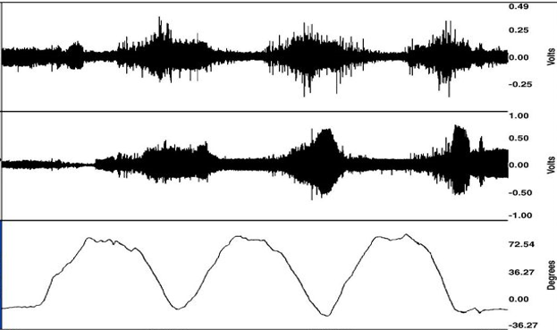
Protocols for evaluating the cervical spine
SURFACE EMG
There are many evaluation protocols that use surface EMG:
Measurement of the flexion-relaxation phenomenon in the cervical spine:
More well-known at the lumbar region: relaxation in the musculature at maximum flexion (healthy subjects).
It is not so evident at the cervical region and it is more complex to measure it, but it can also be evaluated.
Decrease in EMG activity.
Maximum flexion.
Notes:
There are many protocols that use surface EMG for cervical evaluation.
One of them is the measurement known as “flexion-relaxation phenomenon”, which is used far more widely for the lumbar spine, but can also be evaluated in the cervical spine.
This phenomenon involves a relaxation of the muscles in the maximum flexion position in healthy subjects with no pain.

Slide 20
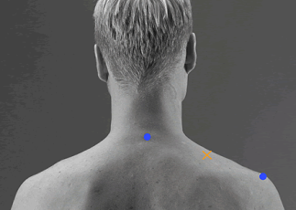
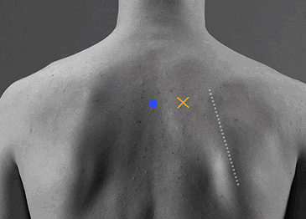
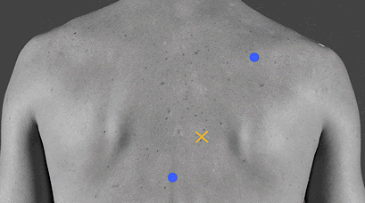
Protocols for evaluating the cervical spine
SURFACE EMGs: other protocols
SENIAM (Surface Electromyography for the non-invasive assessment of muscles) includes a series of proposals to evaluate muscle activity in the superficial cervical muscles, including recommendations for action or movement to be carried out during the measurement. These include:
http://www.seniam.org/
Muscle | EMG sensors (X) | Activity/Test
Trapezius descendens (upper) |  | Elevate the acromial end of the claviculae and scapula; extend and rotate the head and neck towards the elevated shoulder with face rotated in the opposite direction. Apply pressure against the shoulder in the direction of depression and against the head in the direction of flexion anterolaterally.
Trapezius transversus (middle) |  | Adduction of the scapula from a position of rotation in which the inferior angle is rotated laterally. The elbow needs to be extended and the shoulder at 90 degrees abduction and lateral rotation. This rotation of the shoulder is denoted by the position of the hand with the palm facing cranially (without elevating the shoulder girdle).
Trapezius ascendens (lower) |  | Depression, lateral rotation of the inferior angle, and adduction of the scapula. To obtain this position of the scapula in order to place emphasis on the action of the ascending fibres and to obtain leverage for the test, the arm is placed diagonally overhead with the shoulder laterally rotated. Apply pressure against the forearm in the downward direction.
Notes:
We emphasise the recommendations on surface electromyography for the non-invasive assessment of muscles or SENIAM, which can be found on the Internet, to evaluate the different bundles of the trapezium, including placing the electrode and the movement to be reproduced to activate them.

Slide 21
IMPORTANT ASPECTS OF CERVICAL EVALUATION USING TECHINQUES WITH INSTRUMENTS
There are many protocols to evaluate the cervical spine with techniques using instruments, whether it is to measure strength, motion, muscular activity or something else.
In theory, any gesture can be evaluated with instrumental techniques provided we choose the correct one, a suitable protocol, proper data-processing and we have standardised criteria to interpret the results.
The protocol for measuring in any case must include: the instruments (if required), the gesture we are measuring, the number of repetitions, the prior instructions and the orders given to the patient during the test, the subject’s posture before and after the measurement, the timing (rests, trials), and the greatest amount of detail possible to enable anybody to follow the same protocol.
The definition of a measuring protocol must take into account all possible factors that may alter the validity (we measure what we intend to measure) and reliability (if the protocol is repeated by the same or different evaluator under the same conditions, the results will be similar) of the results.

Slide 22
Class activity (30’)
You are going to work in groups:
Draw up a list of factors that can have an effect on the measurement of spinal strength (force) and mobility, and on the results.
Put these factors into groups according to:
Those related to the gesture to be measured (posture, type of movement, etc.)
Those related to the protocol: prior warm-up, amount of repetitions, etc.
Those related to the orders and instructions given to the subject.
Those related to the subjects themselves or to factors unrelated to the test.
Others.
Create a protocol for measuring cervical mobility by kinematic analysis. You must define gesture, times, number of repetitions, posture, orders and instructions, and any information you can.
Share your impressions and your protocol with your colleagues.
There are articles that may help you by Strimpakos et al. about the factors that can have an influence on an evaluation of mobility, proprioception (part I), and strength (part II) of the cervical spine. You can also include other factors that you think might have an influence on the measurement but which do not appear in those articles.

Slide 23
References
Validity of the Microsoft Kinect for measurement of neck angle: comparison with electrogoniometry. Int J Occup Saf Ergon. 2017 Dec;23(4):524-532.
Díaz, J. G., Montes, J. V., & Díez, M. R. (2018). Fiabilidad del fenómeno de flexión-relajación cervical. Factores que definen el protocolo de valoración. Rehabilitación, 52(2), 75-84.
Dr. Theodore C. Doege, Dr. Thomas P.Houston. (Ed.). (1994). Guías para la evaluación de las Deficiencias Permanentes.American Medical Association, versión castellana. Madrid, España: Ed.ARTEGRAF, S.A.
Fortin, M., Wilk, N., Dobrescu, O., Martel, P., Santaguida, C., & Weber, M. H. (2018). Relationship between cervical muscle morphology evaluated by MRI, cervical muscle strength and functional outcomes in patients with degenerative cervical myelopathy. Musculoskeletal Science and Practice, 38, 1-7.
O'Leary S, Fagermoen CL, Hasegawa H, Thorsen AS, Van Wyk L. Differential Strength and Endurance Parameters of the Craniocervical and Cervicothoracic Extensors and Flexors in Healthy Individuals. J Appl Biomech. 2017 Apr;33(2):166-170.
Strimpakos, N. (2011). The assessment of the cervical spine. Part 1: Range of motion and proprioception. Journal of bodywork and movement therapies, 15(1), 114-124.
Strimpakos, N. (2011). The assessment of the cervical spine. Part 2: strength and endurance/fatigue. Journal of bodywork and movement therapies, 15(4), 417-430.
Websites:
https://www.btetechnologies.com/rehabilitation/mcu/
https://tienda.fisaude.com/dinamometro-evaluacion-musculo-esqueletica-microfet2-p-39680.html
https://www.youtube.com/watch?v=WJpOEvj0NXg
http://www.seniam.org/

Slide 24
The European Commission's support for the production of this publication does not constitute an endorsement of the contents, which reflect the views only of the authors, and the Commission cannot be held responsible for any use which may be made of the information contained therein.

