Slide 1
MODULE BIOMECHANICS SPINE
Didactic Unit D: INSTRUMENTED ANALYSIS OF THE SPINE
D.2. Which dorsal and lumbar biomechanical instrumented evaluation protocols exist?
Notes:
This video is for Didactic Unit D: Instrumented analysis of the spine.
D.2. Which dorsal and lumbar biomechanical instrumented evaluation protocols exist?

Slide 2
D.2. Which dorsal and lumbar biomechanical instrumented evaluation protocols exist?
OBJECTIVES
To recall the main features that make up a biomechanical evaluation test.
To learn some of the protocols used for kinematic evaluation of the dorsal and lumbar spine.
To learn some of the protocols used to evaluate strength and muscular activity in the dorsolumbar spine.
Notes:
This session’s objectives are as follows:
To recall the main features that make up a biomechanical evaluation test.
To learn some of the protocols used for kinematic evaluation of the dorsal and lumbar spine.
To learn some of the protocols used to evaluate strength and muscular activity in the dorsal and lumbar spine.

Slide 3
D.2. Which dorsal and lumbar biomechanical instrumented evaluation protocols exist?
INDEX
Remember: What is a biomechanical test? What does it involve?
Protocols for evaluating motion
Protocols to evaluate strength
Assessment of muscular activity: Surface EMG
Notes:
These are the points we shall review in this video.

Slide 4
D.2. Which dorsal and lumbar biomechanical instrumented evaluation protocols exist?
INDEX
Remember: What is a biomechanical test? What does it involve?
Protocols for evaluating motion
Protocols to evaluate strength:
Assessment of muscular activity: Surface EMG
Notes:
Firstly, as we have seen in previous educational units, we shall briefly recall what defines a biomechanical test.

Slide 5
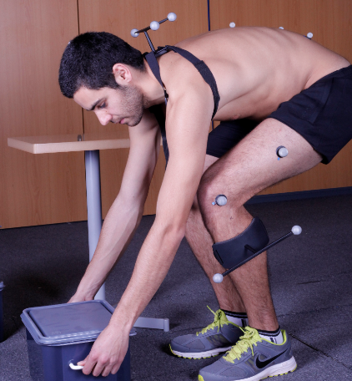
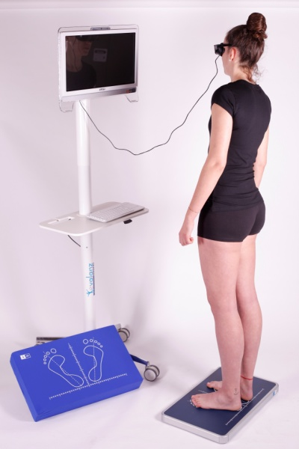
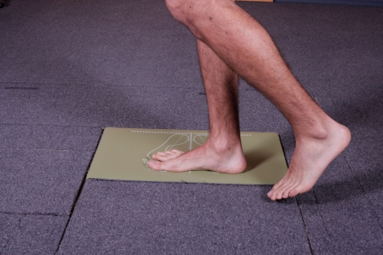
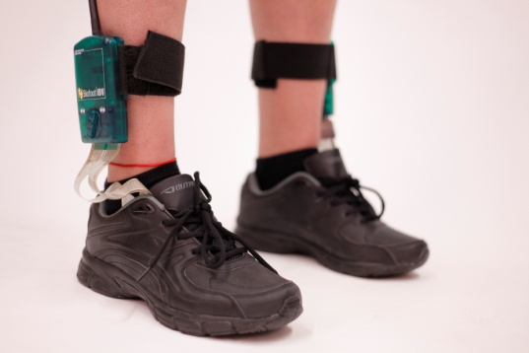
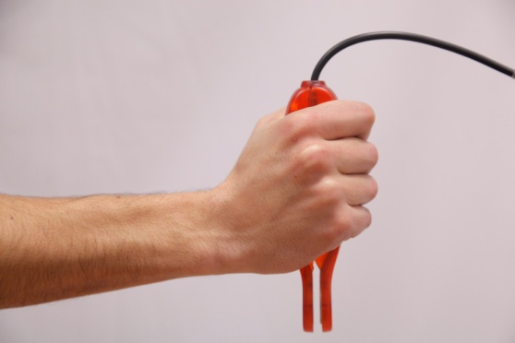
What is a biomechanical test? What does it involve?
A biomechanical assessment test is a complementary test done by means of biomechanical techniques.
Notes:
Remember that a biomechanical evaluation test is a complementary one carried out using different types of instrumental techniques.

Slide 6
What is a biomechanical test? What does it involve?
There are different biomechanical assessment tests. The aspects that define them are:
• What function is being assessed.
• What instrument and technique it is based on.
• What assessment protocol has been used.
• What results it provides, in what units and with what data analysis techniques they have been obtained.
• Standardised criteria for interpretation.
Notes:
As mentioned in previous units, biomechanical tests are defined based on different aspects, including function, instrumental technique, protocol, results and how they are interpreted.
In this educational unit, and as a result of this presentation, we shall focus on reviewing the different existing protocols for evaluation of the dorsal and lumbar spine. That includes knowing what gesture we are measuring and what instruments are used if necessary.
Remember that in the following educational units in this block (D.3 to D.6) you have more extensive information about the results obtained in many of these tests and how to interpret them, including normal and pathological cases. In order to understand where such results come from, it is important to know how the results that give them have been carried out.

Slide 7
D.2. Which dorsal and lumbar biomechanical instrumented evaluation protocols exist?
INDEX
Remember: What is a biomechanical test? What does it involve?
Protocols for evaluating motion
Protocols to evaluate strength:
Assessment of muscular activity: Surface EMG
Notes:
Next, we shall see some examples of systems and protocols for evaluating the pattern of motion in the dorsal and lumbar spine.

Slide 8
Protocols for evaluating motion
Dorsolumbar spine: protocols?
We could decide to measure any other gesture provided that:
We know how to choose the right instrument and technique;
Suitable biomechanical model;
Correct, well-defined and standardised protocol;
Proper data processing;
Valid, reliable results obtained;
Standardised interpretation of the results.
Notes:
Actually, in addition to evaluating motion by performing maximum active and passive motions, or gestures like those already described such as sitting and getting up or lifting boxes, we could assess any other gesture of interest for the dorsolumbar spine provided that:
We know how to choose the right instrument and technique;
The biomechanical model is suitable;
The protocol is correct, well-defined and standardised, if possible;
The data is properly processed;
The results obtained are valid and reliable;
There are standardised criteria for interpreting the results.

Slide 9
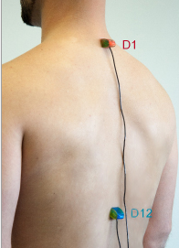
Protocols for evaluating motion
Electronic inclinometry system using two inclinometers:
The inclinometers are placed to assess the axes of motion for dorsal flexion-extension and rotation.
INCLINOMETRY
Protocol based on the American Medical Association’s guide.
The neutral position is measured, then the active or passive motion to be assessed (flexion and rotation) is performed.
A minimum of three valid measurements according to the AMA’s repeatability criterion, differing by less than 10% or 5°.
Notes:
Next, we can see an evaluation protocol for the dorsal spine using software designed to measure the active and passive ranges of motion for the upper and lower limbs and the spine.
In the case of spinal motion, this system uses two electronic inclinometers.
The inclinometers are placed at vertebrae (spinous processes) T1 and T12, as seen in the image.
In order to measure the angles, the system has a protocol based on the American Medical Association’ guide. According to these recommendations, a minimum of three measurements are taken which must differ by less than 10% or 5º between themselves in order to meet the repeatability requirement.
For each of the arcs, firstly a neutral benchmark is taken. Then the subject is asked to perform a maximum active motion, or else they are assisted to measure the passive motion.

Slide 10
Protocols for evaluating motion
INCLINOMETRY: Dorsal flexion and extension
Neutral position
Maximum flexion motion (increase in kyphosis).
Maximum extension motion (reduction of kyphosis, opening of chest).
Notes:
First the benchmark (neutral) posture is taken up, then the patient is asked to perform the motion to measure it at least three times.
For dorsal flexion and extension, we must firstly record a neutral position in which the subject’s trunk is erect and their shoulders relaxed. This is preferably performed standing.
Then we ask for a maximum dorsal flexion, which implies a voluntary increase in kyphosis. The subject is then asked to return to the neutral position and lastly they perform a maximum dorsal extension, which we also record. This complete process is repeated three times.
The final result is the mean of these.
As we have mentioned before, the American Medical Association’s repeatability criterion is applied, which states that the measurements should not diverge by more than 10% or 5° between each other.

Slide 11
Protocols for evaluating motion
INCLINOMETRY: Dorsal rotation
Neutral position (trunk in flexion, arms crossed, no rotation).
Maximum left and right rotation motion (rotation with the trunk in flexion, lifting an elbow towards the ceiling).
Notes:
In order to measure dorsal rotation, the inclinometers are placed in the same position as for measuring flexion and extension before. We also follow the same premise of carrying out at least three measurements for each arc, taking into account the AMA criterion that states that they must not differ by more than 10% or 5º between each other.
The dorsal rotation motion is measured starting from a neutral posture, with the trunk flexed and arms crossed, as shown in the image on the left. Once the neutral posture has been recorded, each of the arcs being studied is evaluated.
Next, the subject is asked to rotate their dorsal region as far as possible, attempting to lift their elbow towards the ceiling on the side to which they are rotating, while keeping their elbow in flexion. The same movement is then made on the other side.

Slide 12
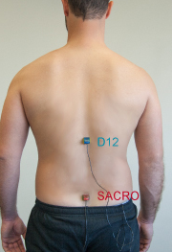
Protocols for evaluating motion
INCLINOMETRY
Electronic inclinometry system using two inclinometers:
The inclinometers are placed to assess the axes of motion for lumbar flexion-extension and lateral flexion.
Protocol based on the American Medical Association’s guide. The neutral position is measured, then the maximum active or passive motion to be assessed.
A minimum of three valid measurements according to the AMA’s repeatability criterion, differing by less than 10% or less than 5°.
Notes:
In the protocol for evaluating the lumbar spine with this same system, the inclinometers are placed over the spinous process of vertebra T12 and over the sacrum, approximately at S1.
Again, this system’s protocol is based on the guidelines of the American Medical Association mentioned before for measuring dorsal motion.

Slide 13
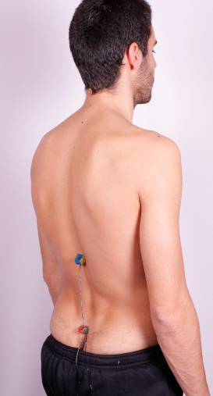
Protocols for evaluating motion
INCLINOMETRY: Lumbar flexion and extension
Neutral position
Maximum flexion motion (fingertips towards the ground).
Maximum extension motion
Notes:
When the inclinometers have been put in place, the lumbar spine’s arcs of motion are assessed.
In order to measure the flexion-extension, first the patient is placed in the neutral position, which in this case means standing with their arms hanging alongside their body with their trunk erect. They should be looking forwards.
It is necessary to record this neutral posture before evaluating each arc.
Next, we ask the subject firstly to perform a maximum flexion of the lumbar region, trying not to move their pelvis backwards and keeping their knees outstretched, attempting to move their fingertips as close as possible to the floor. Once the maximum flexion has been recorded, the subject must then stretch their lumbar column to its maximum possible extension (passing through the neutral posture), trying not to move their pelvis forwards.

Slide 14
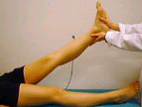
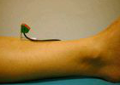
Protocols for evaluating motion
INCLINOMETRY and lumbar flexion-extension LUMBAR VALIDITY TEST
Additional confirmation of AMA repeatability: a lumbosacral flexion-extension test takes into account the motion of the hips at the sacrum:
Sacrum flexion-extension range > 55º.
Sacrum flexion-extension range > 65º.
If this is not met, a validity test is advisable:
Valid test: lowest passive elevation angle is no more than 15º greater than the sacral flexion-extension.
Notes:
When evaluating lumbar flexion-extension, in addition to the American Medical Association’s repeatability criterion, it is necessary to carry out an additional confirmation related to the motion of the hips at the sacrum measured during the evaluation.
In order for the lumbar flexion-extension to be valid from this point of view, the sacral flexion-extension range must reach 55º or more in men, and 65º or more in women.
If this is not so, the system recommends carrying out the lumbar validity test, which confirms the real maximum angle of sacral flexion by passively lifting the lower limb (a motion that involves flexion of the hip).
To do so:
Firstly, place one of the inclinometers over the tibia’s medial anterior region, as shown in the image. The patient is placed in decubitus supine with their knees outstretched, and the neutral position is recorded.
From the neutral position, they are passively assisted to lift the extended leg up to where the patient allows. That position is recorded. The leg is returned to the neutral position. The same measurement is taken for the opposite lower limb, changing the inclinometer to that leg.
The test is valid when the elevation angle of the lower limb that has been passively lifted the least is no greater than 15° more than the sacral flexion-extension range calculated during the prior evaluation. If not, this validity criteria is not met.

Slide 15
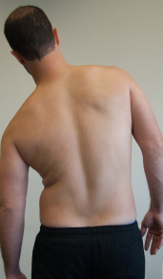
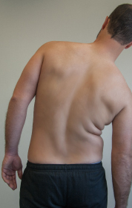
Protocols for evaluating motion
INCLINOMETRY: Lateral flexions
Neutral position
Maximum left and right lateral flexion motion (arm at body’s side).
Notes:
To measure lateral lumbar flexions, the inclinometer is placed the same way as for flexion-extension. The initial neutral posture recorded will also be the same.
In order to perform the lateral flexions, the subject is asked to laterally bend their trunk as far as possible, attempting not to move their pelvis in the opposite direction, while trying to reach their hand as far as possible down the side of their body. Each of these maximum arcs is recorded by the system at least three times.

Slide 16
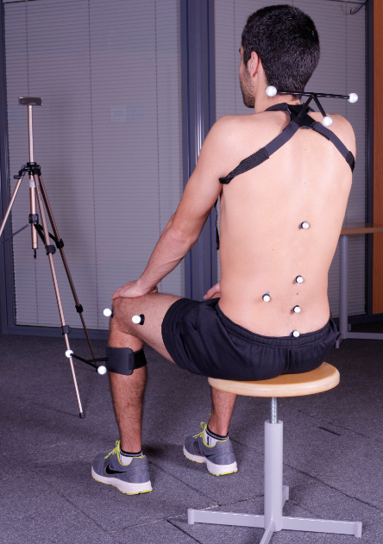
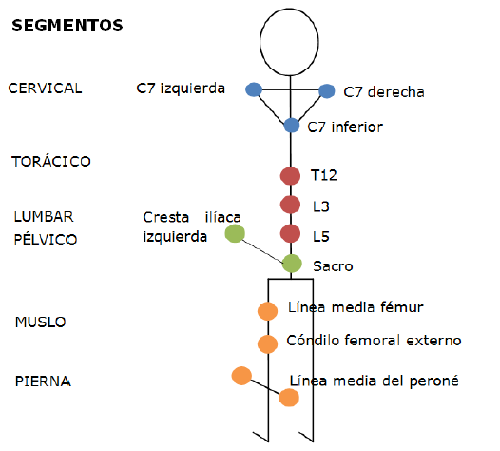
Protocols for evaluating motion
PHOTOGRAMMETRY
Notes:
The protocol for evaluation of the lumbar spine by means of the NedLumbar/IBV system is described next. It is based on kinematic evaluation of the spine while performing two activities: standing up from a chair and lifting different weights.
This system uses 3D photogrammetry for kinematic evaluation. In order to carry out this evaluation, firstly it is necessary to prepare the instruments, placing markers on the subject according to the previously defined model.
As we can see, to do so the subject is seated upright. It should be noted that the model using markers shown allows us to evaluate the movement of the trunk and its different segments relative to each other, most notably the lumbar segment’s motion and the motion performed at the knee. The markers are placed on the anatomical points shown in the image.
It should be noted that although this system mainly assesses the nature of the motion performed (kinematic evaluation), two dynamometric platforms are also used, which will measure the reaction forces generated in each lower limb during the gestures, thus allowing us to analyse whether the subject tends to put more of their body weight on to one side or another.

Slide 17
Protocols for evaluating motion
PHOTOGRAMMETRY: Getting up from a chair
Notes:
In the video shown, we can see a subject under study performing the gesture of sitting and getting up from a chair, following the guidelines previously shown by the evaluator and their instructions. It is often necessary to carry out a trial run of the gesture before recording it, in order to do a small warm-up and check that the subject has understood what they have to do.

Slide 18
Protocols for evaluating motion
PHOTOGRAMMETRY: Lifting a weight
Notes:
Likewise, in this video we can see a subject under study performing the gesture of sitting and getting up from a chair, following the guidelines previously shown by the evaluator and their instructions.
It should be remembered that although they do not appear in this video, the instructions and orders given by the evaluator are essential to carry out the protocol properly.

Slide 19
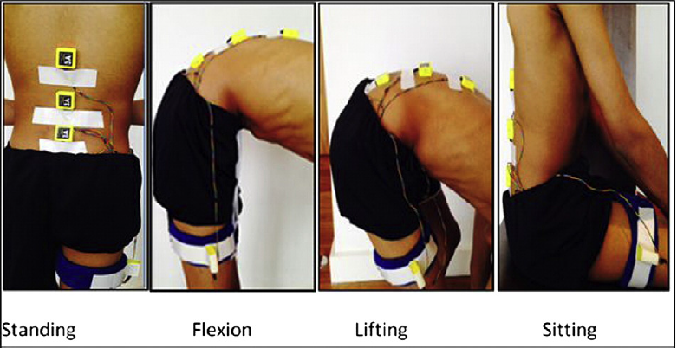
Protocols for evaluating motion
Alqhtani R.S. et al. also evaluated ADL: standing, flexion, lifting an object and sitting.
Accelerometry system: four sensors at S1, L3, T12 and lateral thigh.
Measurement of relative motion between sensors: hip angle, lower and upper lumbar region.
Prior warm-up (trunk flexion-extension and rotation).
Gestures measured:
Starting with feet over marks on the floor, upright position staring at a predetermined mark on the wall at a height of 2 m. Arms relaxed at the side of the body.
Motions: maximum anterior flexion, lifting an object from the ground (such as a wooden box with handles), and sitting down and getting up from a stool.
A complete gesture is performed as a test before measuring.
Notes:
Next we can see an example from the bibliography in which common gestures from daily life are also evaluated, such as standing and maximum lumbar flexion, as well as lifting an object from the ground or sitting and getting up from a stool.
In the study by Alghtani R.S. et al., the protocol is very similar to those already described, but in this case a system is used with an accelerometer and four sensors placed on vertebrae S1, L3, T12 and the lateral right thigh region. The relative motions between the sensors are evaluated with these instruments, measuring angles at the hip and upper and lower lumbar regions.
In order to perform the gestures, the subject stands looking forwards with their arms alongside their body instead of crossed. The authors of this article carry out an initial trial to ensure the subject has understood the instructions before the evaluation.

Slide 20
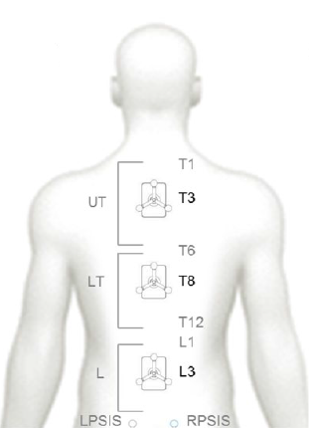
Protocols for evaluating motion
Other protocols:
Needham R. et al. and Steele J. et al. concentrated on kinematic evaluation of the spine while carrying out a habitual activity: walking.
Author(s) | Objective of study
Needham R. et al. | To develop and validate a multi-segmented kinematic model to evaluate lumbar and dorsal spine motion while walking.
Protocol used
Kinematic model of the spine: model of Markers. Validated with mechanical model. Measurements compared with electrogoniometer and torsiometer. Enables 3D angular Measurement (XZY axes). | Walking barefoot in a walkway at a self-chosen speed. The Wireless Timing Gates system was used (Brower Timing Systems, Draper, UT, USA) to ensure said speed was reached. Five measurements or walks in the walkway are performed, ensuring tread upon two dynamometric platforms. The entire process is repeated a week later (test-retest repeatability study).
Notes:
Another example of kinematic evaluation from the bibliography is the one shown in the article by Needham R. et al. In this study, the authors attempt to develop and validate a multi-segmented kinematic model to evaluate lumbar and dorsal spine motion while walking. To do so, they use a 3D photogrammetry system with the model of markers shown in the image, previously validated by comparison with the measurements taken by electrogoniometer and torsiometer.
The protocol involved walking barefoot in a walkway at a self-chosen speed. At least five measurements or walks are made in the walkway for each subject, ensuring in all of them that both feet tread on the two dynamometric platforms used. The procedure was repeated twice in order to carry out a repeatability study or test-retest study.

Slide 21
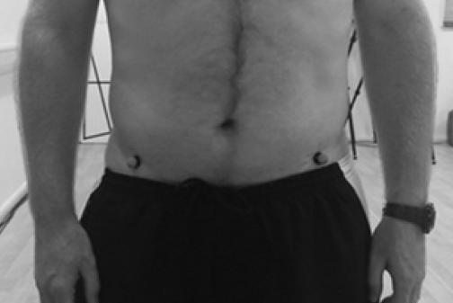
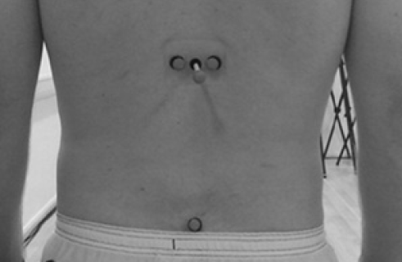
Protocols for evaluating motion
Other protocols:
Kinematic evaluation of the spine while carrying out a habitual activity: walking.
Author(s) | Objective of study
Steele et al. | To study the relationship between the spine’s kinematics while walking with pain and the lumbar spine’s extensor strength in subjects with lumbalgia.
Protocol used
Pelvic and thoracolumbar markers model. This enables lumbar motion to be measured with respect to the pelvis in 3D. | The subject walks at a self-chosen speed along a marked walkway of 8 m in length. At least five walks or attempts are gathered.
Notes:
In this other study by Steele et al., an analysis of lumbar spine mobility while walking is chosen, using a simple model of markers. In this case, the subjects assessed had lumbar pain and an attempt was made to study the relationship between the spine’s kinematics while walking with the level of referred pain and the lumbar extensor strength.

Slide 22
D.2. Which dorsal and lumbar biomechanical instrumented evaluation protocols exist?
INDEX
Remember: What is a biomechanical test? What does it involve?
Protocols for evaluating motion
Protocols to evaluate strength
Assessment of muscular activity: Surface EMG
Notes:
Next, we shall see some examples of systems and protocols for evaluating strength in the dorsal and lumbar spine.

Slide 23
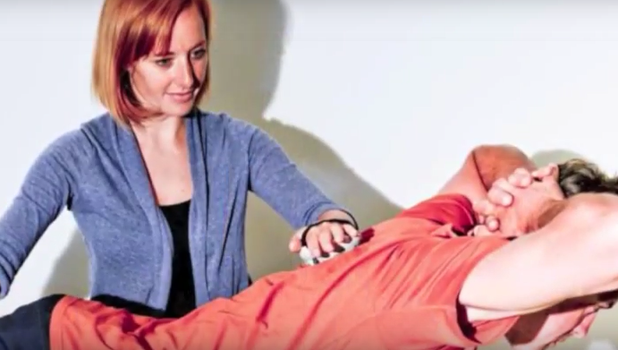
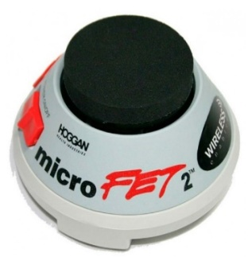
Protocols to evaluate strength
ISOMETRIC DYNAMOMETRY
These devices are for measuring resistance force without changing the length of the muscle fibres and with no movement of the joints.
Different protocols.
Evaluation of isometric force in each arc, including force from the trunk, especially in extension. Maximum force peak determined and force curves and graphs generated.
MicroFET2 manual dynamometer for musculoskeletal evaluation
Information and images from:
https://tienda.fisaude.com/dinamometro-evaluacion-musculo-esqueletica-microfet2-p-39680.html
Notes:
One of the simplest systems used for evaluating the strength of the trunk is by using isometric dynamometers.
Isometric dynamometers measure resistance force without a change in length of muscle fibres; in other words, with no movement of the joints or of the segment being assessed.
There are different protocols to carry out this kind of assessment, although manual dynamometers are fairly often used, which the evaluator holds, opposing resistance and holding back movement of the trunk in the axis studied. This is the case with the MicroFET2 dynamometer shown on the screen, which determines the peak force, while also generating force graphs and curves. For more information about this kind of device, you can see the product’s website shown on the screen.

Slide 24
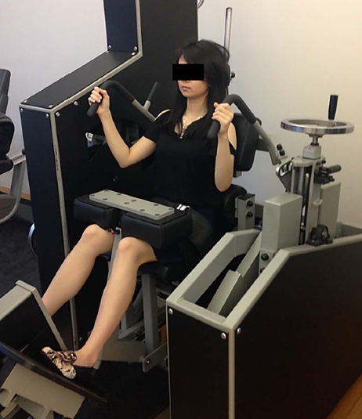
Protocols to evaluate strength
ISOMETRIC DYNAMOMETER: Some protocols to assess dorsolumbar spinal strength in the bibliography.
Author(s) | Objective of study
Pranata A. et al. | To study the ability to check on the lumbar extensor strength in subjects with chronic lumbar pain, and to analyse whether it is related to the perceived level of disability.
Protocol used
Lumbar extensor maximum voluntary isometric contraction (MVIC) was measured to derive sub-maximum values (20-50% of MVIC) for the target-matching task in a supported seated position using a lumbar extensor dynamometer (MedX). The MedX stabilises the pelvis via a restraint system which prevents pelvic rotation by isolating the lumbar extensor muscle group. Previous 30-second warm-up: lumbar flexion and extension (pain-free range of motion). Posture: neutral spine position (12° flexion, 0° at full extension) with their back supported by the backrest. Subjects should press their back against the backrest, increasing the isometric force to MVIC over a 4-second period.
Notes:
In the study by Pranata A. et al., they carried out a protocol aimed at studying the ability to check on the lumbar extensor strength in subjects with chronic lumbar pain, and to analyse whether it is related to the perceived level of disability according to a self-administered questionnaire.
To do so, an isometric dynamometer system is used (MEdX), which stabilises the pelvis and prevents it from moving during the evaluation, isolating the lumbar region.
Initially, the subject being assessed does 30 seconds of warm-up including lumbar flexion and extension movements in a non-painful range.
Afterwards, starting from a neutral initial position of the spine (defined as 12º of spinal flexion), seated with back support, the subject exerts pressure on it up to the maximum isometric force possible for four seconds.

Slide 25
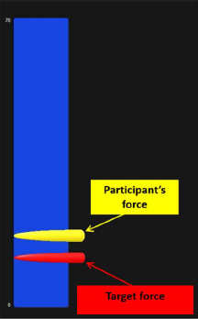
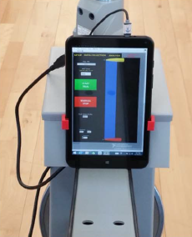
Protocols to evaluate strength
ISOMETRIC DYNAMOMETER: Some protocols to assess dorsolumbar spinal strength in the bibliography.
Author(s) | Objective of study
Pranata A. et al. | To study the ability to check on the lumbar extensor strength in subjects with chronic lumbar pain, and to analyse whether it is related to the perceived level of disability.
Protocol used
Lumbar extensor force matching task: Subjects should match the force target as accurately as possible by increasing and decreasing their isometric force from 20 to 50% of MVIC at a frequency of 0.16 Hz. The lower and upper force target limits (i.e., 20% and 50% MVIC) were selected based on lumbar extensor contraction intensities used in activities of daily living. Two trials of 60 s duration with a 30-second rest between them. Trials were performed. Visual feedback was provided. No verbal encouragement was provided and the testing and environment were kept silent.
Notes:
After carrying out the maximum extensor isometric force, the system calculates 20% and 50% of it to perform the so-called “force-matching task”, related to motor control or control over the spinal extensor force generated.
In this task, the subjects must reach the exact force indicated by the system using a visual feedback system. The target force alternates between 20% and 30% of the subject’s maximum at a frequency of 0.16 Hz.
Two measurements of 60 seconds each were taken, with a rest of 30 seconds between them. The patient was not encouraged during the task, which was performed in silence without distractions.

Slide 26
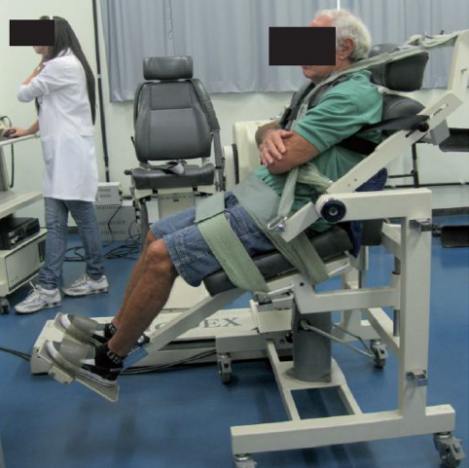
Protocols to evaluate strength
ISOKINETIC DYNAMOMETRY
This evaluates the moment of force (Fxd) or torque generated in a joint or body segment at a predetermined speed and within a predetermined range of motion.
Different positions: sitting, standing, prone, supine and decubitus lateral. The sitting position seems to be the most suitable, since it allows the pelvis to be stabilised, thus minimising muscular activity from the hip.
In this case, the protocol includes choosing the total range and velocity (º/s) at which the measurement of force is to be taken:
Depending on the pathology being assessed, different ranges and velocities can cause limitations. For example, in subjects with a facet joint pathology, pain appears on extending the trunk at a low speed and maximum range, reducing the maximum moment (torque) generated.
Ferreira Quintino L. et al.
Notes:
Trunk strength can also being evaluated using other types of dynamometry, such as isokinetic dynamometry, which evaluates the torque generated in a motion performed at a predetermined speed and range.
This evaluation can be carried out sitting, standing, prone, supine or in decubitus lateral. The sitting position seems to be the most suitable of these, since it allows the pelvis to be stabilised, thus minimising muscular activity from the hip.
In these kinds of protocols is important to choose the complete range in which we intend to evaluate the motion, and the speed (in degrees per second) at which we wish to do so. Depending on the type of pathology being assessed, different ranges and speeds can cause limitations or not. For example, in subjects with a facet-based pain, a lot of pain appears on extending the trunk at a low speed and maximum range, decreasing the maximum torque generated.
The image we see is taken from a study by Ferreira et al. in which the measurement of the trunk’s isokinetic force is made within a range of 65°, beginning with an extension of 15° then reaching a flexion of 50°. The choice of this range is based on the most commonly used ranges in activities of daily life.
Prior warm-up exercises are carried out initially at speeds of 60 º/s and 120 º/s, subsequently carrying out three series of concentric contractions at 60°/s, and another five at 120º/s.

Slide 27
D.2. Which dorsal and lumbar biomechanical instrumented evaluation protocols exist?
INDEX
Remember: What is a biomechanical test? What does it involve?
Protocols for evaluating motion
Protocols to evaluate strength
Assessment of muscular activity: Surface EMG
Notes:
Next, we shall review some aspects related to the guidelines for evaluating muscular activity in the dorsolumbar spine by using surface electromyography.

Slide 28
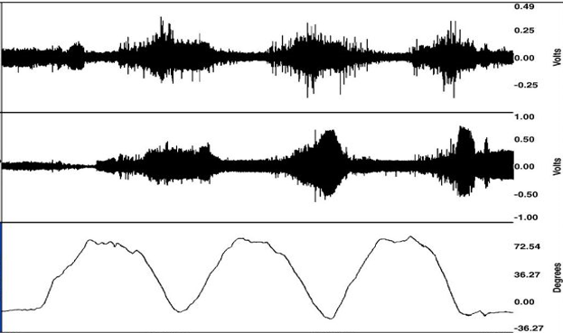
Assessment of muscular activity: Surface EMG
SURFACE EMG
There are many evaluation protocols for muscular activity that use surface EMG:
Measurement of the flexion-relaxation phenomenon in the lumbar spine:
Relaxation of the musculature at maximum flexion (healthy subjects).
There are different protocols as regards the instruments and requirements for the gesture that is to be performed in order to evaluate this phenomenon. Many of them specify the minimum flexion required of the lumbar spine for the evaluation of the phenomenon to be valid.
Decrease in EMG activity.
Maximum flexion.
You can see an example of the protocol for performing this type of test via the following link:
https://www.youtube.com/watch?v=rrMUmVgEOWg
Notes:
ELECTROMYOGRAPHY OR SURFACE EMG ALLOWS US TO EVALUATE DIFFERENT CHARACTERISTICS OF MUSCULAR ACTIVATION (such as range, frequency, etc.) BY STUDYING ITS ELECTRICAL SIGNAL.
There are many evaluation protocols for muscular activity that use surface EMG. In subjects with a painful pathology in the lumbar spine, measurement of the flexion-relaxation phenomenon is especially well-known.
This phenomenon involves a relaxation of the musculature, which can be confirmed by the existence of an electromyographic silence in the maximum lumbar flexion position for healthy subjects. In theory, this silence does not appear with subjects who are in pain.
There are different protocols as regards the instruments and requirements for the gesture that is to be carried out in order to evaluate this phenomenon. They normally require instrumentalisation with various electrodes in both paravertebral regions at one or several lumbar regions. Many of the protocols can also specify the time required to perform the flexion or to remain flexed, or the minimum level of flexion in the lumbar spine required for the evaluation of the phenomenon to be valid.

Slide 29
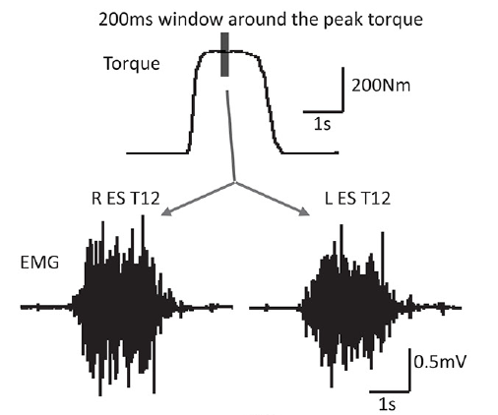
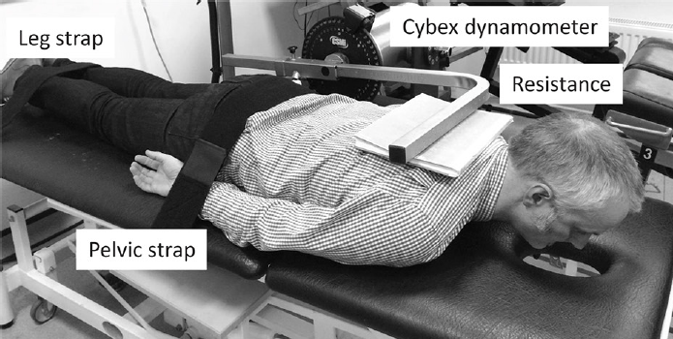
Protocols for evaluating the lumbar spine
SURFACE EMG
Chiou Sy et al.
Objective of study
To study the ability to check on the lumbar extensor strength (EMG in terms of frequency) in subjects with lumbar pain, and to analyse whether it is related to the perceived disability.
Protocol used
Bilateral electrodes in erector spinae L4 and T12 (EMG). Subjects performed three brief maximum voluntary isometric contractions (MVICs) of the back extensors and the torque was measured using a dynamometer. The frequency of the EMG signal is studied at the moment of peak torque, obtaining: a ratio (low/high frequencies) of the energy, peak power and the frequency of the peak power for each recording site, averaged and correlated.
Notes:
In this slide, we can see an example of the evaluation of the spine based on dynamometry and surface electromyography for studying the lumbar spine in subjects with pain, carried out by Chiou Sy et al. In this case, the authors attempt to study the ability to check on the lumbar extensor strength (EMG activity in terms of frequency) in subjects with chronic lumbar pain, and they analyse whether it is related to the level of disability perceived via a self-administered questionnaire.
In order to measure the electromyographic signal, electrodes are placed bilaterally at the erector spinae L4 and T12.
This signal is measured during three brief maximum isometric contractions of the trunk extensors, carried out in decubitus prone as shown in the lower photo. The authors study: the frequency of the EMG signal at the moment of peak torque, ratio (low/high frequencies) of the energy, peak power and the frequency of the peak power for each recording site, averaged and correlated.

Slide 30
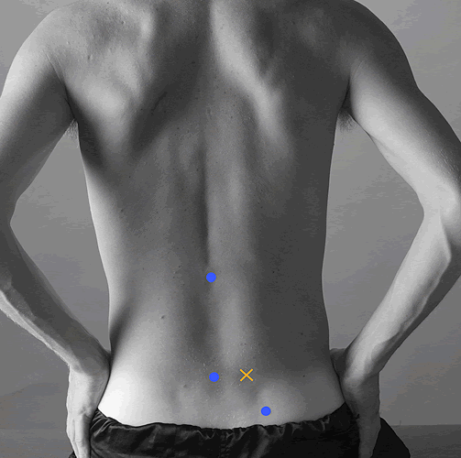
Protocols for assessment of muscular activity
SURFACE EMG: Other protocols
SENIAM (Surface Electromyography for the Non-Invasive Assessment of Muscles) includes a series of proposals to evaluate muscle activity in the trunk, including recommendations for the action or motion to be carried out during the measurement. These include:
http://www.seniam.org/
Muscle | EMG sensors (X) | Activity/Test
Multifidus |  | Clinical testing would consist of lifting the trunk from a prone position.
Notes:
We emphasise the recommendations on surface electromyography for the non-invasive assessment of muscles or SENIAM, which can be found on the Internet, to evaluate the different muscle groups of the trunk, including placing the electrode and the motion to be reproduced to activate them. In this image, you can see the placement of the electrode and the recommended movements to evaluate the multifidus.
In this case, the requested movement involves lifting or extending the trunk from decubitus prone.

Slide 31
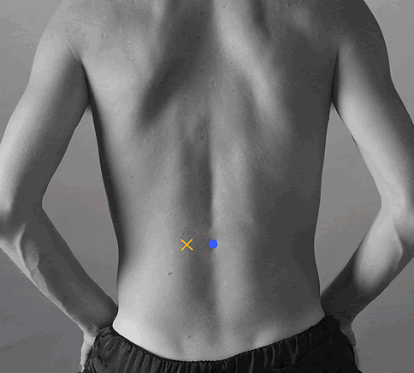
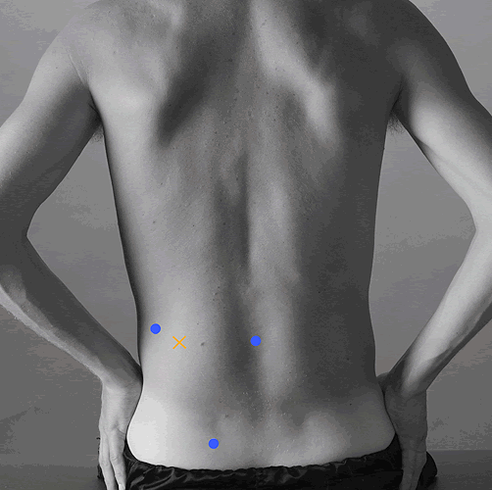
Protocols for assessment of muscular activity
SURFACE EMG: Other protocols
http://www.seniam.org/
Muscle | EMG sensors (X) | Activity/Test
Erector spinae longissimus |  | Clinical testing would consist of lifting the trunk from a prone position.
Erector spinae iliocostalis
Notes:
Using the same trunk extension motion in prone, the muscular activation of other muscles such as erector spinae longissimus and iliocostalis can also be assessed by placing electrodes at the points shown in the image.

Slide 32
IMPORTANT ASPECTS OF SPINAL EVALUATION USING TECHNIQUES WITH INSTRUMENTS
There are many protocols to evaluate the dorsolumbar spine with techniques using instruments, whether it is to measure strength, motion, muscular activity or something else.
In theory, any gesture can be evaluated with instrumental techniques provided we choose the correct one, a suitable protocol, proper data processing and we have standardised criteria to interpret the results.
The protocol for measuring in any case must include: the instruments (if required), the gesture we are measuring, the number of repetitions, the prior instructions and the orders given to the patient during the test, the subject’s posture before and after the measurement, the timing (rests, trials), and the greatest amount of detail possible to enable anybody to follow the same protocol.
The definition of a measuring protocol must take into account all possible factors that may alter the results’ validity (we measure what we intend to measure) and reliability (if the protocol is repeated by the same or different evaluator under the same conditions, the results will be similar).
Notes:
Finally, emphasis should be placed on:
There are many protocols to evaluate the dorsolumbar spine with techniques using instruments, whether it is to measure strength, motion, muscular activity or something else.
In theory, any gesture can be evaluated with instrumental techniques provided we choose the correct one, a suitable protocol, proper data processing and we have standardised criteria to interpret the results.
The protocol for measuring in any case must include: the instruments (if required), the gesture we are measuring, the number of repetitions, the prior instructions and the orders given to the patient during the test, the subject’s posture before and after the measurement, the timing (rests, trials), and the greatest amount of detail possible to enable anybody to follow the same protocol.
The definition of a measuring protocol must take into account all possible factors that may alter the results’ validity (we measure what we intend to measure) and reliability (if the protocol is repeated by the same or different evaluator under the same conditions, the results will be similar).

Slide 33
Class activity (30’)
You are going to work in groups:
Read the article by S. Alqhtani et al. carefully.
Look at the protocol for measuring, including the instruments, gestures, conditions and instructions/orders.
Could you reproduce the experiment exactly?
Do you think there is anything missing in the description of the experiment in order to be able to reproduce it? What? Why is it important and how do you think it could affect the results obtained?
Share your conclusions with your colleagues.

Slide 34
References
Correlation of lumbar-hip kinematics between trunk flexion and other functional tasks. Journal of manipulative and physiological therapeutics, 38(6), 442-447.
Needham, R., Naemi, R., Healy, A., & Chockalingam, N. (2016). Multi-segment kinematic model to assess three-dimensional movement of the spine and back during gait. Prosthetics and orthotics international, 40(5), 624-635.Needham R. et al.
Steele, J., Bruce-Low, S., Smith, D., Jessop, D., & Osborne, N. (2014). Lumbar kinematic variability during gait in chronic low back pain and associations with pain, disability and isolated lumbar extension strength. Clinical Biomechanics, 29(10), 1131-1138.
Pranata, A., Perraton, L., El-Ansary, D., Clark, R., Fortin, K., Dettmann, T., ... & Bryant, A. (2017). Lumbar extensor muscle force control is associated with disability in people with chronic low back pain. Clinical Biomechanics, 46, 46-51.
Chiou, S. Y., Koutsos, E., Georgiou, P., & Strutton, P. H. (2018). Association between spectral characteristics of paraspinal muscles and functional disability in patients with low back pain: a cohort study. BMJ open, 8(2), e017091.
Quintino, L. F., Franco, J., Gusmão, A. F. M., Silva, P. F. D. S., & Faria, C. D. C. D. M. (2018). Trunk flexor and extensor muscle performance in chronic stroke patients: a case–control study. Brazilian journal of physical therapy, 22(3), 231-237.
Websites:
https://tienda.fisaude.com/dinamometro-evaluacion-musculo-esqueletica-microfet2-p-39680.html
http://www.seniam.org/

Slide 35
The European Commission's support for the production of this publication does not constitute an endorsement of the contents, which reflect the views only of the authors, and the Commission cannot be held responsible for any use which may be made of the information contained therein.

