Slide 1
MODULE BIOMECHANICS OF SPINE
Didactic Unit D: INSTRUMENTED ANALYSIS OF THE SPINE
D.4. How is a normal biomechanical assessment of the lumbar spine?

Slide 2
OBJECTIVES
To recognise the normal results of a lumbar biomechanical assessment.
To become familiar with the interpretation of the results obtained from the lumbar biomechanical assessment in a normal population.
To become familiar with the interpretation of the results obtained from the assessment of lumbar muscle strength in a normal population.
To apply the knowledge acquired to a clinical case.
Notes:
The objectives of this didactic unit are:
To recognise the normal results of a lumbar biomechanical assessment.
To become familiar with the interpretation of the results obtained from the lumbar biomechanical assessment in a normal population.
To become familiar with the interpretation of the results obtained from the assessment of lumbar muscle strength in a normal population.
To apply the knowledge acquired to a clinical case.

Slide 3
CONTENTS
Functional assessment of the lumbar spine
Assessment of the lumbar range of motion
Kinematic assessment of the lumbar spine
Kinematic and kinetic assessment in daily activities and low back pain
Force assessment of the lumbar spine
Key ideas
Notes:
In order to achieve those objectives, the theory material of the didactic unit contains an explanation of the following concepts.
Functional assessment of the lumbar spine with the factors that influence the assessment results.
Assessment of lumbar range of motion. Inclinometers and regulations of the American Medical Association.
Kinematic assessment of the lumbar spine, focusing on the kinematic results most frequently used in clinical evaluation.
Kinematic and kinetic assessment in daily activities. This section focuses on the results obtained from the biomechanical analysis of the daily life activities that are commonly affected in lumbar pathologies with pain.
Force assessment of the lumbar spine. This section deals with the results of the isokinetic assessment of the lumbar musculature, and with the analysis of lumbar muscle activity using surface electromyography and studying a specific signal phenomenon.
The contents of the class end by summarising the most important ideas of the didactic unit.

Slide 4
Functional assessment of the lumbar spine
ASSESSMENT FUNCTION
INSTRUMENTAL TECHNIQUE
OUTCOMES
MOBILITY
Range of movement Range of movement (º) Inclinometers
Electrogoniometers
Characteristics Range of movement (º)
of the movement Photogrammetry Angular acceleration (º/s2) /Velocity(º/s)
Inertial systems Reaction force/Asymmetries
Dynamometric platform Repeatability
FORCE
Isokinetic force Dynamometer Torque (Nw m)
Muscle activity Surface electromyography Muscle activity (flex-relax phenomenon)
Notes:
To assess the lumbar spine from a biomechanical point of view, remember that it is important to know the objective of the assessment, the instrumental techniques that can be used to achieve that objective, and the general results obtained with those techniques.
This slide schematically presents the functions assessed in the spine (mobility and strength), the instrumental techniques frequently used to assess these functions, and some of the results most frequently included in the clinical reports of these assessments.

Slide 5
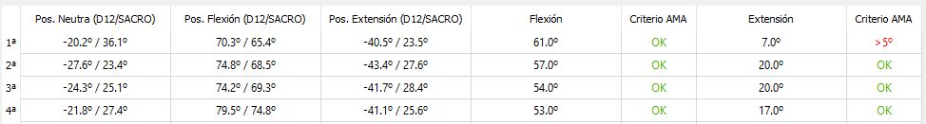
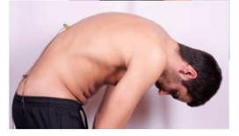
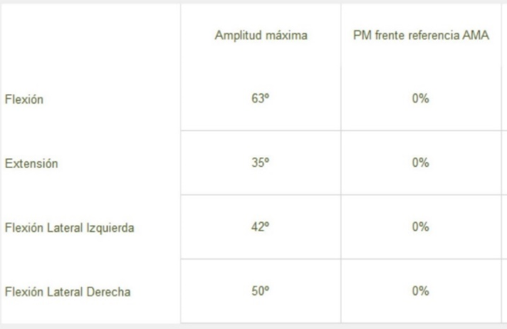
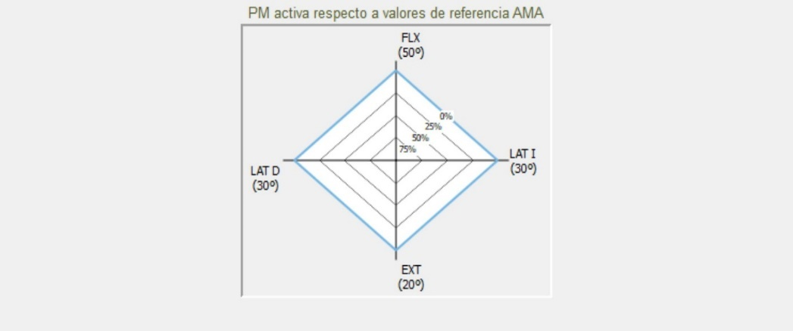
Assessment of the lumbar range of motion
Electronic dual inclinometry system placed on the appropriate bony prominences (T12-sacrum) to assess the maximum joint range in the flexion-extension movement of the lumbar spine.
OUTCOMES: Range of movement (º) and mobility loss (ML)
Notes:
A dual inclinometer technique can be used to assess the range of motion of the lumbar spine.
The results can be expressed in two types of format: numerical and/or graphic.
These results are shown in the lower table and are obtained from the calculations made with the data recorded by the inclinometers for each measuring position (upper table with the result of each inclinometer in the neutral position, at maximum flexion and maximum extension).
In the case of the spine, it is important to have reference data from normal population with which to compare them. The graph on the right shows the results of the measurement in relation to the reference values of the American Medical Association (AMA). It is recommended that these data come from measurements performed using the same protocol and instrumental technique. It would also be advisable to segment the data, mainly by age.

Slide 6
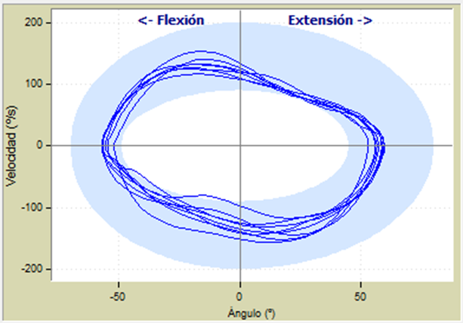
Kinematic assessment of the lumbar spine
MEASURING EQUIPMENT: Photogrammetry, inertial systems.
TYPE OF ANALYSIS: Kinematic.
GRAPH: Angular velocity (º/s) of the lumbar spine versus flexion-extension range of motion (º). The blue band represents the normal reference values for both speed and range of motion.
INTERPRETATION OF THE RESULT: Movement of the lumbar spine in the sagittal plane at a normal speed, and range within reference values.
Notes:
This slide shows the graphic result of a kinematic analysis of the lumbar spine in the flexion/extension movement. To understand the results, it is advisable to follow each section highlighted on the slide when discussing the results in class with the students.
What measuring equipment do you think was used?
Does this record fall under any type of analysis?
What does this graph represent?
How would you interpret this result?
Normal pattern: a normal movement is related to fast speed and good range of motion of the lumbar spine.

Slide 7
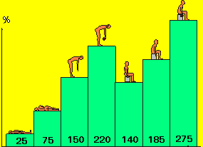
Kinematic and kinetic assessment in daily activities
In people with low back pain, activities such as bending the trunk or lifting weights are associated with significant increases in intradiscal pressure and therefore pain.
The biomechanical analysis of these activities provides a more precise definition of them, detecting movement disorders that may be associated with pathology or a functional alteration of the spine.
Graphical comparison of intradiscal pressures at L3-L4 during different activities (Image: Nachemson, A. L. (1976). The lumbar spine an orthopaedic challenge. spine, 1(1), 59-71)
Notes:
In people with low back pain, activities such as bending the trunk or lifting weights are associated with significant increases in the intradiscal pressure, and consequently pain. In 1976, Nachemson conducted a study on intradiscal pressures at L₃-L₄ level during different activities. He determined that the values in the sitting position are greater than standing and that they increase if the person is holding a weight in the hand. The data represented in Figure 6 are based on this study and the values are given in relation to a reference value established in the standing position (100%).
The kinematic and kinetic analysis of the aforementioned movements allows us to define them more accurately through the analysis of the range of motion (ROM), the angular acceleration and speed at which the movement is performed, as well as other parameters such as the reaction force and repeatability of the movement. An alteration in the parameters that define the movement is associated with a functional alteration of the person to perform the analysed tasks.

Slide 8
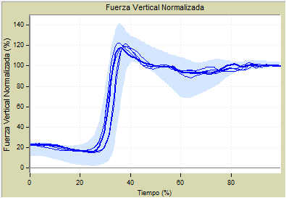
Kinematic and kinetic assessment in daily activities
MEASURING EQUIPMENT: Dynamometric platform.
TYPE OF ANALYSIS: Kinetic.
GRAPH: It represents the different recorded repetitions of the reaction force during the sit-to-stand movement. The blue band represents the normal pattern of force in this movement.
INTERPRETATION OF THE RESULT: Repeatable and normal reaction force pattern, which means adequate momentum to perform the sit-to-stand movement (strength and coordination of trunk and lower limbs).
Activity: rising from a chair
Notes:
To understand the results, it is advisable to follow each section highlighted on the slide when discussing the results in class with the students.
What measuring equipment do you think was used?
Does this record fall under any type of analysis?
What does this graph represent?
How would you interpret this result?
Normal pattern: a normal sit-to-stand movement is related to good momentum to rise from the chair and therefore with an increased curve slope and a maximum peak greater than 100% of the normalised vertical force.

Slide 9
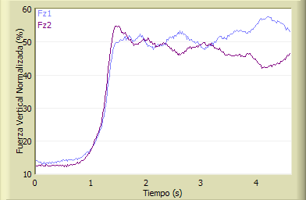
Kinematic and kinetic assessment in daily activities
MEASURING EQUIPMENT: 2 dynamometric platforms.
TYPE OF ANALYSIS: Kinetic.
GRAPH: It represents the reaction force generated by each lower limb during the sit-to-stand movement.
INTERPRETATION OF THE RESULT: Symmetrical force pattern. Similar weight-bearing on both lower limbs when performing the sit-to-stand movement.
Activity: rising from a chair
FORCE ASYMMETRY
Notes:
To understand the results, it is advisable to follow each section highlighted on the slide when discussing the results in class with the students.
What measuring equipment do you think was used?
Does this record fall under any type of analysis?
What does this graph represent?
How would you interpret this result?
Normal pattern: a normal sit-to-stand is related to a symmetrical support and therefore a similar weight-bearing on both lower limbs whilst the person is rising from the chair during practically the whole the movement.

Slide 10
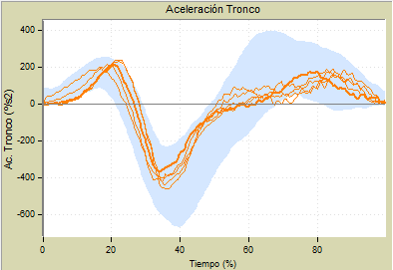
Kinematic and kinetic assessment in daily activities
MEASURING EQUIPMENT: Photogrammetry or inertial system.
TYPE OF ANALYSIS : Kinematic.
GRAPH: It represents the angular acceleration of the spine (º/s2) in different recorded repetitions of the sit-to-stand activity. The blue band represents the normal pattern of acceleration in this activity.
INTERPRETATION OF THE RESULT: Normal angular acceleration of the spine, which involves speed and effectiveness in the movement performed.
Activity: rising from a chair
Notes:
To understand the results, it is advisable to follow each section highlighted on the slide when discussing the results in class with the students.
What measuring equipment do you think was used?
Does this record fall under any type of analysis?
What does this graph represent?
How would you interpret this result?
Normal pattern: a normal sit-to-stand movement is quick, and has a good spine acceleration and deceleration component according to the phase of the movement, that is, the flexion phase, which involves hip flexion and trunk tilt to generate the momentum, and the extension phase, in which the hip and knees are extended to lift the centre of gravity and raise the body to a standing position. A decrease in the acceleration of the movement means difficulty in performing and completing the activity efficiently.

Slide 11
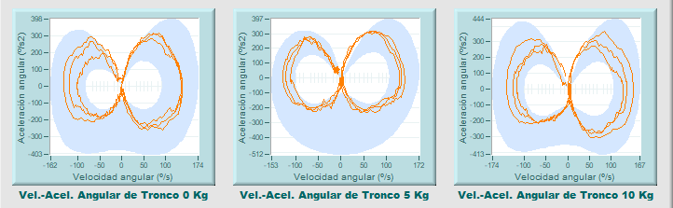
Kinematic and kinetic assessment in daily activities
Activity:
lifting a weight
MEASURING EQUIPMENT: Photogrammetry or inertial system.
TYPE OF ANALYSIS: Kinematic.
GRAPH: It represents the angular acceleration of the trunk versus its angular speed in different recorded repetitions of the movement of lifting a weight. The result is shown for the three increasing weights. The blue band represents the normal pattern of acceleration and speed in this movement.
INTERPRETATION OF THE RESULT: The angular speed and acceleration of the trunk are normal for all the weights lifted, which implies good mobility and speed in the movement performed. The movement does not get worse when the weight lifted is increased.
Notes:
Remember: To understand the results, it is advisable to follow each section highlighted on the slide when discussing the results in class with the students.
What measuring equipment do you think was used?
Does this record fall under any type of analysis?
What does this graph represent?
How would you interpret this result?
Normal pattern: the weight is lifted with a quick movement of the trunk to generate enough momentum to lift it. The weights handled do not usually imply significant differences among them in terms of movement quality.
These graphs represent the angular velocity of the spine versus its angular acceleration when performing the activity of lifting different weights consecutively (the movements lifting 0, 5 and 10 kg are represented on the left, centre and right graph, respectively). The blue band represents the normal force pattern considered in the measuring equipment used (NedLumbar/IBV). As seen in the previous slide, if there is no spinal pathology, a normal recording shows a movement performed with speed, both when bending to pick up the weight (flexion phase of the activity) and when lifting it (extension phase of the activity).

Slide 12
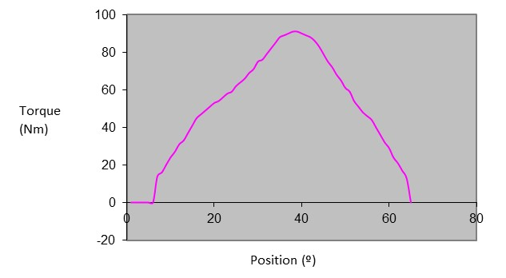
Force assessment of the lumbar spine
MEASURING EQUIPMENT: Isokinetic dynamometer.
TYPE OF ANALYSIS: Physiological (strength).
GRAPH: Curve of the concentric isokinetic moment of torsion. The vertical axis reflects the amount of force produced by the muscle, and the horizontal axis the range of movement where the assessment is performed.
INTERPRETATION OF THE RESULT: A high slope both at the beginning and the end of the curve indicates that the subject can produce force and stop producing it. For a more accurate interpretation, the maximum peak it reaches depends on the maximum force values with which we are comparing.
Notes:
Remember: To understand the results, it is advisable to follow each section highlighted on the slide when discussing the results in class with the students.
What measuring equipment do you think was used?
Does this record fall under any type of analysis?
What does this graph represent?
How would you interpret this result?
Normal pattern: We will look for a high slope both at the beginning and the end of curve, which means that the person can produce force and stop producing it. The maximum peak of the curve also depends on the maximum force values with which we are comparing.

Slide 13
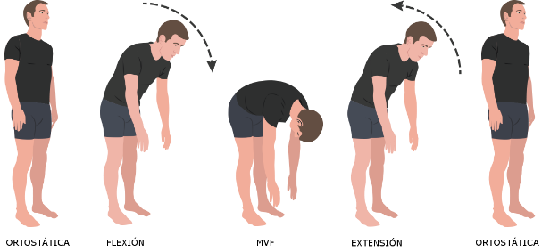
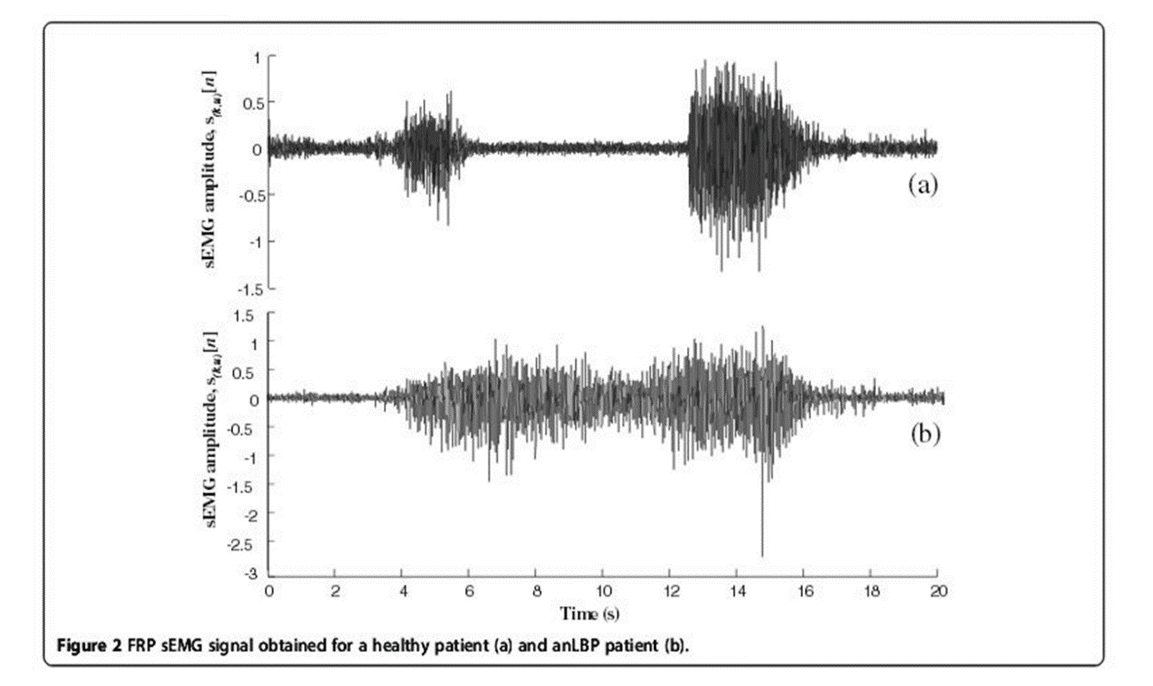
Force assessment of the lumbar spine
MEASURING EQUIPMENT: Surface electromyography.
TYPE OF ANALYSIS: Physiological.
GRAPH: It represents the muscle activity during a lumbar spine flexion-extension test.
INTERPRETATION OF THE RESULT: The activity of the lumbar paraspinal muscles decreases in relation to the beginning of the trunk flexion and extension, which is compatible with the flexion-relaxation phenomenon.
Notes:
In normal and healthy people, EMG activity during the flexion of the lumbar paraspinal muscles initially increases and then decreases as the ligaments start to support the trunk and the flexion angle increases. At maximum voluntary flexion (MVF), sEMG activity is often at or below the level of sEMG activity in the standing position.
In a normal pattern, myoelectric silence is expected (signal decrease at maximum spine flexion).

Slide 14

Example of the outcomes
Esta foto de Autor desconocido está bajo licencia CC BY-SA-NC

Slide 15
The results of a case after performing a functional assessment of the lumbar spine are discussed below. This test kinetically and kinematically analyses the movement of the lumbar spine in simple activities to detect abnormal or non-functional movements secondary to lumbar pain.
The NEDLUMBAR/IBV assessment system was used, together with photogrammetry and two force dynamometric platforms as recording techniques.
To perform the assessment, this system compares the results obtained with those of a group of subjects whose characteristics were comparable to those of the patient (databases consisting of normal and pathological patients segmented by age and gender.)
The assessment protocol is standardised and includes two activities:
Activity of rising from a chair.
Activity of lifting weights.
The results obtained provide biomechanical information about the movement pattern performed such as force, mobility, acceleration and repeatability of the movement, among others.
At the end, the study of the activity is summarised in a functional index. If the result of this index is greater than 90%, the ability of the person assessed to perform the activity falls within normal limits.
Notes:
The results that can be obtained in the assessment of a person with no functional limitation caused by pain or lumbar pathology are shown below. A biomechanical test is applied to analyse the performance of an activity.
This test kinetically and kinematically analyses the movement of the lumbar spine in simple activities to detect abnormal or non-functional movements secondary to lumbar pain. NedLumbar/IBV is the software used for the assessment, together with 3D photogrammetry and two force dynamometric platforms as recording techniques. To perform the assessment, Nedlumbar/IBV compares the parameters obtained with those of a group of subjects whose characteristics are comparable to those of the patient (databases consisting of normal and pathological patients segmented by age and gender.)
At the end, the study of the activity is summarised in a functional index. If the result of this index is greater than 90%, the ability of the person assessed to perform the activity falls within normal limits.

Slide 16
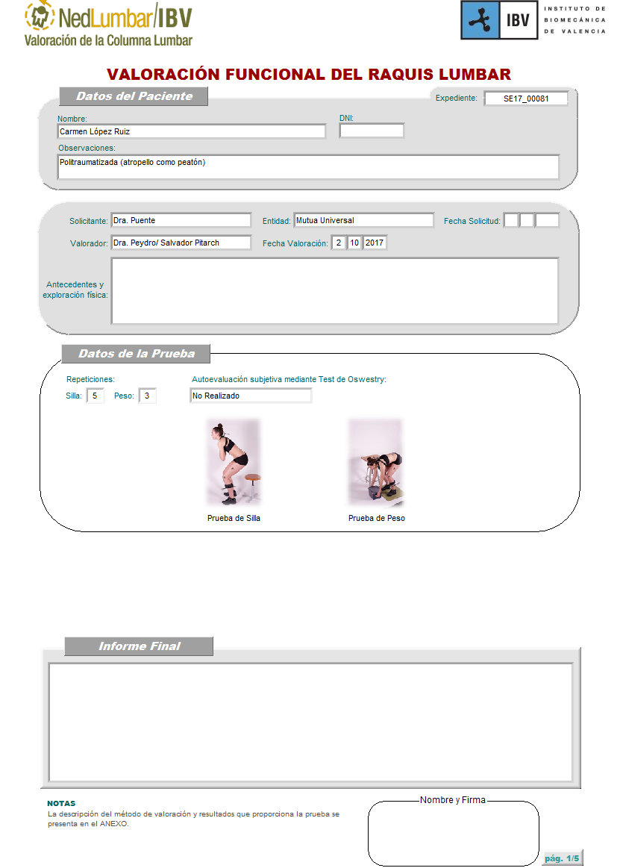
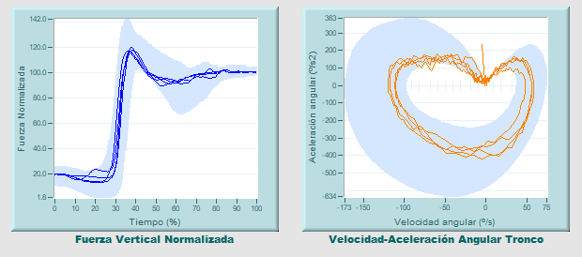
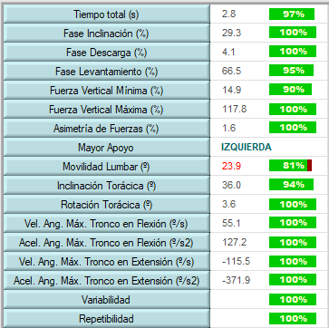

Activity: rising from a chair
Notes:
This slide shows the numerical and graphical results of the biomechanical analysis of the sit-to-stand activity.
We will look at some of the parameters such as the performance time of the activity, reaction force, angular speed and acceleration of the trunk, repeatability in the performance of the movement, and we will end with an index that summarises the global functionality, as well as the indexes that we have seen on functional scales.
The time needed to perform the activity was 2.8 s. The comparison with the normality data used as a reference indicates that it is a normal value, (it is above 90%, which is the limit considered normal in this assessment system). This means that the time needed by the person being assessed to perform the activity was appropriate and similar to people without pain or pathology.
Other interesting parameters in the analysis of this activity, and within spinal pathology, are the maximum vertical force and force asymmetry. In this case, the patient rises without difficulty in the momentum (observe the slope of the reaction force curve: it is a very steep slope that matches the normality band throughout its length). There is no asymmetry, which means that the person rises with similar weight-bearing on both lower limbs.
As for the results related to the angular speed and acceleration of the trunk during the movement, they are all within the data considered as a reference of normality.
The repeatability of the movement was also very high, which is compatible with a normal movement pattern.
The final information that the NedLumbar/IBV assessment system shows is a global result of the activity analysis expressed as an index. The normality index informs about the functionality of the patients regarding their mobility when performing this activity. Their functionality is considered altered when this result is below 90%. In this case, the functionality index (Global Assessment) has obtained a result of 98%, which means that the patient performs this activity with normal functionality and, based on the data found, the movement pattern would be compatible with a normal pattern, that is, not altered by low back pain.

Slide 17
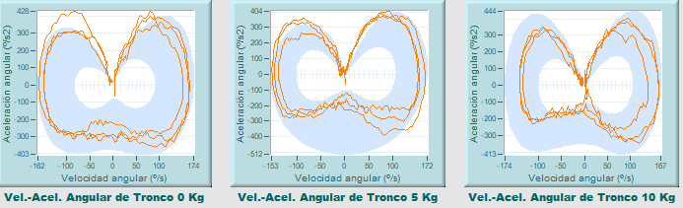
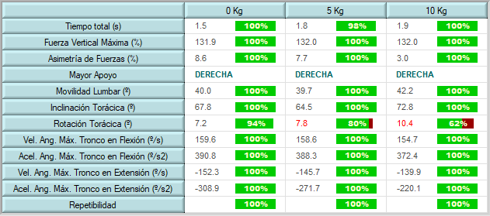

Activity: lifting a weight
Notes:
The results of the weight-lifting test are displayed on the screen. If you look at the parameters discussed (performance time, maximum vertical force, force asymmetry, angular speed and acceleration), you can see that the movement performed by the person during this activity is within normality in all these parameters, and therefore, lumbar pain does not affect speed or the way the movement is performed. There is only one deficit in trunk rotation when lifting the heaviest weight. This deficit (62% of normality) may be related to the difficulty in handling the greatest weight. The rest of the parameters are within what the measuring system considers a normal pattern, and therefore, the final functionality index of the activity indicates, with 91% of normality, that the patient’s performance of the movement is compatible with a pattern that can be considered normal.
This screen shows the numerical and graphical results of the biomechanical analysis of the activity of lifting a weight. If we look at the parameters discussed on the previous slide (performance time, maximum vertical force, force asymmetry, angular speed and acceleration) the results are as follows:
The time needed to perform the activity shows high values for all the weights lifted, which is compatible with an easy-to-perform normal movement.
The results obtained for the reaction force are also normal, there was a good momentum when lifting the weights that is not affected by the increase in the load.
The results related to the angular velocity and acceleration of the trunk during the movement are within the reference of normality. These results mean good spine mobility during the performance of these activities, no alteration is observed when the weight is being lifted (moment in which there is greater overload at the level of the spine.)
The repeatability of the movement is also very high, which is compatible with a movement pattern with no pain.
The final information that the NedLumbar/IBV assessment system provides as a global result of the activity analysis is 91%, which means that the patient performs this activity with normal functionality and, based on the data found, the movement pattern would be compatible with a function pattern not altered by low back pain.

Slide 18


Class activity
Working on a clinical case (document)
Notes:
Next, the activity to be performed by the students in class is introduced. They will be given a document about a clinical case which is based on a biomechanical test performed to assess the range of motion of the lumbar spine using a dual inclinometer technique. The students will read it and complete the activities. At the end, they will interpret the results of the clinical case following a guide of questions that are shown in the next slide and which are also included in their document.
At the end of the activity, the teacher will guide the class discussion about the results of the case.
This activity can be done individually or in groups. A maximum of 4-5 people per group is recommended.

Slide 19
Questions guide
Were the records obtained valid in terms of repeatability?
Was a validity straight leg raising test necessary?
What was the maximum range recorded for each movement?
Is the mobility recorded for each axis considered as normal?
What values were taken as a reference for normality?
What is the most limited movement or with the greatest loss of mobility? And the least limited movement?
Is the loss of mobility recorded significant?
Were important asymmetries found in the laterality of the movements?
Notes:
After reading the clinical case, the students will answer these questions and then share their responses with the teacher and the other students. The teacher can add questions that may be interesting for the case and its biomechanical assessment.

Slide 20
Case solution
Were the records obtained valid in terms of repeatability? Yes, they meet the validity criteria of the AMA; three consecutive repetitions are obtained whose maximum flexion and extension value falls within 5º from the mean.
Was a validity straight leg raising test necessary? No, because the flexion-extension mobility recorded by the inclinometers on the sacrum was greater than 55º.
What was the maximum range recorded for each movement? Flexion: 25º Extension: 5º Left lateral flexion: 23º Right lateral flexion: 22º
Is the mobility recorded for each axis considered as normal? No, because there is a significant loss of mobility with respect to the values that were taken as reference. For example, there is a loss of mobility of 75% for extension and 50% for flexion.
Notes:
The teacher has the answers to the questions asked.

Slide 21
Case solution
What values were taken as a reference for normality?
The mobility values of the American Medical Association.
What is the most limited movement or with the greatest loss of mobility? And the least limited movement?
Extension was the most limited movement, with 75% of mobility loss. The least limited movement was left lateral flexion, with 22% of mobility loss.
Is the loss of mobility recorded significant?
It was in the case of flexion/extension.
Were important asymmetries found in the laterality of the movements?
No. Asymmetry in laterality can only be observed in lateral flexions, and there is only 1º of difference.
Notes:
The teacher has the answers to the questions asked.

Slide 22
Key ideas
Mobility changes with age, and the range of motion reduces as the person gets older. It is important to compare the values obtained using the same protocols and measuring equipment.
In order to measure the range of motion of the spine more accurately, the American Medical Association (AMA) recommends the use of inclinometers as an accurate method to estimate true spine motion.
Low back pain causes limitations when performing frequent and common activities of daily life, such as sitting and getting up from a chair or lifting and handing weights in both domestic and work tasks. The kinematic and kinetic analysis of these movements allows us to define them more accurately through the analysis of the range of motion (ROM), the angular acceleration and speed with which the movement is performed, and other parameters such as the reaction force and the repeatability of the movement.
There are systems to measure the strength of the paravertebral muscles. Isokinetic systems, which keep the angular velocity of the movement constant throughout the whole range of motion selected, are one of the most widely used.
The activity of the trunk muscles can be indirectly estimated by means of electromyography. This is the reason why surface EMG is a frequently used technique to assess the lumbar area, specifically to analyse muscle behaviour during movements such as trunk flexion-extension. In the case of lumbar pathologies, an analysis of the myoelectric silence is performed.
Notes:
To conclude, these are some of the most important ideas discussed throughout this didactic unit.

Slide 23
The European Commission's support for the production of this publication does not constitute an endorsement of the contents, which reflect the views only of the authors, and the Commission cannot be held responsible for any use which may be made of the information contained therein.

