Slide 1
MODULE BIOMECHANICS OF SPINE
Didactic Unit D: INSTRUMENTED ANALYSIS OF THE SPINE
D.5. How do I interpret a biomechanics instrumented analysis report in a case of spinal pathology?

Slide 2
OBJECTIVES
To learn how to interpret the results of a cervical kinematic assessment in a pathological population.
To learn how to interpret the results of an assessment of cervical muscle strength in pathological population.
To learn how to interpret the results of a lumbar kinematic assessment in a pathological population.
To learn how to interpret the results of the assessment of lumbar strength in a pathological population.
To discuss the results of cervical and/or lumbar biomechanical assessment through clinical cases.
Notes:
The objectives of this didactic unit are:
- To learn how to interpret the results obtained from the cervical kinematic assessment in a pathological population.
- To learn how to interpret the results obtained from the assessment of cervical muscle strength in pathological population.
- To learn how to interpret the results obtained from a lumbar kinematic assessment in a pathological population.
- To learn how to interpret the results obtained from the assessment of lumbar strength in a pathological population.
- To discuss the results of a cervical and/or lumbar biomechanical assessment through clinical cases.

Slide 3
CONTENTS
Pathological results of a cervical spine assessment
Pathological results of a lumbar spine assessment
Cervical biomechanical assessment. Clinical case
Lumbar biomechanical assessment. Clinical case
Key ideas
Notes:
For that purpose, the didactic unit includes theoretical material containing an explanation of the following concepts:
Pathological results of an assessment of the cervical spine through the analysis of movement and cervical force.
Pathological results of an assessment of the lumbar spine through the evaluation of strength, mobility, muscle activity and the analysis of daily life activities.
The results of a cervical clinical case on which the students have previously worked are shown and discussed.
Finally, the results of a clinical case of low back pain on which the students have previously worked will be presented and discussed.
The didactic unit ends by highlighting the most important ideas.

Slide 4
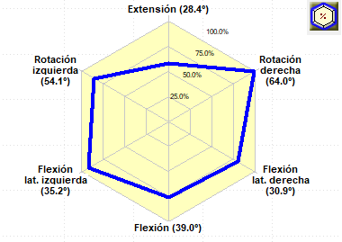
Assessment of the cervical range of motion
MEASURING EQUIPMENT: Photogrammetry system or inclinometers.
TYPE OF ANALYSIS: Kinematic.
GRAPH: Range of motion of the cervical spine in the three planes. The outer edge of the graph represents the normality zone.
INTERPRETATION OF THE RESULT: Limited mobility (º) of the cervical spine in different axes of movement. The flexion-extension limitation is particularly noticeable, followed by left rotation, in which there is also a significant asymmetry with respect to right rotation.
Cervical range of motion
Notes:
To understand the results, it is advisable to follow each section highlighted on the slide when discussing them in class with the students.
What measuring equipment was used?
Does this record fall under any type of analysis?
What does this graph represent?
How would you interpret this result?

Slide 5
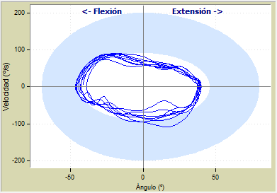
Kinematic assessment of the cervical spine
MEASURING EQUIPMENT: Photogrammetry system.
TYPE OF ANALYSIS: Kinematic.
GRAPH: Angular velocity (º/s) of the cervical spine versus the range of flexion-extension movement (º).
INTERPRETATION OF THE RESULT: Slow movement with limitation of the cervical spine extension, whereas flexion is close to normality limits.
Cervical mobility
Notes:
To understand the results, it is advisable to follow each section highlighted on the slide when discussing them in class with the students.
What measuring equipment was used?
Does this record fall under any type of analysis?
What does this graph represent?
How would you interpret this result?

Slide 6
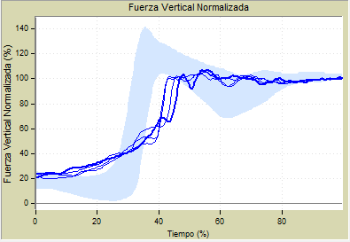
Functional assessment of the lumbar spine
MEASURING EQUIPMENT: Dynamometric platform
TYPE OF ANALYSIS: Kinetic.
GRAPH: It represents the different repetitions recorded of the reaction force during the sit-to-stand movement.
INTERPRETATION OF THE RESULT: Repeatable but altered force pattern. The slope of the curve is horizontal, with the maximum peak of the curve being lower and delayed in time. This means that the generated momentum is insufficient to stand up, which can be associated with pain, strength deficit or lack of coordination.
Activity: rising from a chair
Notes:
To understand the results, it is advisable to follow each section highlighted on the slide when discussing them in class with the students.
What measuring equipment was used?
Does this record fall under any type of analysis?
What does this graph represent?
How would you interpret this result?

Slide 7
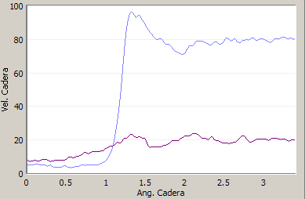
Functional assessment of the lumbar spine
MEASURING EQUIPMENT: Dynamometric platform
TYPE OF ANALYSIS: Kinetic.
GRAPH: It represents the reaction force generated by each lower limb during the sit-to-stand movement.
INTERPRETATION OF THE RESULT: Asymmetric force pattern. Increased weight-bearing on the lower right limb during the sit-to-stand, which implies an asymmetric movement.
Activity: rising from a chair
FORCE ASYMMETRY
Notes:
To understand the results, it is advisable to follow each section highlighted on the slide when discussing them in class with the students.
Which measuring equipment was used?
Does this record fall under any type of analysis?
What does this graph represent?
How would you interpret this result?

Slide 8
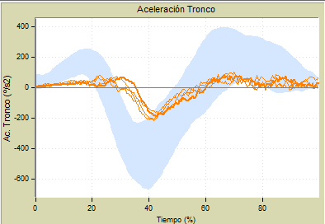
Functional assessment of the lumbar spine
MEASURING EQUIPMENT Photogrammetry, inertial systems.
TYPE OF ANALYSIS: Kinematic.
GRAPH: It represents the angular acceleration of the trunk in different recorded repetitions of the sit-to-stand movement.
INTERPRETATION OF THE RESULT: Low accelerations, which implies slow trunk movement when performing the movement.
Activity: rising from a chair
Notes:
To understand the results, it is advisable to follow each section highlighted on the slide when discussing them in class with the students.
What measuring equipment was used?
Does this record fall under any type of analysis?
What does this graph represent?
How would you interpret this result?

Slide 9
Functional assessment of the lumbar spine
Activity: lifting a weight
MEASURING EQUIPMENT: Photogrammetry, inertial systems.
TYPE OF ANALYSIS: Kinematic.
GRAPH: It represents the angular acceleration of the trunk versus its angular speed in different recorded repetitions of the movement of lifting a weight. The result is shown for increasing weights.
INTERPRETATION OF THE RESULT: Low acceleration and speed in all movements, which involves slow trunk motion. Slower movements are observed as the weight increases, therefore, the movement gets worse as the load handled increases.
Notes:
To understand the results, it is advisable to follow each section highlighted on the slide when discussing them in class with the students.
Which measuring equipment was used?
Does this record fall under any type of analysis?
What does this graph represent?
How would you interpret this result?

Slide 10
Assessment of the flexion-relaxation phenomenon
MEASURING EQUIPMENT: Surface electromyography (sEMG).
GRAPH: Kinematic and EMG results during the flexion-relaxation test of the lumbar spine.
INTERPRETATION OF THE RESULT: No myoelectric silence is observed at maximum spine flexion.
Notes:
To understand the results, it is advisable to follow each section highlighted on the slide when discussing them in class with the students.
What measuring equipment was used?
What does this graph represent?
How would you interpret this result?

Slide 11
Example outcome
Esta foto de Autor desconocido está bajo licencia CC BY-SA-NC
Notes:
Let's see some examples

Slide 12
30-year patient. She works as a clerk. She had a rear-end collision 2 weeks ago. Cervical pain. Treatment: cervical immobilization and analgesics. After removing the immobilization (one week after the accident), the patient reported limited mobility due to pain. She is referred to the biomechanics laboratory to assess cervical mobility and prescribe a rehabilitation treatment. On physical examination: the limited active mobility in the last degrees of all the movements is particularly noticeable, with preserved passive mobility, although painful. On palpation, symmetrical muscle tone with painful points in the left temporal region and right trapezius.
Cervical clinical case
Notes:
The clinical information of the person evaluated is shown here; the results of the assessment are shown below.

Slide 13
The results of the functional assessment of the cervical spine performed in one case are discussed below. This test kinematically analyses the movement of the cervical spine in simple activities to detect abnormal or non-functional movements secondary to cervical pain. The NEDCERVICAL/IBV assessment equipment was used and the recording technique was photogrammetry. To perform the assessment, the system compares the parameters obtained with those of a group of subjects whose characteristics are comparable to those of the patient (data bases made up of normal and pathological subjects, segmented by age and gender.) The assessment protocol is standardised and consists of two movements: Limit test: it analyses the functional limits of movement in each spatial direction. Functional test (or lamp test): it analyses the cervical movement while the patient directs her vision to the lamps located on the ceiling.
Notes:
This test kinematically analyses the movement of the cervical spine in simple activities to detect abnormal or non-functional movements secondary to cervical pain. The software used to perform the assessment is NedCervical/IBV and the recording technique is 3D photogrammetry. To perform the assessment, NedCervical/IBV compares the parameters obtained with those of a group of subjects whose characteristics are comparable to those of the patient (data bases made up of normal and pathological subjects, segmented by age and gender.)

Slide 14
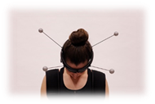
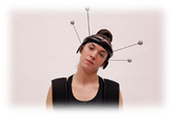
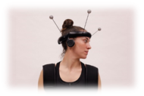
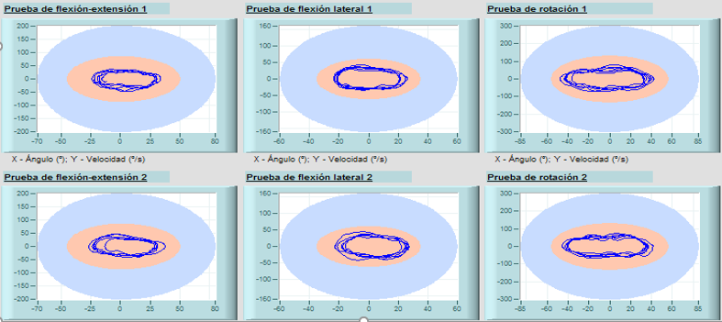
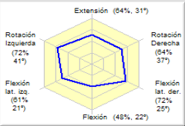
Notes:
Here you can see the results of the limit test in two formats: the numerical format shown in the table of parameters, and the graphic format.
If we analyse the results obtained in the parameter tables, we see that most results are very far from the 100% of normality, that is, the characteristics of the patient's motion when moving the cervical spine are away from a mobility pattern that would be considered normal because of its similarity to the movement performed by healthy people the same age and gender. Specifically, the ranges of the movements and the performance speed were very low. According to the available scientific evidence, these are the most representative parameters of cervical functionality.
The tables also show other parameters such as harmony, which represents the homogeneity or smoothness of the movement. In this case, harmony got 100% of normality in all repetitions and movements. In addition, the results also inform us about the repeatability of the movement performed.
Thus, intratest repeatability tells us about the similarity of the cycles within the same movement, whereas intertest repeatability informs about the similarity between two different repetitions or tests of the same type of movement, for example, flexion-extension 1 and flexion-extension 2. In this case, only the intratest repeatability of flexion-extension and rotations is reduced; still, the repeatability can be considered very high when comparing both tests of the same movement.
As for the graphic information, we have on one hand, the hexagon of the movement, where the different ranges reached by the patient are represented, and on the other, the representation of the mobility of each axis with respect to the angular speed of the movement.
The hexagon shows us the maximum mobility in each axis of movement. In this case, all of them were below 90% of normality; therefore, they are considered movements with a reduced range, within them different axes of movement. In this graph, you can see the value of each movement in degrees.
The other graphs (angular velocity versus range of movement) show how the different cycles of movement are far from the blue band of normal pattern used as a reference.
In addition, in this graph you can also see the regularity or irregularity of the movement. The 6 graphs show that the lines are quite similar to each other, which qualitatively indicates that it is a very regular and homogeneous movement (assessed in the harmony parameter).

Slide 15
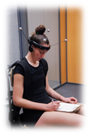
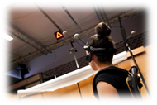
Notes:
Here we can see the results that the NedCervical/IBV assessment application provides in the evaluation of a functional activity, in this case, the activity called the lamp test or functional test.
When evaluating the information of the table of parameters, we see again that it incorporates the most interesting information in the movement assessment, that is, the range and maximum speed of movement. In this case, low percentages of normality are recorded (much less than 100%), which indicates that the person being assessed also performs this test with a cervical movement that is away from a normal pattern (range and speed reduced when performing these activities).
As for the graphic information, observe how the movements performed by the patient when looking at each lamp are represented. You just need to match the colour of the record with the movement that it represents.
Remember that lamp 1 is located in the upper left area of the patient, so it generates a left rotation, lamp 2 is located over the patient, so it mainly requires extension, and lamp 3 is in the upper right area of the patient, which fundamentally involves cervical right rotation. Therefore, this graph shows the ranges that the patient performed when looking at each lamp in each axis of movement.

Slide 16
Altered
The function studied is considered to be normal when the Index of Normality is between 90 and 100%.
The lower the Index of Normality, the greater the degree of functional alteration.
Notes:
Finally, the NedCervical/IBV application provides an index as a global result.
The normality index informs about the functionality of the cervical spine with respect to the mobility studied.
It is considered altered when this result is below 90%.
In this case, after reviewing the results, we can see that functionality has obtained a result of 56%, which means that the mobility of the patient’s cervical spine is altered, due to a general reduced range of motion and a very slow performance.

Slide 17
60-year patient. Lorry driver. He fell off the lorry, which resulted in wedge fracture of L1 He was administered a conservative treatment of the fracture. Back brace removed 3 months later. Four months after the fracture, he continued to report low back pain radiating to the right lower limb. On physical examination: low back pain but no muscle contractures on palpation. Lumbar flexion is painful. Negative Lasègue and Bragard. Good muscle function. The MRI performed shows that the anterior wedge fracture of vertebral body L1 is consolidated and cannot be observed. There are degenerative signs in the disc space of L4-L5 and L5-S1 without compromising both conjunction holes.
Lumbar clinical case
Notes:
Now we will be reviewing the results of a clinical case with lumbar pathology assessed using biomechanical tests.

Slide 18
The results of a case after performing a functional assessment of the lumbar spine are discussed below. This test kinetically and kinematically analyses the movement of the lumbar spine in simple activities to detect abnormal or non-functional movements secondary to cervical pain. The NEDLUMBAR/IBV assessment equipment was used and the recording technique was photogrammetry and two dynamometric platforms. To perform the assessment, this system compares the results obtained with those of a group of subjects whose characteristics are comparable to those of the patient (databases made up of normal and pathological patients segmented by age and gender). The assessment protocol is standardised and consists of two movements: Activity of rising from a chair. Activity of lifting weights. The results obtained tell us about the movement pattern performed through biomechanical information on force, mobility, acceleration and repeatability of the movement, among others. At the end, the study of the activity is summarised in a functional index. If the result of this index is higher than 90%, the ability of the person assessed to perform the activity falls within normality.
Notes:
This test kinetically and kinematically analyses the movement of the lumbar spine in simple activities to detect abnormal or non-functional movements secondary to lumbar pain. The software used in the assessment was NedLumbar/IBV and the recording technique 3D photogrammetry and force dynamometric platforms. To carry out the assessment, Nedlumbar/IBV compares the parameters obtained with those of a group of subjects whose characteristics are comparable to those of the patient (databases consisting of normal and pathological subjects, segmented by age and gender).
At the end, the study of the activity is summarised in a functional index. If the result of this index is higher than 90%, the ability of the person assessed to perform the activity falls within normality.

Slide 19
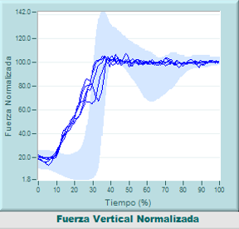
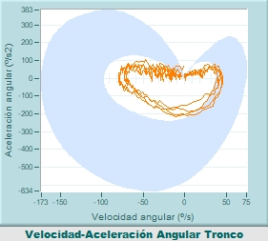
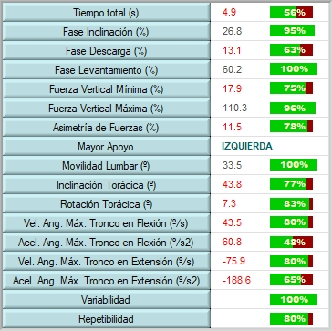
Notes:
This screen shows the numerical and graphical results of the biomechanical analysis of the sit-to-stand activity.
We will look at some of the parameters such as performance time of the activity, reaction force, angular speed and acceleration of the trunk, repeatability in the performance of the movement, and we will end with an index that summarises the global functionality, as well as the indexes that we have seen on the functional scales.
It took the patient 4.9s to perform the activity, a value that, compared with the normality data used as a reference, is very high (it is below 90%, which is the limit considered normal in this assessment system). This means that the person assessed performs the activity very slowly. Slow movements are associated with pain.
Other interesting parameters in the analysis of this activity, and within spine pathology, are the maximum vertical force and the asymmetry of forces. In this case, the patient has difficulty in the momentum to stand up (observe the start of the slope of the reaction force curve). This horizontalization of the curve indicates difficulty in performing the movement. Also note that there is a significant force asymmetry (78% of normality), which means that the patient stands up with greater weight-bearing on the left lower limb. This result may be related to irradiation of pain to the right leg.
With regard to the results for angular speed and acceleration of the trunk during the movement, they are all outside the data considered as reference of normality., fundamentally in the final phase of the movement (extension phase in which the body weight is transferred from the chair to both lower limbs). These results mean that the movement performed by the spine is slow, mainly in it the extension phase.
Movement repeatability was also good and consistent with a pain movement pattern.
The final information that the NedLumbar/IBV assessment system provides as a global result of the analysis of this activity is expressed as an index. The normality index informs about the functionality of the patients in relation to their mobility to perform this activity. The functionality is considered altered when this result is below 90%. In this case, the functionality index (Global Assessment) obtained a result of 71%, which indicates that the patient's functionality is altered in the performance of this activity and, based on the data found, the movement pattern would be compatible with an alteration caused by low back pain.

Slide 20
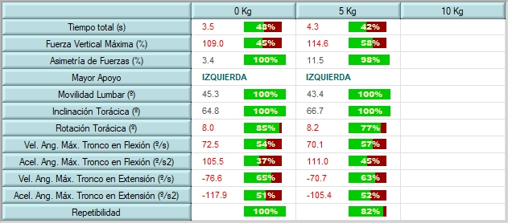
Notes:
This screen shows the numerical and graphical results of the biomechanical analysis of the activity of lifting a weight. If we look at the parameters discussed on the previous slide (performance time, maximum vertical force, asymmetry of forces, angular speed and acceleration) the results are as follows:
The time it took the patient to perform the activity was high for the two lifted weights; in addition, it increases (the subject is slower) as the weight lifted increases. In both, it is far from normal with 48% and 42% of normality. Slow movements are related to pain; besides, in this case, the patient could not lift the maximum load of the applied protocol.
Regarding the reaction force, the patient lifted the weight with difficulty. The maximum vertical force is decreased compared to normal values and, although there is no asymmetry, there is still greater weight-bearing on the left side, which is consistent with the result of the previous test.
Regarding the results on the angular velocity and acceleration of the trunk during movement, they are all outside the normality reference, fundamentally in the final phase of the movement (hip lifting phase). These results mean that the movement performed by the spine is slow and controlled throughout the movement; in addition, it clearly worsens when the weight increases.
Movement repeatability was also good and consistent with a movement pattern of pain.
In general, all the data show a worsening compared to the same movement with less weight.
The final information shown by the NedLumbar/IBV assessment system as a global result of the analysis of the activity, that is, 65%, indicates that the patient's functionality is altered in the performance of this activity and, based on the data found, the movement pattern is compatible with an alteration due to low back pain.

Slide 21
Activity class
Working on clinical cases (Documents)
Notes:
The students must read and interpret the results they find in the clinical case given to them in a document.
To interpret the results, the students will follow the guide of questions shown on the next slide.
The students, guided by the teacher, will discuss the results.
This activity can be done either individually or in groups.
The teacher has the answers.

Slide 22
Question guide of the cervical case
Is there a limitation of cervical mobility?
Which is the most limited movement?
Does he perform quick neck flexion-extension movements?
Is there any asymmetry in the movement?
Based on the graph, does he perform repeatable movements?
Is there an improvement in the second biomechanical assessment session?
Notes:
The students, after reading the review of the clinical case provided, will try to answer these questions and then discuss them with the teacher and the rest of the class.
The teacher can use an online methodology like Kahoot to collect the answers.

Slide 23
Case solution
Is there a limitation of cervical mobility in the first assessment? Yes
Which is the most limited movement? Flexion
Does he perform quick neck flexion-extension movements? No. They are slow.
Is there any asymmetry in the movement? No
Based on the graph, does he perform repeatable movements? For instance, in rotations. Yes
Is there an improvement in the second biomechanical assessment session? Yes
Notes:
The teacher can use a methodology like Kahoot to collect the students' answers.
The valid answer is shown in red. The students' responses should be in the same vein.
The professor has the same document of the clinical case that is provided to the students but with a section for the interpretation of the results in order to help in the discussion of the case with the students.

Slide 24
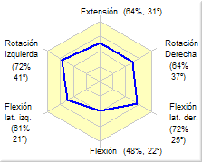
Solutions:
Is there a limitation of cervical mobility in the first assessment?
Notes:
Yes

Slide 25
Solutions:
Which is the most limited movement?
Notes:
Flexion.
They are all limited, with flexion being the most limited movement.

Slide 26
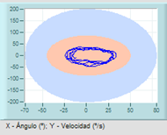
Solutions:
Does he perform quick neck flexion-extension movements?
Notes:
Not.
The speed is very slow. It is very far from the reference pattern in both flexion and extension.

Slide 27
Solutions:
Is there any asymmetry in the movement?
Notes:
No.
The limitation is generalized; there are no significant differences in lateral movements such as rotations and lateral flexions.

Slide 28
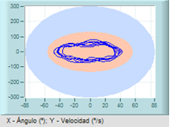
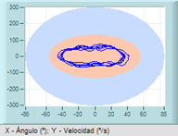
Solutions:
Based on the graph, does he perform repeatable movements? For instance, in rotations.
Notes:
Yes.
The movement pattern (speed and range) is quite similar.

Slide 29
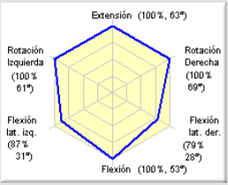
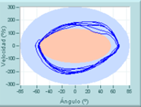
Solutions:
Is there an improvement in the second biomechanical assessment session?
Notes:
Yes.
It is clearly observed that both mobility and speed have increased.

Slide 30
Question guide of the lumbar case
Is there an increase in the time needed to perform each activity?
Is there any element in the graphs of the sit-to-stand that you can associate with difficulty in performing such movement? Why? (Discuss with the teacher)
Do you think that the speed of movement of the trunk is fast and corresponds to normal motion?
Can you find any asymmetry in the support while performing the activity?
Has the patient improved compared to the previous session? Why? (Discuss with the teacher)
Notes:
After reading the review of the clinical case presented, the students will answer these questions and then discuss them with the teacher and the rest of the class.

Slide 31
Case solution
Is there an increase in the time needed to perform each activity? Yes
Is there any element in the graphs of the sit-to-stand that you can associate with difficulty in performing such movement? Why? (Discuss with the teacher) Yes
Do you think that the speed of movement of the trunk is fast and corresponds to normal motion? No
Can you find any asymmetry in the support while performing the activity? Yes
Has the patient improved compared to the previous session? Why?
Notes:
After reading the review of the clinical case presented, the students will answer these questions and then discuss them with the teacher and the rest of the class.

Slide 32
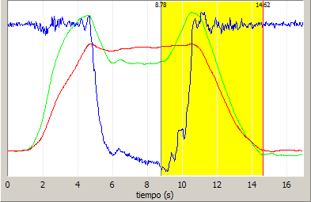
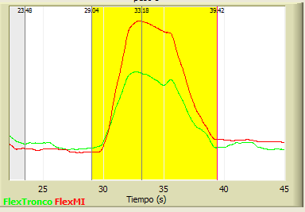
Solutions:
Is there an increase in the time needed to perform each activity?
Notes:
Yes
A person without any problems can rise from a chair in less than 2 seconds. Something similar happens when lifting a weight. You can look at the graphs that have been given to you, which identify a normal time interval.

Slide 33
Solutions:
Is there any element in the graphs of the sit-to-stand that you can associate with difficulty in performing such movement?
Notes:
Yes
The oscillations of the vertical reaction force when the subject begins to rise.

Slide 34
Solutions:
Do you think that the speed of movement of the trunk is fast and corresponds to normal motion?
Notes:
No
When compared with the reference values, the results are limited. Low speed when bending over to lift a weight.

Slide 35
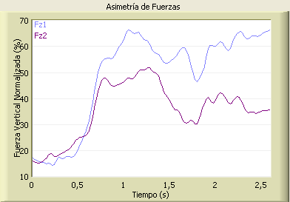
Solutions:
Can you find any asymmetry in the support of both lower limbs when performing the activity?
Notes:
Yes
The right lower limb supports more weight (Fz1) than the left one.

Slide 36
Has the patient improved compared to the previous session?
Discuss as a group why
Notes:
This question remains open to a discussion. The students should discuss why they think that the patient has improved, justifying their responses.

Slide 37
Key ideas
The biomechanical analysis techniques that allow us to know the strength and mobility of the spine provide objective information about its functionality.
The range of motion of both the lumbar spine and the cervical spine can be analysed using biomechanical analysis techniques. Limited ranges of motion are a common result in people with pain.
Strength can also be assessed in people with low back pain, mainly using isokinetic systems. The most common results include a decrease in strength together with changes in the agonist/antagonist muscles ratio.
Another test related to muscle activity in people with low back pain is the flexion-relaxation analysis. The result of this test is usually altered since the phenomenon known as myoelectric silence disappears.
The movement patterns in daily life activities can also be assessed in people with low back pain. The results provided by this biomechanical analysis measure the functional alteration and serve as a guide to monitor the patient’s progress.
In order to obtain reliable results, all these tests require highly standardised measurement protocols and a good command of the recording techniques applied.
Notes:
To complete the lesson, we highlight the key ideas:
Spinal pain has a high prevalence in the clinical setting and frequently causes an alteration in the mobility of the spine.
The biomechanical analysis techniques that allow us to know the strength and mobility of the spine provide objective information about its functionality.
The range of motion of both the lumbar spine and the cervical spine can be analysed using biomechanical analysis techniques. Limited ranges of motion are a common result in people with pain.
Strength can also be assessed in people with low back pain, mainly using isokinetic systems. The most common results include a decrease in strength together with changes in the agonist/antagonist muscles ratio.
Another test related to muscle activity in people with low back pain is the flexion-relaxation analysis. The result of this test is usually altered since the phenomenon known as myoelectric silence disappears.
The movement patterns in daily life activities can also be assessed in people with low back pain. The results provided by this biomechanical analysis measure the functional alteration and serve as a guide to monitor the patient’s progress.
In order to obtain reliable results, all these tests require highly standardised measurement protocols and a good command of the recording techniques applied.

Slide 38
The European Commission's support for the production of this publication does not constitute an endorsement of the contents, which reflect the views only of the authors, and the Commission cannot be held responsible for any use which may be made of the information contained therein.

