Slide 1
MODULE: EVALUATION: CONCEPT AND METHODOLOGY
Didactic Unit A: CLASSIFICATION OF ACTIVITIES AND FUNCTIONS ACCORDING TO THE ICF SUT

Slide 2



Introduction
The terminology of the International Classification of Disability and Health (ICF) makes it possible to describe the functioning of a person in conjunction with his health problems. It is not the classification of people, but their functioning referred to the human body, human activity as individuals and their participation in society. It does not treat disability and health as merely characterising (or reducing the functioning of the individual), but also takes into account the relationship between the individual and the environment in which it operates [1].
Notes:
International Classification of Disability and Health describes the functioning of man, related to his health problems. Furthermore, the classification of ICF with regard to disability shows the relationship between the individual and the environment in which it operates.

Slide 3
Basic terminology ICF
From the ICF perspective, one can distinguish basic terminology / definition approaches:
• Functions of the human body (including mental functions) are physiological processes of individual body systems.
• The structures of the human body are its anatomical parts such as organs, limbs and their components.
• Impairments are changes in function or structure of the body, such as loss or significant deviation from the normal state.
• Activity is a person's execution of a task or taking action.
• Participation is the involvement of a person in certain life situations.
• Activity restrictions are the difficulties a person may have in taking action.
• Restrictions on participation are problems that make it difficult for a person to engage in life situations [2].
Notes:
The first seven terms define body functions and structures, impairment or changes in body function or structure, human activity, which should be understood as completing a task, but also participation and activity restrictions.

Slide 4
Basic terminology ICF
.
• Contextual factors (arising from context): these are products that, taken together, are the full overall context of an individual's life, and includes the basis for disease diseases, are classified in ICF.
• Personal factors are a component of contextual factors, relate to an individual, and include characteristics such as age, gender, social status, life experiences [2].
• Environmental factors create a physical and social environment and
a system of attitudes in which people live. [2].
• Health states and health domains - this is the level of functioning within
a given health area at the ICF.
• Health-related states and health-related fields: The health-related condition is the level of functioning within a given area of health ICF.
Notes:
Another part of the selected conceptes concerns contextual factors classified in ICF, personal, environmental and health and health. The last deadline covers health-related areas.

Slide 5

Basic terminology ICF
Health-related states and health-related fields: The health-related condition is the level of functioning within a given area of health ICF.
• A medical condition is a broad term to cover a disease (acute or chronic), disorder, injury or injury.
• Functioning is a broad concept for body function, body structures, activity and participation.
• Disability is a broad concept that includes impairment, restriction of activity and restrictions on participation.
[acess: 07.02.2020]
Notes:
ICF terminology also refers to the medical condition, human functioning including body functions, structure and activity and participation. When discussing these concepts, the term disability, which concerns disorders, business restrictions and restrictions on participation, deserves attention.

Slide 6
Basic terminology ICF
• Facilitation are factors in the environment of an individual which, through their presence or lack thereof, improve the functioning and reduce disability.
• Barriers are factors in the environment of individuals that limit the functioning and cause disability.
• Ability is a term that indicates, as a qualifier, to the highest possible level of functioning that an entity can achieve in the field of the Activity list and participation at any given time.
• Execution is a concept that it describes as a qualifier, what people do in their current environment, and thus presents an aspect of each person's involvement in life situations.
[acess: 07.02.2020]
Notes:
The basic concepts of ICF are also facilitations which, through their presence or lack thereof, improve the functioning and reduce human disability. Barriers indicating restrictions on human activity are also a very important term. Important concepts are also: skills regarding the functioning of man at the highest and possible level and execution.

Slide 7

The objectives and characteristics of the ICF
the creation of a scientific basis for understanding and researching health issues and related states, outcomes and determinants;
establishing the common language applied to the description of the health and states connected with the health, in order to streamline the intercommunication of different users, like e.g. of health service employees, researchers, decision-makers and the society, including disabled persons;
to enable the comparison of data from different countries;
the creation of a structured encoding scheme for information systems in the field of health.
Notes:
When discussing the objectives and characteristics of ICF, it is worth noting that in addition to the scientific basis for the study of health issues, the most important condition is the establishment of a common language of this description in order to improve communication between different users. ICF allows you to compare data from different countries and encode health information systems

Slide 8

The ICF Classification
The ICF classification primarily determines what should be the subject of a measure, and therefore which areas – in the language of the ICF called "categories", and what are the dependencies between them.
Notes:
The Classification of ICF defines in particular the scope of its activities, describing the categories and dependencies between them

Slide 9

The ICF Classification
ICF categories are organised in two parts:
Part one: the functioning and Disability:
1. Functions and structure of the (construction) of the body,
2. Activity (activity) and Participation
Part two: Contextual Factors:
1. Environmental Factors,
2. Individual Factors
Notes:
ICF classification categories consist of two parts. The first relates to functioning and disability. It consists of functions and structures of the body and activity and participation. The second part, on the other hand, discusses contextual factors, which include environmental and personal factors.

Slide 10

Classification ICF-justification
Each of the presented parts has two components. For the first part of the “Functions and structure of the body" and “Activity and participation". The first component of the human body contains two classifications,
one includes the functioning of body systems (actions), and the second structure (construction) of the body. The second component includes
a full range of areas concerning the operation both from the perspective of the individual and the society.
Notes:
In general, one of the factors of classification of ICF includes the functioning of body systems (actions) and the other structure (structure) of the body. The second component points to the full range of areas of action from both the point of view of the individual and the public.

Slide 11

Classification ICF-justification
These areas are related to such qualifiers as ability and execution. The capacity is the highest possible way to perform the activity in the standardised environment. While the implementation defines the capabilities of the activities by the people in the (current) environment.
The difference between capacity and implementation illustrates the limitations posed by taking the steps in the current environment, and provides the basis for actions to improve the situation.
Notes:
Activity and performance concern the issue of how to perform an activity in a standardized environment and their capabilities. And the identified difference between the qualifiers is the basis for actions aimed at improving the situation.

Slide 12

Classification ICF-justification
In the second part of the first component there are "environmental factors", and the second "personal factors". Personal factors are not classified in ICF due to related social and cultural diversity. They include: gender, race, age, physical fitness, lifestyle, habits, way of dealing with the difficulties. If necessary, an assessment of their impact on the field of operation is left to the user.
Notes:
It should be noted that personal factors are not classified in the ICF due to the discernible social and cultural diversity.

Slide 13
Classification ICF-justification
In the case of environmental factors, the first qualifier may be used both to determine the scope of positive environmental aspects, i.e. facilitations, and to determine the scope of negative effects, i.e. barriers.
Environmental factors can be encoded (a) with respect to each design individually or (b) in general, without reference to a specific design. Preferce for the first option, as indicating better the effect of the factor.
Notes:
The first environmental factor qualifier is used to determine the range of positive environmental aspects. It can be encoded individually and in general.

Slide 14

CLASS ACTIVITY

Slide 15

CLASS ACTIVITY
Problematic questions
The first task we do in groups
Each group will answer two questions about:
identifying and discussing the objectives of the Classification of ICF
why use ICF classification to describe human health?
The answer is given by a representative of the group
Notes:
The first task is done in groups. Each group will answer two questions: First: please define and discuss the objectives of the ICF classification, and the second why should ICF be used to describe human health?

Slide 16

Model ICF

Slide 17
Model ICF
ICF provides a multidimensional approach to classifying functioning and disability as an interactive and evolutionary process. It provides "structural modules" to users who want to create models and explore different aspects of this process. In this sense, ICF can be seen as language: texts that can be created with it depend on users, their creativity and scientific orientation. The following diagram can be helpful in understanding the current meaning of the relationship between the individual components: [2]
Notes:
From an ICF perspective, it can be said that this is an interactive and evolutionary process and provides a multidimensional approach to classifying functioning and disability. ICF can be seen as language, but the form of its use depends on users, their creativity and scientific orientation.

Slide 18
Model ICF
Notes:
When analysing the components of the graph, it is noted that the functioning of an individual in a specific field is perceived as an interaction or a complex relationship between health and contextual factors (i.e. environmental and personal factors). There is a dynamic interaction between these factors: interventions at one level can potentially modify other related elements.

Slide 19
Medical model and disability
The medical model perceives disability as a personal problem, directly caused by illness, injury or other medical condition, requiring medical care in the form of individual treatment provided by professionally prepared persons.
The aim of disability management is to heal or adapt the individual and change his or her behavior.
Medical care is seen as a key issue and at policy level, the main response is to modify or reform health care policies.
Notes:
An important aspect of the ICF model is to see different conditions of human functioning. One of them is the medical model. It is precisely this model that sees disability as a human problem, but also support in recovering health.

Slide 20

Social model and disability
The social model of disability, in turn, sees the issue as a problem created by people and basically as the issue of full social integration.
Disability is not a feature of the unit, but rather a complex set of states, many of which are a result of the social environment.
Therefore, the procedure requires social action, and the society as
a whole with its collective responsibility to modify the environment necessary for the full participation of the people with disabilities in all areas of life social.
Notes:
The social model of disability, on the other hand, points out that lack of fitness is not a feature of the individual, but rather a complex set of states, many of which result from the social environment. It is this environment that becomes responsible for the full participation of people with disabilities in all areas of social life.

Slide 21

Medical and social model in the ICF
ICF is based on a combination of these two extreme models.
A 'biopsychosocial' approach is used to capture the integration of different dimensions of functioning.
The objective of ICF is, therefore, to produce a synthesis that provides a coherent picture of various dimensions of health at biological, individual and social levels.
Notes:
The International Classification of Functioning, Disability and Health is based on a combination of these two models. This new approach, defined as biopsychosocial, allows the integration of many dimensions of human functioning.

Slide 22
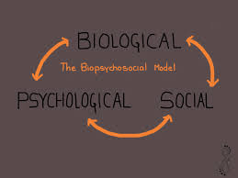
Bio-psycho-social model of functioning and disability
Finding the right description, understandable worldwide, of how people with disabilities function seems to be crucial in the light of an ageing population, globalisation and the growing need for healthcare and social systems. The WHO responded to this need. ICF is often described as an inclusive bio-psycho-social model of functioning and disability. This classification provides a standard language and a common framework for describing human health and health problems [3]
Notes:
The bio-psycho-social model of functioning and disability has become the basis for finding a proper and understandable way around the world to describe the functioning of people with disabilities. The ICF developed a common framework for describing human health problems as an inclusive model of functioning and disability

Slide 23
The structural characteristics of the ICF classification
ICF provides a standard, operational definitions of health and health-related areas in contrast to the popular definition of health.
These definitions describe the essential characteristics of each discipline (e.g., quality, properties, and relationships) and shall contain information about the area it includes and excludes.
Definitions contain commonly used checkpoints to assess all that you can encode.
Notes:
ICF defines many health-related terms. They describe the essential characteristics of each discipline, including exclusion factors. Definitions contain commonly used checkpoints to assess all that you can encode.

Slide 24
The structural characteristics of the ICF classification
The ICF classification is organized hierarchically. It consists of two parts consisting of two components:
1) Functioning and disability:
a) Human body functions (code b) and Human body structures (coded s),
b) Activity and participation (coded d).
2) Contextual factors:
a) Environmental factors (code e),
b) Personal factors – not yet classified in ICF [4,2,3].
Notes:
The ICF classification has a hierarchical layout. The first part is Functioning and Disability and contains two ingredients. The functions of the human body are code b, and body structures code p. The second part of the classification is formed by contextual factors, consisting of environmental factors with e and personal codes not yet classified in the ICF.

Slide 25
General structure of ICF
.
Notes:
The Classification of ICF is formed from two parts – the first is "Functioning and disability", the second describes the so-called. "Contextual factors.

Slide 26
Body functions
Notes:
Referring to the basic division, each chapter was divided into eight parts. In turn, the different parts of structures and functions correspond to each other and are created according to the systems of the human body.

Slide 27
Body structure
Notes:
Coding of human functioning and disability according to ICF is created in relation to a fairly simple principle. Each group ("Body Functions" and "Body Structures") have been assigned with appropriate letter code markings, while anatomical elements have subsequent numerical designations.

Slide 28
Activity and participation in the structure of ICF
Notes:
Activity and Participation, which include performing simple activities known as self-service (basic daily activities such as personal hygiene, dressing, preparing and eating meals, and anything related to movement of the body, also with the help of appropriate equipment).

Slide 29
Contextual factors by ICF Classification
Notes:
Contextual factor is the second part of the ICF classification, which describes in its entirety the environment in which a person lives. Figure illustrates which groups of contextual factors have found a place in the ICF classification.

Slide 30

The structural characteristics of the ICF classification
ICF categories are "nested" so that wider categories contain more specific subcategories (for example, Chapter 4 in part, activity and participation on the topic to move includes separate categories such as state, sitting, walking, moving items etc.).
A short version (Simplified) classification has two levels, while the full version (detailed) includes four levels
Notes:
ICF categories are "nested" so that wider categories contain more specific subcategories (for example, Chapter 4 in part, activity and participation on the topic to move includes separate categories such as state, sitting, walking, moving items etc.).

Slide 31

ICF - coding

Slide 32
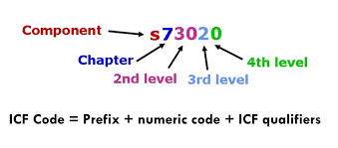
ICF qualifiers.
ICF codes are complete only if they appear together with a qualifier indicating the level of health (e.g. severity of the health problem). Qualifiers are in the form of one, two or more digits after the decimal point (or separator). The use of each code should be accompanied by at least one qualifier. Without qualifiers, the codes are not meaningful.
Notes:
ICF codes can be considered complete when they appear together with a qualifier indicating the level of health. The code layout consists of a prefix, a code number, and an ICF qualifier, as shown on the slide.

Slide 33

The structural characteristics of the ICF classification.
In case of coding "no problem" or "total problem„, the measurement has
a margin of error of up to 5%.
While the assessment of "moderate problem" goes back to the middle of the scale, determining the full difficulty. Interest periods must be scaled in individual domains (areas) in relation to the standards of the population such as percentiles.
Notes:
W In case of coding "no problem" or "total problem„, the measurement has
a margin of error of up to 5%.
While the assessment of "moderate problem" goes back to the middle of the scale, determining the full difficulty.

Slide 34

The structural characteristics of the ICF classification.
xxx.0 No problem (no, absent, irrelevant,...) 0-4 %
xxx.1 Slight problem (small,…) 5-24 %
xxx.2 Moderate problem (the average, disputes,…) 25-49 %
xxx.3 Significant problem (great, strong,…) 50-95 %
xxx.4 Extremely big problem (complete,…) 96-100 %
xxx.8 not specified
xxx.9 not applicable
Notes:
Wide interest intervals shall be taken into account in those cases where scaled assessment tools or other meters are available for the quantitative determination of impairment of body function.

Slide 35

The structural characteristics of the ICF classification.
In the ICF health of a person and the items associated with it are determined through a series of codes that include both parts of the classification. Therefore, the maximum number of codes for one person is 34 on the 1-digit level (8 functions of the human body, 8 body structures, 9 for implementation and 9 for capacity).
Similarly, the second level of the code is 362. For a more detailed classification, the code is 1424.
In real-world applications ICF set from 3 to 18 codes may be sufficient to describe the case of accuracy to the second level (three digits).
Notes:
It should be emphasized that the maximum number of codes per patient is 34 at 1-digit level. In real-world applications ICF set from 3 to 18 codes may be sufficient to describe the case of accuracy to the second level (three digits).

Slide 36
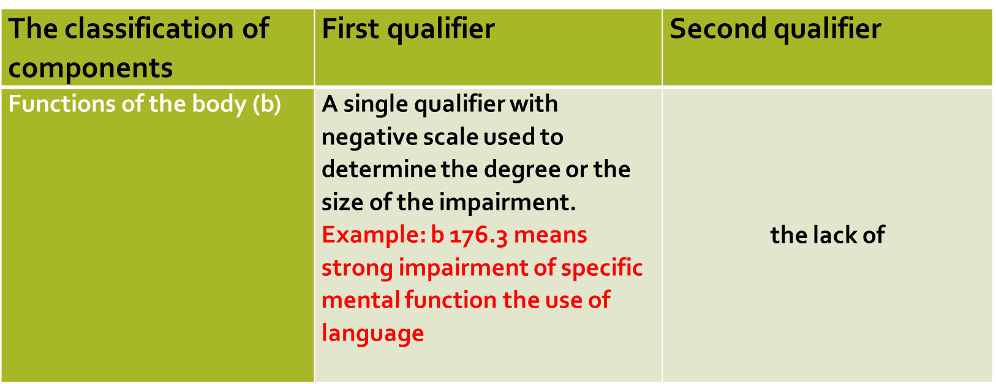
ICF Qualifiers.
Notes:
The first table shows the body functions and the description of the first qualifier with an example

Slide 37
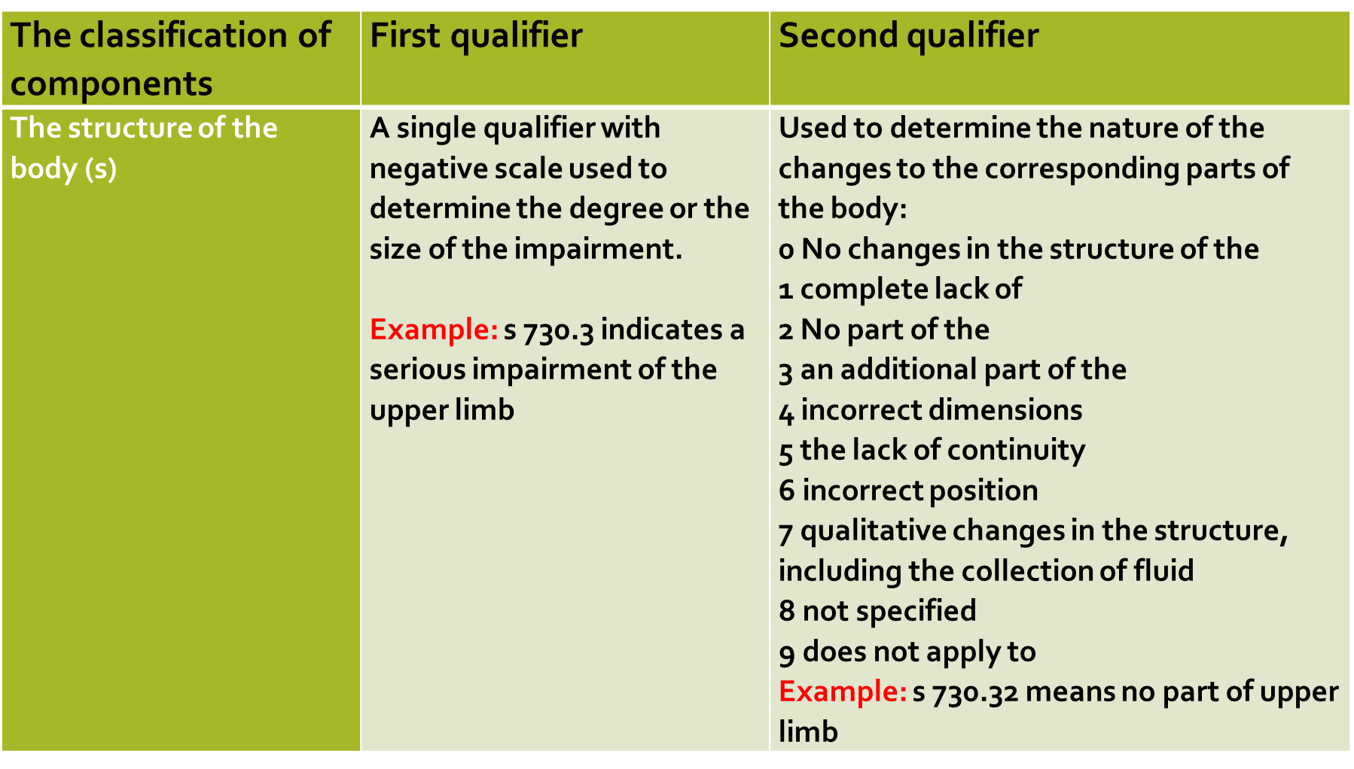
ICF Qualifiers.
Notes:
Table two concerns the structure of the body, taking into account the first and second qualifiers with examples

Slide 38
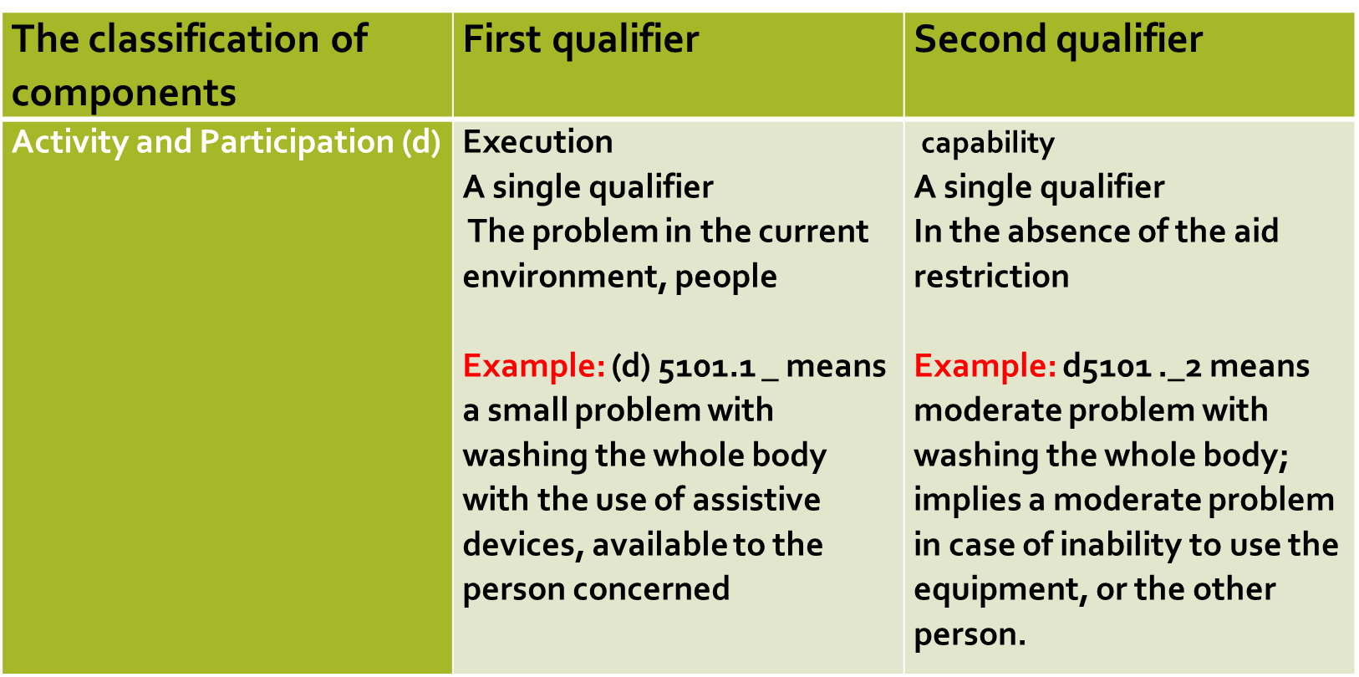
ICF Qualifiers.
Notes:
The next table specifies the activity and participation for the first and second qualifier with description

Slide 39
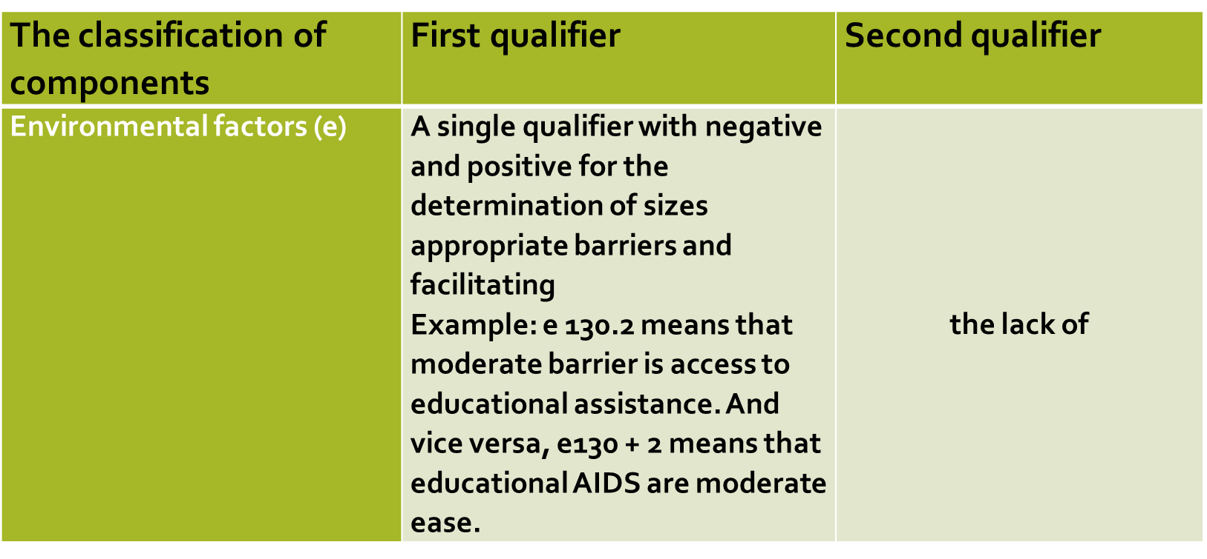
ICF Qualifiers.
Notes:
The last table presented is about environmental factors, but contains only one qualifier

Slide 40
Two-stage classification ICF
Mental functions- General mental functions (b110-b139)
Specific mental functions (b140-b189)
Sensory functions and pain - Seeing and related functions (b210-b229)
Hearing and vestibular functions (b230-b249)
Additional features of the sense organs (b250-b 279)
Pain (b280 – b289)
Voice and speech functions – (b310 - b399)
Notes:
Examples of indications of mental function, sensory and pain organs, voice and speech that can be identified in the ICF manual

Slide 41

Two-stage classification ICF
In order to describe the scope of functioning or level of disability and the extent to which the environmental factor constitutes facilitation or limitation, qualifiers have been introduced into the classification. They constitute a common language that allows comparison of population health at individual level in different regions of the country, at the same and different times.
Notes:
Qualifiers, which are numerical codes, describe the scope of functioning or the level of human disability and the extent to which the environment facilitates or restricts them. They are a common language for comparing people's health in the country and even in the world.

Slide 42
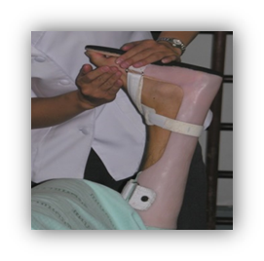
ICF qualifier for body function – a person with joint mobility problem
1. Qualifier = extent of the handicap
b7101.3
XXX.0 no impairment
XXX.1 mild impairment
XXX.2 moderate impairment
XXX.3 severe impairment
XXX.4 complete impairment
XXX.8 not specified [access: 20.01.2020]
XXX.9 not applicable
Notes:
The areas that make up the body's functions and structures relate to two basic and integral description structures of the body focused on its functioning and anatomical structure. The functions of the human body refer to the physiological and psychological processes of individual body structures. Whereas body structures include the anatomical structure of the body

Slide 43
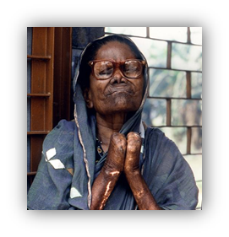
ICF qualifier for body structures – anatomical limitation/hand structure
Notes:
The structure and functions of the body affect the human ability to function in a particular physical and social environment, but it is also important to take into account the direct impact of this environment on human functioning. The next slide contains qualifiers for this case

Slide 44
ICF qualifier for body structures – anatomical limitation/hand structure
Notes:
ICF qualifier indicators for body structure - anatomical limitation/hand structure.

Slide 45
Coding according to ICF classification - example
Notes:
All ingredients classified in ICF (Body Functions, Body Structure, Activity and Participation, and Environmental Factors) are quantified using the same overall scale.

Slide 46
CLASS ACTIVITY
FRIST TASK

Slide 47
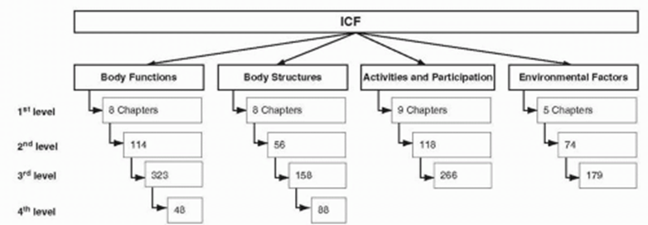
CLASS ACTIVITY - FIRST TASK
First task,
We perform the task in groups
Each group will answer the question:
Why and to what extent ICF codification is a universal language - give an example
Notes:
Please do the exercise

Slide 48
CLASS ACTIVITY -coding (second case)
We perform the task in groups
In the course of the task we use the manual https://www.who.int/classifications/drafticfpracticalmanual.pdf
the first encoding concerns activity and participation for a person with
a low level of hand performance,
- the second concerns environmental factors for disabled people (requiring total support)
Notes:
Exercise

Slide 49

CLASS ACTIVITY –coding (example)
ICF qualifiers for activities and participation
A. qualifier = Performance
d550…./…. B. qualifier = Capacity
Notes:
Eating/ Eating meals
Carrying out the coordinated task and actions of eating food that has been served, bringing it to the mouth and consuming it in culturally acceptable ways, cutting or breaking food into pieces, opening bottles and cans, using eating implements, having meals, feasting or dining

Slide 50
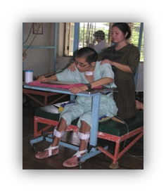
CLASS ACTIVITY –coding (example)
ICF qualifier for environmental factors
1. qualifier = scope of the barrier or facilitator
E310 …
XXX.0 No barrier XXX+0 No facilitator
XXX.1 Mild barrier XXX+1 Mild facilitator
XXX.2 Moderate barrier XXX+2 Moderate facilitator
XXX.3 Severe barrier XXX+3 Substantial facilitator
XXX.4 Complete barrier XXX+4 Complete facilitator
XXX.8 Not specified XXX+8 Not specified
XXX.9 Not applicable XXX+9 not applicable
Notes:
Please do the task

Slide 51

CLASS ACTIVITY
Discussion of exercise 1

Slide 52
Discussion of exercise 1
Performance
Describes what an individual does in his current environment. This context includes the environmental factors – all aspects of the physical, social and attitudinal world which can be coded using the environmental factors component.
Capacity
Describes an individual’s intrinsic ability to execute a task or an action. This construct indicate the highest probable level of functioning that a person can achieve in a given domain at a given time.
right code d550.23
Notes:
The correct code is d550.23

Slide 53

CLASS ACTIVITY
Discussion of exercise 2

Slide 54
Discussion of exercise 2
Immediate family
Individuals related by birth, marriage or other relationship recognized by the culture as immediate family, such as spouses, partners, parents, siblings, children, foster parents, adoptive parents and grandparents [5, s. 187].
In relation to the presented parts of the classification, it is noted that, contrary to the traditional view that disability concerns only the person affected, this change emphasizes the idea that disability is a social structure based on the interaction of the person and the environment [17, 18].
Right code = E310+04
Notes:
The correct code is E310+04

Slide 55
CONCLUSION
Classification allows you to look at man complementarily by establishing a standard and unified language in the health description and the conditions associated with it. The International Classification of Disability and Health ICF covers all aspects of the functioning of the human unit, as well as some elements of physical and mental well-being that are important for a healthy Human [2, 3].
Notes:
Classification allows you to look at man complementarily by establishing a standard and unified language in the health description and the conditions associated with it.

Slide 56
On-line materials
From the perspective of practical exercises, specialist literature can be used (among others practical ICF manual):
- https://www.who.int/classifications/drafticfpracticalmanual.pdf
Notes:
The specified page address will redirect you to the Publication of the ICF

Slide 57

On-line materials
An important issue is also the general availability of the worked out examples of individual cases:
Proposals can be found on the: https://www.icf-casestudies.org/
Notes:
The address of the website will redirect you to the developed individual cases

Slide 58

On-line materials
Animated videos are also important teaching aids:
1) Video 1 SA: What is the International Classification of Functioning, Disability and Health (ICF)?
https://www.youtube.com/watch?v=Iwfn6NutlZM
2) Video 5 NA: How do different parts of the ICF work together?
https://www.youtube.com/watch?v=Vj7cF63egGU
Notes:
The given page address will redirect to animated films

Slide 59
Bibliography
A., Wilmowska-Pietruszyńska, D. Bilski, „ICF jako narzędzie ilościowej oceny naruszenia sprawności w orzekaniu dla potrzeb zabezpieczenia społecznego”. Orzecznictwo Lekarskie”, vol. 1, nr 7, s. 1-13, 2010.
Międzynarodowa klasyfikacja Funkcjonowania, Niepełnosprawności i Zdrowia. World Health Organization Geneva, 2001. https://www.pfon.org/images/dodatki/20140723_icf.pdf [accessed: 20.01.2020r.].
D. M. Fal, „Znaczenie klasyfikacji ICF w opisie niepełnosprawności”. Wiadomości Ubezpieczeniowe, nr 1, s.89, 2018.
B. Üstün, “The international classification of functioning, disability and health—a common framework for describing health states”, [in:] Ch., J., L., Murray, J. A. Salomon, C. D. Mathers, A. D. Lopez, [ed.] Summary Measures of Population Health Concepts, Ethics, Measurement and Applications. World Health Organization, Geneva, pp. 343-48, 2002.
ICF Nowe spojrzenie na człowieka. Wydawca: Centrum Edukacji Ubezpieczeniowej Sp. z o.o., Warszawa 2015. https://piu.org.pl/public/upload/ibrowser/ICF_prev.pdf [accessed:: 26.01.2020]. and others

Slide 60
Thank you for your attention

Slide 61
