Slide 1
MODULE FUNTIONAL EVALUATION
Didactic Unit C:
Classification of functional impairments and disability

Slide 2
INDEX
Definition of "disability"
ICF - International Classification of Functioning, Disability and Health
Model of Functioning and Disability
ICF model
Classification of functional impairments and disability
WHODAS 2.0
Access City Award
Key facts

Slide 3

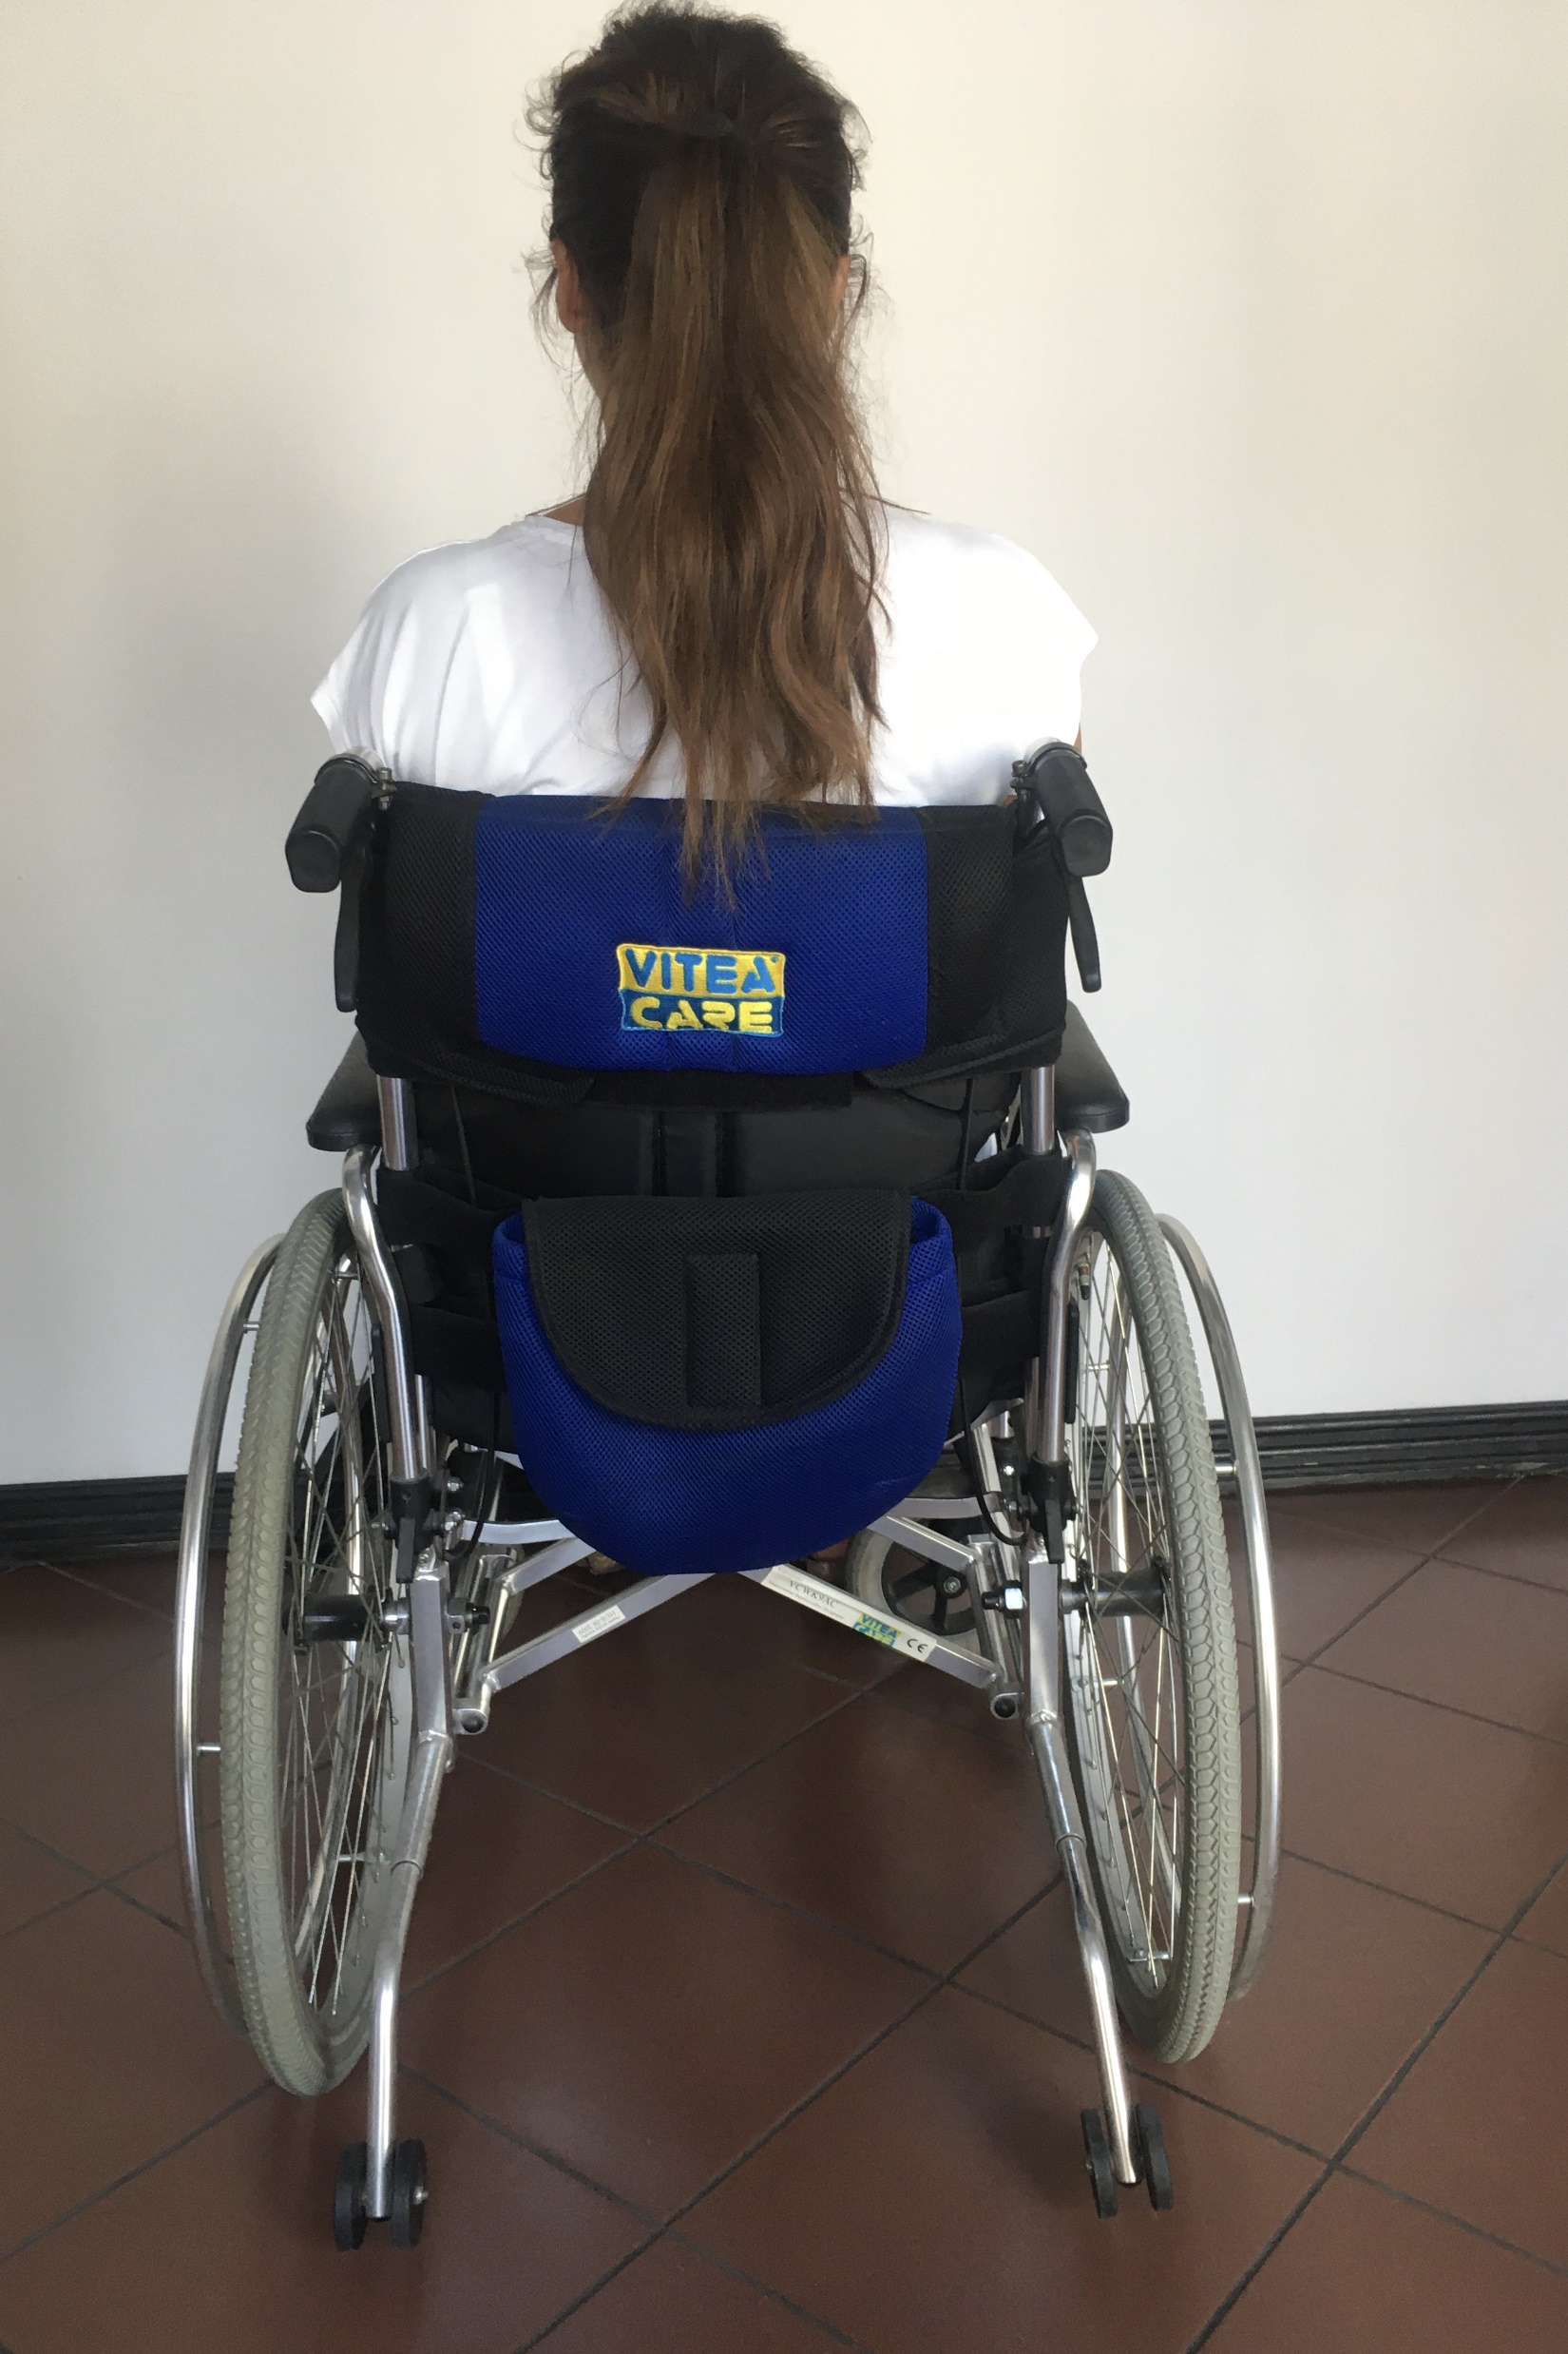



Development of the definition of „DISABILITY”
.
Notes:
+ zdjecie z aparatem słuchowym
+ zdjęce z białą laską
+ zdjecie dziecka z zespołem Down

Slide 4


Development of the definition of „DISABILITY"
Barriers in the environment
Disability as the umbrella term for the negative aspects of functioning that arise in interaction with barriers in the environment
DISABILITY
Impariment
Handicap
(participation restriction)
Impairments
Disability (activity limitations)

Slide 5

Development of the definition of „DISABILITY"
"Disabilities is an umbrella term, covering impairments, activity limitations, and participation restrictions. An impairment is a problem in body function or structure; an activity limitation is a difficulty encountered by an individual in executing a task or action; while a participation restriction is a problem experienced by an individual in involvement in life situations. Disability is thus not just a health problem. It is a complex phenomenon, reflecting the interaction between features of a person’s body and features of the society in which he or she lives.”
World Health Organization, 2001

Slide 6
Development of the definition of „DISABILITY"
According to the World Health Organization, disability has three dimensions:
Impairment
any loss of fitness or abnormality in the structure or functioning of the body in terms of psychological, psychophysical or anatomical
Disability
any limitation or inability (resulting from inability) to lead an active life in a way or scope considered typical for a human being
Handicap
disability of a specific person resulting from disability or disability, limiting or preventing the full implementation of a social role corresponding to age, gender and in line with social and cultural condition

Slide 7
Development of ICF
1972
WHO developed a preliminary scheme
1976
Twenty-ninth World Health Assembly
1980
ICIDH was published
1993
Revision of ICIDH

Slide 8
Development of ICF
1997
Beta – 1 draft was produced
1999
Beta – 2 draft was produced
2000
Prefinal version of ICIDH - 2
2001
The Fifty-fourth World Helath Assembly, Endorsement of the final version

Slide 9

ICF - International Classification of Functioning, Disability and Health
Introduced in 2001
World Health Organization (WHO)
United Nations (UN)
Coding system for functioning and disability

Slide 10
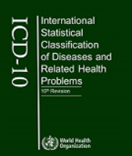
ICD-10 International Statistical Classification of Diseases and Related Health Problems
Introduced in 1990
World Health Organization (WHO)
Diagnosis of diseases and health disorders
Current until 01.01.2022, it will be replaced by ICD-11

Slide 11
WHO's international classifications of health and functioning, ICD and ICF
ICF
Health outcomes
ICD-10
Morbidity data
ICF + ICD-10
Understanding of health and how the interaction between the individual and the environment hinders facilitates a good life

Slide 12








Medical and social models
"You must stay home"
"I am the boss, director, manager” with the appropriate adjustment of the workplace
Medical model
Social model
"You are sick”
"I'm driving a car” with the appropriate equipment
"You need care"
"I can go to a restaurant” with a personal assistant, friends
"You don't need education"
"You can't get married”
"You don't hear, speak, walk, see”
"I clean and cook at home” using appropriate devices

Slide 13
Medical and social models
The medical model views disability as a problem of the person, directly caused by disease, trauma or other health condition, which requires medical care provided in the form of individual treatment by professionals. Management of the disability is aimed at cure or the individual’s adjustment and behaviour change. Medical care is viewed as the main issue, and at the political level the principal response is that of modifying or reforming health care policy.
Medical model
Social model
The social model of disability, sees the issue mainly as a socially created problem, and basically as a matter of the full integration of individuals into society. Disability is not an attribute of an individual, but rather a complex collection of conditions, many of which are created by the social environment.
ICF model

Slide 14
Model of Functioning and Disability
Health condition (disorder or disease)
Body Functions and Structures
Activities
Participation
Contextual Factors
Environmental Factors
Personal Factors

Slide 15
Model of Functioning and Disability
The ICF focuses on three components body, activities, participation (at individual and societal levels) and contextual (personal and environmental).
These three components underscore the importance of the interplay and inﬂuence of both internal and external factors to each individual’s health status.

Slide 16
Overview of ICF components:
Body functions are the physiological functions of body systems (including psychological functions)
Activity limitations are difficulties an individual may have in executing activities
Body structures are anatomical parts of the body such as organs, limbs and their components
Impairments are problems in body function or structure such as a significant deviation or loss
Activity is the execution of a task or action by an individual. Participation is involvement in a life situation
Participation restrictions are problems an individual may experience in involvement in life situations
Environmental factors make up the physical, social and attitudinal environment in which people live and conduct their lives

Slide 17

Functional assessment according to ICF
The most important thing is not what disease we have diagnosed with and its effects, but what our functional capabilities are!
Assessment of the functions and structure of the human body (damage)
Activity Score (Activity limits)
Assessment of personal factors
Participation (strengthening, limiting participation)
Assessment of environmental factors
Assessment of medical condition (disorder or disease)

Slide 18
ICF classification objectives
To provide a scientific basis for understanding and researching health issues and related states, outcomes, and determinants
Establishing a common language used to describe health and health-related conditions to facilitate communication between different users, such as health professionals, academics, policy makers and the public, including people with disabilities
Allowing data to be compared across countries, across multiple healthcare domains, services and time periods
Developing a structured coding scheme for health information systems

Slide 19
ICF classification
Classification
ICF
Parts
Part 1: Functioning and Disability
Part 2: Contextual Factors
Components
Body Functions and Structures
Activities and Participation
Environmental Factors
Personal Factors
Constructs/qualifiers
Change in body function
Change in body structure
Capacity
Performance
Facilitator/barier
Domains and categories
at different levels
Item levels - 1st - 2nd - 3rd & 4th
Item levels - 1st - 2nd - 3rd & 4th
Item levels - 1st - 2nd - 3rd & 4th
Item levels - 1st - 2nd - 3rd & 4th
Item levels - 1st - 2nd - 3rd & 4th

Slide 20
Detailed classification with definitions
On the website:
https://apps.who.int/iris/bitstream/handle/10665/42407/9241545429.pdf

Slide 21
Classification of functional impairments and disability according to ICF
Neurological diseases, including neurodegenerative ones
Motor disability
Intellectual disability
Metabolic disorders
Diseases of the genitourinary system
Diseases of the respiratory and circulatory systems
Disability of the organ of vision and deaf-blindness
Hearing and/or speech disability
Genetic diseases
Cancers
Mental disorders
Obesity

Slide 22
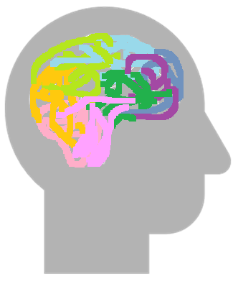
1. Neurological diseases, including neurodegenerative ones
The nervous system is a complex system that controls all processes in our body, and allows us to register and perceive what is happening both inside and outside of us
Types of diseases:
Multiple sclerosis
Cerebral Palsy
Stroke
Epilepsy
Alzheimer's disease and dementias
Parkinson's disease
Nervous system diseases can be the result of: - developmental defects, - mechanical injuries, - infections, - degenerative changes
Neurodegenerative diseases are associated with progressive damage to cells that build structures belonging to the nervous system
Diseases can affect the central part (e.g., epilepsy), the peripheral part (e.g., nerve damage and inflammation) or both

Slide 23
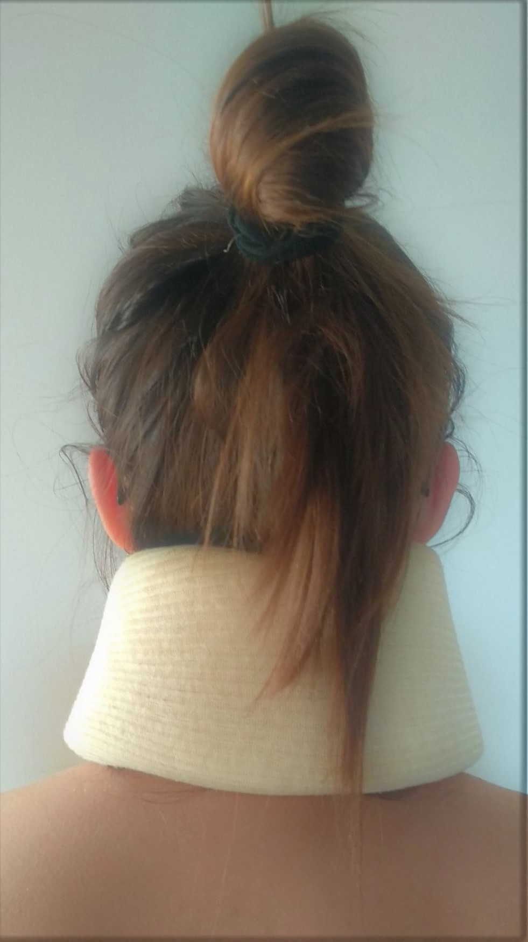
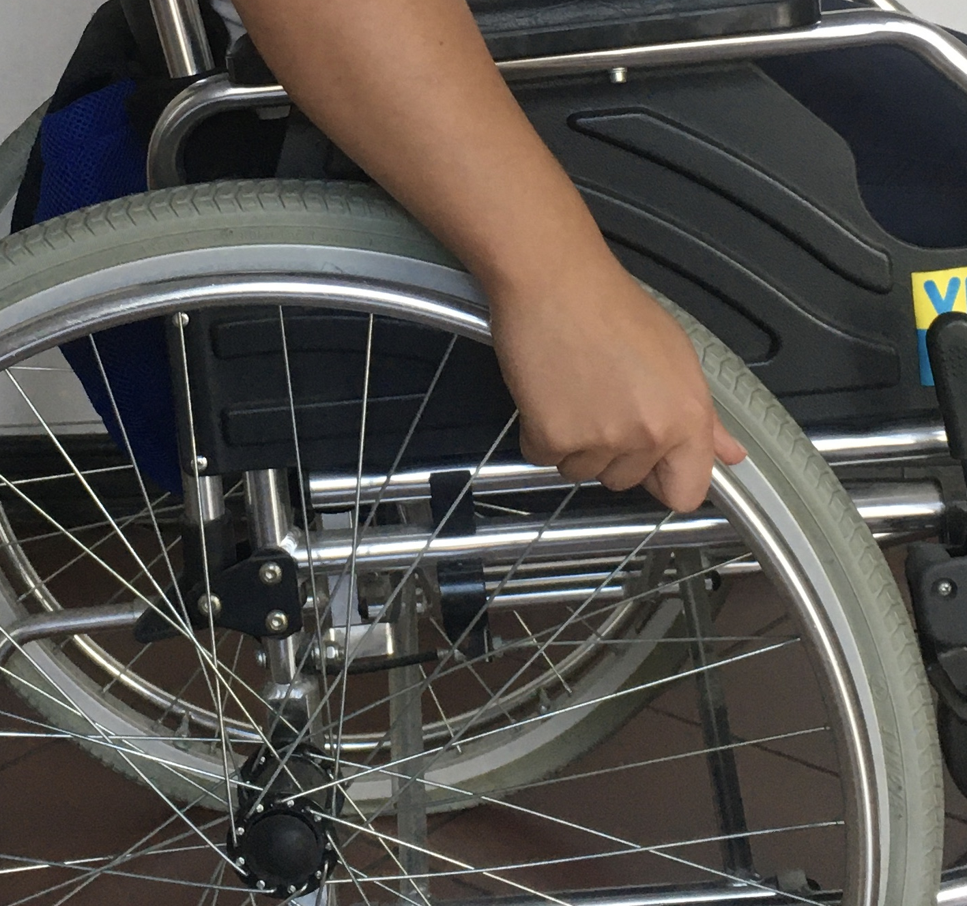
2. Motor disability
A motor disability is a condition of a person who is in a situation of reduced motor abilities of the body
Types of diseases:
Paraplegia and tetraplegia
Amputations
Rheumatic diseases
body.
Notes:
Zd w kulach i orteza,
Kołnierz na szyji

Slide 24
3. Intellectual disability
“Intellectual disability is a significant reduction in the overall level intellectual functioning, and difficulties in adaptive behavior, occurring before the age of 18. "
Significant limitation in adaptive behavior
Onset before age 18
Low IQ: between 70 -75 or below
Developmental disorders related to intellectual disability:
1. Genetically conditioned disorders
2. Pervasive development disorders
3. Neurological disorders
4. Conditions after infections of the prenatal period
Intellectual disability

Slide 25
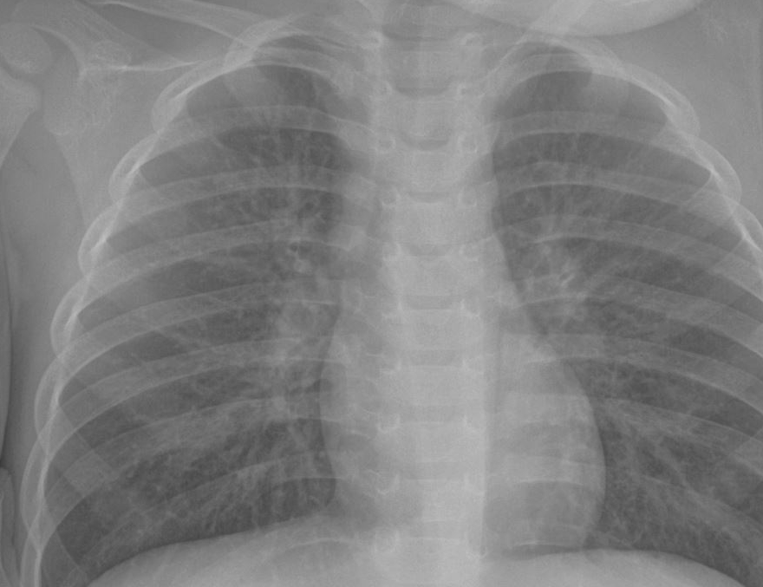
4. Diseases of the respiratory and circulatory systems
Cardiovascular diseases - diseases of the organs and tissues of the circulatory system, in particular the heart, arteries and veins.
Respiratory Diseases - all medical conditions affecting or associated with the respiratory tract.
The most common diseases of the respiratory system:
Infectious diseases,
Cancers,
Occupational diseases,
Genetic diseases
The most common diseases of the circulatory system:
Atherosclerosis
Ischemic heart disease
Rhythm and conduction disturbances
Heart defects (congenital and acquired)
Endocardial disease
Diseases of the heart muscle

Slide 26
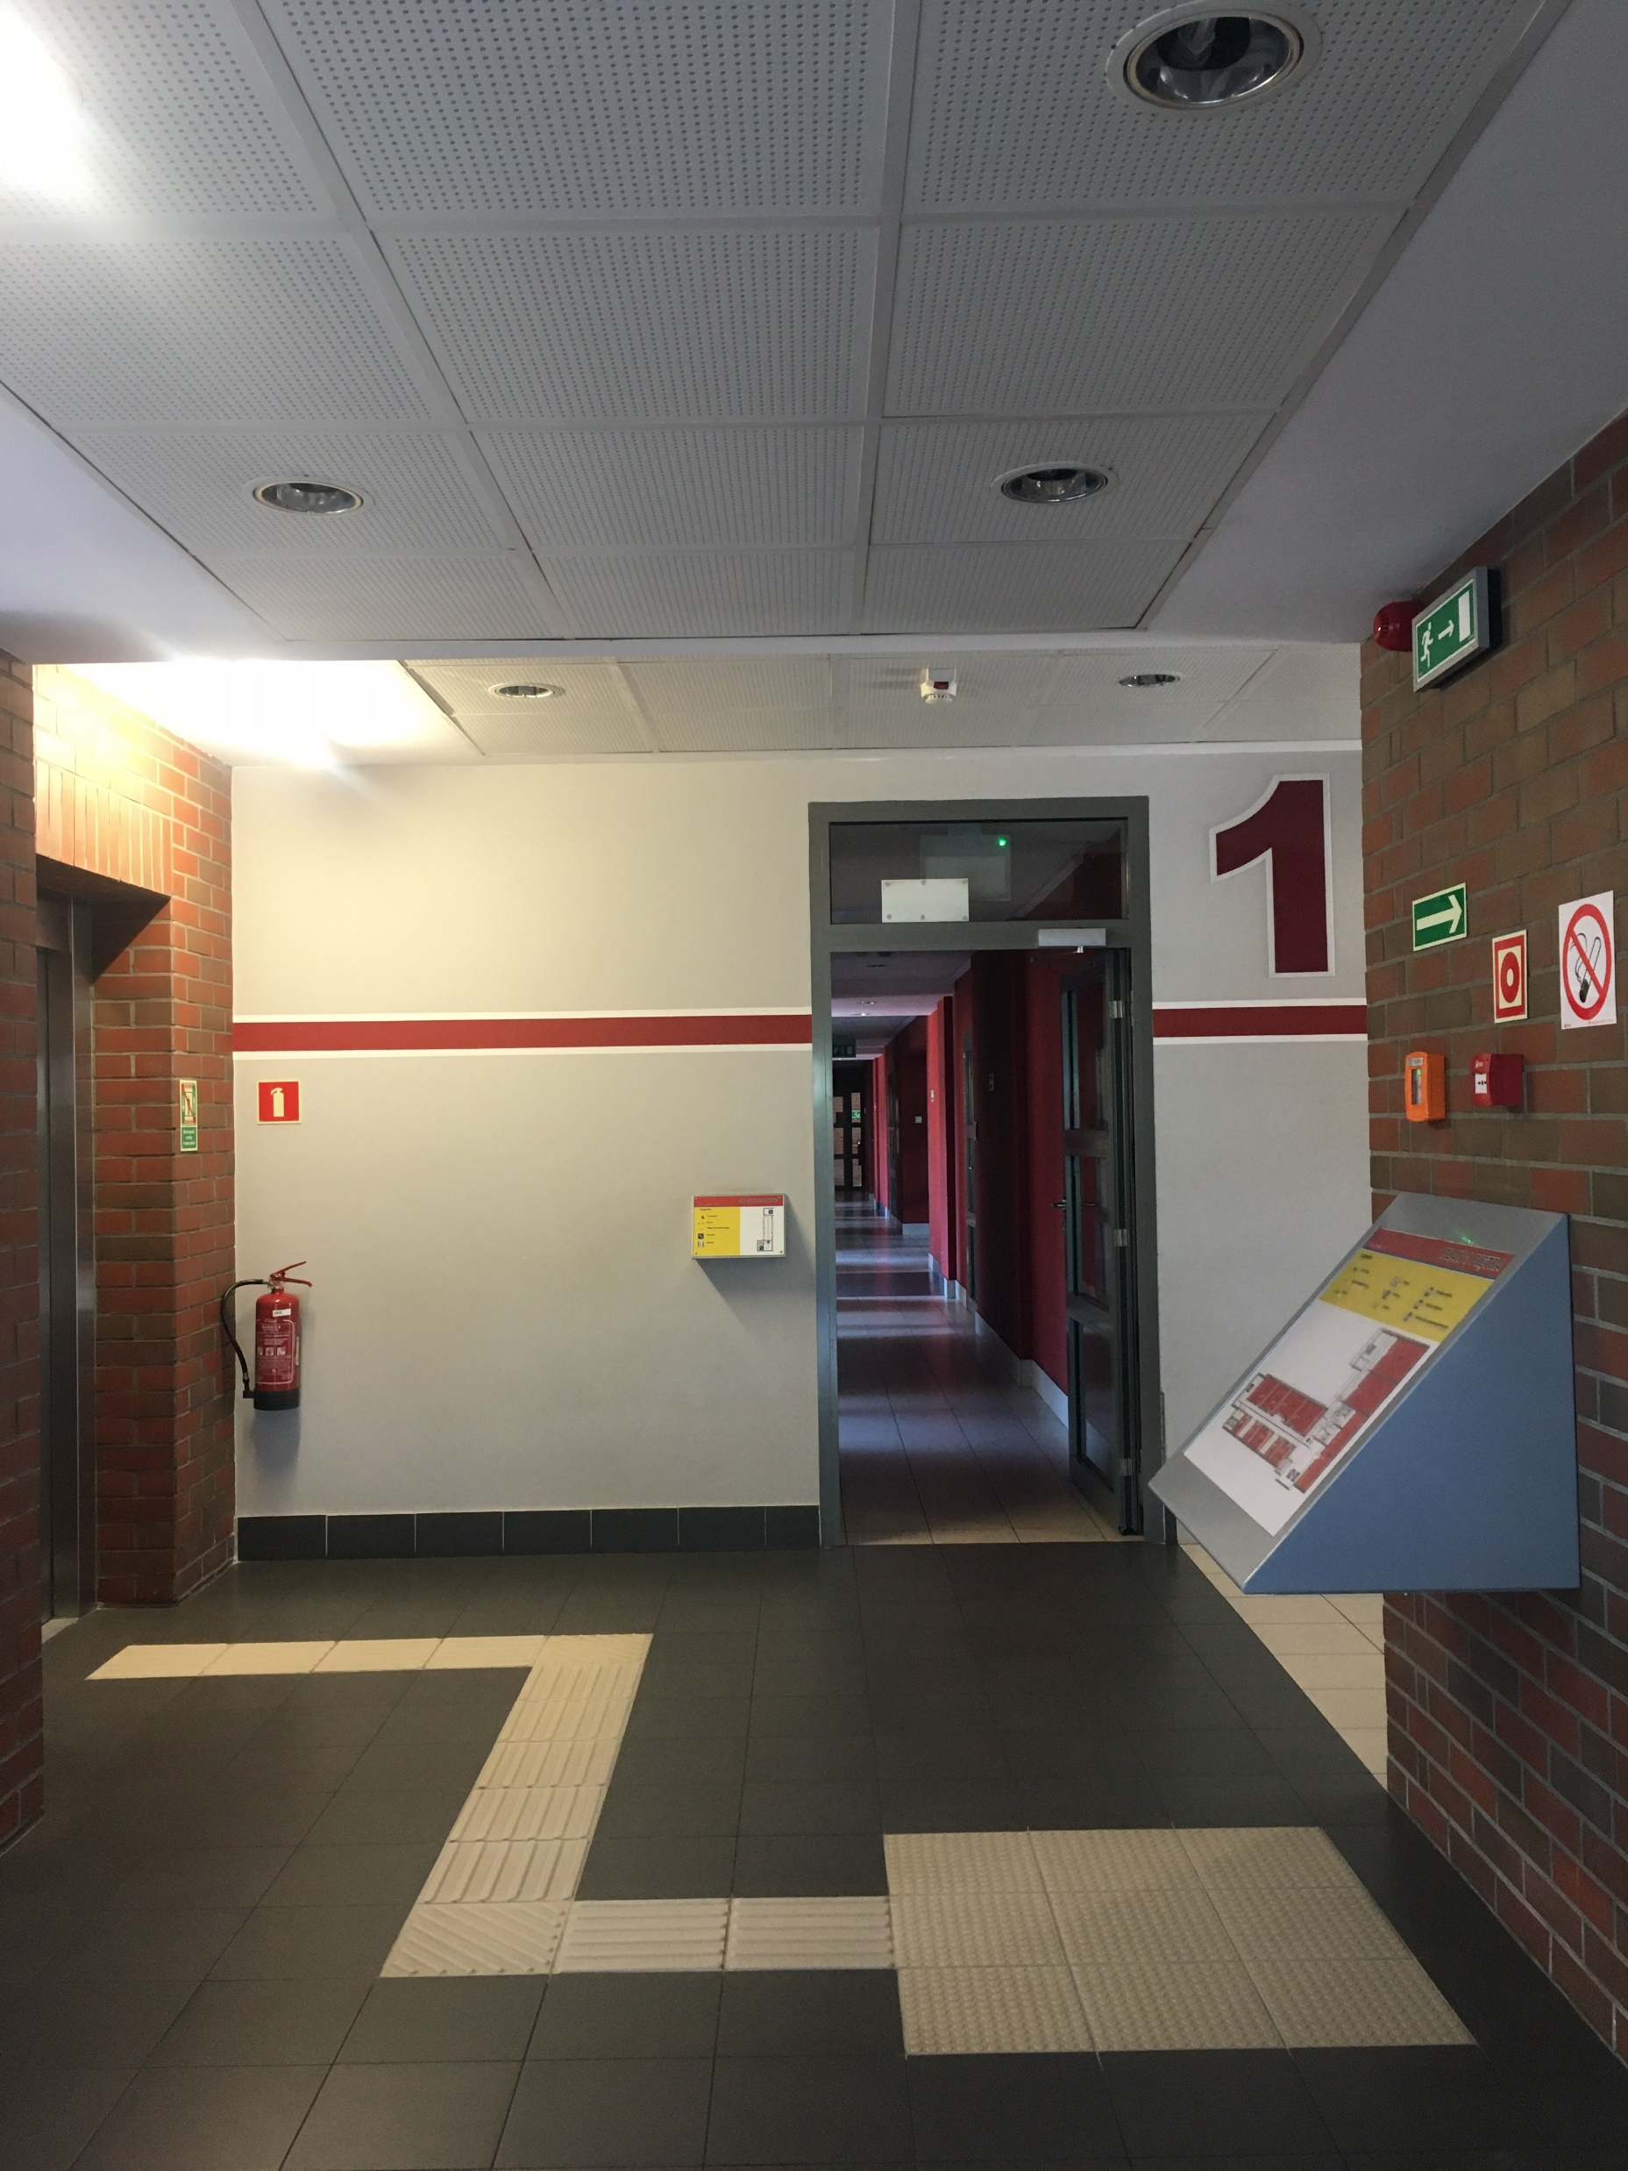
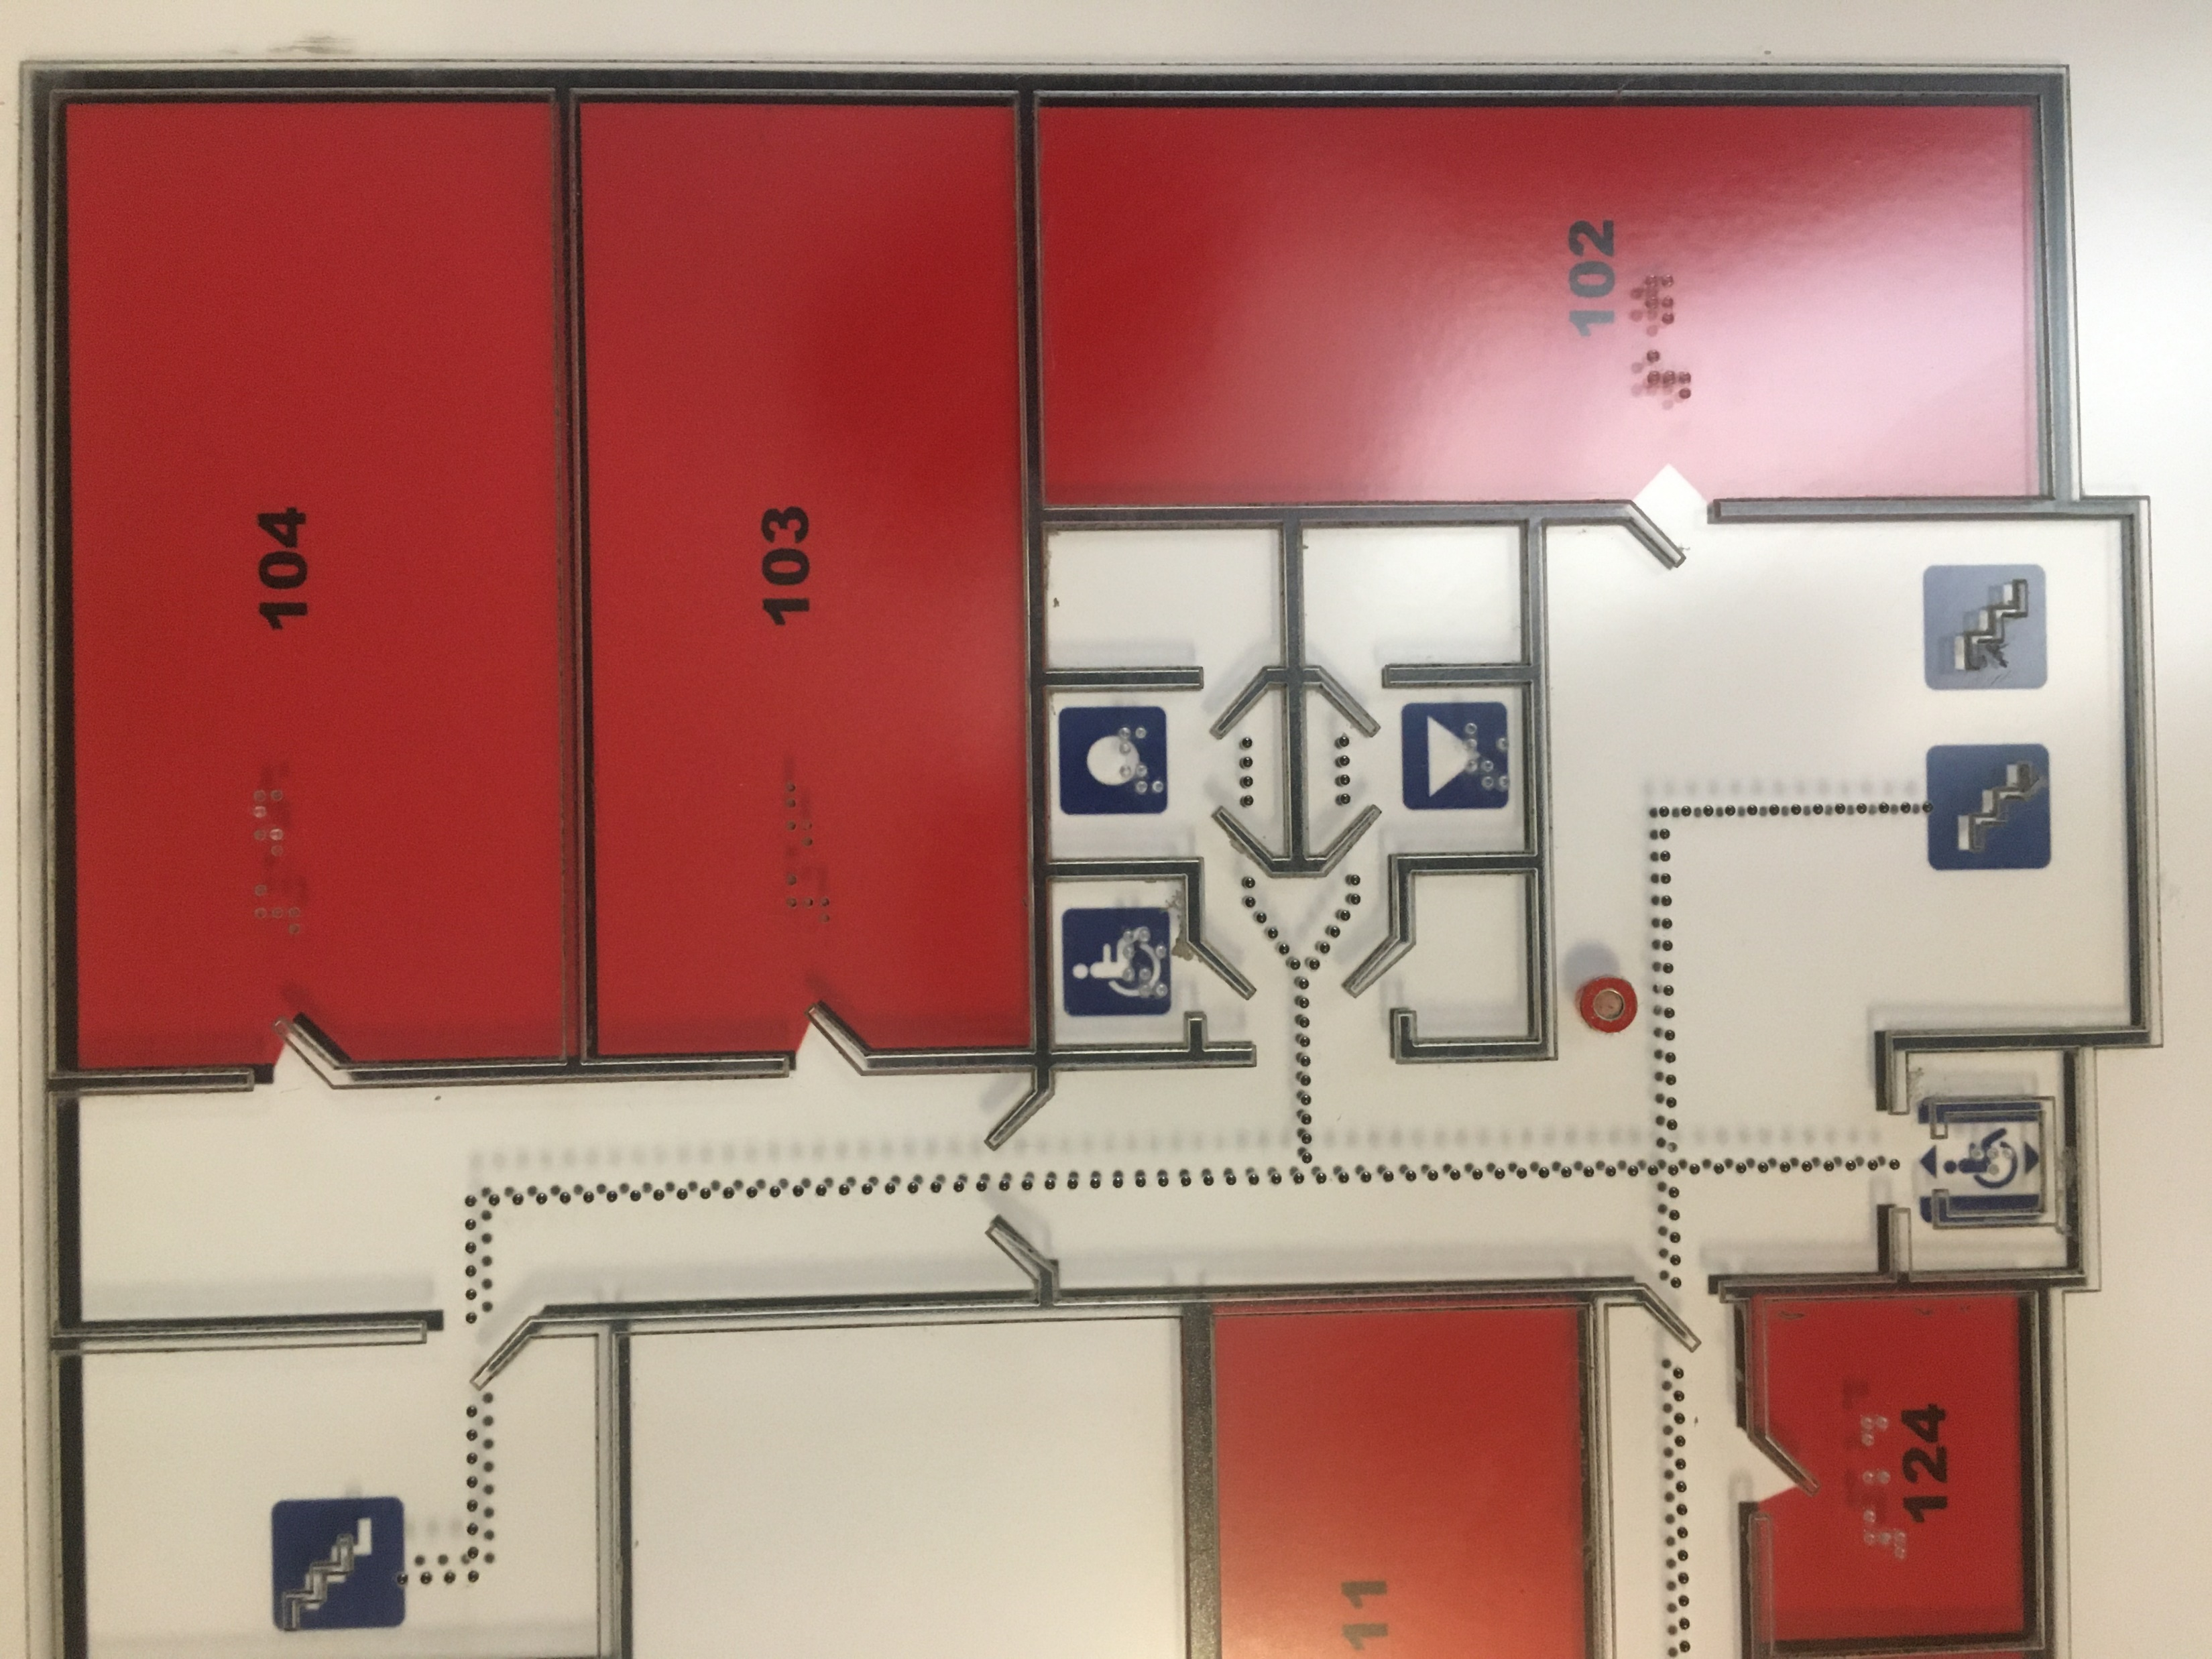
5. Disability of the organ of vision and deaf-blindness
According to the World Health Organization (WHO) classification, the following can be distinguished among people with visual impairment:
1. Blind people - these are people:
completely blind
with a sense of light
with residual vision
with a significant reduction in the field of view
2. Visually impaired people - these are people:
with a reduction in visual acuity from 0.06 to 0.3
with the field of view narrowed down to 30 degrees
“A deaf-blind person is a person who has both hearing loss and sight damage; coupling them causes that it encounters specific difficulties in everyday functioning, especially in communication, access to information and getting around.”
Nordic Staff Training Centre for Deafblind Services (NUD, 2006)

Slide 27
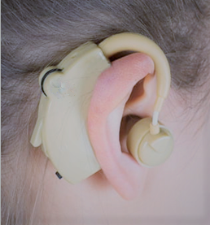
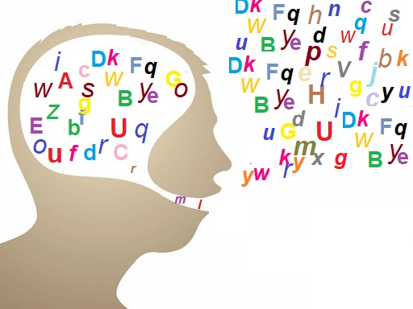
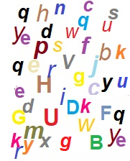
6. Hearing and/or speech disability
Hearing loss - a hearing impairment involving incorrect conduction or perception of sounds. The incidence of hearing loss increases with age.
Speech disorders - a group of disorders that includes various types of speech difficulties. They include difficulties in speaking, speech defects, the use of inappropriate words, so they are related to articulation, phonation, tone of voice, fluency, etc. This makes it difficult to understand the spoken message. Speech disorders may also be associated with more general language disorders.

Slide 28

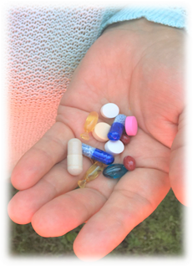
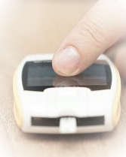
7. Metabolic disorders
Metabolic diseases (metabolic disorders) are a group of diseases that are characterized by an abnormal course of metabolic processes in the body.
Disease types:
Diabetes
Crohn's disease

Slide 29
8. Mental disorders
Mental disorders, mental diseases - patterns or complexes of behavior, ways of thinking, feeling, perceiving and other mental activities and relationships with other people, which are the source of suffering or difficulties in the individual functioning of the affected person.
Factors that can cause disorders include:
-Genetic factors,
-Damage to the nervous system
-Medical history
-Stress, frustration, developmental limitations, mental abuse
-Hard life events
-Decline in well-being, low self-esteem, prolonged sadness
-Lack of emotional support
-Long-lasting fatigue
Types of disorders:
Addiction,
Neuroses,
Depression,
Schizophrenia,
Anorexia

Slide 30
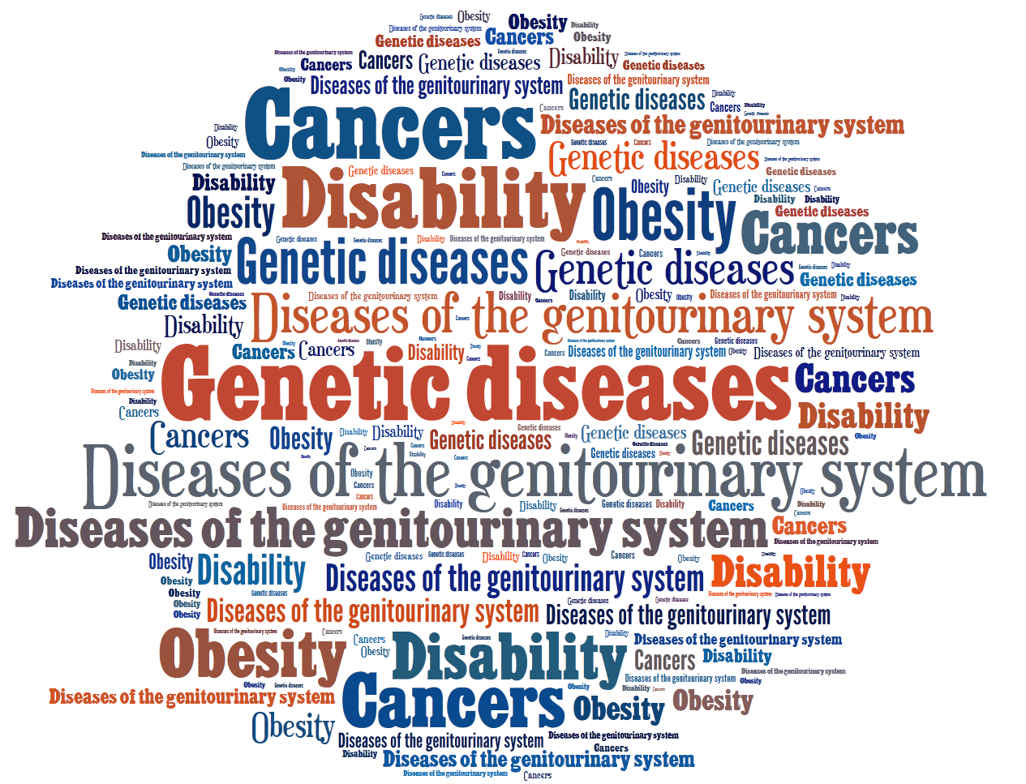
9. Genetic diseases
10. Cancers
11. Obesity
12. Diseases of the
genitourinary system

Slide 31
Why learn and use a disability measure?
Diagnosis and assessment of disability is valuable because it can predict the factors that medical diagnosis (assigning a disease label) alone fails to predict, these include:
SERVICE NEEDS – What are the patient’s needs?
LEVEL OF CARE – Should the patient be in primary care, specialty care, rehabilitation or another setting?
OUTCOME OF THE CONDITION – What will the prognosis be?
LENGTH OF HOSPITALIZATION – How long will the patient stay as an inpatient?
RECEIPT OF DISABILITY BENEFITS – Will the patient receive any pension?
WORK PERFORMANCE – Will the patient return to work and perform as before?
SOCIAL INTEGRATION – Will the patient return to the community and perform as before?
Notes:
tym systematycznym przeglądzie analizowane są badania i praktyczne zastosowania harmonogramu oceny niepełnosprawności Światowej Organizacji Zdrowia (WHODAS 2.0) jako podstawa do ustalenia szczegółowych kryteriów oceny odpowiedniej międzynarodowej literatury naukowej. Celem było ustalenie zasięgu międzynarodowego rozpowszechniania i wykorzystania WHODAS 2.0 oraz analiza badań psychometrycznych różnych tłumaczeń i adaptacji. W szczególności chcieliśmy podkreślić, które cechy psychometryczne zostały zbadane, koncentrując się na strukturze czynników, niezawodności i ważności tego instrumentu.

Slide 32
Why learn and use a disability measure?
Disability assessment is thus useful for health care and policy decisions, in terms of:
Identifying needs
Matching treatments and interventions
Measuring outcomes and effectiveness
Setting priorities
Allocating resources
Notes:
tym systematycznym przeglądzie analizowane są badania i praktyczne zastosowania harmonogramu oceny niepełnosprawności Światowej Organizacji Zdrowia (WHODAS 2.0) jako podstawa do ustalenia szczegółowych kryteriów oceny odpowiedniej międzynarodowej literatury naukowej. Celem było ustalenie zasięgu międzynarodowego rozpowszechniania i wykorzystania WHODAS 2.0 oraz analiza badań psychometrycznych różnych tłumaczeń i adaptacji. W szczególności chcieliśmy podkreślić, które cechy psychometryczne zostały zbadane, koncentrując się na strukturze czynników, niezawodności i ważności tego instrumentu.

Slide 33
WHODAS 2.0
A generic assessment instrument for health and disability A tool to produce standardized disability levels and profiles Applicable across cultures, in all adult populations Directly linked at the level of the concepts to the International Classification of Functioning, Disability and Health (ICF)
Used across all diseases, including mental, neurological and addictive disorders
Short, simple and easy to administer (5 to 20 minutes)
Applicable in both clinical and general population settings
A tool to produce standardized disability levels and profiles
Applicable across cultures, in all adult populations
Directly linked at the level of the concepts to the International Classification of Functioning, Disability and Health (ICF)
Notes:
tym systematycznym przeglądzie analizowane są badania i praktyczne zastosowania harmonogramu oceny niepełnosprawności Światowej Organizacji Zdrowia (WHODAS 2.0) jako podstawa do ustalenia szczegółowych kryteriów oceny odpowiedniej międzynarodowej literatury naukowej. Celem było ustalenie zasięgu międzynarodowego rozpowszechniania i wykorzystania WHODAS 2.0 oraz analiza badań psychometrycznych różnych tłumaczeń i adaptacji. W szczególności chcieliśmy podkreślić, które cechy psychometryczne zostały zbadane, koncentrując się na strukturze czynników, niezawodności i ważności tego instrumentu.

Slide 34
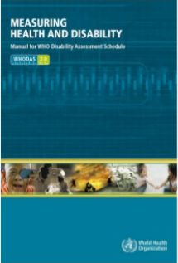
WHODAS 2.0 COVERS 6 DOMAINS OF FUNCTIONING, INCLUDING:
WHODAS 2.0
Cognition
Mobility
Life activities
Participa-tion
Self-care
Getting along
Notes:
tym systematycznym przeglądzie analizowane są badania i praktyczne zastosowania harmonogramu oceny niepełnosprawności Światowej Organizacji Zdrowia (WHODAS 2.0) jako podstawa do ustalenia szczegółowych kryteriów oceny odpowiedniej międzynarodowej literatury naukowej. Celem było ustalenie zasięgu międzynarodowego rozpowszechniania i wykorzystania WHODAS 2.0 oraz analiza badań psychometrycznych różnych tłumaczeń i adaptacji. W szczególności chcieliśmy podkreślić, które cechy psychometryczne zostały zbadane, koncentrując się na strukturze czynników, niezawodności i ważności tego instrumentu.

Slide 35
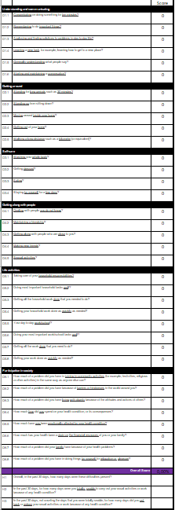
WHODAS 2.0 (36-item version)
Areas:
Understanding and communicating
Getting around
Self-care
Getting along with people
Life activities
Participation in society
Provides most detail
Allows to compute overall and 6 domain specific functioning scores
Available as interviewer-, self-, and proxy-administered forms
Average interview time: 20 min.
SCALE: 0 - No Difficulty
1 - Mild Difficulty
2 - Moderate Difficulty
3 - Severe Difficulty
4 - Extreme Difficulty or Cannot Do

Slide 36
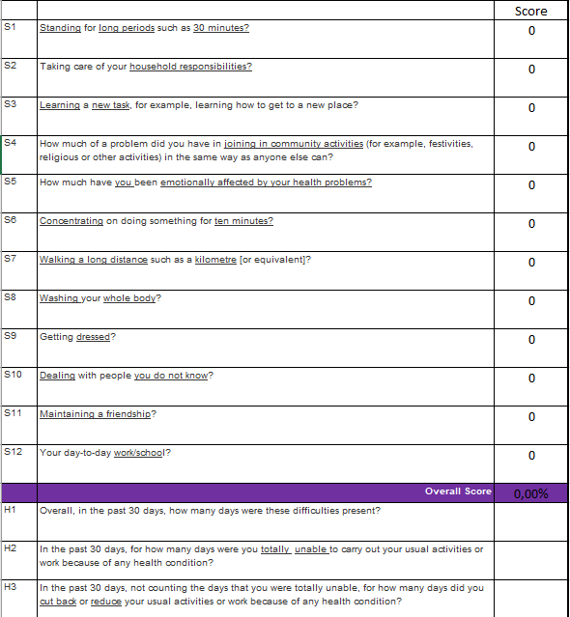
WHODAS 2.0 (12-item version)
Useful for brief assessments of overall functioning in surveys
Allows to compute overall functioning scores
Explains 81% of the variance of the 36-item version
Available as interviewer-, self-, and proxy-administered forms
Average interview time: 5 min.
SCALE: 0 - No Difficulty
1 - Mild Difficulty
2 - Moderate Difficulty
3 - Severe Difficulty
4 - Extreme Difficulty or Cannot Do
For the interesting:
In an article by Lee H.H. et al., 2017: Is WHODAS 2.0 useful for colorectal cancer survivors? compares the level of disability of people with different diseases using the 12-item version WHODAS 2.0.

Slide 37
Interpretation of the Global Disability Score by ICF severity ranges
0-4% no problem
5–24% mild disability
25–49% moderate disability
50-100% severe/extreme disability

Slide 38
More information about "Measuring
Health and Disability "
On the website:
https://apps.who.int/iris/bitstream/handle/10665/43974/9789241547598_eng.pdf?sequence=1

Slide 39
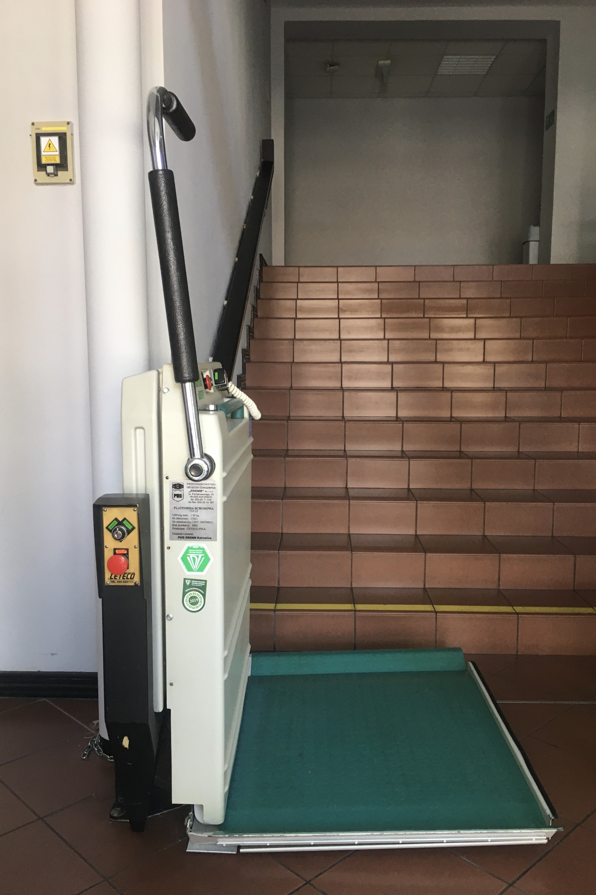
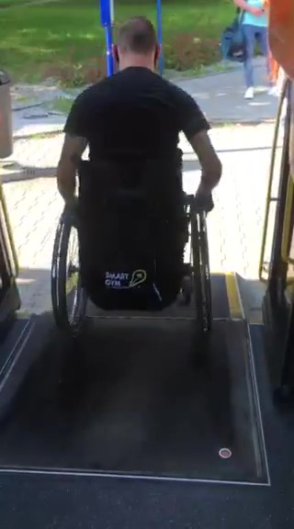
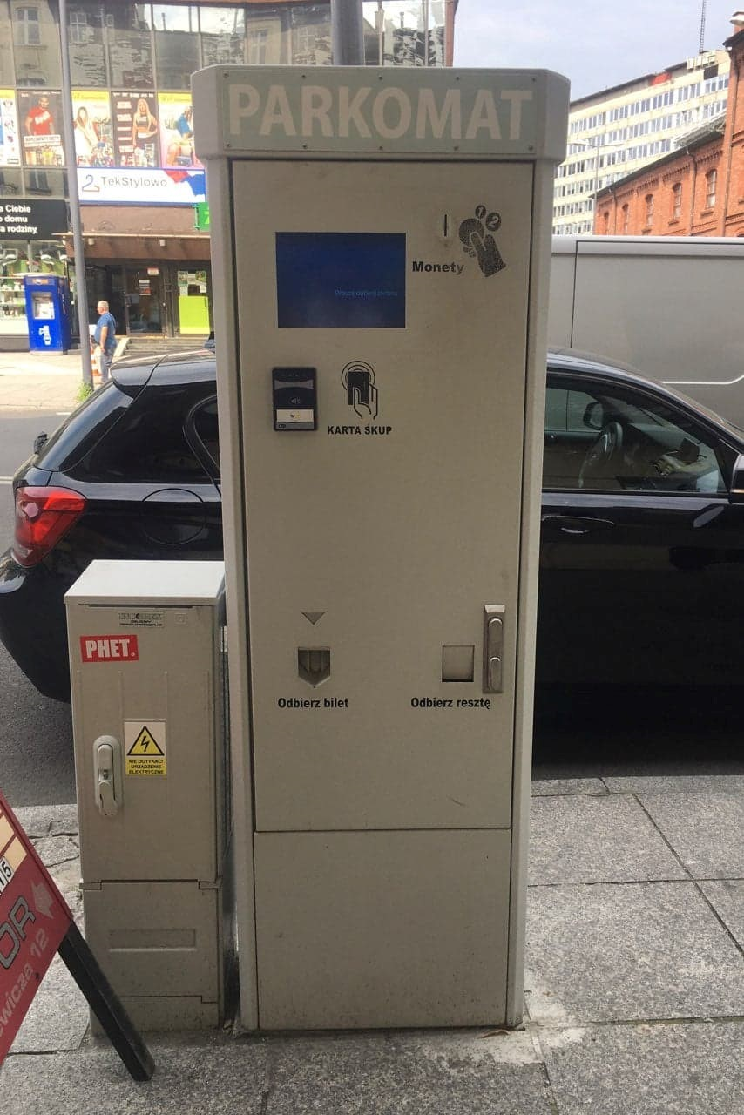
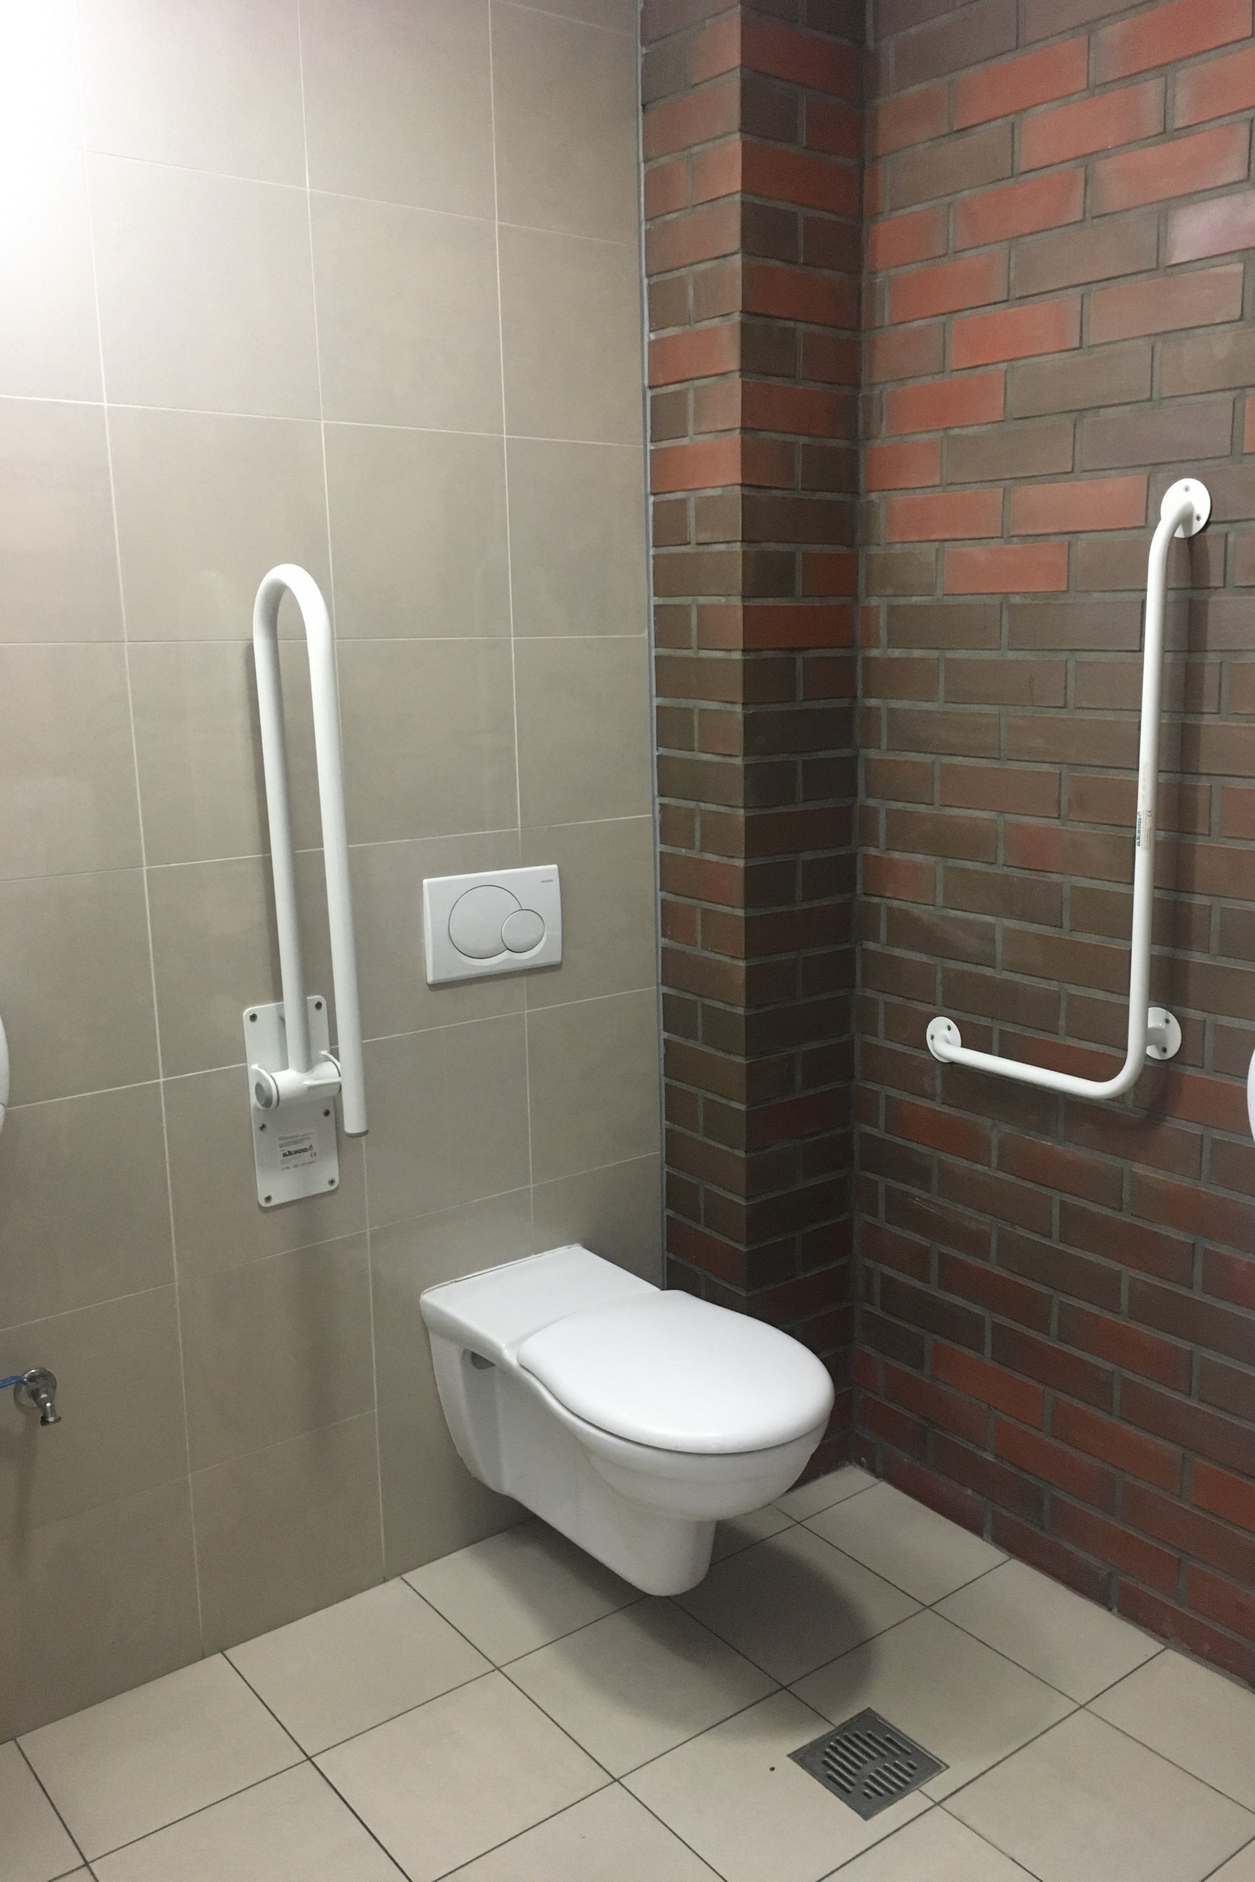
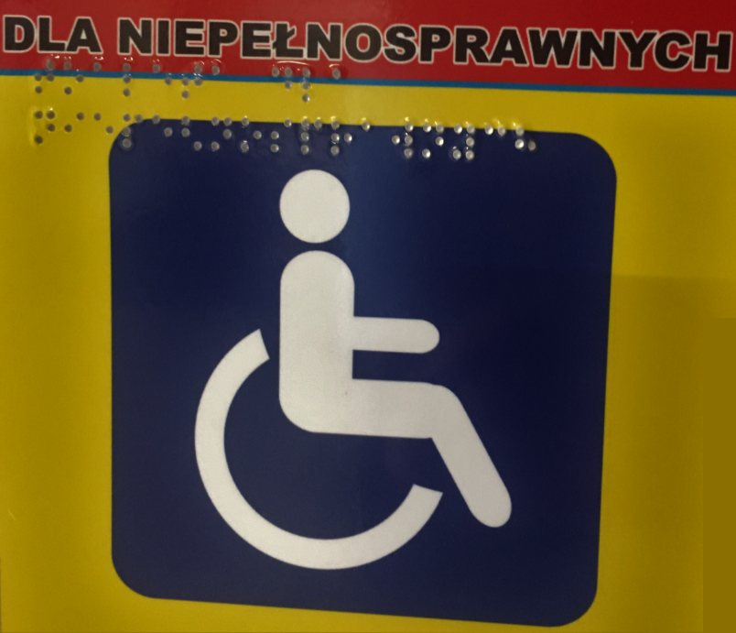
ACCESS CITY AWARD

Slide 40
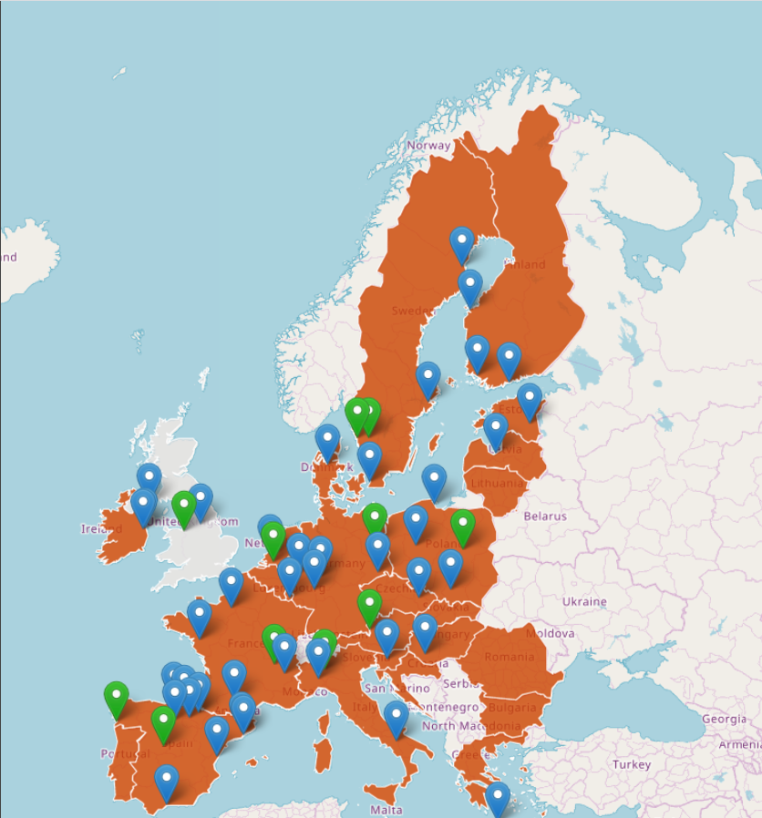
ACCESS CITY AWARD
Germany:
Spain:
Poland:
Berlin 2013
Cologne 2011
Cologne 2011
Marburg 2012
Marburg 2012
Berlin 2013
Berlin 2013
Dresden 2014
Luxemburg 2015, 2018
Wiesbaden 2016
Barcelona 2011
Barcelona, 2011
Ávila 2011
Ávila, 2011
Terrassa 2012
Terrassa, 2012
Santander 2012
Pamplona 2013
Pamplona, 2013
Bilbao 2013
Bilbao, 2013
Málaga 2014
Logroño 2015
Vigo 2019
Castellón de la Plana 2020
Cracow 2012
Cologne 2011
Gdynia 2013, 2019
Marburg 2012
Poznań 2014
Berlin 2013
Poznań 2014

Slide 41
International Day of Persons with Disabilities 3.12
KEY FACTS
Over a billion people, about 15% of the world's population, have some form of disability
Between 110 million and 190 million adults have significant difficulties in functioning
Rates of disability are increasing due to population ageing and increases in chronic health conditions, among other causes
People with disability have less access to health care services and therefore experience unmet health care needs

Slide 42
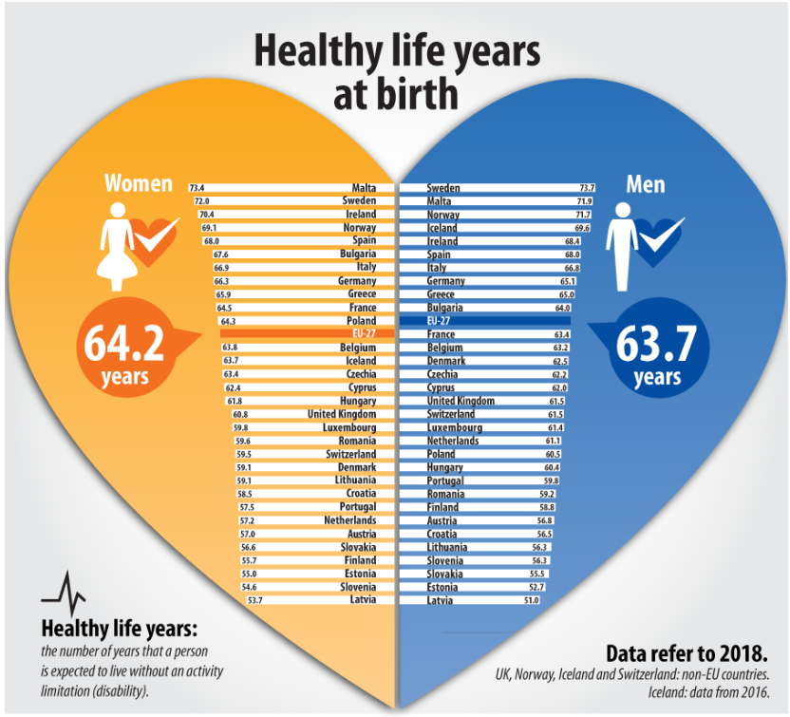
OBJECTIVES

Slide 43
TASKS
In teams of two, see the case study presented on the next slide. One of the people will play the role of a patient who had Cholecystectomy 14 days ago, and the other will act as an interviewer assessing the degree of disability. For this purpose, use the 12-item Instrument Scoring Sheet.xlsx questionnaire. After the interview and completion of the questionnaire, present and discuss the results of the measurement.

Slide 44
A patient came to the general surgery department for a planned Cholecystectomy. Patient: female, 35 years old, BMI 38, comorbidities: type 2 diabetes, professionally active. The procedure was performed laparoscopically using the 4-incision technique. The procedure followed the procedure, no adverse events occurred. Discharge the patient from the ward on the 3rd day after surgery.
PATIENT INFORMATION

Slide 45
GOOD LUCK!

Slide 46
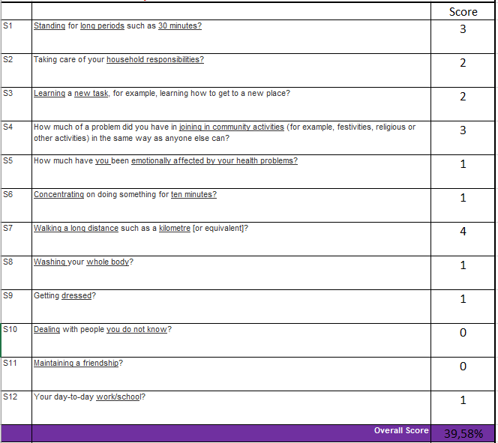
SOLUTION OF THE TASK
Solution of the task
Overall Score:
39,58%

Slide 47
As a result of the survey, moderate disability can be stated. It should be noted that the limitations resulting from the patient's obesity have a significant impact on the degree of disability obtained.
SOLUTION OF THE TASK
RESULTS: 39.58%

Slide 48
Bibliography:
European Comission: https://ec.europa.eu/
World Report on Disability, WHO 2011: https://www.who.int/
Margareta Adolfsson: Applying the ICF-CY to identify everyday life situations of children and youth with disabilities, Jönköping 2011
Michael Linden: Definition and Assessment of Disability in Mental Disorders under the Perspective of the International Classification of Functioning Disability and Health (ICF) DOI: 10.1002/bsl.2283
Jonas-Sébastien Beaudry: Beyond (Models of) Disability? DOI: 10.1093/jmp/jhv063
WHO Disability Assessment Schedule 2.0 (WHODAS 2.0): https://www.who.int/classifications/icf/more_whodas/en/
Mohammad Imran Younus, Di‑Miao Wang, Fang‑fang Yu, Hua Fang, Xiong Gu: Reliability and validity of the 12‑item WHODAS 2.0 in patients with Kashin–Beck disease. DOI 10.1007/s00296-017-3723-4
Beata Trębicka-Postrzygacz: About disability in definitions and regulations in the perspective of social inclusion.
Stefano Federicia, Marco Bracalentia, Fabio Melonia, Juan V. Lucianob: World Health Organization disability assessment schedule 2.0: An international systematic review, DOI 10.1080/09638288.2016.1223177
Disability: http://www.niepelnosprawni.pl/

Slide 49
Thank you for your attention

Slide 50
