Slide 1
MODULE FUNCTIONAL EVALUATION:
CONCEPT AND METHODOLOGY
Didactic Unit E:
Importance of cognitive abilities in the performance of motor task.
Why it is important to include biomechanical analysis
in cognitive impairments?

Slide 2
E. Importance of cognitive abilities in the performance of motor task.
Why it is important to include biomechanical analysis
in cognitive impairments?
Objectives
Cognition
Cognitive load addition to motor performance
Motor performance in people with cognitive impairment
Dual-task assessment
Key ideas
Bibliography

Slide 3
Importance of cognitive abilities in the performance of motor task.
Objectives

Slide 4
1. OBJECTIVES
The objectives of this didactic unit are:
Identify the principals cognitive functions and their brain bases.
Analyze the implications of the impaired cognitive functions, its evaluation and preservation in the exercise the professional health activity.
Know the interference caused by cognitive load in normal and pathological motor performance.
Study motor performance in people who have impaired cognitive functions and mental disorders.
Analyze how a motor gesture with cognitive load should be evaluated with biomechanical assessment tools.
Notes:
In this Didactic Unit, the learner will be acquainted with the main cognitive functions, their involvement in motor performance and what happens when one of these functions is impaired.
The objectives of this didactic unit are:
• Identify the principals cognitive functions and their brain bases
• Analyse the implications of the impaired cognitive functions, its evaluation and preservation in the exercise the professional health activity.
• Know the interference caused by cognitive load in normal and pathological motor performance
• Study motor performance in people who have impaired cognitive functions and mental disorders
• Analyse how a motor gesture with cognitive load should be evaluated with biomechanical assessment tools.

Slide 5
Importance of cognitive abilities in the performance of motor task.
Cognition

Slide 6
2. COGNITION
The action or mental process of acquiring knowledge and understanding through experience and the senses.
The ability to perceive and react, store and retrieve information, process and understand such information, make decisions and produce appropriate responses that guide behavior to interact safely with the environment.
It is necessary to extract the essential elements for daily functioning and survival.
Notes:
Cognition traditionally defined as the action or mental process of acquiring knowledge and understanding through experience and the senses. More precisely, cognition can be conceived as the ability to perceive and react, store and retrieve information, process and understand such information, make decisions and produce appropriate responses that guide behavior to interact safely with the environment. Since the sensory information that can be received is vast and complicated, cognition is necessary to extract the essential elements for daily functioning and survival.

Slide 7
2.1. COGNITIVE FUNCTIONS
Higher order mental (brain) processes on which cognition depends.
More specific, but no less complex that interact with each other.
Jointly involved in the execution of any daily task or activity
Making it possible for the human being to have an active role in the reception, storage, selection, elaboration, transformation and recovery of the information.
Are not independent of each other
Some can be explained separately, being a frequent object of research and practical applications in various areas of health.
Notes:
Cognition as a general process depends on many other more specific, but no less complex, processes that interact with each other, called domains or cognitive functions. These higher order mental (brain) processes are jointly involved in the execution of any daily task or activity, making it possible for the human being to have an active role in the reception, storage, selection, elaboration, transformation and recovery of the information. Although the different domains or cognitive functions are not independent of each other, some can be explained separately, being a frequent object of research and practical applications in various areas of health.

Slide 8
2.1. COGNITIVE FUNCTIONS
Orientation
Gnosis
Praxis
Attention
Memory
Prossesing speed
Executive functions
Social cognition
Language
Figure 1. Main cognitive domains of humans
Notes:
Figure shows the main cognitive domains

Slide 9
2.1.1. ORIENTATION DYSFUNCTION – DISORIENTATION
The ability that allows a person to be aware of himself, of others and of the context in which he is at a given time
To be able to develop the activities of that space / time situation.
There are three types of orientation:
Personal
Age
Marital status
Temporal
Day
Time
Presence of other people
Spatial
Address
Breadth
Month
Education
Figure 2. Examples of personal, temporal and spatial orientation.
Notes:
Orientation is the ability that allows a person to be aware of himself, of others and of the context in which he is at a given time, to be able to develop the activities of that space / time situation.
There are three types of orientation:
. Personal orientation: It is the ability to integrate information related to history and personal identity.
. Temporal orientation: It is the ability to handle information on different facts and place them in their correct chronology.
. Spatial orientation: It is the ability to handle information related to places.
Some examples of the different types of orientation are shown in the Figure.

Slide 10
2.1.1. ORIENTATION DYSFUNCTION – DISORIENTATION
Symptom of different medical conditions: delirium and dementia.
Some physical disorders may cause disorientation: cerebral arteritis, central nervous system infections, concussion, dehydration, sepsis, stroke, vitamin deficiency, vestibular disorders.
Side effect of some drugs, including alcohol, marijuana, prescription medications.
Withdrawal from certain drugs can also cause disorientation.
The treatment of disorientation should be based on the root causes.
Notes:
Disorientation can be a symptom of different medical conditions such as delirium and dementia. As well some physical disorders may cause disorientation: amnesia, carbon monoxide poisoning, cerebral arteritis, or inflammation of arteries in the brain, cirrhosis and liver failure, central nervous system infections such as encephalitis or meningitis, complex partial seizures, concussion, dehydration, drug overdoses, electrolyte abnormalities, epilepsy, fever, heat-related illnesses, hypo or hyper glycaemia, hypothermia, hypothyroidism or hyperthyroidism, hypoxia, a mass lesion in the brain like a tumour or hematoma, renal failure, sepsis, stroke, vitamin deficiency, vestibular disorders. Disorientation can be a side effect of some drugs, including alcohol, marijuana, prescription medications. Withdrawal from certain drugs can also cause disorientation.
The treatment of disorientation should be based on the root causes.

Slide 11
2.1.2. GNOSIS
The ability to recognize elements, stimulus or any other previously learned information and attribute meaning to them.
There are various types of gnosis:
Somatognosis / body scheme
Perception and visual construction
Visuospatial reasoning
Simple gnosis
Figure 3. Type of gnosis.
Notes:
It is the ability of the brain to recognize elements, stimulus or any other previously learned information, through the sensitive channels and attribute meaning to them.
There are various types of gnosis (Figure):
. Simple gnosis according to the sensory channels involved: There are visual, auditory, tactile, olfactory and gustatory gnosis.
. Somatognosis or body scheme perception: It is the ability to recognize and feel mentally the body as a whole and it is parts. This function allows us to know the movements we can do with each parts of the body and it is orientation in the space.
. Visuospatial reasoning: It is the ability to represent, analyse and manipulate objects, places, distances and spaces mentally. Two other cognitive processes are involved in this function: the spatial relationship, or ability to represent and manipulate objects in two dimensions mentally, and the spatial visualization, what it means to have the ability to represent and manipulate objects in three dimensions mentally.
. Perception and visual construction: It is an active brain process of reinterpretation of visual information.

Slide 12
2.1.2. GNOSIS DYSFUNCTION – AGNOSIA
Visual agnosia: brain inability to recognize or understand visual stimuli.
Prosopagnosia: inability to recognize faces that are familiar even our self in a mirror.
Visuospatial agnosia: individuals can report objects in their visual fields, but not the spatial relationships of the objects to one another
Notes:
Gnosis dysfunction is known as agnosia.
Despite these disorders are rarely seen in isolation there are many specific names for each particular sensory channel dysfunction or some of its combinations.
A visual agnosia, the most common form of the disorder, can be the inability to find the razor on the sink despite adequate scanning abilities (the razor can only be located by touch), also, when encountering the faces of familiar persons such as family members or close friends, a patient with prosopagnosia is unable to identify those persons, or even to recognize that they are familiar; a visuospatial agnosia can be the misjudging the distance while reaching for a cup resulting in an inappropriate endpoint (the hand ends up several inches from the cup) or the difficulties orienting a shirt to one's body; a tactile agnosia can be the difficulty with clothing fasteners despite intact motor function or the inability to recognize objects that are in one's pockets unless vision is also used; as well, the person with an apperceptive agnosia, which is a failure to construct an internal representation of an object, finds difficult colouring in the individual objects drawn in overlapping fashion, or copying drawings, but they cannot identify the objects in question.
Agnosia treatment usually focuses on teaching the patient to use the others intact sensory modalities. For example, in tactile agnosia, the patient is taught to use visual, olfactory, and auditory senses to recognize objects.
More importantly, the agnosia treatment should focus on teaching awareness of deficits and the consequences of the impairments, because some of the patients with lower order deficits or “pseudoagnosias” may underestimate the consequences of the deficit.

Slide 13
2.1.2. GNOSIS DYSFUNCTION – AGNOSIA
Tactile agnosia: inability to recognize objects through touch.
Apperceptive agnosia: a failure in recognition that is due to a failure of perception. Perception occurs but recognition still does not occur.
Agnosia treatment: teach the patient to use the others intact sensory modalities and the awareness of deficits and its consequences.
Notes:
Gnosis dysfunction is known as agnosia.
Despite these disorders are rarely seen in isolation there are many specific names for each particular sensory channel dysfunction or some of its combinations.
A visual agnosia, the most common form of the disorder, can be the inability to find the razor on the sink despite adequate scanning abilities (the razor can only be located by touch), also, when encountering the faces of familiar persons such as family members or close friends, a patient with prosopagnosia is unable to identify those persons, or even to recognize that they are familiar; a visuospatial agnosia can be the misjudging the distance while reaching for a cup resulting in an inappropriate endpoint (the hand ends up several inches from the cup) or the difficulties orienting a shirt to one's body; a tactile agnosia can be the difficulty with clothing fasteners despite intact motor function or the inability to recognize objects that are in one's pockets unless vision is also used; as well, the person with an apperceptive agnosia, which is a failure to construct an internal representation of an object, finds difficult colouring in the individual objects drawn in overlapping fashion, or copying drawings, but they cannot identify the objects in question.
Agnosia treatment usually focuses on teaching the patient to use the others intact sensory modalities. For example, in tactile agnosia, the patient is taught to use visual, olfactory, and auditory senses to recognize objects.
More importantly, the agnosia treatment should focus on teaching awareness of deficits and the consequences of the impairments, because some of the patients with lower order deficits or “pseudoagnosias” may underestimate the consequences of the deficit.

Slide 14
2.1.3. PRAXIS
The ability to voluntarily execute organized, simple or complex movements, to perform a task, manipulate objects or achieve a specific objective.
There are several types of praxis :
Ideomotor
Ideational
Visuoconstructive
Figure 4. Type of praxis.
Notes:
It is the acquired ability to voluntarily execute organized, simple or complex movements, to perform a task, manipulate objects or achieve a specific objective (walking, dressing, eating, smiling, speaking). There are several types of praxis (Figure):
. Ideomotor praxis: It is the ability to perform a simple movement or gesture intentionally. Within this, there is another call Facial Praxis, that is, the ability to voluntarily perform movements or gestures with various parts of the face (lips, tongue, eyes, eyebrows, cheeks, etc.).
. Ideational praxis: It is the ability to manipulate objects through a sequence of gestures, which implies knowledge of the object's function, the action, and, the serial order of the acts that lead to the action.
. Visuoconstructive praxis: It is the ability to plan and perform the movements necessary to organize a series of elements in the space to form a drawing or create a final figure.
In the ideational and the visuoconstructive praxis, in addition to the motor skills themselves, the use of other complex cognitive processes such as planning and motor representation of the action is required, which are essential for the performance of motor tasks such as strength, speed, precision or coordination.

Slide 15
2.1.3. PRAXIS DYSFUNCTION – APRAXIA
Inability to perform a previously learned skilled act that is unexplained by weakness, incoordination, dementia, or sensory loss.
Ideomotor apraxia: inability to correctly imitate hand gestures and voluntarily mime tool use.
Dissociation apraxia: inability to pantomime to command, with spared ability to imitate gestures and manipulate objects in the environment.
Conceptual/ideational apraxia: inability to conceptualize a task and to complete multistep actions.
Dyspraxia: when the deficits in skilled movement are not complete.
Treatment for apraxia includes physical, cognitive and or occupational therapy. If it is a symptom of another disorder, the underlying disorder it should be treated.
Notes:
The inability to perform a previously learned skilled act that is unexplained by weakness, incoordination, dementia, or sensory loss, it is known as apraxia; when the deficits in skilled movement are not complete, it is called dyspraxia.
Patients with apraxia may lose the ability to manipulate commonly used tools, or the ability to perform something more complex, such as sewing or knitting. In the most common type, ideomotor apraxia, the patients cannot demonstrate skilled movements through pantomime or cannot perform single motor tasks, such as combing hair or waving goodbye. These patients make different errors such as incorrect finger configuration, improper timing, or moving the wrong joints. For example, when asked to demonstrate how to use a pair of scissors, the subject may instead hold out the index and middle fingers and scissor them together as if playing rock–paper–scissors. In the dissociation apraxia pantomiming an action to command is impaired but the subject may still imitate the examiner and use the desired object. In the conceptual apraxia, the patients are unable to associate a use with a particular tool. In the ideational apraxia, the patient is unable to sequence a series of actions such as lighting a match and then blowing it out or with multilevel tasks such as taking the proper sequence of steps for brushing teeth.
Some dyspraxias are dressing dyspraxia (difficulty with dressing and putting clothes on in order), oromotor dyspraxia (difficulty with speech), and constructional dyspraxia (difficulty with spatial relations). In general, a patient with apraxia may have some of the following characteristics: coordination problems including, awkwardness in walking, clumsiness or trouble with hopping, skipping, throwing and catching a ball, or riding a bicycle; confusion about which hand to use for tasks; inability to hold a pen or pencil properly; sensitivity to touch; poor short-term memory; trouble with reading and writing; poor sense of direction; speech problems; phobias or obsessive behavior; and impatience.
Generally, treatment for individuals with apraxia includes physical, cognitive and or occupational therapy. If apraxia is a symptom of another disorder, the underlying disorder it should be treated.
To promote the independence and safety of apraxia patients, the intervention should be done in the context of the patients’ homes, which provide a natural day-to-day living environment.
The occupational therapy intervention should be based on combined functional rehabilitation program focusing on restorative and compensatory techniques.

Slide 16
2.1.4. ATTENTION
State of observation and alert that allows awareness of what happens in the environment.
To carry out this process, it is necessary to focus on specific stimulus, ignoring other minor ones. The most traditionally studied types are:
Focused, sustained or "Surveillance"
Selective
Alternating or divided
Complex
Figure 5. Type of attention.
Notes:
Attention is defined as the state of observation and alert that allows awareness of what happens in the environment. It is a capacity or process by which specific mental resources are generated and directed on the most relevant aspects of the environment or the most appropriate actions, maintaining the appropriate state of activation to achieve a goal or purpose. To carry out this process, it is necessary to focus on specific stimulus, ignoring other minor ones.
It is considered as a cognitive "meta-function", since it is indispensable for the general cognitive functioning of individuals. It is responsible for selecting and filtering the information that will be processed by other complex cognitive functions such as memory.
The most cognitive systems can function more or less independently, but none could do so without "attention".
Specifically, attention is involved in processes of selection, distribution and maintenance of cognitive activity in general. It is difficult to separate attention from concentration or from mental tracking, since it is a multidimensional set of processes that involve various cognitive domains, variety of components and multiple hierarchical levels. The most traditionally studied types are (Figure):
. Focused or sustained attention or "Surveillance": It is the ability to continuously maintain the focus of attention on a task or event for a certain period of time.
. Selective attention: It is the ability to direct attention and focus on a task or event without allowing other stimuli, external or internal, to interrupt the task.
. Alternating or divided attention: It is the ability to change the focus of attention from one task or event to another, in a fluid way.
. Complex attention: This capability includes both simple attention and the speed of information processing.

Slide 17
2.1.4. ATTENTION DYSFUNCTION – INATTENTION
There are several factors that affect an individual’s ability to sustain their attention: the nature of the task, fatigue, stress, personality, etc.
Inattention can directly interfere most activities of daily life.
Has an important and negative effect on learning.
The most important disorder related to attention is Attention-deficit/hyperactivity disorder (ADHD).
The best strategy for avoiding the problems associated with the vigilance decrement is to redesign the task/system to avoid this requirement.
More complex attention deficits such as ADHD may require pharmacological treatment.
The behavior intervention plans long term may result in permanent improvement in concentration skills.
Notes:
The ability to perform tasks that require attention affects various activities of daily life. For example, when reading an article in the newspaper, the ability to concentrate on the reading activity for a long enough period to read the whole article, is highly dependent on sustained attention. Also, the ability to drive a car from one point to another while avoiding hitting other cars or objects requires a high level of sustained, selective and alternating attention. The human being uses his attention to complete planned and sequenced actions and thoughts such as following a recipe, reading a map, organizing a social event, interacting socially, or writing a report.
There are several factors that affect an individual’s ability to sustain their attention: the nature of the task, fatigue, stress, personality, etc. Thus, lack of attention or inattention can directly interfere most activities of daily life. However, especially, lack of attention has an important and negative effect on learning.
The most important disorder related to attention is Attention-deficit/hyperactivity disorder (ADHD).
The strategies for improving only the inattention are quite limited. The best strategy for avoiding the problems associated with the vigilance decrement is to redesign the task/system to avoid this requirement. More complex attention deficits such as ADHD may require pharmacological treatment, but the behavior intervention plans long term may result in permanent improvement in concentration skills which medication cannot provide.

Slide 18
By the nature
Verbal
Non verbal
By the type
Semantic (impersonal)
Episodic (autobiographic)
By the access method
Explicit or declarative
Implicit or procedural
By the access modality
Type of sensory channel
Type of task
By the time span
Immediate or short
delayed or long term
2.1.5. MEMORY
Thanks to memory you can learn, evolve, and have personality.
Is the ability to encode, store and retrieve, effectively learned information or lived events.
Memory classification:
Figure 6. Memory classification.
Notes:
Thanks to memory you can learn, evolve, and have personality. By definition, it is often said that memory is the ability to encode, store and retrieve, effectively learned information or lived events. In the first explanatory models, the cognitive processes involved in memory were attention, coding, storage, consolidation and information retrieval. In addition, there was a distinction between sensorial memory, short-term memory and long-term memory.
Currently, neuropsychology understands that memory is a much more complex function that involves many other cognitive processes and functions, subdivided into tasks and classified in several ways (Figure):
. By the information nature of the recall: Verbal or nonverbal memory.
. By the information type of the recall: It can be “semantic” (impersonal information) that includes knowledge about the meaning of words, facts and concepts, objects and their interrelations, and general information about the world; and "episodic" (autobiographical information) or memory of the past events, specified by its time characteristics.
. By the access method to recall: It can be divided into “explicit” or “declarative”, information that can be accessed consciously, and “implicit” or “procedural”, automatic recall of actions or sequence of learned acts.
. By the access modality to recall: The type of sensory channel (vision, hearing, touch, taste, smell, kinesthesia), individually or in combination, and the type of task (free, guided, interfered or by recognition).
. By the time span in which the information is recalled: It can be divided into “immediate” or “short” (seconds or few minutes) and “delayed” or “long term” (several minutes up to several hours), with or without interference.

Slide 19
2.1.5. MEMORY DYSFUNCTION – AMNESIA
Everyone forgets things at times.
Some degree of memory problems is a common part of aging.
There is a difference, however, between normal changes in memory and memory loss associated with a disease.
Some memory problems are the result of treatable conditions: lack of sleep, medications, head trauma, stress, anxiety or depression.
Others are symptoms or characteristics of neurologic or neurodegenerative diseases: severe mental disorders, Alzheimer's, Parkinson's and other types of dementia.
Treatment may require pharmacological treatment.
Cognitive rehabilitation or the use of memory training techniques can be very useful for medium or lower memory deficits.
Notes:
Everyone forgets things at times.
Some degree of memory problems is a common part of aging.
There is a difference, however, between normal changes in memory and memory loss associated with a disease.
The first or more-recognizable signs of the clinical condition of memory loss are: asking the same questions repeatedly, forgetting common words when speaking, mixing words up, saying "bed" instead of "table," for example, taking longer to complete familiar tasks, such as following a recipe, misplacing items in inappropriate places, such as putting a wallet in a kitchen drawer, getting lost while walking or driving in a familiar area, having changes in mood or behavior for no apparent reason, etc. Some memory problems are the result of treatable conditions: lack of sleep, medications or a combination of medications, minor head trauma or injury, emotional disorders, stress, anxiety or depression, alcoholism, vitamin B-12 deficiency, hypothyroidism, brain diseases (a tumour or infection in the brain), etc. Others are symptoms or characteristics of neurologic or neurodegenerative diseases such as severe mental disorders, Alzheimer's, Parkinson's and other types of dementia, or of permanent brain injuries.
The treatment for improving the most serious memory impairments may require pharmacological treatment but the cognitive rehabilitation or the use of memory training techniques can be very useful for medium or lower memory deficits.

Slide 20
2.1.6. PROCESSING SPEED
Ability to automatically and quickly process information, without consciously thinking. The rate to complete a task, or the time it takes between a stimuli is received, and a response is emitted.
Slow processing speed:
It manifests as the difficulty to keep up with the pace of learning from others, completing tasks on time, or in following directions.
Play a part in learning and attention disabilities like dyslexia, attention deficit disorder, autism, dysgraphia, dyscalculia.
Treatment: Modifying and accommodation of the environment, differentiating the style of instruction or using compensatory strategies. The most serious cases should be evaluated and treated by an experienced neuropsychologist.
Notes:
It is the ability to automatically and quickly process information, without consciously thinking.
Is defined as the rate to complete a task, or the time it takes between a stimuli is received, and a response is emitted.
Slow processing speed it manifests as the difficulty to keep up with the pace of learning from others, difficulty completing tasks on time, or problems in following directions. Slow processing speed can play a part in learning and attention disabilities like dyslexia, attention deficit disorder, autism, dysgraphia, dyscalculia, and auditory processing disorder.
When mental efficiency in focusing concentration is required, students of all ages with slower processing speed have difficulty performing simple cognitive tasks fluently and automatically. In these cases, the strategies of modifying and accommodation of the environment and classroom assessment demands, and differentiating the style of instruction are appropriate to ensure that they have equal access to the curriculum. However, some of they need to be directly taught compensatory strategies that they can employ on their own across environments and encourage them to develop their own learning strategies, and to take advantage of available classroom resources.
Nevertheless the most serious cases should be evaluated and treated by an experienced neuropsychologist, who should assess the nature and the severity of the problem and identify its causes, ruling out the existence of other disorders, especially those related to learning, intellectual disability, oppositional defiant disorder, anxiety or depression.

Slide 21
2.1.7. LANGUAGE
A higher order cognitive function. Result of a complex nervous activity. Symbolization processes: encoding and decoding.
Is composed of several cognitive processes:
Vocabulary
Writing
Reading
Naming
Repetition
Discrimina-tion
Fluency
Com-prehension
Expression
Figure 7. Cognitive processes of language
Notes:
Language is a higher order cognitive function, the result of a complex nervous activity, which develops symbolization processes related to the encoding and decoding of information. The production of language is the materialization of signs (loud, not loud, verbal or written) to symbolize objects, ideas, etc. according to a convention of a linguistic community that allows inter-individual communication. The language is composed of several cognitive processes (Figure):
. Vocabulary: It is the lexical knowledge.
. Writing: It is the ability to transform ideas into symbols, characters and images.
. Reading: It is the ability to interpret symbols, characters and images and transform them into speech.
. Naming: It is the ability to name objects, people or facts.
. Repetition: It is the ability to reproduce the linguistic information received in the same way.
. Discrimination: It is the ability to recognize, differentiate and interpret content related to language.
. Fluency: It is the ability to produce linguistic content quickly and efficiently.
. Comprehension: It is the ability to understand the meaning of words and ideas.
. Expression: It is the ability to formulate ideas with meaning and grammatically correct way.

Slide 22
2.1.7. LANGUAGE DISORDER
Is an impairment in the processing of linguistic information that affects an individual’s ability to receive and/or express language.
Is commonly affected by both focal brain lesions and neurodevelopment or neurodegenerative disorders.
Can be classified according to the aspect of language that is impaired, its severity, and whether it affects comprehension, production, or both.
Types: alexia, agraphia, aphasia, dyspraxia, dyslexia, etc.
Treatment should be a multidisciplinary approach that involves speech-language therapists, audiologists, behavioral therapists and special education professionals, as well as physician to identify (or rule out) physical causes behind language impairments.
Notes:
Language disorders or language impairments is an impairment in the processing of linguistic information that affects an individual’s ability to receive and/or express language. As a brain function that require a number of cognitive processes, is commonly affected by both focal brain lesions and neurodevelopment or neurodegenerative disorders. They can be classified according to the aspect of language that is impaired (phonology, syntax, morphology, semantics, and/or pragmatics), its severity (mild, moderate, or severe), and whether it affects comprehension (receptive language), production (expressive language), or both. Accordingly there are various types of language disorders: alexia, agraphia, aphasia, dyspraxia, dyslexia, and other overlapping terminology (the expressive/receptive and fluent/dysfluent divisions of aphasia). Language disorders are one of the four disorders classified under communication disorders by DSM-V along with speech disorders, central auditory processing disorders and hearing disorders.
The impact of language disorders on daily life can go from being detached from others in family, school or play environment to, lack confidence and assertiveness as a result of difficulties comprehending and expressing information. Language neurodevelopment disorders are typically identified in early childhood when a child fails to display age-appropriate language abilities.
The treatment for language disorders should be a multidisciplinary approach that involves speech-language therapists, audiologists, behavioral therapists and special education professionals, as well as physician to identify (or rule out) physical causes behind language impairments. In addition, the most effective therapies are those that are conducted in these natural environments where the patient not only learns faster in a natural environment but also more easily maintains the new behavior and skills in these familiar settings. The use of new technologies to support treatment is currently a powerful communication tool to improve communication and social skills, however, communication and educational professionals must foremost focus on the communication needs of the individual, and ensure the tool addresses those needs. Other useful tools are play programs and music therapy programs. In any case, early identification of language disorders is key to early intervention, which will produce better long-term treatment results.

Slide 23
2.1.8. EXECUTIVE FUNCTIONS
Higher order cognitive processes, or complex mental activity. Include both cognitive and behavioral components. Allow to design plans, facilitate self-regulation, allow the resolution of complex problems, the decision-making and the selection of correct actions.
There are several types of executive functions:
Time estimation
Planning
Reasoning
Decision-making
Inhibition
Dual execution
Multitasking
Cognitive flexibility
Working memory
Figure 8. Type of executive functions.
Notes:
They are a set of higher order cognitive processes, or complex mental activities, that use and modify information from many cortical sensory systems in the anterior and posterior brain regions to modulate and produce behavior. This cognitive function include both cognitive and behavioral components, related to each other, to organize, guide, review, regularize, establish and initiate activities. It also involves any other mental operation necessary to adapt effectively to the environment and to manage independent activities of daily living.
These functions, through feedback, facilitate self-regulation and the suppression of inappropriate responses or behaviours and the verification of errors or the monitoring of strategies. They also allow the resolution of complex problems, the use of abstract concepts, decision-making and the selection of correct actions. They are responsible for flexibility and cognitive change in new or complex situations, to keep the behavior under control and oriented towards the pre-established objectives.
There are several types of executive functions (Figure):
. Time estimation: It is the ability to calculate approximately the time span and the duration of an activity or event.
. Inhibition: It is the ability to ignore impulses or irrelevant information both internally and externally, when perform a task.
. Dual execution: It is the ability to perform two tasks of different types at the same time, paying attention to both constantly.
. Multitasking (branching): It is the ability to organize and perform tasks optimally simultaneously, intercalating them and knowing where each one is at all times.
. Planning: It is the ability to generate objectives, develop action plans to achieve them (sequence of steps) and choose the most appropriate based on the anticipation of consequences.
. Reasoning: It is the ability to compare results, draw inferences and establish abstract relationships, to solve problems of various kinds in a conscious way, establishing causal relationships between them.
. Decision-making: It is a mental process that allows you to make a choice between several alternatives depending on the needs, weighing the results and consequences of all options.
. Cognitive flexibility: It is the ability to generate new strategies to adapt behavior to changes in the demand of the environment. This ability allows changes to something previously planned, thus adapting to the surrounding circumstances. It also allows you to correct your own mistakes and modify habits.
. Working memory or operational memory: It is the capacity for temporary storage of information and its processing. This is one of the subtypes of the "way in which it is remembered" and represents a variant of the "immediate memory" in which not only the information is retained for a few seconds, but also a manipulation of the information is performed to issue a response. This complex cognitive function needs its own system for the maintenance, manipulation and transformation of specific information for a particular period. For this, it coordinates with other systems such as the “articulation loop” to keep verbal information active, the “visuospatial agenda” to maintain and manipulate images and the central executive system to regulate and select strategies. Although it could be considered as one of the types of memory, it should be included in the classification of executive functions since it is vital to organize future thoughts and actions from the recent past.

Slide 24
2.1.8. EXECUTIVE DYSFUNCTION
Difficulties in any of its abilities or capacities.
It can be a symptom of another condition.
In everyday life: disability to change plans, difficulties doing homework, misplacing things, difficulty with time management, difficulty dealing with frustration, trouble with memory recall, etc.
The treatment depend on the conditions and the specific types of executive dysfunctions that are present.
Includes working with various kinds of therapists such as neuropsychologists, psychologist, speech or occupational therapists.
Medication can be helpful for the most severe cases.
Notes:
Difficulties in any of these abilities or capacities. It can be a symptom of another condition for instance conduct disorder, depression, obsessive-compulsive disorder, schizophrenia, bipolar disorder, fetal alcohol spectrum disorders, learning disabilities, autism, Alzheimer's disease, drug or alcohol addiction, stress or sleep deprivation, and frontal lobes traumatic brain injury. In everyday life, it show up in things like: the disability to change plans, difficulties doing homework, not recalling what you need to pick up at the store, misplacing things, difficulty with time management, difficulty organizing schedules, trouble keeping places organized, constantly losing personal items, difficulty dealing with frustration or setbacks, trouble with memory recall or following multistep directions, inability to self-monitor emotions or behavior.
The treatment depend on the conditions and the specific types of executive dysfunctions that are present; is an ongoing process that is often lifelong and can vary over time. Treatment typically includes working with various kinds of therapists such as neuropsychologists, psychologist, speech therapists, or occupational therapists. Medication can be helpful for the most severe cases. For the milder cases, treatments that focus on developing strategies to address the particular dysfunction are also helpful (sticky notes, organizational apps, timers, etc.).

Slide 25
2.1.9. SOCIAL COGNITION
It is the ability to think and make sense of ourselves, others and their behavior, and social relationships. It is necessary to regulate behavior and emotions in the social context and for empathy capacity.
Components:
Social perception
Metacognition
Theory of mind
Emotional processing
Attributional style
Figure 9. Components of social cognition.
Notes:
It is a set of cognitive and emotional processes to perceive, remember, analyse, interpret, predict, attribute and use information about the social world. It is the ability to think and make sense of ourselves, others and their behavior, and social relationships. Social cognition is necessary to regulate behavior and emotions in the social context. It also facilitates the interpretation of other people's emotions, thoughts and reactions to specific situations (empathy).
This type of cognition has some components (Figure):
. Social perception: It is the ability to understand social reality. It refers to how others are perceived and how their behavior is interpreted.
. Metacognition: It is the ability to mentally represent the intentions and beliefs of other people.
. Theory of mind: It is the ability to automatically be aware of the differences that exist between the point of view of the others and ourselves, almost unconsciously.
. Emotional processing: It is a process in which, situations, things, people, etc., they are put on a scale of values. From the analysis performed, the quality and intensity of the associated emotion will emerge, resulting in a subjective assessment, changes in physiological activation and / or behavioral mobilization.
. Attributional style or attributional bias: These are the differences with which people attribute causes to what happens to them. Attributions are a series of internal messages, not unconscious, but sometimes it is difficult to detect. There are different types of attributions: global or specific, stable or unstable, and, internal or external control locus.

Slide 26
2.1.9. SOCIAL COGNITION
Everyday life include: cooperate, compete, or simply to go about day-to-day business. Those interactions, must include the ability to understand and predict the actions of the other people in terms of beliefs, desires, and intentions. This process involves at least four levels of mentalizing:
Our belief about our partner’s role
Our belief about how our partner views his role
Our belief about how our partner believes we view our role
Our belief about how our partner believes we view him
Figure 10. Levels of mentalizing.
Notes:
In everyday life the constant interact between people include cooperate, compete, or simply to go about day-to-day business. Those interactions, to be successful must include the ability to understand and predict the actions of the other people in terms of beliefs, desires, and intentions. People while interact with others, read their signals and send back signals for others to read, thus mutually sharing their mental states, actively responding in order to change them: to make them trust or fear. For example, in an action in which two people cooperate in order to achieve some common goal, participants must understand how they and their partner view each other’s roles within the partnership, being able to understand the intentions of our partner and predict his actions. This process involves at least four levels of mentalizing: (1) our belief about our partner’s role, (2) our belief about how our partner views his role, (3) our belief about how our partner believes we view our role, and finally (4) our belief about how our partner believes we view him (Figure).

Slide 27
2.1.9. SOCIAL COGNITION
Social impairments are common and contribute a great deal to the burden of mental illness or disability.
Disorders defined by social and communication impairment: autism, certain types of schizophrenia, psychopathic and borderline personalities.
In patients with psychosis social disability play an important role in the etiology of both positive and negative psychotic symptoms.
Treating social disability may include socially-focused behavioral interventions, interaction training, cognitive‐behavioral treatments, and pharmacological treatments for more severe cases.
Notes:
Social impairments are common and contribute a great deal to the burden of mental illness or disability. Autism is one developmental disorder that is defined by social and communication impairment as well in certain types of schizophrenia, psychopathic and borderline personalities. Patients with psychosis has shown a clear deficit in social cognition across its multiple domains playing an important role in the etiology of both positive and negative psychotic symptoms. For example, experiences of paranoia have been related to deficits in emotion recognition and attribution biases, that is, misattributing neutral stimuli to be negative. Asocial behavior (such as social isolation and social anhedonia) can be partially explained by social impairments.
Treating social disability may include socially-focused behavioral interventions, interaction training, cognitive‐behavioral treatments, and pharmacological treatments for more severe cases.

Slide 28
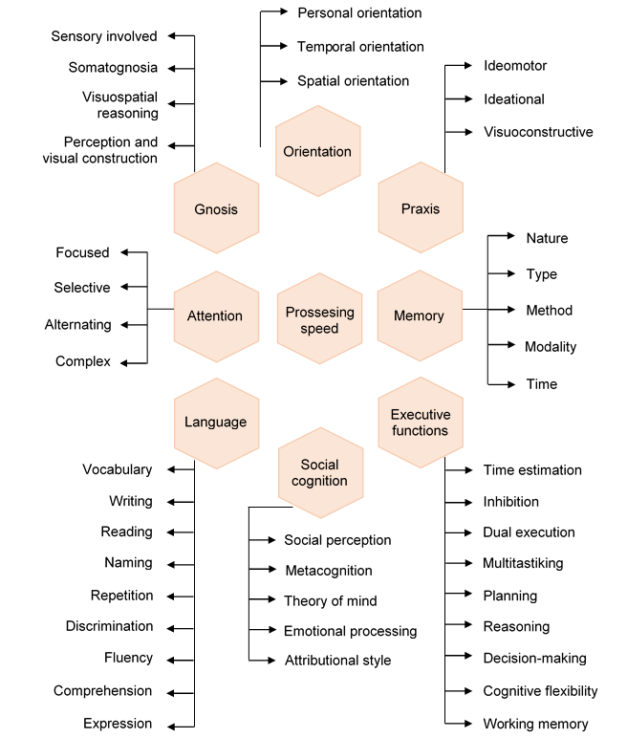
Diagram 1. Summary of the cognitive domains and subfunctions involved
.

Slide 29
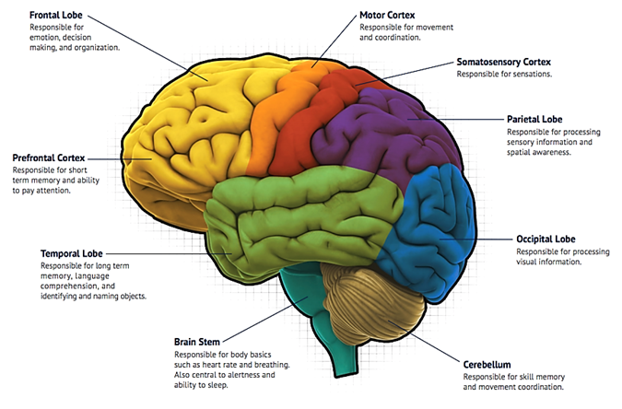
2.2. BRAIN BASES OF COGNITIVE FUNCTIONS
Traditionally, neuroscience has focused mainly on the topological organization of cognitive functions in specific brain regions.
Figure 11. Brain mapping (from “North Jersey Health & Wellness”).
Notes:
Traditionally, neuroscience has focused mainly on the topological organization of cognitive functions in specific brain regions (Figure).

Slide 30
New "network paradigm“
The human brain contains at least five major core functional networks (Mesulam, 1990):
I. Spatial attention network
II. A language network
III. An explicit memory network
IV. A face-object recognition network
V. A working memory–executive function network
Posterior parietal cortex (PPC) and frontal eye fields
Wernicke’s and Broca’s areas.
Hippocampal–entorhinal complex and inferior parietal cortex
Midtemporal and temporopolar cortex
Prefrontal and inferior parietal cortex
Figure 12. Five major core functional networks
Notes:
However, actually there are a new "network paradigm" to understand the neuronal basis of cognition: the key to understanding the functions of any specific brain region lies in understanding how its connectivity differs from the pattern of connections in other functionally related brain areas. Shifting neuroscientific interests towards the development of a deeper understanding of how the intrinsic architecture of the brain influences the processing of cognitive information.
According to Mesulam (1990), the human brain contains at least five major core functional networks:
I. A spatial attention network anchored in posterior parietal cortex (PPC) and frontal eye fields.
II. A language network anchored in Wernicke’s and Broca’s areas.
III. An explicit memory network anchored in the hippocampal–entorhinal complex and inferior parietal cortex.
IV. A face-object recognition network anchored in midtemporal and temporopolar cortices.
V. A working memory–executive function network anchored in prefrontal and inferior parietal cortices.

Slide 31
Other new network modules
(VI) An intrinsic connectivity networks involved in executive control, episodic memory, autobiographical memory, self-related processing, and detection of salient events.
(VII) A sensorimotor network anchored in bilateral somatosensory and motor cortices.
(VIII) A visuospatial attention network anchored in intraparietal sulci and frontal eye fields
Notes:
In addition, Independent Component Analysis (ICA) has been used to identify intrinsic connectivity networks involved in executive control, episodic memory, autobiographical memory, self-related processing, and detection of salient events.
This studies has revealed a sensorimotor network anchored in bilateral somatosensory and motor cortices; a visuospatial attention network anchored in intraparietal sulci and frontal eye fields; a higher-order visual network anchored in lateral occipital and inferior temporal cortices; and a lower-order visual network anchored in the striate and extrastriate cortex.
Those network modules can vary their intraconnectivity and the intermodule connectivity.

Slide 32
Other new network modules
(IX) A higher-order visual network anchored in lateral occipital and inferior temporal cortices.
(X) A lower-order visual network anchored in the striate and extrastriate cortex.
Those network modules can vary their intraconnectivity and the intermodule connectivity.
Notes:
In addition, Independent Component Analysis (ICA) has been used to identify intrinsic connectivity networks involved in executive control, episodic memory, autobiographical memory, self-related processing, and detection of salient events.
This studies has revealed a sensorimotor network anchored in bilateral somatosensory and motor cortices; a visuospatial attention network anchored in intraparietal sulci and frontal eye fields; a higher-order visual network anchored in lateral occipital and inferior temporal cortices; and a lower-order visual network anchored in the striate and extrastriate cortex.
Those network modules can vary their intraconnectivity and the intermodule connectivity.

Slide 33
Topology of the modular organization
(A) brain regions are organized into cytoarchitectonically distinct areas
(B) each cytoarchitectural configuration has structural properties with different implications for computational functions
(C) cytoarchitectural regions can be represented as nodes in a network
Notes:
Figure shows a topology example of the modular organization of functional brain networks, demonstrating the communication between computational resources of different types: (A) brain regions are organized into cytoarchitectonically distinct areas, (B) each cytoarchitectural configuration has structural properties with different implications for computational functions, (C) cytoarchitectural regions can be represented as nodes in a network, (D) the nodes have functional associations, represented as edges that extend beyond spatial boundaries evident in cytoarchitectural organization.

Slide 34
Topology of the modular organization
(D) the nodes have functional associations, represented as edges that extend beyond spatial boundaries evident in cytoarchitectural organization.
Figure 13. From nodes to networks (Medaglia et al., 2015).
Notes:
Figure shows a topology example of the modular organization of functional brain networks, demonstrating the communication between computational resources of different types: (A) brain regions are organized into cytoarchitectonically distinct areas, (B) each cytoarchitectural configuration has structural properties with different implications for computational functions, (C) cytoarchitectural regions can be represented as nodes in a network, (D) the nodes have functional associations, represented as edges that extend beyond spatial boundaries evident in cytoarchitectural organization.

Slide 35
2.3. IMPAIRED COGNITIVE FUNCTIONS
As mentioned earlier, the loss of cognitive abilities is due to the natural aging process.
The way in which this degenerative process develops depends on multiple conditions: health, functional capacity, genetic structure and environment.
Other factors can alter cognitive abilities acutely or chronically: neurodegenerative diseases, neurodevelopmental disorders, intellectual disabilities, mental illnesses, addictions, severe physical or mental traumas, etc.
The affectation in one or more of the cognitive functions has a direct implication on the daily functioning of people, individually or in interaction with others and the environment.
Notes:
As mentioned earlier, the loss of cognitive abilities is due to the natural aging process. However, the way in which this degenerative process develops depends on multiple conditions: health, functional capacity, genetic structure and environment. In addition, other factors can alter cognitive abilities acutely or chronically: neurodegenerative diseases, neurodevelopmental disorders, intellectual disabilities, mental illnesses, addictions, severe physical or mental traumas, etc.
The affectation in one or more of the cognitive functions has a direct implication on the daily functioning of people, individually or in interaction with others and the environment.

Slide 36
Implications in carrying out activities of daily life
Cognitive function | Activities of daily life
Recognition of the body scheme | Difficulties in dressing, using objects in relation to the body (comb, toothbrush, cutlery, etc.).
Sustained attention | Difficulties in following a movie or book, studying, etc.
Selective attention | Difficulties in working in an environment with other people, with noise or other possible distractions.
Divided attention | Difficulties in driving a vehicle, home care or children, etc.
Semantic memory | Forgetting previously acquired knowledge, forgetting the name of known people.
Episodic memory | Forgetting where you left your car, keys or glasses, forgetting itineraries (holidays, visits, etc.)
Prospective memory | Forgetting the next day's appointments, forgetting what you want to buy, etc.
Executive functions | Difficulties to plan and carry out the meal, to use the computer, to control expenses, to organize trips or trips, to solve problematic situations, etc.
Table 1: Implications of cognitive deficits in carrying out activities of daily life
Notes:
Table shows the implications of some of the cognitive function in carrying out activities of daily life.

Slide 37
Deficit reduction
DETERIORATION CAN SLOW DOWN or
MAKE COGNITIVE DEFICITS LIGHTER,
maintaining an active and healthy life,
in stimulating environments, and
if it continues to stimulate or
develop these functions
through cognitive stimulation practices and exercises
Notes:
In recent years and through multiple studies worldwide, it has been shown that deterioration can slow down or make cognitive deficits lighter, maintaining an active and healthy life, in stimulating environments, and if it continues to stimulate or develop these functions through cognitive stimulation practices and exercises.

Slide 38
2.4. EVALUATION OF COGNITIVE FUNCTIONS
An adequate cognitive or neurocognitive evaluation may involve
Observation, interviews, clinical and psychosocial scales, cognitive tests, neuroimaging techniques, or any other appropriate form of evaluation.
Focusing also on the specific treatment needs of the affected person.
The neurocognitive evaluation should include at least the study of general intellectual performance, temporal and spatial orientation, attention, speed of information processing, learning and memory capacity, visuospatial abilities, perceptual and motor skills, language and communication, reasoning, the ability to solve problems and some of the executive functions.
Notes:
An adequate cognitive or neurocognitive evaluation may involve the application of observation, interviews, clinical and psychosocial scales, cognitive tests, neuroimaging techniques, or any other appropriate form of evaluation. Focusing also on the specific treatment needs of the affected person.
In general, the neurocognitive evaluation should include at least the study of general intellectual performance, temporal and spatial orientation, attention, speed of information processing, learning and memory capacity, visuospatial abilities, perceptual and motor skills, language and communication, reasoning, the ability to solve problems and some of the executive functions.

Slide 39
Evaluation instruments
I. Short scales or cognitive tracking tests
Tests easy to apply
Little time for application (5 to 20 minutes).
Allows obtaining a “cut-off point” between normal and pathological,
Allows the remission to a more detailed neuropsychological evaluation.
Limited to providing a quick view of the patient, monitoring patients, and establishing correlations between this global score and other relevant variables.
Notes:
These tests are easy to apply and require little time for application (5 to 20 minutes). Most of them were originally designed to assess cognitive deficits in elderly patients, although they have been applied in general to patients with all types of both acute and chronic cognitive deficits. The overall score obtained allows obtaining a “cut-off point” between normal and pathological, allowing the remission of those who need a more detailed neuropsychological evaluation. Its main utilities are limited to providing a quick view of the patient, monitoring patients, and establishing correlations between this global score and other relevant variables. E.g. Mini-Mental State Examination (MMSE): evaluate Orientation to time, Orientation to place, Registration, Attention and calculation, Recall, Language, Repetition, and, Complex commands (Figure).

Slide 40
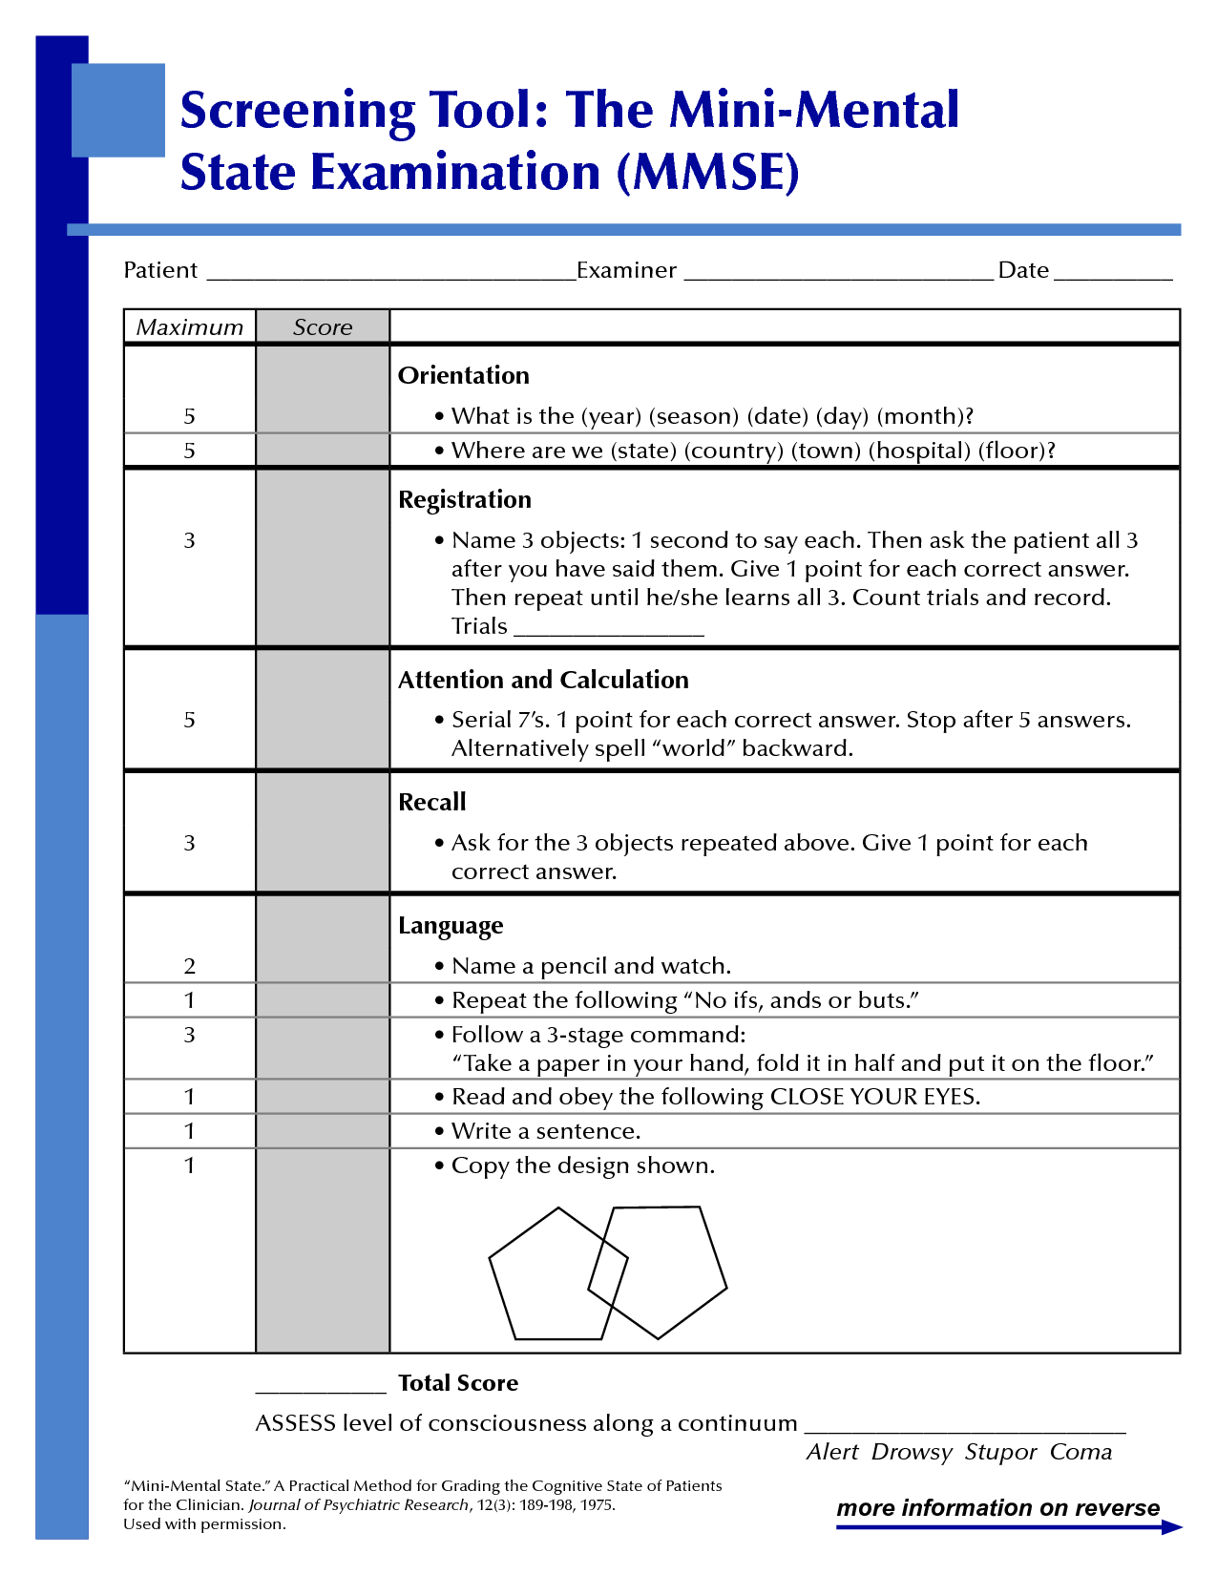
Evaluation instruments
Figure 14: Mini-Mental State Examination (MMSE)
Notes:
These tests are easy to apply and require little time for application (5 to 20 minutes). Most of them were originally designed to assess cognitive deficits in elderly patients, although they have been applied in general to patients with all types of both acute and chronic cognitive deficits. The overall score obtained allows obtaining a “cut-off point” between normal and pathological, allowing the remission of those who need a more detailed neuropsychological evaluation. Its main utilities are limited to providing a quick view of the patient, monitoring patients, and establishing correlations between this global score and other relevant variables. E.g. Mini-Mental State Examination (MMSE): evaluate Orientation to time, Orientation to place, Registration, Attention and calculation, Recall, Language, Repetition, and, Complex commands (Figure).

Slide 41
Evaluation instruments
II. General evaluation batteries
Set of test that explore the main cognitive functions systematically.
Advantages: to have a large database that facilitates obtaining a profile that characterize different levels of people cognitive domains, and variables control
Identify not only the main deficits but also the skills preserved
Essential for the establishment of a subsequent personalized rehabilitation program.
Notes:
II. General evaluation batteries
Those are a set of tests or elements that explore the main cognitive functions systematically. The main advantages of its use is the opportunity to have a large database that facilitates obtaining a profile that characterize different levels of people cognitive domains, and a greater control over a set of variables that may affect the performance of individuals (age, educational level, etc.). They identify not only the main deficits but also the skills preserved in each person, essential for the establishment of a subsequent personalized rehabilitation program. E.g. Weschsler Adult Intelligence Sacale (WAIS): evaluate Vocabulary, Similarities, Information, Comprehension, Arithmetic, Digit Span, Letter-number sequencing, Picture completion, Block design, Matrix Reasoning, Digit symbol coding, Symbol search (Figure).

Slide 42

Evaluation instruments
Figure 15: Weschsler Adult Intelligence Sacale (WAIS)
Notes:
II. General evaluation batteries
Those are a set of tests or elements that explore the main cognitive functions systematically. The main advantages of its use is the opportunity to have a large database that facilitates obtaining a profile that characterize different levels of people cognitive domains, and a greater control over a set of variables that may affect the performance of individuals (age, educational level, etc.). They identify not only the main deficits but also the skills preserved in each person, essential for the establishment of a subsequent personalized rehabilitation program. E.g. Weschsler Adult Intelligence Sacale (WAIS): evaluate Vocabulary, Similarities, Information, Comprehension, Arithmetic, Digit Span, Letter-number sequencing, Picture completion, Block design, Matrix Reasoning, Digit symbol coding, Symbol search (Figure).

Slide 43
Evaluation instruments
III. Specific tests
Focused on examining specific cognitive function deterioration.
Used to develop a realistic work plan for the patient.
Cognitive or neurocognitive evaluation should be done by a neuropsychologist,
Cognitive screening tests, are accessible to all health professionals, who, with minimal preparation, and in a short time, can make a previous evaluation that allows them refer a patient.
Notes:
III. Specific tests of neuropsychological evaluation.
These tests are focused on examining specific cognitive function deterioration. Used to develop a realistic work plan for the patient. E.g. Conners CPT – CATA: measures sustained and selective attention. (Figure).
Although the cognitive or neurocognitive evaluation should be done by a neuropsychologist, the cognitive screening tests, are accessible to all health professionals, who, with minimal preparation, and in a short time, can make a previous evaluation that allows them refer a patient to the appropriate professional.

Slide 44

Evaluation instruments
Figure 16: Conners CPT - CATA
Notes:
III. Specific tests of neuropsychological evaluation.
These tests are focused on examining specific cognitive function deterioration. Used to develop a realistic work plan for the patient. E.g. Conners CPT – CATA: measures sustained and selective attention. (Figure).
Although the cognitive or neurocognitive evaluation should be done by a neuropsychologist, the cognitive screening tests, are accessible to all health professionals, who, with minimal preparation, and in a short time, can make a previous evaluation that allows them refer a patient to the appropriate professional.

Slide 45
2.5. PROGRESS TOWARD OBJECTIVE COGNITIVE ASSESSMENT
The cognitive evaluation has always been carried out through standardized tests and scales in which an observer scores the performance of the person evaluated while answering their questions.
Possible errors:
The evaluator may have a mistake in the scaling of responses.
The evaluated person may feel uncomfortable in presence of the evaluator. Meaning in a poor perform.
In neurological disease, motor and verbal function is compromised. Meaning in a inferior results.
Notes:
III. Specific tests of neuropsychological evaluation.
These tests are focused on examining specific cognitive function deterioration. Used to develop a realistic work plan for the patient. E.g. Conners CPT – CATA: measures sustained and selective attention. (Figure).
Although the cognitive or neurocognitive evaluation should be done by a neuropsychologist, the cognitive screening tests, are accessible to all health professionals, who, with minimal preparation, and in a short time, can make a previous evaluation that allows them refer a patient to the appropriate professional.

Slide 46
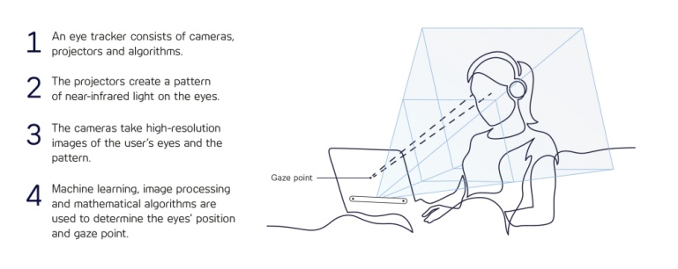
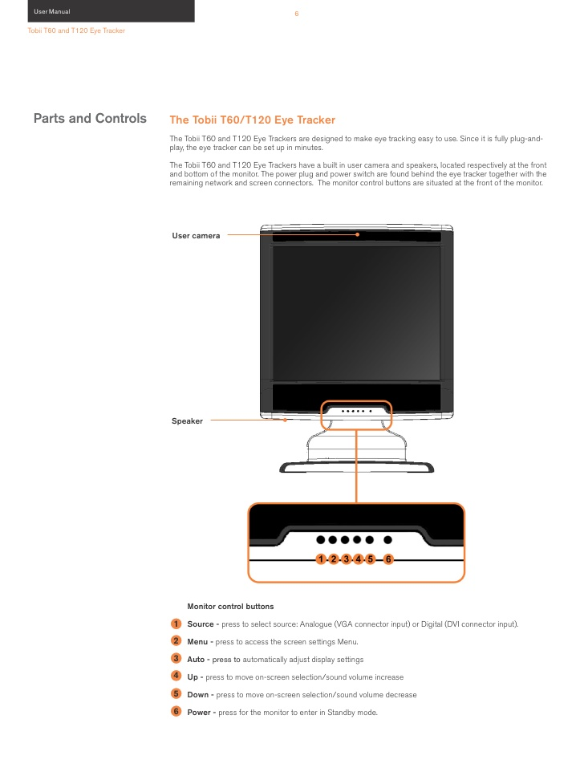
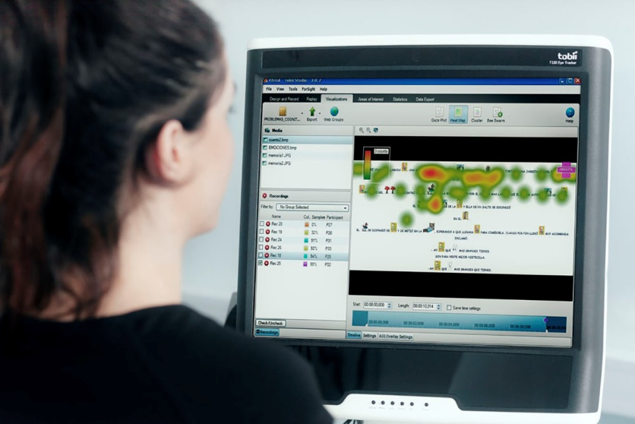
2.5. PROGRESS TOWARD OBJECTIVE COGNITIVE ASSESSMENT
The Eye-tracking is a non-invasive method to objetify the cognitve evaluator.
Figure 17: Eye gaze assessment with the eye-tracker system Tobii studio 120, software release 2.2.
(Upper images from Tobii user manual).
Notes:
III. Specific tests of neuropsychological evaluation.
These tests are focused on examining specific cognitive function deterioration. Used to develop a realistic work plan for the patient. E.g. Conners CPT – CATA: measures sustained and selective attention. (Figure).
Although the cognitive or neurocognitive evaluation should be done by a neuropsychologist, the cognitive screening tests, are accessible to all health professionals, who, with minimal preparation, and in a short time, can make a previous evaluation that allows them refer a patient to the appropriate professional.

Slide 47
2.5. PROGRESS TOWARD OBJECTIVE COGNITIVE ASSESSMENT
Outcome | Description
Number of gaze fixations | A high number of fixations indicates a lower search efficiency of items on the screen.
Average time of gaze fixation | Long fixations are usually indicative of the difficulty of the participant in extracting the stimulus information.
Number of fixations of the gaze in each area of interest | The number of gaze fixations in a special element of the stimulus should reflect the importance of that element. Most important elements will receive a greater number of fixations.
Time percentage of the gaze in each area of interest | The proportion of time looking at a particular element of the stimulus could reflect the importance of that element.
Spontaneous eye-blink rate | Correlates with levels of dopamine in the central nervous system and can reveal processes underlying learning and goal-directed behavior.
Table 2.1: Results from eye-tracking system assessment.
Notes:
III. Specific tests of neuropsychological evaluation.
These tests are focused on examining specific cognitive function deterioration. Used to develop a realistic work plan for the patient. E.g. Conners CPT – CATA: measures sustained and selective attention. (Figure).
Although the cognitive or neurocognitive evaluation should be done by a neuropsychologist, the cognitive screening tests, are accessible to all health professionals, who, with minimal preparation, and in a short time, can make a previous evaluation that allows them refer a patient to the appropriate professional.

Slide 48
2.5. PROGRESS TOWARD OBJECTIVE COGNITIVE ASSESSMENT
Outcome | Description
Pupil dilation | The pupils of the eye not only constrict in response to light and dilate in response to darkness; in children as well as adults, they also dilate during autonomic arousal and mental activity. Thereason that the pupil responds to arousal and mental activity is thatpupil dilation is modulated by the noradrenergic locus coeruleus, implied on the regulation of physiological arousal and cognitive functioning.
Gaze trajectory | Circuit of the tracked look during a test. It allows obtaining an order of the places in which the person fixes the sight on the screen.
Blink rate | Frequency at which the eyelids open and close. Serve as a non-invasive, indirect measure of dopamine activity in the central nervous system. This neurotransmitter is involved in learning, working memory, and goal-oriented behavior.
Table 2.2: Results from eye-tracking system assessment.
Notes:
III. Specific tests of neuropsychological evaluation.
These tests are focused on examining specific cognitive function deterioration. Used to develop a realistic work plan for the patient. E.g. Conners CPT – CATA: measures sustained and selective attention. (Figure).
Although the cognitive or neurocognitive evaluation should be done by a neuropsychologist, the cognitive screening tests, are accessible to all health professionals, who, with minimal preparation, and in a short time, can make a previous evaluation that allows them refer a patient to the appropriate professional.

Slide 49
Importance of cognitive abilities in the performance of motor task.
3. Cognitive load interference
on motor performance

Slide 50
3. COGNITIVE LOAD INTERFERENCE ON MOTOR PERFORMANCE
The cognitive load can alter motor task development.
Several task at the same time examples:
Multiple cognitive task.
  While people walk and think about a destination.
  While people walk and mantain a conversation.
  While people walk and search for something.
Maintain a conversation while planning what to say.
Ordening the steps in a recipe while handing objects and cooking.
Notes:
III. Specific tests of neuropsychological evaluation.
These tests are focused on examining specific cognitive function deterioration. Used to develop a realistic work plan for the patient. E.g. Conners CPT – CATA: measures sustained and selective attention. (Figure).
Although the cognitive or neurocognitive evaluation should be done by a neuropsychologist, the cognitive screening tests, are accessible to all health professionals, who, with minimal preparation, and in a short time, can make a previous evaluation that allows them refer a patient to the appropriate professional.

Slide 51
3. COGNITIVE LOAD INTERFERENCE ON MOTOR PERFORMANCE
In healthy people, the cognitive load can be measured because the performance of the primary task is not the same as when a cognitive load in not included.
MacPherson (2019)
Stroop task / Congruent and incongruent reading task.
An increased cognitive load in incongruent condition associated with increased articulatory coordination variability and movement duration.
Chatain et al (2019)
Isometric quadriceps contraction.
Cognitive load can interfere with motor tasks that do not need cognitive functions for its development.
Notes:
III. Specific tests of neuropsychological evaluation.
These tests are focused on examining specific cognitive function deterioration. Used to develop a realistic work plan for the patient. E.g. Conners CPT – CATA: measures sustained and selective attention. (Figure).
Although the cognitive or neurocognitive evaluation should be done by a neuropsychologist, the cognitive screening tests, are accessible to all health professionals, who, with minimal preparation, and in a short time, can make a previous evaluation that allows them refer a patient to the appropriate professional.

Slide 52
Importance of cognitive abilities in the performance of motor task.
4. Motor performance in people with cognitive impairment and mental disorders

Slide 53
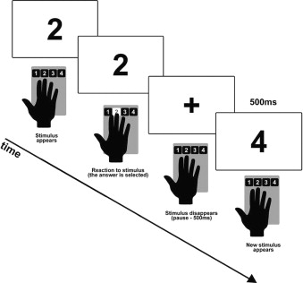
4. MOTOR PERFORMANCE IN PEOPLE WITH COGNITIVE IMPAIRMENT AND MENTAL DISORDERS
BIPOLAR DISORDERS AND MAJOR DEPRESSION
Cognitive impairment stable and lifelong feature.
Affected verbal memory, psychomotor speed, executive functioning, visual memory and attention
Cognitive deficits affects social and occupational functioning.
Motor signs such as lower speed gait, balance problema during gait ans sit-to stand and los of muscle forcé.
Picture 18: Serial reaction time task
for implicit motor learning assessment.
The task from the study of Chrobak
et al.
Notes:
III. Specific tests of neuropsychological evaluation.
These tests are focused on examining specific cognitive function deterioration. Used to develop a realistic work plan for the patient. E.g. Conners CPT – CATA: measures sustained and selective attention. (Figure).
Although the cognitive or neurocognitive evaluation should be done by a neuropsychologist, the cognitive screening tests, are accessible to all health professionals, who, with minimal preparation, and in a short time, can make a previous evaluation that allows them refer a patient to the appropriate professional.

Slide 54
4. MOTOR PERFORMANCE IN PEOPLE WITH COGNITIVE IMPAIRMENT AND MENTAL DISORDERS
SCHIZOPHRENIA
Devastating disorder mainly results from cerebral pathology.
Prevalence of motor symptoms such as catatonia, neurological soft signs, parkinsonism, involuntary movements.
Poor comunication from motor cortex with nucleus of the basal ganglia circuit.
Poor subcircuit control movement feedback.
HEPATIC DAMAGE
Liver failure leading to hepatic encephalopathy (HE).
Brain impairment due to amonia and inflammation. Generated metabolic toxicity alter bain functioning.
Cognitive deterioration such as attention deficits and mild cognitive impairments.
Trigger physical failty.
Notes:
III. Specific tests of neuropsychological evaluation.
These tests are focused on examining specific cognitive function deterioration. Used to develop a realistic work plan for the patient. E.g. Conners CPT – CATA: measures sustained and selective attention. (Figure).
Although the cognitive or neurocognitive evaluation should be done by a neuropsychologist, the cognitive screening tests, are accessible to all health professionals, who, with minimal preparation, and in a short time, can make a previous evaluation that allows them refer a patient to the appropriate professional.

Slide 55
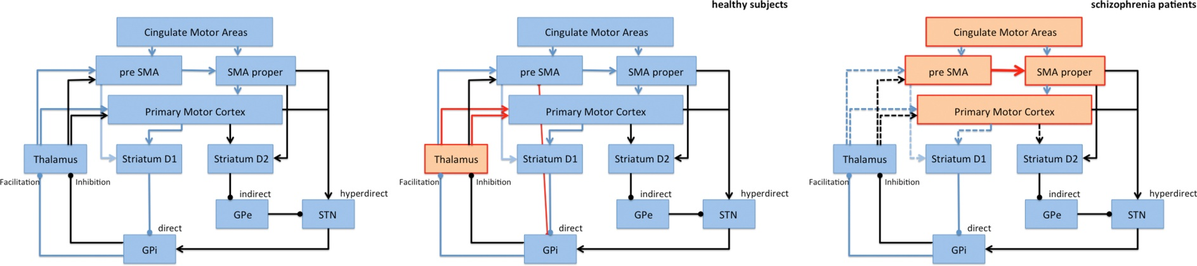
4. MOTOR PERFORMANCE IN PEOPLE WITH COGNITIVE IMPAIRMENT AND MENTAL DISORDERS
Figure 19: Connections between cortical and subcortical components of the motor loop.
(Left) Circuit of Healthy subjects, (Right) Altered circuit of people with schizophrenia.
Image from Walther S. 2015.
Notes:
III. Specific tests of neuropsychological evaluation.
These tests are focused on examining specific cognitive function deterioration. Used to develop a realistic work plan for the patient. E.g. Conners CPT – CATA: measures sustained and selective attention. (Figure).
Although the cognitive or neurocognitive evaluation should be done by a neuropsychologist, the cognitive screening tests, are accessible to all health professionals, who, with minimal preparation, and in a short time, can make a previous evaluation that allows them refer a patient to the appropriate professional.

Slide 56
4. MOTOR PERFORMANCE IN PEOPLE WITH COGNITIVE IMPAIRMENT AND MENTAL DISORDERS
CANCER
Cognitive problems after chemotherapy.
Cognitive problems such as motor impairment in activities and fuctioning.
Cognitive impairment due to celular toxicity, reduced white matter integrity and inflamatory reactions.
Mild to moderate cognitive problems.
Notes:
III. Specific tests of neuropsychological evaluation.
These tests are focused on examining specific cognitive function deterioration. Used to develop a realistic work plan for the patient. E.g. Conners CPT – CATA: measures sustained and selective attention. (Figure).
Although the cognitive or neurocognitive evaluation should be done by a neuropsychologist, the cognitive screening tests, are accessible to all health professionals, who, with minimal preparation, and in a short time, can make a previous evaluation that allows them refer a patient to the appropriate professional.

Slide 57
Importance of cognitive abilities in the performance of motor task.
5. Dual-task assessment

Slide 58
5. DUAL-TASK ASSESSMENT
Dual-task or dual-tasking is refered as a simultaneous development of two tasks with diffferent objectives requiring attention for their execution.
Proper way to assess cognitive load in a motor task.
Assess used in older people or who suffer from motor impairment.
Gait is the most evaluated motor gesture.
Gait performance as a primary task and cognitive or motor performance as dual task using the arms.
Assessment of patient focus attention.
  Automatical gait perform by spine or mesencephalic center.
  Gait adaptation perform by cerebral cortex area.
Notes:
III. Specific tests of neuropsychological evaluation.
These tests are focused on examining specific cognitive function deterioration. Used to develop a realistic work plan for the patient. E.g. Conners CPT – CATA: measures sustained and selective attention. (Figure).
Although the cognitive or neurocognitive evaluation should be done by a neuropsychologist, the cognitive screening tests, are accessible to all health professionals, who, with minimal preparation, and in a short time, can make a previous evaluation that allows them refer a patient to the appropriate professional.

Slide 59
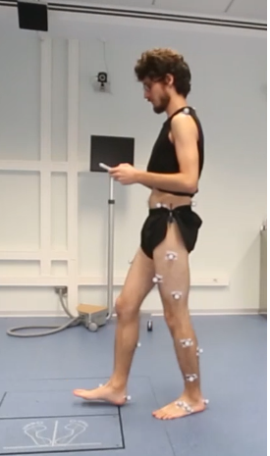
5. DUAL-TASK ASSESSMENT
Primary Task: GAIT
Secondary Task: motor task of upper limb
Figure 20: Dual-task assessment. In this example the primary task is the gait and the secondary task is the manipulation of the mobile phone. The gait assessment is performed with a photogrammetry system which allows register the cinematic outcomes of the evaluation, such as gait velocity, spatiotemporal parameters and joint angles.
Notes:
III. Specific tests of neuropsychological evaluation.
These tests are focused on examining specific cognitive function deterioration. Used to develop a realistic work plan for the patient. E.g. Conners CPT – CATA: measures sustained and selective attention. (Figure).
Although the cognitive or neurocognitive evaluation should be done by a neuropsychologist, the cognitive screening tests, are accessible to all health professionals, who, with minimal preparation, and in a short time, can make a previous evaluation that allows them refer a patient to the appropriate professional.

Slide 60
Importance of cognitive abilities in the performance of motor task.
6. Key ideas

Slide 61
6. KEY IDEAS
The cognitive functions in the human being allow to carry out effectively all kinds of activities, both mental, social and motor. Within cognitive functions, executive functions are widely studied because they allow the performance of multiple tasks efficiently and because of their involvement in the movement.
The evaluation of cognitive functions is traditionally mediating scales and psychometric tests that have a subjective component because the response observed by the evaluator or given by the patient comes from a subjective perception. Tools such as the eye-tracker allow us to objectify a cognitive response through the monitoring of eye movement, identifying the pupil.
Notes:
III. Specific tests of neuropsychological evaluation.
These tests are focused on examining specific cognitive function deterioration. Used to develop a realistic work plan for the patient. E.g. Conners CPT – CATA: measures sustained and selective attention. (Figure).
Although the cognitive or neurocognitive evaluation should be done by a neuropsychologist, the cognitive screening tests, are accessible to all health professionals, who, with minimal preparation, and in a short time, can make a previous evaluation that allows them refer a patient to the appropriate professional.

Slide 62
6. KEY IDEAS
Cognitive burden has an impact on the motor performance of healthy people, elderly or with neurological disorders. The most studied functions under cognitive load are gait and balance, finding a worse performance when an additional task is performed at the same time.
People with diseases that implies to cognitive impairment show motor impairment for two reasons mainly: 1) because altered cognitive functions are involved in motor activities such as work or driving, and 2) because, in addition to the brain abnormalities that show cognitive damage, there are mechanisms where motor circuits are also affected. Examples of these pathologies are bipolar disorder, schizophrenia, chronic liver damage and patients with cancer and chemotherapy treatment.
Notes:
III. Specific tests of neuropsychological evaluation.
These tests are focused on examining specific cognitive function deterioration. Used to develop a realistic work plan for the patient. E.g. Conners CPT – CATA: measures sustained and selective attention. (Figure).
Although the cognitive or neurocognitive evaluation should be done by a neuropsychologist, the cognitive screening tests, are accessible to all health professionals, who, with minimal preparation, and in a short time, can make a previous evaluation that allows them refer a patient to the appropriate professional.

Slide 63
6. KEY IDEAS
The way to evaluate the cognitive load in a motor task, or vice versa, is through a dual-task, where the attention of the person evaluated fluctuates between the development of the primary task and the secondary task. The indicator of this interference is the dual-task cost parameter, which indicates the percentage of deterioration of the additional load to the primary task.
The importance of biomechanical evaluation under dual conditions is that, on the one hand, they are a functional and habitual context for people, and on the other hand, many mental or cognitive pathologies, in turn, cause motor damage, may require medical attention in this domain.
Notes:
III. Specific tests of neuropsychological evaluation.
These tests are focused on examining specific cognitive function deterioration. Used to develop a realistic work plan for the patient. E.g. Conners CPT – CATA: measures sustained and selective attention. (Figure).
Although the cognitive or neurocognitive evaluation should be done by a neuropsychologist, the cognitive screening tests, are accessible to all health professionals, who, with minimal preparation, and in a short time, can make a previous evaluation that allows them refer a patient to the appropriate professional.

Slide 64
Importance of cognitive abilities in the performance of motor task.
7. Bibliography

Slide 65
BIBLIOGRAPHY
Adams R, Parsons O. Neuropsychology for clinical practice: etiology, assessment, and treatment of common neurologic disorders. Washington, DC: American Psychological Association; 2003.
Alvarez JA, Emory E. Executive function and the frontal lobes: a meta-analytic review. Neuropsychol Rev 2006;16:17-42.
American Psychiatric Association. (2013). Diagnostic and statistical manual of mental disorders (5th ed.). Arlington, VA: Author.
Baddeley A. Modularity, Mass-Action and Memory. The Quarterly Journal of Experimental Psychology Section A, Volume: 38 issue: 4, page(s): 527-533. November 1, 1986.
Ballesteros, S. (2001). Habilidades cognitivas básicas: Formación y deterioro. Madrid: UNED.
Ballesteros, S. (2002). Psicología General. Atención y percepción. (Vol. II). Madrid: UNED.Ballesteros, S. (2014). La atención selectiva modula el procesamiento de la información y la memoria implícita [Selective attention modulates information processing and implicit memory]. Acción Psicológica, 11(1).
Chatain C., Radel R., Vercruyssen F., Rabahi T., Vallier JM., Bernard T., Gruet M. Influence of cognitive load on the dynamics of neurophysiological adjustments during fatiguing exercise. Psychophysiology. 2019 Jun;56(6):e13343.

Slide 66
BIBLIOGRAPHY
Collette F, Hogge M, Salmon E, Van der LM. Exploration of the neural substrates of executive functioning by functional neuroimaging. Neuroscience 2006;139:209-221.
Dorfman J. Problem solving, inhibition and frontal lobe function. In: Raz N, editor. The other side of the error term: aging and development as model systems in cognitive neuroscience. Amsterdam, The Netherlands: Elsevier Science; 1998. p 395–448.
Dosenbach NU, Fair DA, Cohen AL, Schlaggar BL, Petersen SE. A dual-networks architecture of top-down control. Trends Cogn Sci. 2008 Mar;12(3):99-105. doi: 10.1016/j.tics.2008.01.001. Epub 2008 Feb 11.
Eckestein M., Guerra-Carrillo B., Miller Singley A., Bunge S. Beyond eye gaze: What else can eyetracking reveal about cognition and cognitive development? Developmental Cognitive Neuroscience 25 (2017) 69–91.
Fox MD, Raichle ME. Spontaneous fluctuations in brain activity observed with functional magnetic resonance imaging. Nat Rev Neurosci. 2007 Sep;8(9):700-11.
Fritz NE., Cheek FM., Nichols-Laren DS. Motor-cognitive dual-task training in neurological disorders: A systematic review. J Neurol Phys Ther. 2015 July ; 39(3): 142–153.
Greicius MD, Krasnow B, Reiss AL, Menon V. Functional connectivity in the resting brain: a network analysis of the default mode hypothesis. Proc Natl Acad Sci U S A. 2003 Jan 7;100(1):253-8. Epub 2002 Dec 27.

Slide 67
BIBLIOGRAPHY
Greicius MD, Krasnow B, Boyett-Anderson JM, Eliez S, Schatzberg AF, Reiss AL, Menon V. Regional analysis of hippocampal activation during memory encoding and retrieval: fMRI study. Hippocampus. 2003;13(1):164-74.
John D. Medaglia, Mary-Ellen Lynall, and Danielle S. Bassett. J Cogn Neurosci. 2015 August; 27(8): 1471–1491.
Kopelman MD. Disorders of memory, Brain, Volume 125, Issue 10, October 2002, Pages 2152–2190.
Lachman, R., Lachman, J. L., & Butterfield, E. C.Cognitive psychology and information processing. An introductory. Hillsdale, NJ: Erlbaum.1979.
Lezak MD, Howieson DB, Bigler ED, Tranel D. Neuropsychological assessment. Fifth edition. New York: Oxford University Press; 2012.
Light, J., & McNaughton, D. (2013). Putting People First: Re-Thinking the Role of Technology in Augmentative and Alternative Communication Intervention. Augmentative and Alternative Communication, 29(4), 299-309.
Lynne Beal A., Holdnack James A., Saklofske Donald H., Weiss Lawrence G. Chapter 3 - Practical Considerations in WISC-V Interpretation and Intervention in WISC-V Assessment and Interpretation Scientist-Practitioner Perspectives Practical Resources for the Mental Health Professional. 2016, Pages 63-93.
MacPherson MK. Cognitive Load Affects Speech Motor Performance Differently in Older and Younger Adults. J Speech Lang Hear Res. 2019 May 21;62(5):1258-1277.

Slide 68
BIBLIOGRAPHY
Menon V (2010) Large-Scale Brain Networks in Cognition: Emerging Principles. In: Analysis and Function of Large-Scale Brain Networks. (Sporns O, ed) pp. 44-53. Washington, DC: Society for Neuroscience.
Meehan TP, Bressler SL. Neurocognitive networks: findings, models, and theory. Neurosci Biobehav Rev. 2012 Nov; 36(10):2232-47. doi: 10.1016/j.neubiorev.2012.08.002. Epub 2012 Aug 18.
Mirsky, A.F., Anthony, B.J., Duncan, C.C. et al. Analysis of the elements of attention: A neuropsychological approach. Neuropsychol Rev 2, 109–145 (1991).
Morice R and Delahunty A. Frontal/Executive Impairments in Schizophrenia. Schizophrenia Bulletin, Volume 22, Issue 1, 1996, Pages 125–137.
North Jersey Health and Wellness. Comprehensive and Prreventive Health Care. Brain Mapping. Cited: January 2020 (Available from: https://njhwllc.com/brain-mapping/).
Persad C., Jones JL., Ashton-Miller J., Alexander NB. and Giordan B. Executive Function and Gait in Older Adults With Cognitive Impairment. Journal of Gerontology: 2008, Vol. 63A, No. 12, 1350–1355.
Ridderinkhof KR, van den Wildenberg WP, Segalowitz SJ, Carter CS. Neurocognitive mechanisms of cognitive control: the role of prefrontal cortex in action selection, response inhibition, performance monitoring, and reward-based learning. Brain Cogn 2004; 56:129-140.

Slide 69
BIBLIOGRAPHY
Seeley W, Menon V, Schatzberg AF, Keller J, Glover GH, Kenna H, Reiss AL, Greicius MD. Dissociable intrinsic connectivity networks for salience processing and executive control. J Neurosci. 2007 Feb 28;27(9):2349-56.
Seeley WW1, Allman JM, Carlin DA, Crawford RK, Macedo MN, Greicius MD, Dearmond SJ, Miller BL. Divergent social functioning in behavioral variant frontotemporal dementia and Alzheimer disease: reciprocal networks and neuronal evolution. Alzheimer Dis Assoc Disord. 2007 Oct-Dec;21(4):S50-7.
Squire LR. The organization and neural substrates of human memory. International Journal of Neurology, 01 Jan 1987; 21-22:218-22.
Stuss DT, Alexander MP. Executive functions and the frontal lobes: a conceptual view. Psychol Res 2000;63:289-298.
Tirapu J (2007) La evaluación neuropsicológica. Intervención Psicosocial, Vol. 16 N.° 2. Págs. 189-211. Colegio Oficial de Psicólogos de Madrid.
Witlox L., Schagen S., Ruiter M., Geerlings M., Peeters P., Koevoets E., van der Wall E., Stuiver M., Sonke G., Velthuis M., van der Palen L., Jobsen J., May A., Monninkhof E. Effects of physical exercise on cognitive function and brain measures after chemotherapy in patients with breast cancer (PAM study): protocol of a randomised controlled trial. BMJ Open 2019;9:e028117.
Yogev G., Hausdorff JM., and Giladi N. The Role of Executive Function and Attention in Gait. Mov Disord. 2008 Feb 15; 23(3):329-472.

Slide 70


