Slide 1
MODULE FUNCTIONAL EVALUATION: CONCEPT AND METHODOLOGY
Didactic Unit F: Functional evaluation assessment: classical assessments
vs instrumented analysis

Slide 2
Functional evaluation assessment
(definitions)
A functional abilities evaluation (FAE) or functional capacity evaluation (FCE) or functional evaluation assessment (FEA) is a comprehensive evaluation of your physical and functional abilities, using objective and measurable tests.
The assessment of functional abilities will allow determination of physical possibilities based on the review of medical records, interview processes and objective tests using measuring equipment.
Source: https://www.lifemark.ca/services/fae 15.01.2020
Introduction

Slide 3
Why and when do we perform functional abilities evaluation ?
Depending on the nature of your injury and the type of work you do, before you return to work after an injury or accident, a functional abilities evaluation may be used to help determine your abilities and outline any immediate or long-term risks from resuming normal at-work functions.
The purpose of the FAE is to objectively identify impairments or disabilities and how they may affect your ability to return to certain parts or all of your normal work duties.
The FAE can also determine which job modifications or restrictions are required to protect your current abilities and prevent future injury.
Source: https://www.lifemark.ca/services/fae 15.01.2020
Introduction

Slide 4

Classical Assessment
A set of tests for assessing movement predispositions, most often performed in medical facilities. The classic approach is mainly based on the methods of observing the subject and classifying his mobility using specific scales.
Source: https://www.lifemark.ca/services/fae 15.01.2020
http://triclinium.pl/badania-kliniczne/
Source : http://triclinium.pl/badania-kliniczne/ 15.01.2020
Training contents

Slide 5
Classical Assessment in clinical practice
Practical clinical methods consist in assessing the degree of disability of the patient based on observation of his psychomotor performance and coordination, as well as on assessing contact with the environment.
Quantitative methods make it possible to determine the degree of disability using defined scales and degrees using clinimetric tests, apparatus and laboratory methods.
http://triclinium.pl/badania-kliniczne/
Source: http://triclinium.pl/badania-kliniczne/ 15.01.2020
Training contents

Slide 6
Classical Assessment in clinical practice
The scales used can be used to assess the degree of disability or to evaluate the progress of therapy.
There are the following scales:
http://triclinium.pl/badania-kliniczne/
• differential - used for classification into specific groups,
• estimated - specifying therapeutic results,
• prognostic - providing further development opportunities.
Źródło: http://triclinium.pl/badania-kliniczne/ 15.01.2020
Training contents

Slide 7
Examples of indicators used in clinical practice
GMFCS (Gross Motor Function Classification Scale)
It determines on a five-level scale the patient's independence during normal activities such as:
- move,
- gait,
- seat.
It is often used in the assessment of children with cerebral palsy.
http://triclinium.pl/badania-kliniczne/
Source: http://triclinium.pl/badania-kliniczne/ 15.01.2020
Training contents

Slide 8
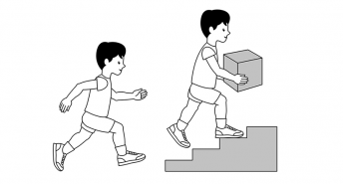
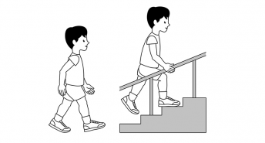
Examples of indicators used in clinical practice
GMFCS Level I
Children walk at home, school, outdoors and in the community. They can climb stairs without the use of a railing. Children perform gross motor skills such as running and jumping, but speed, balance and coordination are limited.
http://triclinium.pl/badania-kliniczne/
GMFCS Level II
Children walk in most settings and climb stairs holding onto a railing. They may experience difficulty walking long distances and balancing on uneven terrain, inclines, in crowded areas or confined spaces.
Children may walk with physical assistance, a handheld mobility device or used wheeled mobility over long distances. Children have only minimal ability to perform gross motor skills such as running and jumping.
Source https://cerebralpalsy.org.au/our-research/about-cerebral-palsy/what-is-cerebral-palsy/severity-of-cerebral-palsy/gross-motor-function-classification-system/ 15.01.2020
Training contents

Slide 9
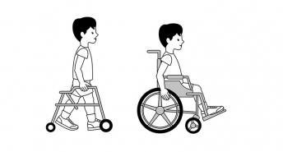
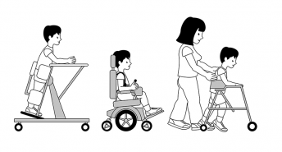
Examples of indicators used in clinical practice
GMFCS Level III
Children walk using a hand-held mobility device in most indoor settings. They may climb stairs holding onto a railing with supervision or assistance. Children use wheeled mobility when traveling long distances and may self-propel for shorter distances.
http://triclinium.pl/badania-kliniczne/
GMFCS Level IV
Children use methods of mobility that require physical assistance or powered mobility in most settings. They may walk for short distances at home with physical assistance or use powered mobility or a body support walker when positioned. At school, outdoors and in the community children are transported in a manual wheelchair or use powered mobility.
Source https://cerebralpalsy.org.au/our-research/about-cerebral-palsy/what-is-cerebral-palsy/severity-of-cerebral-palsy/gross-motor-function-classification-system/ 15.01.2020
Training contents

Slide 10
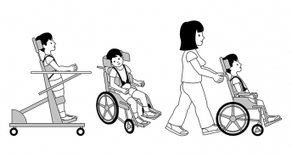
Examples of indicators used in clinical practice
http://triclinium.pl/badania-kliniczne/
GMFCS Level V
Children are transported in a manual wheelchair in all settings. Children are limited in their ability to maintain antigravity head and trunk postures and control leg and arm movements.
Source https://cerebralpalsy.org.au/our-research/about-cerebral-palsy/what-is-cerebral-palsy/severity-of-cerebral-palsy/gross-motor-function-classification-system/ 15.01.2020
Training contents

Slide 11
Examples of indicators used in clinical practice
GMFM (Gross Motor Function Measure) – the patient has specific movement sequences, and each task is available in sizes. The value of the set is the sum of various grades obtained by the respondents.
There are two versions of the GMFM. The GMFM-88 is the original 88-item measure. Items span the spectrum of gross motor activities in five dimensions.
A: Lying and Rolling,
B: Sitting,
C: Crawling and Kneeling,
D: Standing,
E: Walking, Running and Jumping.
http://triclinium.pl/badania-kliniczne/
Training contents

Slide 12
Examples of indicators used in clinical practice
MACS (Manual Ability Classification System) - manual skills classification system. The patient's ability to make specific movements is assessed when handling everyday objects. Traffic flow is also taken into account.
BMFM (Bimanual Fine Motor Function) – similar to MASC but only for upper limbs
FAQ (Gillette Functional Assessment Questionnaire) – evaluation system, which consists of a ten-level walk classification during 22 activities performed, assessed on the Likert scale from 0 to 5
http://triclinium.pl/badania-kliniczne/
Training contents

Slide 13
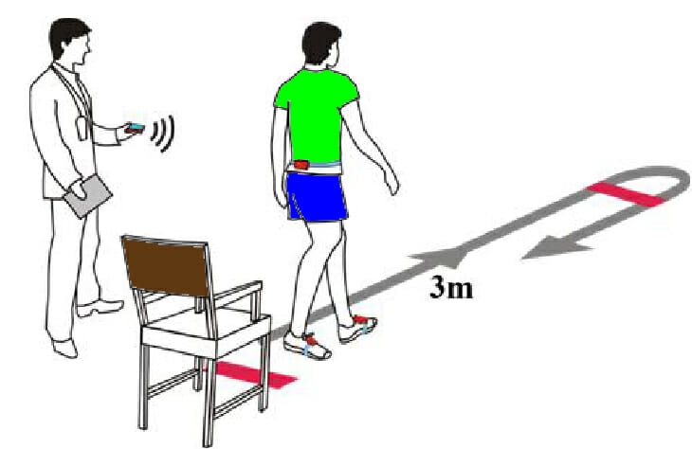
Test Up and Go as an example of a test for assessing the patient's functional abilities
- test used in clinical sssessment
At the "START" command, the subject has the task of:
1. Stand up from the chair
2. Cover the distance 3 meters at a normal pace
3. Cross the line ending the designated distance
4. Make a 180 degree rotation
5. Return to the chair and re-sit
Source https://x10therapy.com/wp-content/uploads/2019/08/TUG-TEST.jpg 15.01.2020
Training contents

Slide 14
Test Up and Go as an example of a test for assessing the patient's functional abilities
- test used in clinical sssessment
RESULTS :
<10 seconds - norm, proper functional efficiency (low risk of falls)
10-19 seconds - the examined person can go outside on their own, does not need walking equipment, independent in most everyday activities, in-depth assessment of falls risk is recommended (average risk of falls)
> / = 19seconds - significantly reduced functional efficiency, cannot go outside alone, auxiliary walking equipment recommended (high risk of falls)
Source http://dpssopot.pl/wp-content/uploads/2014/06/ 15.01.2020
Training contents

Slide 15
Advantages and disadvantages of assessing functional abilities in classic clinical assessment
Advantages
They do not require a lot of time
They do not require specialized equipment
They can be carried out in clinical settings
They can be performed by a person after a short training
Disadvantages
Subjective
Inaccurate
Non unique results
LIMITATIONS
They do not allow accurate measurements of the patient's movement system
They are based solely on external observations
(they do not allow assessing the patient's internal tissues)
Summary

Slide 16
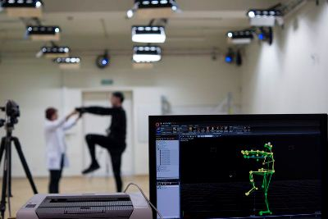
Instrumented Analysis
Methods for analyzing physical phenomena and / or movement possibilities using specialized measuring devices. This analysis is most often carried out in specialized laboratories, often in combination with scientific units (universities)
Source: https://www.lifemark.ca/services/fae 15.01.2020
Source : https://www.ncn.gov.pl/finansowanie-nauki/przyklady-projektow/switonski 15.01.2020
Training contents

Slide 17
Instrumented Analysis
The results of instrumental analysis are most often biomechanical quantities describing e.g.:
Gait parameters
  speed
  stride length
  percentage value of foot load in individual walking cycles
  angular ranges in individual joints
Ability to maintain balance
  center of pressure path length
  average field of the ellipse determined from the center of pressure displacements
  and other measurable physical quantities.
Training contents

Slide 18
Instrumented Analysis
Based on the measured quantities that are available with data described in detail in terms of some of the characteristics of the patient being examined.
The indicators are determined on the basis of basic measured unit sizes.
For measuring the quantities used, advanced laboratory equipment is used, which are most often used by engineers of tools to support the process of diagnosis of the musculoskeletal system
Training contents

Slide 19
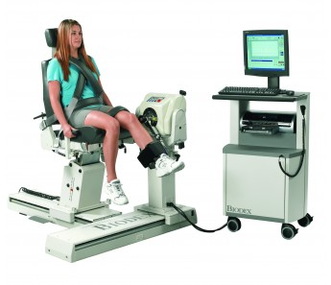
Engineering tools to support the process
of diagnostics of the human locomotor system
A set for assessment and training
in isometric, isotonic (concentric) conditions
and eccentric), isokinetic (eccentric
and concentric), reactive eccentric
and passive traffic with the option of full archiving
and data export for statistical analysis.
Determined quantities:
Strength values of individual muscle
parts of the lower limbs
Weight measurement of individual segments
Measurement of symmetry of forces in the limbs
Measurement of force moments
Measurement of achieved angles in the joints
Speed measurement by limb movement
BIODEX SYSTEM 4 PRO
Source: https://technomex.pl/ 15.01.2020
Training contents

Slide 20
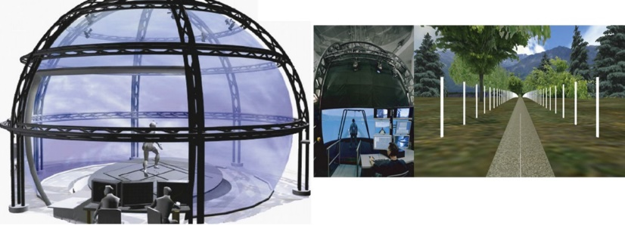
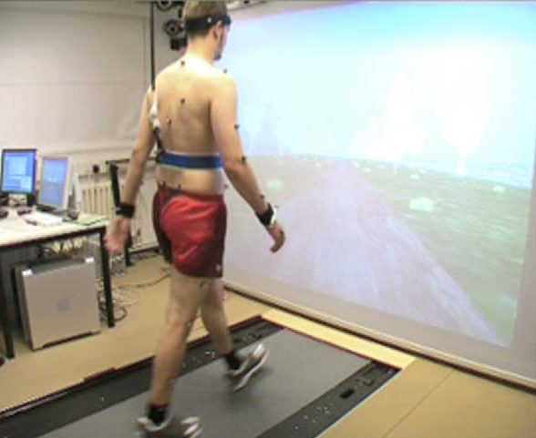
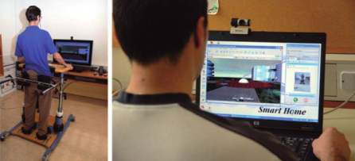
Engineering tools to support the process
of diagnostics of the human locomotor system
Motion Capture Analysis
Stabilomethry
Methods for measuring
ground reaction
Methods for identifying
loads in the musculoskeletal system
Therapeutic systems supporting upper limb rehabilitation using computer games
Rehabilitation system based on 2D projections using a computer monitor
Research and diagnostic systems with a 2D projector
Training contents

Slide 21
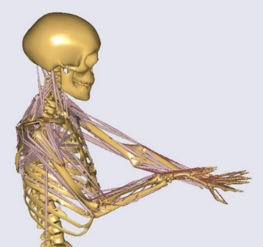
Engineering tools to support the process
of diagnostics of the human locomotor system
Methods for identifying loads in the musculoskeletal system:
Direct measurement of interaction in joints using measuring implants,
Determination of muscle strength based on EMG measurement,
Identification of muscle strength and joint effects
using modeling and optimization methods
Model of upper limbs based on research
Kyung Kim
Training contents

Slide 22
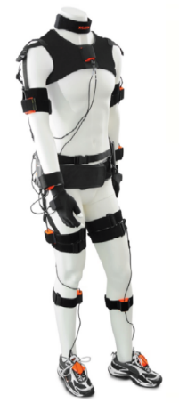
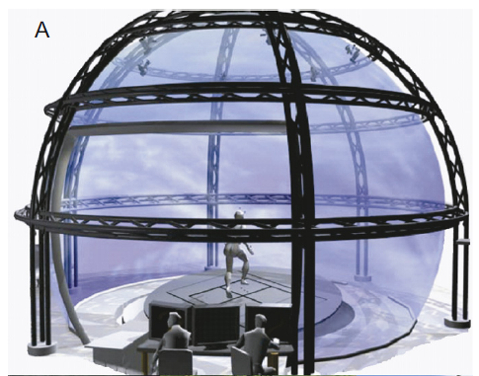

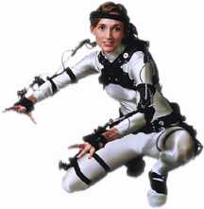
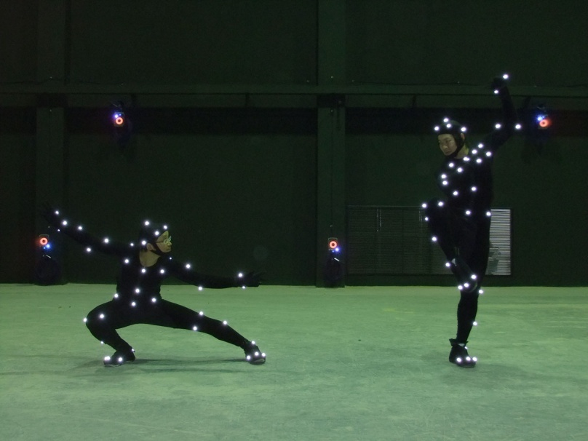
Engineering tools to support the process
of diagnostics of the human locomotor system
Xsens MVN - Motion Capture Systems
Source: https://www.xsens.com/ 15.01.2020
Training contents

Slide 23
Advantages and disadvantages of assessing functional abilities in instrumented analysis
Advantages
Repeatable and accurate analysis results
Measurements of many quantities
Thorough functional analysis
Objective analysis
Disadvantages
Time consuming analyzes
They require specialized equipment
They require extensive knowledge and skills of using the equipment
LIMITATIONS
They may only be carried out in specialized laboratories
Summary

Slide 24
Conceptual Map
Functional evaluation assessment
Classical Assessment
Instrumented Analysis
Observation methods
Clinical scales
Tests in laboratory
- Kinematics analysis
- Dynamics analysis
They do not require a lot of time
They do not require specialized equipment
They can be carried out in clinical settings
They can be performed by a person after a short training
Repeatable and accurate analysis results
Measurements of many quantities
Thorough functional analysis
Objective analysis
Conceptual Map

Slide 25
Key ideas of the course
Functional assessment is a comprehensive assessment of physical and functional abilities, carried out using measurable tests
In functional assessment, it is possible to use classic clinical tools and advanced measuring devices
The clinical approach most often includes functional tests enabling rapid but low accurate assessment of the functional level of patients
Instrumental analysis provides accurate information about patients' mobility, but requires professional measuring equipment and trained personnel
Summary

Slide 26
Bibliography
https://www.lifemark.ca/services/fae 15.01.2020
http://triclinium.pl/badania-kliniczne/ 15.01.2020
https://cerebralpalsy.org.au/our-research/about-cerebral-palsy/what-is-cerebral-palsy/severity-of-cerebral-palsy/gross-motor-function-classification-system/ 15.01.2020
https://x10therapy.com/wp-content/uploads/2019/08/TUG-TEST.jpg 15.01.2020
http://dpssopot.pl/wp-content/uploads/2014/06/ 15.01.2020
https://www.ncn.gov.pl/finansowanie-nauki/przyklady-projektow/switonski 15.01.2020
https://www.xsens.com/ 15.01.2020
https://technomex.pl/ 15.01.2020
Bibliography

Slide 27


